Slide 1

SunMAP: AI-Powered 3D Solar Planner for Every Building in Bharat
SHAMBHUNATH COLLEGE OF EDUCATION HACKATHON 2025
Problem Statement Title - SunMAP: AI-Powered 3D Solar Planner for Every Building in Bharat
Theme - AI for a Safer, Smarter & Inclusive Bharat
PS Category - Software
Team Name - IronLogic
Team Leader Name - Mohnish Narayan Gupta

Slide 2

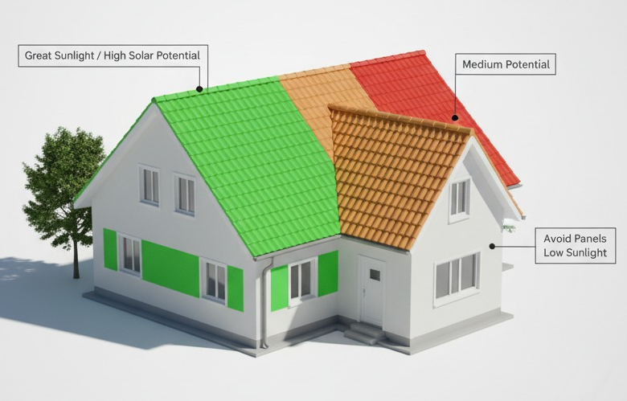
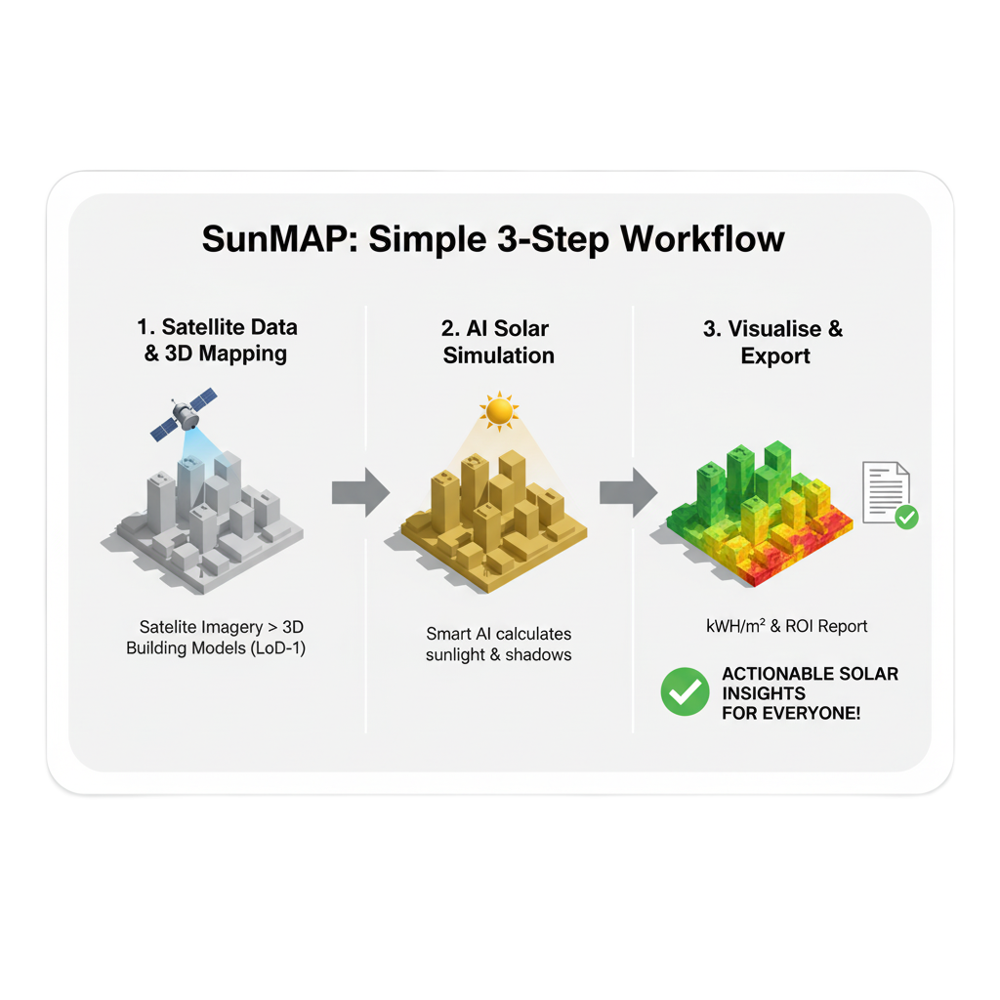
SunMAP: AI-Powered 3D Solar Planner for Every Building in Bharat
IronLogic
Rapid 3D Analysis & Simulation: Instantly models 3D building surfaces, performing hourly ray-tracing shadow simulations.
Explainable Energy Decision: Provides clear, trustworthy justifications (XED) for optimal panel placement and ROI. Visualizes solar potential with actual calculated kWh and shadow maps.
"What If" Scenarios for Optimal Design: Allows users to simulate changing the number of panels, tilt angle, or mounting location to visualize the impact on Annual Energy Generation (kWh) and Estimated Saving.
Secure & Scalable Data Integration: Ingests local CityGML files and uses pvlib's internal models for analysis. No external APIs are used for weather or geometry.
Core Innovation
Pioneering Hybrid AI/Physics Model: An open-source, physics-based workflow merging the Solar Position Algorithm (pvlib) with 3D CityGML parsing. No AI or ray-tracing.
Integrated XED for Trust: Provides XED by visualizing concrete metrics (kWh/m², tilt, area) to help users prioritize sites for physical surveys.

Slide 3

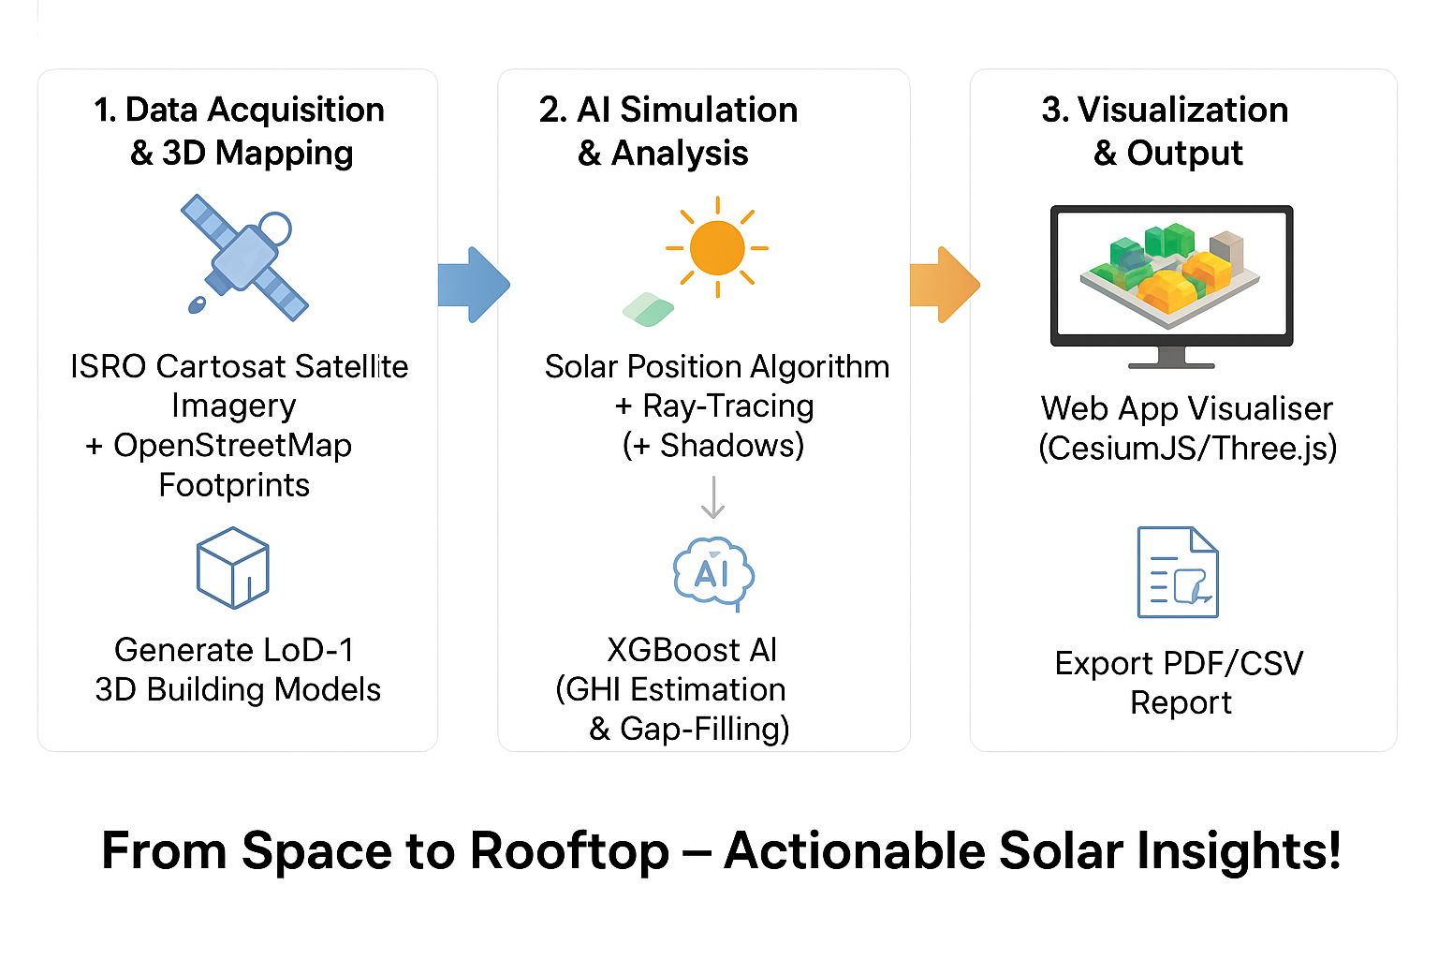
TECHNICAL APPROACH
IronLogic
Programming languages & frameworks :-
Python (Numpy, Pandas, pvlib, lxml)
Python http.server
Three.js
Vanilla JavaScript
Dataset :-
Realistic Simulated Data (generates a high-quality json file)
Validation-Grade Input
Procedural 3D City Engine
Others :-
Spatial Database: Local file system (Customized)
DevOps: Netlify ,GitHub Actions (CI/CD).
Methodology:-

Slide 4





FEASIBILITY AND VIABILITY
IronLogic
Technical feasibility
Industry-Standard Solar Library
Open API for Installers/Financing
Standard Input Format
Financial feasibility
Quantifiable ROI (kWh/Payback Time)
Phased Funding Aligned to City Rollouts
Zero Hardware CapEx (Software Only)
Operational feasibility
Policy-Centric DSS (XED)
Direct NIWE/DISCOM Utility
Audit and Validation (GHI/Field checks)
Challenges & Risks
Data Heterogeneity: Ensuring seamless, high-resolution DEM and footprint data across diverse urban/rural geographies.
Solar Angle Precision: Accurately modeling shadow and incidence angles for highly irregular rooftops and walls.
Adoption Barrier: Overcoming public and installer skepticism regarding a free, instant, AI-generated site assessment over a traditional physical survey.
Model Calibration: Accurately correlating AI-predicted GHI values with ground-truth energy generation.
Strategies to Overcome
Physics-First Accuracy: Use a robust physics engine with SPA and Ray-Tracing for precise, trustworthy shadow modeling.
Phased Rollout: Dependent on acquiring valid, high-quality CityGML data in a target area, as tool processes exisiting data.
Trust Through Transparency: Builds confidence by transparently visualizing physics-based results (kWh/m²) in the frontend, helping users prioritize which sites require a physical survey.
Rapid Scaling: Scaling is a manual process that involves acquiring a new CityGML dataset and running the local analysis
scripts

Slide 5


IMPACT AND BENEFITS
IronLogic
Potential Impact:
Rooftop Solar Adoption: Achieve an estimated 15−20% increase in residential rooftop solar installations across the top 20 cities by eliminating the cost and complexity of initial site surveys.
Decentralized Energy Security: Provides citizens with the confidence to become prosumers, reducing dependence on central grid infrastructure and boosting climate resilience during peak demand or extreme weather events.
MSME Efficiency: Provides solar startups and installers with high-quality, pre-vetted leads, leading to a 50% reduction in site-visit costs and enabling faster deployment and higher profitability.
Policy & Planning: Creates city-scale PV potential heatmaps instantly, empowering DISCOMs and Urban Planning bodies to target subsidies and accelerate Net-Zero transition goals.
Benefits:
Economic: Generates significant savings for homeowners via reduced electricity bills and faster payback on investment (ROI). Creates new, high-quality jobs in the localized solar MSME ecosystem.
Operational: Ensures real-time clarity on solar viability, allowing installers to instantly qualify leads and citizens to make informed decisions without waiting for a physical assessment.
Technological Leap: Positions India as a leader in applying ISRO-data-driven AI/Physics models for urban sustainability planning, aligning perfectly with Atma Nirbhar Bharat.
Knowledge Transfer: Creates a valuable public data utility (Open API) for solar potential, driving innovation in related finance, insurance, and installation services.

Slide 6
RESEARCH AND REFERENCES
IronLogic
Digital Twin & Physics Modeling:
Reference: Solar Position Algorithm (SPA) by NREL, and established Ray-Tracing principles in Computer Graphics/GIS (ThreeJS).
Relevance: Provides the rigorous, physical validation needed for the Sun-Physics Engine (shadow modeling and angle calculation) to ensure highly precise and trustworthy kWh energy estimates. 🔗
Advanced AI for GHI Gap-Fill:
Reference: Studies on machine learning applications (XGBoost,Random Forest) for solar irradiance forecasting and estimation using meteorological data and satellite imagery.
Relevance: Validates the use of the XGBoost model to accurately predict Global Horizontal Irradiance (GHI) in specific microclimates where ground data (from NIWE/IMD) is sparse, making the tool truly inclusive across rural and urban India. 🔗
Strategic Need & Data :
Reference: The Open Geospatial Consortium (OGC) CityGML standard.
Relevance: The project is built to be data-agnostic by using the international CityGML standard for 3D city models. Its strategic value lies in its ability to process any dataset that conforms to this open standard, making the analysis compatible with global and national 3D city models. 🔗

