Slide 1


IT Job Market Analysis
Using Web Scraping
Presented by:
Guru Preeth Reddy
Saisree
Hari Krishna

Slide 2
Problem Statement
The IT job market is continuously evolving with changing demand for skills, experience, and technologies.
However, analyzing job market trends manually is difficult because thousands of job postings are spread across online platforms.
This project aims to analyze IT job market trends by collecting job listing data through web scraping and performing data analysis to identify patterns in skills demand, salary distribution, experience requirements, and hiring locations.

Slide 3

Data Source
Data Source: AmbitionBox
Website link: https://www.ambitionbox.com/
Dataset Description
AmbitionBox is an online platform that provides information about companies, salaries, and job opportunities..
The dataset was collected by scraping IT job listings from AmbitionBox.
The scraping process was executed four times to collect a large dataset and improve data coverage..
Tools: Python · Pandas · Matplotlib · Seaborn

Slide 4
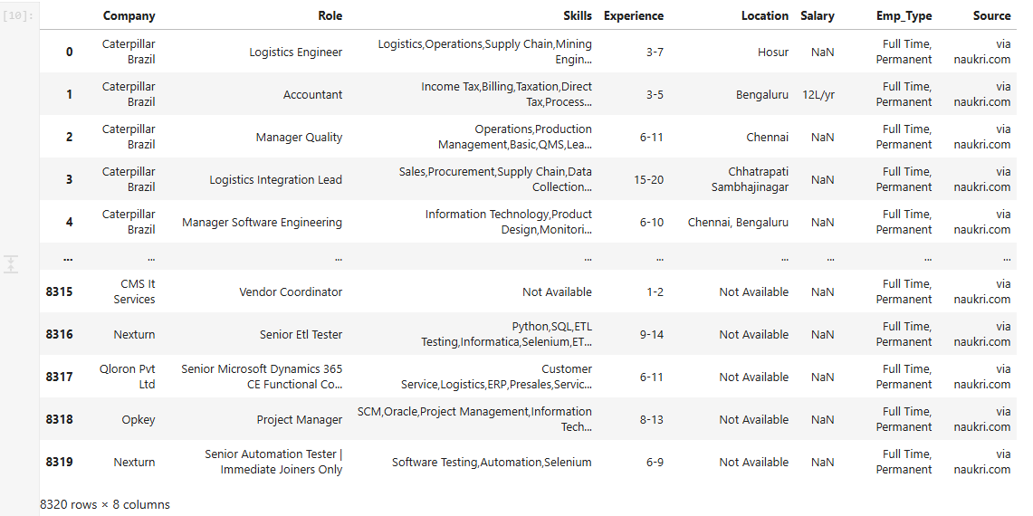
Raw Dataset after Extraction
Dataset has 8320 rows and 8 Columns

Slide 5
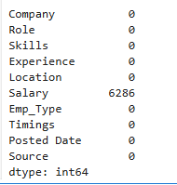
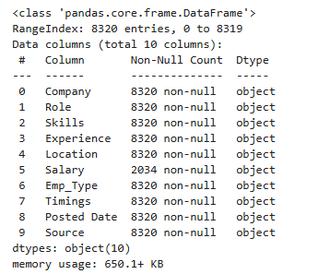
Data Cleaning
Cleaning skills Column
Recommendation → Rating
Before performing data cleaning, the dataset was inspected to understand its structure and quality
The following checks were performed:
Previewing the dataset
Checking column data types
Identifying missing values
Removing duplicate records
Cleaning unnecessary text from columns
Locality
Experience
Hospital_Name

Slide 6
Data Cleaning
Some columns contained unstructured text data.
To improve analysis:
Removed duplicate records using drop_duplicates()
Cleaned the Location column to extract city names
Cleaned the Source column to remove unnecessary text
The Experience column contained text values.
Numeric values were extracted to create two new columns:
• Min_Exp • Max_Exp
Cleaning skills Column
Recommendation → Rating
Locality
Experience
Hospital_Name

Slide 7
Handling Missing Values
Locality
Recommendation → Rating
Missing values were identified in the Salary column and handled using a multi-step approach :
First, missing salary values were filled using the average salary for each skill group.
Remaining missing values were filled using the average salary for each experience level.
Any remaining missing values were finally replaced using the overall mean salary.
Experience
Hospital_Name

Slide 8
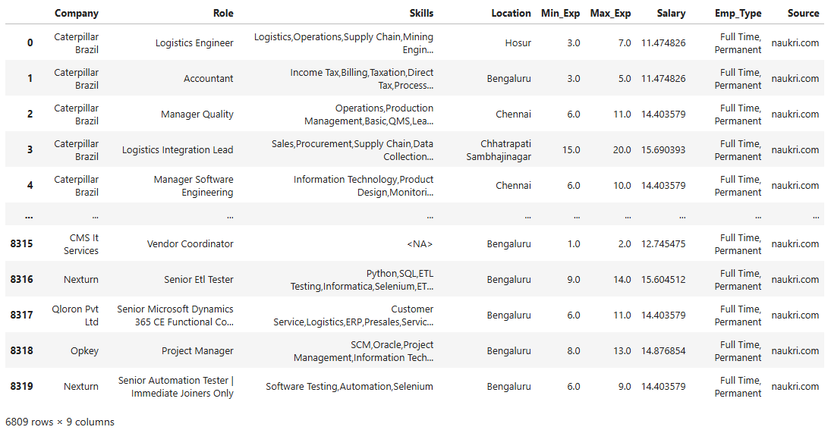
After Cleaning
Dataset has 6809 rows and 9 Columns

Slide 9
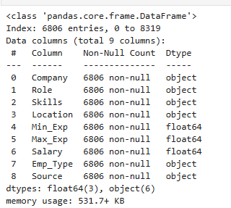
df.info()
Output is showing the dataset after data Cleaning , handling missing and duplicates

Slide 10
Column Description
Column | Type | Description
Company | Object | Name of the company offering the job position
2. Role | Object | Title of the job role or position
3. Skills | Object | Technical skills required for the job
4. Location | Object | City where the job opportunity is located
5. Min_Exp | Float | Minimum years of experience required
6. Max_Exp | Float | Maximum years of experience required
7. Emp_Type | Object | Type of employment (Full-time, Contract, etc.)
8. Source | Object | Job platform from which the listing was collected
9. Salary | Float | Estimated annual salary offered for the role (LPA)

Slide 11
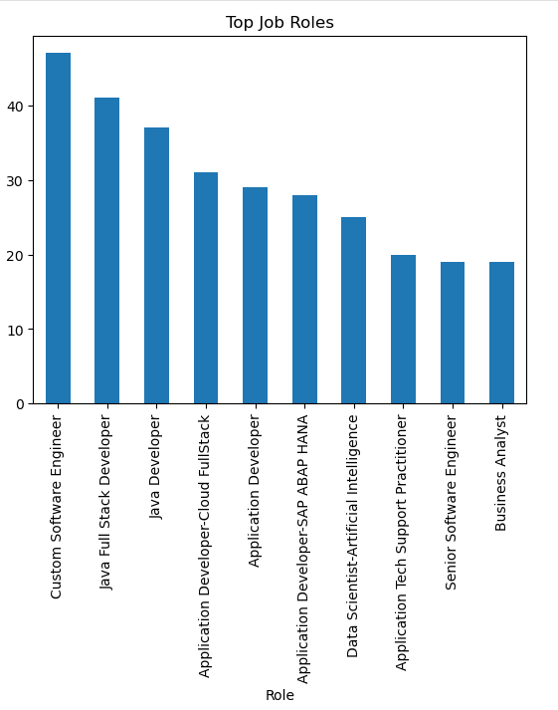
Observation: Density Plot of Doctor Experience
The distribution of doctor experience appears right-skewed (positively skewed).
Univariate Analysis
Role Distribution
Observation and Insights
Most jobs in the dataset are Custom Software Engineer roles.
The next common roles are Java Full Stack Developer and Java Developer.
Other roles like Cloud Full Stack, Application Developer, Data Scientist, and Data Analyst appear frequently
Senior Software Engineer and Business Analyst roles are fewer compared to other roles.
This shows that software development roles are the most common in the IT job market.

Slide 12
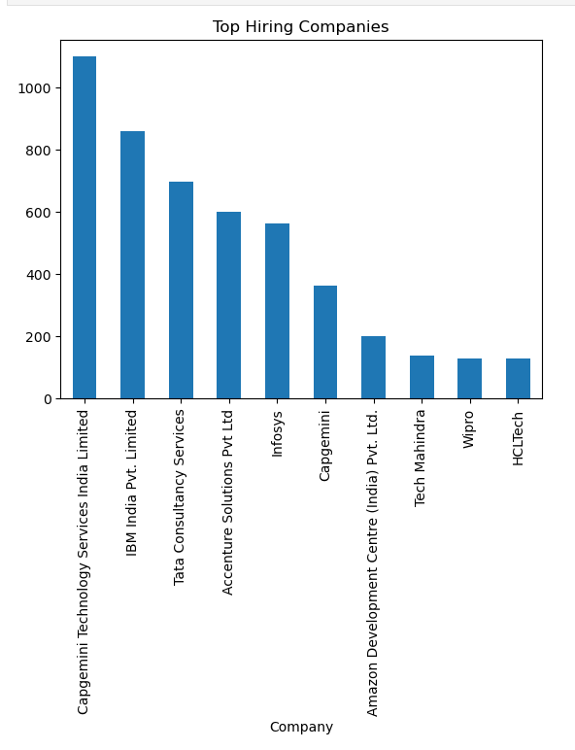
Observation: Density Plot of Doctor Experience
The distribution of doctor experience appears right-skewed (positively skewed).
Top Hiring Companies
Observation and Insights
Capgemini Technology Services India Ltd has the highest number of job openings.
IBM India Ltd and Tata Consultancy Services (TCS) also hire many employees.
Companies like Accenture Solutions Pvt Ltd and Infosys have a moderate number of jobs.
A few companies such as Cognizant, Amazon Development Center, Publicis Sapient, and HCL Tech have fewer job postings.
This shows that large IT companies provide most of the job opportunities.

Slide 13
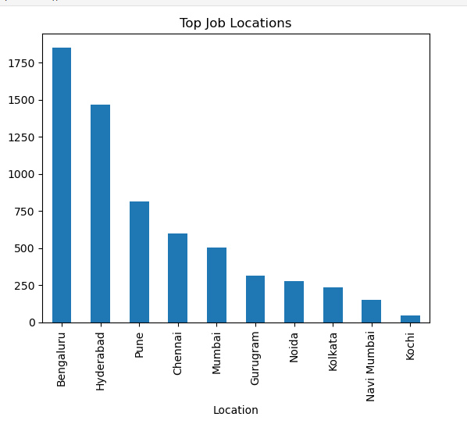
Observation: Density Plot of Doctor Experience
The distribution of doctor experience appears right-skewed (positively skewed).
Top Job Locations
Observation and Insights
Bengaluru has the highest number of IT job opportunities.
Hyderabad is the second city with many job openings.
Cities like Pune, Chennai, and Mumbai also have a good number of IT jobs.
Gurugram, Noida, and Kolkata have a moderate number of job postings.
Navi Mumbai and Kochi have fewer job opportunities compared to other cities.

Slide 14
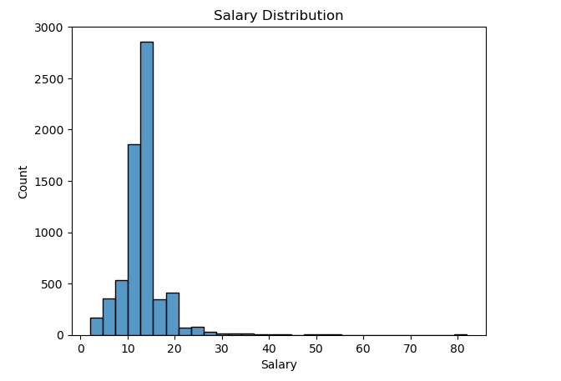
Observation: Density Plot of Doctor Experience
The distribution of doctor experience appears right-skewed (positively skewed).
Salary Distribution
Observation and Insights
Most salaries are between 10 LPA and 20 LPA, which is the most common salary range.
Many jobs offer around 12–15 LPA, where the salary frequency is highest.
A smaller number of jobs offer higher salaries above 25 LPA.
Very high salaries are rare, so they appear less in the dataset.
This creates a right-side tail, meaning only a few jobs have very high salaries.

Slide 15
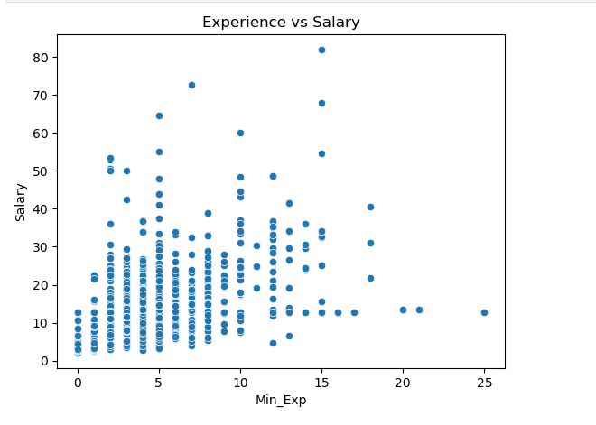
Observation: Density Plot of Doctor Experience
The distribution of doctor experience appears right-skewed (positively skewed).
Bivariate Analysis
Experience VS Salary
Observation and Insights
The scatter plot shows the relationship between experience and salary in IT job roles.
Salaries generally increase as experience increases, indicating that professionals with more experience tend to receive higher compensation.
Most job listings fall within the 2–6 years experience range, showing strong demand for mid-level professionals.

Slide 16
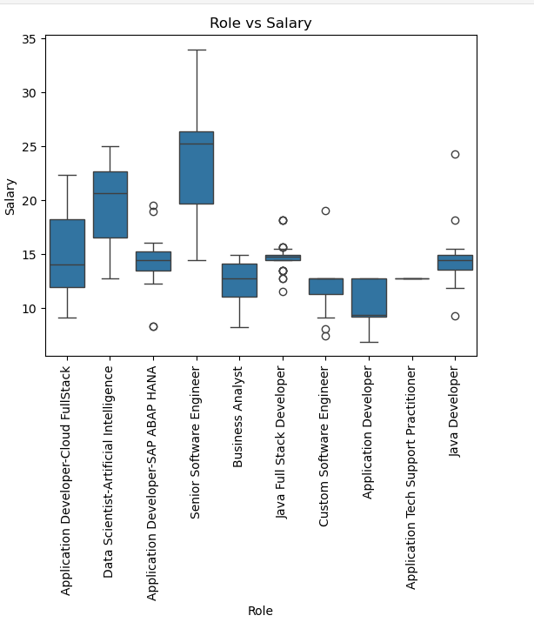
Observation: Density Plot of Doctor Experience
The distribution of doctor experience appears right-skewed (positively skewed).
Role VS Salary
Observation and Insights
The boxplot compares salary distribution across different IT job roles.
Roles such as Senior Software Engineer and Data Scientist show higher median salaries, indicating higher compensation for advanced technical roles.
Some roles display wider salary ranges, suggesting variation in experience levels and responsibilities within those roles.
The boxplot compares salary distribution across different IT job roles.

Slide 17
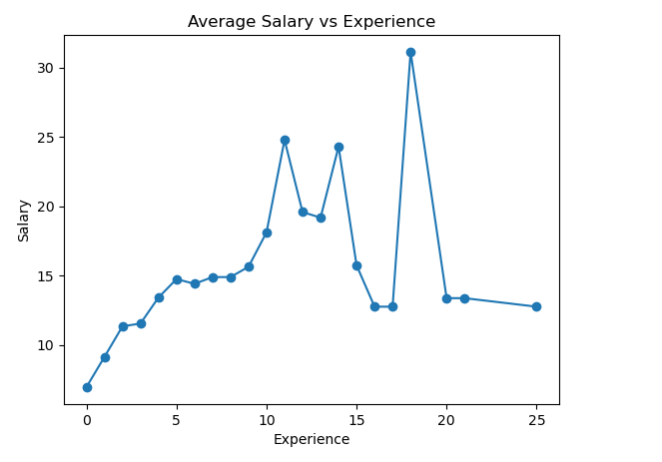
Observation: Density Plot of Doctor Experience
The distribution of doctor experience appears right-skewed (positively skewed).
Salary VS Experience Trend
Observation and Insights
The line chart shows how average salary changes with increasing experience levels.
Salary generally increases as experience increases, indicating that experienced professionals receive higher compensation
The trend shows that mid-level to senior professionals tend to have higher salary growth compared to entry-level roles.
Some fluctuations in the trend indicate that salary also depends on factors such as role, company, and specialization, not only experience

Slide 18
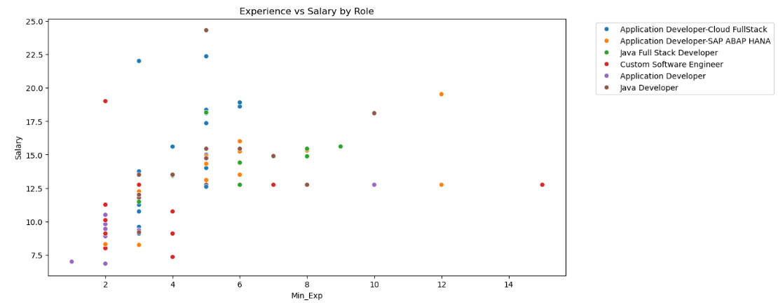
Observation: Density Plot of Doctor Experience
The distribution of doctor experience appears right-skewed (positively skewed).
Multi-Variate Analysis
Experience + Role + Salary
Observation and Insights
The scatter plot analyzes the relationship between experience, salary, and job role in the IT job market.
The chart shows that salary generally increases with experience across most roles.
Some roles, such as Application Developer and Java Developer, show higher salary values at moderate experience levels.
The variation in salary for the same experience level indicates that salary is influenced by job role and specialization.

Slide 19
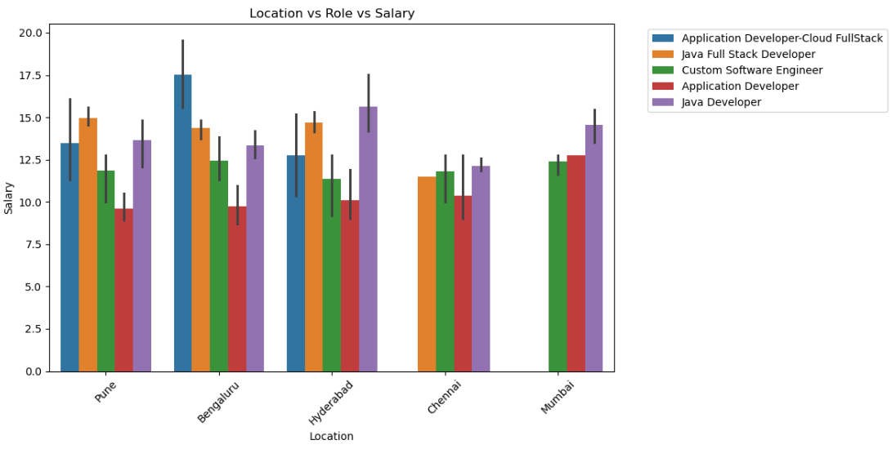
Observation: Density Plot of Doctor Experience
The distribution of doctor experience appears right-skewed (positively skewed).
Location + Role + Salary
Observation and Insights
This chart compares average salary across different job roles and locations in the IT job market.
Major IT hubs such as Bangalore, Hyderabad, Pune, and Mumbai show competitive salary levels across multiple roles.
Some roles demonstrate higher salary values in specific cities, reflecting the influence of regional demand for technical skills..
The variation in salary across roles and locations indicates that both job specialization and geographic location influence compensation levels.

Slide 20
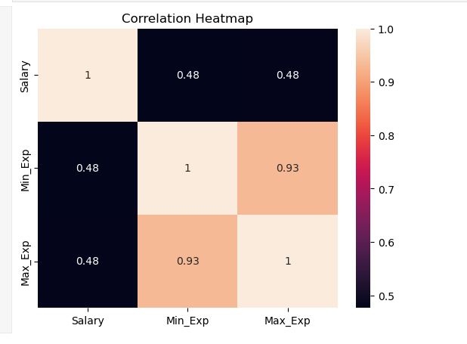
Observation: Density Plot of Doctor Experience
The distribution of doctor experience appears right-skewed (positively skewed).
Correlation Heatmap of Numerical Features
Observation and Insights
The heatmap shows the correlation between numerical features, including Salary, Minimum Experience, and Maximum Experience.
There is a moderate positive correlation between experience and salary, indicating that professionals with higher experience generally earn higher salaries.
The strong correlation between Min_Exp and Max_Exp is expected, as both represent experience range requirements in job listings.
Overall, the heatmap indicates that experience is an important factor influencing salary levels in the IT job market.

Slide 21

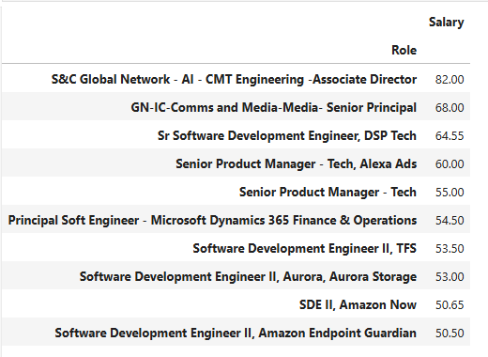
Observation: Density Plot of Doctor Experience
The distribution of doctor experience appears right-skewed (positively skewed).
Top Skills In Demand
Observation and Insights
The pivot table highlights the job roles with the highest salary values in the dataset.
Senior-level roles such as Senior Product Manager, Principal Software Engineer, and Senior Software Development Engineer appear among the highest paying positions.
These roles typically require higher experience levels and specialized technical skills, which contribute to higher compensation.
The analysis indicates that leadership and advanced technical roles tend to offer the highest salary packages in the IT job market.

Slide 22
Conclusions
💻
Development Demand
Salary Growth
🌍
IT Hubs
📈
The analysis shows a clear positive relationship between experience and salary, with senior professionals receiving significantly higher compensation.
Cities such as Bangalore, Hyderabad, Pune, and Mumbai offer the highest number of job opportunities due to their strong IT ecosystems.
Software development roles such as Application Developer, Java Developer, and Full Stack Developer dominate the job market, indicating strong demand for programming expertise.
🧠
Skills Demand
💰
High Paying Roles
Senior Product Manager, Principal Software Engineer, and Senior Software Development Engineer are among the highest-paying roles in the dataset due to their advanced expertise and leadership requirements.
Skills like Python, Java, SQL, and modern development frameworks appear frequently in job listings, highlighting their importance in the IT industry.

Slide 23

THANK
YOU

