Slide 1


Department of Computer Science and Engineering
Wellness Guard AI Health Analyzer
Dr. M. RAKESH KUMAR
Associate Professor
MOHAMMED REHAN SHARIEF MT 220701515 GURUBARAN T 220701522

Slide 2
Problem Statement and Motivation
Traditional health monitoring is often reactive, relying on manual check-ups and delayed responses, which can lead to late diagnoses and higher healthcare costs. This system lacks real-time tracking and personalized insights, making it difficult to detect health issues early. WellnessGuardAI aims to bridge this gap by using AI and data from wearable devices to continuously monitor wellness indicators, detect potential health risks, and provide timely, personalized feedback. The motivation behind the project is to promote proactive health management, reduce reliance on manual monitoring, and support a preventive approach to healthcare.

Slide 3
Existing System
The existing wellness monitoring systems primarily rely on manual health check-ups, periodic assessments, and self-reported data, which are often inconsistent and lack real-time accuracy. These systems depend heavily on human observation, making them prone to delays, errors, and subjective judgment. Data from fitness trackers or health apps is often isolated and not effectively analyzed for predictive insights. Additionally, traditional systems are not equipped to detect subtle health anomalies or provide personalized recommendations. This reactive approach limits early detection of potential health risks and reduces the overall
effectiveness of wellness management.

Slide 4
Objectives
The objective of WellnessGuardAI is to develop an AI-powered system that enables real-time health monitoring using data from wearable devices. It aims to detect early signs of health risks, provide personalized wellness insights, and promote preventive healthcare. The system will automate data analysis to reduce dependency on manual evaluations, support timely interventions, and enhance user engagement in their own well-being. Additionally, it seeks to integrate seamlessly with existing digital health ecosystems to deliver scalable, cost-effective, and accurate
wellness tracking.

Slide 5
Abstract
WellnessGuardAI is an AI-driven health monitoring system designed to provide real-time analysis of individual wellness through data collected from wearable devices and sensors. It uses machine learning algorithms to detect early signs of health risks and delivers personalized recommendations for preventive care. By automating wellness tracking and integrating continuous health insights, the system aims to reduce dependency on manual check-ups and promote proactive healthcare. WellnessGuardAI enhances user awareness, supports timely interventions, and contributes to a
smarter, more efficient health ecosystem.

Slide 6
Proposed System
WellnessGuardAI is an AI-powered health monitoring system designed to provide continuous, real-time tracking of users' health metrics, such as heart rate, sleep patterns, stress levels, and physical activity. Using data from wearables and sensors, the system leverages machine learning algorithms to detect health anomalies, predict risks, and offer personalized recommendations. It integrates seamlessly with existing smart health ecosystems, enabling users to monitor their wellness proactively and make informed decisions. By automating health assessments and delivering insights in real time, WellnessGuardAI aims to improve preventive healthcare, enhance well-being, and reduce long-term
healthcare costs.

Slide 7
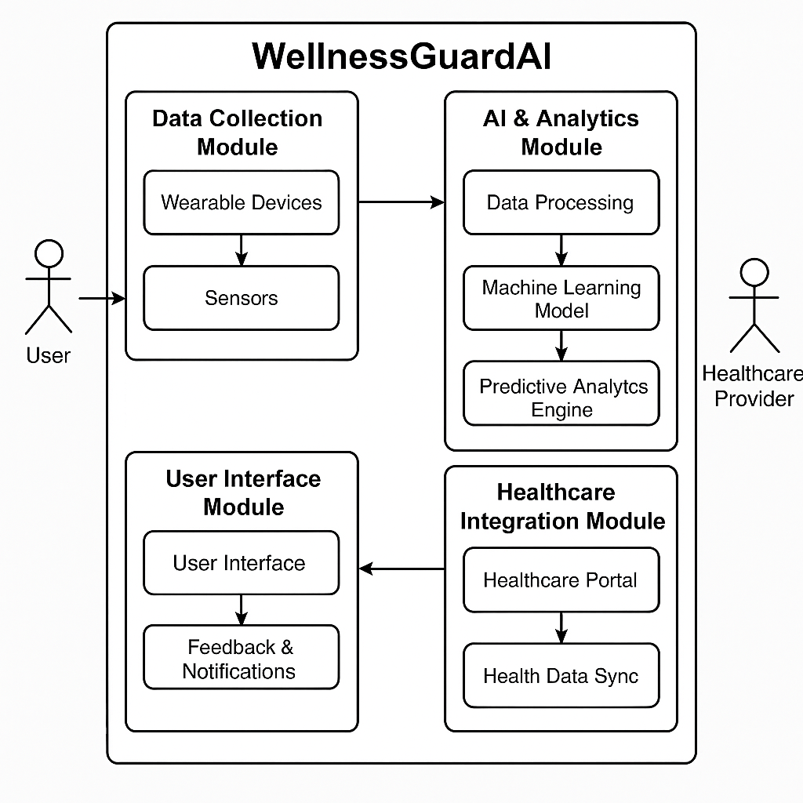
System Architecture
The WellnessGuardAI system architecture consists of wearable devices collecting real-time health data, which is processed by an AI engine for risk assessment. The AI generates personalized insights and recommendations, which are then displayed on a user-friendly interface.

Slide 8
List of Modules
Data Collection
Gathers real-time health data from wearables.
Health Risk Prediction
Predicts health risks using AI.
Anomaly Detection
Detects unusual health patterns.
Personalized Recommendations
Offers tailored wellness advice.
Real-time Monitoring & Alerts
Continuously tracks health and sends alerts.

Slide 9
Functional Description for each modules with DFD and Activity Diagram
Data Collection
Function: Collects real-time health data from wearables (e.g., fitness trackers, smartwatches).
Process: Data is gathered and sent to the system for processing.
Health Risk Prediction
Function: Predicts potential health risks using AI based on collected data.
Process: Data is analyzed to forecast health risks, providing alerts when needed.
Anomaly Detection
Function: Identifies abnormal health patterns (e.g., sudden spikes in heart rate).
Process: Continuously monitors data and flags irregularities for review.

Slide 10
Functional Description for each modules with DFD and Activity Diagram
Personalized Recommendations
Function: Offers personalized wellness advice (e.g., exercise, diet).
Process: Data-driven suggestions are provided based on individual health profiles.
Real-time Monitoring & Alerts
Function: Monitors health data continuously and sends alerts when necessary.
Process: Health parameters are constantly tracked, triggering alerts if they fall outside safe ranges.

Slide 11
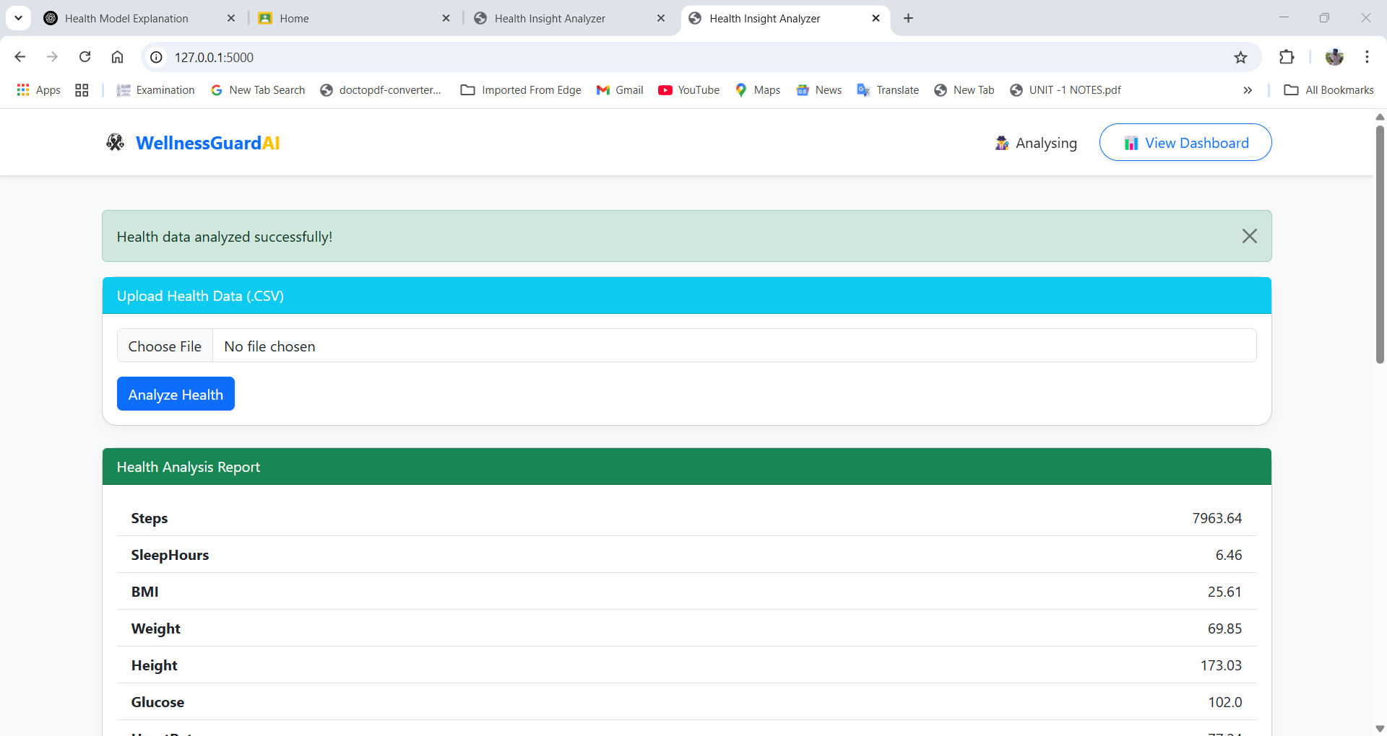
OUTPUT SCREENSHOT

Slide 12
Implementation & Results of Module
The implementation of WellnessGuardAI involved collecting real time health data from wearable devices and processing it using machine learning models. Data was cleaned and analyzed to predict health risks and detect anomalies. The system provided personalized wellness suggestions and real-time alerts through a simple dashboard. Results showed high accuracy in identifying health risks and unusual patterns, with timely notifications. The solution proved effective for continuous health
monitoring and proactive wellness support.

Slide 13
Conclusion & Future Work
WellnessGuardAI effectively uses AI and wearable data for real-time health monitoring and early risk detection. It provides timely alerts and personalized wellness suggestions, promoting proactive healthcare. In the future, the system can be improved by adding more health parameters, refining prediction models, and integrating with health records. Features like mental health tracking and voice alerts will further enhance user experience. This project lays the foundation for smarter, AI-driven personal health management systems.

Slide 14
References
[1]. Rajendran, R., et al. (2020). Artificial Intelligence in Healthcare: Past, Present, and Future. Journal of Healthcare Informatics Research, 6(2), 45-65.
[2]. Gupta, V., et al. (2019). AI-Based Systems for Personal Health Monitoring and Wellness. Journal of Medical Systems, 43(4), 34-52.
[3]. Patel, M., & Sharma, R. (2020). Wellness Monitoring Systems Using IoT and Machine Learning. IEEE Transactions on Industrial Informatics, 16(6), 4212-4220.
[4]. Kumar, S., & Verma, P. (2021). AI for Preventive Healthcare: The Next Frontier. Journal of Healthcare Management, 29(3), 135-148.
[5]. Lee, J., & Cho, S. (2018). Smart Wellness: An AI Approach for Healthcare Services. Journal of Health Informatics, 24(1), 92-107.

Slide 15
Thank You

