Slide 1
PCA
PCA(Principal Component Analysis) is a method of extracting important variables/features from a large set of variables available in a data set. It extracts low dimensional set of features from a high dimensional data set with a motive to capture as much information as possible.

Slide 2
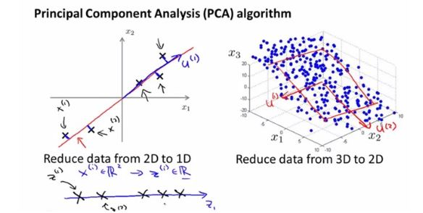
Dimensionality Reduction
Basically we try to reduce the dimensions of data in order to have a better visual representation of the important features, for example from n dimension to 3D,from 3D to 2D, 2D to 1D

Slide 3
Dimensionality
It is the number of random variables in a dataset or simply the number of features, or rather more simply, the number of columns present in your dataset.

Slide 4
Correlation
It shows how strongly two variable are related to each other. The value of the same ranges for -1 to +1. Positive indicates that when one variable increases, the other increases as well, while negative indicates the other decreases on increasing the former.

Slide 5
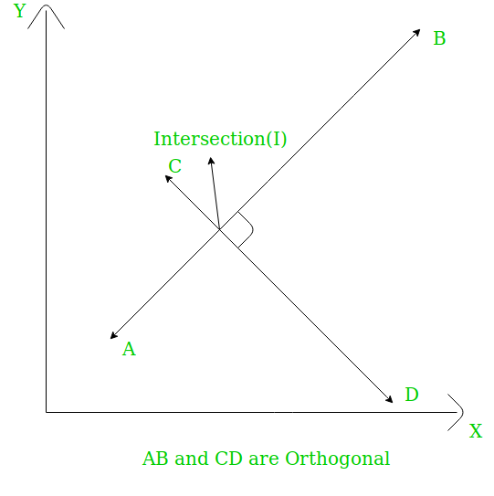
Orthogonal
Uncorrelated to each other, i.e., correlation between any pair of variables is 0.

Slide 6
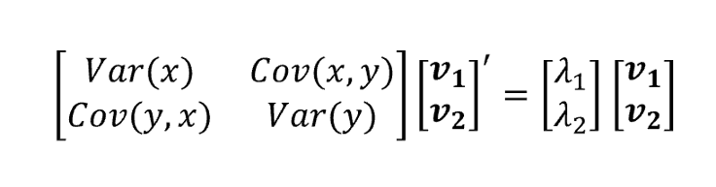
Eigenvectors
Eigenvectors and Eigenvalues are in itself a big domain, let’s restrict ourselves to the knowledge of the same which we would require here. So, consider a non-zero vector v. It is an eigenvector of a square matrix A, if Av is a scalar multiple of v. Or simply: Av = ƛv
Here, v is the eigenvector and ƛ is the eigenvalue associated with it.

Slide 7
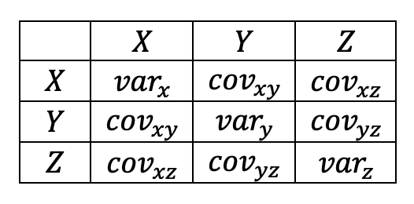
Covariance Matrix
This matrix consists of the co-variances between the pairs of variables. The (i,j)^{th} element is the covariance between i-^{th} and j-^{th} variable.

Slide 8
Properties of Principal Component
Technically, a principal component can be defined as a linear combination of optimally-weighted observed variables. The output of PCA are these principal components, the number of which is less than or equal to the number of original variables. Less, in case when we wish to discard or reduce the dimensions in our dataset.
The PCs possess some useful properties which are listed below:
The PCs are essentially the linear combinations of the original variables, the weights vector in this combination is actually the eigenvector found which in turn satisfies the principle of least squares.
The PCs are orthogonal, as already discussed.
The variation present in the PCs decrease as we move from the 1st PC to the last one, hence the importance.

Slide 9
Applications of Principal Component Analysis
PCA is predominantly used as a dimensionality reduction technique in domains like
facial recognition,
computer vision and
image compression.
It is also used for finding patterns in data of high dimension in the field of finance, data mining, bioinformatics, psychology, etc.

Slide 10
PCA for images
Any square image of size NxN pixels can be represented as a NxN matrix where each element is the intensity value of the image. So if you have a set of images, we can form a matrix out of these matrices, considering a row of pixels as a vector, we are ready to start principal component analysis on it. How is it useful ?
Say you are given an image to recognize which is not a part of the previous set. The machine checks the differences between the to-be-recognized image and each of the principal components. It turns out that the process performs well if PCA is applied and the differences are taken from the ‘transformed’ matrix. Also, applying PCA gives us the liberty to leave out some of the components without losing out much information and thus reducing the complexity of the problem.
For image compression, on taking out less significant eigenvectors, we can actually decrease the size of the image for storage. But to mention, on reproducing the original image from this will lose out some information for obvious reasons.

Slide 11
PCA of the Boston Housing Dataset
Overview of the dataset columns/features
- CRIM per capita crime rate by town
- ZN proportion of residential land zoned for lots over 25,000 sq.ft.
- INDUS proportion of non-retail business acres per town
- CHAS Charles River dummy variable (= 1 if tract bounds river; 0)
- NOX nitric oxides concentration (parts per 10 million)
- RM average number of rooms per dwelling
- AGE proportion of owner-occupied units built prior to 1940
- DIS weighted distances to five Boston employment centres
- RAD index of accessibility to radial highways
- TAX full-value property-tax rate per $10,000
- PTRATIO pupil-teacher ratio by town
- B 1000(Bk - 0.63)^2 where Bk is the proportion of blacks by town
- LSTAT % lower status of the population
- MEDV Median value of owner-occupied homes in $1000's
from sklearn.datasets import load_boston
boston_dataset = load_boston()
boston = pd.DataFrame(boston_dataset.data, columns=boston_dataset.feature_names)
print(boston_dataset.DESCR)

Slide 12
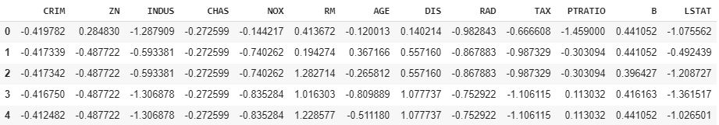
Standardize data
PCA is largely affected by scales and different features might have different scales. So it is better to standardize data before finding PCA components. Sklearn's StandardScaler scales data to scale of zero mean and unit variance. It is important step in many of the machine learning algorithms.
from sklearn.preprocessing import StandardScaler x = StandardScaler().fit_transform(boston) x = pd.DataFrame(x,columns=boston_dataset.feature_names)

Slide 13
Getting PCA Components
Calculating PCA involves following steps:
Calculating the covariance matrix
Calculating the eigenvalues and eigenvector
Forming Principal Components
Projection into the new feature space
In PCA(), n_components specifies how many components are returned after fit and tranformation.
from sklearn.decomposition import PCA
pcamodel = PCA(n_components=2)
pca = pcamodel.fit_transform(x)
pca.shape
>> (506, 2)

Slide 14
PCA model attribute plots
PCA components and their significance can be explained using following attributes
Explained variance is the amount of variance explained by each of the selected components. This attribute is associated with the sklearn PCA model as explained_variance_
Explained variance ratio is the percentage of variance explained by each of the selected components. It's attribute is explained_variance_ratio_
pcamodel.explained_variance_
>>array([6.1389812 , 1.43611329])
pcamodel.explained_variance_ratio_
>>array([0.47129606, 0.11025193])

Slide 15
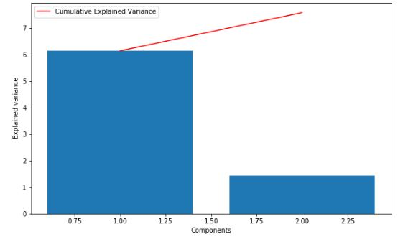
explained_variance_ and it's cumulative sum Plot
plt.bar(range(1,len(pcamodel.explained_variance_ )+1),pcamodel.explained_variance_ )
plt.ylabel('Explained variance')
plt.xlabel('Components')
plt.plot(range(1,len(pcamodel.explained_variance_ )+1),
np.cumsum(pcamodel.explained_variance_),
c='red',
label="Cumulative Explained Variance")
plt.legend(loc='upper left')

Slide 16
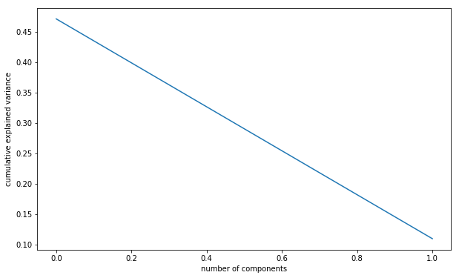
explained_variance_ratio_ Plot
plt.plot(pcamodel.explained_variance_ratio_)
plt.xlabel('number of components')
plt.ylabel('cumulative explained variance')
plt.show()

Slide 17
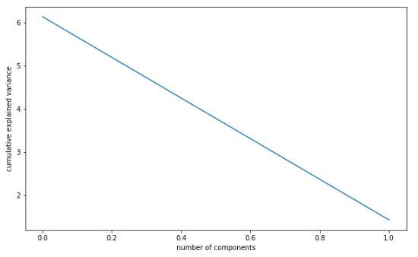
Scree plot
Scree plot is nothing but plot of eigen values(explained_variance_) for each of the components.
plt.plot(pcamodel.explained_variance_)
plt.xlabel('number of components')
plt.ylabel('cumulative explained variance')
plt.show()

Slide 18
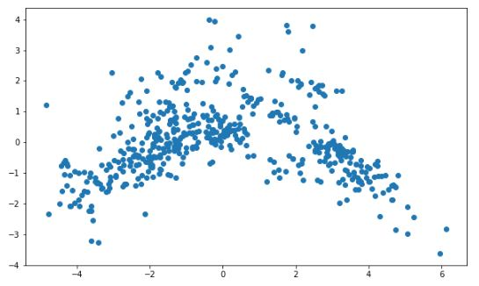
Scatter plot of PCA1 and PCA2
plt.scatter(pca[:, 0], pca[:, 1])

Slide 19
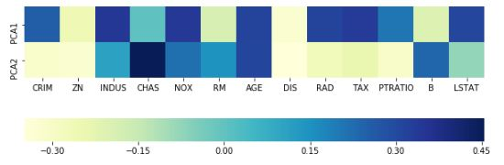
Effect of variables on each components
components_ attribute provides principal axes in feature space, representing the directions of maximum variance in the data. This means, we can see influence on each of the components by features.
plt.rcParams['figure.figsize'] = (10,6)
ax = sns.heatmap(pcamodel.components_,
cmap='YlGnBu',
yticklabels=[ "PCA"+str(x) for x in range(1,pcamodel.n_components_+1)],
xticklabels=list(x.columns),
cbar_kws={"orientation": "horizontal"})
ax.set_aspect("equal")

Slide 20
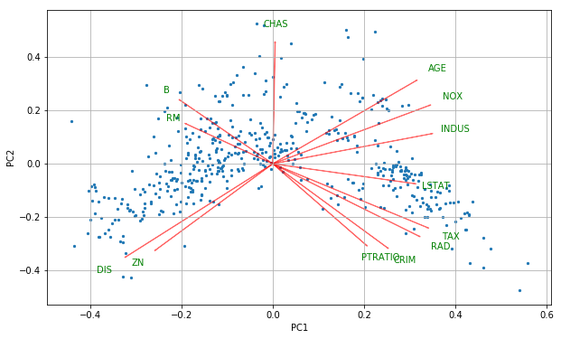
PCA Biplot
Biplot is an interesting plot and contains lot of useful information.
It contains two plots:
PCA scatter plot which shows first two component ( We already plotted this above)
PCA loading plot which shows how strongly each characteristic influences a principal component.
def myplot(score,coeff,labels=None):
xs = score[:,0]
ys = score[:,1]
n = coeff.shape[0]
scalex = 1.0/(xs.max() - xs.min())
scaley = 1.0/(ys.max() - ys.min())
plt.scatter(xs * scalex,ys * scaley,s=5)
for i in range(n):
plt.arrow(0, 0, coeff[i,0], coeff[i,1],color = 'r',alpha = 0.5)
if labels is None:
plt.text(coeff[i,0]* 1.15, coeff[i,1] * 1.15, "Var"+str(i+1), color = 'green', ha = 'center', va = 'center')
else:
plt.text(coeff[i,0]* 1.15, coeff[i,1] * 1.15, labels[i], color = 'g', ha = 'center', va = 'center')
plt.xlabel("PC{}".format(1))
plt.ylabel("PC{}".format(2))
plt.grid()
myplot(pca[:,0:2],np.transpose(pcamodel.components_[0:2, :]),list(x.columns))
plt.show()

