Slide 1
Fire and Smoke Detection using Deep Learning Models
Project Progress Presentation
Chintakunta Guru Dinesh Reddy
220905438
CSE
Under the guidance of
Dr. Sucharitha Shetty
Assistant Professor
School of Computer Engineering
March 28, 2026
1/17

Slide 2
Presentation Outline
Introduction
Literature Survey / Background Theory Problem Definition
Objectives Methodology Workdone so far Remaining work Scope Conclusion References
1
2
3
4
5
6
7
8
9
10
2/17

Slide 3
1. Introduction
Fire incidents can occur in various environments such as forests, industrial areas, residential buildings, and public places.
Traditional fire detection systems rely on hardware sensors like smoke detectors and temperature sensors, which may not perform effectively in large or outdoor environments.
These systems may fail to detect fire at an early stage due to environmental conditions, leading to severe damage.
Modern systems generate large amounts of visual data (images/videos) that contain important information such as:
• Flame color and intensity • Smoke patterns and texture • Movement of fire and spread behavior
The use of Artificial Intelligence and Deep Learning techniques helps to: • Detect fire and smoke in real time • Identify patterns in visual data • Improve accuracy and speed of detection
Advanced models like YOLO (You Only Look Once) enable fast and accurate object detection, making them suitable for fire monitoring systems.
3/17

Slide 4
2. Literature Survey
Year | Research Paper | Methodology | Limitations
2016 | Convolutional Neural Networks for Video Fire Detection [5] | Standard CNN Classifiers | Evaluates the whole image, cannot draw bounding boxes or localize the fire's exact position.
2018 | Digital Image Processing [9] | HSV Color Space Analysis | Relies on manual thresholds, highly susceptible to environmental lighting and noise.
2019 | Fire Detection using Faster R-CNN and Deep Learning [6] | Region-Based CNN (Faster R-CNN) | High accuracy but computationally heavy, too slow for true real-time video processing.
2024 | YOLOv8: Learning What You Want to Learn [4] | Advanced One-Stage Detectors | Excellent speed and localization, but output is strictly binary (identifies "Fire" but not the type).
4/21

Slide 5
3. Research Gap
Existing systems only detect fire presence, not the type of fire Class A, Class B.
Most models provide only binary output (fire / no fire) without detailed information.
Lack of real-time fire classification for practical safety applications.
Limited use of advanced models like YOLOv8 for fire type classification.
5/21

Slide 6
4. Objectives
To implement object detection techniques to accurately draw bounding boxes and localize anomalies within a frame.
To evaluate and train high-speed baseline YOLO models (v8-v11) to achieve true real-time processing speeds.
To curate and precisely annotate a novel, domain-specific dataset uniquely categorized into Class A and Class B fire hazards.
To develop a deep learning classification module (YOLOv8) capable of intelligently categorizing the specific hazard type.
6/21
Notes:
(Solves the CNN limitation)
(Solves the Faster R-CNN limitation)
(Solves the Binary Detection limitation)
(Solves the manual Color Analysis limitation)

Slide 7
4. Methodology
Dataset Collection & Understanding: Collect and analyze fire and smoke images from different environments such as forests, buildings, and industries.
Data Preprocessing & Annotation: Clean data, resize images, and annotate fire/smoke regions; split dataset into training, validation, and testing sets.
Model Training & Development: Train deep learning models (YOLOv8, YOLOv9, YOLOv10, YOLOv11) for fire and smoke detection.
Model Evaluation: Evaluate performance using precision, recall, and mean average precision (mAP).
Fire Type Classification: Classify detected fire into Class A and Class B using a classification model and HSV-based feature analysis.
7/17

Slide 8
4.1 Dataset Collection & Data Preprocessing
The dataset consists of fire and smoke images collected from publicly available sources.
It includes images from different real-world scenarios such as forests, buildings, and industrial environments.
Preprocessing steps such as removing corrupted images, organizing data, and resizing images (e.g., 640×640) were performed.
Feature | Description | Type
label | Class label (Fire / Smoke) | String
fire_type | Type of fire (Class A / Class B) | String
bounding_box | Coordinates of detected fire/smoke region | Array
image_size | Resolution of image (e.g., 640×640) | Integer
8/17

Slide 9
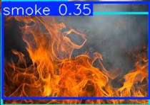
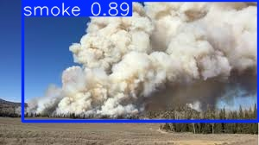
4.2 Image Annotation & Data Splitting
Annotated images by drawing bounding boxes around fire and smoke regions.
Labeled each object into two categories: Fire and Smoke.
Performed dataset splitting into training, validation, and testing sets.
Ensured proper data distribution to improve model generalization on unseen data.
9/17

Slide 10
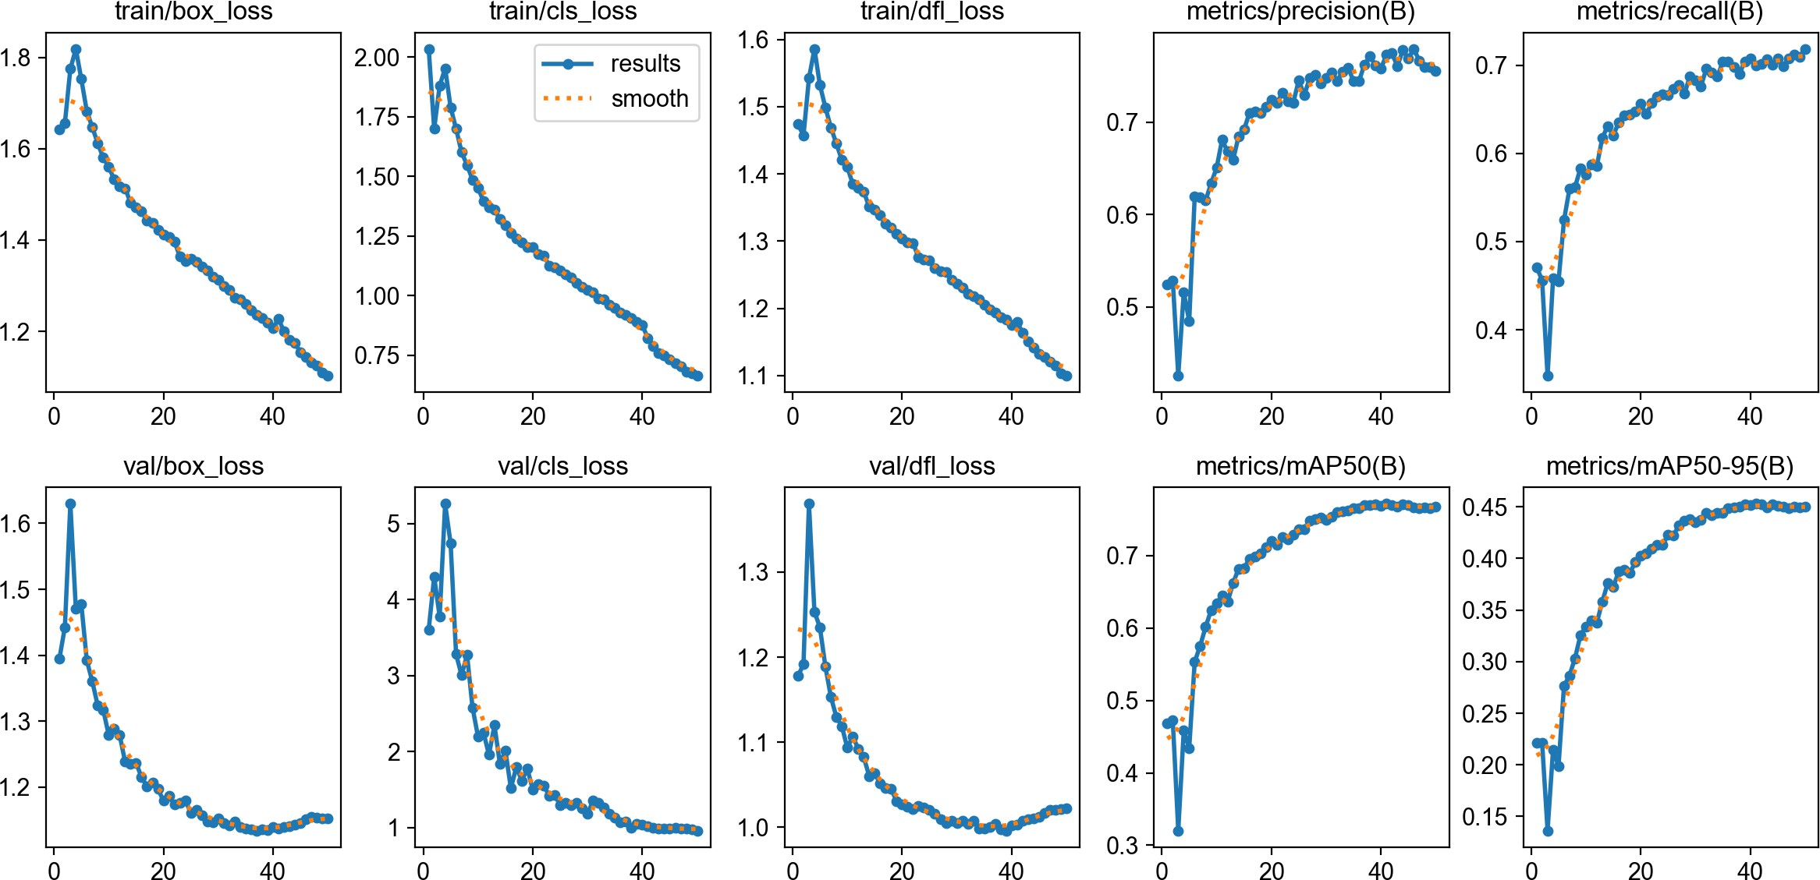
4.3 Model Training and Development
Applied deep learning models such as YOLOv8, YOLOv9, YOLOv10, and YOLOv11 for fire and smoke detection.
Used YOLO models as they are efficient in detecting objects in real time with high accuracy.
Trained multiple models to compare performance and identify the most effective model for detection.
Conducted train-test split to evaluate model performance using metrics like precision, recall, and mean average precision (mAP).
10/17

Slide 11
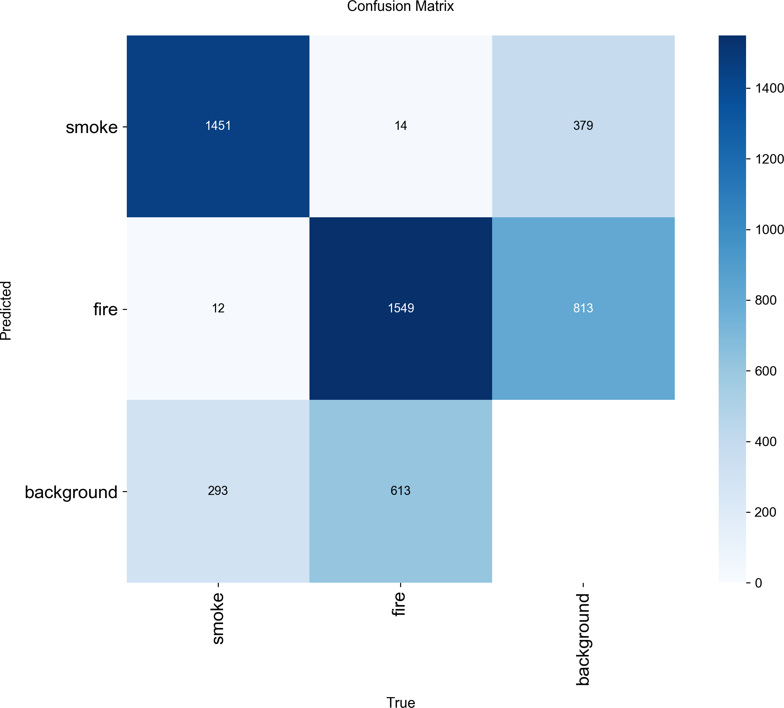
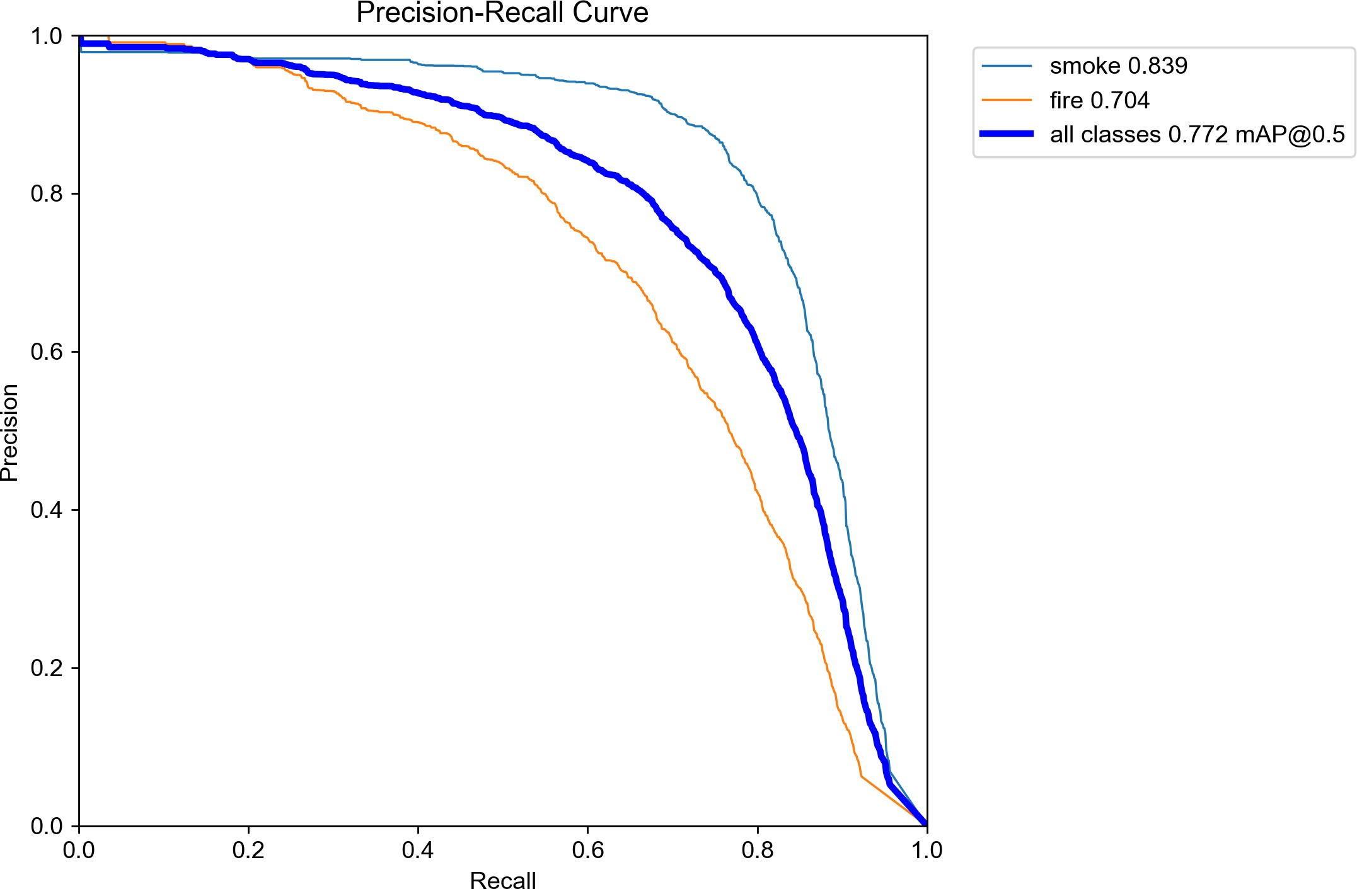
4.4 Model Evaluation
Evaluated model performance using standard metrics such as precision, recall, and mean average precision (mAP).
Analyzed confusion matrix to understand correct and incorrect predictions of fire and smoke detection.
Used Precision-Recall curve to evaluate the trade-off between precision and recall.
Evaluated F1-score to measure the balance between precision and recall.
11/17

Slide 12
5. Work Done So Far & Contribution of Each Member
Collected and preprocessed fire and smoke image dataset from publicly available sources.
Performed image annotation using bounding boxes and split dataset into training, validation, and testing sets.
Trained multiple YOLO models (YOLOv8, YOLOv9, YOLOv10, YOLOv11) for fire and smoke detection.
Achieved good performance, with YOLOv8 giving best results in terms of precision, recall, and mAP.
Developed initial fire type classification module using YOLOv11 with a custom dataset of ~400 images.
Contribution of each member :
Chintakunta Guru Dinesh Reddy : Dataset collection, preprocessing, annotation, and model training to improve results.
Adnan Sami : Model evaluation and fire type classification
12/17

Slide 13
6. Remaining Work
Improve the fire type classification model by expanding the dataset and enhancing model accuracy.
Apply advanced techniques such as HSV-based feature analysis to improve classification reliability.
Integrate fire detection and classification into a single system for real-time monitoring.
Perform testing on different scenarios and optimize the system for better performance and robustness.
13/17

Slide 14
7. Scope
Analyzing visual data using deep learning techniques to detect fire and smoke in real-time.
Identifying fire characteristics and classifying fire types to support accurate and effective emergency response.
Applying the system in real-world scenarios such as industrial safety, forest fire monitoring, and smart city surveillance.
Enhancing public safety by enabling early detection and reducing damage to life, property, and the environment.
14/17

Slide 15
8. Conclusion
Successfully developed a deep learning-based system to detect fire and smoke using computer vision techniques.
Applied YOLO models to accurately identify fire and smoke regions in images with good performance.
Enhanced the system by introducing fire type classification (Class A and Class B) for better decision-making.
Demonstrated the effectiveness of combining detection and classification in a two-stage pipeline.
The proposed solution shows the potential of AI and deep learning in improving fire safety and early disaster detection systems.
15/17

Slide 16
9. References
J. Redmon et al., “You Only Look Once: Unified, Real-Time Object Detection,” CVPR, 2016.
Z. Ge et al., “YOLOX: Exceeding YOLO Series in 2021,” arXiv, 2021.
C.-Y. Wang et al., “YOLOv7: Trainable Bag-of-Freebies Sets New State-of-the-Art,” arXiv, 2022.
T. Wang et al., “YOLOv9: Learning What You Want to Learn Using Programmable Gradient Information,” arXiv, 2024.
S. Frizzi et al., “CNN for Video Fire and Smoke Detection,” IEEE, 2016.
P. Barmpoutis et al., “Fire Detection Using Faster R-CNN and Deep Learning,” 2019.
S. Muhammad et al., “Vision-Based Fire Detection System Using Deep Learning,” IEEE Access, 2018.
J. Schmidhuber, “Deep Learning in Neural Networks: An Overview,” 2015.
R. C. Gonzalez et al., “Digital Image Processing,” Pearson, 2018.
A. Krizhevsky et al., “ImageNet Classification with Deep CNNs,” NeurIPS, 2012.
G. Jocher et al., “Ultralytics YOLO,” 2023.
16/17

Slide 17
Thank You
17/17

