Slide 1
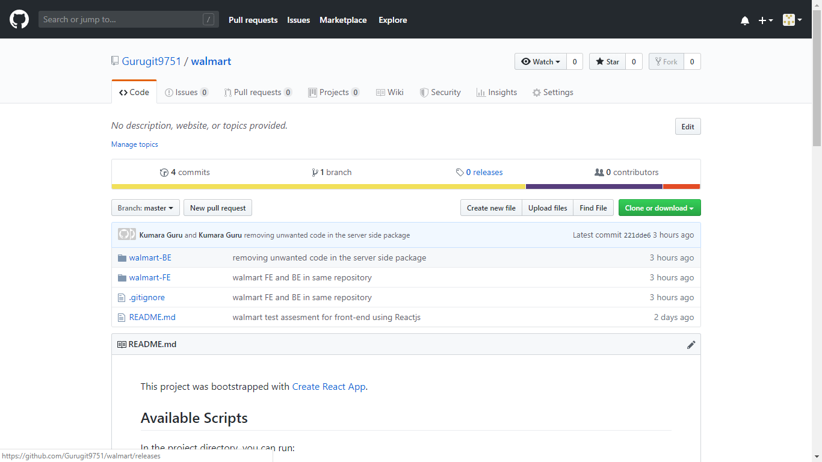
Walmart Test Assessment in the Git Repository by Kumaraguru,ITC
Back End code in Node js
Front End code in React Js, Javascript, Html , CSS

Slide 2



Technology Used in this Assesment
Front End
React JS
Javascript
Html
CSS
Back End
Node js
Express js

Slide 3

Core Components of the Applications
UI (Front End (DOM, Framework))
Request Layer (Web API)
Back End (Server, Logic)
Server
Client
API
Front End
Browser
Logic
JSON
Walmart URL
Cache data and store into local.
Notes:
Break down into front end and back end

Slide 4
Workflow diagram for this Application
ReactJS
Browser
Server
Walmart Server
Step-1
Fetch URL List Items()
HTTP - request
Request
https://mobile-tha-server.firebaseapp.com/walmartproducts/1/30
Response
Response 200 OK
Response-JSON Data
Step-2
Fetch List for Particular Content
HTTP - request
http://localhost:5000/walmartproducts/:id:
Create Local Array and to Store the Response
Get the Result and process the Response
Json Response for particular Item
Step-3
Fetch List based on the User Filter Ex Rating,Count,…)
HTTP - request
http://localhost:5000/products/filter:
Get the result and process the response
Json Response for filter items in json format

Slide 5
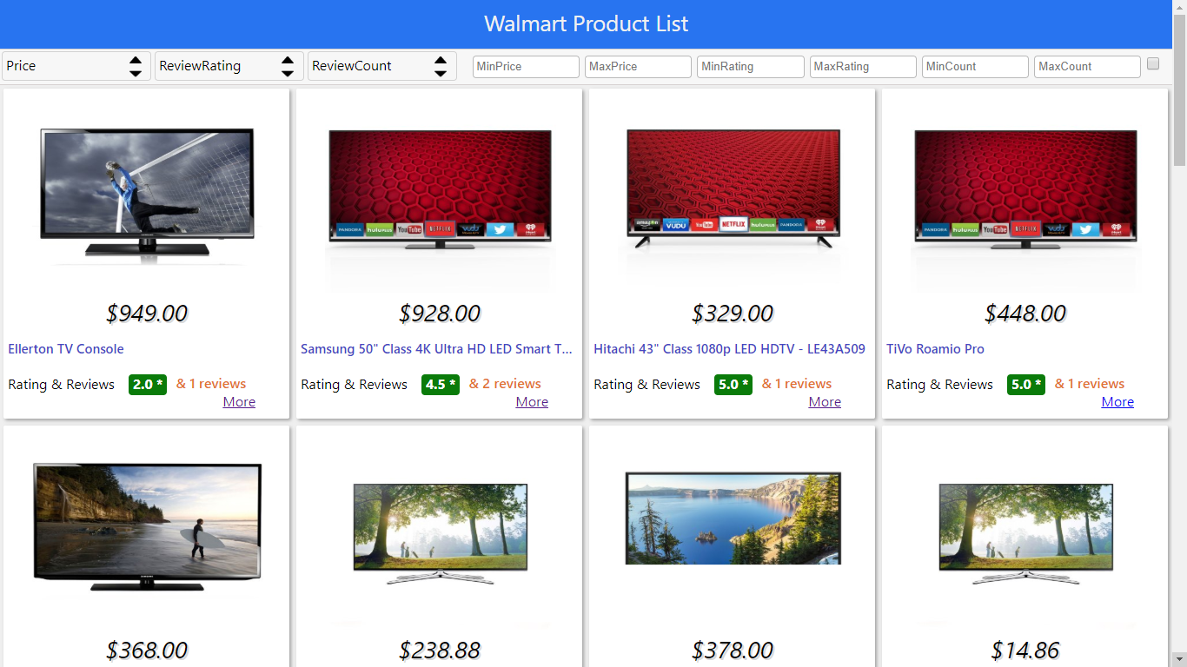

Slide 6
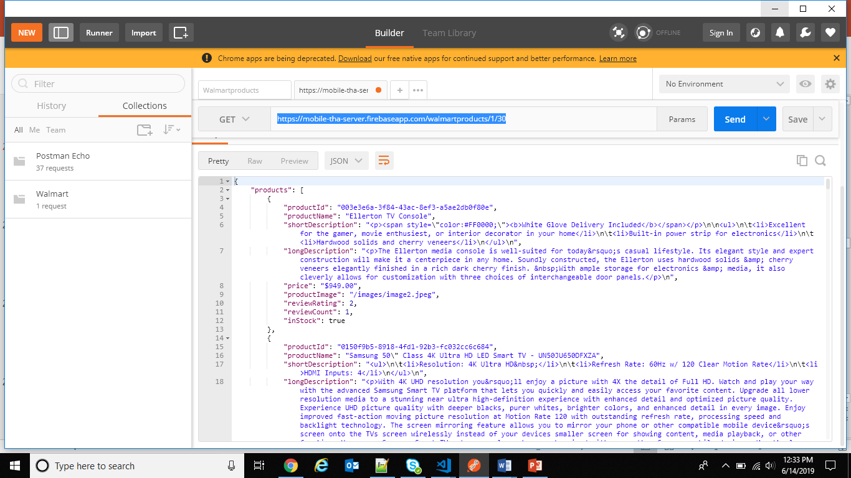
Tools for Testing WebAPI
Postman Chrome extension

