Slide 1
Indonesian Language Model
Using
Universal Language Model Fine-tuning for Text Classification
(ULMFiT)

Slide 2
Language Model
Predicting the next word based on previous words
Joko Widodo adalah …
One of main researches on NLP
Applications: speech recognition, text classification, text recognition, machine translation, semantic extraction, etc…

Slide 3
Type of Language Model
N-Gram based LM
Neural network based LM

Slide 4
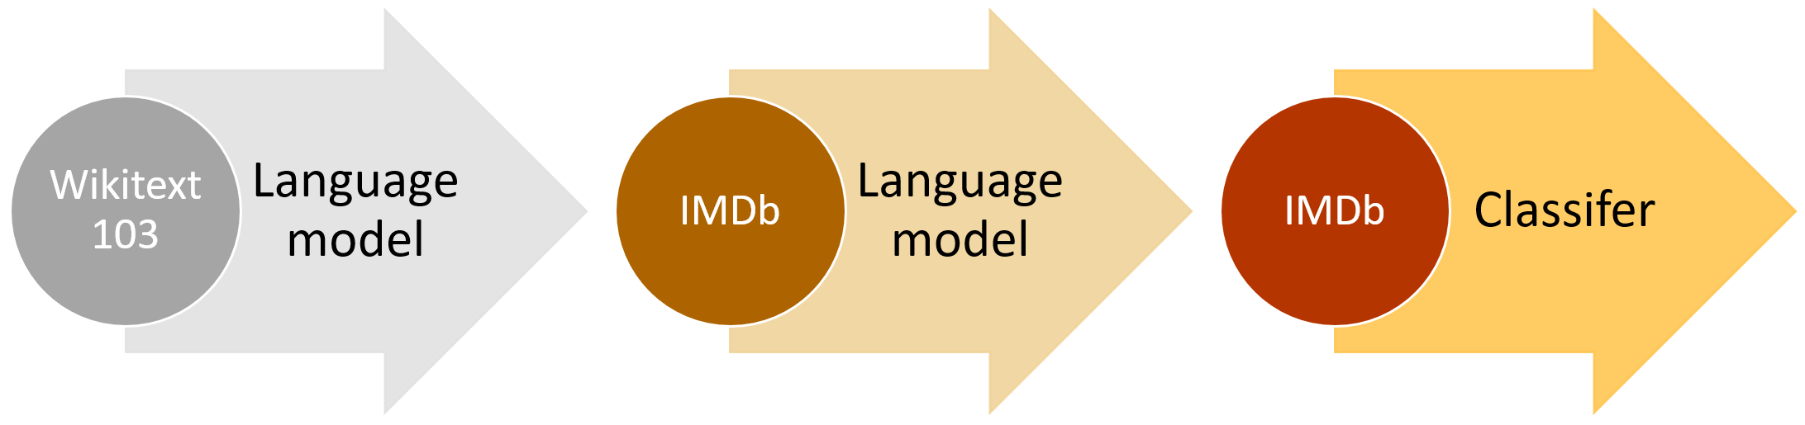
Universal Language Model Fine-tuning for Text Classification (ULMFiT)

Slide 5
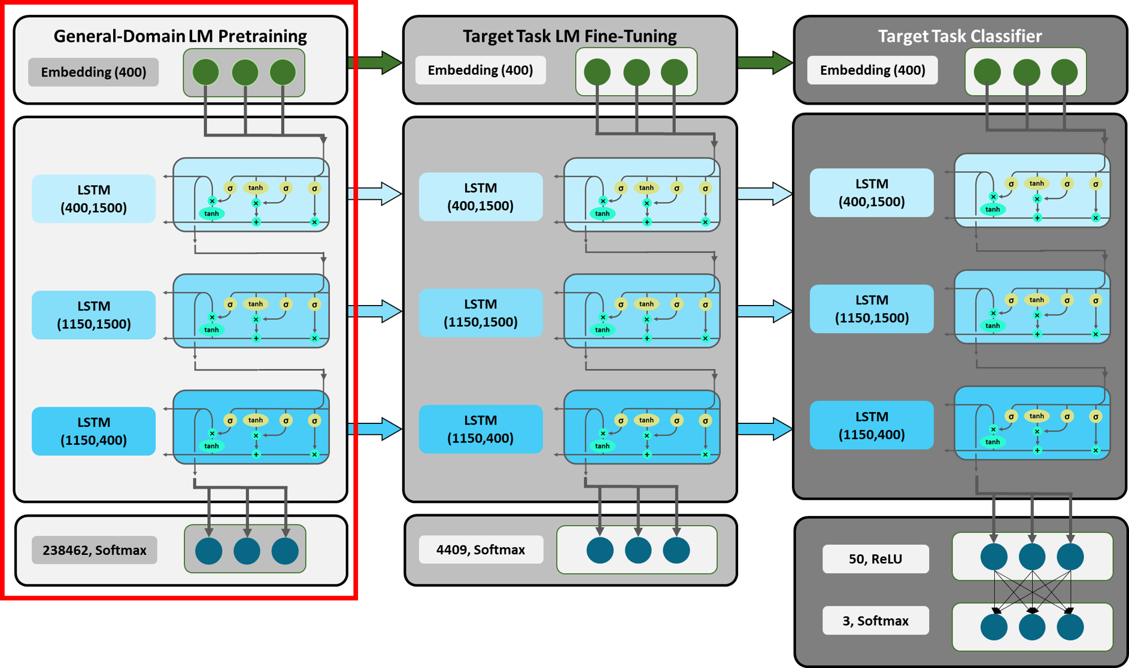
ULMFiT Architecture

Slide 6
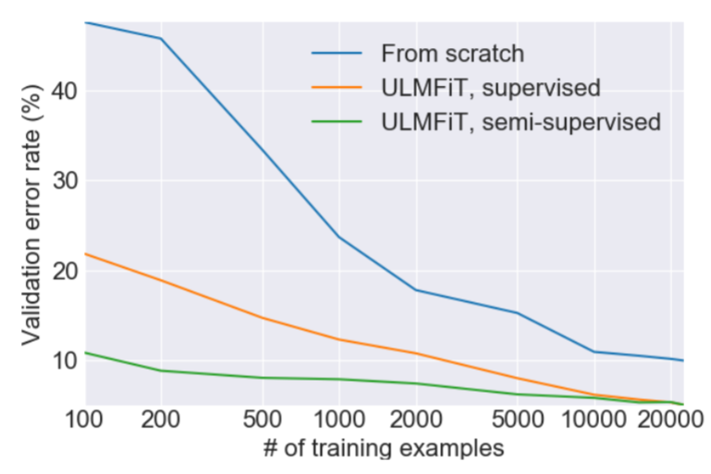
ULMFiT on Text Classification

Slide 7
ULMFiT for Bahasa Indonesia
Dataset: Indonesian Wikipedia
> 400K articles
Vocabulary size: 60K
Perplexity: 27.67
Comparison:
400 (?) on N-Gram Indonesian LM
40.68 on English wikitext2 (Yang et al, 2017)
29.2 on English wikitext103 (Rae et al, 2018)

Slide 8
ULMFiT for Bahasa Indonesia Text Classification
Dataset: Word Bahasa Indonesia Corpus and Parallel English Translation (BPPT) for PAN Localization
indonesian-english translation
500K words
Categories:
Economy
International
Science
Sport

Slide 9
ULMFiT for Bahasa Indonesia Text Classification
Name | Accuracy
NB, Count Vectors | 0.9269
NB, WordLevel TF-IDF | 0.9162
NB, N-Gram Vectors | 0.7822
NB, CharLevel Vectors | 0.8433
LC, Count Vectors | 0.9265
LC, WordLevel TF-IDF | 0.9179
LC, N-Gram Vectors | 0.8085
LC, CharLevel Vectors | 0.8888
SVM, N-Gram Vectors | 0.7970
RF, Count Vectors | 0.8392
RF, WordLevel TF-IDF | 0.8338
Xgb, Count Vectors | 0.8087
Xgb, WordLevel TF-IDF | 0.8070
Xgb, CharLevel Vectors | 0.8202
CNN | 0.9263
Kim Yoon’s CNN | 0.9163
RNN-LSTM | 0.9305
RNN-GRU | 0.9296
Biderectional RNN | 0.9267
RCNN | 0.9221
FasText(1) | 0.8550
ULMFit | 0.9563
Performance Comparison:

Slide 10
ULMFiT for Bahasa Indonesia Text Generation
https://lmzoo.uncool.ai/text-generator/

Slide 11
Future Work for Indonesian Language Model
Language Model based on OpenAI GPT2 or better
Dataset collections
Training on 100+ Google TPUs with the help from Tensorflow Research Cloud https://www.tensorflow.org/tfrc

Slide 12
Thank You

