Slide 1
GURUKUL Boot Camp - SQL
Date – 2024-10-01

Slide 2

Introduction To SQL:
What is SQL?
SQL is a short-form of the structured query language, and it is pronounced as S-Q-L or sometimes as See-Quell.
This database language is mainly designed for maintaining the data in relational database management systems. It is a special tool used by data professionals for handling structured data (data which is stored in the form of tables). It is also designed for stream processing in RDSMS.
What is Database?
A database is an organized collection of data stored in a computer system and usually controlled by a database management system (DBMS). The data in common databases is modeled in tables, making querying and processing efficient. Structured query language (SQL) is commonly used for data querying and writing.
Relational Database: A relational database is made up of a set of tables with data that fits into a predefined category.
Normalization of DBMS
Normalization is the process of minimizing redundancy from a relation or set of relations. Redundancy in relation may cause insertion, deletion, and update anomalies.
In database management systems (DBMS), normal forms are a series of guidelines that help to ensure that the design of a database is efficient, organized, and free from data anomalies.

Slide 3
Types of Big Data:
Big Data includes huge volume, high velocity, and extensible variety of data. There are 3 types: Structured data, Semi-structured data, and Unstructured data.
Structured data – Structured data is data whose elements are addressable for effective analysis. It has been organized into a formatted repository that is typically a database. It concerns all data which can be stored in database SQL in a table with rows and columns. They have relational keys and can easily be mapped into pre-designed fields. Today, those data are most processed in the development and simplest way to manage information. Example: Relational data.
Semi-Structured data – Semi-structured data is information that does not reside in a relational database but that has some organizational properties that make it easier to analyze. With some processes, you can store them in the relation database (it could be very hard for some kind of semi-structured data), but Semi-structured exist to ease space. Example: XML data.
Unstructured data – Unstructured data is a data which is not organized in a predefined manner or does not have a predefined data model, thus it is not a good fit for a mainstream relational database. So for Unstructured data, there are alternative platforms for storing and managing, it is increasingly prevalent in IT systems and is used by organizations in a variety of business intelligence and analytics applications. Example: Word, PDF, Text, Media logs.

Slide 4
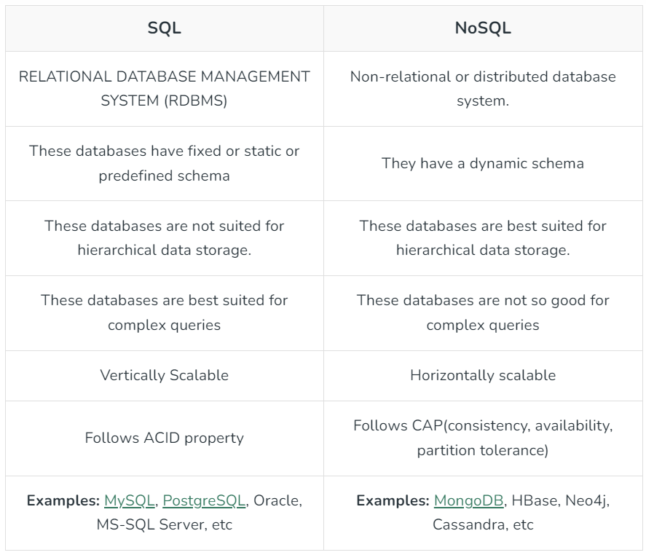
Difference between SQL and NoSQL:

Slide 5
What Can SQL do?
SQL can execute queries against a database
SQL can retrieve data from a database
SQL can insert records in a database
SQL can update records in a database
SQL can delete records from a database
SQL can create new databases
SQL can create new tables in a database
SQL can create stored procedures in a database
SQL can create views in a database
SQL can set permissions on tables, procedures, and views

Slide 6
SQL Syntax:
When you want to do some operations on the data in the database, then you must have to write the query in the predefined syntax of SQL.
The syntax of the structured query language is a unique set of rules and guidelines, which is not case-sensitive. Its Syntax is defined and maintained by the ISO and ANSI standards.
You can write the keywords of SQL in both uppercase and lowercase, but writing the SQL keywords in uppercase improves the readability of the SQL query.
SQL statements or syntax are dependent on text lines. We can place a single SQL statement on one or multiple text lines.
You can perform most of the action in a database with SQL statements.
SQL Statement-
SQL statements tell the database what operation you want to perform on the structured data and what information you would like to access from the database.
The statements of SQL are very simple and easy to use and understand. They are like plain English but with a particular syntax.

Slide 7
SQL Commands:
SQL commands are the instructions used to communicate with a database to perform tasks, functions, and queries with data.
Data Definition Language
SQL commands used to create the database structure are known as data definition language (DDL).
Data Manipulation Language
A relational database can be updated with new data using data manipulation language (DML) statements.
Command | Description
CREATE | Creates a new table, a view of a table, or other object in the database.
ALTER | Modifies an existing database object, such as a table
DROP | Deletes an entire table, a view of a table, or other objects in the database
Command | Description
SELECT | Retrieves certain records from one or more tables.
INSERT | Creates a record.
UPDATE | Modifies records.
DELETE | Deletes records.

Slide 8
SQL Commands:
Data Query Language
Data retrieval instructions are written in the data query language (DQL), which is used to access relational databases. The SELECT command is used by software programs to filter and return particular results from a SQL table.
Data Control Language
Data control language (DCL) is a programming language used by database administrators to control or grant other users access to databases.
Transaction Control Language
To automatically update databases, the relational engine uses transaction control language (TCL). For instance, the database can reverse a mistaken transaction using the ROLLBACK command.
Command | Description
GRANT | Gives a privilege to the user.
REVOKE | Takes back privileges granted by the user.

Slide 9
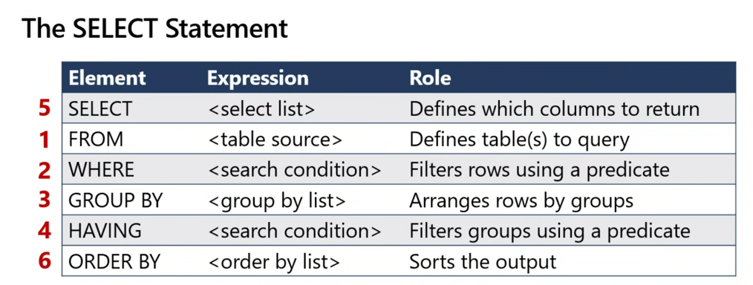
SQL Commands-Order of Execution:

Slide 10
SQL Database Commands:
The CREATE DATABASE statement is used to create a new SQL database.
CREATE DATABASE databasename; -
The DROP DATABASE statement is used to drop an existing SQL database.
DROP DATABASE databasename;
To change the name of a database in SQL, use the syntax:
ALTER DATABASE old_database_name MODIFY NAME = new_database_name;
The USE DATABASE statement is not a standard SQL command, but rather a variation of the USE command used in some SQL database management systems (DBMS) to select a specific database for the current session.
USE database_name;
The BACKUP DATABASE statement is used in SQL Server to create a full back up of an existing SQL database.
BACKUP DATABASE databasename TO DISK = 'filepath’;
A differential back up only backs up the parts of the database that have changed since the last full database backup.
BACKUP DATABASE databasename TO DISK = 'filepath' WITH DIFFERENTIAL;

Slide 11
SQL Table Commands:
The CREATE TABLE statement is used to create a new table in a database.
CREATE TABLE table_name ( column1 datatype, column2 datatype, column3 datatype, .... );
The DROP TABLE statement is used to drop an existing table in a database.
DROP TABLE table_name;
The ALTER TABLE statement is used to add, delete, or modify columns in an existing table.
The ALTER TABLE statement is also used to add and drop various constraints on an existing table.
ALTER TABLE table_name - To add a column in a table ADD column_name datatype;
ALTER TABLE table_name - To delete a column in a table DROP column_name datatype;
ALTER TABLE table_name - To rename a column in a table RENAME column_name datatype;
EXEC sp_rename 'table_name.old_name', 'new_name', 'COLUMN'; - To rename a column in a table in SQL Server

Slide 12
SQL Table Commands:
SQL DELETE TABLE
The DELETE statement is used to delete rows from a table. If you want to remove a specific row from a table you should use WHERE condition.
DELETE FROM table_name [WHERE condition];
But if you do not specify the WHERE condition it will remove all the rows from the table.
DELETE FROM table_name;
Difference between DELETE and TRUNCATE statements
There is a slight difference b/w delete and truncate statement. The DELETE statement only deletes the rows from the table based on the condition defined by WHERE clause or delete all the rows from the table when condition is not specified.
But it does not free the space containing by the table.
The TRUNCATE statement: it is used to delete all the rows from the table and free the containing space.
SQL TRUNCATE TABLE-
A truncate SQL statement is used to remove all rows (complete data) from a table. It is similar to the DELETE statement with no WHERE clause.
TRUNCATE TABLE Vs DELETE TABLE
Truncate table is faster and uses lesser resources than DELETE TABLE command.
TRUNCATE TABLE Vs DROP TABLE
Drop table command can also be used to delete complete table but it deletes table structure too. TRUNCATE TABLE doesn't delete the structure of the table.
TRUNCATE TABLE table_name;

Slide 13
SQL Commands:
SELECT - The SELECT statement in SQL is used to fetch or retrieve data from a database.
To access all column from the table, use SELECT syntax with * asterisk sign.
SELECT * FROM table_name;
To access any particular column(s), mention the column name separated by comma instead of * asterisk sign.
SELECT Column_Name_1, Column_Name_2, ....., Column_Name_N FROM Table_Name;
SQL SELECT DISTINCT-
The SQL DISTINCT command is used with SELECT key word to retrieve only distinct or unique data.
In a table, there may be a chance to exist a duplicate value and sometimes we want to retrieve only unique values. In such scenarios, SQL SELECT DISTINCT statement is used
SELECT DISTINCT column_name ,column_name FROM table_name;
SQL SELECT COUNT
The SQL COUNT() is a function that returns the number of records of the table in the output.
This function is used with the SQL SELECT statement.
SELECT COUNT(column_name) FROM table_name;

Slide 14
SQL Commands:
SQL SELECT DATE
SQL SELECT DATE is used to retrieve a date from a database. If you want to find a particular date from a database, you can use this statement.
For example: let's see the query to get all the records after '2013-12-12'.
SELECT * FROM table-name WHERE your date-column >= '2013-12-12’
SQL WHERE
A WHERE clause in SQL is a data manipulation language statement.
WHERE clauses are not mandatory clauses of SQL DML statements. But it can be used to limit the number of rows affected by a SQL DML statement or returned by a query.
Actually. it filters the records. It returns only those queries which fulfill the specific conditions.
SELECT column1, column 2, ... column n
FROM table_name
WHERE [conditions] ;
SQL AND
The SQL AND condition is used in SQL query to create two or more conditions to be met.
It is used in SQL SELECT, INSERT, UPDATE and DELETE
Let's see the syntax for SQL AND:
SELECT columns FROM tables WHERE condition 1 AND condition 2;
The SQL AND condition require that both conditions should be met.
The SQL AND condition also can be used to join multiple tables in a SQL statement.
SELECT * FROM emp WHERE Department = "IT" AND Location = "Chennai";

Slide 15
SQL OR
The SQL OR condition is used in SQL query to create a SQL statement where records are returned when any one condition met. It can be used in a SELECT statement, INSERT statement, UPDATE statement or DELETE statement.
Let's see the syntax for the OR condition:
SELECT columns FROM tables WHERE condition 1 OR condition 2;
SELECT * FROM emp WHERE Department = "IT" OR Location = "Chennai";
SQL WITH CLAUSE
The SQL WITH clause is used to provide a sub-query block which can be referenced in several places within the main SQL query. It was introduced by oracle in oracle 9i release2 database.
There is an example of employee table:
Syntax for the SQL WITH clause –
WITH <alias_name_A> AS (sql_sub-query_statement)
<alias_name_B> AS (sql_sub-query_statement_from_alias_name_A
Or sql_sub-query_statement)
SELECT <column_list>
FROM <alias_name_A >,< alias_name_B >, [tablenames]
[WHERE < join_condition>]
SQL SELECT AS
SQL 'AS' is used to assign a new name temporarily to a table column or even a table.
It makes an easy presentation of query results and allows the developer to label results more accurately without permanently renaming table columns or even the table itself.
Let's see the syntax of select as:
SELECT Column_Name1 AS New_Column_Name, Column_Name2 AS New_Column_Name FROM Tabl

Slide 16
HAVING Clause in SQL
The HAVING clause places the condition in the groups defined by the GROUP BY clause in the SELECT statement.
This SQL clause is implemented after the 'GROUP BY' clause in the 'SELECT' statement.
This clause is used in SQL because we cannot use the WHERE clause with the SQL aggregate functions. Both WHERE and HAVING clauses are used for filtering the records in SQL queries.
SELECT SUM(Emp_Salary), Emp_City FROM Employee GROUP BY Emp_City HAVING SUM(Emp_Salary)>5000;
SQL ORDER BY Clause
Whenever we want to sort the records based on the columns stored in the tables of the SQL database, then we consider using the ORDER BY clause in SQL.
The ORDER BY clause in SQL will help us to sort the records based on the specific column of a table. This means that all the values stored in the column on which we are applying ORDER BY clause will be sorted, and the corresponding column values will be displayed in the sequence in which we have obtained the values in the earlier step.
Using the ORDER BY clause, we can sort the records in ascending or descending order as per our requirement. The records will be sorted in ascending order whenever the ASC keyword is used with ORDER by clause. DESC keyword will sort the records in descending order.
If no keyword is specified after the column based on which we have to sort the records, in that case, the sorting will be done by default in the ascending order.
SELECT ColumnName1,...,ColumnNameN FROM TableName ORDER BY ColumnName ASC;

Slide 17
SQL INSERT STATEMENT
SQL INSERT statement is a SQL query. It is used to insert a single or a multiple records in a table.
There are two ways to insert data in a table:
1) Inserting data directly into a table
You can insert a row in the table by using SQL INSERT INTO command.
There are two ways to insert values in a table.
In the first method there is no need to specify the column name where the data will be inserted, you need only their values.
INSERT INTO table_name VALUES (value1, value2, value3....);
INSERT INTO table_name (column1, column2, column3....) VALUES (value1, value2, value3.....);

Slide 18
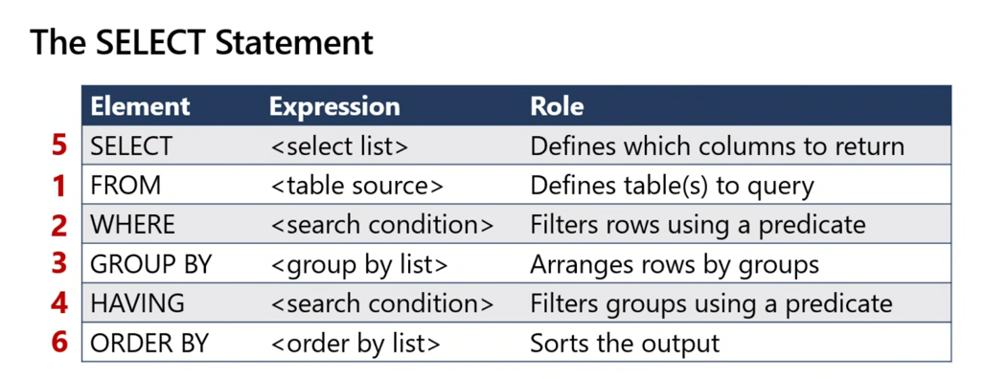
Order of Execution:

Slide 19
Connection of Local Sql database through Python:
import pyodbc import pandas connection_string = ("Driver={ODBC Driver 17 for SQL Server};"
"Server=C-PF3PR332\SQLEXPRESS;"
"Database=adventureworks;"
"Trusted_Connection=yes;")
Connection=pyodbc.connect(connection_string) Cursor = Connection.cursor() df = pd.read_sql('select * from SalesLT.Customer',Connection)
print(df)

Slide 20
Connection of Remote Sql database through Python:
import mysql.connector
import pandas as pd,os,glob,warnings
warnings.filterwarnings("ignore")
#Connect to the database
cnx = mysql.connector.connect(
host="10.58.88.90",#"192.168.2.90",
port=3306,
user="npgdc",#"isatdb3",
password="nhRtgT",#"6E4B483B7D3E6",#
database="ioh_tableau"
)
# Check if the connection is successful
if cnx.is_connected():
print("Connected to the database!")
else:
print("Failed to connect to the database.")
df = pd.read_sql(sql="SELECT * FROM ioh_tableau.cx_systemkey_4g_bw_day;", con=cnx)
cnx.close()
print(df)

