Slide 1
GURUKUL Boot Camp Python (Day-1 Continued)
Date – 2024-09-20

Slide 2
Type Casting
Operators
Reading Input from the Keyboard
Flow Control
File handling

Slide 3

TYPE Casting :
Type Casting is the method to convert the Python variable datatype into a certain data type in order to perform the required operation by users. In this article, we will see the various techniques for typecasting. There can be two types of Type Casting in Python:
Python Implicit Type Conversion
Python Explicit Type Conversion
1. Implicit Type Conversion in Python
In this, method, Python converts into datatype automatically. Users don’t have to involve in this process.
# Python automatically converts a to int
a = 7
print(type(a))
# Python automatically converts b to float
b = 3.0
print(type(b))
# Python automatically converts c to float as it is a float addition
c = a + b
print(c)
print(type(c))
# Python automatically converts d to float as it is a float multiplication
d = a * b
print(d)
print(type(d))

Slide 4
TYPE Casting :
Exercise: Convert any Float variable to Int Data type:
Explicit Type Conversion in Python
In this method, Python needs user involvement to convert the variable data type into the required data type.
Mainly type casting can be done with these data type functions:
Int(): Python Int() function take float or string as an argument and returns int type object.
float(): Python float() function take int or string as an argument and return float type object.
str(): Python str() function takes float or int as an argument and returns string type object.
Python Convert Int to Float
Here, we are Converting Int to Float in Python with the float() function.
# Python program to demonstrate type Casting
# int variable
a = 5
# typecast to float
n = float(a)
print(n)
print(type(n))
Python Convert String to float
Here, we are casting string data type into float data type with float() function.
# Python program to demonstrate type Casting
# string variable
a = "5.9"
# typecast to float
n = float(a)
print(n)
print(type(n))

Slide 5
Operators in python :
In Python programming, Operators in general are used to perform operations on values and variables. These are standard symbols used for logical and arithmetic operations. In this we will look into different types of Python operators.
OPERATORS: These are the special symbols. Eg- + , * , /, etc.
OPERAND: It is the value on which the operator is applied.
Types of Operators in Python
Arithmetic Operators
Comparison Operators
Logical Operators
Equality Operators
a = 9
b = 4
add = a + b
sub = a - b
mul = a * b
mod = a % b
p = a ** b
print(add)
print(sub)
print(mul)
print(mod)
print(p)
Operator Description Syntax
+ Addition: adds two operands x + y
– Subtraction: subtracts two operands x – y
* Multiplication: multiplies two operands x * y
/ Division (float): divides the first operand by the second x / y
// Division (floor): divides the first operand by the second x // y
% Modulus: returns the remainder when the first operand is divided by second x % y
** Power: Returns first raised to power second x ** y

Slide 6
Operators in python :
Division Operators
There are two types of division operators:
Float division
Floor division
Float division
The quotient returned by this operator is always a float number, no matter if two numbers are integers. For example:
Example: The code performs division operations and prints the results. For example, ’10/2′ results in ‘5.0’, and ‘-10/2’ results in ‘-5.0’.
Floor division
The quotient returned by this operator is dependent on the argument being passed. If any of the numbers is float, it returns output in float. It is also known as Floor division because, if any number is negative, then the output will be floored. For example:
Example: It provides results as follows: ’10//3′ equals ‘3’, ‘-5//2’ equals ‘-3’, ‘5.0//2′ equals ‘2.0’, and ‘-5.0//2’ equals ‘-3.0’. Integer division returns the largest integer less than or equal to the division result.
Example of Float Division
Example of Floor Division
print(5/5) 1.0
print(10/2) 5.0
print(-10/2) -5.0
print(20.0/2) 10.0
print(10//3) 3
print (-5//2) -3
print (5.0//2) 2.0
print (-5.0//2) -3.0

Slide 7
Operators in python :
a = 10 b = 20 print("a > b is ", a > b) print("a >= b is ", a >= b) print("a < b is ", a < b) print("a <= b is ", a <= b)
COMPARISON Operator:
‘>’
‘<‘
‘>=’
‘<=‘
a > b is False
a >= b is False
a < b is True
a <= b is True
a = 10 b = 20 c = 'Monday' d = 'Tuesday' print("a = b is ", a == b) print("a != b is ", a != b) print("c = d is ", c == d) print("c != d is ", c != d)
Equality Operator:
‘==’ -> Equal to
‘!=‘ -> Not Equal To
a = b is False
a != b is True
c = d is False
c != d is True
Logical Operator:
And -> If both arguments are true then True
Or -> If any one argument is True then True else False
Not -> Complement (If evalutates to False then result is True otherwise False

Slide 8
Reading Dynamic Input from the Keyboard:
Input()
This function always reads the data from the keyboard in the form of String Format.
We have to convert that string type to our required type by using the corresponding. type casting methods
Write a program to read 2 numbers from the keyboard and print sum Special operators
Write a Program to read Employee Data from the Keyboard and print that Data
x=input("Enter First Number:") y=input("Enter Second Number:") i = int(x) j = int(y) print("The Sum:",i+j)
eno = int(input("Enter Employee No:")) ename = input("Enter Employee Name:") esal = float(input("Enter Employee Salary:")) eaddr = input("Enter Employee Address:") married = bool(input("Employee Married ?[True|False]:")) print("Please Confirm Information") print("Employee No :", eno) print("Employee Name :", ename) print("Employee Salary :", esal) print("Employee Address :", eaddr) print("Employee Married ? :", married)

Slide 9
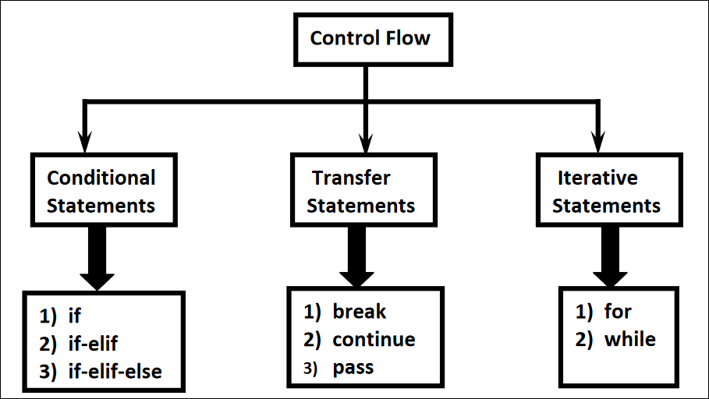
Flow Control :
Flow control describes the order in which statements will be executed at runtime
fruit = input("Enter Name:") if fruit == "apple": print("Hello ! Good Morning") print("How are you!!!")
Conditional Statements
If condition is true then statements will be executed
if condition : statement
OR
if condition :
statement-1
statement-2
statement-3

Slide 10
Flow Control :
Conditional Statements : if - else
if condition:
Action-1
else:
Action-2
name = input("Enter Name:") if name == "Raj": print("Hello {} Good Morning".format(name)) else: print("Hello Guest Good Morning") print("How are you!!!")
Conditional Statements : if – elif - else
if condition1:
Action-1
elif condition2:
Action-2
...
else:
Default Action
brand=input("Enter Your Favourite Brand:") if brand=="Hyundai": print("It is a Car brand") elif brand=="Parle": print("It is Biscuit Brand") elif brand=="Haldiram": print("It's Snacks Brand") else : print("Other Brands are not recommended")

Slide 11
Flow Control :
Multiple if statements | If-elif-else statements
Each condition is checked independently | Stops checking conditions once one is true.
Can result in multiple actions being executed | Only one block of code will execute.
When to use each:
Multiple if statements are useful when you want to check multiple independent conditions and potentially execute multiple blocks of code. For example, if you need to apply different filters or conditions that can all be true at once, multiple if statements are the way to go.
if-elif-else should be used when the conditions are mutually exclusive, meaning only one of the conditions can be true at a time, and only one block of code should run. This is more efficient because it stops evaluating once a true condition is found.

Slide 12
Flow Control – Iterative statements :
If we want to execute a group of statements multiple times then we should go for Iterative statements
Python supports 2 types of iterative statements.
1) for loop
2) while loop
For Loop:
If we want to execute some action for every element present in some sequence
for x in sequence:
Body
1. Write a program to display numbers from 1 to 10 in descending order.
for x in range(10, 0, -1): print(x)
2. Write a program to sum all the elements from list.
list = eval(input("Enter List:")) sum=0 for x in list: sum=sum + x; print("The Sum=",sum)

Slide 13
Flow Control – Iterative statements :
While Loop:
If we want to execute a group of statements iteratively until some condition false,then
we should go for while loop.
while condition :
body
1. To print numbers from 1 to 10 by using while loop
x = 1 while x <= 10: print(x) x = x+1
2. Infinite Loop.
i=0 while True: i=i+1 print("Hello", i)
2. Nested Loop.
for i in range(4): for j in range(4): print("i=",i," j=",j)

Slide 14
Flow Control – Iterative statements :
When to Use Each:
Use a for loop when:
You know how many times the loop should run.
You are iterating over a sequence (like a list, string, or range).
Use a while loop when:
You don't know in advance how many times the loop should run.
You need to keep looping until a condition becomes false.

Slide 15
Flow Control – Transfer Statements :
Break Statement:
We can use break statement inside loops to break loop execution based on some condition.
for i in range(10): if i == 7: print("processing is enough..plz break") break print(i)
Continue Statement:
We can use continue statement to skip current iteration and continue next iteration.
for i in range(10): if i % 2 == 0: continue print(i)
Pass Statement:
pass is a keyword in Python.
In our programming syntactically if block is required which won't do anything then we can define that empty block with pass keyword.
def m1():
pass

Slide 16
File Handling :
File handling in Python refers to reading from or writing to files. It allows you to store data permanently on a disk, process it, and retrieve it when needed. Python provides built-in functions for working with files, using a file object to interact with them.
Python uses different modes to open a file, depending on what you want to do:
r (read): Opens a file for reading. If the file doesn’t exist, it raises an error.
w (write): Opens a file for writing. It creates a new file if the file doesn't exist or truncates the content if it does.
a (append): Opens a file for appending. It creates the file if it doesn’t exist and appends new content to the end of the file.
r+ (read and write): Opens a file for both reading and writing.

Slide 17
File Handling :
1. Open a file: Use the open() function to open a file.
file = open("filename.txt", "r") # Opens in read mode
2. Close a file: After performing file operations, use the close() method to close the file.
file.close()
3. Read from a file: To read the contents of a file, you can use methods like read(), readline(), or readlines().
content = file.read() # Reads the entire file content
4. Write to a file: To write content to a file, you can use write() or writelines().
file.write("This is a new line of text.")
5. Append to a file: To add content to the end of an existing file, open it in append mode (a).
file = open("filename.txt", "a")
file.write("This line is appended.")

Slide 18
PRACTICE and Assignments

Slide 19
Operators in python - Exercise :
a = int(input("Enter First Number:")) b = int(input("Enter Second Number:")) c = int(input("Enter Third Number:")) max = a if a > b and a > c else b if b > c else c print("Maximum Value:", max)
Write a Program to find Maximum of 3 Numbers .

Slide 20
Flow Control - Exercise :
1. Write a Program to find Biggest of given 2 Numbers from the Key Board?
n1 = int(input("Enter First Number:")) n2 = int(input("Enter Second Number:")) if n1 > n2: print("Biggest Number is:", n1) else: print("Biggest Number is:", n2)
2. Write a Program to Check whether the given Number is in between 1 and 10?
n=int(input("Enter Number:")) if n >= 1 and n <= 10 : print("The number",n,"is in between 1 to 10") else: print("The number",n,"is not in between 1 to 10")

Slide 21
Assignment:
Question 1: Write a Python program that takes two numbers as input from the user and performs the following operations:
Addition
Subtraction
Multiplication
Division
Modulus
Display the results for each operation.
Question 2: Write a Python program that checks whether a given number is even or odd using the modulus operator.
Question 3: Write a Python program that takes a number as input from the user and checks if it is positive, negative, or zero.
Question 4: Write a Python program that calculates the grade of a student based on the marks entered by the user. The grading scale is as follows:
90 and above: A
80 - 89: B
70 - 79: C
60 - 69: D
Below 60: F

Slide 22
Assignment:
Question 5: Write a Python program to create a text file called sample.txt and write the sentence "Hello, this is a sample file." to the file. Then, read and display the content from the file.
Question 6: Write a Python program that reads a text file called data.txt and counts the number of words in the file.
Question 7: Write a Python program to print the numbers from 1 to 10 using a for loop.
Question 8: Write a Python program to display the multiplication table of a number entered by the user using a for loop.

