Slide 1
GURULAKSHMI S
(813821104043)
Final Project

Slide 2

PROJECT TITLE :
FAKE NEWS DETECTION USING NLP

Slide 3


AGENDA
Importing and reading the dataset
Calculating shape of data
Creating the target column and Concatenating title and text of news
Appending two datasets
Text Processing
News-Punctuation Cleaning
News-Stop words
Count of fake news and true news
Word Cloud of Fake and True News
Stemming the reviews
3/21/2024 Annual Review

Slide 4

PROBLEM STATEMENT
The fake news dataset is one of the classic text analytics datasets available on Kaggle. It consists of genuine and fake articles’ titles and text from different authors. Our job is to create a model which predicts whether a given news is real or fake.

Slide 5

PROJECT OVERVIEW
The main goal of this project is to develop a model, for identifying news using a dataset obtained from Kaggle.
The key challenge here is to distinguish between fake news articles by analysing the text in their titles and main content.
We must use natural language processing (NLP) techniques to preprocess the text data, building a machine learning model for classification, and evaluate the model's performance

Slide 6

WHO ARE THE END USERS?
General Public
Media Organizations
Social Media Platforms
Government Agencies
Educational Institutions
Fact-Checking Organizations
Corporate Entities
Each of these user groups may have specific requirements, such as real-time processing, scalability, accuracy, and interpretability, that influence how the fake news detection system is designed and deployed.

Slide 7

YOUR SOLUTION AND ITS VALUE PROPOSITION
The solution and value proposition for a fake news detection system using Natural Language Processing (NLP) lie in its ability to address the growing challenge of misinformation and disinformation in the digital age. Here's a breakdown of the solution and its value proposition:
Advanced NLP Techniques
Machine Learning Models
Data Integration
Real-time Monitoring
Scalability and Efficiency
Customizable Alerts and Reports
Trust and Credibility
Compliance and Ethics

Slide 8

THE WOW IN YOUR SOLUTION
For developing a fake news detection project involves a multifaceted approach that combines data collection, preprocessing, model building, deployment, and ongoing monitoring and improvement. It's a challenging but rewarding endeavor that contributes to combating misinformation and promoting media literacy in the digital age.
3/21/2024 Annual Review

Slide 9
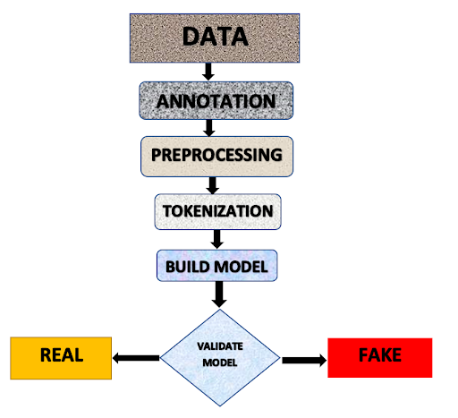
MODELLING
Data Collection: Gather a diverse dataset of news articles labeled as real or fake.
Preprocessing: Tokenization, lowercase, stop words, lemmatization/stemming.
Feature Engineering: Bag of Words (BoW), TF-IDF, Word Embeddings
Model Selection: Classical ML (Naive Bayes, SVM) or DL (RNNs, Transformers).
Training: Split data, train model, tune hyperparameters.
Evaluation: Use metrics like accuracy, precision, recall, F1-score.Deployment: Deploy as API or integrate into a web app.
Continuous Improvement: Monitor, retrain with new data periodically.

Slide 10
RESULTS
The final result of our fake news detection project would ideally be a deployed model that can accurately classify news articles as real or fake. Users can interact with this system through an API or a user interface, submitting news articles for analysis and receiving the classification results.
Contributing to the broader effort of promoting media literacy and combating the spread of misinformation in digital media.

Slide 11
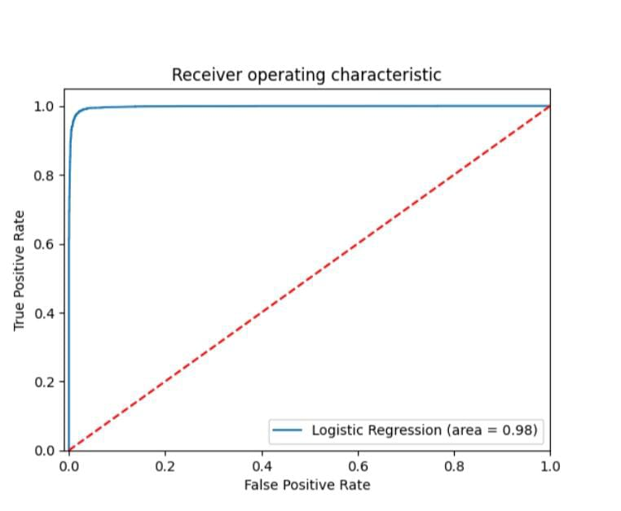
OUTPUT

Slide 12
