Slide 1
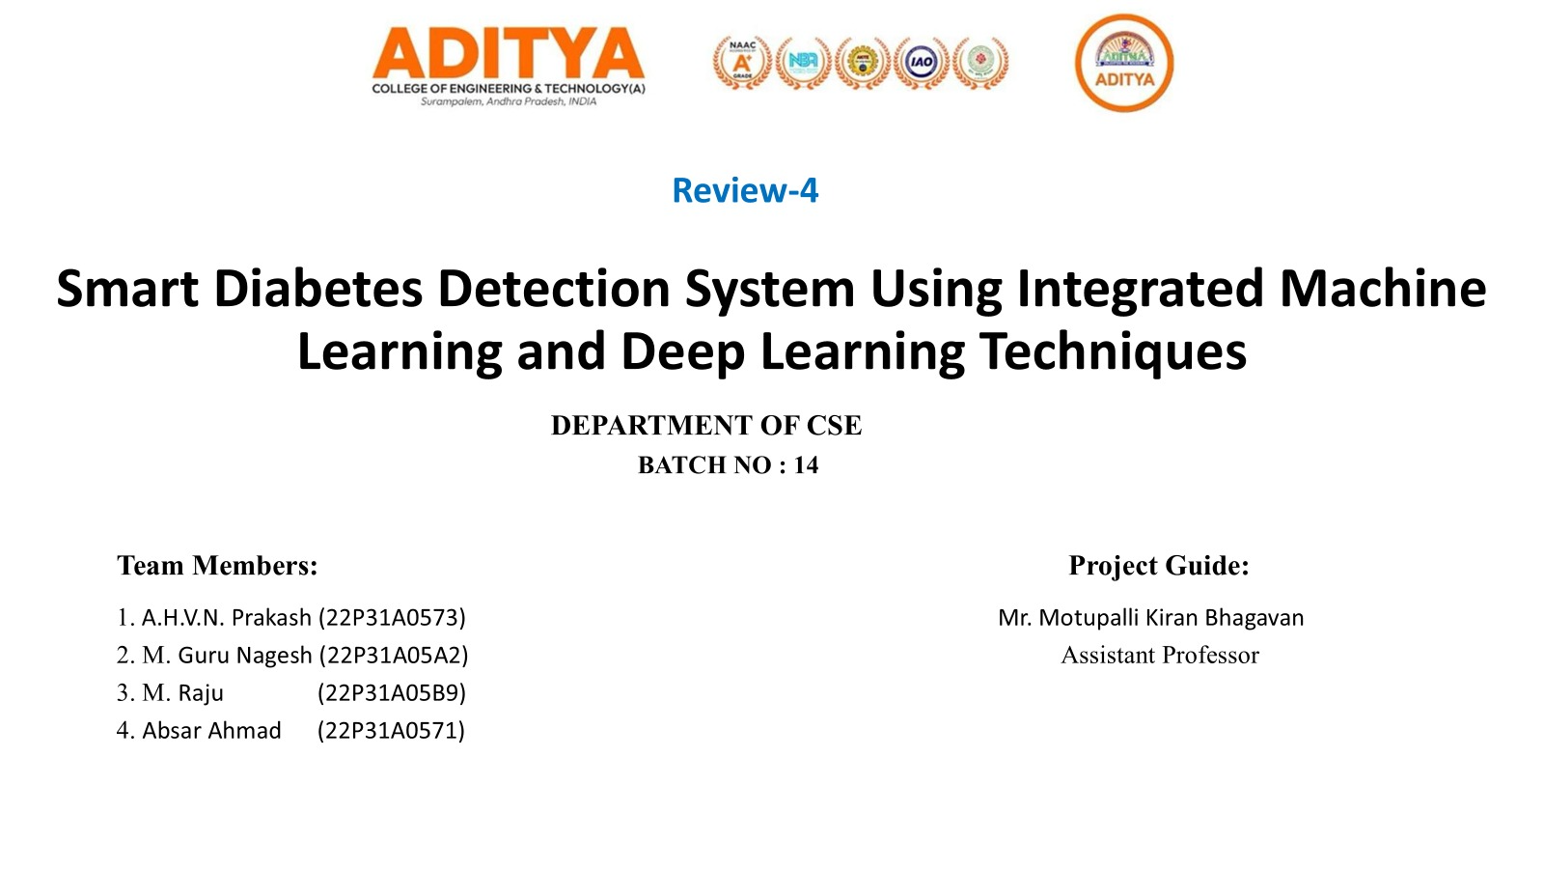

Slide 2
OVERVIEW
Presentation Agenda
01
02
03
04
05
Introduction
System Architecture
Implementation
Results
Conclusion
Problem, motivation & objectives
ML pipeline, dataset & feature engineering
Models, training, SHAP & Streamlit app
Metrics, SHAP findings & model comparison
Key findings & future scope
Smart Diabetes Detection System | Aditya College of Engineering & Technology
2 / 18

Slide 3
INTRODUCTION
Problem Statement
India's Diabetes Crisis
Current System Limitations
Existing tools trained on Western/PIMA data — not calibrated for Indian BMI thresholds or comorbidity patterns
Binary yes/no output with no explanation of WHY — doctors cannot trust black-box predictions
Clinical features only — lifestyle factors (stress, activity, diet) are completely ignored
No What-if Simulation — patients cannot see how lifestyle changes reduce their risk
No population benchmarking — no comparison against Indian national reference values
101M+
Diabetic adults in India (ICMR 2023)
136M
Pre-diabetic adults at risk
#1
India ranked top globally for diabetes burden
50%
Cases undiagnosed due to lack of screening
Smart Diabetes Detection System | Aditya College of Engineering & Technology
3 / 18

Slide 4
INTRODUCTION
Project Objectives
🎯 Accurate Prediction
🔍 SHAP Explainability
🧬 Risk Stratification
Train LR, RF, XGBoost & DL models with 5-fold CV. Achieve ROC-AUC ≥ 0.99 on Indian population-calibrated data.
Provide per-patient SHAP waterfall explanations. Tell doctors exactly WHY a risk prediction was made.
Classify patients into Low / Medium / High risk bands — not just diabetic/not. Enables tiered clinical intervention.
🔮 What-if Simulation
🇮🇳 Indian Population Focus
🌐 Deployed Web App
Model 90-day risk reduction from realistic lifestyle changes. Turn predictions into actionable goals.
Apply ICMR 2023 BMI thresholds, diagnostic criteria, and national survey benchmarks throughout.
4-page Streamlit app with light/dark theme, Risk DNA radar, dual-model comparison, and personalised insights.
Smart Diabetes Detection System | Aditya College of Engineering & Technology
4 / 18

Slide 5
INTRODUCTION
Dataset Overview
5,292
27
34
55/45
Patient Records
Original Features
After Engineering
Diabetic / Non-Diabetic Split
Feature Groups in the Dataset
Category | Key Features | Count | Role
Clinical | HbA1c, Fasting BS, Postprandial BS, BMI, Waist-Hip Ratio, Glucose Tolerance | 12 | Primary diagnostic markers
Lifestyle | Physical Activity, Stress Level, Smoking, Alcohol, Diet Type, Urban/Rural | 8 | Modifiable risk drivers
Comorbidity | Hypertension, Thyroid, PCOS, Medication, Family History, Regular Checkups | 7 | Compounding conditions
Engineered ✦ | Clinical_Risk_Index, BMI_Category, HbA1c_Category, Lifestyle_Risk_Score, Comorbidity_Score… | +8 | Domain-informed derived features
Smart Diabetes Detection System | Aditya College of Engineering & Technology
5 / 18

Slide 6
INTRODUCTION
Key Data Challenge: Label Reconstruction
⚠ Problem Discovered in EDA
✅ ICMR-Based Label Reconstruction
Weighted clinical risk score using ICMR 2023:
HbA1c (50%) + FBS (30%) + PPBS (20%) + risk factors
Threshold at 45th percentile → 55/45 split
HbA1c correlation after: +0.70 ✦
Original labels were randomly assigned
HbA1c correlation with target: -0.019
Fasting Blood Sugar correlation: -0.002
1,920 patients with diabetic-range HbA1c
labelled as 'No Diabetes'
→
Correlation with Diabetes Target — Before vs After
Smart Diabetes Detection System | Aditya College of Engineering & Technology
6 / 18

Slide 7
IMPLEMENTATION
End-to-End ML Pipeline
1
2
3
4
5
6
7
8
Data Loading
Preprocessing
EDA
Feature Eng.
Model Training
Evaluation
Tuning
SHAP + Deploy
→
→
→
→
→
→
→
5,292×27 dataset
Audit nulls, dtypes
Fix PCOS types
Impute Alcohol
ICMR labels
KDE plots
Correlation heatmap
Outlier IQR
8 new features
27→34 columns
LR, DT, RF,
XGBoost, DL
5-fold CV
F1, ROC-AUC
Threshold @ 0.10
Recall=1.00
RandomizedSearchCV
Overfit 0.039→0.014
Global+local SHAP
Streamlit 4-page app
Smart Diabetes Detection System | Aditya College of Engineering & Technology
7 / 18

Slide 8
IMPLEMENTATION
Feature Engineering — 8 New Features
Clinical_Risk_Index ⭐ #1 predictor
BMI_Category
Formula: HbA1c/12×0.5 + FBS/180×0.3 + PPBS/300×0.2
Formula: Underweight <18.5 | Normal <23 | Overweight <27.5 | Obese ≥27.5
Weighted composite of top 3 WHO diagnostic markers. SHAP: 7.24 (4× higher than any raw feature).
Indian-specific thresholds (ICMR 2023). Western threshold of 30 misclassifies Asian patients.
HbA1c_Category
Lifestyle_Risk_Score
Formula: Normal <5.7% | Pre-Diabetic 5.7–6.4% | Diabetic_Range ≥6.5%
Formula: Smoking + Alcohol + Low Activity + High Stress (0–4)
WHO diagnostic bands. Converts continuous value into clinically meaningful threshold zones.
Aggregates 4 modifiable risk factors into single lifestyle burden score.
Comorbidity_Score
BMI_Activity_Index
Formula: Hypertension + Thyroid + PCOS + Chronic Medication (0–4)
Formula: BMI × Physical_Activity_Level (Low=1, Med=2, High=3)
Captures compounding effect of co-existing conditions on insulin resistance.
Interaction term: high BMI + low activity = amplified risk beyond additive effect.
Smart Diabetes Detection System | Aditya College of Engineering & Technology
8 / 18

Slide 9
IMPLEMENTATION
Models Evaluated
🏆 Best CV
🔍 SHAP
📊 Benchmark
🧪 Experiment
Logistic Regression
XGBoost
Random Forest
Deep Learning MLP
PRIMARY MODEL
SECONDARY MODEL
COMPARISON
EXPERIMENTAL
Params:
Params:
Params:
Params:
C=tuned, solver=lbfgs, class_weight=balanced
max_depth=3, lr=0.2, subsample=0.6, reg_lambda=2.0
n_estimators=200, max_depth=10, n_jobs=-1
128→64→32, BatchNorm, Dropout(0.3), Adam, BCE loss
Best CV F1 (0.984) with lowest overfit gap (0.003). Linearly separable after feature engineering.
CV F1=0.987 after tuning. Best SHAP support via TreeExplainer. Overfit gap reduced 0.040→0.014.
CV F1=0.940. Handles non-linearity well. Used as benchmark between LR and XGBoost.
PyTorch feedforward network. Confirms tree models outperform DL on tabular data <10K rows (Grinsztajn 2022).
Smart Diabetes Detection System | Aditya College of Engineering & Technology
9 / 18

Slide 10
IMPLEMENTATION
Training Strategy & Evaluation
Training Pipeline
Why Threshold = 0.10?
Stratified 80/20 train-test split (preserves 55/45 class ratio)
5-fold StratifiedKFold cross-validation on training set
Metrics: Accuracy, F1, ROC-AUC, Precision, Recall
RandomizedSearchCV (n_iter=30) for hyperparameter tuning
Threshold optimised to 0.10 to maximise Recall (healthcare priority)
Both models saved: lr_final_model.pkl, xgb_final_model.pkl
Default 0.50 → 23 missed diabetics
Threshold 0.10 → 0 missed diabetics
In healthcare: False Negative >> False Positive
Missed diagnosis = untreated condition
Train/Test Split
Train: 4,233 (80%)
Test: 1,059 (20%)
Stratified split preserves class ratio in both sets
Smart Diabetes Detection System | Aditya College of Engineering & Technology
10 / 18

Slide 11
IMPLEMENTATION
SHAP Explainability Layer
What is SHAP? — SHapley Additive exPlanations (Lundberg & Lee, NeurIPS 2017)
Based on cooperative game theory Shapley values. Each feature is a 'player'. Its SHAP value = its fair contribution to the prediction, averaged across all possible orderings of features.
📊 Global Importance
💧 Waterfall Charts
📈 Dependence Plots
Mean |SHAP| across all test patients.
Shows which features matter OVERALL.
Clinical_Risk_Index = 7.24 (dominant)
Per-patient explanation.
Shows how each feature pushed THIS prediction up or down.
3 patients: High / Low / Borderline
How feature VALUE affects SHAP contribution.
As HbA1c increases → SHAP impact increases.
Top 6 features plotted.
[ Insert: shap_summary_beeswarm.png from Colab Cell 8.1 output on the next slide ]
Smart Diabetes Detection System | Aditya College of Engineering & Technology
11 / 18

Slide 12
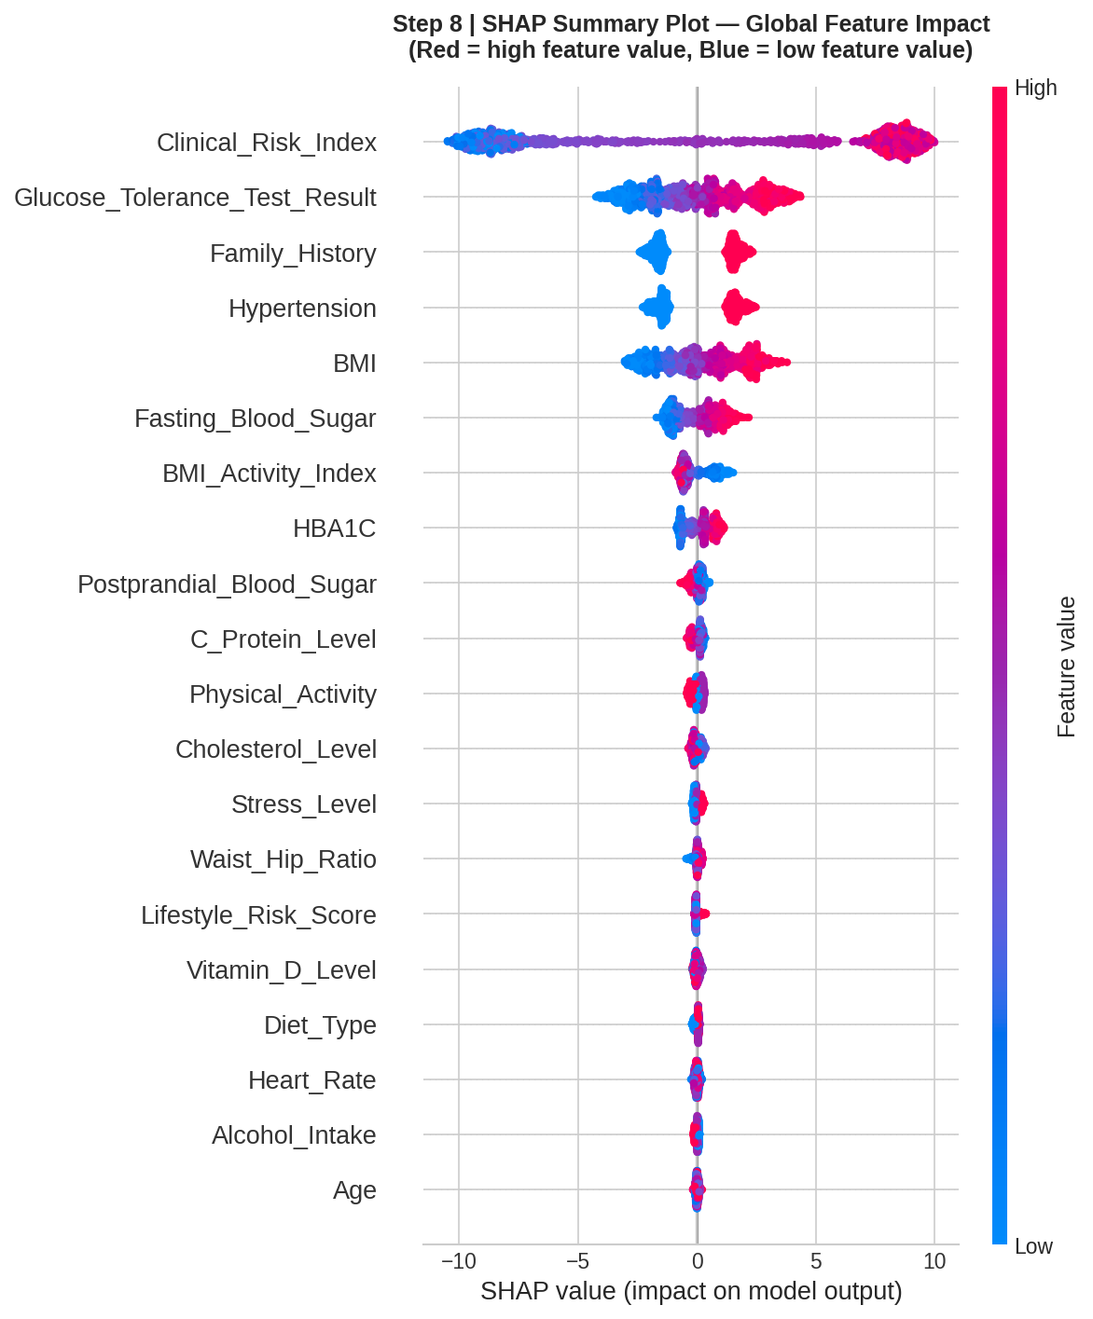
IMPLEMENTATION
SHAP Feature Importance — Global View
Beeswarm plot showing global feature impact — red = high feature value, blue = low
Key Finding: Clinical_Risk_Index (engineered) = 7.24 mean |SHAP| — 4× higher than any raw feature
Smart Diabetes Detection System | Aditya College of Engineering & Technology
12 / 18

Slide 13
IMPLEMENTATION
DiabetesIQ — Streamlit Web Application
Page 1
Page 2
Page 3
Page 4
📋 Patient Input
📊 Risk Dashboard
🔮 What-if Simulator
💡 Personalised Insights
Grouped form: Clinical, Lifestyle, Comorbidity sections. 26 fields with clinical tooltips.
Ensemble risk score, dual-model comparison, Risk DNA radar (5-axis), Clinical vs Lifestyle split, SHAP chart.
Manual explorer with live risk gauge. 90-Day Recovery Simulation: project risk after lifestyle changes.
SHAP-driven insights per patient. Ranked action plan. Indian population benchmarking panel (ICMR data).
Unique Technical Features:
☀️/🌙 Light & Dark theme toggle
5-axis Risk DNA radar chart
Dual-model agreement score
Indian population benchmarking (ICMR)
90-day recovery simulation
Module-based architecture (predictor, explainer, recommender)
Smart Diabetes Detection System | Aditya College of Engineering & Technology
13 / 18

Slide 14
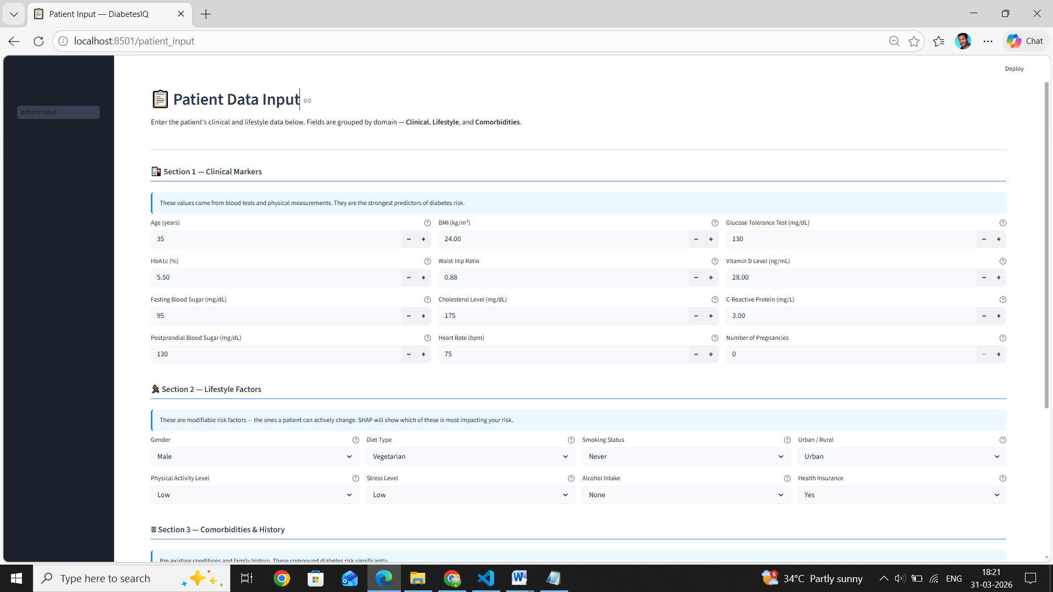
IMPLEMENTATION
Application Screenshots
[ PASTE: Page 2 — Risk Dashboard (radar + SHAP) ]
[ PASTE: Page 3 — What-if Simulator screenshot ]
[ PASTE: Page 4 — Insights & Benchmarking screenshot ]
Smart Diabetes Detection System | Aditya College of Engineering & Technology
14 / 18

Slide 15
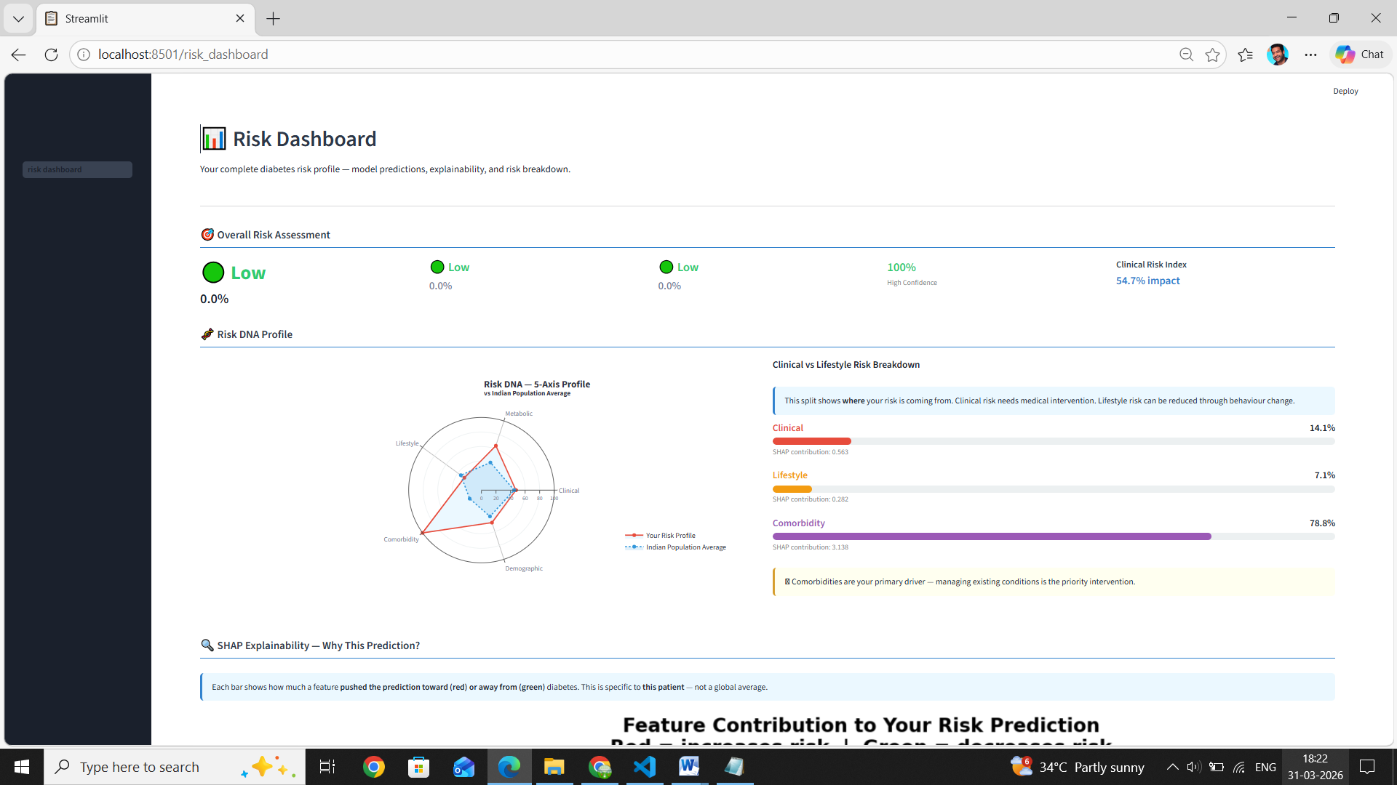
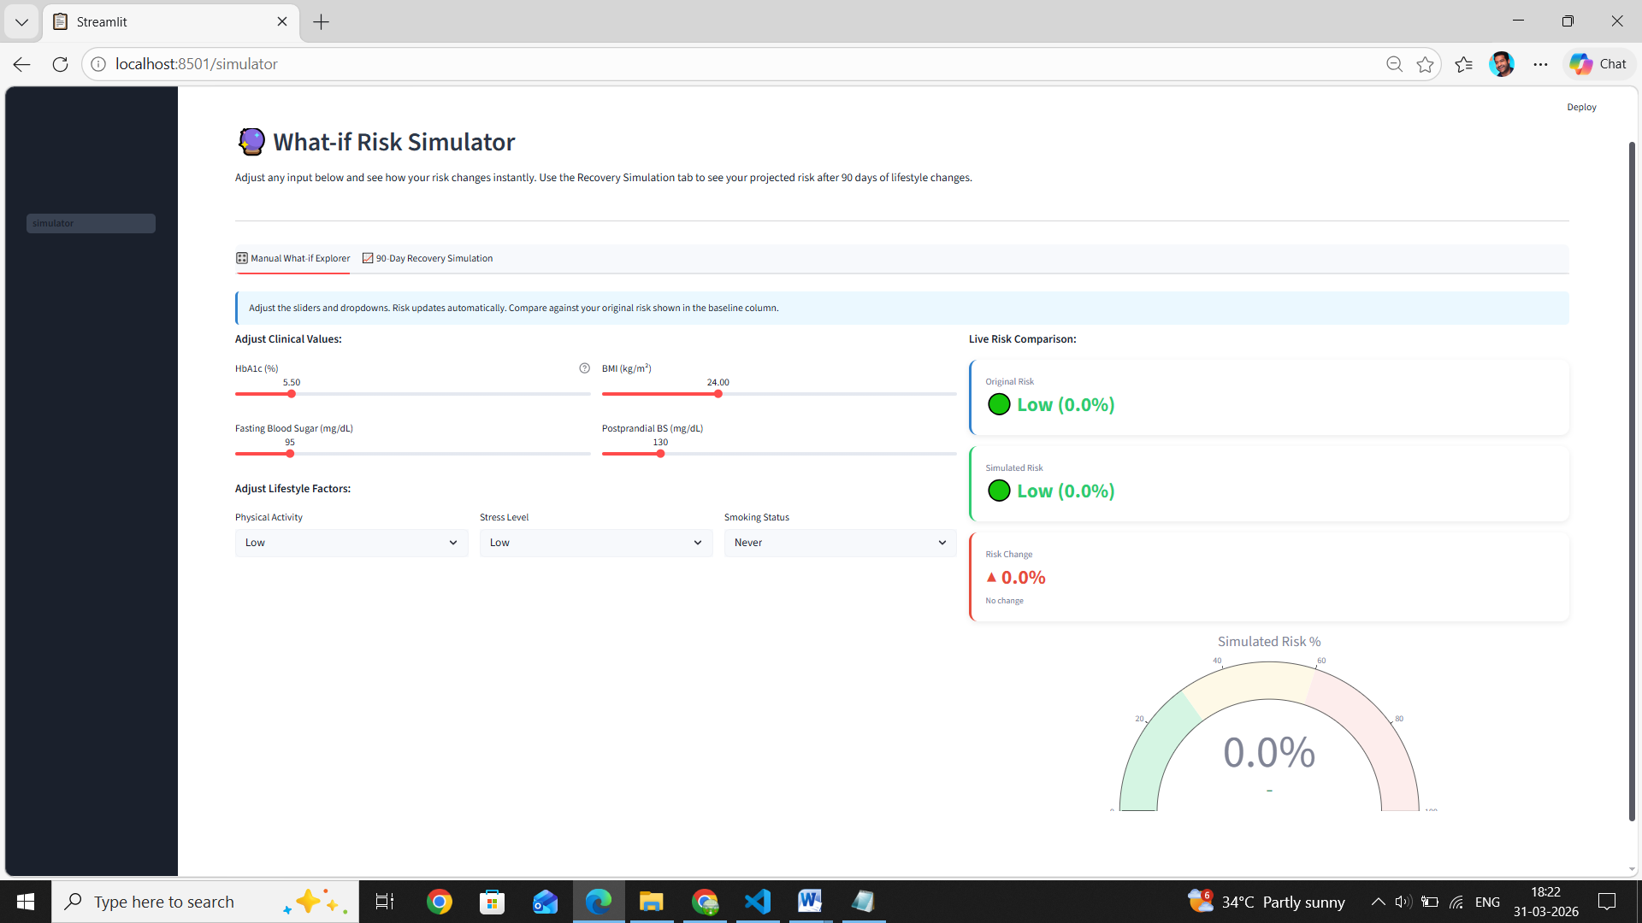

Slide 16
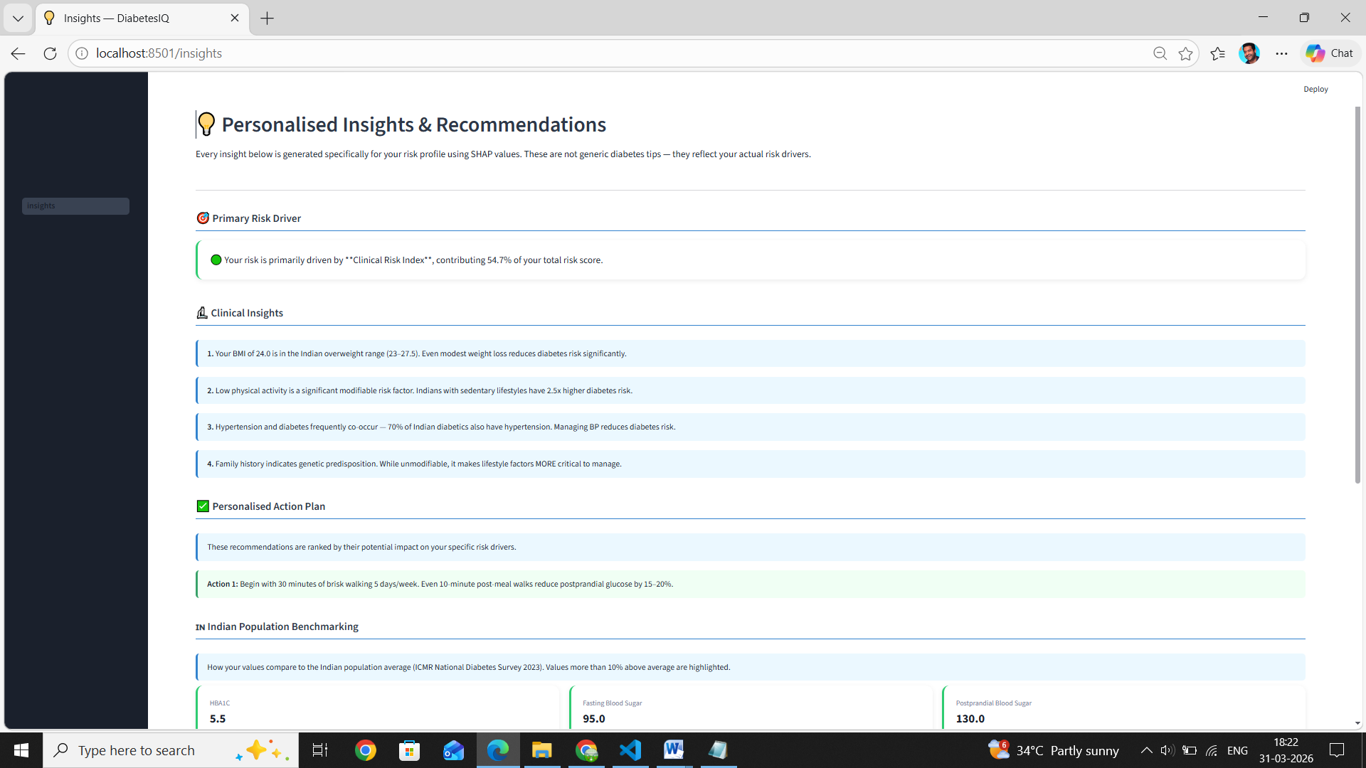

Slide 17
RESULTS
Model Performance Comparison
Model | CV F1 | ROC-AUC | Recall | Overfit Gap | Role
Logistic Regression ⭐ | 0.9840 | 0.9990 | 1.0000 | 0.0028 ✓ | Primary
XGBoost (Tuned) | 0.9871 | 0.9952 | 0.9900 | 0.0142 ✓ | Secondary
Random Forest | 0.9403 | 0.9873 | 0.9330 | 0.0405 | Comparison
Decision Tree | 0.9116 | 0.9682 | 0.8900 | 0.0277 | Baseline
Deep Learning MLP | 0.9643 | 1.0000 | 0.9900 | — | Experimental
Key Takeaways
LR outperforms on CV F1 with near-zero overfitting
XGBoost best for SHAP (TreeExplainer)
DL confirms tree models > neural nets on tabular data
Ensemble probability used in final app
Smart Diabetes Detection System | Aditya College of Engineering & Technology
15 / 18

Slide 18
RESULTS
SHAP Results & Risk Stratification
Risk Stratification (Test Set)
🔴 High Risk
584 patients (55.1%)
🟡 Medium Risk
5 patients (0.5%)
🟢 Low Risk
470 patients (44.4%)
★ = Engineered features
LR Threshold = 0.10
Bands: Low<0.30 | Medium 0.30–0.60 | High>0.60
Smart Diabetes Detection System | Aditya College of Engineering & Technology
16 / 18

Slide 19
CONCLUSION
Conclusions & Future Scope
01
Feature Engineering Adds Measurable Value
02
LR > DL on Tabular Healthcare Data
03
Threshold Tuning is Critical in Healthcare
Clinical_Risk_Index (engineered) = mean |SHAP| 7.24 — 4× higher than any raw clinical feature. Domain knowledge beats raw data.
Logistic Regression CV F1 = 0.984 with overfit gap 0.003. DL (MLP) confirmed worse — consistent with Grinsztajn et al. NeurIPS 2022.
Default threshold 0.50 → 23 missed diagnoses. Threshold 0.10 → 0 missed. Recall = 1.00 achieved by clinically justified threshold selection.
04
Explainability Enables Clinical Trust
05
Indian Population Context Matters
Per-patient SHAP waterfall charts show exactly why risk is high. Clinical vs Lifestyle domain split guides intervention type.
ICMR thresholds (BMI ≥23, not 30), national benchmarking, and ICMR-calibrated labels make this system uniquely relevant for Indian patients.
Future Scope: Real clinical dataset validation • Federated learning • IoT wearable integration • Multilingual UI • EHR / HIS integration
Smart Diabetes Detection System | Aditya College of Engineering & Technology
17 / 18

Slide 20
Thank You
Smart Diabetes Detection System — DiabetesIQ
Aditya College of Engineering & Technology (A)
Department of Computer Science & Engineering
Guide: Mr. M.Kiran Bhagavan • Academic Year: 2025–2026
Questions & Discussion Welcome
DiabetesIQ • Explainable Risk Intelligence for the Indian Population • SHAP • LR • XGBoost • PyTorch • Streamlit

