Slide 1
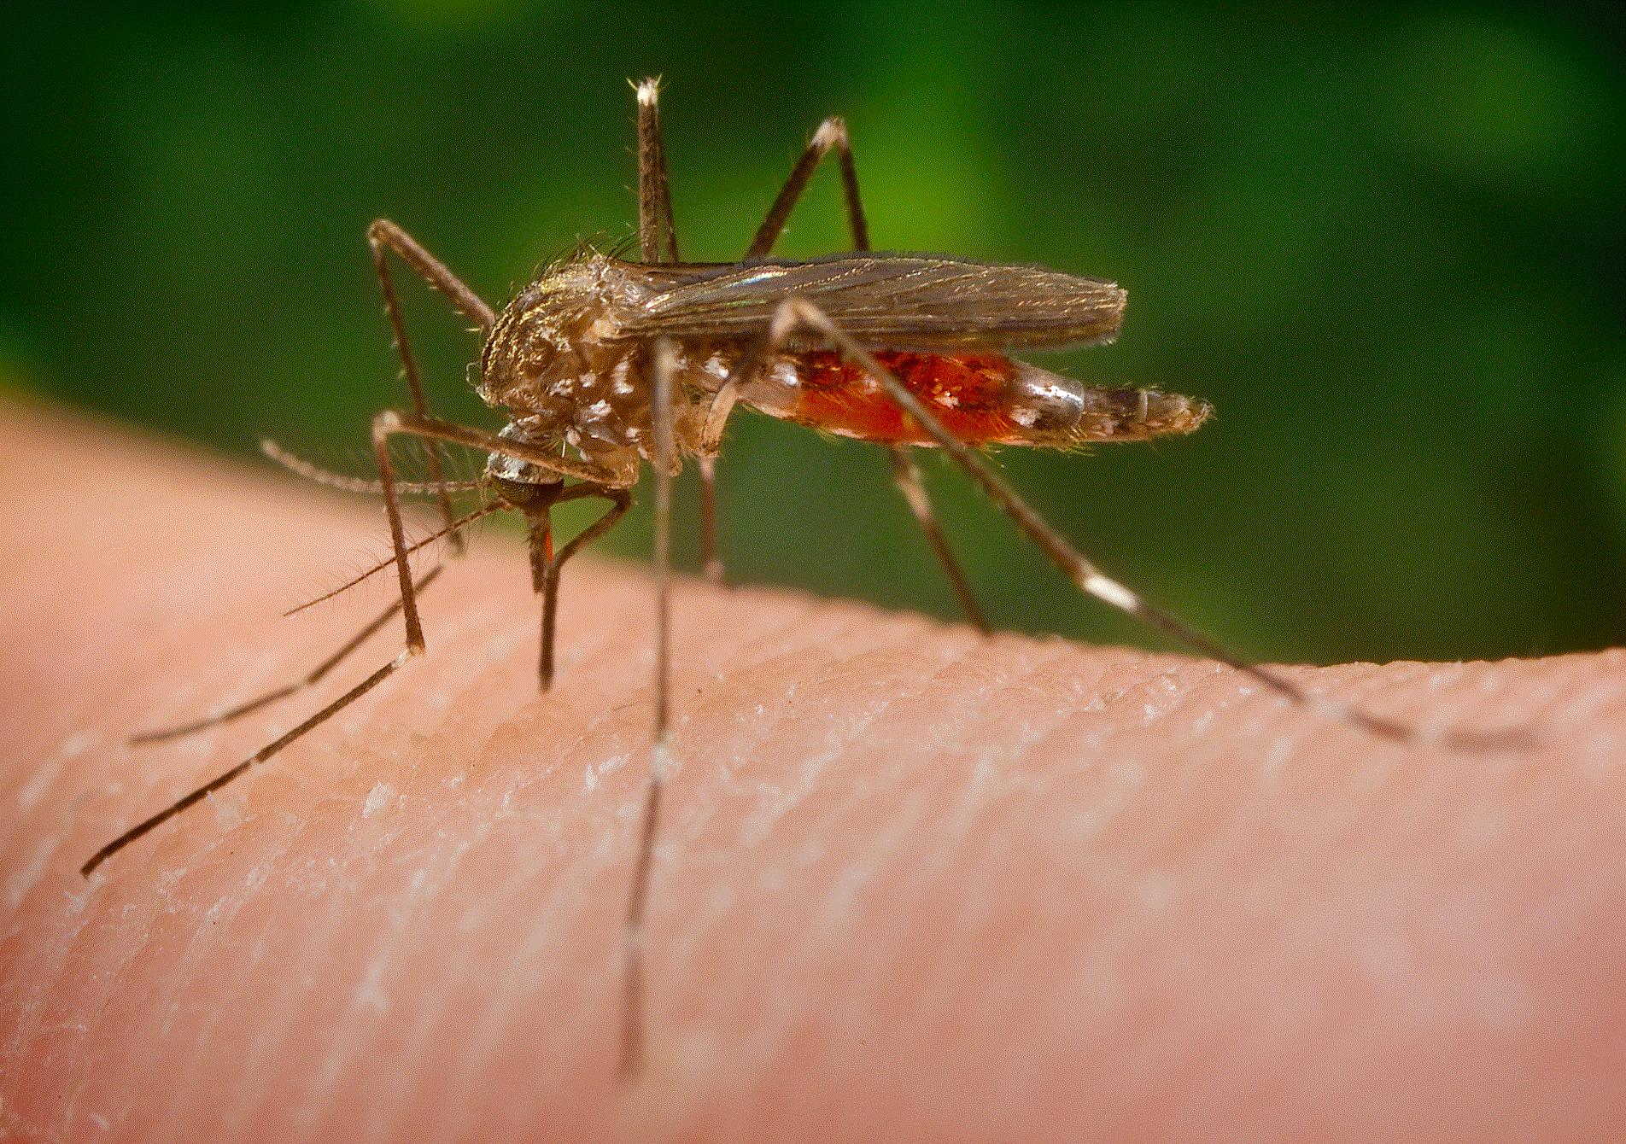
West Nile Virus Prediction Case study

Slide 2
Purpose of the case study
Determine the dynamic effects of weather on virus
Identify potential causes of virus spread
Analyze the effectiveness of aerial spraying
Propose an effective model to control the outbreak of WNV virus in Chicago region

Slide 3
Key Facts
West Nile virus (WNV) can cause a fatal neurological disease in humans.
Approximately 80% of people who are infected don’t show any symptoms.
There is no vaccine for it’s treatment yet.
Birds are the natural hosts of West Nile virus.

Slide 4
Timeline
The first case in US
First seen in New York producing a large and dramatic outbreak that spread throughout the US
The first case
West Nile Virus (WNV) was first isolated in a woman in the West Nile district of Uganda in 1937
1953
2002
1937
1999
Virus spotted on birds
caused the death of different bird species presenting signs of encephalitis and paralysis
case in Chicago region
First reported case in chicago region

Slide 5
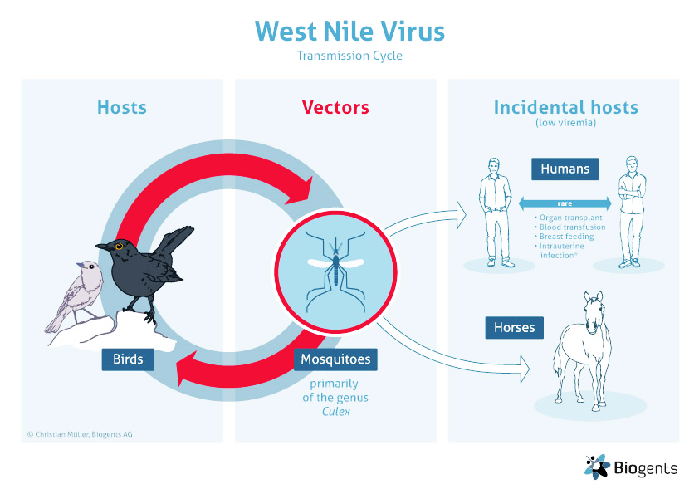
West Nile Virus
Transmission Cycle

Slide 6
DATA
Source: Kaggle (provided by Chicago health department)
Contains 4 dataset (train, test, weather, and spray)
train
DATA
spray
test
weather

Slide 7
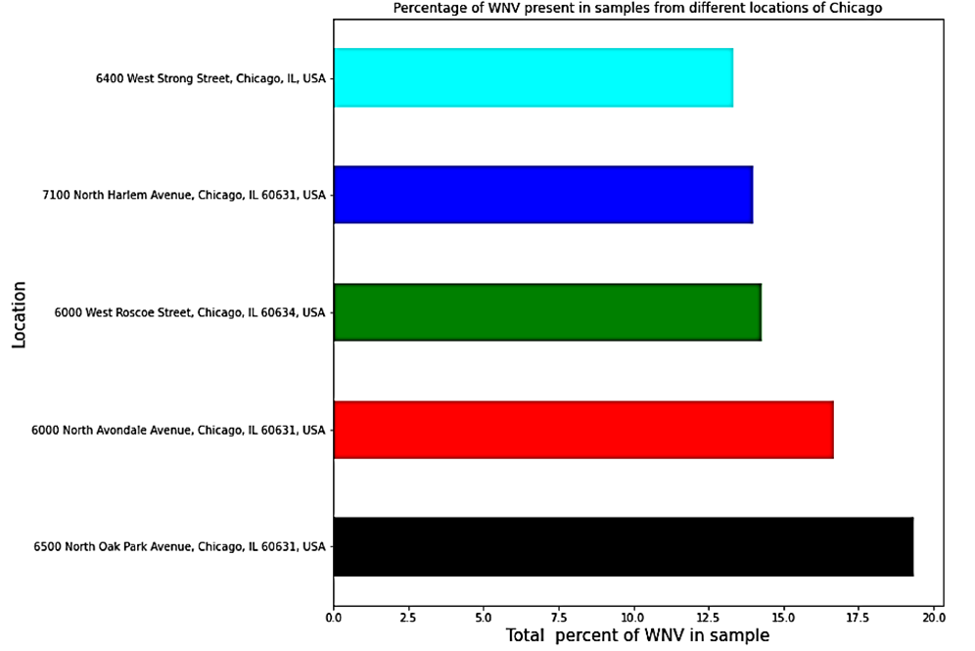
Some interesting facts
Highest sample collection area : O’Hare International Airport
The most infected area:
6500 North oak park Ave (19.35 % sample contains WNV)
2nd most infected area: 6000 N Avondale Ave (16.67% infection rate)

Slide 8
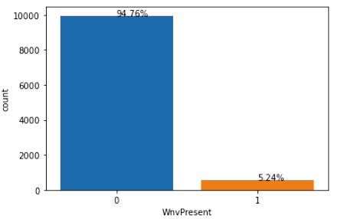
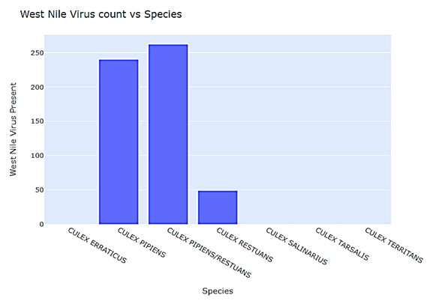
7 different species of mosquitoes were observed
Only 3 species contain the virus
About 5% of the total sample is infected

Slide 9
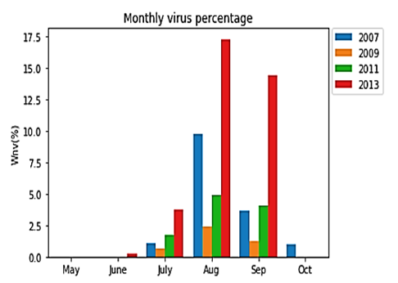
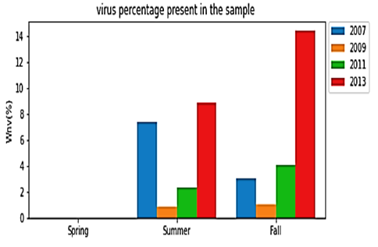
Findings
maximum sample was collected in 2007, however maximum virus was observed in 2013
virus appears to be active mostly from July to September

Slide 10
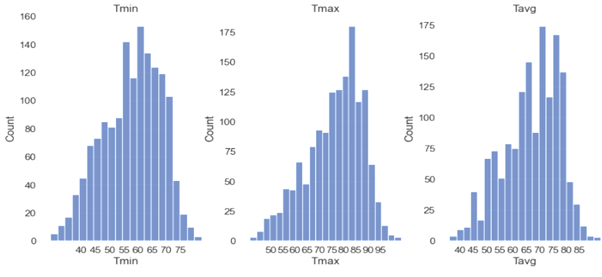
Effect of temperature:
Warmer temperature is associated statistically with higher WNV infection.
Year | Mean Temperature (F)
2007 | 75-80
2009 | 65-70
2011 | 50-55
2013 | 75-80

Slide 11
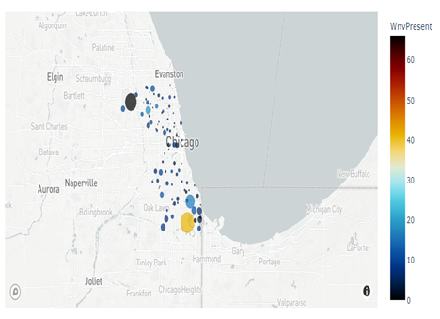
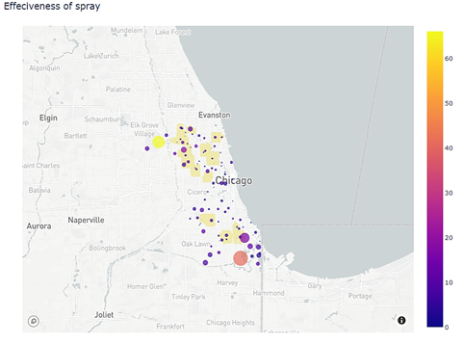
Effectiveness of aerial spray
Aerial spraying on infected area is effective as seen in the map below
Before spray After spray

Slide 12
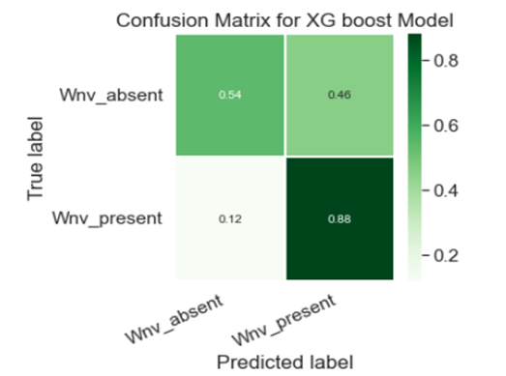
Machine learning model and it’s
effectiveness
Used method: binary classification model
Information value <0.1 and >0.8 were opted out to minimize bias.
The confusion matrix predicted the presence of virus with a probability of 0.88 and the absence of virus with 0.54. Thus, the model is efficient/

Slide 13
Conclusion and recommendation
Surveillance on mosquitoes species must be increased to collect more sample and to get the better predictions.
Spraying is an effective way to minimize the mitigation.
This information can be used as a guideline to develop threshold for public health safety measures by the Chicago city.

