Slide 1

User Manual for Plant Scanning & Agricultural App

Slide 2
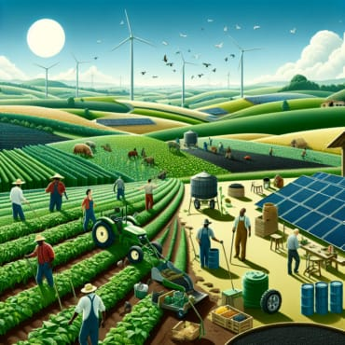
INTRODUCTION
This app is designed to assist users with plant identification, agricultural resources, and pest management by scanning technology and reports. It is suitable for both hobbyists and professionals in the agricultural sector.

Slide 3

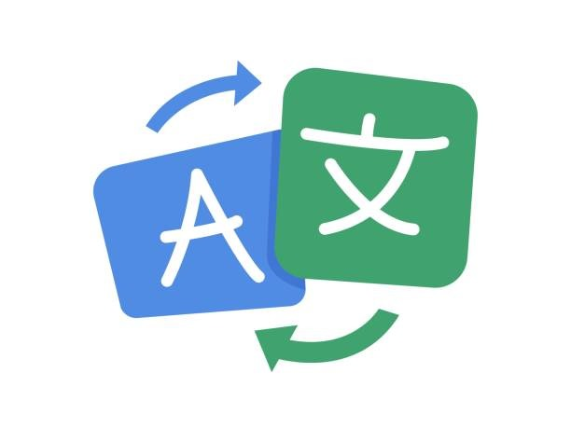


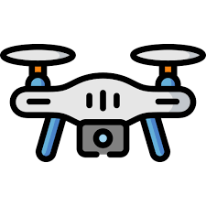
Key Features
->Language Support: Users can choose between English and Hindi.
->Plant Scanner: Identify plants and pests through the integrated camera scanning tool.
->Agricultural Resources: Access weather reports, tips on farming, and purchase products through the integrated store.
->Drone Technology: Feature for drone-based field scanning and analysis (as shown in the image).

Slide 4



Getting Started
Sign Up/Log In
->The first screen provides options to either Sign Up or Log In.
->Users can select their preferred language (English/Hindi).
->Enter credentials like phone number or password to access the app.

Slide 5




Home Screen
Upon logging in, the home screen shows various sections such as:
->Scanner: A tool for scanning plants or pests.
->Drone: This feature allows for drone-based monitoring and analysis.
->Reports: Users can view detailed reports on plant health and agricultural issues.
->Weather: Check the latest weather reports for your location.

Slide 6

Plant/Pest Scanning
Scan Plants or Pests: Users can click on the scanning feature from the home screen.
->The camera will open, and users are prompted to scan the plant or pest.
->The app will identify the plant or pest, provide information, and recommend actions or products.

Slide 7


Results & Recommendations
After scanning, the app displays details of the identified plant or pest.
->Each identified pest or plant shows its name, description, and potential treatments or actions users should take.
->There is also an option to view detailed pest profiles, which provide information about prevention and control.

Slide 8
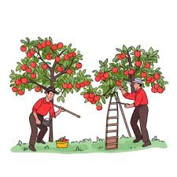
Reports
Users can view all reports that provide updates on:
->Scanned plants/pests.
->Agricultural issues.
->Field conditions using drone analysis.

Slide 9
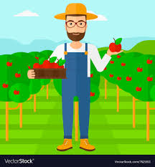
Weather Report
->Users can get live weather updates relevant to their agricultural activities.
->Weather forecasts are shown based on the user's location, helping in planning farming operations.

Slide 10

Advanced Features
Drone Technology (Advanced)
->The app provides a drone service for analyzing fields. This feature is designed for professional use to monitor large agricultural areas.
->Drones can scan and report on crop health, soil conditions, and pest infestations.

Slide 11

Conclusion
This app offers a complete solution for plant identification, pest control, and agricultural product shopping. With an easy-to-use interface, language support, and integration with advanced technology like drones, it serves as a valuable tool for farmers and gardening enthusiasts.

