Slide 1

Real-Time Data Migration Pipeline

Slide 2
Project Overview
Modern organizations generate large volumes of operational data in on-premise systems. To enable scalable analytics and reporting, this data must be efficiently migrated to the cloud.
This project demonstrates an end-to-end data engineering pipeline that extracts data from an On-Premise SQL Server, processes it using Azure Data Factory, and stores it in Azure Data Lake Storage Gen2. The pipeline implements a metadata-driven incremental loading strategy using a watermark table, ensuring that only new or updated records are processed.

Slide 3
Project Architecture
Parent Pipeline (Orchestration Layer)
Lookup: Watermark Table (ADF_Watermark_Table)
ForEach (Each Table)
Execute Child Pipeline (Incremental Load)
Child Pipeline (Incremental Logic)
Lookup: MAX(WatermarkColumn)
from Source Table
IF Condition
New Data Exists?
(NULL OR MAX > LastLoad)
Copy Activity
(Full / Incremental Load)
SQL → Parquet (ADLS)
Execute SP Pipeline
(Update Watermark)
Child Pipeline (Stored Procedure)
Stored Procedure
dbo.UpdateWatermark (Update LastLoadValue)

Slide 4
Data Warehouse Model
Star Schema used for analytics
Dimension Tables: DimCustomer, DimProduct, DimDate, DimRegion, DimStore etc.,,,
Fact Tables: FactSales, FactOrders, FactPayments, FactReturns etc.,,
Optimized for reporting and BI queries

Slide 5
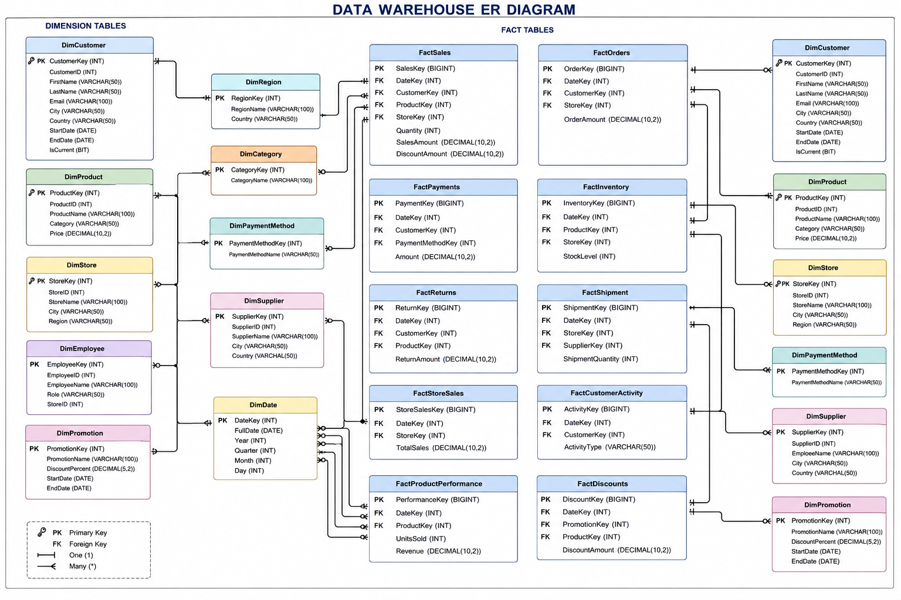
Data Warehouse Model

Slide 6
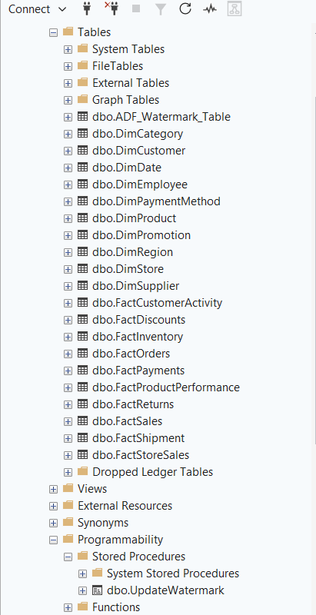
DATAWAREHOUSE - CONFIGURATIONS
Create Database:
CREATE DATABASE <Database Name>;
GO
USE <Database Name>;
GO
Watermark Table
Dimension tables
Fact tables
Store Procedure Update Watermark Table

Slide 7
ADF Pipeline Logic
Lookup activity retrieves table metadata
ForEach loop processes tables dynamically
Condition checks if new records exist
Copy activity loads data to ADLS

Slide 8
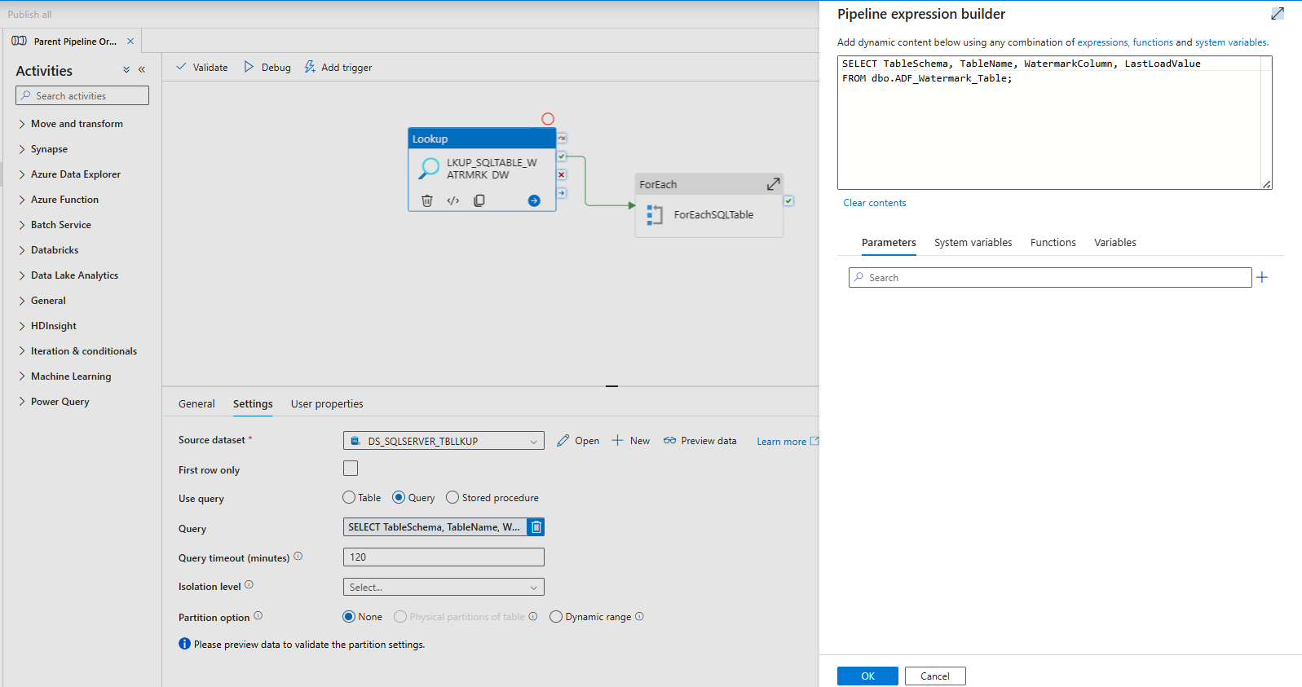
Parent Pipeline Orchestration (Master Pipeline)
1.Lookup Activity - This query extracts metadata, including schema, table name, watermark column, and last processed value, from the ADF watermark table. (SELECT TableSchema, TableName, WatermarkColumn, LastLoadValue FROM dbo.ADF_Watermark_Table;)

Slide 9
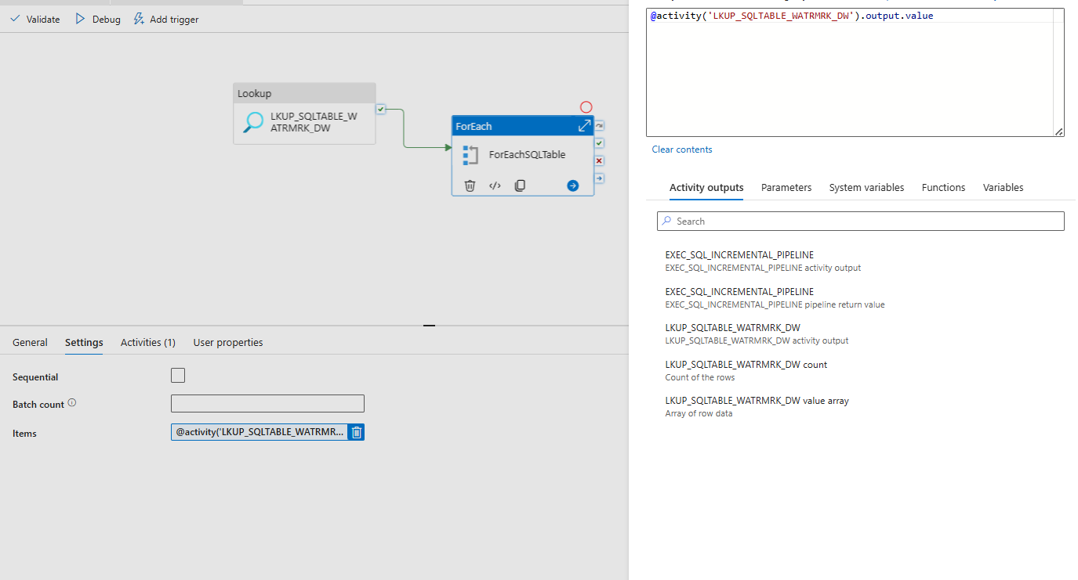
Parent Pipeline Orchestration (Master Pipeline)
2.Foreach Activity - @activity('LKUP_SQLTABLE_WATRMRK_DW').output.value
This expression retrieves the array of records returned by the lookup activity, which is used as input for iteration in the ForEach activity.

Slide 10
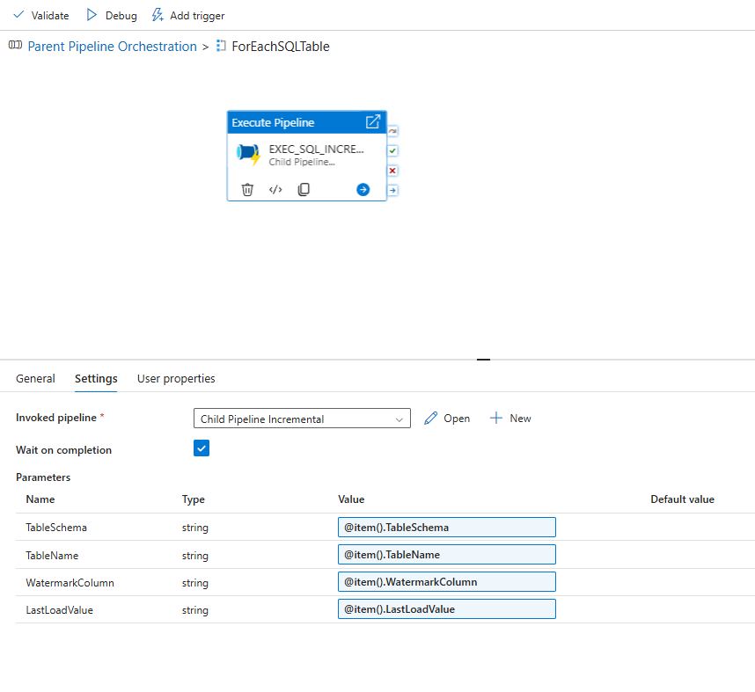
Parent Pipeline Orchestration (Master Pipeline)
2.Execute Pipeline - This pipeline invokes the child pipeline by dynamically passing parameters (@item().TableSchema, @item().TableName, @item().WatermarkColumn, @item().LastLoadValue) for table-wise incremental processing.

Slide 11
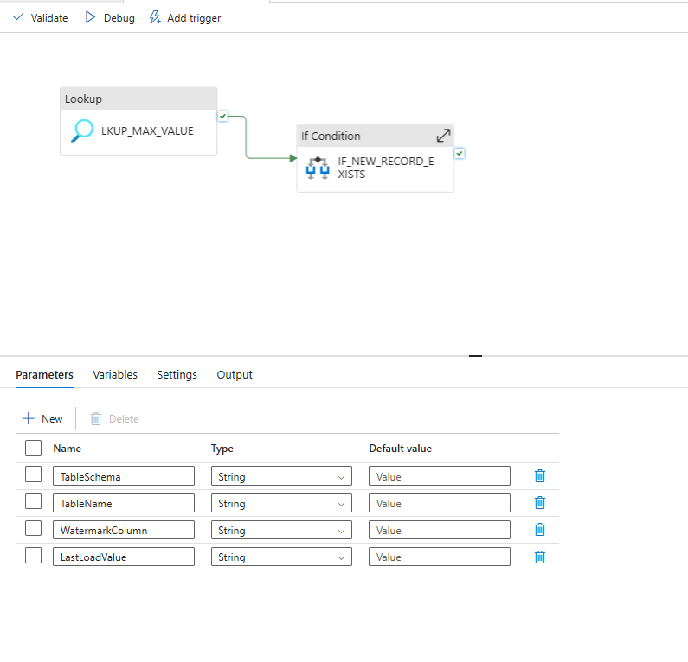
Child Pipeline Incremental (Child Pipeline)
Child Pipeline (Definition): Parameters are defined in the child pipeline under the Parameters tab
(canvas → click on blank area → Parameters section). TableSchema,TableName,WatermarkColumn,LastLoadValue

Slide 12
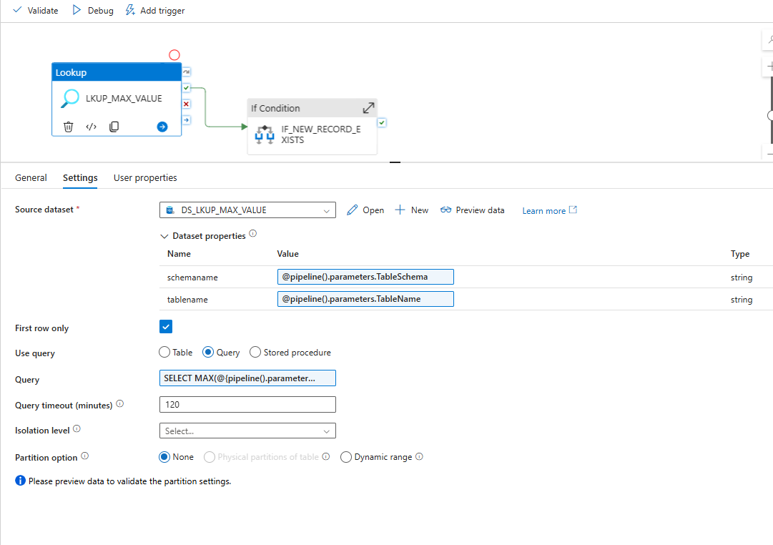
Child Pipeline Incremental (Child Pipeline)
1.Lookup Actiivty: Retrieves the maximum value of the watermark column from the source table to identify the latest available data
Query: SELECT MAX(@{pipeline().parameters.WatermarkColumn}) AS MaxValue
FROM @{pipeline().parameters.TableSchema}.@{pipeline().parameters.TableName}

Slide 13
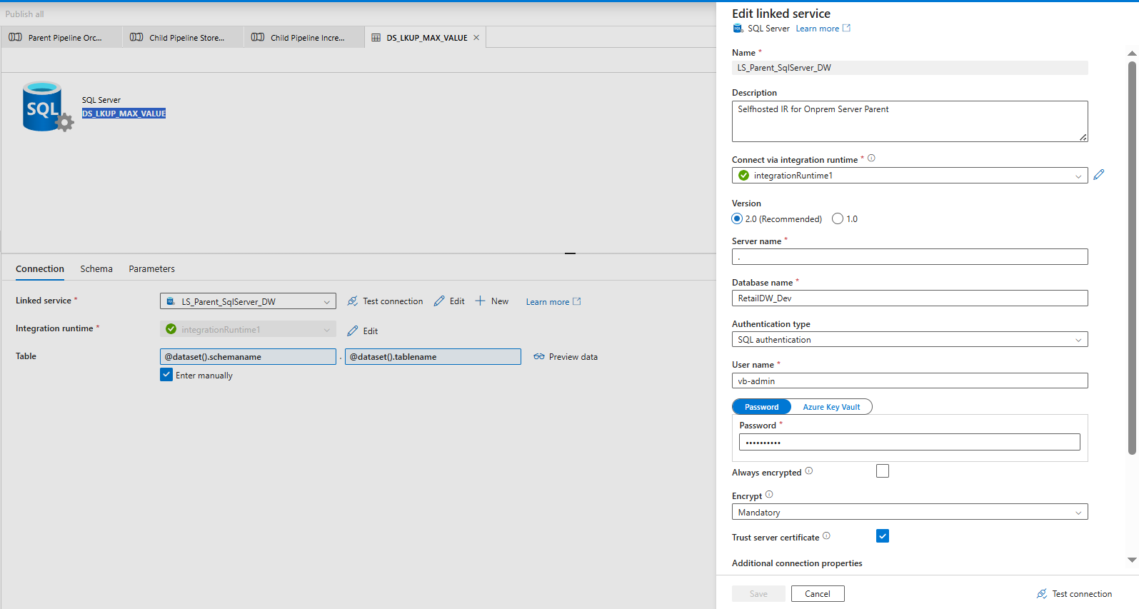
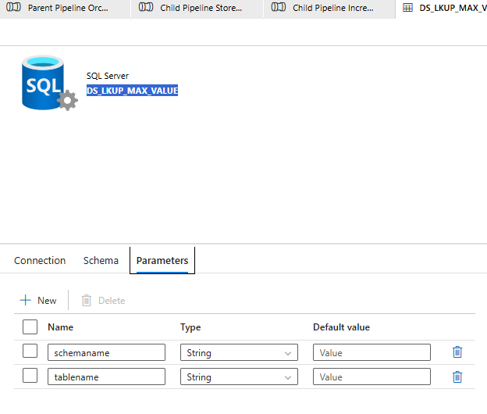
Child Pipeline Incremental (Child Pipeline)
1.Lookup Actiivty Source dataset: SQL Server DS_LKUP_MAX_VALUE Parameter tab add Schema name and table name

Slide 14
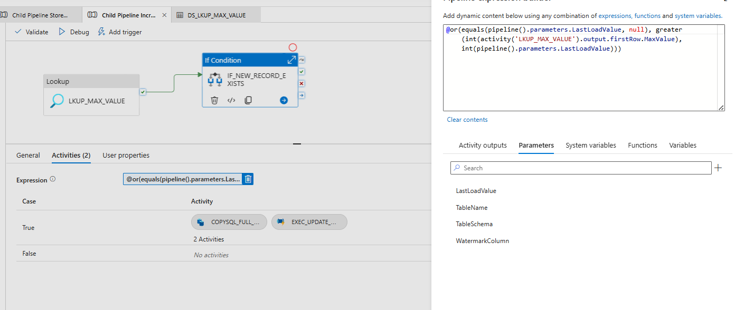
Child Pipeline Incremental (Child Pipeline)
2.IF Actiivty: Checks whether new data exists by comparing the latest watermark value with the last loaded value, triggering the load if conditions are met.
Expression: @or(equals(pipeline().parameters.LastLoadValue, null), greater(int(activity('LKUP_MAX_VALUE').output.firstRow.MaxValue), int(pipeline().parameters.LastLoadValue)))

Slide 15
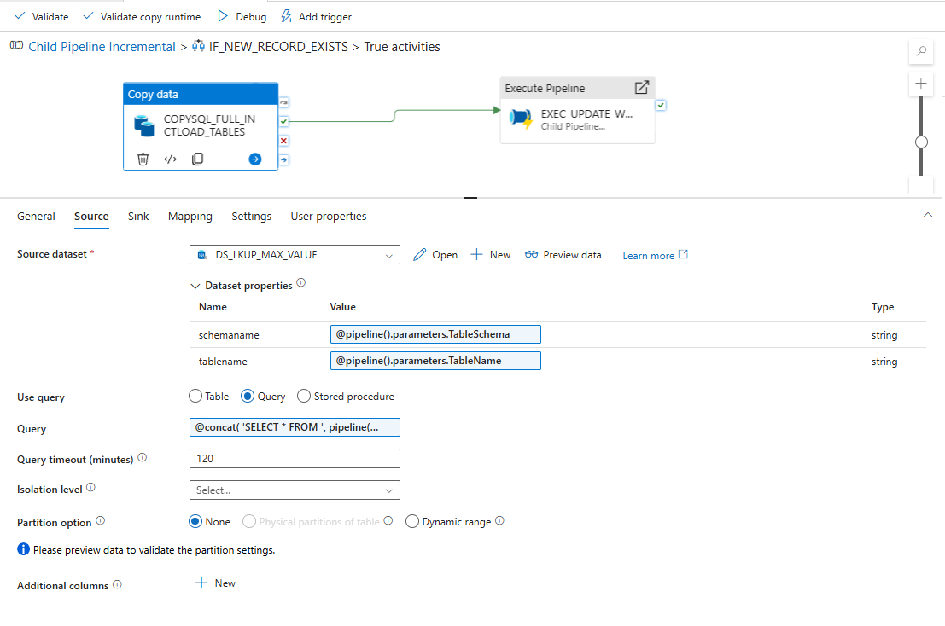
Child Pipeline Incremental (Child Pipeline)
2.IF Actiivty TRUE case-CopyActivity Source:Copies data from the source table to the target in Parquet format, performing a full load if no previous watermark exists or an incremental load by filtering records greater than the last loaded value.
Query: @concat(
'SELECT * FROM ',
pipeline().parameters.TableSchema, '.', pipeline().parameters.TableName,
if(
equals(pipeline().parameters.LastLoadValue, null),
'',
concat(
' WHERE ', pipeline().parameters.WatermarkColumn,
' > ''', pipeline().parameters.LastLoadValue, ''''
)
)
)

Slide 16
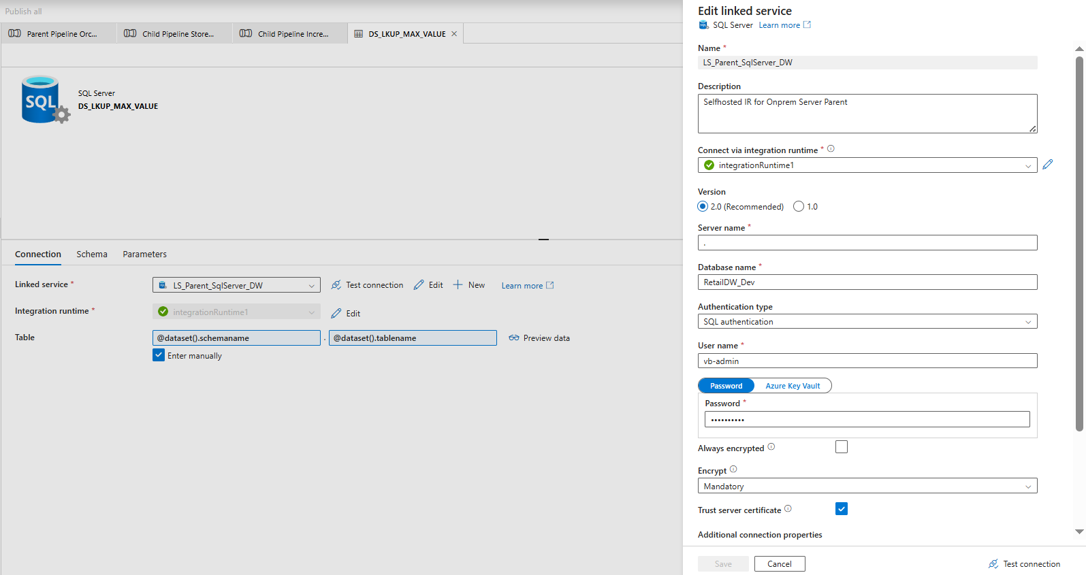
Child Pipeline Incremental (Child Pipeline)
2.1Copy Activity Dataset(source): SQL Server DS_LKUP_MAX_VALUE.

Slide 17
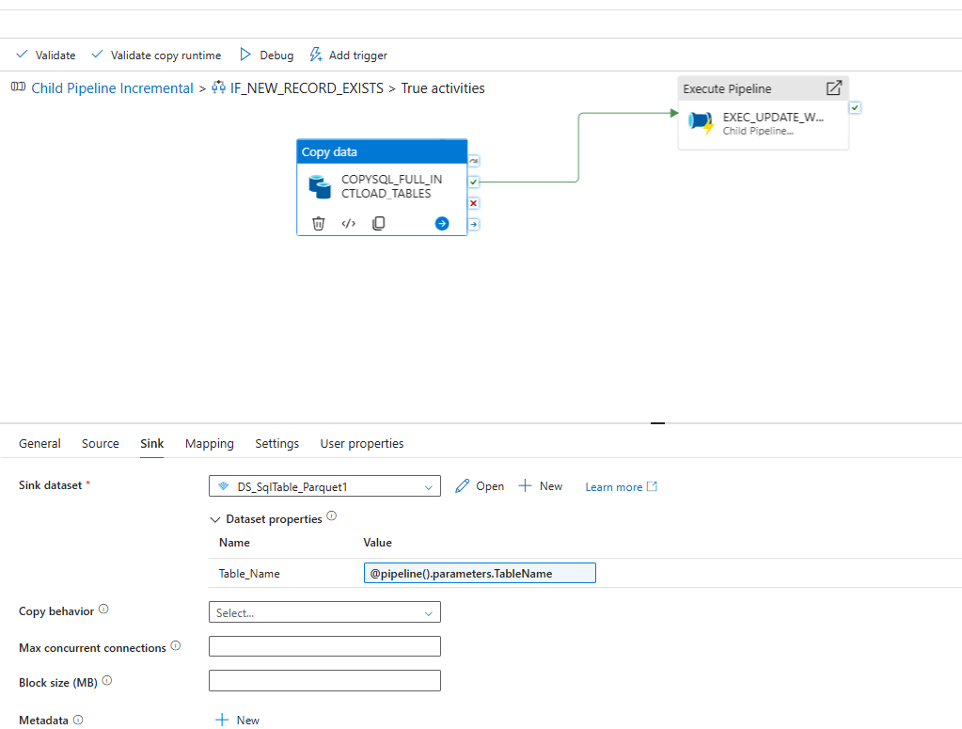
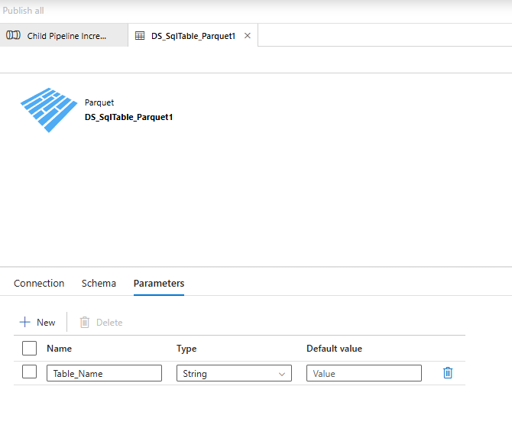
Child Pipeline Incremental (Child Pipeline)
2.IF Actiivty TRUE case-CopyActivity : SINK A pipeline that loads table data into ADLS as Parquet files with dynamic naming and date-partitioned folder structure..
Dataset Properties:
@pipeline().parameters.TableName

Slide 18
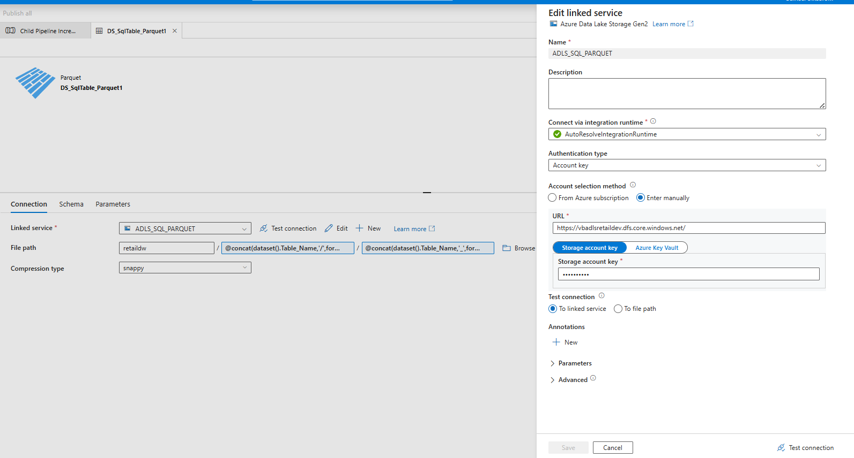
Child Pipeline Incremental (Child Pipeline)
2.1Copy Activity Dataset (sink): SQL Server DS_LKUP_MAX_VALUE.
File System (Container)
Folder Path
File Name
Expression: @concat(dataset().Table_Name,'/',formatDateTime(utcNow(),'yyyy/MM/dd’))
Expression:@concat(dataset().Table_Name,'_',formatDateTime(utcNow(),'yyyyMMddHHmmss'),'.parquet')

Slide 19
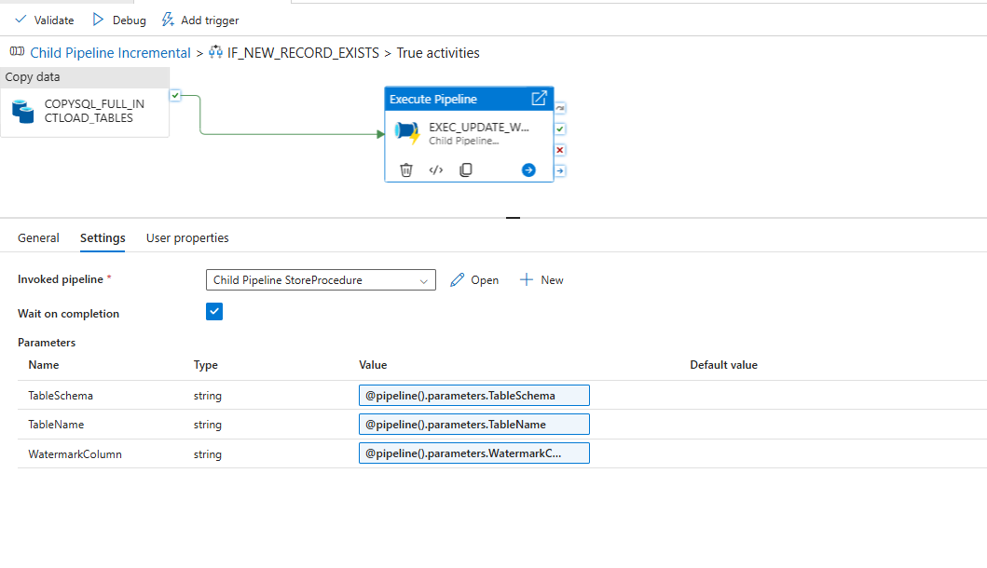
Child Pipeline Incremental (Child Pipeline)
2.2.Foreach Activity: Triggers a child pipeline with parameters to perform downstream processing
.

Slide 20
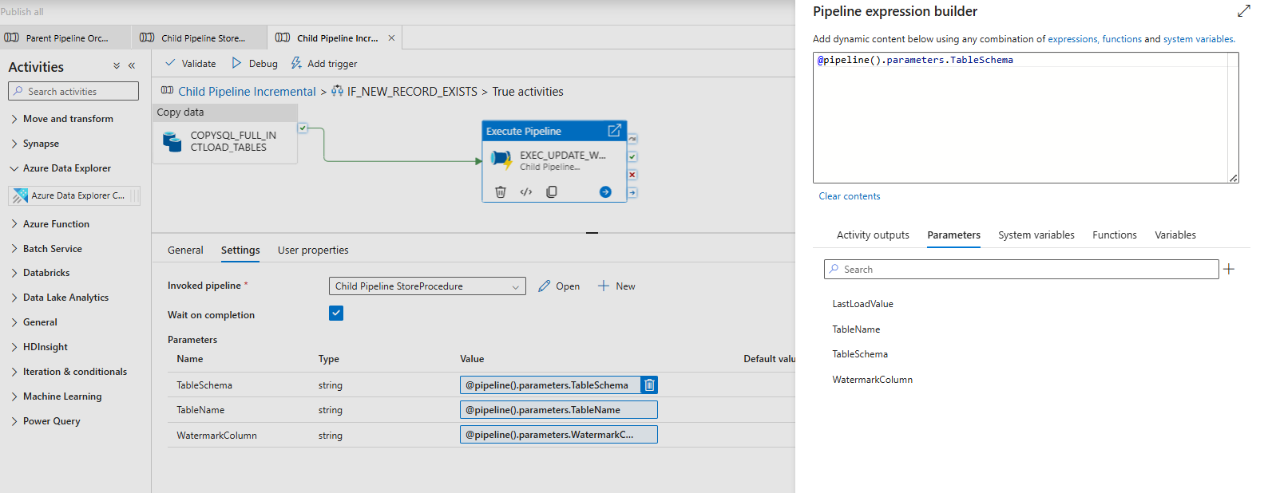
Child Pipeline Incremental (Child Pipeline)
2.2.Foreach Activity: Triggers a child pipeline with parameters to perform downstream processing
.

Slide 21
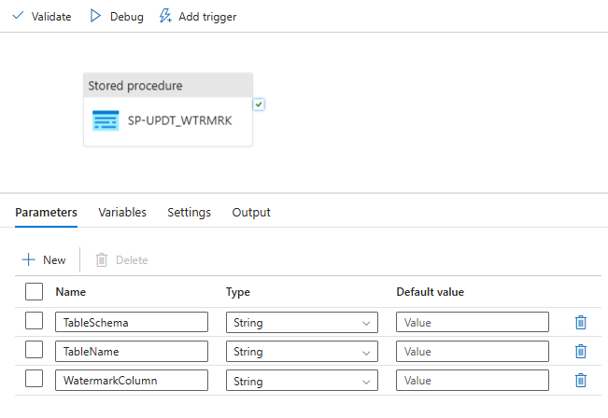
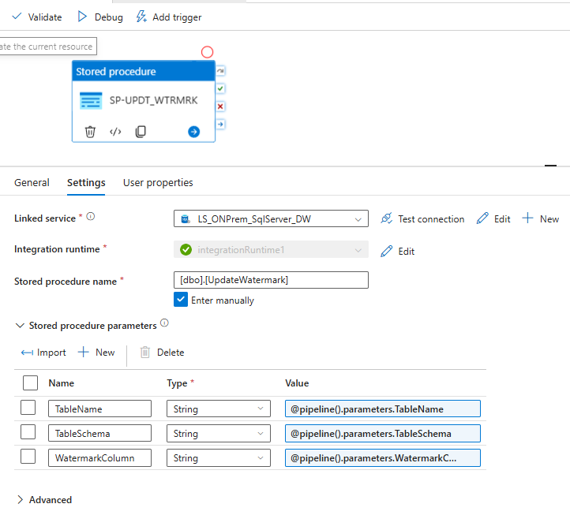
Child Pipeline Incremental (Child Pipeline)
Store Procedure: Executes a stored procedure to update the watermark value in the control table using the provided table schema, table name, and watermark column
.

Slide 22
Key Takeaways
This solution implements a scalable and efficient incremental data loading framework using watermark logic. It ensures optimized data movement, reduces processing time, and maintains data consistency through dynamic pipeline orchestration and automated watermark updates
Built an end-to-end data engineering pipeline
Implemented metadata-driven ingestion
Used incremental loading for efficiency
Designed scalable cloud architecture

