Slide 1

Emerging Market Bond
Delta VIX, Oil Returns, and Delta Credit Spreads-Driven Trading Strategy
Can changes in VIX, credit spreads, and oil predict next-day EM bond returns, and can those predictions generate a profitable trading strategy?

Slide 2
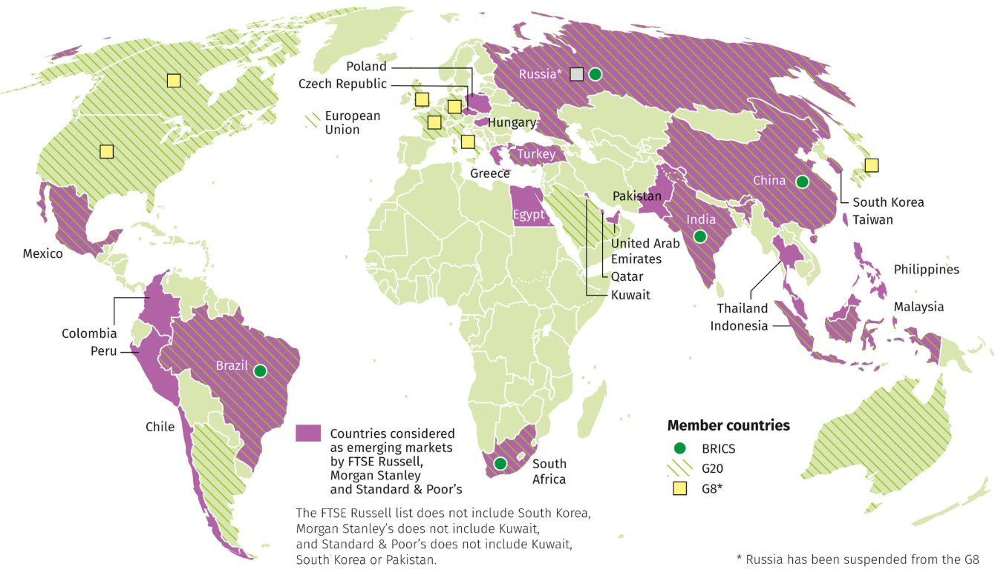
OVERVIEW
What Are Emerging Market Bonds
01
Bonds issued by less stable but developing countries like Turkey, Brazil, and Indonesia
02
Riskier than US Treasury bonds due to a variety of factors (political/economic/social)
03
We study the iShares J.P. Morgan USD Emerging Markets Bond ETF (EMB). EMB is the ETF; it tracks an index of USD-denominated EM bonds.

Slide 3
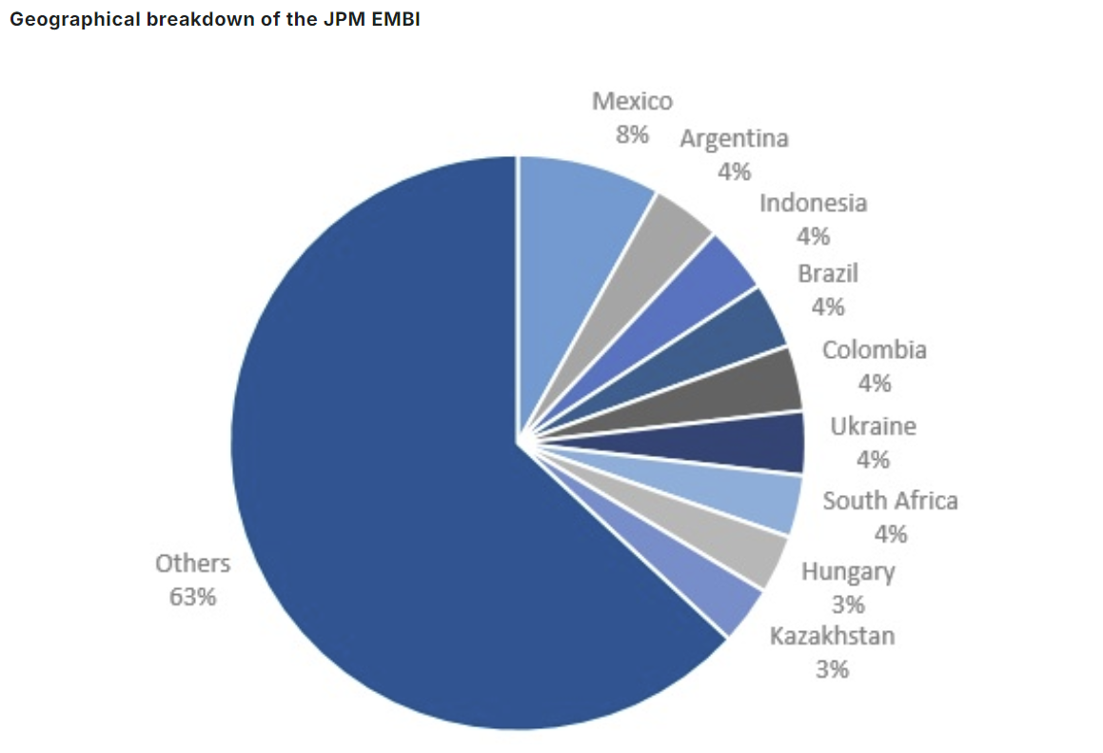
OVERVIEW
Composition: JPMorgan EMBI GD Index
The index provides exposure to liquid, US dollar-denominated emerging market sovereign debt.
The following graph shows some, but not all of the countries’ bonds that make up its portfolio.

Slide 4
OUR PITCH
Our Research Question
Can we predict when EM bonds recover after a flight-to-safety panic, and how can we profit from it?
We Tested 3 Fear Signals
We Tested 3 Models
Delta (Change in) VIX
Cboe Volatility Index tracks forward expectations of volatility in the US market
First Model - Delta VIX Only
We used a one-factor model with only continuous changes in VIX to predict EMB returns
Delta Credit Spreads
The credit spread index we used tracks the difference between BB U.S. high-yield credit spread over Treasuries.
Second Model - All 3 Signals (No Ridge)
We used a three-factor model continuously trading on changes in oil prices, VIX, and credit spreads
Oil Returns
Crude oil futures track changes in the price of oil
Third Model - All 3 Signals (Ridge)
We used a three-factor model continuously trading on changes in oil prices, VIX, and credit spreads with ridge regression to reduce the impact of multicollinearity

Slide 5
Model 1
Single Factor OLS

Slide 6
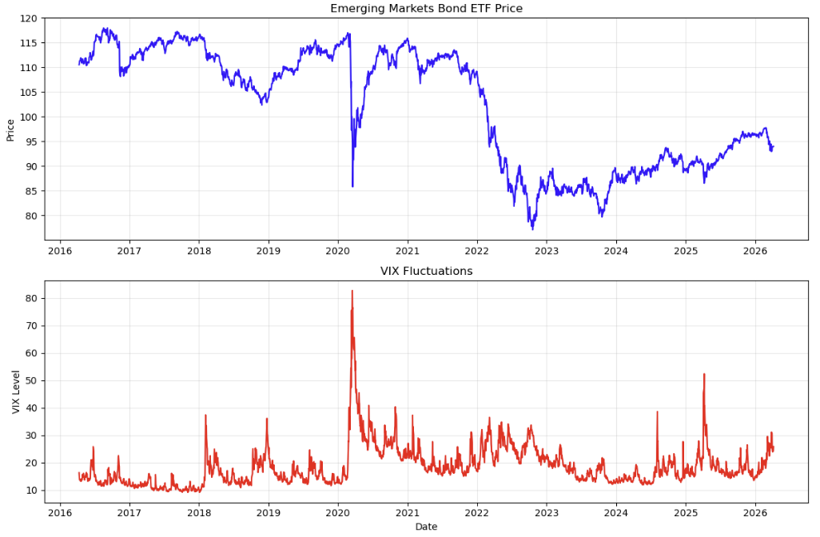
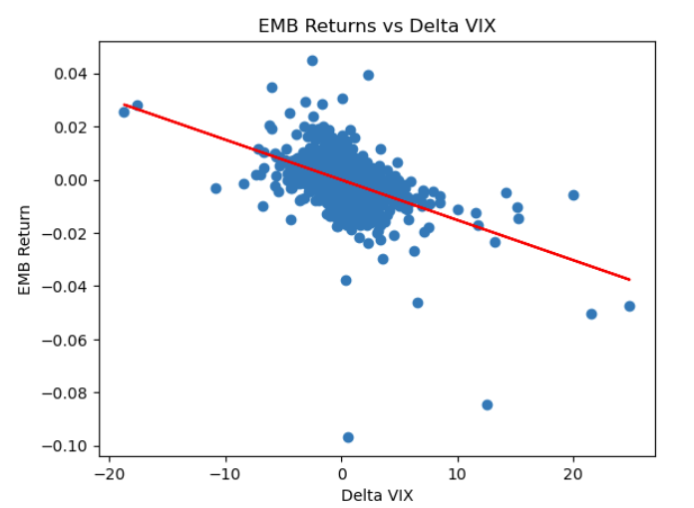
Model 1 - INTRO
Why Use VIX As Our Independent Variable

Slide 7
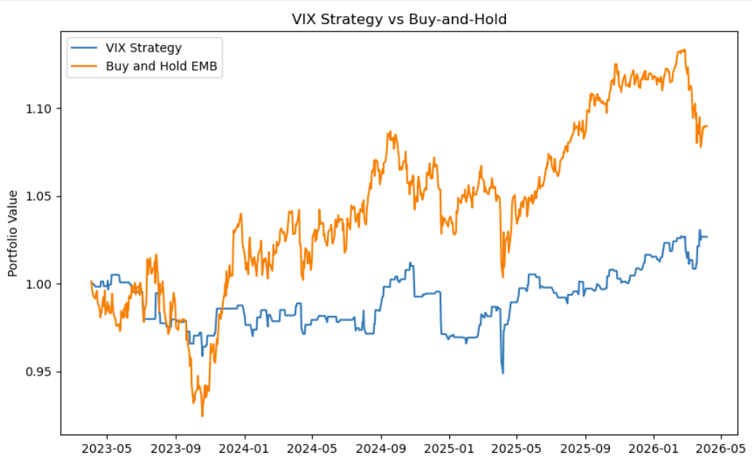
MODEL 1 - INTRO
Model 1: Setup & Results
ŷ = -0.0001 + 0.0003 · ΔVIX(t) + ε(t)
Methodology
Bivariate OLS regression: Δ VIX (today) → EMB return (tomorrow)
70% train / 30% test on daily data 2016–2026
Predicts t+1 returns — eliminates look-ahead bias
Strongest single predictor: ΔVIX (corr = −0.47 same day)
On the right, we tested this strategy versus a traditional buy-and-hold
Key Insight — Sign Reversal
Correlation is negative (−0.47) but regression coefficient is positive (+0.0003). Why? Correlation is same-day panic. Regression predicts next day — when fear subsides, prices bounce back.

Slide 8
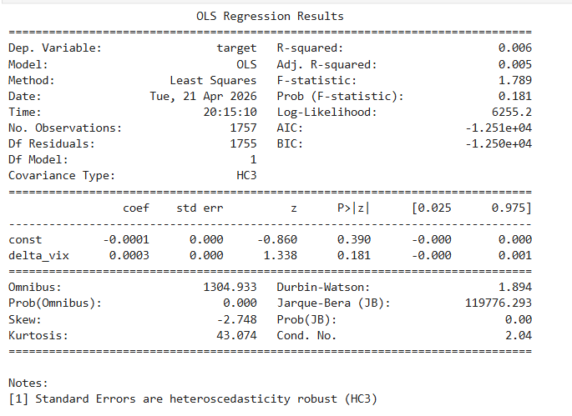
MODEL 1 - RESULTS
Model 1 (continued)
+0.0003
0.181
Δ VIX Coefficient
P-Value
-1.01%
0.21
Test R-Squared
Annualized Sharpe Ratio
Negative Test R² (-1.01%) is standard in financial return prediction because of high noise in daily EMB returns. ΔVIX had the strongest same-day relationship with EMB and a positive next-day coefficient (thereby suggesting possible short-term rebound after volatility shocks), but the coefficient was not statistically significant after applying HC3 robust standard errors.
Notes:
Same-day panic vs. next-day reversal: ΔVIX is negatively correlated with EMB returns contemporaneously, but its next-day coefficient is positive, suggesting a possible short-term rebound after volatility shocks. We interpret this as suggestive rather than conclusive because the HC3 p-value is 0.181.

Slide 9
Model 2
All Three Signals

Slide 10

MODEL 2 - SELECTION
Why Also Use Oil or Δ Credit Spreads?
Δ Credit Spreads
Measures default probability and US investment climate.
Widening Spreads: Indicates increasing risk and worsening financial conditions.
Return Impact: Clear link between positive change in spreads (widening) and a reduction in EMB returns.
Oil Returns
Major commodity export for EMB nations.
Return Impact: Sudden spikes in oil may signify massive geopolitical volatility.
One Complication: Slow longer-term rises in the price may signify a stronger economy and currency for exporting countries.
By focusing on the delta (change) of these variables, we capture the momentum and shock factors essential for predicting short-term emerging market bond performance.

Slide 11
DATA
Dataset & Feature Engineering
2016–2026
2,500+
3
70 / 30
Date Range
Daily Observations
Predictors
Train / Test Split
Variable | Constructed As | Role | Intuition
em_return (Y) | log(EMBt / EMBt-1) | Dependent variable | What we predict and trade
Δ VIX (X₁) | VIXₜ − VIXₜ₋₁ | Primary predictor | Δ in levels; fear spike detector
Δ Credit Spread (X₂) | Spreadt − Spreadt-1 | Risk premium proxy | Δ in levels; increased risk off climate
Oil Return (X₃) | log(OIL_t / OIL_t-1) | Global risk appetite | Δ in levels; increased macro uncertainty
Returns used for prices (oil, EMB); first differences used for non-prices (VIX, spreads). Eliminates look-ahead bias by predicting t+1 returns using t predictors.

Slide 12
DATA - CORRELATIONS
How the Variables Move Together
On the SAME day: when fear spikes, investors panic-sell EMBs. This is a contemporaneous reaction, not a prediction.
Δ VIX vs EMB Return
−0.47 (Strong Negative)
Higher credit spreads = more market stress = investors dump risky EM bonds on the same day they see spreads widen.
Δ Credit Spread vs EMB
−0.35 (Moderate Negative)
Rising oil = healthy global economy = more risk appetite. But the relationship is noisy since geopolitical volatility increases prices.
Oil Return vs EMB Return
+0.24 (Weak Positive)
PROBLEM: Two of our predictors are highly correlated with each other; they explain the same variation in EMB returns.
Δ VIX vs Δ Credit Spread
+0.46 (⚠ Multicollinearity)
Important: correlations are same-day (time t) relationships which is good for understanding reactions, but NOT as good for predicting future returns.

Slide 13
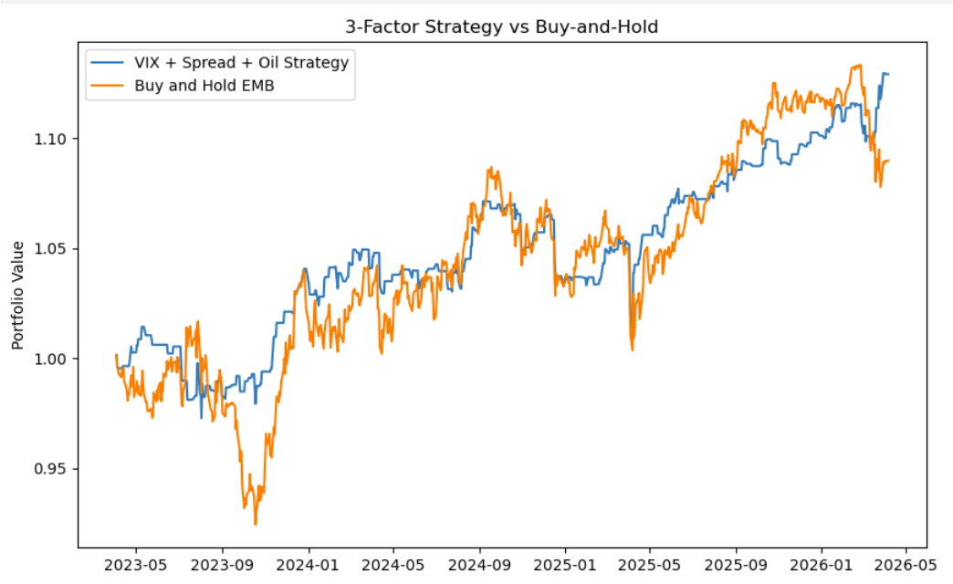
MODEL 2 - INTRO
Model 2: Setup & Results
Methodology
Using 3 factors to predict EMB Returns, and we have 2 choices: long (only invest today if predicting EMB return tomorrow is positive) or stay out (do nothing)
Corrected for heteroskedasticity by using HC3 (Heteroskedacity-Consistent standard errors type 3) - helps provide more reliable p-values by ensuring outliers don't make your p-values look smaller
The test R-Squared decreased from -0.0101 (for delta_vix only) to -0.0162 → this means the multivariate model became less accurate in predicting EMB returns
We plotted the cumulative returns of our strategy and compared it to a buy and hold strategy
Negative Test R² (-1.01%) is standard in financial return prediction because of high noise in daily EMB returns. The key finding is that Δ VIX is statistically significant and directionally correct for short-term reversals.

Slide 14
MODEL 2 - 3 FACTOR MODEL
Model 2 Regression Statistics
3 Factor Model - Delta Vix, Delta Credit Spreads, & Oil Returns
0.0104
0.0003
Oil Return Coefficient
Delta VIX
Test R-Squared = -0.0162
Annualized Sharpe Ratio = 0.84
0.0016
-0.0001
Delta Spread
Constant
Equation: ŷ = 0.0104 * (oil_return) + 0.0003 * (delta_vix) + 0.00160 * (delta_spread) - 0.0001

Slide 15
MODEL 2 - MULTI-FACTOR OLS
Model 2 Analysis
EMB Return_t+1 = α + β₁·ΔVIX_t + β₂·ΔSpread_t + β₃·Oil_Return_t + ε
What Improved
The Problem: Multicollinearity
Used HC3 heteroskedasticity correction for more reliable p-values
Strategy: go long tomorrow if predicted EMB return > 0, else stay out
Annualized Sharpe ratio: ~0.20 (model 1) vs 0.84 (model 2)
Δ VIX and Δ Credit Spread are 0.46 correlated — shared signal
Condition number = 84 (>30 = very high multicollinearity)
Result: none of the 3 predictors are individually significant
More variables did not improve prediction — double-counting noise
Fix: Ridge regression adds penalty term to shrink correlated predictors
Strategy vs Buy-and-Hold
3-factor strategy ends at 1.129 × vs buy-and-hold at 1.09×
Sep 2023: strategy protected capital when buy-and-hold crashed
Strategy consistently hovers at or above buy-and-hold
Lesson: adding correlated predictors inflates the condition number and destroys individual significance, even when R² marginally improves.

Slide 16
Model 3
All Three Signals with Ridge

Slide 17
MODEL 3 – Ridge 3 FACTOR MODEL
Model 3: Ridge 3 Factor Model
3 Factor Model (Ridge) - Delta Vix, Delta Credit Spreads, & Oil Returns
0.000245
0.000512
Oil Return Coefficient
Delta VIX
Test R-Squared = -0.0149
Annualized Sharpe Ratio = 0.89
0.000160
-0.000141
Delta Spread
Constant
Equation: ŷ = 0.00937428* (oil_return) + 0.00025108 * (delta_vix) + 0.00160883* (delta_spread) - 0.00013946
*Note: Coefficients in the boxes are standardized coefficients – these are NOT the original unit-coefficients (see footnote).
Notes:
Ridge was estimated using standardized predictors so variables with different scales were penalized consistently. Standardized coefficients show the effect of a one-standard-deviation change in each predictor. Original-unit coefficients convert the model back to the variables’ actual measurement units—for example, VIX-point changes, credit-spread percentage-point changes, and oil returns—so they can be used in the final regression equation. Both sets of coefficients represent the same Ridge model.

Slide 18
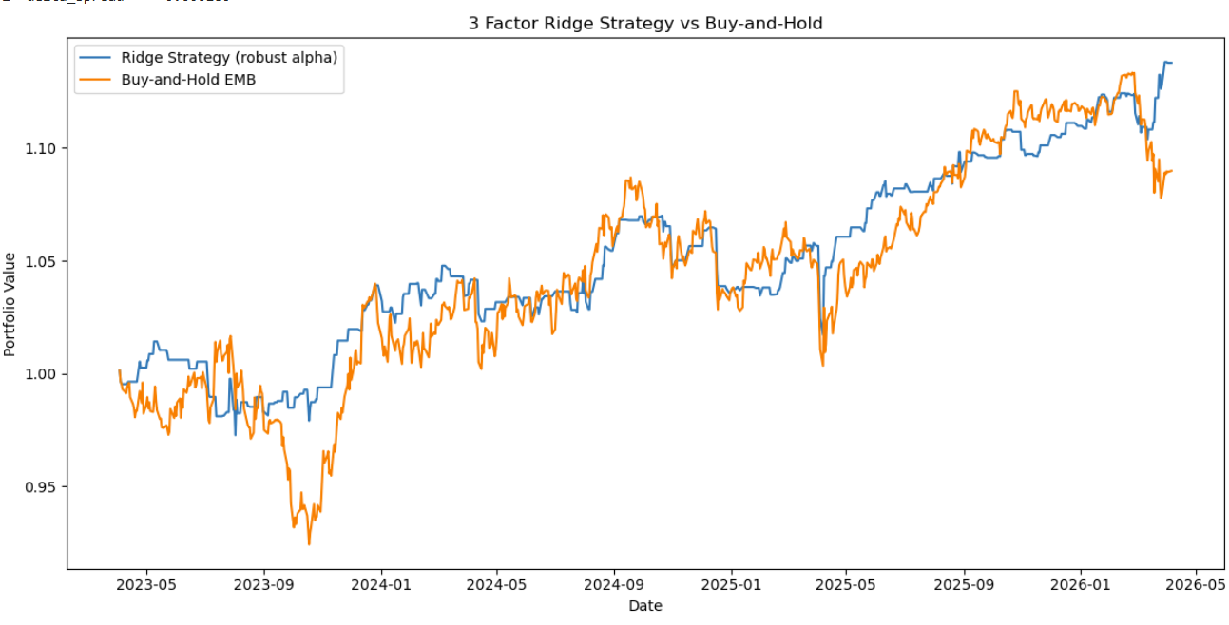
MODEL 3 – Ridge 3 Factor Model
Model 3 Analysis
EMB Return_t+1 = α + β₁·ΔVIX_t + β₂·ΔSpread_t + β₃·Oil_Return_t + ε
What Improved
Annualized Sharpe ratio: ~0.84 (model 2) vs 0.89 (model 3)
Returns: 12.9% (model 2) vs 13.8% (model 3)
Penalty term to shrink correlated predictors – more stable
Test R-Squared: -0.0162 (model 2) vs -0.0149 (model 3)
Strategy vs Buy-and-Hold
Ridge 3-factor strategy ends at 1.138 × vs buy-and-hold at 1.09×
Sep 2023: strategy protected capital when buy-and-hold crashed
Strategy consistently hovers at or above buy-and-hold
Lesson: ridge regression improved returns and Sharpe ratio by adding penalty terms to shrink correlated predictors and reduce the model's sensitivity to overlapping predictor information.

Slide 19
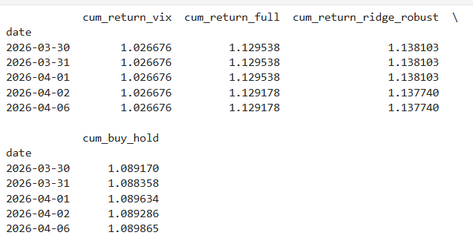
MODEL 2 - RESULTS
Ending returns comparing Models 1,2, and 3
All strategies started off with $1. The following table shows how much we end up with at the end of the 30% testing data period.
1 factor model (delta_vix only) → Portfolio value ≈ 1.027 → 2.7% return
3 factor model (no ridge) → Portfolio value ≈ 1.129→ 12.9% return
3 factor model (ridge) → Portfolio value ≈ 1.138 → 13.8% return
Buy & Hold strategy → Portfolio value ≈ 1.09 → 9.0% return

Slide 20
MODEL COMPARISON
Overview of the Three Models
Model 1
OLS (1-factor)
Model 2
OLS (3-factor No Ridge)
Model 2
OLS (3-factor No Ridge)
Approach
Regression
Regression
Ridge Regression
Signal
Δ VIX
Δ VIX + Spreads + Oil
Δ VIX + Spreads + Oil
Prediction
Tomorrow's return
Tomorrow's return
Tomorrow's return
Test R²
-1.01%
-1.62%
-1.49%
Sharpe
0.20
0.84
0.89
Return
2.7%
12.9%
13.8%
Best Feature
Stat. significance
Beats buy-and-hold + Model 1
Beats buy-and-hold + Models 1 & 2
Limitation
Single factor
Multicollinearity

Slide 21


RISKS & LIMITATIONS
Key Risks in the Trade & Limitations in the Models
OLS Assumptions are Violated
VIX is already priced in
Autocorrelation, heteroskedasticity, and fat tails are present. HC3 improves inference under heteroskedasticity but doesn’t address nonlinear relationships or changing market regimes.
VIX is a widely observed measure of market risk, so changes in VIX can be incorporated into asset prices very quickly. As a result, much of the contemporaneous relationship between VIX and EMB returns are already be priced in.
USD/FX Risk Omitted
Trading Costs
A strong USD increases the local-currency burden of paying off USD-denominated debt for sovereign EMs. This model doesn’t include dollar strength or country-specific currency conditions.
We assumed costless entry/exit, but we need to consider bid-ask spreads and broker costs because trading is costly. Incorporating these costs could materially reduce the advantage of our strategy vs buy and hold.
Not Fully Capturing Total Returns
EMB returns are calculated from historical closing prices rather than dividend-adjusted prices. Because EMB makes monthly distributions, the strategy measures price returns rather than total investor returns. Since EMB makes cash distributions via dividends, these aren’t captured in the returns we calculate.

Slide 22
MODEL 1 & 2 — OLS ASSUMPTIONS
OLS Assumptions Are Violated in Practice
Autocorrelation
Heteroskedasticity
If model underpredicts during a crash, it also underpredicts the next day. Durbin Watson statistics slightly below 2 for all regression outputs, so there is mildly positive first-order autocorrelation. (See footnote for more info)
Volatility clustering: tiny errors in calm markets, massive errors during crises. Error variance is NOT constant over time.
Normal Residuals
Multicollinearity
Financial data has fat tails (high kurtosis > 3). Extreme events happen far more often than a normal distribution predicts.
Δ VIX and Δ Credit Spread are 0.46 correlated. They share explanatory power, inflating standard errors in multi-factor models.
Kurtosis reference: Normal distribution has a kurtosis of 3. Financial data has kurtosis levels typically around 5–15+, meaning extreme moves are far more common than OLS assumes.
Notes:
Note: First-order autocorrelation means the regression error today, $e_{t}$, is correlated with the regression error one period earlier, $e_{t−1}$. If the autocorrelation is positive, errors tend to have the same sign on consecutive days. For example, if your model underpredicts EMB's return today, it may also be somewhat more likely to underpredict tomorrow.

Slide 23



What's Next?
Potential extensions to improve predictive power
Geopolitical Risk Index
Rolling Model Re-Estimation
Caldara-Iacoviello GPR Index quantifies geopolitical/geoeconomic risk by analyzing international newspaper coverage.
Current model does not capture geopolitical risk directly.
Test if changes in geopolitical risk provide incremental out-of-sample predictive power.
The current 70/30 split assumes factor relationships remain stable over the entire period.
Relationships among factors may change as market regimes and monetary conditions evolve.
Re-estimate the model periodically using a rolling window to account for changing factor relationships over time.
Move to Country-Level EM Bonds
Add USD/EM-FX Factor
EMB aggregates bonds across countries with very different exposures to commodities, geopolitics, currencies, and capital flows.
Aggregation dilutes country-specific relationships between macro shocks and bond returns.
Extend the strategy to country-specific EM bond indices and construct a portfolio based on predicted returns.
A stronger U.S. dollar can increase the local-currency burden of servicing USD-denominated debt for emerging-market sovereigns.
More pressure on sovereign bond prices due to higher capital outflows and tighter financial conditions in emerging markets.
A USD or EM-FX factor could help capture the effect of dollar strength and EM currency flows.
Notes:
A broad USD index (ex. DXY) tells us whether USD strengthens/weakens against other major currencies. EM Currency returns tell us if EM currencies appreciate/depreciate against USD. Stronger USD = EM country needs more local currency to pay off USD-denominated debt

Slide 24
Key Takeaways
Main Lessons Learned
1. Statistical Fit ≠ Trading Performance
All models had negative test R², showing that next-day EMB return magnitudes are difficult to predict. However, the multifactor models generated substantially stronger risk-adjusted trading performance.
2. Combining Factors Improved the Trading Signal
VIX alone produced limited economic value, while combining VIX, credit spreads, and oil generated a much stronger trading strategy.
3. Ridge Provided a Modest Improvement
Ridge regularization slightly improved both out-of-sample R² and Sharpe relative to the unregularized 3-factor model, suggesting some benefit from coefficient shrinkage.
4. Results Are Promising, but Not Yet a Deployable Strategy
The Ridge strategy ended the test period at approximately 1.138 versus 1.090 for buy-and-hold, but transaction costs, cash returns, and EMB distributions are not incorporated.

Slide 25

Thank You
Questions?
-1.49%
0.89
13.8%
Test R²
Annualized Sharpe Ratio
Return

