Slide 1
Selenium-3 WebDriver

Slide 2
What is WebDriver?
https://www.selenium.dev/selenium/docs/api/java/org/openqa/selenium/WebDriver.html
It is an interface that consists of all the methods which can be invoked on browser
All browser classes like FirefoxDriver, ChromeDriver, OperaDriver are implements this interface

Slide 3
We need Gecko Driver to work with Firefox
System.setProperty(“webdriver.gecko.driver”,”location of gecko driver.exe file”
System.setProperty(“webdriver.firefox.bin”,”location firefox.exe file”);
Gecko:
It is a web browser engine developed by Mozilla (written in C++)
It renders marked up content like html, css, images, xml on browser
Gecko Driver – it is a proxy to interact with Gecko. It provides HTTP API to communicate with Gecko browsers like Firefox

Slide 4
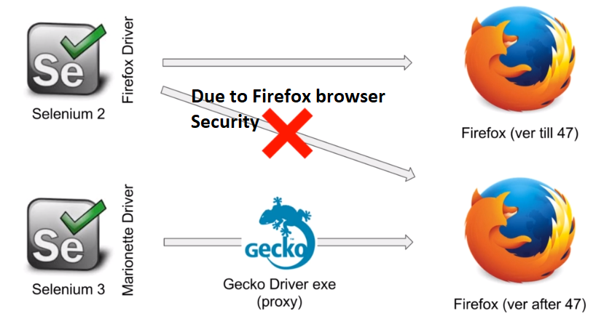
Why Gecko driver required?
Firefox version > 47 does not accept any third-party drivers to interact with it due to security reason. Hence, we use an proxy Gecko driver.

Slide 5
How Gecko Driver works:
When we call WebDriver it does internally calls Marionette driver
WebDriver driver = new FirefoxDriver();
Here FirefoxDriver is calling Marionette driver. Hence, we could replace it with MarionetteDriver class implemented by WebDriver interface like,
WebDriver driver = new MarionetteDriver();

Slide 6
Work with Chromer - ChromeDriver:
System.setProperty(“webdriver.chrome.driver”,”path of chromerdriver.exe”);
WebDriver driver = new ChromeDriver();
How to get current Project path location:
String projectPath = System.getProperty("user.dir");
System.out.println("ProjectPath: "+ projectPath);

Slide 7
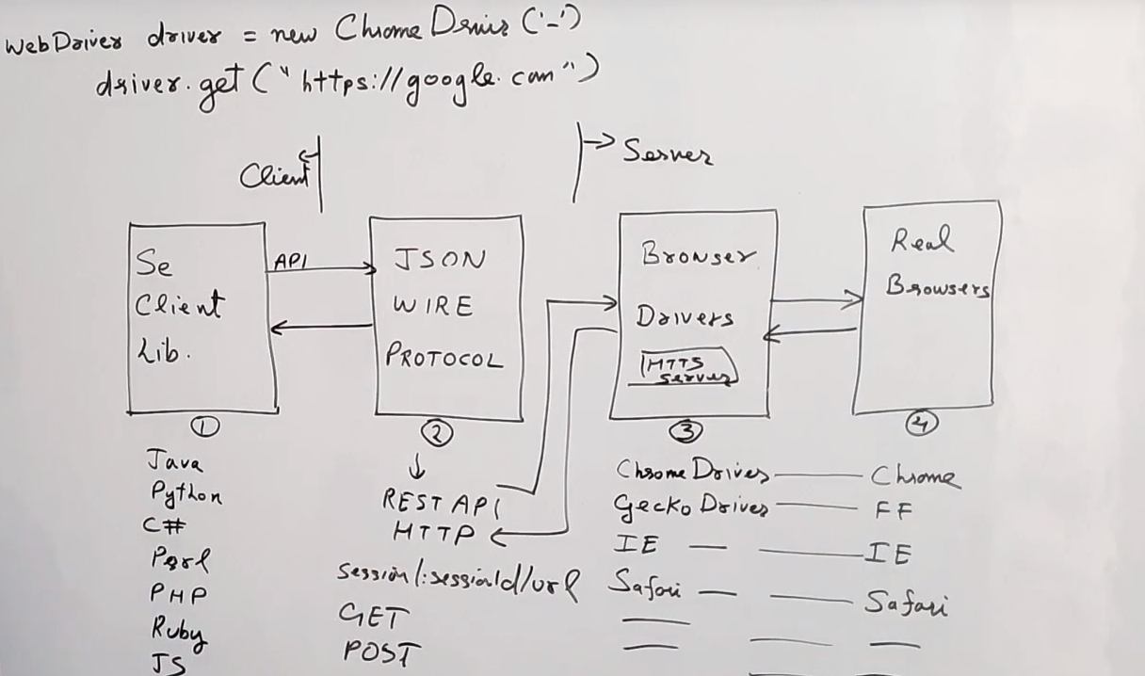
How Selenium Works:

Slide 8
How Selenium works:
Json Wire Protocol
It is Component
has Rest APIs in it Which enables communication b/w
client and Server
i.e For any WebDriver method it internally send a request to server and retrieve the response to Selenium client
For ex: driver.get(“url”);
driver.navigate(“url”);
(Selenium Client)
(Selenium Servers)
Project framework Code
(Written in IDE’s)
Browser Drivers
Ex:
GeckoDriver
ChromeDriver
etc
Request
&
Response
Request
&
Response
Connected
through Proxy
(Project build path)
Real Browsers
Ex:
Firefox
Chrome
etc
Selenium API
(Downloaded from Seleniumdev.org)
https://github.com/SeleniumHQ/selenium/wiki/JsonWireProtocol

Slide 9
Read Properties file:
STEP 1: Create a object of class Properties class
Properties prop = new Properties();
STEP 2 : Create a object of class InputStream
InputStream input = new FileInputStream("location of propertiesfile");
STEP 3 : Load Properties file
prop.load(input);
STEP 4 : Get values from Properties file
prop.getProperty("browser");
*** Here,
1st – loading the properties file
2nd – read key from properties file

Slide 10
Set Properties File:
STEP 1 : Create a object of class Properties class
Properties prop = new Properties();
STEP 2 : Create a object of class OutputStream
OutputStream output = new FileOutputStream("location of properties file");
STEP 3 : Set values
prop.setProperty(“browser", “chrome");
STEP 4 : Store values in properties file
prop.store(output, "comments");
*** Here,
1st – set the key, value to property file
2nd – store the property file

Slide 11

How to run a executable/runnable jar file from cmd:
Cmd cd to the folder (where jar file is located)
Java - jar ‘File.jar’
Also, for converting .class file in to .java file
http://java-decompiler.github.io/

Slide 12
Test Run on Headless Browsers:
Headless Browsers: Browsers without GUI
Ex: PhontumJs, HtmlUnitBrowser, ZombieJs
Why?
- To run the tests on systems like linux os (without GUI)
To simulate multiple browser behavior on a single machine
To use minimal resources
Challenges:
Synchronization issues
It may throw unexpected errors those are not observed in real browsers

Slide 13
Xvfb: it is a server which performs Graphical operations in memory without showing anything on the screen.
References:
Headless Browsers list - https://gist.github.com/evandrix/3694955 Xvfb wikipedia - https://en.wikipedia.org/wiki/Xvfb Xvfb
Jenkins Plugin - https://wiki.jenkins-ci.org/display/JENKINS/ Xvfb+Plugin
Stack Overflow - http://stackoverflow.com/questions/31848410/ selenium-test-execution-via-jenkins-on-linux-machine-without-guicli-only-he

Slide 14
HtmlUnit – HtmlUnitDriver
HtmlUnit: is a headless web browser written in Java. This headless browser can deal with HTTPS security, basic HTTP authentication, automatic page redirection and other HTTP headers.
HtmlUnitDriver: it is a class implements with WebDriver Interface
To run the test on HtmlUnit:
HtmlUnitDriver driver = new HtmlUnitDriver();
To run the test on HtmlUnit with real browser version like chrome, firefox:
HtmlUnitDriver driver = new HtmlUnitDriver(BrowserVersion.CHROME)
https://htmlunit.sourceforge.io/apidocs/com/gargoylesoftware/htmlunit/BrowserVersion.html
https://www.javadoc.io/doc/org.seleniumhq.selenium/selenium-htmlunit-driver/latest/org/openqa/selenium/htmlunit/HtmlUnitDriver.html

Slide 15
HtmlUnitDriver:
Constructor and Description
HtmlUnitDriver()Constructs a new instance with JavaScript disabled, and the default BrowserVersion/HtmlUnit.
HtmlUnitDriver(boolean enableJavascript)Constructs a new instance, specify JavaScript support and using the default BrowserVersion.
HtmlUnitDriver(com.gargoylesoftware.htmlunit.BrowserVersion version)Constructs a new instance with the specified BrowserVersion.
HtmlUnitDriver(com.gargoylesoftware.htmlunit.BrowserVersion version, boolean enableJavascript)Constructs a new instance with the specified BrowserVersion and the JavaScript support.
HtmlUnitDriver(org.openqa.selenium.Capabilities capabilities)Note: There are two configuration modes for the HtmlUnitDriver using this constructor.
HtmlUnitDriver(org.openqa.selenium.Capabilities desiredCapabilities, org.openqa.selenium.Capabilities requiredCapabilities)

Slide 16
HtmlUnitDriver:
HtmlUnit
Browser
HtmlUnitDriver driver = new HtmlUnitDriver();
HtmlUnitDriver driver = new HtmlUnitDriver(BrowserVersion.CHROME);
HtmlUnitDriver driver = new HtmlUnitDriver(BrowserVersion.FIREFOX);
Chrome
Browser
To get the browser client details on which headless browser the test is running
We use WebClient class.
WebClient webClient = (WebClient) get(driver, "webClient");
private static Object get(Object object, String field) throws
Exception {
Field f = object.getClass().getDeclaredField(field);
f.setAccessible(true);
return f.get(object);
}
Firefox
Browser

Slide 17
Test run with PhantomJS
Note: PhantomJs 2.1 is integrated with Ghost Driver hence there is no need separate installation
Import org.openqa.selenium.phantomjs.PhantomJsDriver
System.setProperty(“phantomjs.binary.path”,”location path of phantomjs.exe”);
WebDriver driver = new PhantomJsDriver();

Slide 18
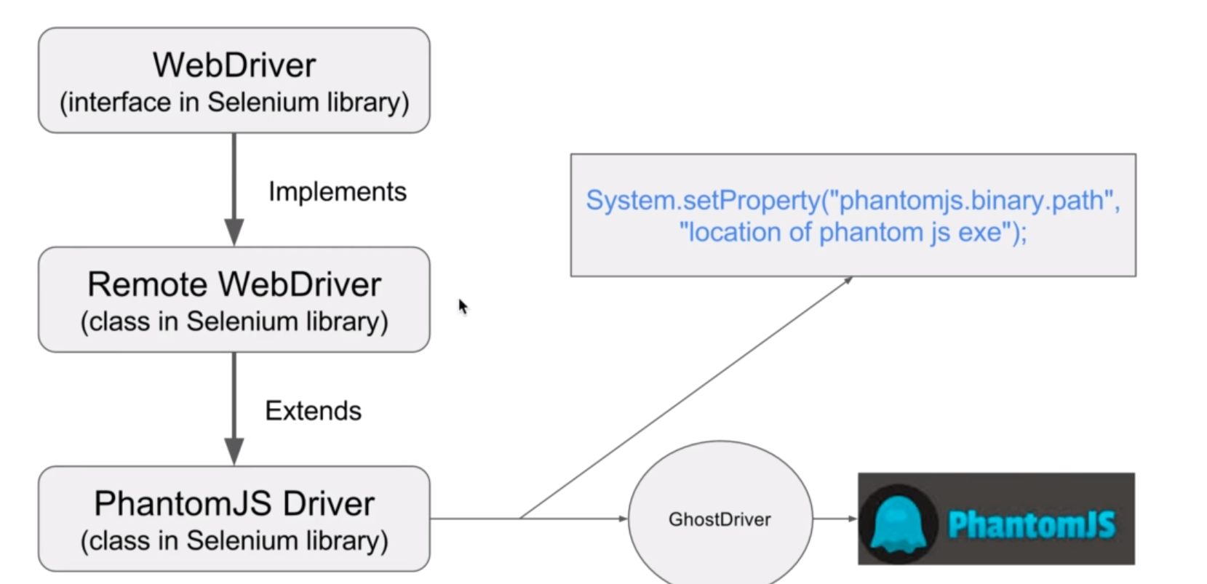
Selenium interaction with PhantomJs

Slide 19
Selenium Selectors:
DOM: The rendered html file (after the page is loaded/processed the content and updated by provide JavaScript in it)

Slide 20
Selenium Waits:
Implicit wait: It is required wait for to complete certain event in DOM.
driver.manage().timeouts().implicitilyWait(30,TimeUnit.SECONDS);
* It is applicable at driver i.e. for all the ements
https://whitecircleschool.com/implicitwait/
Explicit wait: explicitly waiting for an element (We use it with Ajax requests)
https://whitecircleschool.com/explicit-wait-demo1/
Note: In this case implicit wait does not help.
WebDriverWait waitExplicit = new WebDriverWait(driver,30);
waitExplicit.until(ExpectedConditions.visibilityOfElementLocated(By.cssSelector(“cssValue”));
String actualText = driver.findElement(By.cssSelector(“cssValue”)).getText();
Default poling period in Implicit and explicit wait => 0.5 Secs

Slide 21
FluentWait: explicitWait with user-controlled polling period.
Wait<WebDriver> waitEplicit = new FluentWait<WebDriver>(driver)
.withTimeout(Duration.ofSeconds(30))
.polligEvery(Duration.ofSeconds(2))
.ignoring(NoSuchElementException.class);
waitExplicit.until(ExpectedConditions.visibilityOfElementLocated(By.cssSelector(“cssValue”));
String actualText = driver.findElement(By.cssSelector(“cssValue”)).getText();

Slide 22
Navigate Methods:
driver.to(“https://Dell.com”);
driver.navigate().to(https://facebook.com);
driver.navigate().back();
‘driver.navigate().forward();
‘driver.navigate().refresh();

