Slide 1
Selenium

Slide 2
Understanding HTML / DOM Structure of WebElements:
-Browser/page
-Textbox
-List box
-Multi select list box
(https://www.plus2net.com/html_tutorial/html_frmddl.php)
-Radio Button
-Check box
-Image
-Link
-Button
-WebTable
-Text (with color / with background color)
-Scroll bar
URLs for practice:
https://truweight.in/consultation/1.html

Slide 3
Selenium WebDriver:
Checking an element's text
Checking an element's presence/status
Checking an element's attribute values
mouse and keyboard events
(http://beej.us/blog/data/drag-n-drop/)
Performing double-click on an element
Performing drag-and-drop operations
Executing JavaScript code
For frames:
https://www.tutorialspoint.com/html/html_frames.htm
Selenium useful links:
https://www.softwaretestingmaterial.com/selenium-wait-commands/

Slide 4
Controlling the Selenium WebDriver Test execution Flows:
Synchronizing a test with an implicit wait
Synchronizing a test with an explicit wait
Synchronizing a test with custom-expectedconditions
Handling a simple JavaScript alert
Identifying and handling frames/IFRAME

Slide 5
Synchronization points
Pageload : time provided for waiting till page load, if time exceeds webdriver throws an exception
driver.manage().timeouts().pageLoadTimeout(60, TimeUnit.SECONDS);
We can create custom page load using javascript
Implicit wait: time provided for waiting till any element is not found(it is generic to all the elements)
driver.manage().timeouts().implicitlyWait(45, TimeUnit.SECONDS);

Slide 6
Synchronization points
Explicit wait: time provided for waiting till a specific element to load
WebDriverWait explicitWait = new WebDriverWait(driver, 75); explicitWait.until(ExpectedConditions.presenceOfElementLocated(By.cssSelector(".tp-logo")));
Fluent Wait: Explicit wait + additional polling time + ignoring provided exception
//Fluent wait
Wait wait = new FluentWait(driver)
.withTimeout(75, TimeUnit.SECONDS)
.pollingEvery(5, TimeUnit.SECONDS)
.ignoring(NoSuchElementException.class);
wait.until(ExpectedConditions.presenceOfElementLocated(By.cssSelector(".tp-logo")));

Slide 7
Miscellaneous- JavascriptExecutor
When do we go for javascript?
If any action need to perform on page/element and it is not beeing worked by available webdriver methods or there is no appropriate methods for that, then we go for achieve same by javascript.
Ex: Find java script errors in page
boolean errorPresent = false;
JavascriptExecutor js = (JavascriptExecutor) driver;
String error = (String) js.executeScript("var error = window.onerror;\n" +
"\t\treturn JSON.stringify(error);");
System.out.println("JSONErrorObject: " + error+"-"+ error.getClass());
if(!error.equals("null")) errorPresent = true;
return errorPresent;

Slide 8
Selenium Exceptions
Stale element exception (It can be handled using Explicit wait)
https://www.selenium.dev/selenium/docs/api/py/common/selenium.common.exceptions.html
https://www.guru99.com/exception-handling-selenium.html
https://www.softwaretestinghelp.com/exception-handling-framework-selenium-tutorial-19/

Slide 9
Miscellaneous
Code for selecting date picker/ calendar
https://www.travolook.in/
https://www.virginaustralia.com/

Slide 10
Useful links from google
https://www.toolsqa.com/selenium-webdriver/data-base-operations-in-selenium-java/
https://www.softwaretestinghelp.com/exception-handling-framework-selenium-tutorial-19/

Slide 11
Miscellaneous
Setting Proxy:
Proxy proxy =new Proxy();
// Set HTTP Port to 7777
proxy.setHttpProxy("localhost:7777");
// Create desired Capability object
DesiredCapabilities capabilities =new DesiredCapabilities();
// Pass proxy object p
capabilities.setCapability(CapabilityType.PROXY, proxy);
System.setProperty("webdriver.chrome.driver", "C:\\G-Learn\\Selenium\\env\\chromedriver.exe");
WebDriver driver = new ChromeDriver(capabilities);

Slide 12
Miscellaneous
Take Screenshot:
public void takeScreenshot(String filePath) throws IOException {
WebDriver driver = TestBase.getDriver();
TakesScreenshot takesScreenshot = (TakesScreenshot) driver;
File screenshotFile = takesScreenshot.getScreenshotAs(OutputType.FILE);
FileUtils.copyFile(screenshotFile, new File(filePath));
}

Slide 13
Reading Data
From Json file
https://howtodoinjava.com/java/library/json-simple-read-write-json-examples/#maven
From properties file
https://www.javatpoint.com/properties-class-in-java
From data base
https://www.youtube.com/watch?v=xUQEe729Kg0&t=144s
https://www.tutorialspoint.com/mysql/mysql-select-database.htm
https://dev.mysql.com/doc/refman/8.0/en/database-use.html
For download the mysql installer:
https://dev.mysql.com/downloads/installer/
Mysql connector to connect the database and fetch data :
https://search.maven.org/artifact/mysql/mysql-connector-java/8.0.22/jar

Slide 14
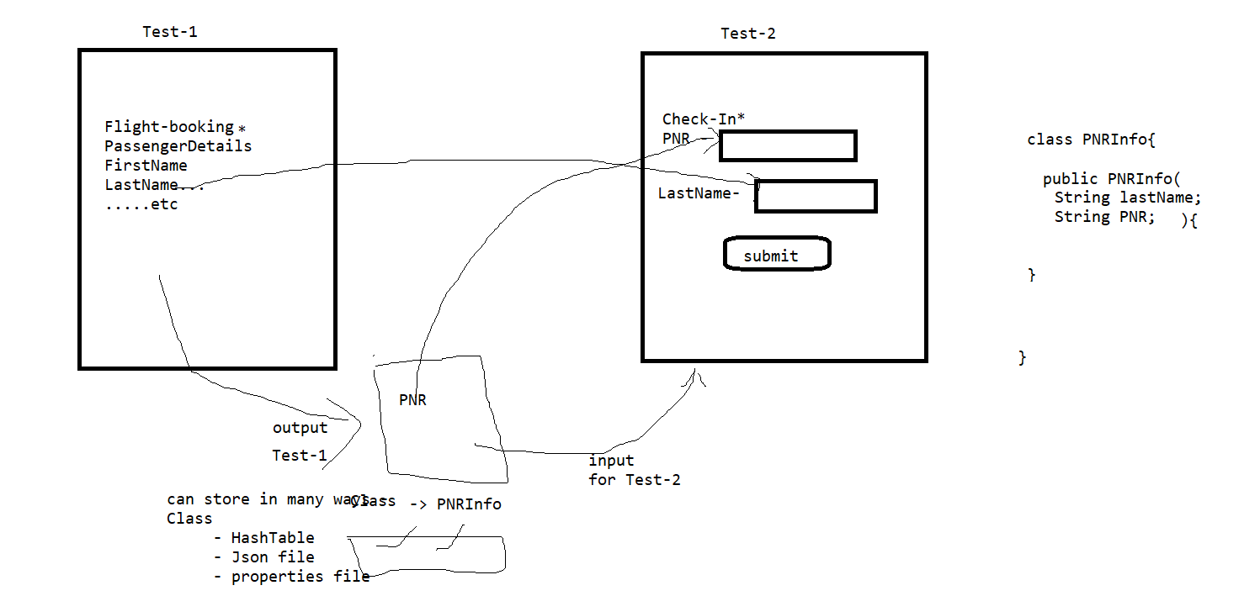
How to pass output of Test-1 as input for Test-2:

Slide 15
Mysql commands
Commands: root/Test123:3036
Show databases
Create database testSelenium
Use testSelenium
Create table customers(id int, firstname varchar(30), lastname varchar(30))
select * from customers
Insert into customers (id, firstname, lastname) values (01,'Raja','Raghu') ;

Slide 16
Working with browsers:
Chrome
https://sites.google.com/a/chromium.org/chromedriver/downloads
Firefox
https://github.com/mozilla/geckodriver/releases
Download: geckodriver-v0.28.0-win64.zip

Slide 17
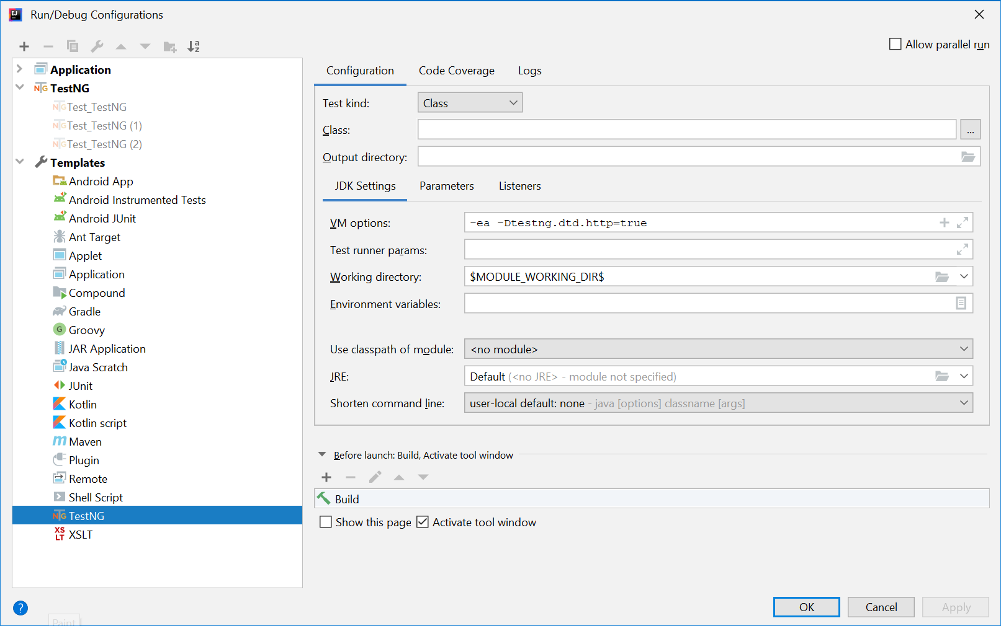
TestNG
https://www.toolsqa.com/testng/install-testng/
https://mvnrepository.com/artifact/org.testng/testng
For IntelliJ: Run--> Edit configuration --> Templates --> Testng - - > VM options --> -ea -Dtestng.dtd.http=true --> apply -> OK
***Also make https protocol:
<!DOCTYPE suite SYSTEM "https://testng.org/testng-1.0.dtd">
<suite name="Practice Suite">
<test name="Test Basics 1">
<parameter name="emailid" value="tester789@gmail.com"/>
<classes>
<class name="testC.TestNG_Priorities"/>
</classes>
</test> <!-- Test -->
</suite> <!-- Suite -->

Slide 18
TestNG
Test Annotations
Test priorities
Test dependents, ignore test
Test Asserts, Reporter.log
Test expected exception, time out
Test groups
Test Parameters
Test Dataproviders
Test Listeners
IRetryAnalyzer
https://howtodoinjava.com/testng/testng-annotations-tutorial/
https://www.toolsqa.com/testng/testng-parameters/

Slide 19
Maven:
For maven setup: https://www.tutorialspoint.com/maven/maven_environment_setup.htm
To learn maven:
https://www.lambdatest.com/blog/getting-started-with-maven-for-selenium-testing/
Maven command to run the tests: ‘ mvn clean test
Note: In Realtime we do not download jar dependencies from maven online repository. We download from internal
Nexus repository. Hence, we need to provide this nexus URL as part of POM.xml file
Ex:
<distributionManagement>
<repository>
<id>releases</id>
<!-- CHANGE HERE by your team nexus server -->
<url>http://localhost:8081/nexus/content/repositories/thirdparty/</url>
</repository>
</distributionManagement>

Slide 20
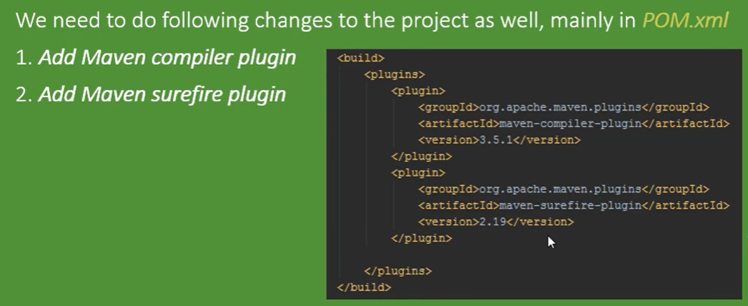
Maven plugins:
For clean and compile the code => compiler plugin
(for this maven goal -> mvn compile)
For run the tests => surefire plugin (for this maven goal -> mvn test)
Maven command / goal to run the tests => mvn clean test

Slide 21

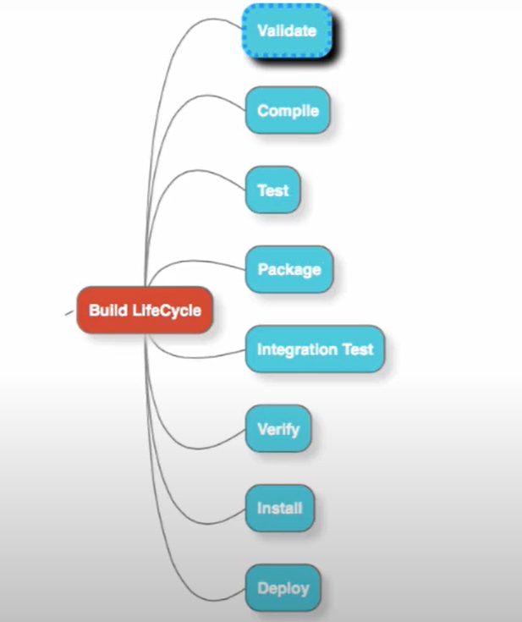
Maven lifecycle ‘ mvn clean test

Slide 22
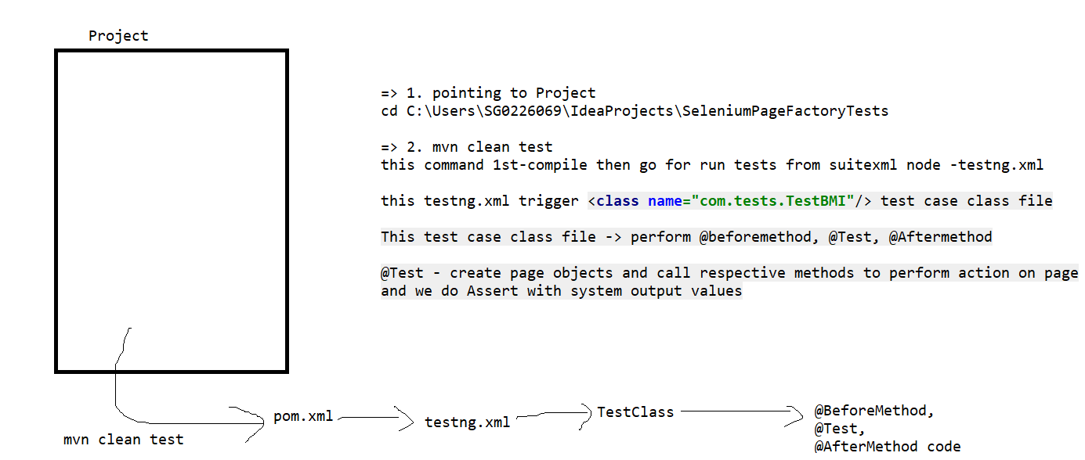
Test execution flow

Slide 23
Using the Page Object Model and PageFactory:
Using the PageFactory class for exposing elements from a page
Using the PageFactory class for exposing an operation on a page
Implementing nested Page Object instances

Slide 24
Automation online learning links
https://automationstepbystep.com/
https://www.youtube.com/channel/UCO1aucBAJgFR8odzfXOZ5uw

Slide 25
Cucumber
What is BDD?
https://www.youtube.com/watch?v=cq_3wPnaX-w&list=PLhW3qG5bs-L_hJZ3Nfg70ejkH3ktyzy34&index=1
https://www.youtube.com/watch?v=4e9vhX7ZuCw
For download cucumber jar:
https://mvnrepository.com/artifact/io.cucumber/cucumber-java
For generating cucumber functions:
https://chrome.google.com/webstore/detail/tidy-gherkin/nobemmencanophcnicjhfhnjiimegjeo?hl=en-GB

Slide 26
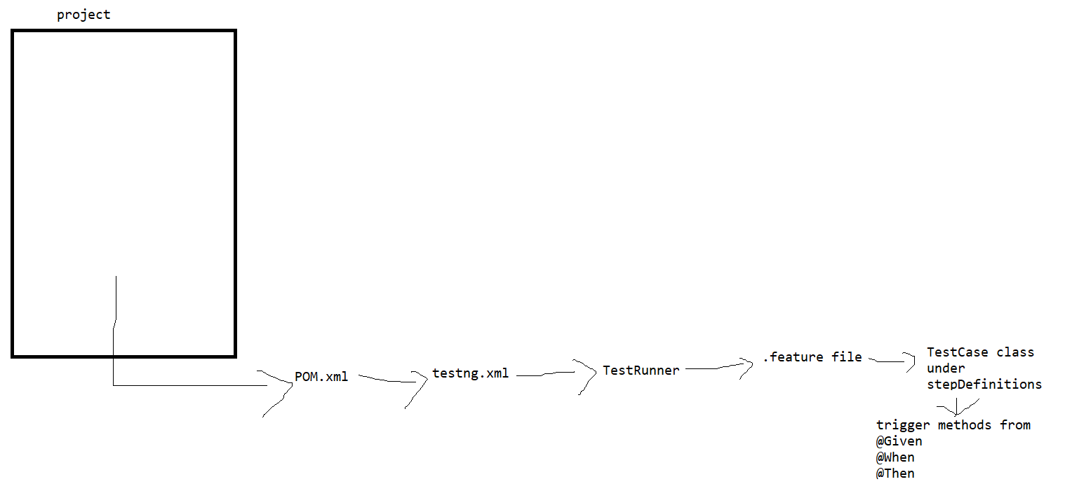
Cucumber execution flow:

Slide 27
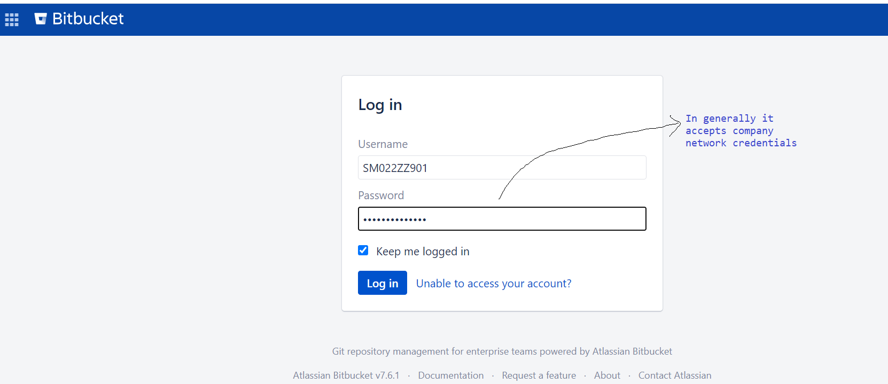
GIT:
Access to company Git URL
Ex: https://git.symphony.com/login?nextUrl=%2Fdashboard

Slide 28
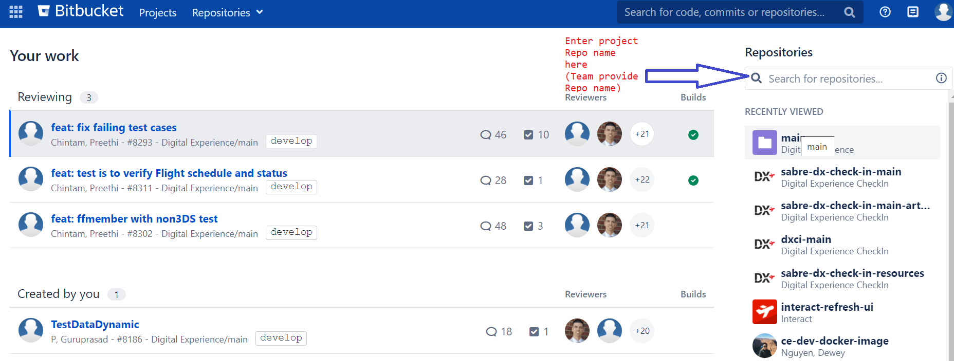
GIT – select Repo

Slide 29
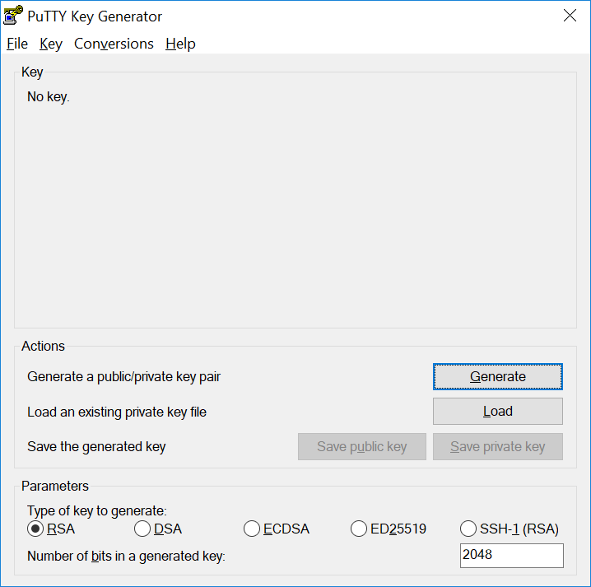
Create SSH key: (1st - Download PuTTY Key Generator)

Slide 30
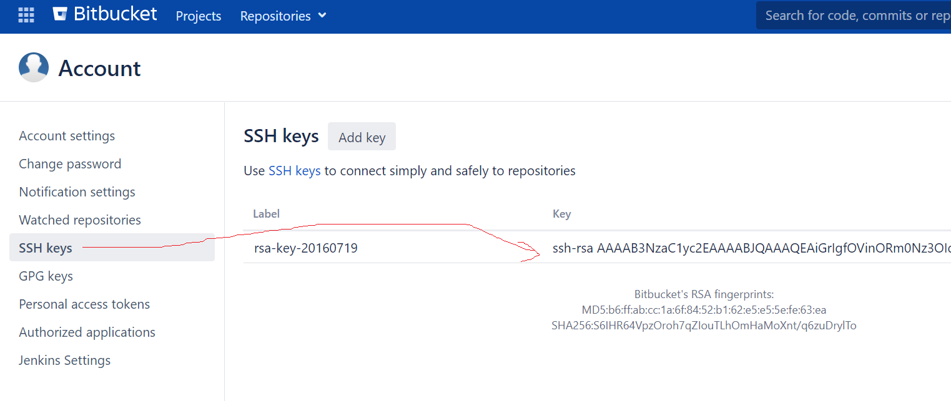
Update ssh key in Git Manage Account:

Slide 31
Git Merge conflicts:
https://www.youtube.com/watch?app=desktop&v=RxunYSzMNKM

Slide 32
For Git repo creation:
https://www.youtube.com/watch?v=pwP9zimYec4
https://github.com/GuruprasadQE/my-maven-projA.git

Slide 33
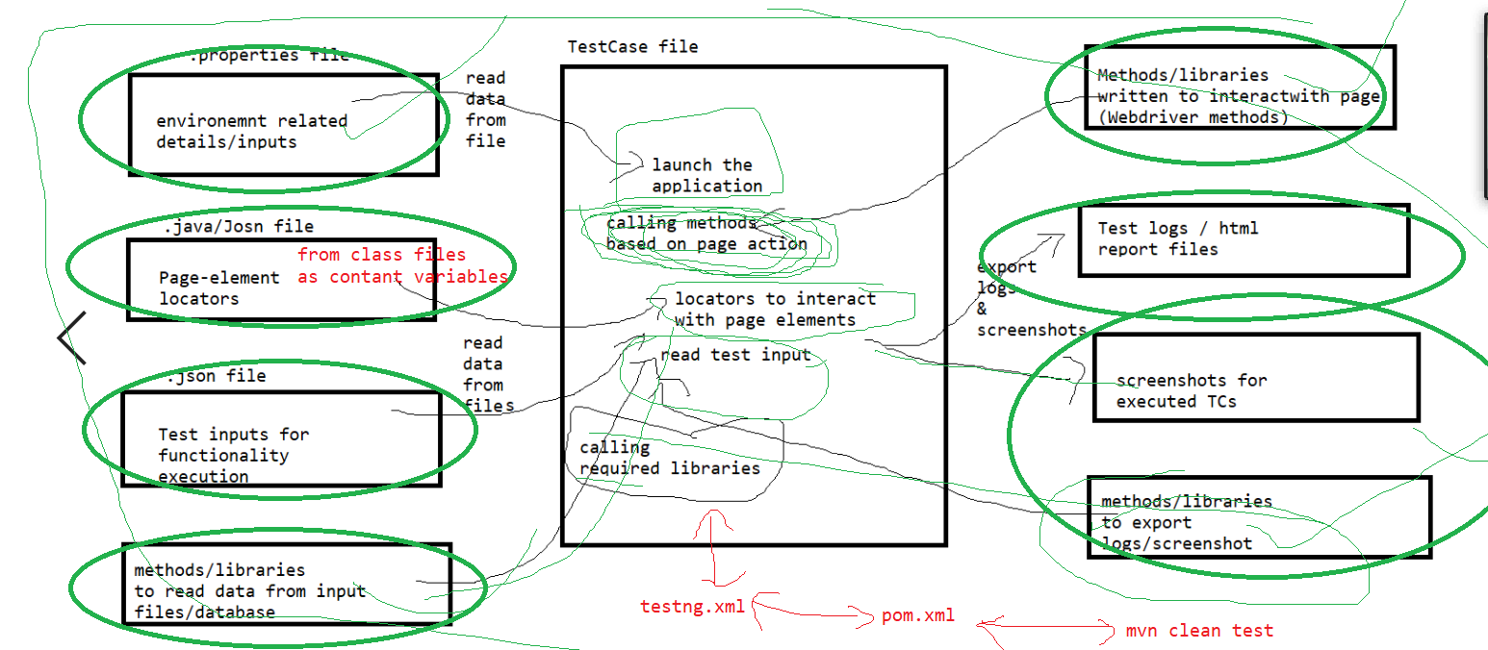
Framework:

Slide 34
Project:
Maven
Reporting
Git
Framework
Jenkins

Slide 35
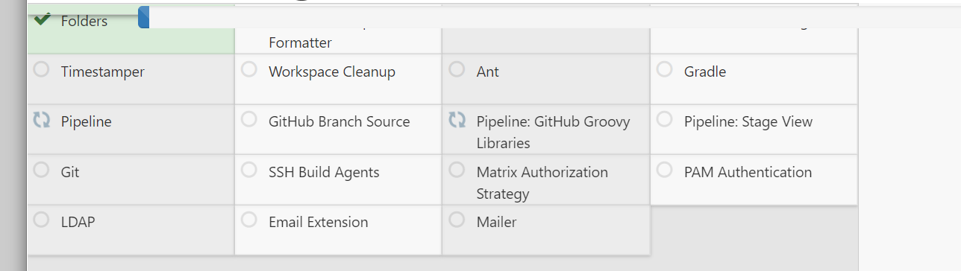
Jenkins plugins for Automation:

