Slide 1
Lending Club Case Study

Slide 2
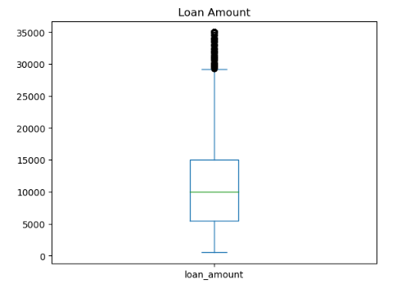
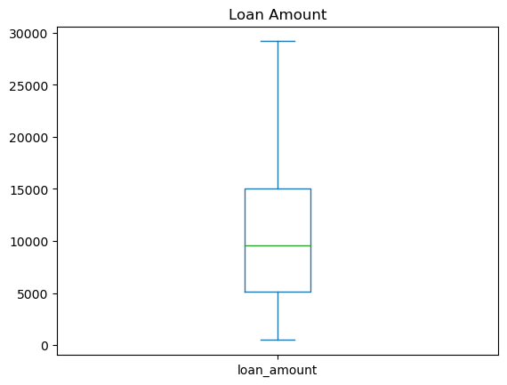
Outliers
Before Removing Outliers
After Removing Outlier

Slide 3
Factor 1
The total number of credit lines currently in the borrower's credit file is inversely proportional to Interest Rate
More the total number of credit lines currently in the borrower's credit file more will be the interest Rate
Total number of credit lines currently in the borrower's credit file (Total_acc) is the greatest Factor for the Applicant to go Defaulter

Slide 4


Slide 5
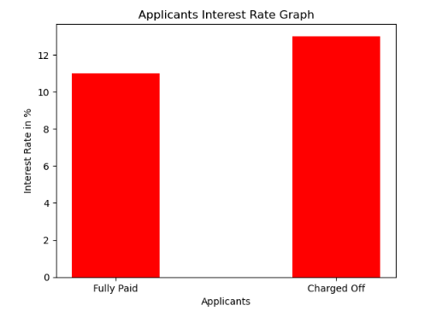
Factor 1-Interest Rate – Univariate Analysis

Slide 6
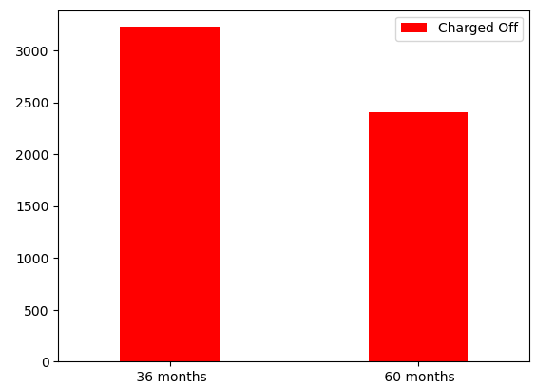
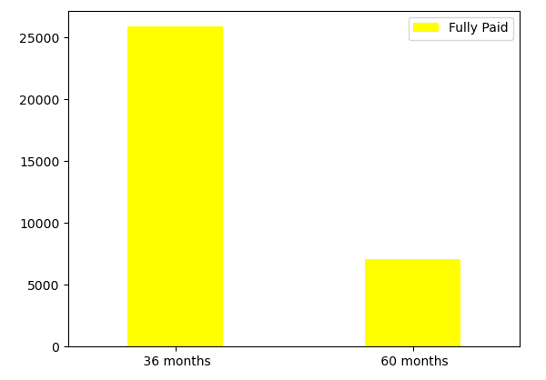
Factor 2-Term Months – Univariate Analysis
Defaulter tend to take more 60 term period loan
Non-Defaulters tend to take 36 term period loan

Slide 7
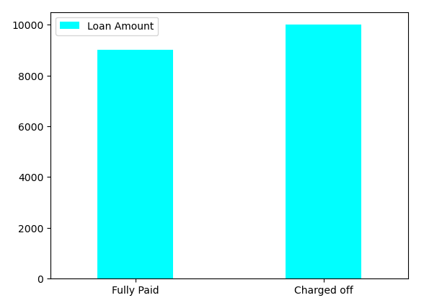
Factor 3 – Loan Amount
Defaulters tend to take more loan

Slide 8
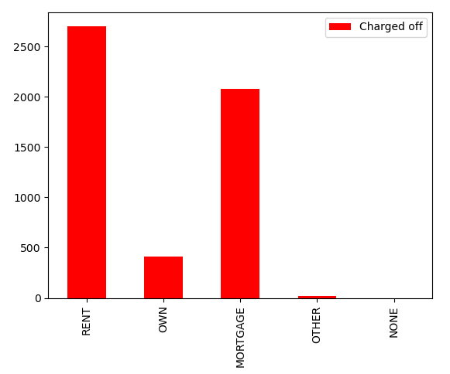
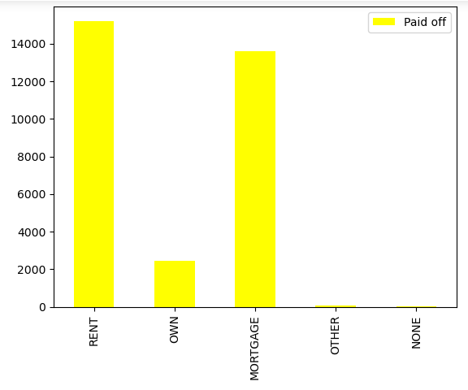
Factor – 4 Home-Ownership- No Impact

Slide 9
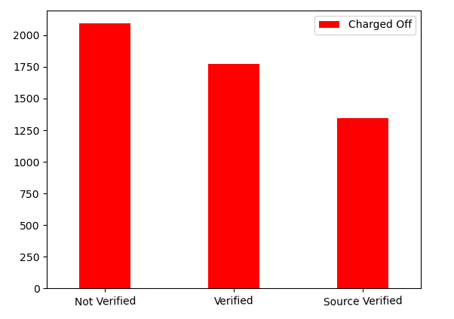
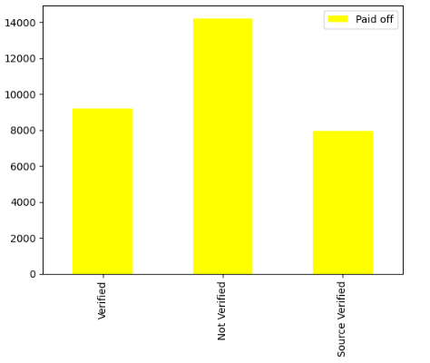
Factor -4 – Source Verified

Slide 10
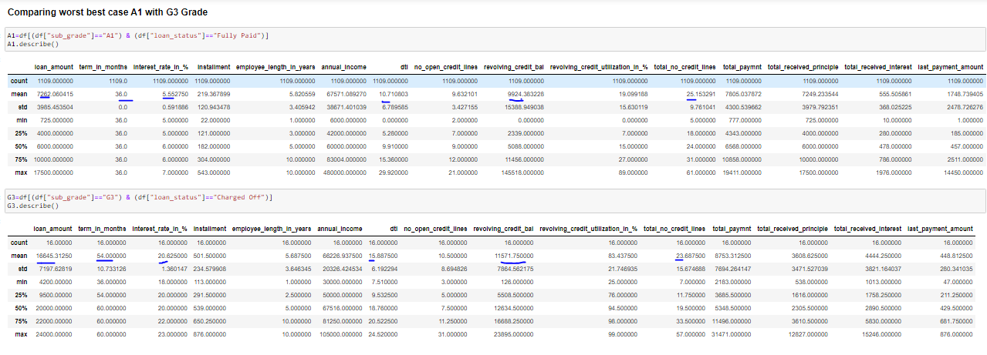
Segmented Analysis (Extreme Good grade A1 to Worst Case G3)

Slide 11
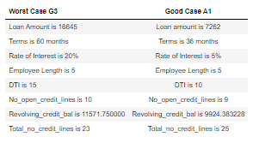
Observation
| Worst Case G3 | Good Case A1 |
| :- | :-: |
| Loan Amount is 16645 | Loan amount is 7262 |
| Terms is 60 months | Terms is 36 months |
| Rate of Interest is 20% | Rate of Interest is 5% |
| Employee Length is 5 | Employee Length is 5 |
| DTI is 15 | DTI is 10 |
| No_open_credit_lines is 10 | No_open_credit_lines is 9 |
| Revolving_credit_bal is 11571.750000 | Revolving_credit_bal is 9924.383228 |
| Total_no_credit_lines is 23 | Total_no_credit_lines is 25 |
#### Observation :- All the important factors are almost half in Ratio

Slide 12
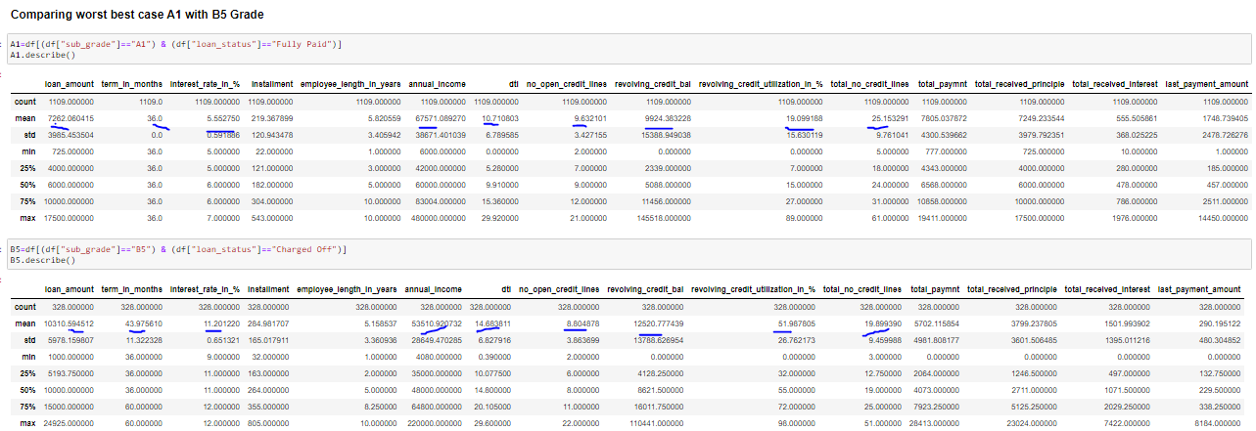
Segmentation (Good grade A1 (FP) - to Bad Case B5 (CO))

Slide 13
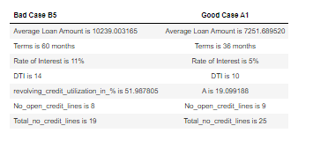
Observation

Slide 14
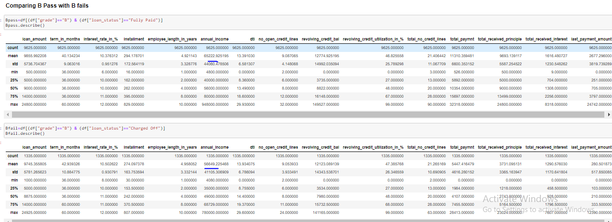
Grade B (FP) to B (CO)

Slide 15
Observation
All other factors match but the Annual income is less

Slide 16
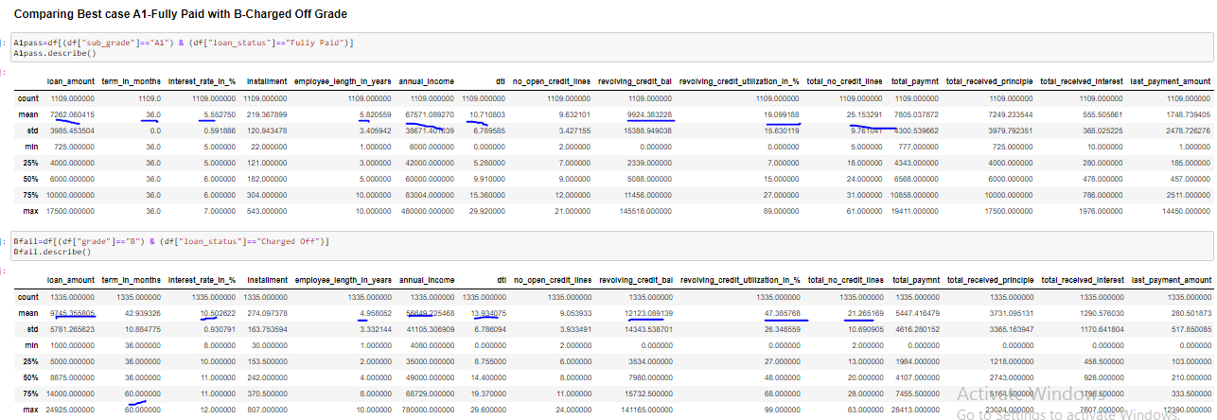
A pass to B overall

Slide 17
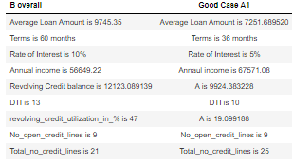
Observation

Slide 18
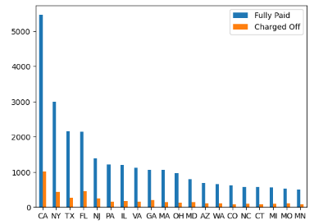
Top 20 cities FP and CO Graph

Slide 19
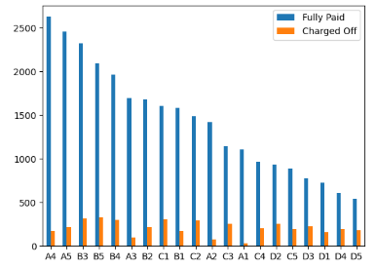
Grades FP and CO

Slide 20
Moral of the Story
Average Loan Amount should be considered where overall after paying the total debits surplus amount is left
Term should be less i.e 36 months
Rate of Interest should be least
Revolving Credit balance should be least
DTI ratio should be low
Revolving_credit_utilization_in_% should be low
No_open_credit_lines and Total_no_credit_lines should be more but its utilization should be least otherwise the CIBIL SCORE may go bad if not correctly managed.

