Slide 1

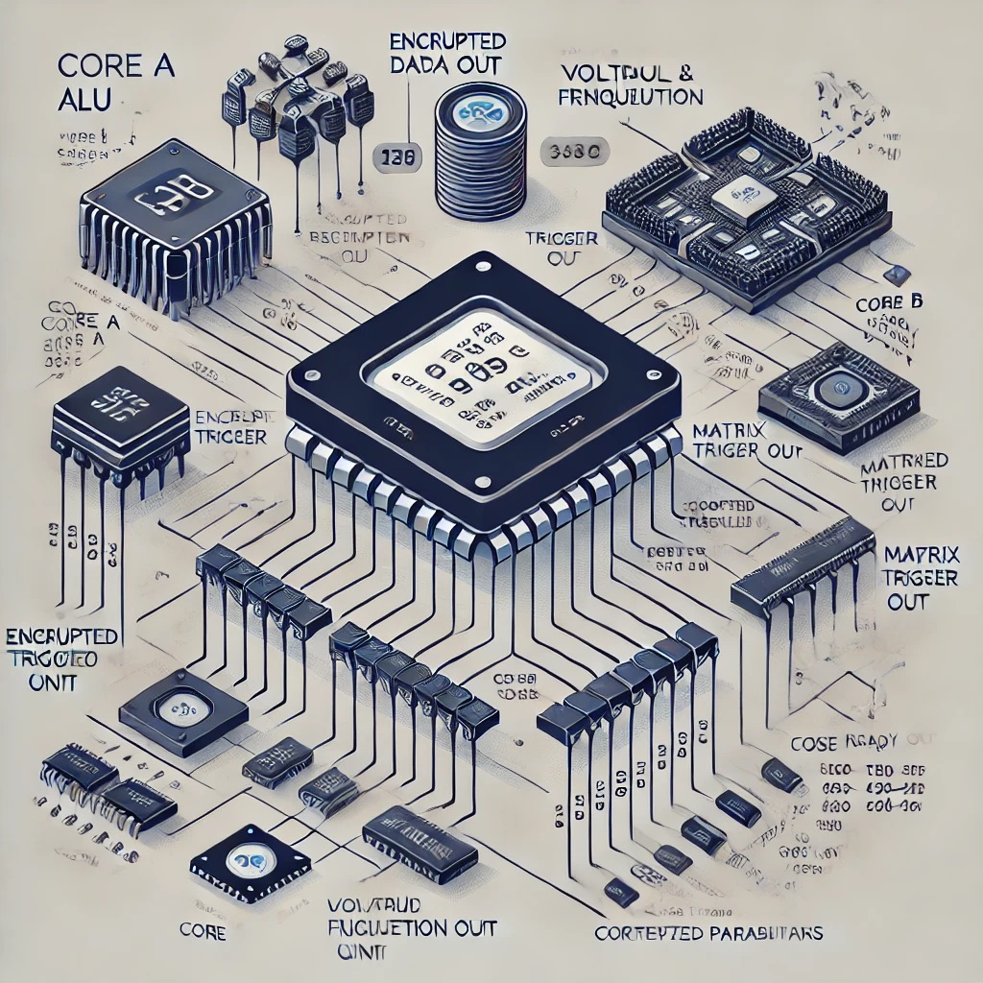
Advanced Heterogeneous Multi-Core Processor with AI Integration
A Unique ASIC Implementation
By: Gururaja S R
Git: Link

Slide 2
Project Overview
Objective: Design a cutting-edge ASIC implementation featuring a heterogeneous multi-core processor with integrated AI capabilities, dynamic voltage and frequency scaling (DVFS), and advanced fault tolerance.
Scope: Encompasses core modules (Core A and Core B), AI Scheduler, DVFS Controller, Fault Monitor, and encryption modules, aiming for high efficiency, adaptability, and robustness.

Slide 3
Motivation
ASIC Design Complexity: Addressing the need for more efficient, high-performance processors that can handle diverse computational tasks in a power-efficient manner.
Innovation Gap: Traditional processors are limited by static design and lack adaptive features. This project introduces a novel approach with real-time AI optimization and dynamic scaling to enhance performance and reliability.

Slide 4
Key Features
Multi-Core Architecture: Combines Core A (specialized for matrix operations) and Core B (advanced data processing) for optimized task execution.
AI Integration: Utilizes reinforcement learning for adaptive task scheduling and in-field self-optimization.
DVFS: Implements dynamic scaling to balance performance and power consumption, adapting to varying workloads.
Advanced Fault Tolerance: Incorporates ECC and a Fault Monitor to ensure system reliability and data integrity.

Slide 5
System Architecture
Multiple cores (Core A and Core B) connected via a shared bus interface: The architecture consists of two distinct cores—Core A handles simpler, arithmetic operations (ALU), while Core B is designed for complex computations like matrix multiplication.
Advanced Modules: Includes AI optimization for adaptive task management, AES encryption for data security, and a DVFS controller to balance power and performance.
Centralized Control: Oversees system operations, monitors power, voltage, and frequency, and adjusts parameters to ensure efficient performance.
Customizable Parameters: Allows dynamic adjustments of voltage, frequency, and operational settings to optimize performance and energy efficiency based on application needs.

Slide 6
Simulation Environment
Tools: Icarus Verilog compiles Verilog code, and GTKWave visualizes signal behavior over time.
Testbench: A detailed testbench is designed to systematically monitor core operations, including the arithmetic and complex computations performed by the cores. It tracks power consumption, outputs, and various system states, such as voltage and frequency levels, and detects triggers for system reconfiguration.
Verilog Modules: Simulate essential components like the ALU, matrix multiplication, AES encryption, and DVFS controller.
Simulation Execution: Run using “vvp” to process the code and observe interactions and results.

Slide 7
Simulation Results
Core A: ALU outputs are captured and tracked during various operation cycles. The results demonstrate the performance of arithmetic and logical operations over time.
Core B: The 4x4 matrix multiplication results are visualized and tracked throughout the simulation. This shows how Core B performs matrix operations step-by-step.
Encryption outputs: AES encryption performance is evaluated, with encrypted data outputs displayed. These results confirm the successful operation of the encryption module in real-time.
Power consumption and reconfiguration triggers: Power consumption metrics are continuously monitored. Reconfiguration triggers are also recorded, demonstrating dynamic system adjustments during execution.

Slide 8
Performance Metrics
Core A and Core B operation counts displayed at each cycle: The operation counts for both cores are recorded and visualized during each simulation cycle.
Monitoring of power consumption, voltage, and frequency levels: Power usage, voltage fluctuations, and frequency scaling are monitored throughout the simulation.
Dynamic adjustments in response to AI optimization and reconfiguration events: AI optimization triggers dynamic changes in core operations, adjusting system parameters as needed. Reconfiguration events are logged to show how the system adapts to varying loads.
Power savings due to DVFS observed during low-load periods: DVFS effectively reduces power consumption by lowering voltage and frequency during periods of reduced workload.

Slide 9
Conclusion
Successful integration of heterogeneous cores with AI optimization and encryption was achieved.
Real-time simulation and performance tracking were demonstrated effectively.
Future work includes expanding core functions and developing more advanced AI optimizations.
Industry applications could involve AI-driven computing and secure data processing.

Slide 10
References
Burr, W. (2003), Selecting the Advanced Encryption Standard (AES): Raising the Bar for Cryptography., Selecting the Advanced Encryption Standard (AES): Raising the Bar for Cryptography. (Accessed August 28, 2024)
Salehi, M. E., Samadi, M., Najibi, M., Afzali-Kusha, A., Pedram, M., & Fakhraie, S. M. (2011). Dynamic voltage and frequency scheduling for embedded processors considering power/performance tradeoffs. IEEE Transactions on Very Large Scale Integration (VLSI) Systems, 19(10), 1931–1935. https://doi.org/10.1109/tvlsi.2010.2057520
Akkaya, K., & Uysal, A. (2021). Optimization of heterogeneous systems with AI planning heuristics and machine learning: A performance and energy aware approach. Proceedings of the 2021 IEEE International Conference on Computer Design (ICCD). (Accessed August 28, 2024)
Bessant, Y.R.A., Jency, J.G., Sagayam, K.M. et al. Improved parallel matrix multiplication using Strassen and Urdhvatiryagbhyam method. CCF Trans. HPC 5, 102–115 (2023). https://doi.org/10.1007/s42514-023-00149-9

