Slide 1
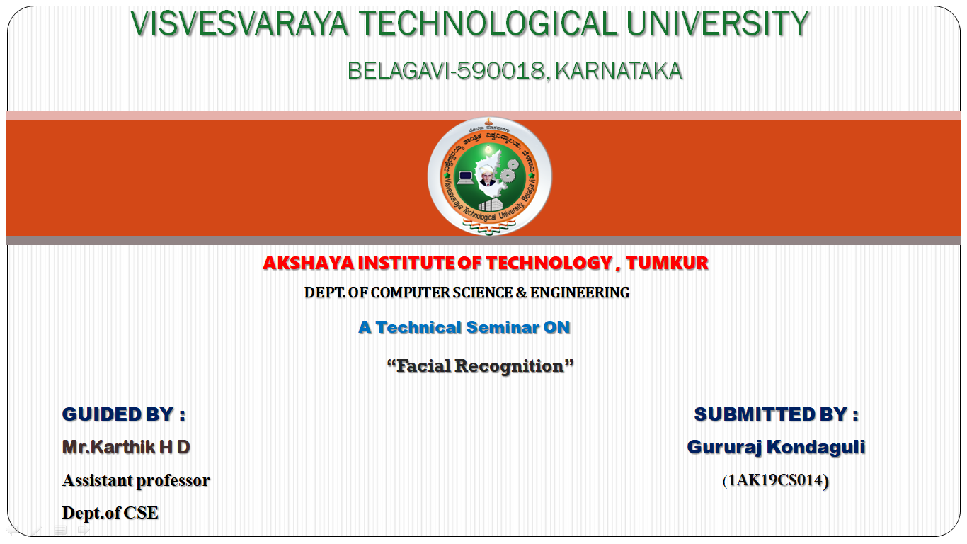

Slide 2
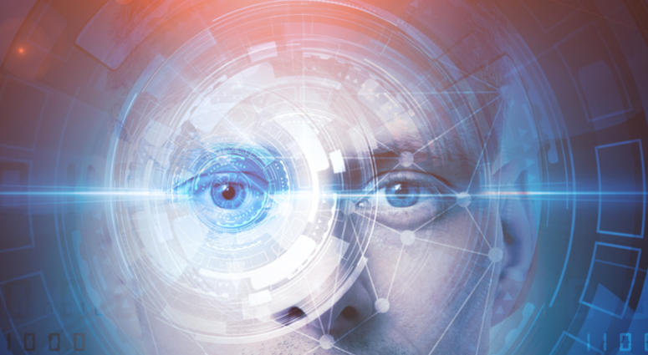
FACE RECOGNISATION
This Photo by Unknown author is licensed under CC BY.

Slide 3
CONTENTS
INTRODUCTION
LITERATURE SURVEY
PROBLEM STATEMENT
SCOPE OF THE TOPIC
IMPLEMENTATION
CONCLUSION
REFERENCES
WORKING PROCEDURE
SOFTWARE PROCESS
ADVANTAGES
DISADVANTAGES
APPLICATIONS

Slide 4

INTRODUCTION
Everyday actions are increasingly being handled electronically paper,pencil or face to face
This growth in electronic transactions result in great demand for fast and accurate user identification and authentication
Acces codes for buildings,bank accounts and computr systems often use PIN's for identification and security clearences
This Photo by Unknown author is licensed under CC BY-SA.

Slide 5

Using the proper PIN gains access, but the user of the PIN is not verified. When credit and ATM cards are lost or stolen, an unauthorized user can often come up with the correct personal codes.Face recognition technology may solve this problem since a face is undeniably connected to its owner expect in the case of identical twins.

Slide 6
LITERATURE SURVEY
1993
First Database of facial images was created by Defence Advance Research Projects Agency
2003
DARPA database upgrades to 24-bit colour facial images
2004
National Institute of Standards and Technology creates the NIST test
2010
Facebook creates images identity auto-tagging using face recognisation
2011
Panama Airport installs first face recognition surveillance system
2011
Body of terror mastermind Osama bin Laden positively identified using face recognition

Slide 7
LITERATURE SURVEY
2013-FaceFirst reaches effective real time mobile match alerts over cellular connection
2014-Automated Regional Justice Information System (ARJIS) deploys a cross-agency system in southern
2014-California, sharing criminal face recognition data across local, state and federal agencies
2016-U.S. CPB deploys exit face recognition at Atlanta Airport
2017- iPhone X becomes the world's top selling phone with face recognition access control
2018-Face First achieves 150,000 facial points of measurement, including the ability to determine identity from 90. degree profile images Japan announces that it will use face recognition to verify the identity of athletes at the 2020 Olympic Games

Slide 8

SCOPE OF THE TOPIC
It requires no physical interaction on behalf of the user
It is accurate and allows for high enrolment and verification rates.
It can use your existing hardware infrastructure, existing camaras and image capture Devices will work with no problems

Slide 9
IMPLEMENTATION
The implementation of face recognisation system includes the following four stages:
Image acquisition
Image processing
Distinctive characteristics location
Template creation
Template Matching

Slide 10

IMAGE ACQUISITION
Facial-scan technology can acquire faces from almost any static camera or video system that generates images of sufficient quality and resolution
This growth in electronic transactions results in great demand for fast and accurate user identification and authentication.
This Photo by Unknown author is licensed under CC BY.

Slide 11
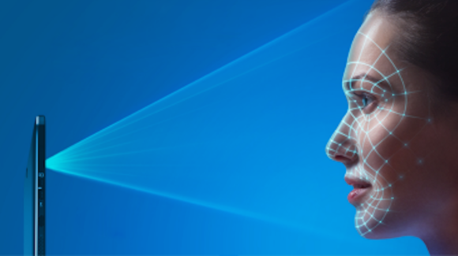
IMAGE PROCESSING
Images are cropped such that the ovoid facial image remains, and color images are normally converted to black and white in order to facilitate initial comparisons based on grayscale characteristics.
First the presence of faces or face in a scene must be detected. Once the face is detected, it must be localized and Normalization process may be required to bring the dimensions of the live facial sample in alignment with the one on the template

Slide 12
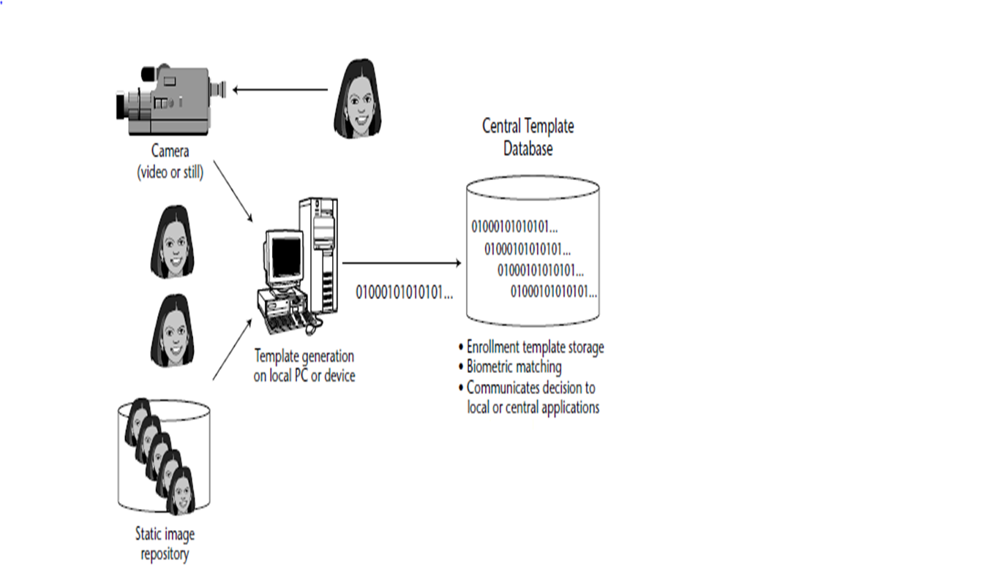
TEMPLATE CREATION

Slide 13
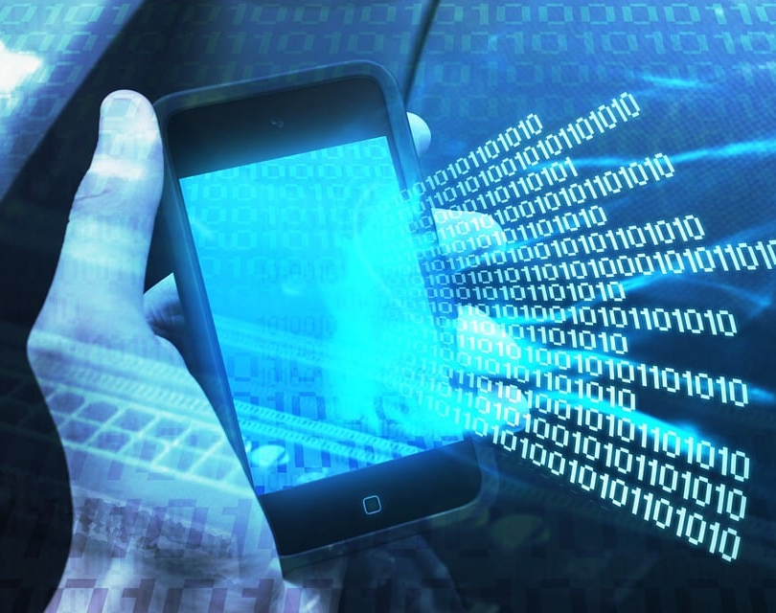
DISTINCTIVE CHARACTERISTIC LOCATION
All facial-scan systems attempt to match visible facial features in a fashion similar to the way people recognize one another.
The features most often utilized in facial-scan systems are those least likely to change significantly over time: upper ridges of the eye sockets, areas around the cheekbones, sides of the mouth, nose shape, and the position of major features relative to each other.

Slide 14
TEMPLATE CREATION
Enrollment templates are normally created from a multiplicity of processed facial images.
These templates can vary in size from less than 100 bytes, generated through certain vendors and to over 3K for templates.
The 3K template is by far the largest among technologies considered physiological biometrics.
Larger templates are normally associated with behavioral biometrics,

Slide 15
TEMPLATE MATCHING
It compares match templates against enrollment templates.
A series of images is acquired and scored against the enrollment, so that a user attempting 1:1 verification within a facial-scan system may have 10 to 20 match attempts take place within 1 to 2 seconds.
facial-scan is not as effective as finger-scan or iris-scan in identifying a single individual from a large database, a number of potential matches are generally returned after large-scale facial-scan identification searches.

Slide 16
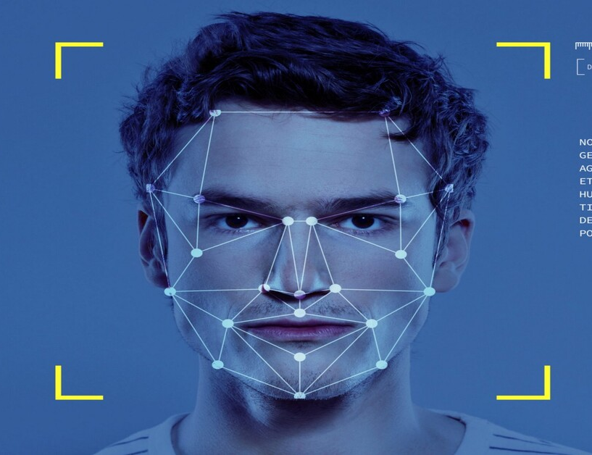
WORKING PROCEDURE
Facial recognition software is based on the ability to first recognize faces, which is a technological feat in itself. If you look at the mirror, you can see that your face has certain distinguishable landmarks. These are the peaks and valleys that make up the different facial features.
VISIONICS defines these landmarks as nodal points. There are about 80 nodal points on a human face.

Slide 17
Nodal points that are measured by the software.
distance between the eyes
width of the nose
depth of the eye socket
cheekbones
jaw line
chin

Slide 18
SOFTWARE
Detection- when the system is attached to a video surveilance system, the recognition software searches the field of view of a video camera for faces. If there is a face in the view, it is detected within a fraction of a second. A multi-scale algorithm is used to search for faces in low resolution. The system switches to a high-resolution search only after a head-like shape is detected.
Alignment- Once a face is detected, the system determines the head's position, size and pose. A face needs to be turned at least 35 degrees toward the camera for the system to register it.

Slide 19
Normalization-The image of the head is scaled and rotated so that it can be registered and mapped into an appropriate size and pose. Normalization is performed regardless of the head's location and distance from the camera. Light does not impact the normalization process.
Representation-The system translates the facial data into a unique code. This coding process allows for easier comparison of the newly acquired facial data to stored facial data.
Matching- The newly acquired facial data is compared to the stored data and (ideally) linked to at least one stored facial representation.

Slide 20
The system maps the face and creates a faceprint, a unique numerical code for that face. Once the system has stored a faceprint, it can compare it to the thousands or millions of faceprints stored in a database.
Each faceprint is stored as an 84-byte file.

Slide 21
ADVANTAGES
DISADVANTAGES
Convenient
social acceptability
Easy to use
Inexpensive technique of identification
Problem with false rejection when people change their hair style, grow or shave a beard or wear glasses.
Identical twins

Slide 22
APPLICATIONS
Replacement of PIN, physical tokens
No need of human assistance for identification
Prison visitor systems
Border control
Voting system
Computer security
Banking using ATM
Physical access control of buildings ,areas etc.

Slide 23
CONCLUSION
Factors such as environmental changes and mild changes in appearance impact the technology to a greater degree than many expect.
For implementations where the biometric system must verify and identify users reliably over time, facial scan can be a very difficult, but not impossible, technology to implement successfully.

Slide 24

THANK YOU

