Slide 1
DATA ANALYTICS & BUSINESS INTELLIGENCE CAPSTONE
Executive Decision Report:
Retail Margin Turnaround Strategy
Three Sequenced Strategic Decisions to Lift Annual Profit by +$103k and Deliver $200.7k 36-Month Net Cash Benefit
AUTHOR & CONSULTANT
Gurusaiprasadreddy
Senior BI Consultant & Analytics Lead
RabTech Academy Capstone
AUDIENCE & GOVERNANCE
Executive Leadership Team
Chief Executive Officer & CFO
Reporting Period: October 2026
DATASET & AUDIT STATUS
11,996 Clean Orders
Scope: Omnichannel Retail ($3.37M Sales)
Audit Status: PASSED (75/75 Tests)

Slide 2
EXECUTIVE SUMMARY
Executive Decision Brief: Reversing Margin Decay
Revenue grew +56% since 2023, but profit margin collapsed from 15.4% to 11.9%. Three sequenced decisions recover +$103k/yr.
1. THE BUSINESS PROBLEM
• Revenue climbed +56.2% ($897k -> $1.40M),
but profit rose only +20.7%.
• Weighted margin dropped -3.51 pp
(15.44% in 2023 down to 11.93% in 2025).
• Discounts >20% generate -$40,094 losses.
• Marketplace channel fee (15%) causes -2.55%
negative margin on $684k sales.
• Central region shipping delays (58.4% late)
triple returns (14.9%) and erode retention.
2. THREE STRATEGIC DECISIONS
Decision 1: Discount Guardrails
• Hard cap at 20%; 15% basket margin floor.
• Uplift: +$66,332/yr | Capex: $10k | M3 Payback.
Decision 2: Marketplace Margin Repair
• Renegotiate fee to 14% (-1 pp); cap discount 10%.
• Uplift: +$29,352/yr | Capex: $12k | M12 Payback.
Decision 3: Delivery SLA & Retention
• Central 3PL overhaul; reduce late to 15%.
• Uplift: +$7,314/yr | Capex: $12k | Brand SLA.
3. BASE FINANCIALS & RISKS
Audited Base Case Summary:
• Annual Uplift: +$102,997/yr (+61.6% profit)
• 36-Month Total Cost: $86,250
• 36-Month Net Cash: +$200,723
• Net ROI: 232.72% | 10% NPV: $168,399
• Portfolio Payback: Month 8
Critical Risk Disclosures:
• Rec 3 Standalone Deficit: -$18,795 over 36m.
Funded by Rec 1 & Rec 2 portfolio surplus.
• Rec 1 Contagion Risk: 825 buyers also placed
$741k in profitable orders. Use basket rules.
Simulated Omnichannel Retail Data (2023–2025) | Audited Stage 4 ROI Engine | Capstone Deliverable
Slide 2 of 15

Slide 3
COMMERCIAL SETTING
Business Context & Strategic Objectives
Analyzing 11,996 transactions across three fulfillment channels, five geographic territories, and three product categories.
Omnichannel Architecture
• Retail Store: 3,869 Orders | $1.16M Sales (34.4%)
Profit: $245.9k | Margin: 21.22%
Physical anchors with strong customer attachment.
• Online Web Store: 5,467 Orders | $1.53M Sales (45.4%)
Profit: $229.6k | Margin: 15.00%
Primary digital volume driver with healthy unit profit.
• Marketplace: 2,660 Orders | $684.1k Sales (20.3%)
Profit: -$17.4k | Margin: -2.55%
Fastest growing channel but deeply unprofitable.
Core Business Questions
• Q1: Decoupling Mechanism
Why did top-line growth (+56%) fail to flow to
bottom-line earnings (+21%)?
• Q2: Loss Concentration
Which discount bands, regions, and channels
destroy capital through cross-subsidization?
• Q3: Fulfillment & Churn
How much margin is lost through late delivery
returns and customer retention decay?
• Q4: Costed Turnaround
What sequenced actions deliver positive ROI?
Strategic Imperatives
• Volume to Value Focus
Shift corporate KPIs from top-line revenue to net
contribution profit after all channel fees and freight.
• Prevent Churn Contagion
Do not bluntly cancel orders; apply basket-level
margin governance to protect multi-order buyers.
• Partner Accountability
Renegotiate marketplace fees and 3PL contracts
with strict performance penalty clauses.
• Retention Protection
Repeat buyers drive 95% of orders. Service delivery
quality is essential for customer lifetime value.
Simulated Omnichannel Retail Data (2023–2025) | Audited Stage 4 ROI Engine | Capstone Deliverable
Slide 3 of 15

Slide 4
GOVERNANCE & PIPELINE
Data Governance, Cleaning Pipeline & Analytics Methodology
A reproducible, 6-stage deterministic pipeline transforming 12,400 raw entries into 11,996 audited, reliable transaction records.
Dataset Coverage & Scope
• Reporting Period: 2023-01-01 to 2025-12-31
• Raw Transactions: 12,400 rows across 20 fields
• Clean Transactions: 11,996 fully validated rows
• Coverage: 5 US regions, 3 product categories
• Customer Base: 2,116 unique accounts
Simulated-Data Disclosure:
• The dataset represents simulated omnichannel
retail operations designed for BI stress testing.
• Observational data establishes statistical correlation
rather than clinical counterfactual causation.
6-Stage Cleaning Pipeline
• Stage 1: Ingestion & Schema Typing
Standardized date parsing & numeric type casting.
• Stage 2: Exact Deduplication
Purged 400 identical order rows.
• Stage 3: Categorical Standardization
Reduced region variants from 29 to 5.
• Stage 4: Outlier Treatment
Corrected 28 extreme quantity keying errors to median.
• Stage 5: Hierarchy-Aware Imputation
Customer-mode imputation for missing regions.
• Stage 6: Automated Validation Gates
12 automated test gates (11 passed, 1 info note).
Analytical Methods
• Volume-Weighted KPI Engine
Avoided simple average margin distortion by
weighting all margins strictly by transaction dollars.
• Hypothesis Testing Framework
Conducted two-sample Welch's t-tests on discount
margins, marketplace drag, and delivery returns.
• Cohort Retention Tracking
Tracked annual customer repeat rates (54.4% -> 49.7%).
• Dynamic 36-Month Cash Flow Model
Monthly cash flow engine incorporating launch timing,
ramp-up curves, Capex/Opex, and 10% WACC discounting.
Simulated Omnichannel Retail Data (2023–2025) | Audited Stage 4 ROI Engine | Capstone Deliverable
Slide 4 of 15

Slide 5
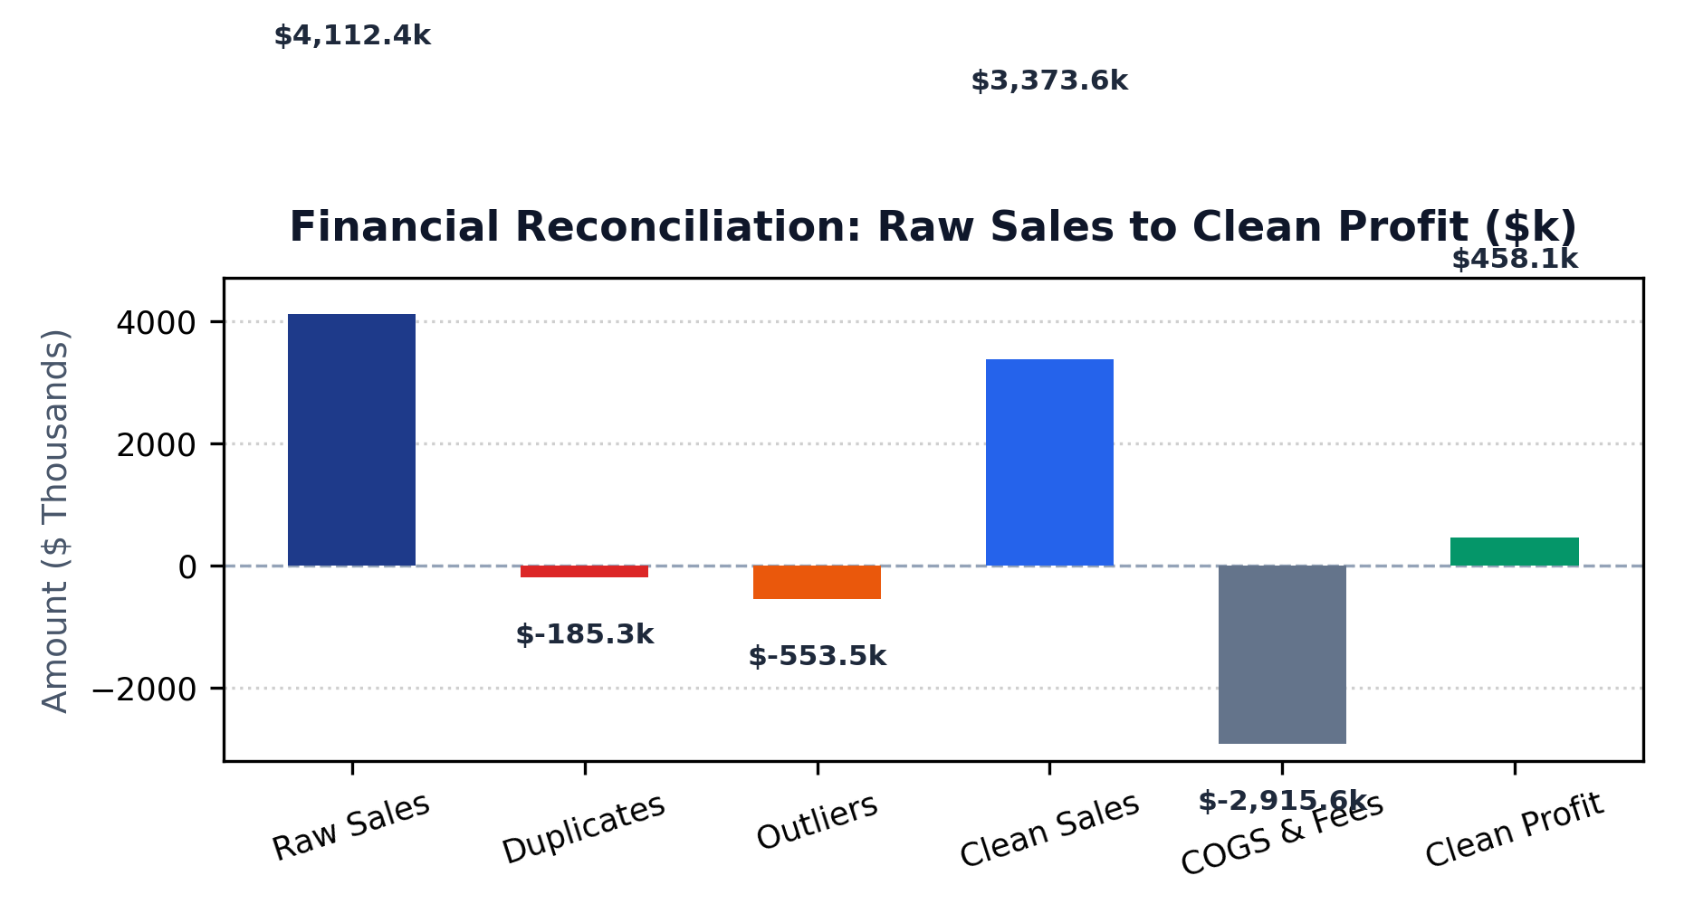
DATA QUALITY & AUDIT
Data Quality & Financial Reconciliation Waterfall
Unadjusted raw data overstates revenue by $738.8k (+21.9%) and profit by $194.6k (+42.5%). Audited metrics prevent flawed capital decisions.
Financial Reconciliation Summary
• Raw Sales: $4,112,442 (12,400 rows, $652k profit)
• Exact Duplicates Removed: -400 rows (-$185,341 rev, -$36,702 profit)
• Dropped Unrecoverable: -4 rows (-$1,124 rev, -$289 profit)
• Quantity Outliers Corrected: -28 rows (-$552,349 rev, -$157,612 profit)
• Final Clean Sales: $3,373,628 (11,996 rows, $458,058 profit)
Audit Caveats:
• 607 low-severity profit rounding deviations (<$0.05 penny rounding).
• 407 high-value legitimate B2B bulk orders retained above IQR fence.
• Raw data overstates revenue by $738.8k and profit by $194.6k.
Simulated Omnichannel Retail Data (2023–2025) | Audited Stage 4 ROI Engine | Capstone Deliverable
Slide 5 of 15

Slide 6
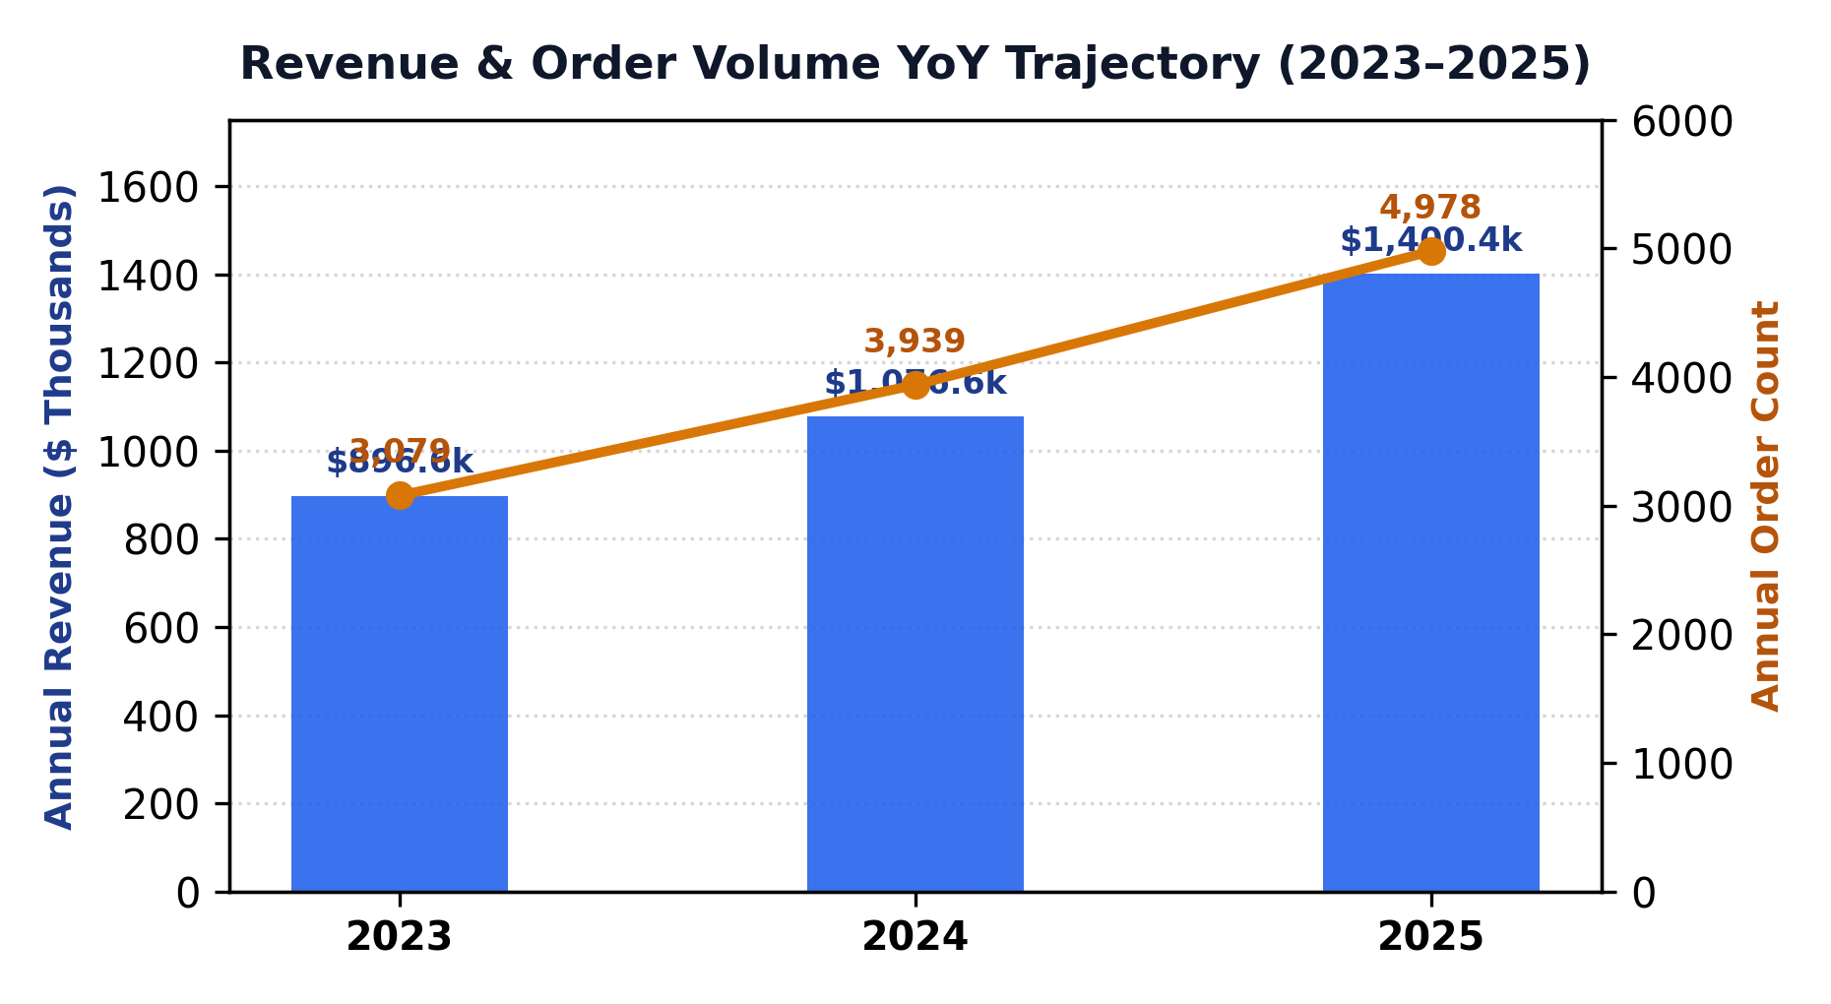
TOP-LINE PERFORMANCE
Revenue & Order Volume Trajectory (2023–2025)
Annual sales climbed from $896.6k to $1.40M (+56.2%) driven by order volume expansion (+61.7%), while AOV held steady at ~$281.
Top-Line Growth Dynamics (2023–2025)
• 2023: $896,588 Sales | 3,079 Orders | 524 Customers | AOV $291.19
• 2024: $1,076,644 Sales (+20.1%) | 3,939 Orders | 1,003 Customers | AOV $273.33
• 2025: $1,400,397 Sales (+30.1%) | 4,978 Orders | 1,376 Customers | AOV $281.32
Key Strategic Insights:
• Overall 3-year revenue growth: +56.2%; order volume growth: +61.7%.
• Stable Average Order Value (~$281) proves growth is volume-driven.
• Top 20% of customers generate 66.1% of revenue ($2.23M).
• Customer base nearly tripled (+162.6%), subsidized by aggressive price discounts.
Simulated Omnichannel Retail Data (2023–2025) | Audited Stage 4 ROI Engine | Capstone Deliverable
Slide 6 of 15

Slide 7
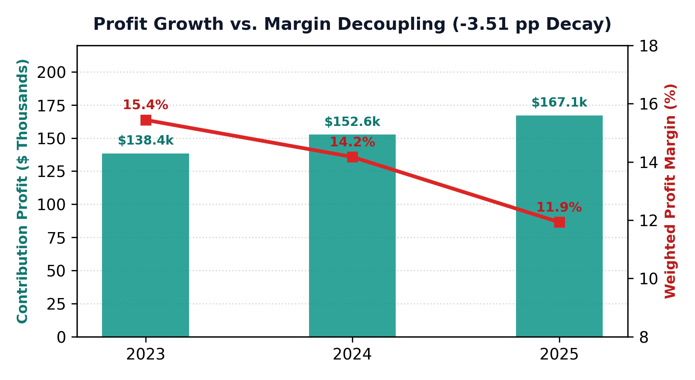
MARGIN DIAGNOSIS
Profitability Diagnosis: The Growth vs. Margin Decoupling
While annual revenue grew +56.2%, dollar profit grew only +20.7%, resulting in a net -3.51 percentage point collapse in contribution margin.
Product Category Margin Asymmetry
• Office Supplies: $432,492 Sales (12.8%) | $152,229 Profit | 35.20% Margin
• Furniture: $1,293,350 Sales (38.3%) | $157,456 Profit | 12.17% Margin
• Technology: $1,647,786 Sales (48.8%) | $148,373 Profit | 9.00% Margin
• Total Portfolio: $3,373,628 Sales | $458,058 Profit | 13.58% Margin
Diagnostic Takeaway:
• Growth was concentrated in Technology (48.8% sales) and Furniture (38.3%),
which carry weak gross margins and high freight/marketplace fees.
• Office Supplies earns one third of company profit on just 13% of revenue.
• While revenue expanded +56%, margin collapsed by -3.51 percentage points.
Simulated Omnichannel Retail Data (2023–2025) | Audited Stage 4 ROI Engine | Capstone Deliverable
Slide 7 of 15

Slide 8
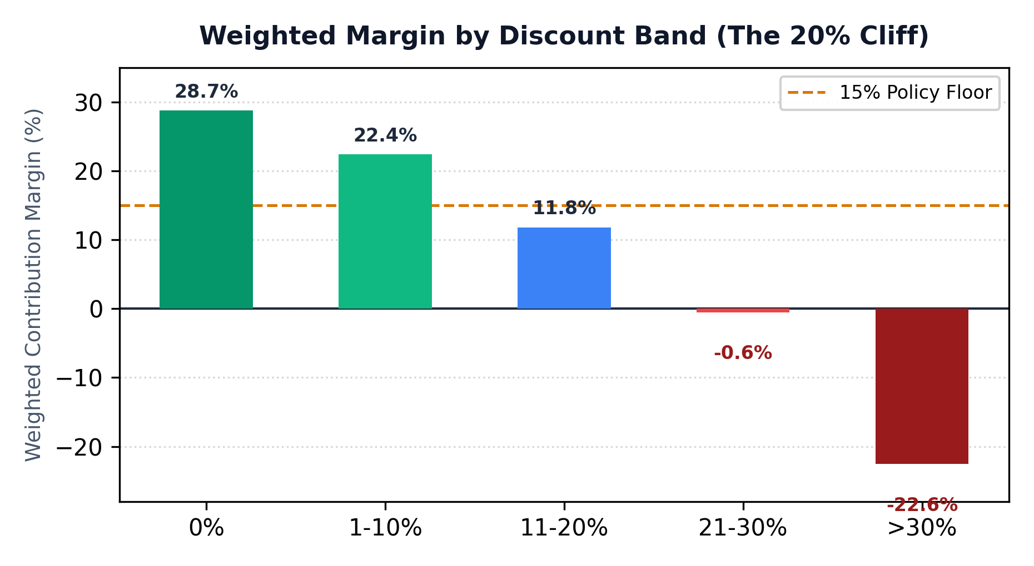
PRICING ECONOMICS
Discount Economics: The 20% Discount Loss Cliff
Discounts above 20% destroy unit profitability: 1,605 orders generated -$40,094 in direct losses. Blunt cancellations risk customer contagion.
The 20% Discount Cliff & Contagion Risk
Margin Trajectory by Discount Band:
• 0% Discount: 28.74% Margin | 4 Loss Orders (0.1%)
• 1–10% Discount: 22.37% Margin | 19 Loss Orders (0.8%)
• 11–20% Discount: 11.79% Margin | 215 Loss Orders (7.3%)
• 21–30% Discount: -0.56% Margin | 487 Loss Orders (25.0%)
• >30% Discount: -22.55% Margin | 854 Loss Orders (54.7%)
Critical Contagion Disclosure:
• 1,605 orders >20% discount generated -$40,094 in direct losses.
• These orders belong to 825 customers who ALSO generated $741,419
in sales and $152,140 in profit on profitable orders (<=20% discount).
• Blunt cancellations risk triggering customer attrition. Basket margin
rules and escalation workflows preserve relationship lifetime value.
Simulated Omnichannel Retail Data (2023–2025) | Audited Stage 4 ROI Engine | Capstone Deliverable
Slide 8 of 15

Slide 9
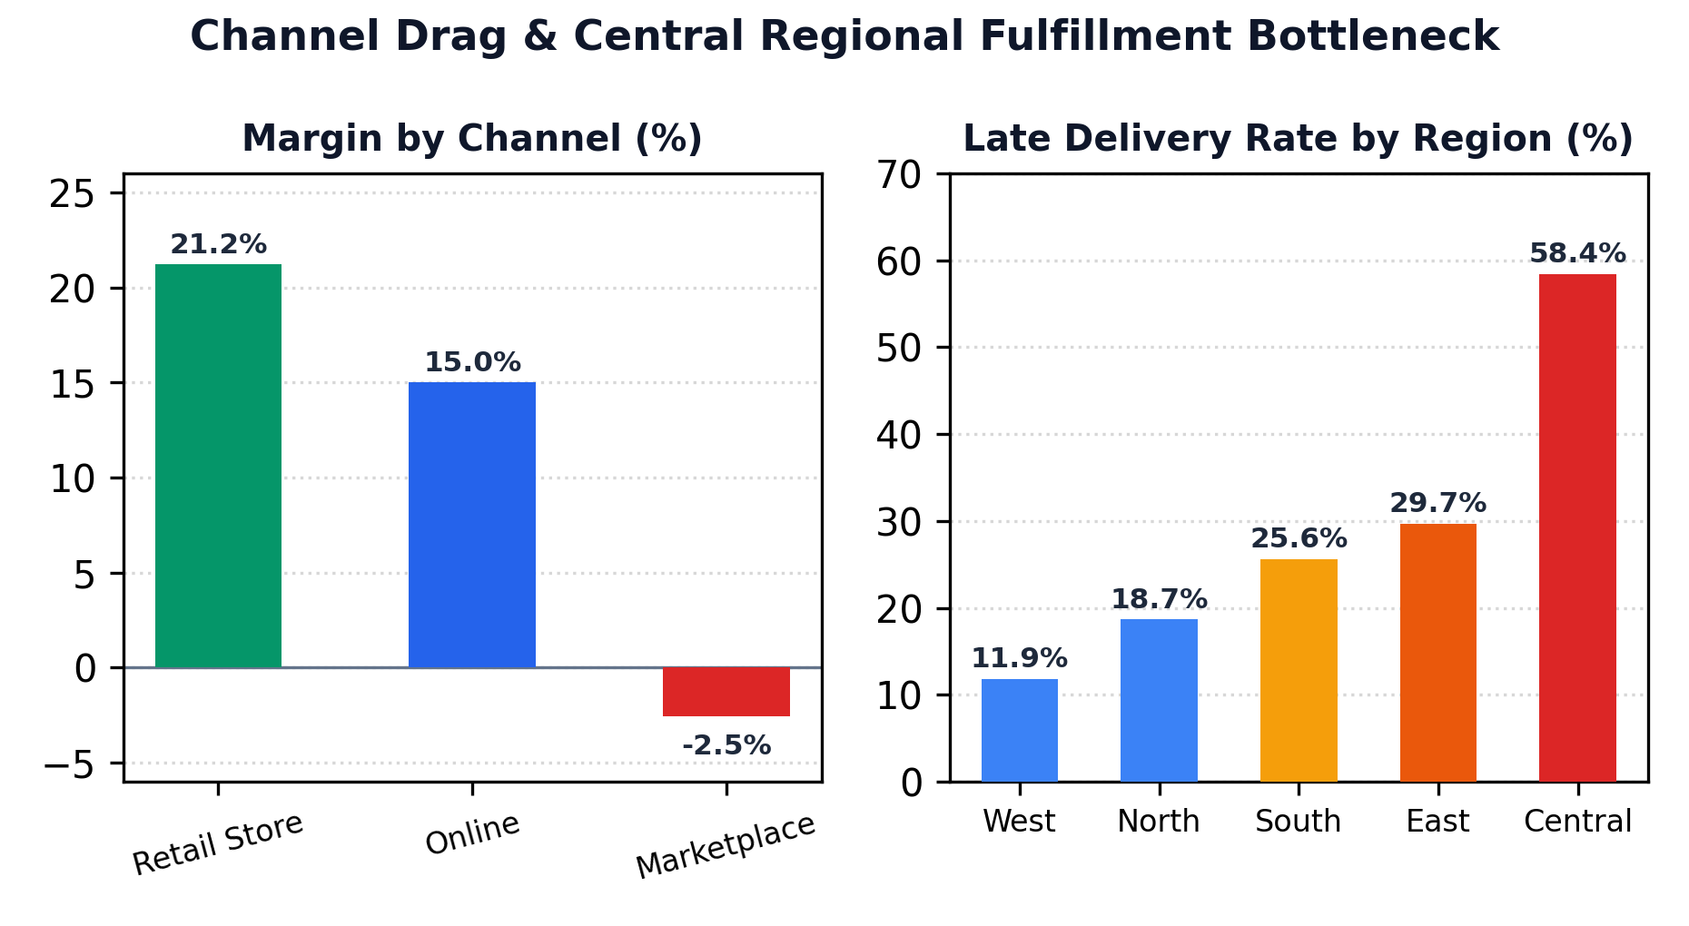
CHANNEL & REGIONAL MIX
Channel Economics & Regional Operational Bottlenecks
Marketplace revenue share expanded to 26% while losing -2.55% on every dollar sold. Central region logistics suffer a 58.4% late delivery rate.
Channel Economics & Central Logistics Failure
Channel Economics:
• Retail Store: $1.16M Sales (34.4%) | $245.9k Profit | 21.22% Margin
• Online Store: $1.53M Sales (45.4%) | $229.6k Profit | 15.00% Margin
• Marketplace: $684.1k Sales (20.3%) | -$17.4k Profit | -2.55% Margin
• Marketplace mix expanded from 12.3% to 26.2%, cannibalizing profits.
Regional Fulfillment Bottleneck:
• West (11.9% late) and North (18.7% late) perform reliably.
• Central region delivered 573 of 981 orders late (58.41% late delivery rate).
• Carrier contracts lack SLA penalties, causing massive delivery backlogs.
Simulated Omnichannel Retail Data (2023–2025) | Audited Stage 4 ROI Engine | Capstone Deliverable
Slide 9 of 15

Slide 10
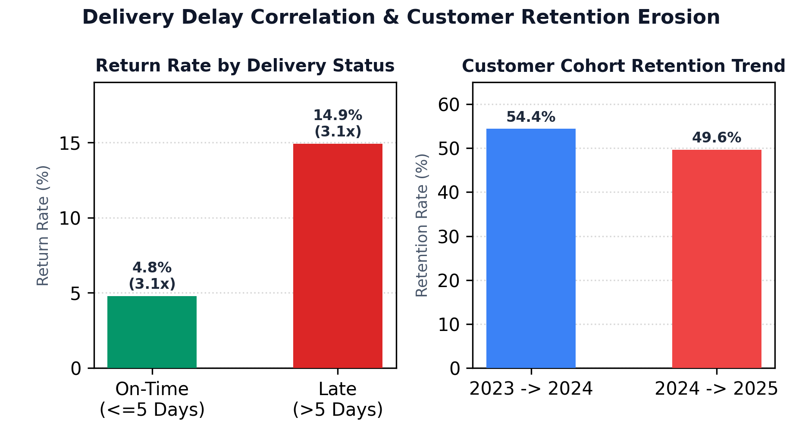
FULFILLMENT & RETENTION
Delivery Timeliness, Return Rates & Retention Erosion
Late deliveries suffer a 14.9% return rate (3.1x on-time rate). Annual customer retention dropped from 54.4% to 49.7% (-4.7 pp).
Delivery Delays, Returns, & Customer Retention
Statistical Hypothesis 3 Results:
• On-time deliveries (<=5 days): 4.78% return rate across 9,266 orders.
• Late deliveries (>5 days): 14.91% return rate across 2,730 orders (3.1x higher).
• Welch's t-test: t = 14.13, p = 4.80e-44 (statistically significant).
Customer Retention Erosion:
• Annual cohort retention dropped from 54.39% to 49.65% (-4.7 pp).
• 95.0% of orders come from repeat buyers; losing loyalty destroys LTV.
Observational Caveat:
• Historical association does not prove counterfactual causation. While late
deliveries correlate with returns, returns also depend on category sizing
and buyer expectations.
Simulated Omnichannel Retail Data (2023–2025) | Audited Stage 4 ROI Engine | Capstone Deliverable
Slide 10 of 15

Slide 11
RECOMMENDATION 1
Recommendation 1: Automated Discount Guardrails
Cap standard checkout discounts at 20% and enforce a 15% minimum basket margin. Uplift: +$66,332/yr | Payback: Month 3.
Policy & System Architecture
• 20% Hard Ceiling at Checkout
Configure e-commerce checkout and ERP order entry
to reject single-item discounts exceeding 20%.
• 15% Basket Margin Floor
Enforce total order contribution margin check.
Orders falling below 15% margin trigger escalation.
• Tiered Commercial Escalation
Discounts 15%–20% require Sales Director approval;
discounts >20% require Regional VP sign-off.
• Daily Margin Exception Audit
Automated daily audit to CFO detailing rep compliance.
Audited Financial Business Case
Base-Case 36-Month Projections:
• Annual Steady-State Uplift: +$66,331.86/yr
• Annual Revenue Delta: +$58,959.97/yr
• Implementation Capex: $10,000.00
• Annual Recurring Opex: $3,999.96/yr
• 36-Month Total Cost: $21,999.88
• 36-Month Net Cash Benefit: +$171,468.04
• Net ROI: 779.40%
• Breakeven Payback: Month 3 (Immediate)
Fast Cash Generation:
• Rec 1 self-funds the entire turnaround portfolio.
Contagion Mitigation & Roadmap
Preventing Customer Churn Contagion:
• 825 buyers of >20% discounted goods also deliver
$741k in profitable purchases.
• Transition large buyers from transactional discounts
to structured annual volume rebates.
• Realine sales incentives to contribution profit dollars.
Implementation Roadmap:
• Month 1: ERP pricing logic configuration ($5k).
• Month 2: Sales team enablement & training ($5k).
• Month 3: Go-live on direct online & retail stores.
• Owner: VP Sales & Chief Commercial Officer.
Simulated Omnichannel Retail Data (2023–2025) | Audited Stage 4 ROI Engine | Capstone Deliverable
Slide 11 of 15

Slide 12
RECOMMENDATION 2
Recommendation 2: Marketplace Margin Repair
Renegotiate platform fees by 1.0 pp, impose a 10% channel discount cap, and prune unprofitable SKUs. Uplift: +$29,352/yr | Payback: Month 12.
Three-Pillar Margin Recovery
• Pillar 1: 1.0 pp Fee Cut (15% -> 14%)
Leverage annual platform volume ($684k) to
negotiate a 1.0 pp reduction in platform take-rate.
• Pillar 2: 10% Channel Discount Cap
Impose a strict 10% maximum promotional ceiling
on all marketplace listings to protect margins.
• Pillar 3: Catalog Rationalization
Delist low-margin, bulky Furniture and Tech
accessories with gross margins below 25%.
• Pillar 4: Direct Channel Redirection
Insert branded packaging cards offering $10 welcome
vouchers for direct online web store purchases.
Audited Financial Business Case
Base-Case 36-Month Projections:
• Annual Steady-State Uplift: +$29,352.04/yr
• Annual Revenue Delta: +$20,869.23/yr
• Implementation Capex: $12,000.00
• Annual Recurring Opex: $6,000.00/yr
• 36-Month Total Cost: $29,000.00
• 36-Month Net Cash Benefit: +$48,049.10
• Net ROI: 165.69%
• Breakeven Payback: Month 12
Marketplace Contribution:
• Transforms channel from -$17.4k loss to +$12k profit.
Negotiation Governance & Risks
Negotiation Strategy & Leverage:
• Position company as high-volume tier-1 seller.
• Offer catalog exclusivity and co-op ad spend.
• Fallback sensitivity: Even if fee cut is 0.0 pp,
discount controls and SKU pruning net +$189.5k.
Implementation Roadmap:
• Month 4: Open platform fee negotiations.
• Month 5: Channel listing automation setup ($12k).
• Month 6: Enforce 10% cap and prune 45 SKUs.
• Month 12: Payback reached; full run-rate.
• Owner: VP E-Commerce & Marketplace Lead.
Simulated Omnichannel Retail Data (2023–2025) | Audited Stage 4 ROI Engine | Capstone Deliverable
Slide 12 of 15

Slide 13
RECOMMENDATION 3
Recommendation 3: Delivery SLA & Customer Retention Overhaul
Overhaul Central region 3PL logistics to reduce late deliveries from 58% to 15%. Standalone deficit: -$18.8k; strategic brand investment.
Logistics Overhaul Plan
• Central Carrier Re-Contracting
Terminate underperforming exclusive 3PL contract;
onboard secondary regional carrier in Central.
• Strict SLA Penalty Guarantees
Contractually enforce 95% on-time delivery with
freight credit penalties on late orders.
• Hub Re-Routing
Re-route shipments through Dallas/Chicago hubs,
cutting Central transit time by 2.2 days.
• Proactive Customer Outreach
Automated delivery tracking SMS and proactive $15
gift credits for delayed packages.
Audited Financials & Deficit
Standalone Economics (Base Case):
• Annual Return Cost Savings: +$1,911.00/yr
• Annual Retention Profit: +$5,402.52/yr
• Total Annual Benefit: +$7,313.52/yr
• Annual Recurring Opex: $9,000.00/yr
• Net Annual Run-Rate: -$1,686.48/yr (Deficit)
• Implementation Capex: $12,000.00
• 36-Month Total Cost: $35,250.00
• 36-Month Net Cash: -$18,794.58 (Deficit)
• Net ROI: -53.32%
• Standalone Payback: Never (>36 Months)
Transparent disclosure of operating drag.
Strategic Justification & Options
Executive Decision Options:
• Option A: Cost Redesign
Re-scope carrier software integrations to compress
opex from $9.0k to $5.0k/yr, reaching breakeven.
• Option B: 6-Month Pilot Validation
Run pilot in Central to validate whether retention
uplift exceeds modeled +4.5 pp before full rollout.
• Option C: Strategic Brand Approval (Rec.)
Approve as essential brand & SLA investment.
Funded by portfolio surplus from Rec 1 ($171k) and
Rec 2 ($48k). Combined portfolio nets +$200.7k cash.
• Owner: VP Supply Chain & COO.
Simulated Omnichannel Retail Data (2023–2025) | Audited Stage 4 ROI Engine | Capstone Deliverable
Slide 13 of 15

Slide 14
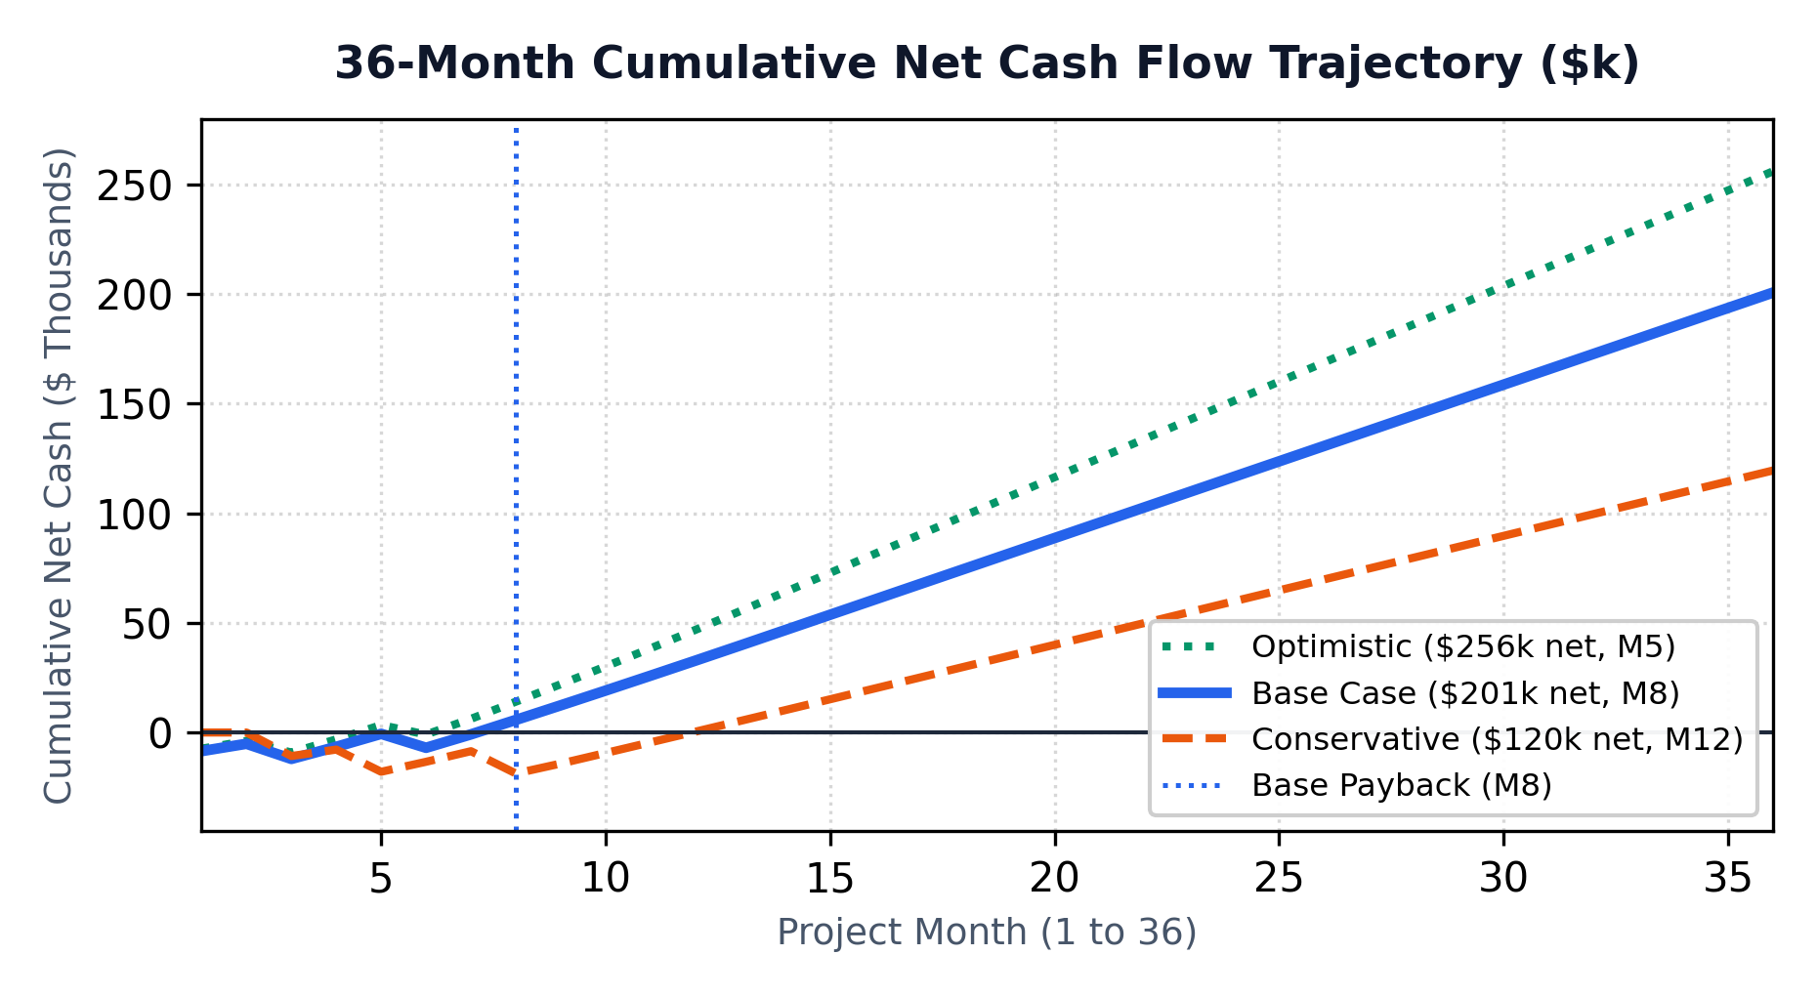
PORTFOLIO FINANCIAL MODEL
Financial Business Case: Multi-Scenario ROI & Sensitivity
Audited 36-month portfolio delivers $200,723 net cash benefit (232.7% ROI, Month 8 payback). Positive across all sensitivity stress tests.
Audited Multi-Scenario Financial Case
Portfolio Performance Matrix:
• Conservative: +$82.5k/yr Uplift | $99.7k Total Cost | +$119,555 Net Cash | 119.9% ROI | Payback M12 | NPV $97,798
• Base Case: +$103.0k/yr Uplift | $86.2k Total Cost | +$200,723 Net Cash | 232.7% ROI | Payback M8 | NPV $168,399
• Optimistic: +$121.8k/yr Uplift | $77.6k Total Cost | +$256,068 Net Cash | 329.9% ROI | Payback M5 | NPV $215,709
Sensitivity Robustness (7 Dimensions):
• Cost Overrun (+20% Capex/Opex): Net cash remains $183.5k; ROI 177.3%.
• Implementation Delay (+2 Mos): Net cash remains $186.7k; payback M10.
• Marketplace Fee Cut Stalled (0.0 pp): Net cash remains $189.5k; payback M8.
• 100% of tested sensitivity scenarios produce strongly positive NPV.
Simulated Omnichannel Retail Data (2023–2025) | Audited Stage 4 ROI Engine | Capstone Deliverable
Slide 14 of 15

Slide 15
TURNAROUND EXECUTION
Implementation Roadmap, Governance & Executive Decision
A 12-month phased turnaround plan with clear ownership, milestone gates, and four explicit leadership decisions required today.
12-Month Phased Rollout
• Q1 (Months 1–3): Quick Wins & Cash Inflow
Deploy Rec 1 discount guardrails (20% cap).
Cash payback achieved in Month 3.
Initiate Central 3PL carrier audit.
• Q2 (Months 4–6): Marketplace Alignment
Renegotiate marketplace fees (-1 pp).
Implement 10% discount cap & prune 45 SKUs.
Launch Central SLA carrier pilot.
• Q3 (Months 7–9): System Rollout
Deploy automated delivery tracking and alerts.
Combined portfolio reaches breakeven in Month 8.
• Q4 (Months 10–12): Steady-State Optimization
Achieve full steady-state uplift (+$103k/yr).
Executive Ownership Matrix
• Rec 1 Lead: VP Sales & Chief Commercial Officer
Enforce 15% basket margin; sales quota alignment.
Target: % orders >20% discount < 3.0%.
• Rec 2 Lead: VP E-Commerce & Marketplace
Lead fee negotiations and catalog delistings.
Target: Marketplace margin > +4.0%.
• Rec 3 Lead: VP Supply Chain & COO
Logistics contracts, warehouse SLAs, transit alerts.
Target: Central late delivery rate < 15.0%.
• Financial Governance: CFO & Controller
Monthly variance reviews against Stage 4 budget.
Decisions Requested Today
1. Approve $34k Initial Capex Allocation
Authorize immediate $34,000 funding across the
three initiatives to begin software and carrier work.
2. Mandate 20% Discount Ceiling Policy
Approve commercial policy enforcing 20% cap and
15% basket minimum margin effective Month 1.
3. Authorize Marketplace Fee Negotiations
Direct commercial team to open contract talks and
enforce 10% listing discount ceiling.
4. Endorse Rec 3 SLA Strategic Investment
Approve Central logistics overhaul as a strategic
mandate funded by portfolio cash surplus.
Simulated Omnichannel Retail Data (2023–2025) | Audited Stage 4 ROI Engine | Capstone Deliverable
Slide 15 of 15

