Slide 1

SENTINELNET
Multi-Agent Adversarial Network Defense Planner
Foundations of Artificial Intelligence • Case Study Project
A* Search | Bayesian Inference | Minimax + Alpha-Beta | CSP Scheduling
1 / 14

Slide 2
AGENDA
01
Problem Statement & Big Picture
02
PEAS Formulation
03
Network Environment & Properties
04
Red Agent — A* Search
05
Blue Agent 1 — Bayesian Belief Tracking
06
Blue Agent 2 — Minimax / Alpha-Beta / Expectimax
07
Blue Agent 3 — CSP Patch Scheduler
08
Multi-Agent Coordination (Message Bus)
09
Simulation Loop & Dashboard
10
Demo Scenarios & Testing
11
Results & Metrics
12
Code Structure & Scalability
13
Q&A
2 / 14

Slide 3
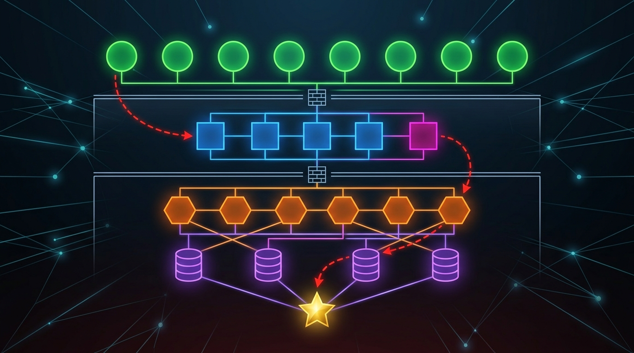
PROBLEM STATEMENT
The Challenge
Enterprise networks face persistent, evolving cyber threats
Attackers use sophisticated pathfinding to reach critical assets
Defenders must detect, respond, and patch under uncertainty
Our Solution: SentinelNet
Abstract simulation — no real exploits or scanning
Red Agent (attacker) vs Blue Team (3 defender agents)
Tick-by-tick adversarial game on a directed graph network
4 distinct AI algorithms, each justified by problem features
Key Question
Can coordinated AI defenders protect a crown jewel asset
against an intelligent attacker under partial observability?
Rubric Coverage
PEAS Formulation — 3 Marks
Environment & Agent Analysis — 3 Marks
Algorithmic Modeling — 3 Marks
Tool/Package Selection — 3 Marks
Multi-Agent Interaction — 3 Marks
Demo & Testing — 3 Marks
Code Structure & Scalability — 1+1 Marks
3 / 14

Slide 4
PEAS FORMULATION
P — Performance
Uptime fraction (% nodes operational)
Compromise value (weighted severity)
Time-to-Detection (TTD in ticks)
Response cost (actions expended)
Utility = 10·uptime − 5·comp − 0.5·cost
E — Environment
Directed graph: 20–500 nodes
Partially Observable (noisy IDS alerts)
Stochastic (exploit probability = vuln_score)
Dynamic (Red moves each tick)
Competitive (Red vs Blue) + Cooperative (Blue team)
A — Actuators
ISOLATE — disconnect node from graph
PATCH — reduce vuln_score to near zero
RESTORE — bring isolated node back online
Red: MOVE + EXPLOIT along graph edges
S — Sensors
IDS alerts (noisy, probabilistic)
detection_rate: P(alert | Red present)
false_alarm_rate: P(alert | Red absent)
Node state queries (after action)
Belief distribution (Monitor output)
4 / 14

Slide 5
ENVIRONMENT & NETWORK TOPOLOGY
Environment Properties
▸ Partially Observable
Blue sees noisy IDS alerts, not Red's true location
▸ Stochastic
Exploit success = vuln_score probability
▸ Sequential
Tick-by-tick decisions affect future state
▸ Dynamic
Red moves independently each tick
▸ Multi-Agent
Red (competitive) + Blue team (cooperative)
▸ Discrete
Finite nodes, edges, and action set
🟢 Safe 🟡 Suspected 🔴 Compromised ⚪ Isolated 🔵 Patching 🟣 Honeypot 🎯 Crown Jewel
5 / 14

Slide 6
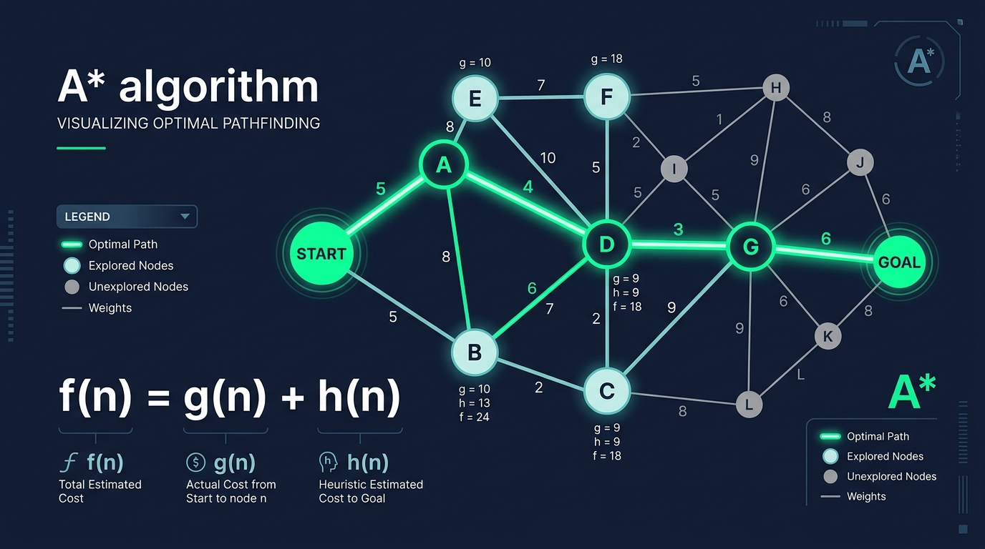
RED AGENT — A* SEARCH
How the Attacker Works
Goal: Reach the Crown Jewel node via the cheapest path
A* Evaluation Function
f(n) = g(n) + h(n)
g(n) — actual cost from entry to node n
h(n) — BFS-based heuristic (admissible, consistent)
Key Behaviors
Each tick: move to next node on A* path
Exploit attempt: success probability = vuln_score
Dynamic Replanning: if Blue isolates a path node, Red replans from current position
IDS Alert Generation
True alert: P(alert) = detection_rate when Red exploits
False alarm: P(alert) = false_alarm_rate on random clean nodes
This noise is what makes the Monitor's job hard!
6 / 14

Slide 7
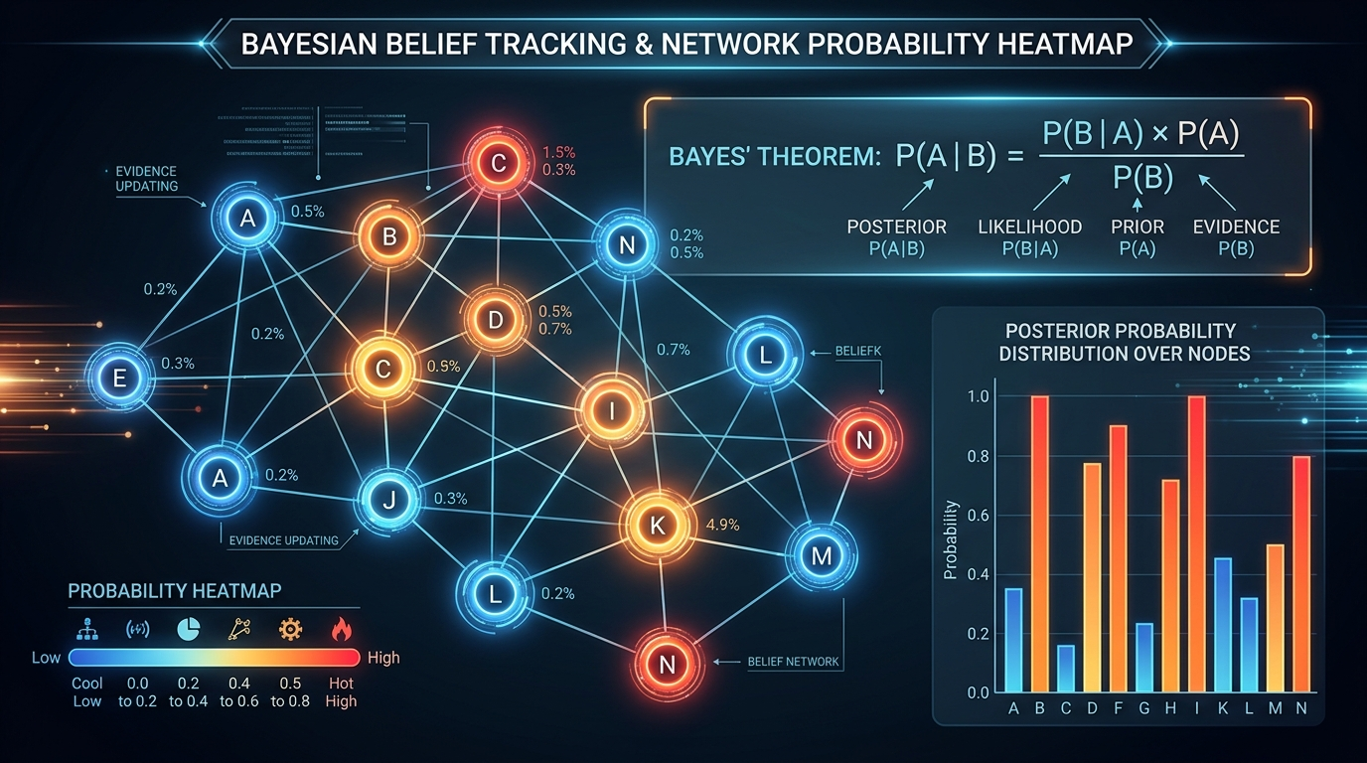
BLUE AGENT 1 — MONITOR (BAYESIAN BELIEF)
Belief Tracking Under Uncertainty
The Monitor never sees Red directly — only noisy IDS alerts.
Step 1: Bayesian Update
P(Red at X | alert at X) ∝ detection_rate × prior(X)
P(Red at Y | alert at X) ∝ false_alarm_rate × prior(Y)
Normalize so all probabilities sum to 1.0
Step 2: Spatial Diffusion
P(Red stays at current node) = 0.6
P(Red moves to neighbour) = 0.4 / N_neighbours
Models attacker movement between observations
Output
Live 'heat map' of suspicion published to Message Bus
Top-5 most-suspected nodes shown in dashboard bar chart
Response agent reads belief to choose defensive moves
7 / 14

Slide 8
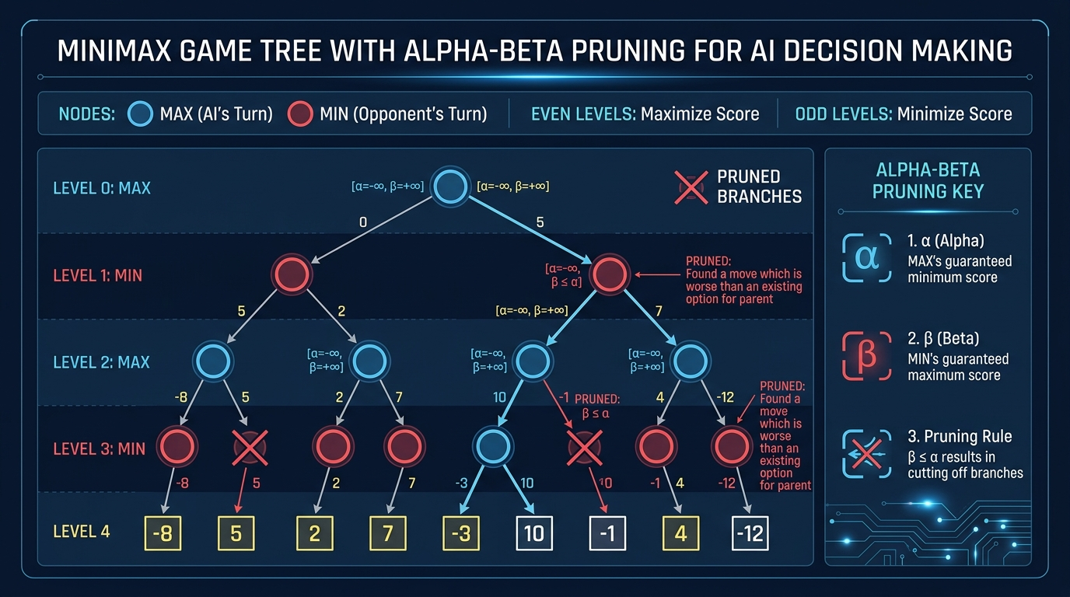
BLUE AGENT 2 — RESPONSE (MINIMAX + EXPECTIMAX)
Game-Tree Decision Making
Minimax with Alpha-Beta Pruning
2-player zero-sum game model
Blue (MAX): choose action maximizing utility
Red (MIN): assume worst-case attacker response
Alpha-Beta: prune branches → O(b^(d/2)) speedup
Expectimax Enhancement
Replace MIN nodes with CHANCE nodes
E[val] = vuln × V(success) + (1-vuln) × V(failure)
More realistic — Red doesn't always succeed
Utility Function
U = 10 × uptime − 5 × comp_value − 0.5 × cost
Actions: ISOLATE | PATCH | RESTORE
8 / 14

Slide 9
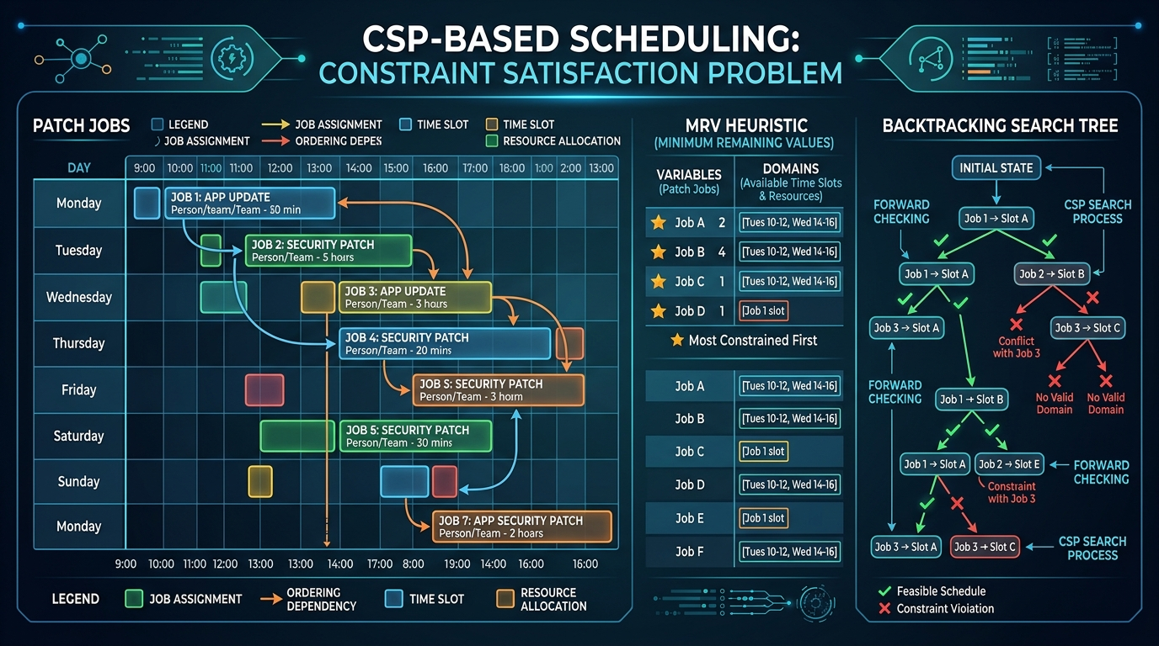
BLUE AGENT 3 — CSP PATCH SCHEDULER
Long-Term Vulnerability Management
CSP Formulation
Variables: patch jobs (one per vulnerable node)
Domains: available maintenance time slots
Constraints:
  • Maintenance window bounds
  • Dependency ordering: slot(A) < slot(B)
  • AllDifferent: no two jobs share a technician slot
Solver Optimizations
MRV (Minimum Remaining Values): pick most constrained variable first → find conflicts early
Forward Checking: after assignment, prune remaining domains → avoid deep dead-ends
Backtracking: systematic exploration with early termination
Execution: runs every 5 ticks, applies next patch job
9 / 14

Slide 10
MULTI-AGENT COORDINATION — MESSAGE BUS
Blackboard Architecture — Pub/Sub Message Bus
Monitor ──[belief]──→ Message Bus ──[belief]──→ Response
↑ │
[alerts] [actions]
│ ↓
Red ────────────────→ Graph (Env)
│
Scheduler ←──[pending_jobs]───────────────────────────┘
└──[patch_plan]──→ Message Bus
Topic: alerts
Topic: belief
Topic: actions
Topic: patch_plan
IDS detection events from Red's actions
Probability map over all nodes (from Monitor)
Defensive moves chosen by Response agent
CSP schedule of upcoming patch jobs
10 / 14

Slide 11
SIMULATION LOOP & LIVE DASHBOARD
One Tick of the Simulation
1. Red.step()
Move via A*, attempt exploit, generate alerts
2. bus.publish()
Emit IDS detection events
3. Monitor.step()
Bayesian update + diffusion → publish belief
4. Response.step()
Minimax/Expectimax → dispatch defensive action
5. Scheduler.step()
Every 5 ticks: run CSP, apply next patch
6. Logger.record()
Save tick metrics (TTD, uptime, state)
7. Check termination
Crown jewel compromised? Red captured? Max ticks?
Streamlit Dashboard Layout
Left (60%) Right (40%)
┌──────────────┐ ┌──────────────────┐
│ Live Network │ │ 📊 Metrics Cards │
│ Graph (Pyvis)│ ├──────────────────┤
│ │ │ 🔍 Belief Chart │
│ 🟢🟡🔴⚪🔵🟣│ ├──────────────────┤
│ 🎯 Red here │ │ 📋 Action Log │
└──────────────┘ └──────────────────┘
[▶ Run] [⏸ Pause] [⏭ Step] [🔄 Reset]
Technologies:
Streamlit — interactive web UI
Pyvis — network graph visualization
Real-time metric cards + belief bar chart
11 / 14

Slide 12
DEMO SCENARIOS & TESTING
#1
Baseline
Crown jewel compromised fast — floor metric
Naive Red vs Random Defender
#2
Stealthy Attacker
Belief tracking still concentrates on Red
detection_rate = 0.25
#3
Multi-Entry
Response must prioritize; one may slip through
Two Red entry points
#4
Resource-Starved
CSP scheduling becomes critical
1 action per 2 ticks
#5
Scalability
Watch nodes_expanded and wall-clock time
✅ Test Suite: 57/57 Tests Passing
test_astar (8) | test_belief_tracking (11) | test_minimax (14) | test_csp_scheduler (13) | test_integration (11)
20 → 100 → 500 nodes
12 / 14

Slide 13
CODE STRUCTURE & SCALABILITY
Project Structure
sentinelnet/
├── config/
│ ├── network_small.yaml (20 nodes)
│ ├── network_medium.yaml (100 nodes)
│ ├── network_large.yaml (500 nodes)
│ └── scenarios.yaml (5 scenarios)
├── sentinelnet/
│ ├── agents/
│ │ ├── red_attacker.py (A*)
│ │ ├── monitor.py (Bayesian)
│ │ ├── response.py (Minimax)
│ │ └── patch_scheduler.py (CSP)
│ ├── coordination/
│ │ └── message_bus.py (Blackboard)
│ ├── environment/
│ │ ├── network_graph.py (NetworkX)
│ │ ├── events.py (Dataclasses)
│ │ └── simulator.py (Tick loop)
│ ├── baselines/
│ │ ├── random_defender.py
│ │ └── greedy_defender.py
│ ├── metrics/logger.py
│ └── viz/dashboard.py (Streamlit)
├── tests/ (57 tests)
├── requirements.txt
└── README.md
Scalability
Config-driven topology: change YAML → scale graph
20-node (demo) → 100-node → 500-node tested
Random graph generator for arbitrary sizes
Modular architecture: swap/add agents without changing core
Technology Stack
Python 3.11 — Core language
NetworkX — Graph data structures & algorithms
PyYAML — Configuration management
Streamlit — Interactive web dashboard
Pyvis — Network graph visualization
python-constraint — CSP solver (fallback)
pytest — Testing framework
13 / 14

Slide 14
THANK YOU
Questions & Answers
SentinelNet • Multi-Agent Adversarial Network Defense Planner
github.com/surya-8143/FOAI
14 / 14

