Slide 1
Bayesian networks
A simple, graphical notation for conditional independence assertions and hence for compact specification of full joint distributions
Syntax:
a set of nodes, one per variable
a directed, acyclic graph (link ≈ "directly influences")
a conditional distribution for each node given its parents:
P (X_{i} | Parents (X_{i}))
In the simplest case, conditional distribution represented as a conditional probability table (CPT) giving the distribution over X_{i} for each combination of parent values

Slide 2
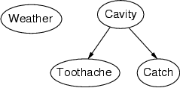
Example
Topology of network encodes conditional independence assertions:
Weather is independent of the other variables
Toothache and Catch are conditionally independent given Cavity

Slide 3
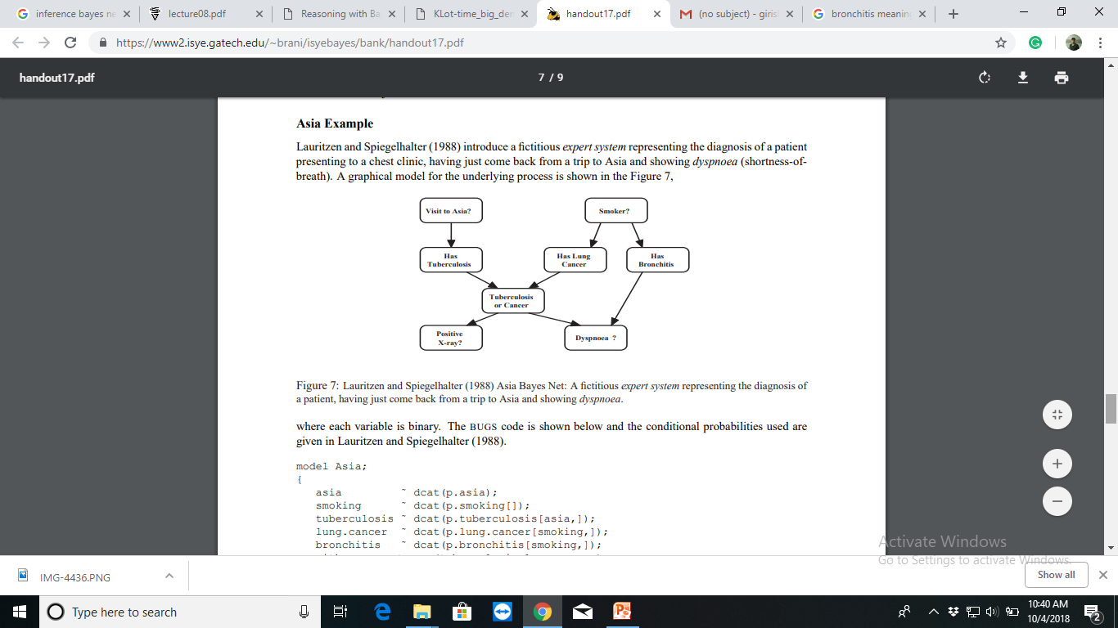

Slide 4
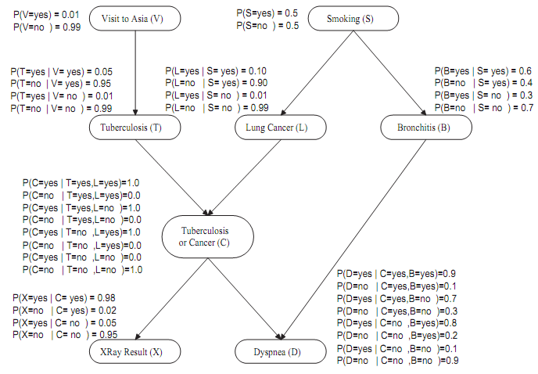

Slide 5
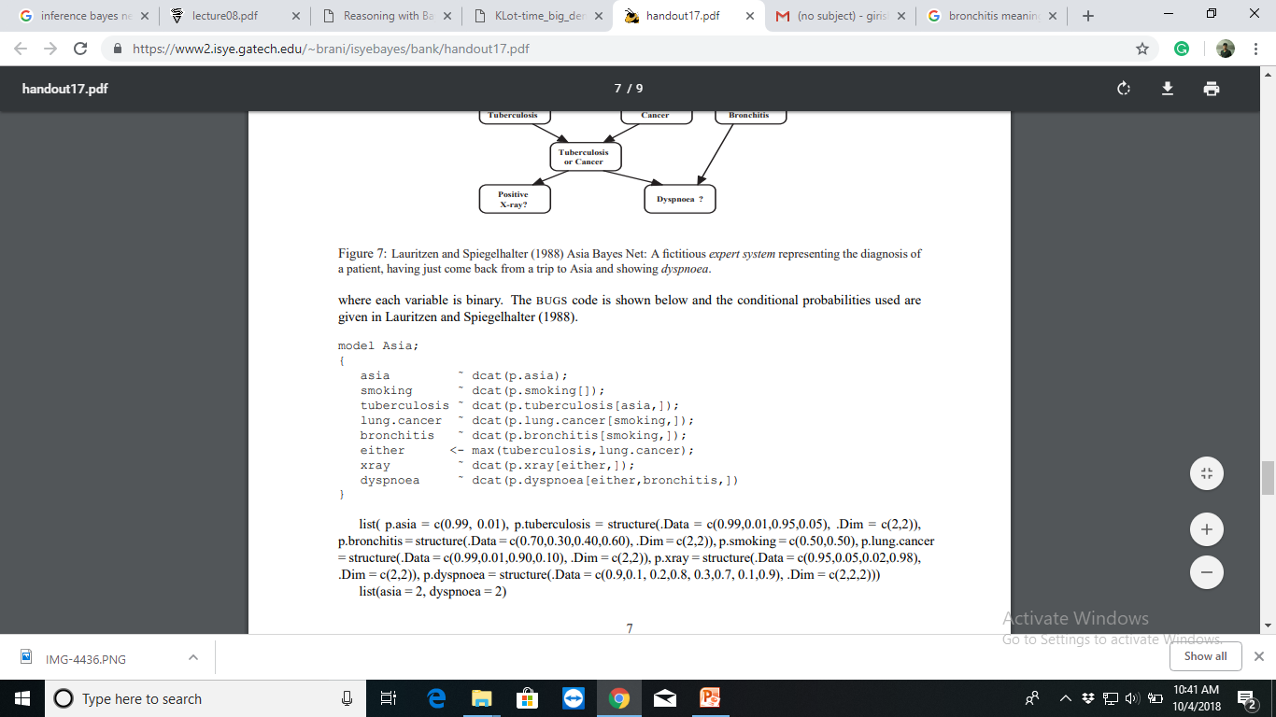

Slide 6
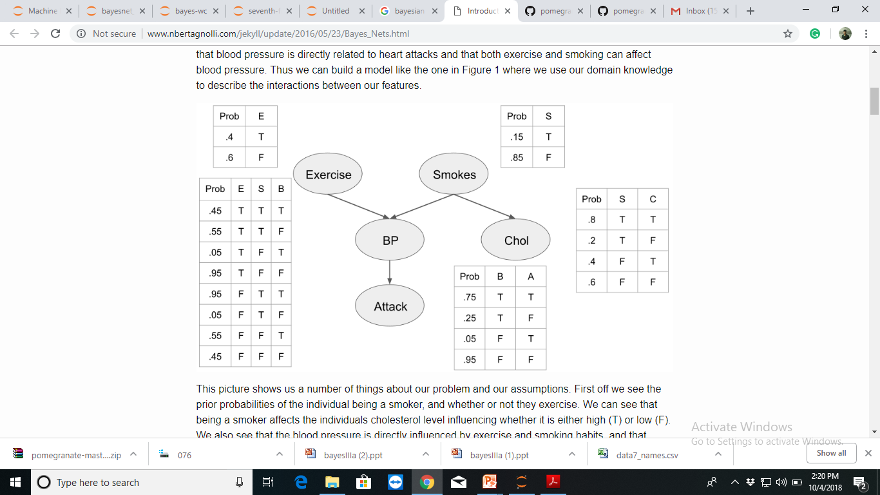

Slide 7
bake()
Finalize the topology of the model.
Assign a numerical index to every state and create the underlying arrays corresponding to the states and edges between the states.
This method must be called before any of the probability-calculating methods.
Parameters: | None
Returns: | None

Slide 8
predict_proba()
Returns the probabilities of each variable in the graph given evidence.
This calculates the marginal probability distributions for each state given the evidence provided through loopy belief propagation
Parameters: data:dict
The evidence supplied to the graph. This can either be a dictionary with keys being state names and values being the observed values .
Returns: probabilities:array-like, shape (n_nodes)
An array of univariate distribution objects showing the probabilities of each variable.

