Slide 1
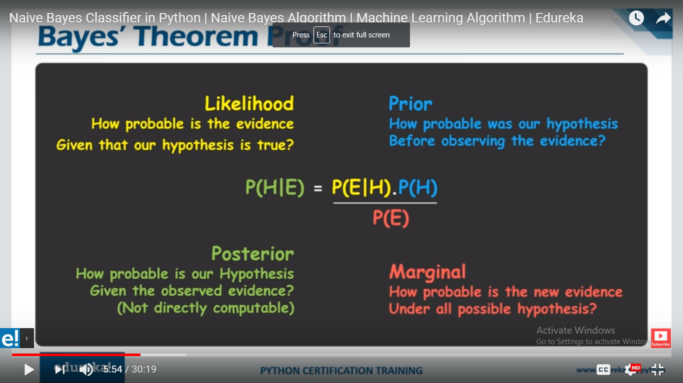

Slide 2
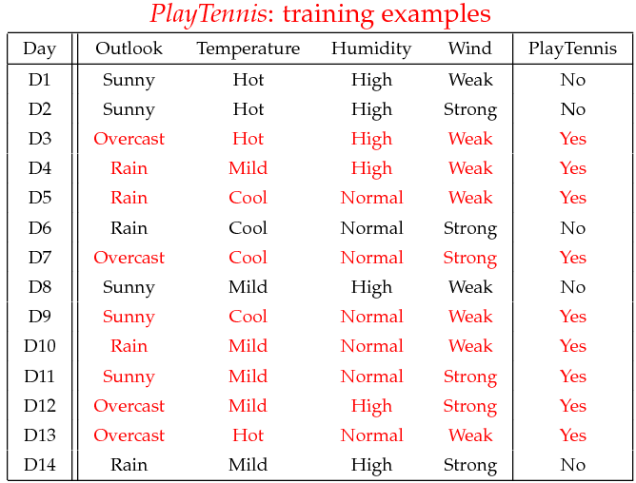
Example
Example: Play Tennis

Slide 3
Example
Learning Phase
Outlook | Play=Yes | Play=No
Sunny | 2/9 | 3/5
Overcast | 4/9 | 0/5
Rain | 3/9 | 2/5
Temperature | Play=Yes | Play=No
Hot | 2/9 | 2/5
Mild | 4/9 | 2/5
Cool | 3/9 | 1/5
Humidity | Play=Yes | Play=No
High | 3/9 | 4/5
Normal | 6/9 | 1/5
Wind | Play=Yes | Play=No
Strong | 3/9 | 3/5
Weak | 6/9 | 2/5
P(Play=Yes) = 9/14
P(Play=No) = 5/14

Slide 4
Example
Test Phase
Given a new instance, predict its label
x’=(Outlook=Sunny, Temperature=Cool, Humidity=High, Wind=Strong)
Look up tables achieved in the learning phrase
Decision making with the MAP rule
P(Outlook=Sunny|Play=Yes) = 2/9
P(Temperature=Cool|Play=Yes) = 3/9
P(Huminity=High|Play=Yes) = 3/9
P(Wind=Strong|Play=Yes) = 3/9
P(Play=Yes) = 9/14
P(Outlook=Sunny|Play=No) = 3/5
P(Temperature=Cool|Play==No) = 1/5
P(Huminity=High|Play=No) = 4/5
P(Wind=Strong|Play=No) = 3/5
P(Play=No) = 5/14
P(Yes|x’) ≈ [P(Sunny|Yes)P(Cool|Yes)P(High|Yes)P(Strong|Yes)]P(Play=Yes) = 0.0053
P(No|x’) ≈ [P(Sunny|No) P(Cool|No)P(High|No)P(Strong|No)]P(Play=No) = 0.0206
Given the fact P(Yes|x’) < P(No|x’), we label x’ to be “No”.

Slide 5
Load the data set
Split the dataset(trainset, testset)
Summarize the data
Separate data by class
Calculate mean
Calculate standard deviation
Summarize data set
Make Predictions
Calculate gaussian probability
Calculate class propbabilty
Make predictions
Calculate the accuracy

