Slide 1
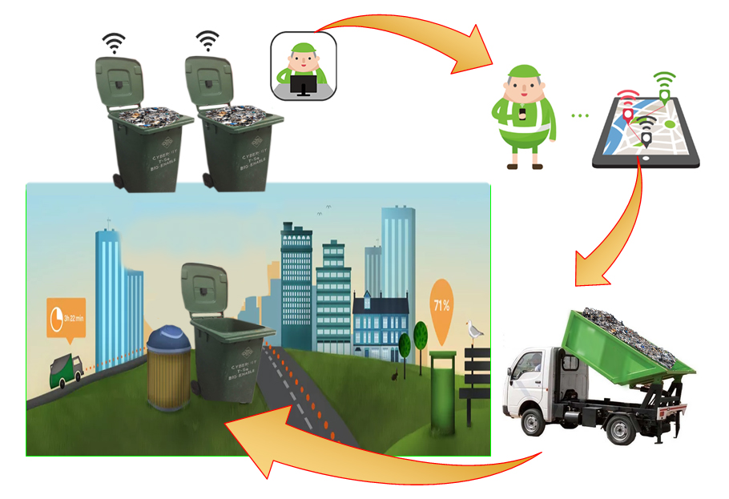
Smart Dustbin With GPS Tracking

Slide 2
CONTENTS
Introduction
Abstract
Problem statement
Literature Review
Block Diagram
Hardware specifications
Design implementation
Future Plan

Slide 3
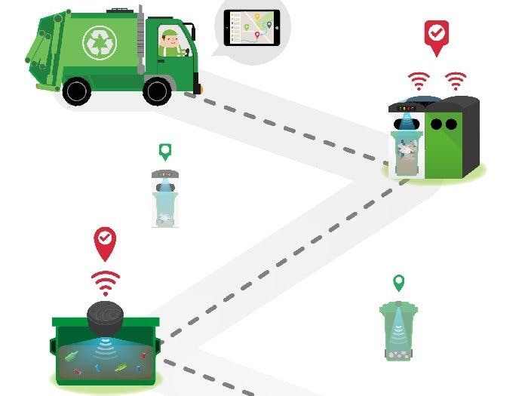
INTRODUCTION
Rapid urbanization and environmental concerns have driven the need for efficient waste management. Traditional collection methods are often inefficient, leading to overflowing bins, unsanitary conditions, and excessive fuel use. To address this, "smart dustbins" with GPS tracking have been developed, allowing for real-time location tracking, fill-level monitoring, and optimized collection routes. These smart bins notify waste management systems when they are full, enabling timely and efficient collections. This approach conserves resources, maintains cleaner public spaces, and supports environmental sustainability, aligning with the goals of smart cities to enhance urban livability and responsibility.

Slide 4
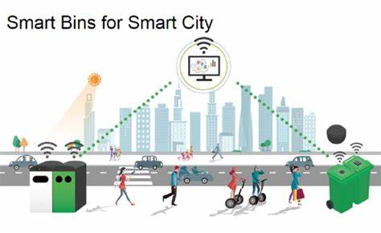
ABSTRACT
This introduces a GPS-enabled smart dustbin to improve waste collection efficiency and urban cleanliness. Equipped with GPS tracking, fill-level sensors, and wireless communication, the smart bin monitors waste levels in real time and relays location and status to a central system. It alerts waste management teams when nearing capacity, enabling optimized collection routes that reduce fuel costs and emissions. Additional features like fire detection, waste segregation, and solar power enhance sustainability. This innovation supports smart city goals, enabling data-driven decisions and fostering sustainable urban development.

Slide 5
PROBLEM STATEMENT
How can we develop a smart, efficient, and scalable system for monitoring garbage levels in bins across urban areas, ensuring timely collection, reducing operational costs, and minimizing environmental impact

Slide 6
LITERATURE REVIEW
1. Technological Integration in Waste Management
IoT and Sensor Technologies: Research by Zhang et al. (2018) emphasizes the integration of Internet of Things (IoT) technologies in waste management. Smart dustbins equipped with sensors can monitor fill levels and environmental conditions. The study demonstrates how these technologies can help cities optimize waste collection schedules, reduce operational costs, and enhance service delivery.
2. Optimizing Waste Collection Routes
Dynamic Routing Algorithms: Ahmed et al. (2019) developed algorithms that utilize real-time data from smart bins to optimize waste collection routes. Their study concluded that integrating GPS data with fill-level information significantly reduces collection time and fuel consumption, leading to a more sustainable waste management approach.

Slide 7
LITERATURE REVIEW
3. Environmental Impact and Sustainability
Reducing Carbon Footprint: Chen et al. (2022) examined the environmental benefits of smart dustbins. The research highlighted that by minimizing fuel consumption and emissions through optimized routing, smart dustbins can significantly contribute to reducing the carbon footprint of waste management operations.
4. Challenges and Limitations
Technical Challenges: Several studies, including Ali et al. (2021), address the technical challenges of deploying smart dustbins, such as connectivity issues in remote areas and sensor reliability. These challenges can hinder the effectiveness of the systems if not addressed adequately.

Slide 8
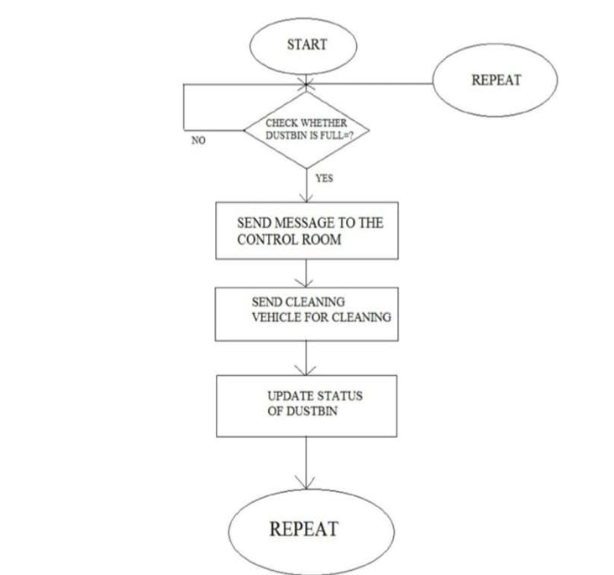
BLOCK DIAGRAM

Slide 9
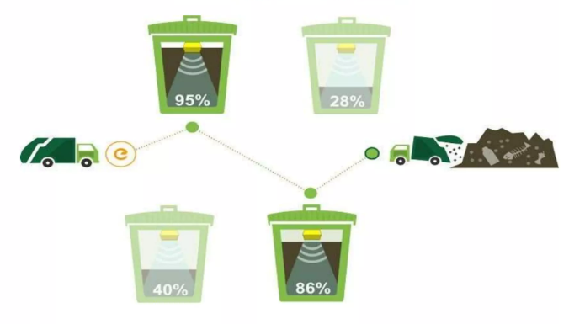
OPTIMISE PATH ROUTE

Slide 10
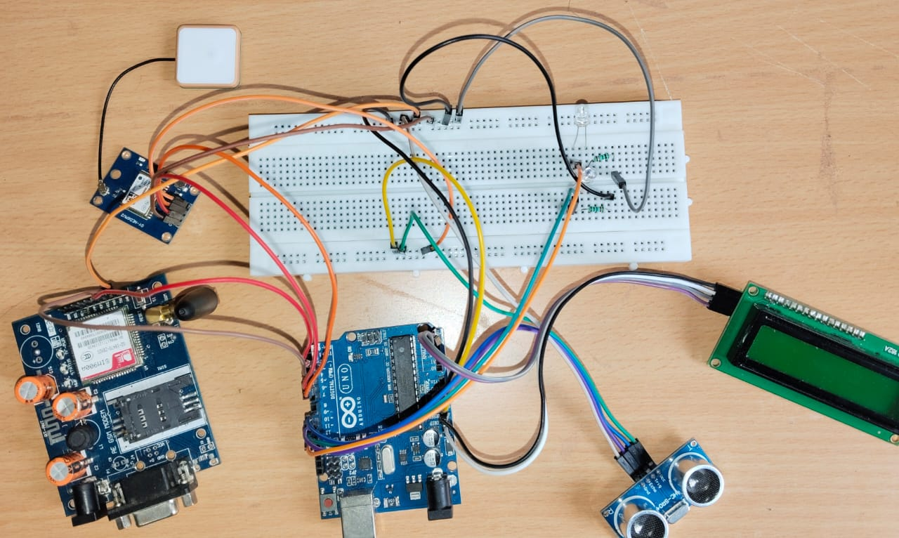
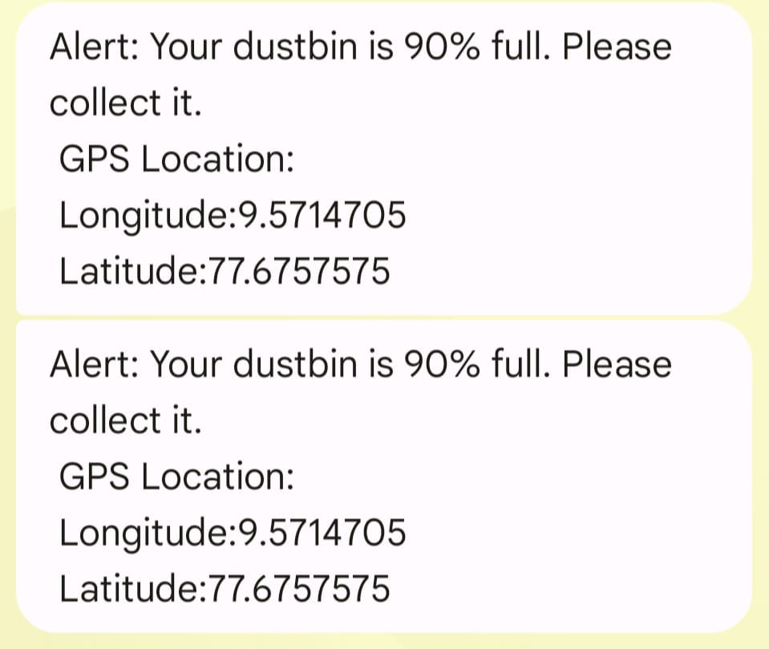
DESIGN IMPLEMENTATION

Slide 11
HARDWARE SPECIFICATIONS
HC-SR04 Ultrasonic Sensor
Measures the distance to monitor the waste level inside the dustbin.
NEO-6M GPS Module
Provides GPS data for real-time location tracking of the dustbin.
SIM800L/SIM900 GSM Module
Sends SMS notifications or alerts about the dustbin’s status to a designated contact.
16x2 LCD Display with I2C Module
Displays waste level, system status, and potentially GPS coordinates.
Red and Green LEDs
Red LED indicates a nearly full dustbin; Green LED shows the dustbin is not full.

Slide 12

SUSTAINABLE GOALS
Goal 11: Sustainable Cities and Communities by fostering a cleaner, more organized, and healthier urban environment through efficient waste management practices. By integrating GPS and waste-level monitoring, the smart dustbin allows for optimized collection routes, ensuring that waste is collected only when bins are full or nearly full. This system minimizes unnecessary collection trips, which saves fuel, reduces emissions, and ultimately lowers operational costs. Such efficiencies not only benefit the environment but also reduce the financial and resource burden on municipal waste management systems, making urban infrastructure more sustainable.

Slide 13

SUSTAINABLE GOALS
Goal 3: Good Health and Well-being by promoting cleaner urban environments and reducing health risks associated with unmanaged waste. Overflowing bins can attract pests, spread unpleasant odors, and harbor harmful bacteria, all of which pose potential health risks to the community. By using ultrasonic sensors to monitor waste levels, this smart dustbin system can alert waste management services when bins are nearing full capacity, ensuring timely collection and preventing waste overflow. This proactive approach helps maintain sanitation in public spaces.

Slide 14
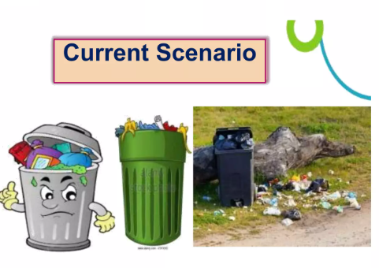
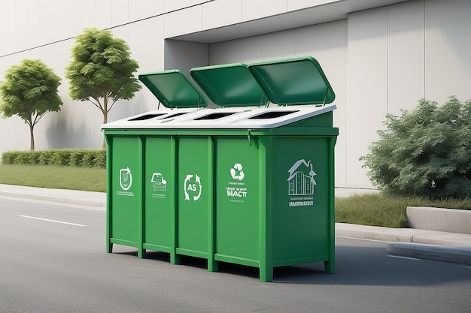
FUTURE PLAN
The Smart Dustbin project can be enhanced with IoT, AI, and Big Data Analytics. Key improvements include solar power for sustainability, data analytics for optimized waste collection, and automation for efficiency. GPS tracking enables real-time monitoring, while large-scale deployment enhances urban waste management. These advancements make the system more adaptive, contributing to cleaner cities and better environmental health.

Slide 15
THANK YOU

