Slide 1


Task 3 – Interactive Dashboard
Created by: B.Guru Tejaswi Date: June 26, 2025 Tool Used: Tableau Public

Slide 2
Objective
The objective of this task was to design an interactive dashboard for business stakeholders using Tableau.
The dashboard provides insights into sales, quantity, and order status using Amazon sales data.

Slide 3
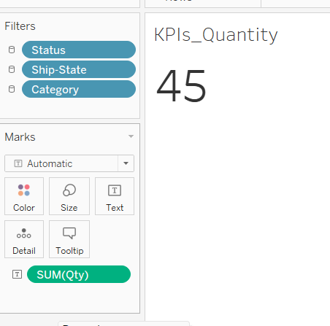
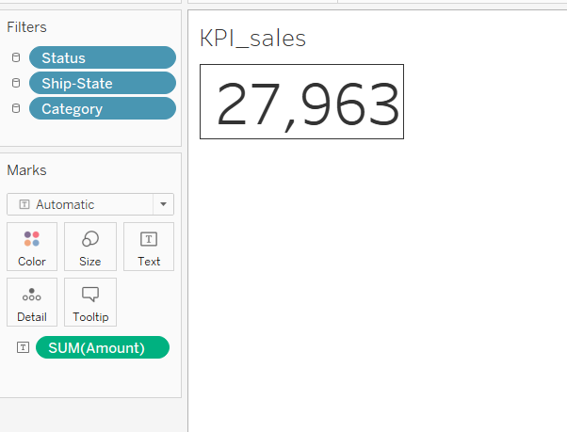
KPI Highlights
Total Sales
Total Quantity Sold

Slide 4
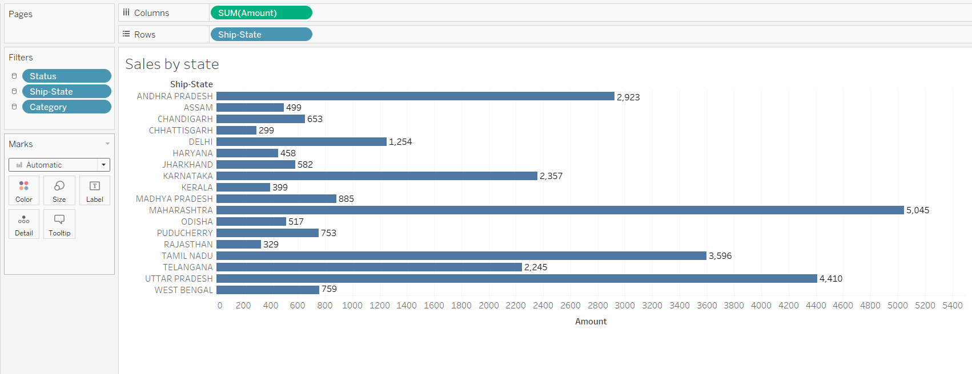
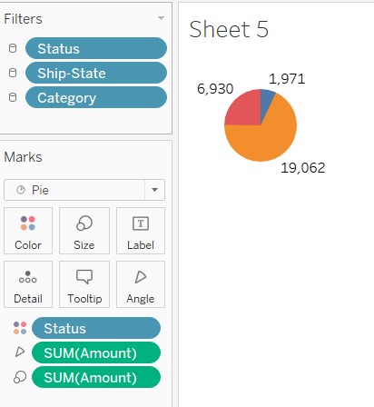
Data Visualization
Monthly Sales (Bar Chart)
Sales by Category (Bar Chart)
Order Status (Pie Chart)
Sales by State (Bar Chart or Map)

Slide 5
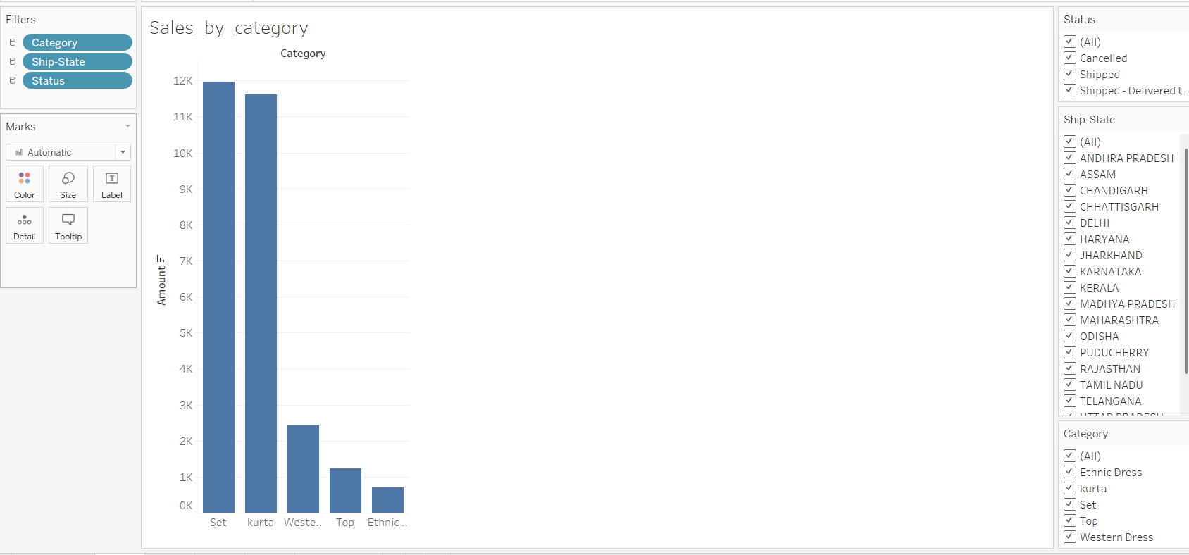
Filters & Interactivity
Filters added for:
Product Category
Ship State
Order Status
📌 These filters apply to all
visualizations and allow users to
slice data as needed.

Slide 6
Outcome & Learnings
✅ Learned how to:
Clean and understand sales data
Create KPIs and visualizations in Tableau
Design an interactive and professional dashboard
💡 This dashboard helps business teams quickly see key metrics and make
decisions.

Slide 7
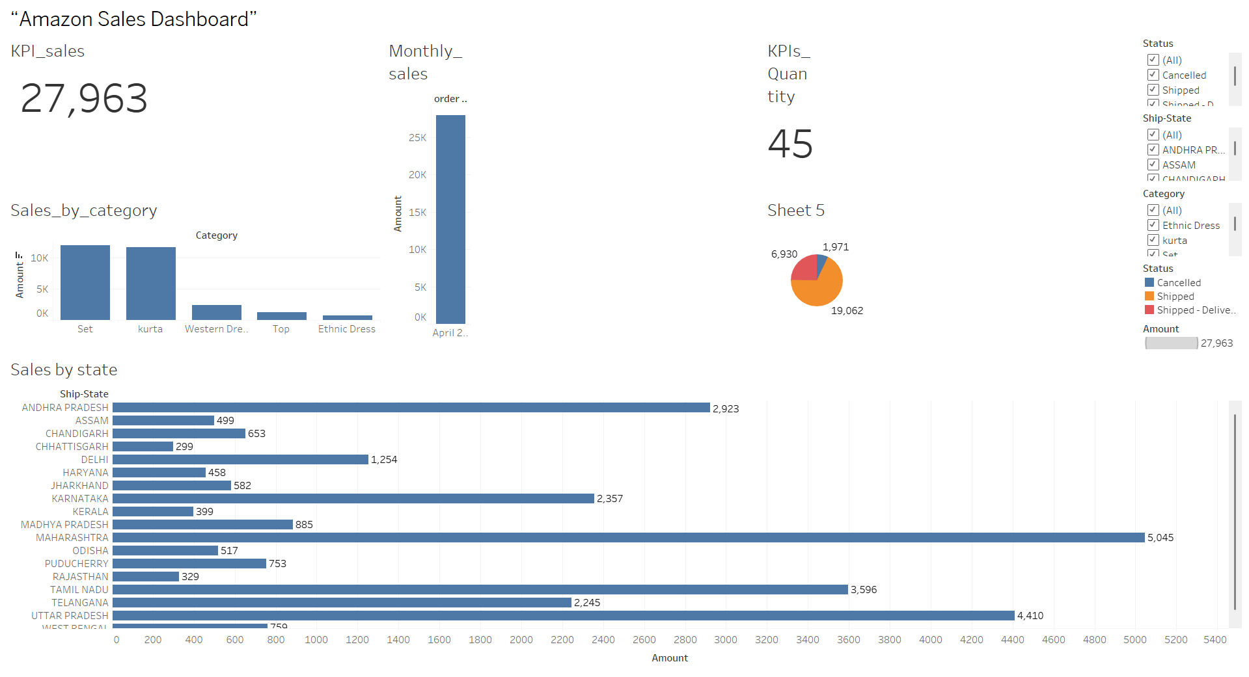
Dashboard

