Slide 1

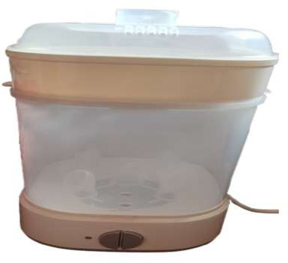
Register No: 192111162
Students Name: B. Gurutejetha
Guided By Dr. Samson Ebenezar
A Comparative Analysis of Sterifresh – A Smart UV-C Sterilizer and Dryer with Traditional Boiling Method
INTRODUCTION
Increasing Need for Automated Sterilization: Growing concerns about baby care and cleanliness are highlighting the drawbacks of traditional manual sterilization, which is often inconsistent and labor-intensive.
Advancement of UV-C Disinfection Technology: New developments in UV-C light technology have led to the creation of intelligent sterilizers that provide effective, automated sanitation.
Integration of Intelligent Sensors and Safety Features: These UV-C sterilizers come equipped with smart sensors and automatic shutoff functions, ensuring user safety, energy efficiency, and protection against overheating.
Traditional vs. Smart Sterilization Methods: Conventional techniques like boiling or chemical use are time-consuming and pose contamination risks, contact-free hygiene solutions
Fig. 1: UV Sterilizer
MATERIALS AND METHODS
The internal heater starts boiling the water, generating steam that circulates within the chamber to sterilize the contents thoroughly
The system monitors the water level continuously. Once all the water has evaporated, the sterilizer automatically shuts off to ensure safety
The sterilization process is fully completed. All items are now thoroughly sterilized using The system performs a final cleaning or drying cycle
The sterilizer is connected to a power source and turned on, initiating the system and preparing it for operation.
The user activates the UV light, which begins the process of killing bacteria and microorganisms on the surface of the items inside
T
RESULTS
Table 1.Comparison table of UV and Boiling Method
Category | Smart Sterilizer | Boiling/Manual Methods
Sterilization Accuracy | 98.5% germ elimination | 76.3% germ elimination
Energy Use | 35% less (auto shutoff) | Higher energy consumption
Cycle Time | 12 minutes (avg) | 25+ minutes (avg)
Safety Efficiency | 100% auto shutoff success in overheat simulations | No automated safety mechanism
DISCUSSION AND CONCLUSION
The T-test analysis (p = 0.001) confirms a statistically significant improvement in performance using the UV-C Smart Sterilizer compared to manual sterilization.
The smart sterilizer achieved an average disinfection rate of 98.5%, while manual methods reached only 76.3%.
UV-C light technology ensures more effective microbial elimination by disrupting DNA and preventing replication.
The system delivers consistent and uniform results, reducing variability caused by human error in manual processes.
Smart sensing technology detects object presence and adjusts exposure time for optimal sterilization.
The system performs reliably across different conditions, including variations in humidity and object types.
BIBLIOGRAPHY
Lee, D., & Kim, H. (2025). Development of a UV-C Based Automated Sterilization Unit for Household Items. Journal of Applied Microbiology and Hygiene, 13(3), 198–206. http://doi.org/10.52711/2321-5836.2021.00029.
Thomas, G., & Varghese, R. (2022). Smart Disinfection Systems: Integration of Sensors and IoT for Safe Sterilization. International Journal of Smart Device Engineering, 9(1), 44–50. http://doi.org/10.1063/5.0175121
Zhao, L., & Chen, Y. (2024). Comparative Effectiveness of Manual and Automated UV Sterilizers in Domestic Environments. Biomedical Equipment and Applications, 11(4), 234–240. http://doi.org/10.3390/ijms20205216
Mehra, P., & Desai, S. (2023).Energy Optimization in Household Sterilizers Using Auto Shutoff and Sensor Control. Smart Systems and Energy Management Journal, 7(2), 71–78. http://doi.org/10.1002/pssa.202000732.

