Slide 1
COGNITION 2026 • AGENTIC AI
AegisOne
AEGIS: In Greek mythology, the aegis was a protective shield associated with Athena and Zeus. Today, the word also conveys protection, defense, and safeguarding.
Think Before AI Acts.
A pre-execution safety layer that verifies, simulates,
and authorizes AI actions before they reach execution.
PROJECT REVIEW / WORKING PROTOTYPE
Team: Quby
Team members: Yash Gupta
Gurutheja Kavuturi
01 / 09

Slide 2
01 / PROBLEM
AI agents can act faster than humans can verify
The gap is not intelligence alone. It is a trustworthy boundary between intent and execution.
ACTION ≠ AUTHORIZATION
CONTEXT CAN CHANGE
AUDIT COMES TOO LATE
A plausible agent decision does not prove the action is permitted.
Recipients, permissions, policy, or evidence may change before commit.
A log after execution cannot prevent a harmful action beforehand.
AegisOne's objectives
Inspect and normalize proposed actions with identity and context.
Estimate consequences and explain risk factors behind a decision.
Enforce deterministic policy and human approval where required.
Revalidate the exact action at commit time and preserve an auditable record.
DESIGN PRINCIPLE Reasoning may advise. Only the policy + commit boundary may authorize.
AEGISONE / THINK BEFORE AI ACTS
02

Slide 3
02 / SOLUTION
A control plane for agent actions
The innovation is the integrated enforcement path—not a standalone risk score or chatbot.
01
CAPTURE
Normalize action + identity
KEY DIFFERENTIATOR
CORE
Commit-time verification detects an action changed after approval.
02
ASSESS
Risk factors + evidence
03
SIMULATE
Outcomes + safer options
ADVISORY AI, NOT AUTHORITY
LLMs can interpret and suggest. They cannot override mandatory policy.
04
DECIDE
Policy: allow / review / block
SAFE BY DEFAULT
05
VERIFY
Bind approval to exact action
Synthetic actions + mock execution prevent external side effects.
Explainable. Reproducible. Auditable.
AEGISONE / THINK BEFORE AI ACTS
03

Slide 4
03 / ARCHITECTURE
A layered trust boundary
Each stage has a clear responsibility; no single model is trusted with the whole decision.
AGENT / TOOL CALL
Untrusted proposed action
CONTROL PLANE
GATEWAY + IDENTITY
Schema validation · auth · canonicalization
Versioned policy, permissions, approval roles.
RISK + SIMULATION
Heuristic · evidence · predicted outcomes
EVIDENCE PLANE
POLICY DECISION POINT
ALLOW / REQUIRE_APPROVAL / BLOCK
Trace, decision reasons, hashes, provenance.
COMMIT GATE
Recheck hash · permissions · expiry · replay
FAIL-CLOSED
MOCK EXECUTION + AUDIT
Receipt · hash-linked events
Required check fails? Hold or block protected action.
AEGISONE / THINK BEFORE AI ACTS
04

Slide 5
04 / IMPLEMENTATION
A pragmatic stack with honest boundaries
Use technologies already present in the repository; verify each integration before claiming it is live.
FRONTEND
APPLICATION API
Existing AegisOne dashboard
Typed UI states · API contracts · event data
Existing backend framework
Validation · auth · lifecycle orchestration
PERSISTENCE
REASONING ADAPTER
PostgreSQL / Supabase if configured
Actions · policies · approvals · evaluations
Optional configured LLM provider
Intent + alternative proposals; advisory only
VERIFICATION
CURRENT CONFIGURATION — AS SHOWN
Hashing · deterministic policy · tests
Action binding · replay protection · regression
Heuristic active · LLM unconfigured · supervised model unavailable
GitHub check: Guruthejax3/aegisone is public.
AEGISONE / THINK BEFORE AI ACTS
05

Slide 6
05 / CAPABILITIES
One lifecycle, multiple operational views
The existing dashboard is organized around safety operations, governance, and forensic evidence.
COMMAND CENTER
AGENT INTELLIGENCE
CONSEQUENCE SIMULATOR
POLICY & AUTHORIZATION
Lifecycle + system health
Intent, trigger, evidence
Outcomes + alternatives
Rules + approval decisions
EVIDENCE & AUDIT
RED-TEAM & EVALUATION
LIVE OBSERVABILITY
GOVERNANCE & RECOVERY
Timeline + integrity
Scenarios + regressions
Persisted events + health
Permissions + safe failure
A section is “working” only when its backend path, persistence, and tests support the UI state.
AEGISONE / THINK BEFORE AI ACTS
06

Slide 7
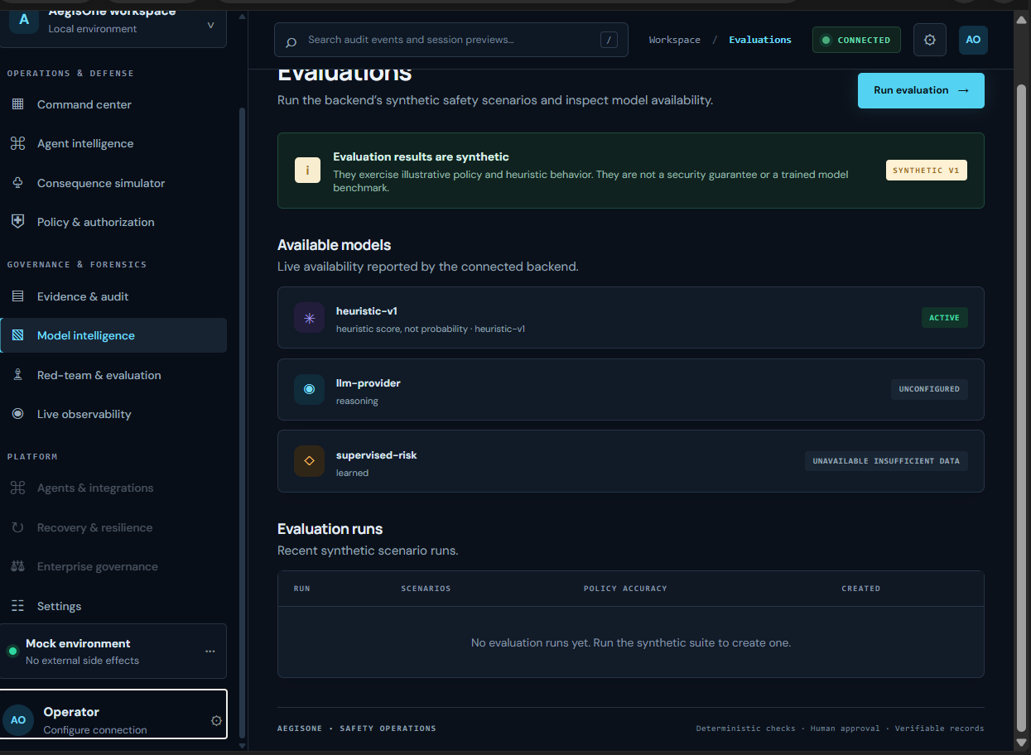
06 / PROTOTYPE EVIDENCE
Current dashboard: Model Intelligence & Evaluations
Evidence from the supplied screenshot; visible labels do not prove every backend path.
VISIBLE: HEURISTIC V1
UI correctly labels score as heuristic, not probability.
VISIBLE: PROVIDER STATUS
LLM unconfigured; supervised risk unavailable due to insufficient data.
VISIBLE: SYNTHETIC EVALUATION
No runs yet; execute and persist the suite for review.
Next proof: alter an approved action and show the backend rejecting commit.
AEGISONE / THINK BEFORE AI ACTS
07

Slide 8
07 / LIVE DEMO
Prove the security invariant—not just the interface
Three reproducible scenarios make the architecture tangible to reviewers.
01
02
03
SAFE DRAFT
SENSITIVE SEND
TAMPER AFTER APPROVAL
Submit a synthetic draft action.
External recipient or sensitive data.
Change recipient after test approval.
Expected: policy decision + persisted event.
Expected: approval required or policy block.
Expected: commit gate rejects hash mismatch.
Evaluation evidence to capture
Per-scenario expected vs actual decision, pass/fail, and policy version.
Persisted run ID, action hash, commit result, and audit-chain verification.
Measured timings only when actually measured; no invented accuracy or uptime.
AEGISONE / THINK BEFORE AI ACTS
08

Slide 9
08 / ROADMAP & CLOSE
From prototype to a pluggable safety layer
Scale only after the enforcement boundary is tested and observable.
NOW / PROVE
NEXT / INTEGRATE
LATER / LEARN
Action lifecycle, approval binding, commit gate, audit verification, evaluations.
Connector adapters, scoped identities, reliable realtime, policy regression.
Collect labelled evaluations before calibrated or supervised risk models.
The takeaway
An AI agent's intention is not authorization. AegisOne separates reasoning from permission, prediction from evidence, and approval from execution.
AEGISONE : THINK BEFORE AI ACTS.
AEGISONE / THINK BEFORE AI ACTS
09

