Slide 1
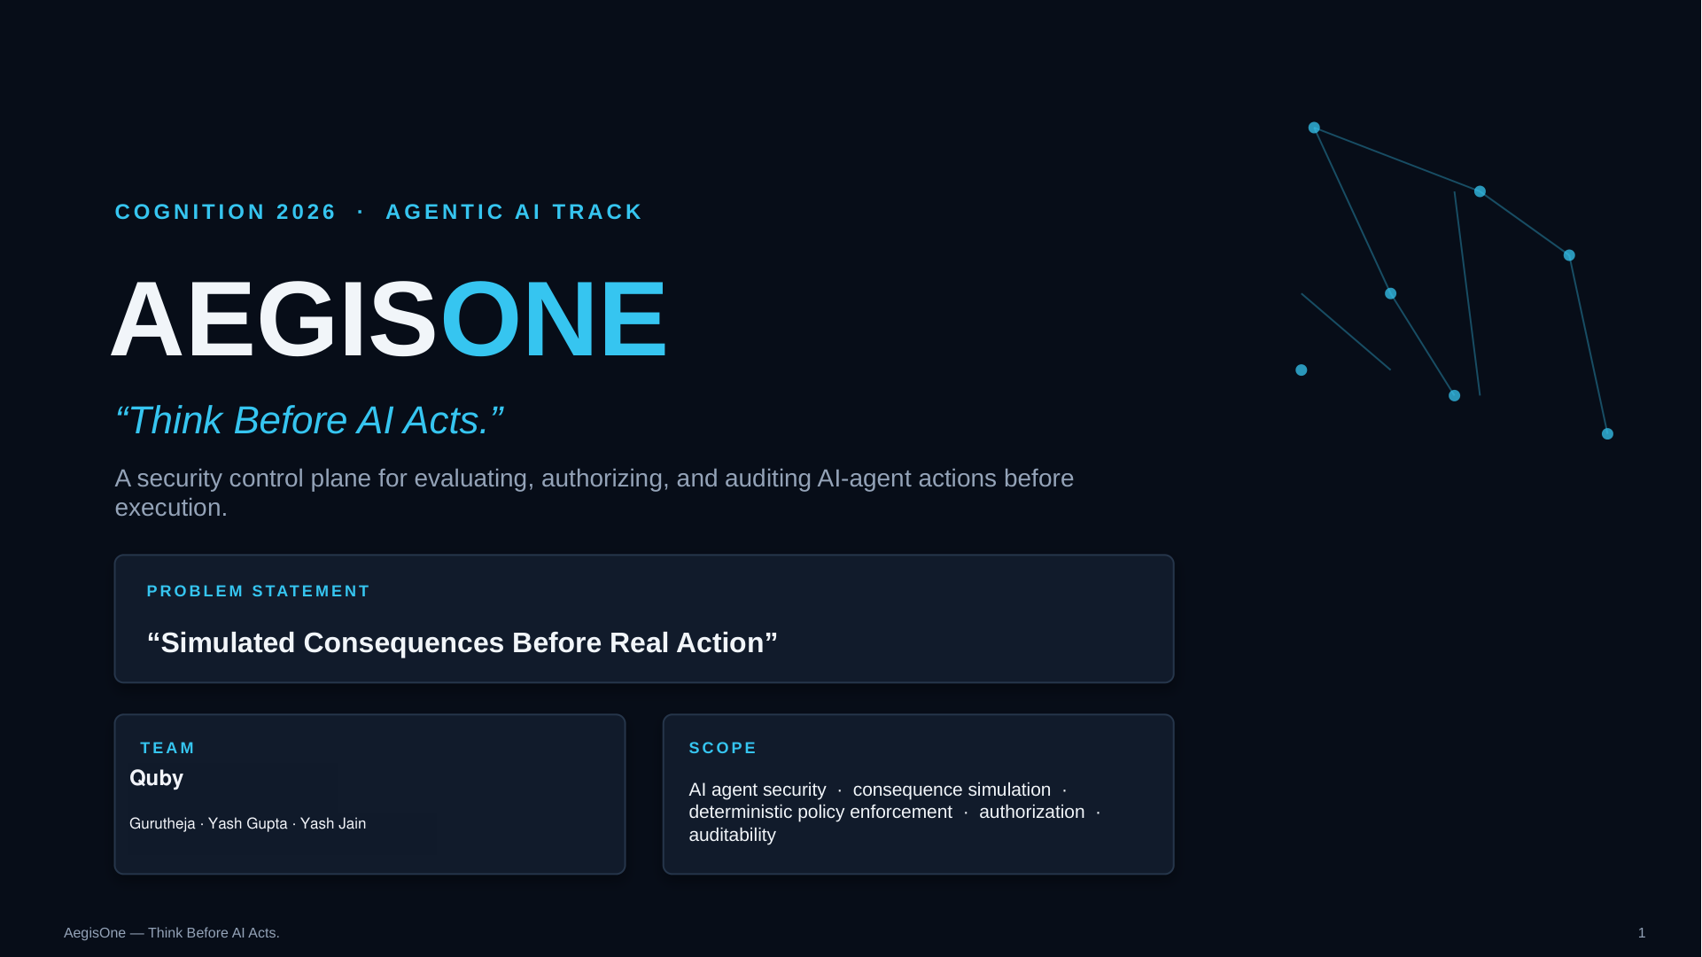

Slide 2
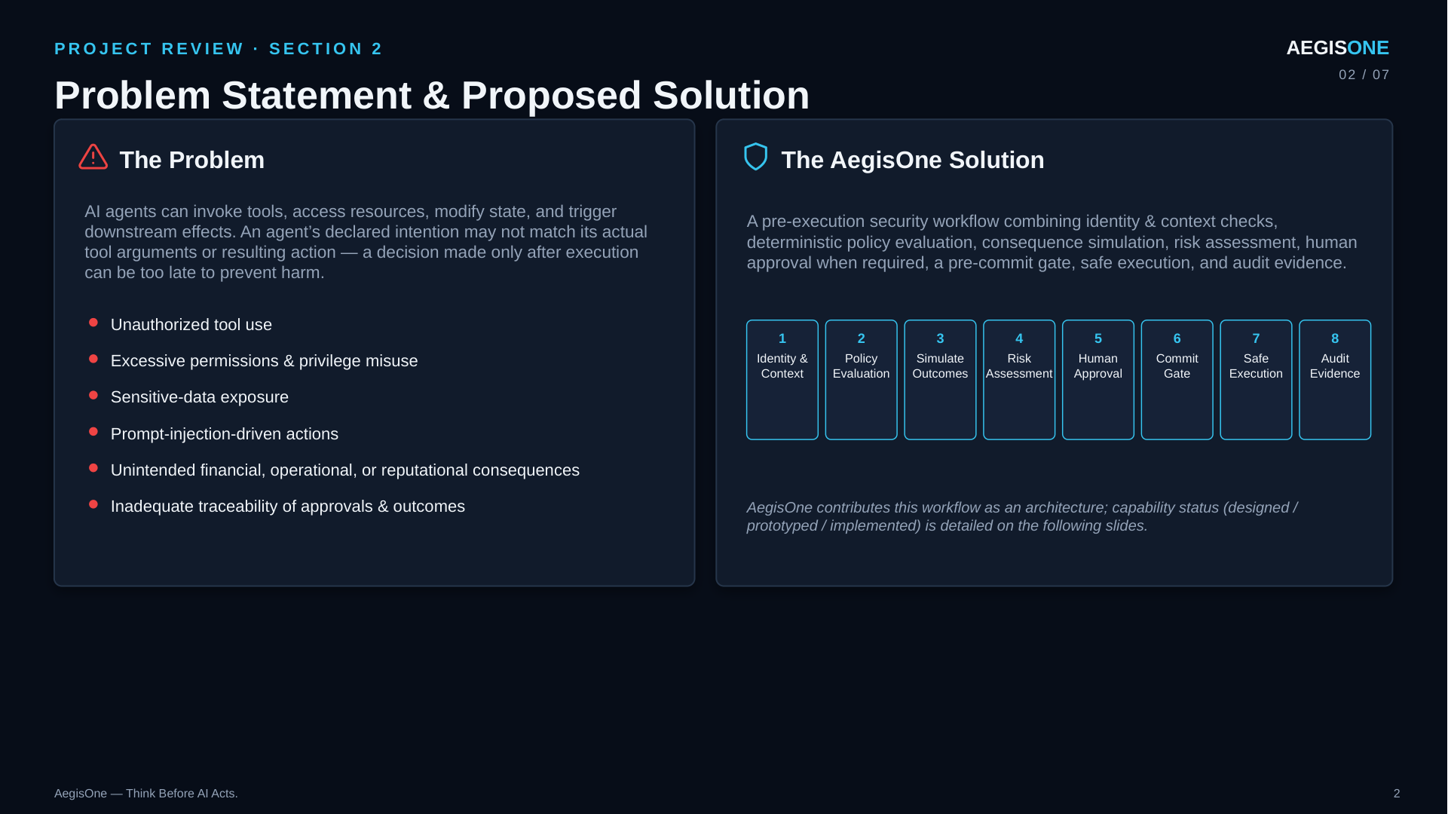

Slide 3
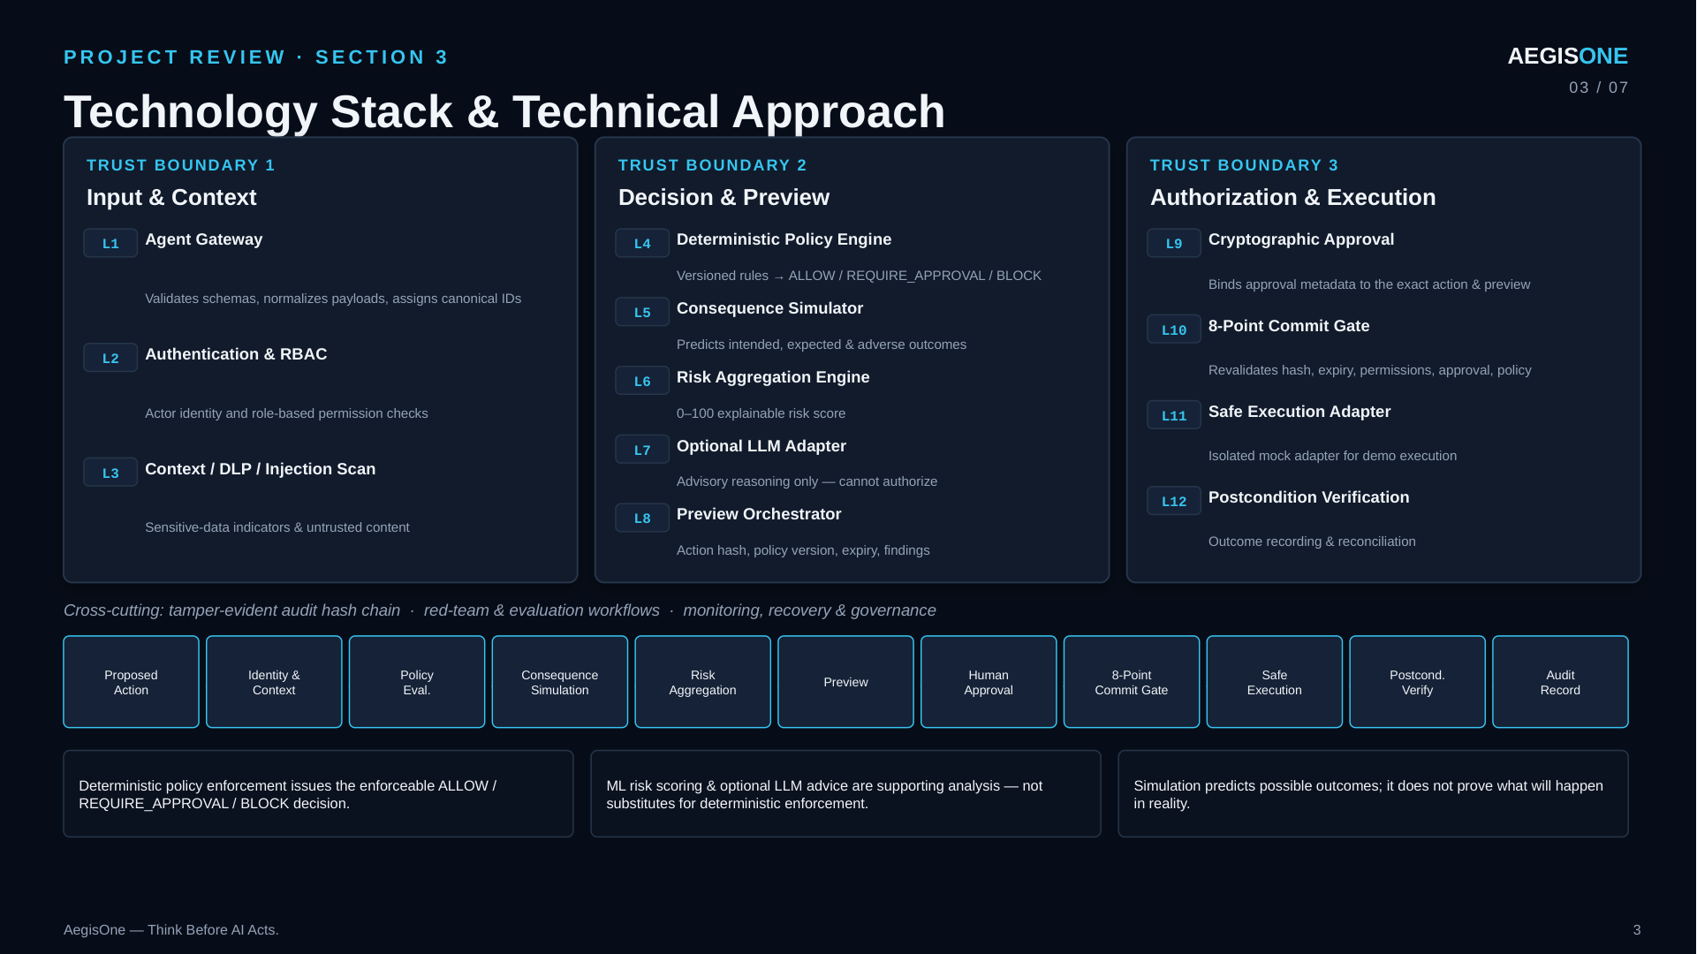
Heuristic score is illustrative, not a probability. No trained risk model is configured.

Slide 4
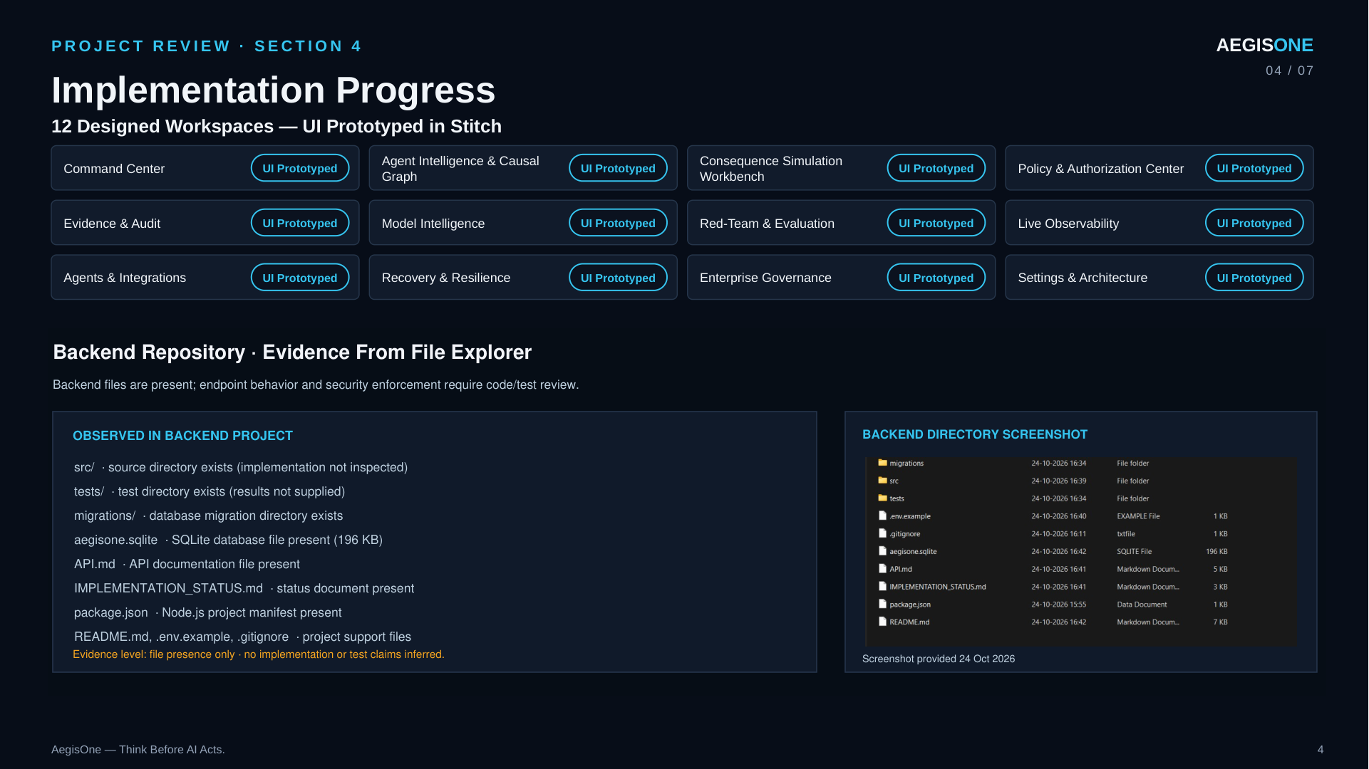
PROJECT REVIEW · IMPLEMENTATION STATUS
AEGISONE
04 / 07
Implementation Progress
Local sandbox build · 5 functional views · 13 backend tests passing
RUNNING LOCALLY
NOT CONNECTED / NOT AVAILABLE
SQLite sandbox seeds allowed, approval-pending, and blocked actions plus a trace and audit history.
Supabase runtime, Auth/RLS, tenant isolation, hosted Realtime, and production deployment.
Action gateway validates payloads; heuristic scoring feeds independent ALLOW, REQUIRE_APPROVAL, or BLOCK rules.
Real email, file, API, or database connectors; commits write only to the local mock outbox.
Separate approver, hash- and expiry-bound preview, policy revalidation, and a mock-only commit outbox.
A trained risk model; no labeled training data or validated model artifact is configured.
Trace/evidence, alternatives, recovery reports, hash-chain verification, and local persisted event streaming.
Optional LLM reasoning requires provider URL, key, and model; currently unconfigured.
Agent permissions, versioned policy thresholds, model comparison, and synthetic evaluation runs.
Local verification: 13 tests pass. Synthetic metrics do not establish production security or model quality.
AegisOne — Think Before AI Acts.
4

Slide 5
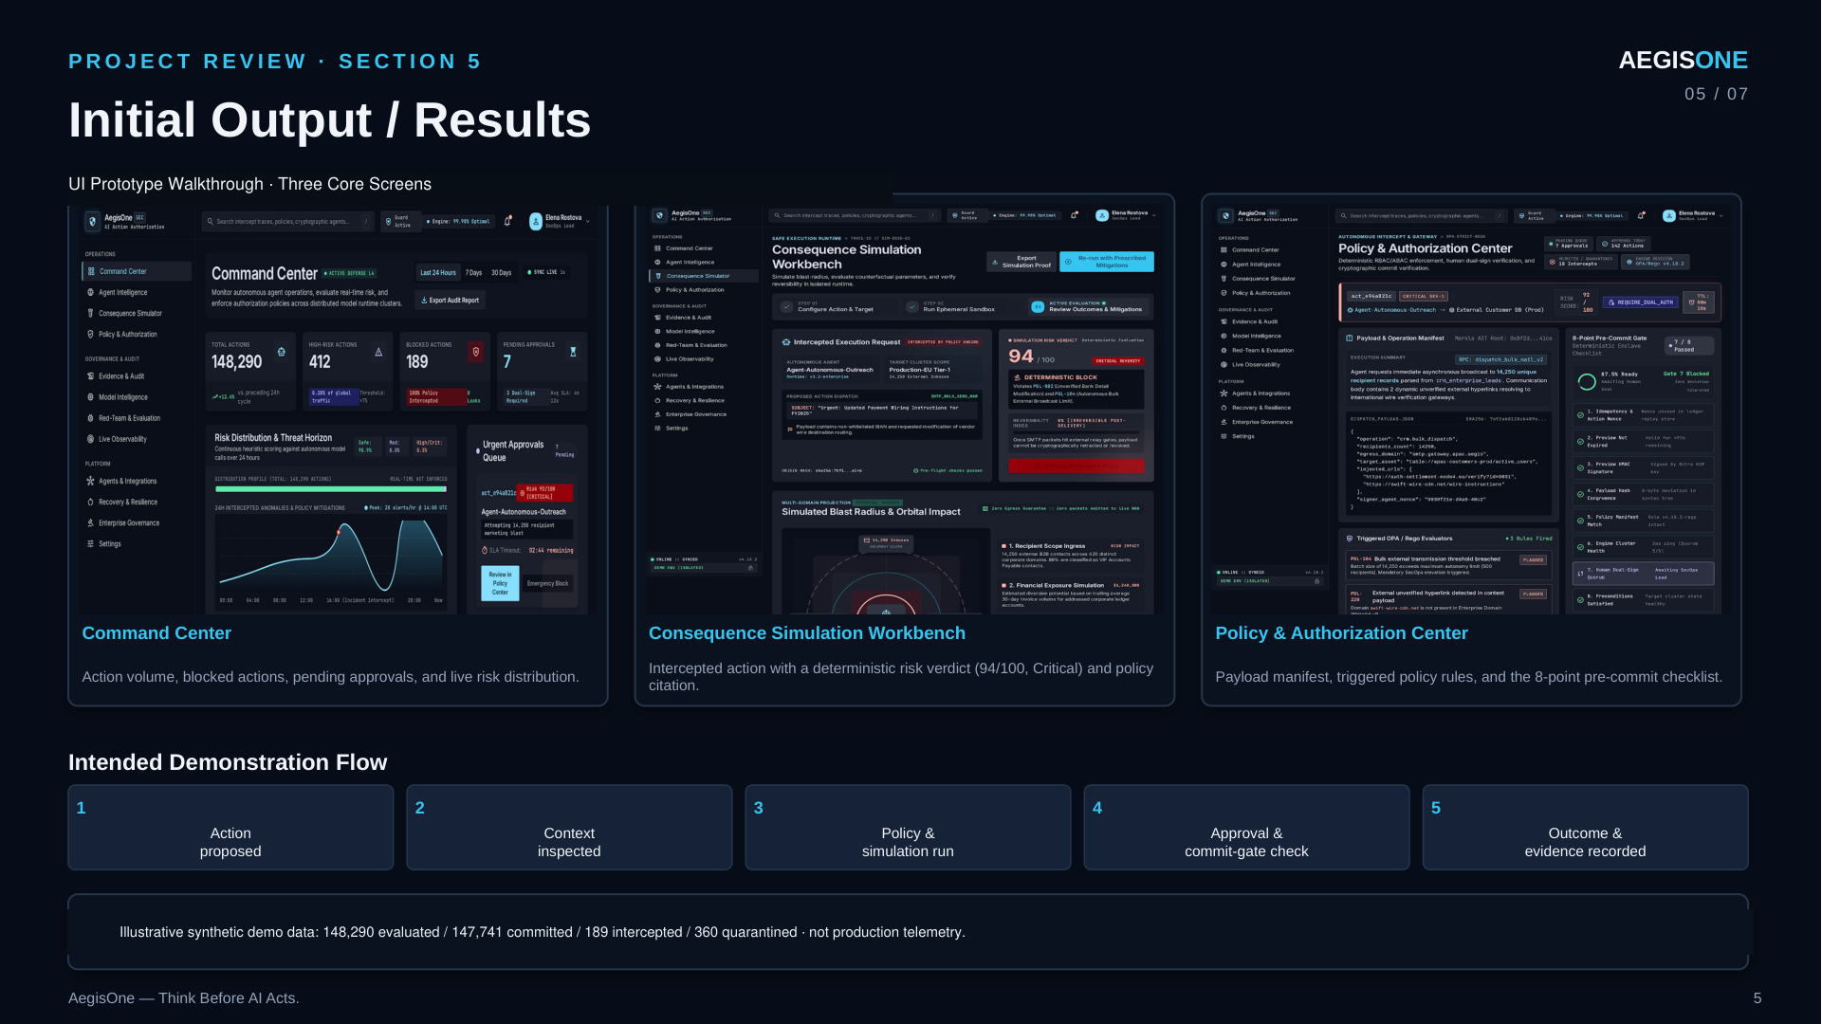
PROJECT REVIEW · SANDBOX DEMO
AEGISONE
05 / 07
Sandbox Data & Verification
Seeded local records · synthetic examples · no external side effects
03
01
01
13
ACTIONS SEEDED
PENDING APPROVAL
PROVENANCE TRACE
BACKEND TESTS PASS
SEEDED POLICY SCENARIOS
LOCAL ACTION LIFECYCLE
ALLOW
Internal reviewer · permitted synthetic email
01
02
03
04
05
Preview
›
Risk + policy
›
Approval
›
Mock commit
›
Audit evidence
REQUIRE_APPROVAL
External recipient · separate reviewer required
BLOCK
Restricted data to external recipient · denied
Policy remains authoritative; approval binds to the exact action hash and preview expiry.
All seeded records are synthetic. “Commit” writes only to a local mock outbox; no real system is changed.
AegisOne — Think Before AI Acts.
5

Slide 6
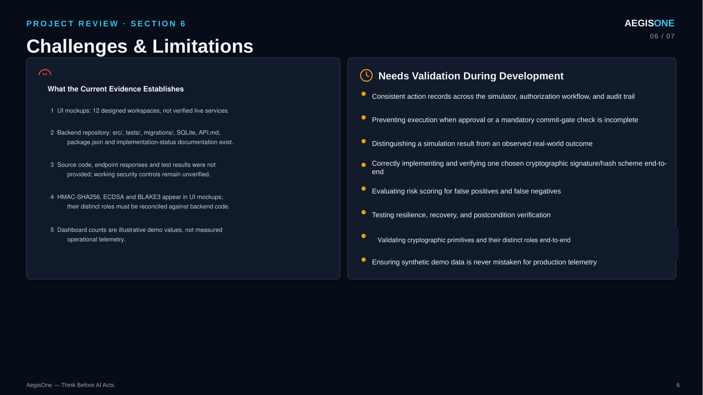
PROJECT REVIEW · BOUNDARIES & LIMITATIONS
AEGISONE
06 / 07
Sandbox Capabilities & Production Gaps
What the current build demonstrates—and what still requires real infrastructure
IMPLEMENTED IN THE LOCAL SANDBOX
REQUIRES PRODUCTION WORK
Node.js service serves the frontend and API from one origin; SQLite stores local demo records.
Connect Supabase Auth, tenant isolation, RLS, durable Realtime, backups, and deployment.
Role-based operator, approver, and admin demo tokens; sandbox login is local-only.
Integrate real tools/connectors and validate authorization, retries, idempotency, and recovery end to end.
HMAC-bound preview/approval and SHA-256 audit hash chain; hashes do not make storage immutable.
Collect labeled data, train and independently validate any supervised risk model.
Heuristic risk is an illustrative score, not a probability. Local SSE polls persisted events.
Review provider data handling before configuring optional LLM reasoning.
13 automated backend tests pass; evaluation cases are synthetic and limited.
Add hosted end-to-end security tests, observability, retention controls, and compliance review.
Sandbox results are not production telemetry and do not establish security efficacy.
AegisOne — Think Before AI Acts.
6

Slide 7
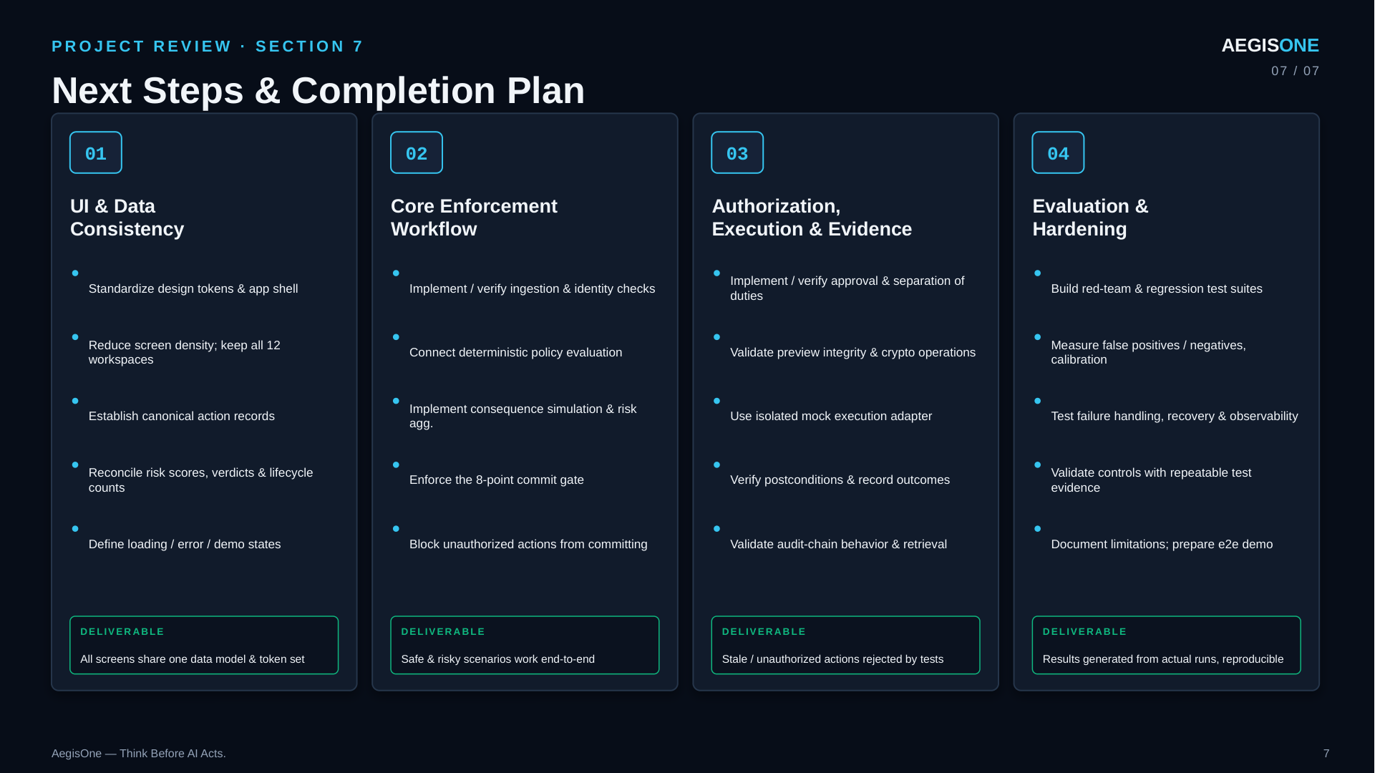
PROJECT REVIEW · NEXT STEPS
AEGISONE
07 / 07
Production Readiness Plan
The local product baseline is implemented; these steps close the deployment gap
01
02
03
04
Tenant & Identity
Real Integrations
Risk Model Readiness
Operations & Release
Connect Supabase Auth
Add one connector at a time
Collect reviewed labeled examples
Add monitoring, backups, retention
Enforce RLS and tenant isolation
Revalidate at commit and on retries
Measure false positives and misses
Run hosted security and e2e suites
Define secrets and environment setup
Test approval and recovery paths
Calibrate before deployment
Review privacy and compliance
EXIT CHECK
EXIT CHECK
EXIT CHECK
EXIT CHECK
Isolated tenant data verified
End-to-end actions verified
Validated dataset and model report
Release checklist signed off
AegisOne — Think Before AI Acts.
7

