Slide 1


AOS Programming Project
Name: Guruvikas Reddy Busa
Email:gxb33800@ucmo.edu
INSTRUCTOR
HYUNGBAE PARK

Slide 2

Libraries
#include <stdio.h>
#include <unistd.h>
#include <stdlib.h>
#include <pthread.h>
#include <semaphore.h>

Slide 3
Semaphore
Semaphores are integer variables that are used to solve the critical section problem by using two atomic operations, wait and signal that are used for process synchronization.
Definition of wait:-
wait(Semaphore S){
While S<=0
;no operation
S--;
}
Definition of Signal:-
signal(S){
S++;
}

Slide 4
sem_init()
1.Prototype: int sem_init(sem_t * sem, int pshared, unsigned int value);
2.Library: #include <semaphore.h>
3.Purpose: This initializes the semaphore *sem. The initial value of the semaphore will be value. If pshared is 0, the semaphore is shared among all threads of a process.If pshared is not zero, the semaphore is shared but should be in shared memory.

Slide 5
sem_wait()
1.Prototype: int sem_wait(sem_t * sem);
2.Library: #include <semaphore.h>
3.Purpose: This implements the wait function described above on the semaphore *sem.

Slide 6
sem_post()
1.Prototype: int sem_post(sem_t * sem);
2.Library: #include <semaphore.h>
3.Purpose: This implements the post function described above on the semaphore *sem

Slide 7

Declaration and initialization of semaphores
Declaration:-
1.sem_t waitingRoom;
2.sem_t TARoom;
3.sem_t tasleep;
4.sem_t students;
Initialization:-
1 .sem_init(&waitingRoom, 0, numChairs);
2.sem_init(&TARoom, 0, 1);
3.sem_init(&tasleep, 0, 0);
4.sem_init(&students, 0, 0);

Slide 8
Create and join student and teaching assistant thread
pthread_create(&assistantId, NULL, sleepingta, NULL);
for (i = 0; i < noOfStudents; i++) {
pthread_create(&tid[i], NULL,student, (void *)&Number[i]);
}
for (i = 0; i < noOfStudents; i++) {
pthread_join(tid[i],NULL);
}
pthread_join(assistantId,NULL);

Slide 9
Thread sleepingta()
STEP1:Function checks TA status
STEP2:If TA == sleeping then
Wake up
Else
Student gets the lock and TA helping the student
STEP3:Student releases the lock and TA is free

Slide 10
Thread student()
STEP1:Student checks the status of the waiting room (condition no of chairs=3)
STEP2: If waiting room is busy then
student will leave
Else
student will check the status of teaching assistant.
STEP3:If TA is sleeping , TA function invokes.

Slide 11
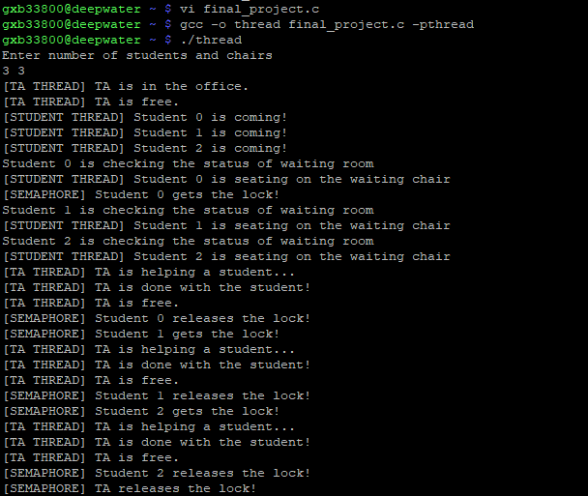
Results

Slide 12

THANK YOU

