Slide 1
Pulmira
An observation-led respiratory digital twin.
Digital Twin Challenge 2026 Chennai Institute of Technology
Research prototype · fictional demonstration data

Slide 2







Making respiratory observations useful
T H E P R O B L E M
measured day 6 · available day 7
SpO₂
missing
Symptoms
Unsure
no sleep, gait or air-quality stream observed
Context
Day 1 Day 2 Day 3 Day 4 Day 5 Day 6
An isolated reading says little on its own. Interpretation needs to know which channels exist, how fresh each reading is, and what was still unknown at the decision time.
Day 7
Pulmira · 02

Slide 3
One connected workspace
T H E P R O D U C T
01
02
03
04
Monitoring
Seven-day formula outlook
A transparent, bounded trend formula. Unvalidated; reported in change points out of 100.
Fictional simulator
Sixteen engineering sensitivity scenarios over 180 fictional days.
Next-day ML experiment
A separately trained model estimating next-day simulated SpO₂ below 90%.
Fictional profiles, separate device and context streams, coverage review and historical replay.
Shared observation engine and ledger underneath. The three analytical modules never borrow each other's numbers.
Pulmira · 03

Slide 4
How the layers connect
A R C H I T E C T U R E
Observation engine
measurement vs availability time
React + TypeScript
Clinician, patient and review interfaces
FastAPI backend
Signed demo roles · request validation
Seven-day formula
bounded trends
Fictional simulator
16 scenarios
Exports
PDF · CSV · JSON
SQLite ledger
Local persistence of records and acknowledgements
Next-day model
trained separately
Results return through the API to the interface. Data enters from historical fictional records; there is no active wearable feed.
Pulmira · 04

Slide 5
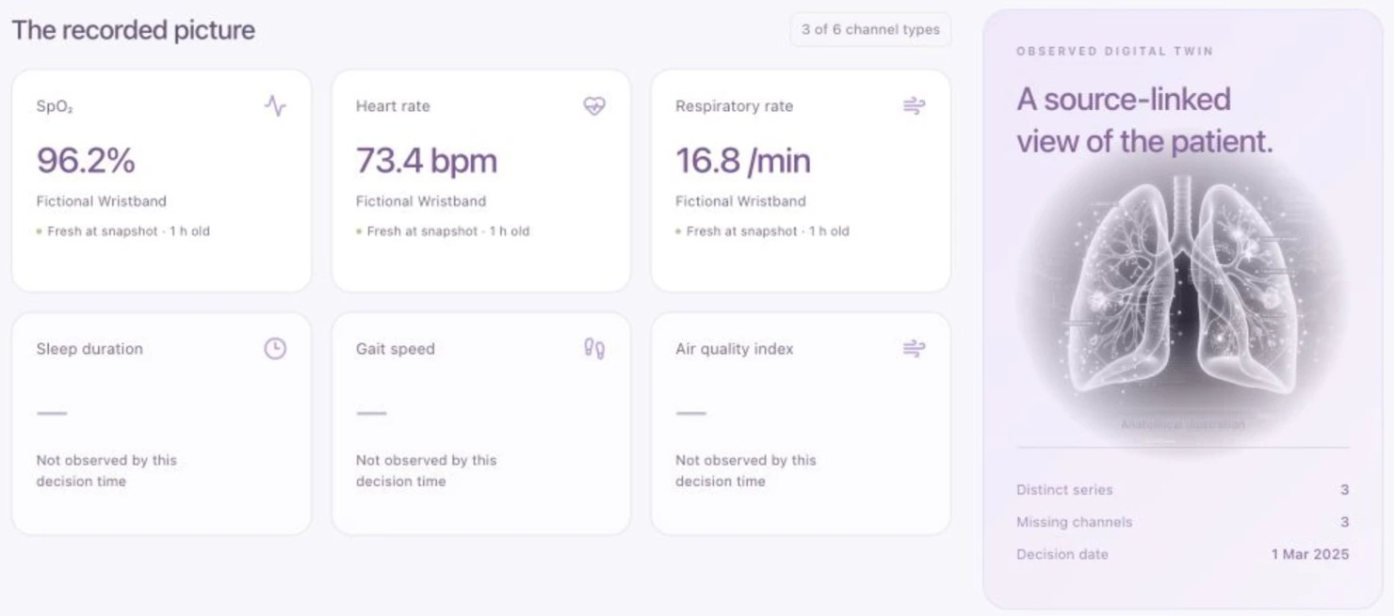
A patient-specific view
P A T I E N T W O R K S P A C E
1
Recorded vitals
SpO₂ 96.2%, heart rate
73.4 bpm and respiratory rate 16.8/min, each with its own source stream and age.
Explicit unknowns
2
Sleep, gait and air quality are not observed by this decision time, so they stay unknown.
Fictional profile at a historical decision time (1 Mar 2025). The lung illustration is decorative anatomy, not a patient scan.
Pulmira · 05

Slide 6
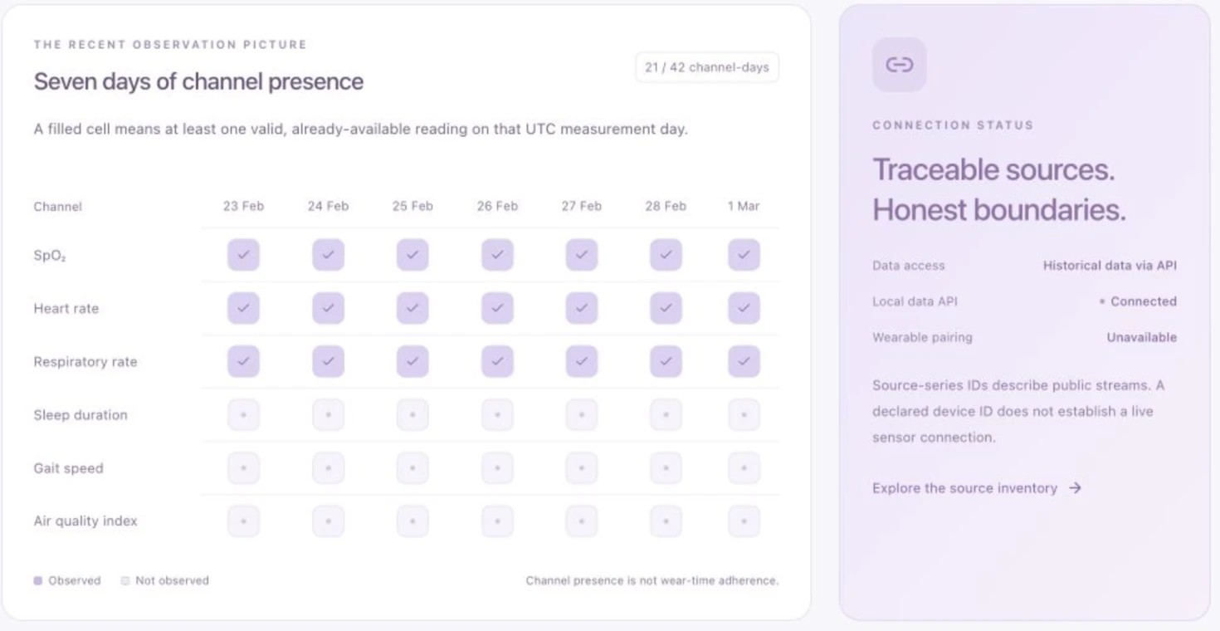
Coverage before interpretation
D A T A Q U A L I T Y
Channel presence
1
21 of 42 channel-days observed. A filled cell means a valid, already-available reading that UTC day.
2
API ≠ wearable
The local data API is connected. Physical wearable pairing is unavailable.
Missing observations remain unknown; they are never treated as normal values. Channel presence is not wear-time adherence.
Pulmira · 06

Slide 7
A transparent seven-day outlook
S E V E N - D A Y O U T L O O K
Unvalidated formula outlook
Observation requirements
Maximum contribution weights (points)
≥4 daily observations spanning 3 days in a 14-day lookback
Eligible readings within 48 hours
SpO₂ plus another eligible vital signal
SpO₂
Respiratory rate |  |  |  |  | 20
Heart rate |  |  |  | 15
Worse breathlessness |  |  | 12
Sputum change |  | 7
Worse cough |  | 6
40
Example peak: 21.8–28.8 change points out of
100. The range comes from unknown inputs, not statistical confidence. Not a probability; predictive accuracy not established.
The historical reference is not a clinically verified stable baseline.
Pulmira · 07

Slide 8
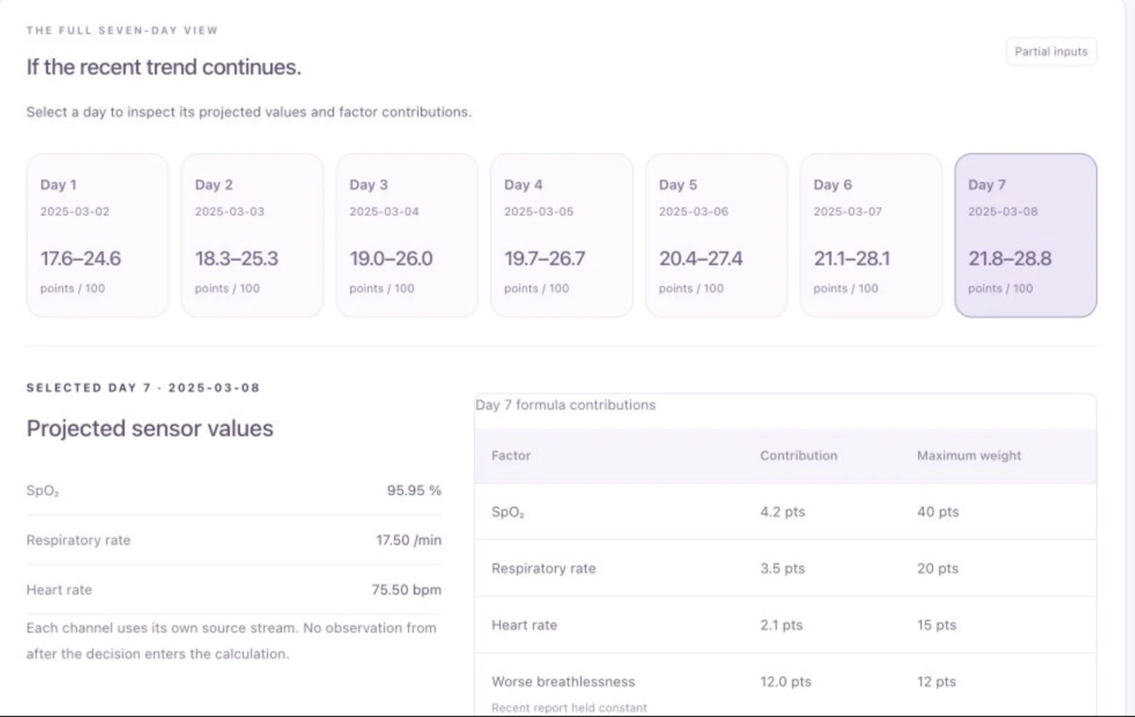
Seven dates, visible assumptions
S E V E N - D A Y O U T L O O K · D E T A I L S
30
Change points (out of 100)
25
20
15
10
2 Mar 3 Mar 4 Mar 5 Mar 6 Mar 7 Mar 8 Mar
Projected ranges from a 1 Mar 2025, 13:00 UTC decision. Historical fictional example.
Future values are projections, not recorded observations.
The 7-point width reflects the unknown sputum-change answer.
Pulmira · 08

Slide 9
Testing fictional scenarios
S Y N T H E T I C S I M U L A T O R
Observed days in a 180-day fictional comparison
Sparse reference monitoring
18 / 180
Denser assumed monitoring
160 / 180
16
engineering sensitivity scenarios vary assumptions such as observation density, then compare what the system can see.
This illustrates an observation-coverage assumption. Changed assumptions do not demonstrate a clinical intervention benefit.
All profiles and values are fictional.
Pulmira · 09

Slide 10
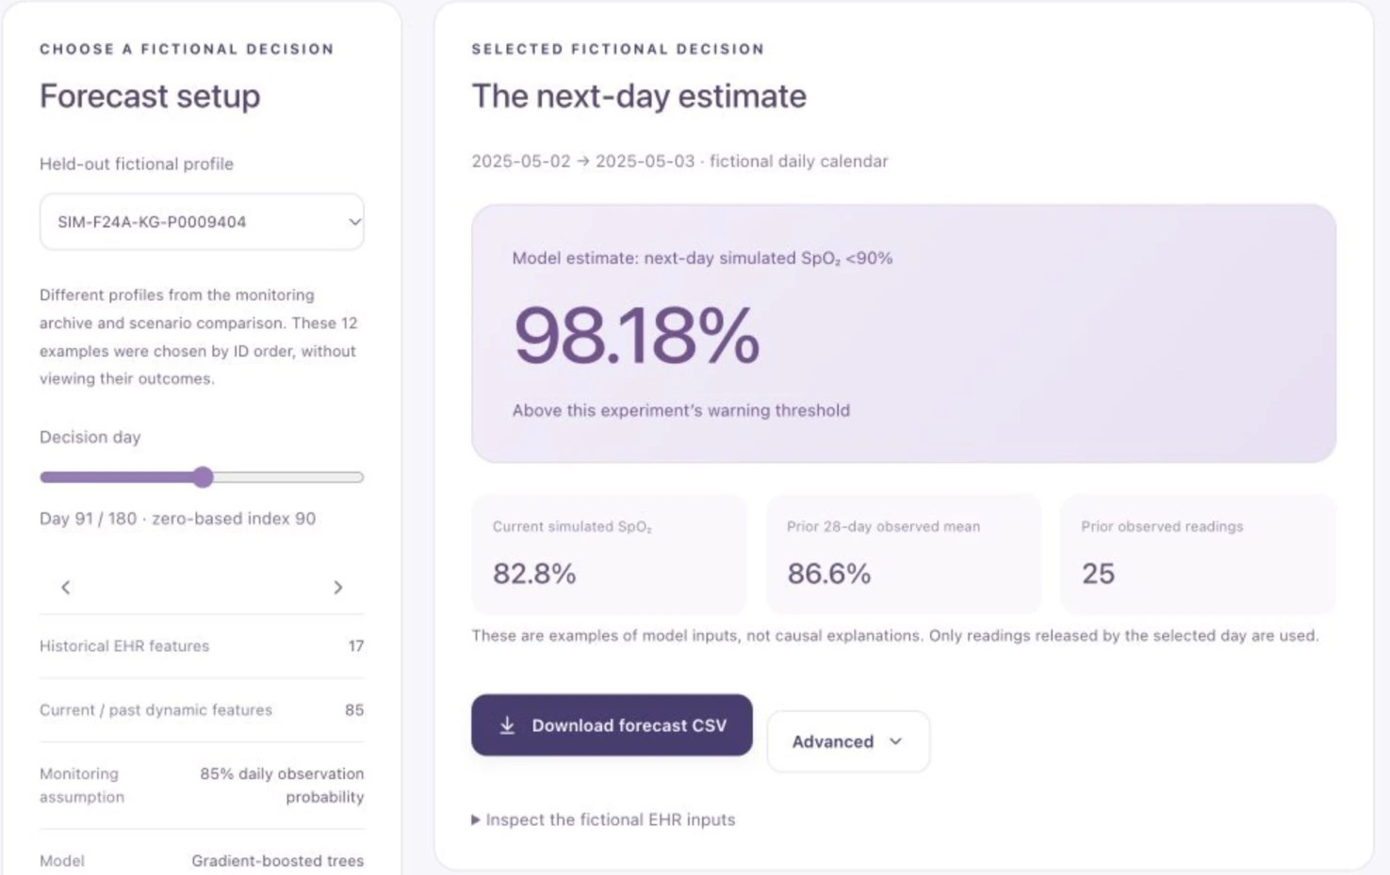
The separate next-day ML model
S E P A R A T E N E X T - D A Y M L M O D E L
102 features
17 static EHR · 85 current/past dynamic
Gradient boosting
160 iterations · depth 3
Target
Next-day simulated SpO₂ below 90%
98.18% is one conditional estimate for one fictional profile, not accuracy or confidence. The current reading is already low (82.8%), so this is not early detection. Separate from the seven-day formula.
Fictional held-out profile · clinical validation not established.

Slide 11
What the synthetic evaluation shows
S Y N T H E T I C N E X T - D A Y S P O ₂ E X P E R I M E N T
Held-out synthetic test accuracy (axis starts at 80%)
84.38%
Precision
77.11%
Recall
100%
95.25%
95%
84.70%
Runtime coverage · 24,320 decisions
17,442
Evaluable labelled days · 160 profiles
90%
87.23%
85%
80%
13.48%
Newly low-state recall when the current reading is not already low. Early detection of new deterioration is not established.
Model
Always-no-warning baseline
Synthetic data only. Not clinical COPD accuracy. Threshold frozen on validation before test.

Slide 12
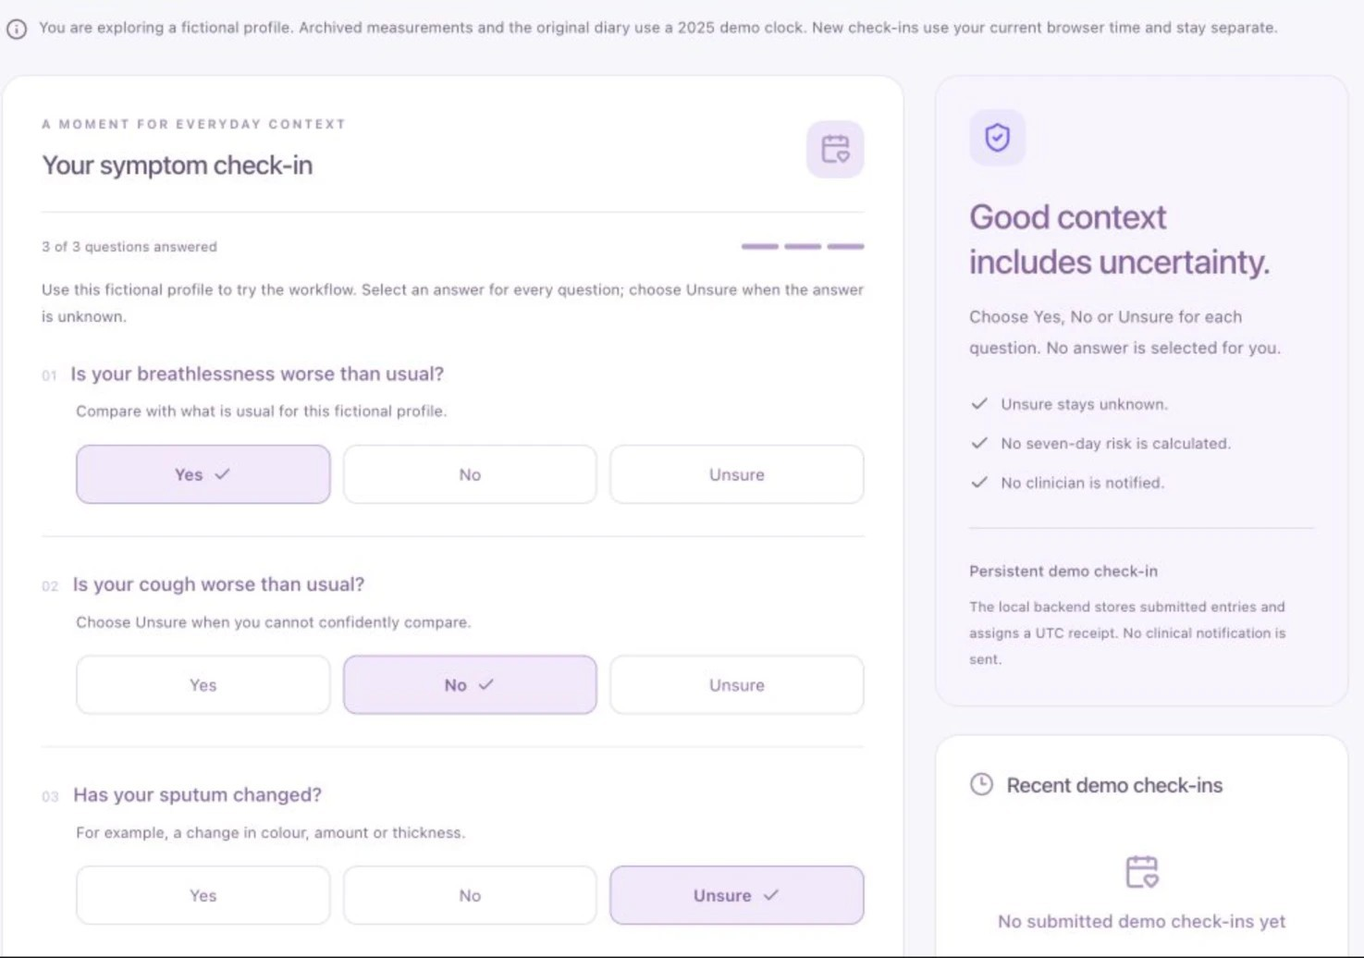
Patient check-in and reporting
P A T I E N T P O R T A L
Yes · No · Unsure
Unsure is stored as unknown, never guessed.
Role-scoped submission
Signed demo roles control who can submit and view.
Separate clocks
Archived data uses a 2025 demo clock; new check-ins use current time.
Exports
PDF, CSV and JSON reports.
Unsubmitted fictional form, shown for illustration.

Slide 13
Evidence and the next validation step
E V I D E N C E
100K-patient synthetic source
Kaggle v3 · Apache-2.0 · hashes verified
8,450
fictional COPD profiles
8,421
simulator initialisation profiles (29 pre-anchor deaths excluded)
800
profiles sampled for the ML experiment
Local archive kept separate, never merged: 86 TOLIFE participants · 53 BIDMC relative-clock recordings. Real-person records are excluded from the public repository.
Next validation step
Software verification
75 automated tests and a production build passed for the public export. This is engineering verification, not clinical validation.
•
•
•
Event-linked longitudinal observations with verified timing Predeclared, patient-separated evaluation
Incident-event recall, calibration and independent validation
Team code MIT-licensed; upstream dataset terms remain Apache-2.0.

Slide 14
Guruyugan Karthik
T E A M
Pulmira
Digital Twin Challenge 2026 Chennai Institute of Technology
Harishram B
Harihara Srinivas T
R E P O S I T O R Y
github.com/GuruyuganKarthik8377/Pulmira
Local research prototype. Fictional demonstration data.

