Slide 1
Contactless Employee Check-In System

Slide 2
Introduction
In problem statement, daily activities of 30 employees using data from their smartphones, which are equipped with sensors like Accelerometers and Gyroscopes. We will classify these activities into six main categories:
1. WALKING
2. WALKING_UPSTAIRS
3. WALKING_DOWNSTAIRS
4. SITTING
5. STANDING
6. LAYING
The sensor data corresponding to these activity labels will be used to build a machine learning model. This model will analyze and identify patterns in an individual's activities and predict whether the person is among the 30 registered employees.
We will evaluate machine learning model based on their accuracy and prediction.

Slide 3
Dataset Analysis
Given dataset has
'features.txt': List of all features.
'train/X_train.txt': Training set.
'train/y_train.txt': Training labels.
'test/X_test.txt': Test set.
'test/y_test.txt': Test labels.

Slide 4
Assumptions
Data Quality: Assuming the dataset is clean and accurately labeled.
Feature Independence: Assumming features are mostly independent, or regularization will manage dependencies.
Sufficient Data: Assuming the dataset size is adequate for training a reliable model.
Real-world Applicability: Assuming that the patterns in the dataset reflect real-world walking patterns of employees.

Slide 5
Choosing Logistic Regression
The dataset has 561 features, Logistic Regression can efficiently handle this number of features.
Baseline Performance: Good starting point for benchmarking other models.
Scalability: Efficiently handles high-dimensional data. Logistic Regression scales well with larger datasets. Given that the dataset contains data from multiple subjects and potentially large amounts of data per subject, Logistic Regression's scalability makes it a practical choice.
Robustness to Noise: Handles noisy data well, which is common in sensor data.
Quick Training: Faster to train compared to more complex models.

Slide 6
Data Loading and Preprocessing
Load the dataset from Google Drive.
Unzip and read the training and test datasets.
Add 'Subject' and 'activity' columns to the dataframes.
Display the first few rows of the data to verify.

Slide 7
Data Loading and Preprocessing
I have downloaded our dataset from this link.
Uploaded UCI HAR Dataset to google drive to use it in google collab notebook.

Slide 8
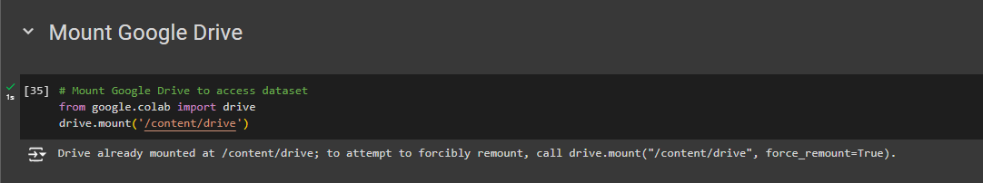
Load the dataset from Google Drive

Slide 9
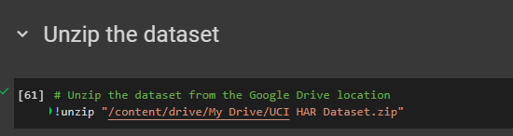
Unzip the dataset

Slide 10
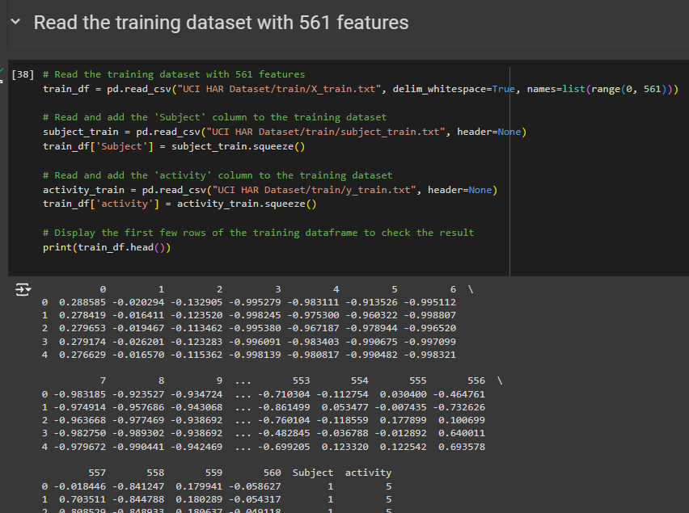
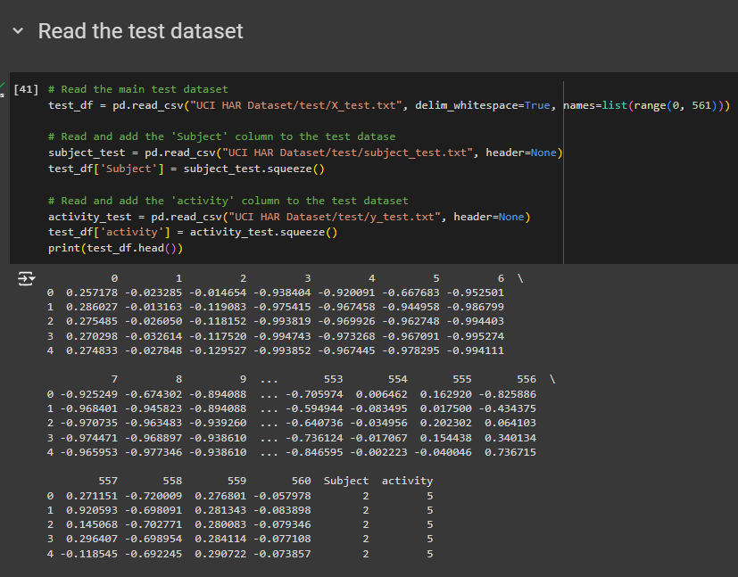
Read the training and test datasets

Slide 11
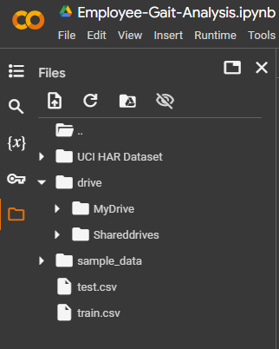
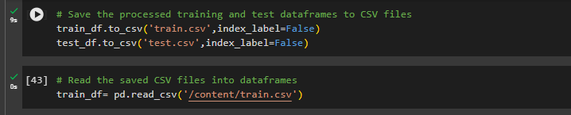


Saving dataframes to CSV files
Save the processed training and test dataframes to CSV files

Slide 12
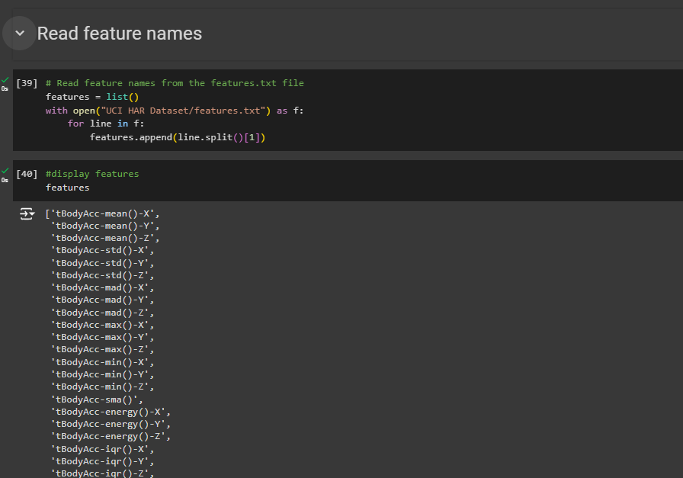
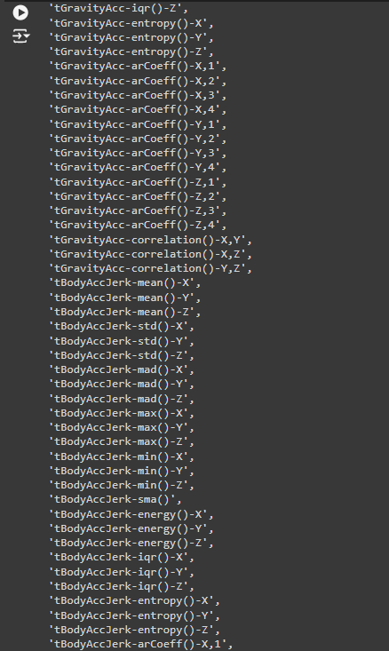
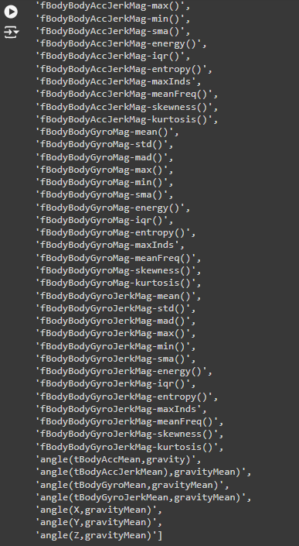
Read feature names

Slide 13
Train-Test Split
Split the dataset into training and testing sets.
Train Test data 70-30 split.
Ensured the target variable ('Activity') is separated from features.
Shapes of the split datasets.

Slide 14
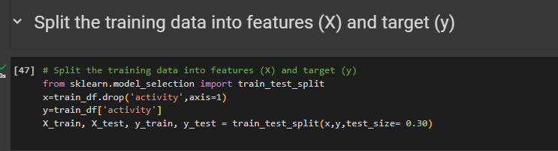
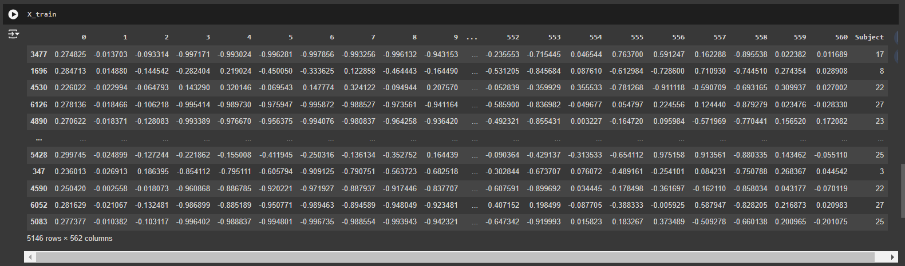
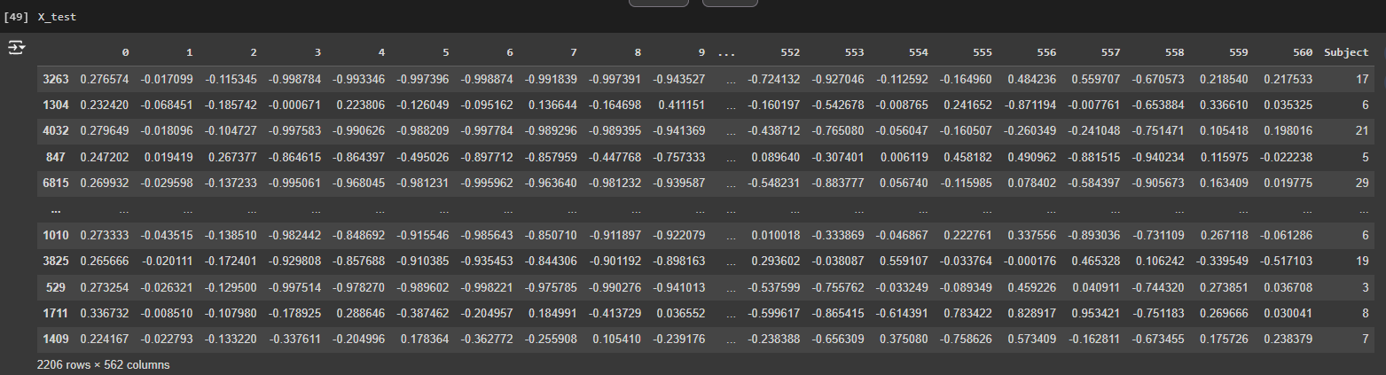
Split the dataset into training and testing sets
test_size is 0.30 to ensure 70-30 split between train-test

Slide 15
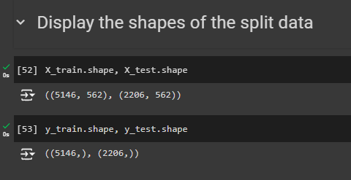

Display shapes of the split datasets

Slide 16
Model Training with Logistic Regression
Initialize and train the Logistic Regression model.
Setting max_iter to 5000 to ensure convergence.
Display training accuracy and prediction

Slide 17
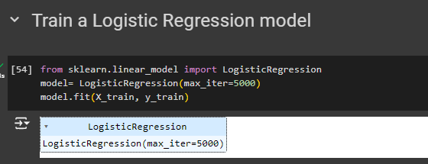
Model Training with Logistic Regression

Slide 18
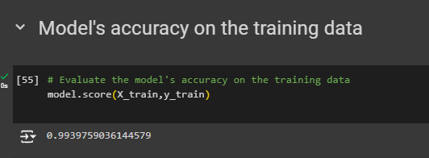

Accuracy on training data

Slide 19
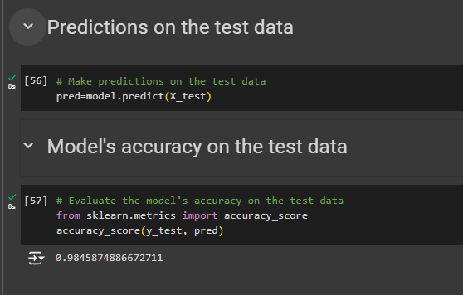
Accuracy on testing data

Slide 20
Performance metrics
Confusion matrix
Classification Report (Recall ,Precision, F1 score, support)

Slide 21
Confusion matrix
A confusion matrix is a table used to evaluate the performance of a classification model. It provides a detailed breakdown of the model's predictions compared to the actual outcomes. The matrix consists of four key components:
True Positives (TP): The number of correctly predicted positive cases.
True Negatives (TN): The number of correctly predicted negative cases.
False Positives (FP): The number of negative cases incorrectly predicted as positive (Type I error).
False Negatives (FN): The number of positive cases incorrectly predicted as negative (Type II error).

Slide 22
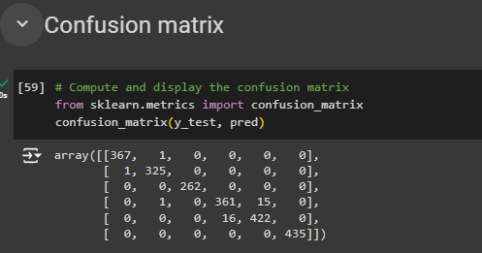
Confusion matrix

Slide 23
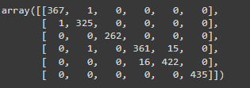
Confusion matrix
High values on the diagonal indicate that the model performs very well in correctly classifying the activities.
Off-diagonal elements are relatively small, indicating few misclassifications.
Only a few instances of false positives and false negatives, which implies the model has high precision and recall.
For example, Activity 1 has only one misclassified instance as Activity 2. Activity 4 has 16 misclassified instances as Activity 5, which is the highest off-diagonal value in the matrix.
Activities 3 and 6 have no misclassifications. All instances of Activity 3 (262) and Activity 6 (435) are correctly classified.
Overall, the model exhibits strong performance in classifying the activities with high accuracy. The confusion between certain activities (particularly Activities 4 and 5) could be an area for further investigation and improvement.

Slide 24
Classification report
Precision: Indicates how many of the predicted positive cases were actually positive.
Recall: Indicates how many of the actual positive cases were correctly identified.
F1 Score: The harmonic mean of precision and recall, providing a single metric that balances both concerns.
Support: Support is the number of actual occurrences of each class in the dataset.

Slide 25
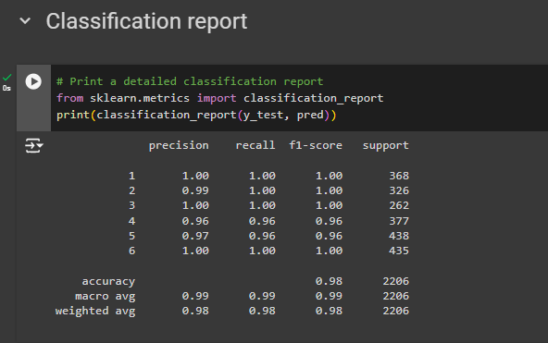
Classification report

Slide 26
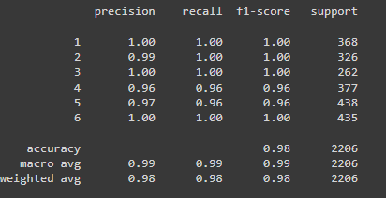
Precision
Activity 1: Precision = 1.00, meaning all instances predicted as Activity 1 are actually Activity 1.
Activity 2: Precision = 0.99, indicating 1% of predictions for Activity 2 are incorrect.
Activity 3: Precision = 1.00, perfect precision.
Activity 4: Precision = 0.96, indicating some misclassification with other activities.
Activity 5: Precision = 0.97, similar slight misclassification as Activity 4.
Activity 6: Precision = 1.00, perfect precision.
High precision (close to 1.00) for most activities indicates that when the model predicts a specific activity, it is almost always correct.

Slide 27
Recall
Activity 1: Recall = 1.00, meaning all actual instances of Activity 1 are correctly predicted.
Activity 2: Recall = 1.00, perfect recall.
Activity 3: Recall = 1.00, perfect recall.
Activity 4: Recall = 0.96, indicating some instances of Activity 4 are misclassified.
Activity 5: Recall = 0.96, similar to Activity 4, some instances are misclassified.
Activity 6: Recall = 1.00, perfect recall.
High recall (close to 1.00) for most activities indicates that the model is able to correctly identify nearly all instances of each activity.

Slide 28
F1-Score
Activity 1: F1-Score = 1.00, perfect balance between precision and recall.
Activity 2: F1-Score = 1.00, perfect balance.
Activity 3: F1-Score = 1.00, perfect balance.
Activity 4: F1-Score = 0.96, indicating a slight drop due to misclassification.
Activity 5: F1-Score = 0.96, similar to Activity 4.
Activity 6: F1-Score = 1.00, perfect balance
High F1-scores (close to 1.00) for most activities indicate a good balance between precision and recall, showing the model's overall effectiveness in classification.

Slide 29
Support
Activity 1: Support = 368, the model predicted 368 instances.
Activity 2: Support = 326, the model predicted 326 instances.
Activity 3: Support = 262, the model predicted 262 instances.
Activity 4: Support = 377, the model predicted 377 instances.
Activity 5: Support = 438, the model predicted 438 instances.
Activity 6: Support = 435, the model predicted 435 instances.
The support values show the number of instances for each activity in the test set, highlighting the distribution and ensuring that the model's performance is consistent across different activities

Slide 30
Conclusion
Our model exhibits exceptional performance across all activities, boasting high precision, recall, and F1-scores. While there are slight dips in metrics for Activities 4 and 5, indicating minor misclassifications, the overall accuracy of 98% underscores the robustness of our model in accurately recognizing and classifying various activities based on the dataset.
Moving forward, focusing on refining the model's handling of Activities 4 and 5 could lead to even greater performance improvements. Overall, our contactless employee check-in system, leveraging machine learning and gait analysis, promises efficient and accurate identification of employees, enhancing security and convenience within Stark Industries.

