Slide 1
Big Data Programming Project
Gurvinder Nagra
5011CEM

Slide 2
Introduction
The goals of this project are to showcase the difference between parallel and sequential processing and how much faster a process can be done.
We will show how from the current analysis time we can process the data much quicker and find the correct number of processors required to achieve the target processing time.
As well as that we shall deal with testing the code itself and improving how we test it.
Finally making sure to extrapolate our results to prove our analysis is correct.

Slide 3
Techniques used to compare parallel and sequential processing
The techniques used to compare parallel and sequential involved running both processes, then taking the results from each.
Using these results we created plots which showed us the difference in time and from there we can use the plots to compare speeds.
Throughout the code we also made use of re-usable functions when calling both parallel and sequential.

Slide 4
Techniques used to run tests
Techniques that were used to test the code made use of both functional and break testing.
The code utilises functions to call different tests when needed throughout, and run them.
Once any functional tests have been run we will make use of break testing to ensure that the code will stop if there are any issues or skip past instead. We also can manually change values to suit the data we are testing better.

Slide 5
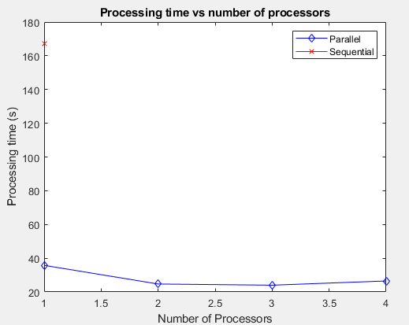
Results of testing
The results of our test showed that as we continued to increase the number of processors we usedthe time taken for parallel processing decreased as shown in the graph and how sequential was much slower in comparison.

Slide 6
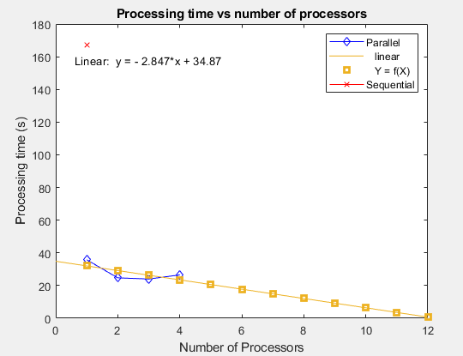
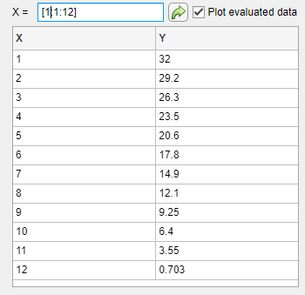
Extrapolation of tests
The extrapolation of our tests gives us the linear line which has a downwards trend on the graph. This shows us for 1000 data that is being processed in increments of 50 will get faster to a certain point.
For 5 hours and 1000 data the target is 12 processors for the fastest time, for the entire dataset this would be estimated at 32,641.97 seconds meaning we would need 24 processors.
From our finding the total amount of workers required for the entire data was calculated to learn that it would take 208,353 seconds (58 hours) to do the entire dataset, since we need to do it within 2 hours would need to do it 30x as fast. Meaning we would need 30 times as many workers so 120 workers.
Resource monitors were also used to help calculate how much memory is needed per worker which is 275mb which means that the total amount of memory that would be needed for the entire 5000 data would be 5500mb from the calculations made.

Slide 7
Summary
Overall our results have shown that parallel processing is indeed faster than sequential processing and will yield the results that we require in a faster more desired time frame.
As well as that modifications we have made allow the code to be more useful through functions and testing.
We are also able to successfully extrapolate our results and use it to estimate what we need for the full dataset.

Slide 8
Questions and Answers
You have tested your code using ozone (o₃). We have many chemical species to analyse, how would you need to adapt your code to work with carbon dioxide (CO₂) for example.
If we wanted to analyse multiple chemical species at the same time, how would that affect our HPC requirements, e.g. number of processors?
One of our measuring instruments uses -9999 as an error code, not NaN. How would you adapt your code to check for this error?

Slide 9
References
MATLAB. (n.d.). parfor. Retrieved from MATLAB Documentation: https://uk.mathworks.com/help/parallel-computing/parfor.html
Rajpurohit, A. (2017, April 17). Must-Know: When can parallelism make your algorithms run faster? When could it make your algorithms run slower? Retrieved from kdnuggets: https://www.kdnuggets.com/2017/04/must-know-parallelism-algorithms.html
MATLAB. (n.d.). Length. Retrieved from MATLAB: https://www.mathworks.com/help/matlab/ref/length.html?searchHighlight=length&s_tid=srchtitle_length_1
MATLAB. (n.d.). Disp. Retrieved from MATLAB Documentation: https://www.mathworks.com/help/matlab/ref/disp.html

Slide 10
END

