Slide 1
ESE-2014 Digital Signal Processing and Storage
Linchen Wang

Slide 2



Review
$${x(t)}_{}$$
Sample
$${x(nT}_{s})$$
Quantize
Encode
$${y(t)}_{}$$
Analog signal
(Continuous in both time and amplitude)
Sampled-data signal
(Discrete in time and continuous in amplitude)
Discrete time discrete amplitude signal
Digital signal

Slide 3
Outline
Types of signal
Some types of sequences in discrete-time signal
Operation on sequences

Slide 4
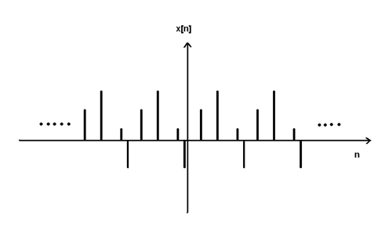
Types of signal: Discrete time signal
Discrete time signal: It is a time series consisting of a sequence of quantities.
It may been obtained by sampling from a continuous-time signal.

Slide 5
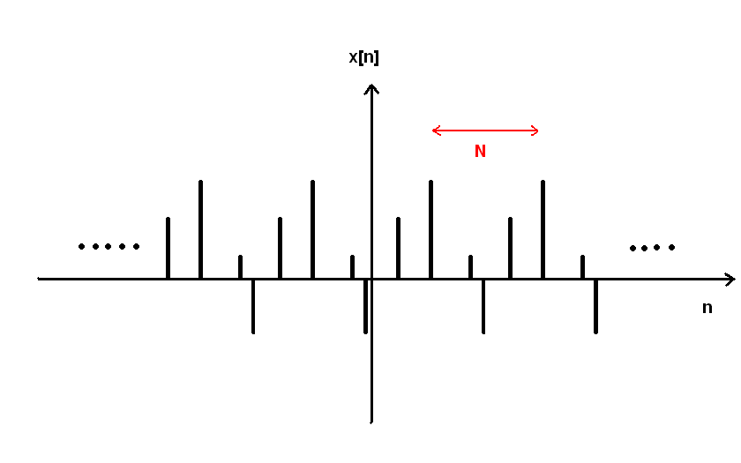

Types of signal: Periodic signal
Periodic signal: A signal if it completes a pattern within a measurable time frame, call a period and repeats that pattern over identical subsequent periods.
Period: it is the smallest value of T satisfying $g\left(t+T\right)=g(t)$ for all $t$.

Slide 6
Types of signal: Energy signal & Power signal
Energy signal and Power signal
The terms signal energy and signal power are used to characterize a signal.

Slide 7

Types of signal: Energy signal & Power signal
Continuous-time signal
$E=\int_{−∞}^{∞}{{|x(t)|}^{2}ⅆt}$ $P=\lim_{T→∞}{\frac{1}{2T}}\int_{−T}^{T}{{|x(t)|}^{2}ⅆt}$
Discrete-time signal
$E=\sum_{n=−∞}^{∞}{{|x[t]|}^{2}}$ $P=\lim_{N→∞}{\frac{1}{2N+1}\sum_{n=−n}^{N}{{|x[t]|}^{2}}}$
If $0<E<∞$, the signal $x(t)$ is an energy signal.
If $0<P<∞$, the signal $x(t)$ is a power signal.

Slide 8









Types of signal: Energy signal & Power signal
A signal can be an energy signal, a power signal, or neither.
A signal can not be both an energy signal and a power signal.
Note, the power for an energy signal is zero (P=0).
The energy for a power signal is infinite (E=$∞$).
$$0<E<∞$$
$$0<P<∞$$
$$P=\frac{E}{t}$$
$$=0$$
$$E=P∗t$$
$$=∞$$
$$∞$$
$$∞$$

Slide 9
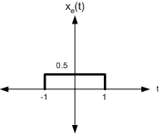
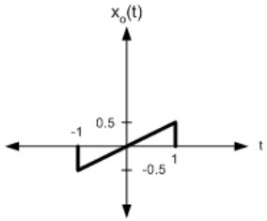

Types of signal: Even & odd signal
One of characteristics of signal is symmetry that may be useful for signal analysis.
Even signals are symmetric around vertical axis.
$x\left(t\right)=x(−t)$ $x\left[t\right]=x[−t]$
Odd signals are symmetric about origin.
$x\left(t\right)=−x(−t)$ $x\left[t\right]=−x[−t]$
An odd signal must be 0 at $t=0$, means odd signals pass the origin.

Slide 10
Some types of sequences in discrete-time signal
X(n) = {…, x(-1), x(0), x(1), …}
Up-arrow indicates the sample at n = 0.
E.g. x(n) = {2, 1, -1, 0, 1, 4, 3, 7}
x = [2, 1, -1, 0, 1, 4, 3, 7]
n = [-3,-2,-1,0, 1, 2, 3, 4]

Slide 11

Unit sample sequence
$$δ\left(n\right)=\left\{\begin{aligned}1, n=0 \\ 0, n≠0\end{aligned}=\{…, 0, 0, 1,0,0,…\}\right.$$
$$δ\left(n−n_{0}\right)=\left\{\begin{aligned}1, n=n_{0} \\ 0, n≠n_{0}\end{aligned}\right.$$

Slide 12

Unit sample sequence
Instead of use zeros(1, n)
$≫$Function [x, n] = impseq (n0, n1, n2)
$≫$% Generates x(n) = delta(n-n0); n1 <= n <= n2
$≫$% [x, n] = impseq (n0, n1, n2)
$≫$n = [n1: n2]; x=[(n-n0)==0];

Slide 13

Unit step sequence
u$\left(n\right)=\left\{\begin{aligned}1, n≥0 \\ 0, n<0\end{aligned}=\{…, 0, 0, 1,1,1,…\}\right.$
u$\left(n−n_{0}\right)=\left\{\begin{aligned}1, n≥n_{0} \\ 0, n<n_{0}\end{aligned}\right.$

Slide 14

Unit step sequence
Instead of use ones(1, n)
$≫$Function [x, n] = stepseq (n0, n1, n2)
$≫$% Generates x(n) = u(n – n0); n1 <= n <= n2
$≫$% [x, n] = stepseq (n0, n1, n2)
$≫$n = [n1 : n2]; x = [(n – n0) >= 0];

Slide 15

Some types of sequences in discrete-time signal
Real-valued exponential sequence
$$x\left(n\right)=a^{n}, ∀n ;a∈R$$
$≫$ n = [0: 10]; x = (0.9).^n;
Complex-valued exponential sequence
$$x\left(n\right)=e^{\left(σ+jω_{0}\right)n},∀n$$
E.g. $x\left(n\right)=e^{\left(2+j3\right)n},0 ≤n$ $≤$ 10
$≫$ n = [0: 10]; x = exp((2+3j)*n);

Slide 16

Some types of sequences in discrete-time signal
Sinusoidal sequence
$$x\left(n\right)=Asin\left(ω_{0}n+θ_{0}\right), ∀n$$
E.g. $x\left(n\right)=3\cos\left(0.1πn+\frac{π}{3}\right)+2sin⁡(0.5πn)$
$≫$ n=[0: 10]; x = 3*cos(0.1*pi*n+pi/3) + 2*sin(0.5*pi*n);

Slide 17
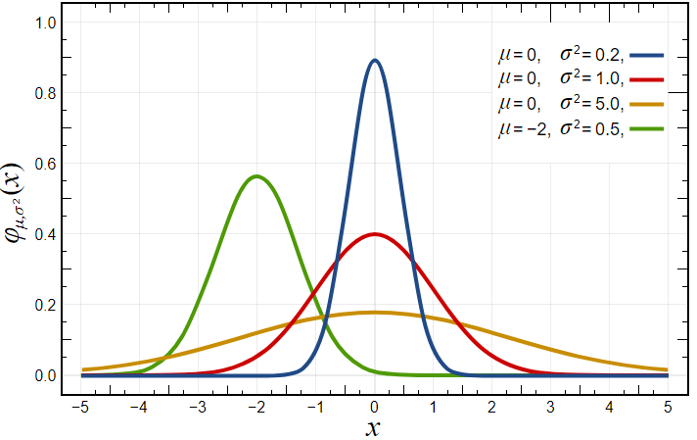
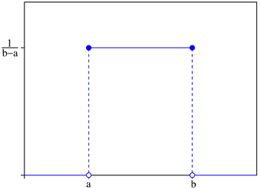
Some types of sequences in discrete-time signal
Random sequence
rand(1,N): generates a length n random sequence whose elements are uniformly distributed between [0, 1].
randn(1,N): generates a length n Gaussian random sequence with mean 0, and variance 1.
Randi(N): generates a length n uniform distribution between [1,N].

Slide 18

Some types of sequences in discrete-time signal
Periodic sequence
$x\left(n\right)=x(n+N)$, N is the fundamental period.
We x tilde to denote a periodic sequence
$≫$ x = [x1, x2, x3, … , xn] % fundamental period
$≫$ xtilde = x’*ones(1,p) % p columns of x; x is a row vector period;
$≫$ xtilde = xtilde(:); % long column vector
$≫$ xtilde = xtilde’; %long row vector

Slide 19

Operation on sequences
There are some basic sequence operations, and let us to talk about their Octave (Matlab) equivalents.
1. Signal addition: This is a sample-by-sample addition given by $\{x1(n)\}+\{x2(n)\}=\{x1(n)+x2(n)\}$
It is implemented in MATLAB by the arithmetic operator “+”. However, the lengths of x1(n) and x2(n)must be the same.

Slide 20
Operation on sequences
If sequences are of unequal lengths, or if the sample positions are diﬀerent for equal length sequences, then we cannot directly use the operator “+”. We have to first augment x1(n) and x2(n) so that they have the same position vector n, which means they should have same length.

Slide 21
Operation on sequences
function [y,n] = sigadd(x1,n1,x2,n2)
% implements y(n) = x1(n)+x2(n)
% [y,n] = sigadd(x1,n1,x2,n2)
% y=sum sequence over n, which includes n1 and n2
% x1=first sequence over n1
% x2=second sequence over n2 (n2 can be different from n1)
% n=min(min(n1),min(n2)):max(max(n1),max(n2)); % duration of y(n)
y1 = zeros(1,length(n)); y2 = y1; % initialization
y1(find((n>=min(n1))&(n<=max(n1))==1))=x1; % x1 with duration of y
y2(find((n>=min(n2))&(n<=max(n2))==1))=x2; % x2 with duration of y
y=y1+y2; % sequence addition

Slide 22

Operation on sequences
2. Signal multiplication: This is a sample-by-sample (or “dot”) multiplication) given by
$$\{x1(n)\} · \{x2(n)\} = \{x1(n)x2(n)\}$$
It is implemented in MATLAB by the array operator .*.

Slide 23
Operation on sequences
function [y,n] = sigmult(x1,n1,x2,n2)
% implements y(n) = x1(n)*x2(n)
% [y,n] = sigmult(x1,n1,x2,n2)
% y=product sequence over n, which includes n1 and n2
% x1=first sequence over n1
% x2=second sequence over n2 (n2 can be different from n1)=min(min(n1),min(n2)):max(max(n1),max(n2));
% duration of y(n)
y1 = zeros(1,length(n)); y2 = y1;
y1(find((n>=min(n1))&(n<=max(n1))==1))=x1; % x1 with duration of y
y2(find((n>=min(n2))&(n<=max(n2))==1))=x2; % x2 with duration of y
y=y1 .* y2; % sequence multiplication

Slide 24

Operation on sequences
3. Scaling: In this operation each sample is multiplied by a scalar α. $$α \{x(n)\} = \{αx(n)\}$$
An arithmetic operator (*) is used to implement the scaling operation in Octave (MATLAB).

Slide 25

Operation on sequences
4. Shifting: In this operation, each sample of x(n) is shifted by an amount k to obtain a shifted sequence y(n).
$$y(n) = \{x(n − k)\}$$
function [y,n] = sigshift(x,m,k)
% implements y(n) = x(n-k)
% [y,n] = sigshift(x,m,k)
n=m+k; y = x;

Slide 26

Operation on sequences
5. Folding: In this operation each sample of x(n) is flipped around n = 0 to obtain a folded sequence y(n). $$y(n) = \{x(−n)\}$$
function [y,n] = sigfold(x,n)
% implements y(n) = x(-n)
% [y,n] = sigfold(x,n)
y=fliplr(x); n = -fliplr(n);

Slide 27

Operation on sequences
6. Sample summation: This operation differs from signal addition operation. It adds all sample values of x(n) between n1 and n2. $$\sum_{n=n_{1}}^{n_{2}}{x(n) = x(n1) + · · · + x(n2) }$$
It is implemented by the sum(x(n1:n2)) function

Slide 28

Operation on sequences
7. Sample products: This operation also differs from signal multiplication operation. It multiplies all sample values of x(n) between n1 and n2. $$\prod_{n_{1}}^{n_{2}}{x(n) = x(n1) × · · · × x(n2)}$$ It is implemented by the prod(x(n1:n2)) function.

Slide 29

Operation on sequences
E.g. Let x(n) = {1,2, 3, 4, 5, 6, 7, 6, 5, 4, 3, 2, 1}.
↑
Determine and plot the following sequences.
x1(n) = 2x(n - 5) - 3x(n + 4)
Since the sequence $x(n)$is nonzero over $−2 ≤ n ≤ 10$
>> n = -2:10; x = [1:7,6:-1:1];
[x1,n1] = sigshift(x,n,5); [x2,n2] = sigshift(x,n,-4);
[x3,n3] = sigadd(2*x1,n1,-3*x2,n2);
subplot(2,1,1); stem(n3,x3);
xlabel(’n’); ylabel(’x3(n)’);

Slide 30
Operation on sequences
b. x2(n) = x(3 - n) + x(n) x(n - 2)
The first term can be written as x(-(n - 3)). >> [x4,n4] = sigfold(x,n); [x4,n4] = sigshift(x4,n4,3);
[x5,n5] = sigshift(x,n,2); [x5,n5] = sigmult(x,n,x5,n5);
[x6,n6] = sigadd(x4,n4,x5,n5);
subplot(2,1,2); stem(n6,x6);
xlabel(’n’); ylabel(’x6(n)’);

