Slide 1
Recurrent Neural Networks
Feb 2026

Slide 2



Definition
In a normal feedforward neural network, each input is independent of other input. But with a sequential dataset, we need to know about the past input to make a prediction. A sequence is an ordered set of items. For instance, a sentence is a sequence of words. Let’s suppose that we want to predict the next word in a sentence; to do so, we need to remember the previous words. A normal feedforward neural network cannot predict the correct next word, as it will not remember the previous words of the sentence. Under such circumstances (in which we need to remember the previous input), to make predictions, we use recurrent neural networks (RNNs).

Slide 3
RNN
If we were asked to predict the blank term in the preceding sentence, we would probably say east. Why would we predict that the word east would be the right word here? Because we read the whole sentence, understood the context, and predicted that the word east would be an appropriate word to complete the sentence.
The Sun rises in the ____
I want to brake ____
If we use a feedforward neural network to predict the blank, it would not predict the right word. This is due to the fact that in feedforward networks, each input is independent of other input and they make predictions based only on the current input, and they don’t remember previous input.

Slide 4
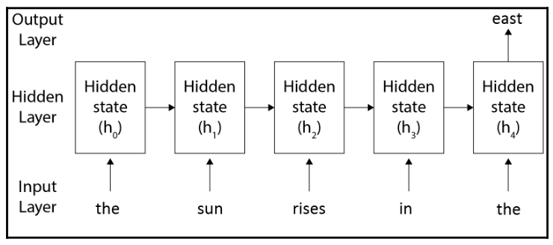
RNN
For instance, let's take the same sentence, The sun rises in the ____. As shown in the following figure, we first pass the word the as an input, and then we pass the next word, sun, as input; but along with this, we also pass the previous hidden state. So, every time we pass the input word, we also pass a previous hidden state as an input.

Slide 5
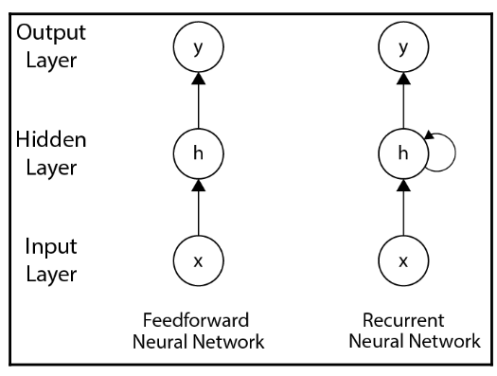
Feedforward Vs RNN
A comparison between an RNN and a Feedforward network is shown in the following diagram:
As you can observe in the preceding diagram, the RNN contains a looped connection in the hidden layer, which implies that we use the previous hidden state along with the input to predict the output.

Slide 6
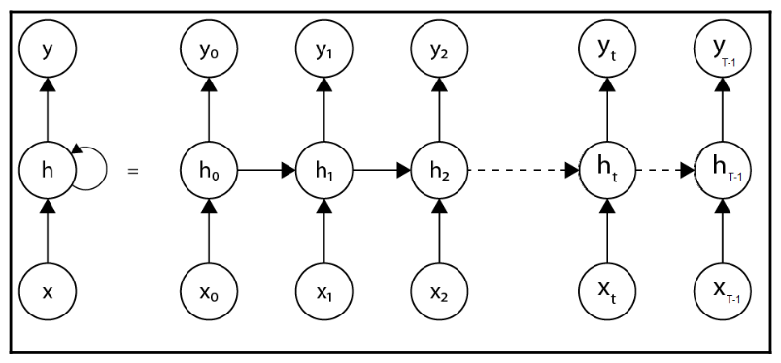
RNN
Let's look at the following unrolled version of an RNN. But wait; what is the unrolled version of an RNN? It means that we roll out the network for a complete sequence. Let's suppose that we have an input sentence with words; then, we will have to layers, one for each word, as shown in the following figure:

Slide 7
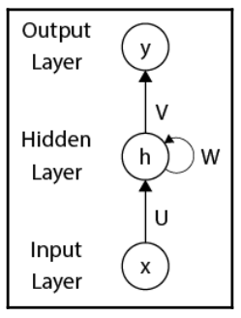
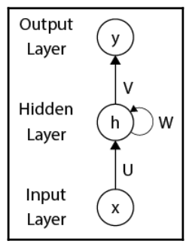

Forward Propagation using RNN
Let's look at how an RNN uses forward propagation to predict the output; but before we jump right in, let's get familiar with the notations:
The preceding figure illustrates the following:
U represents the input to hidden layer weight matrix
W represents the hidden to hidden layer weight matrix
V represents the hidden to output layer weight matrix
The hidden state at a time step can be computed as follows:

Slide 8

Forward Propagation using RNN
The hidden state at a time step can be computed as follows:
The output at a time step can be computed as follows:

Slide 9
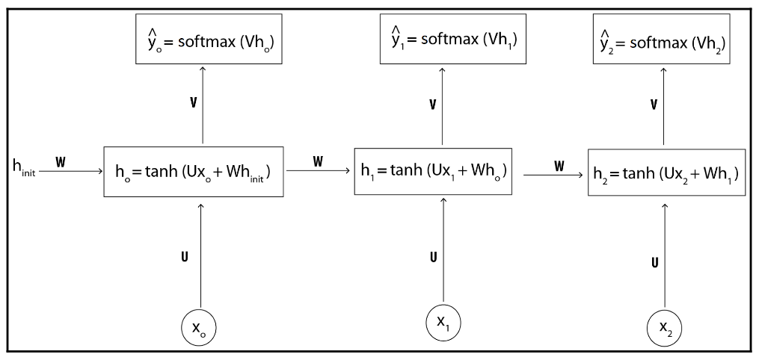
Forward Propagation using RNN
The following diagram shows how forward propagation works in an unrolled version of an RNN:

Slide 10

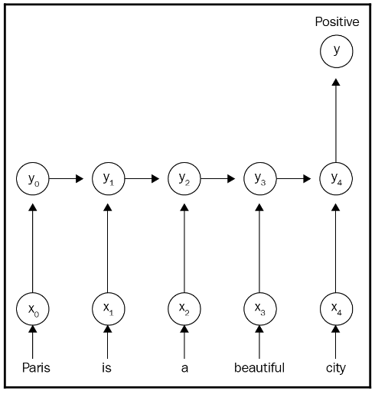
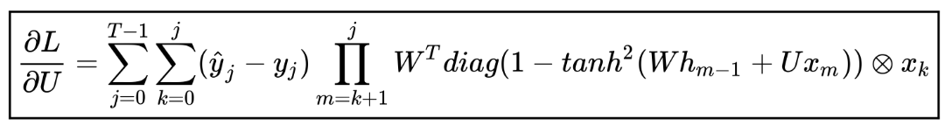



















RNN Example (Many-to-one)
$$h_{1}$$
$$h$$
$$y$$
$$x$$
$$y$$
$$x$$
$$h_{2}$$
recurrent layer
recurrent layer
recurrent layer
$$h_{1,t+1}$$
$$h_{1,t+2}$$
feedforward layer
$$h_{1,t}$$
$$y_{t+2}$$
$$h_{0}$$
$$h_{2,t}$$
$$h_{2,t+1}$$
$$h_{2,t+2}$$
$$x_{t}$$
$$x_{t+1}$$
$$x_{t+2}$$

Slide 11

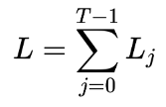
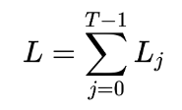
Back Propagation using RNN
We just learned how forward propagation works in RNNs and how it predicts the output. Now, we compute the loss, L , at each time step, t, to determine how well the RNN has predicted the output. We use the cross-entropy loss as our loss function. The los L at a time step t can be given as follows:
The final loss is a sum of the loss at all the time steps. Suppose that we have T-1 layers; then, the final loss can be given as follows:

Slide 12
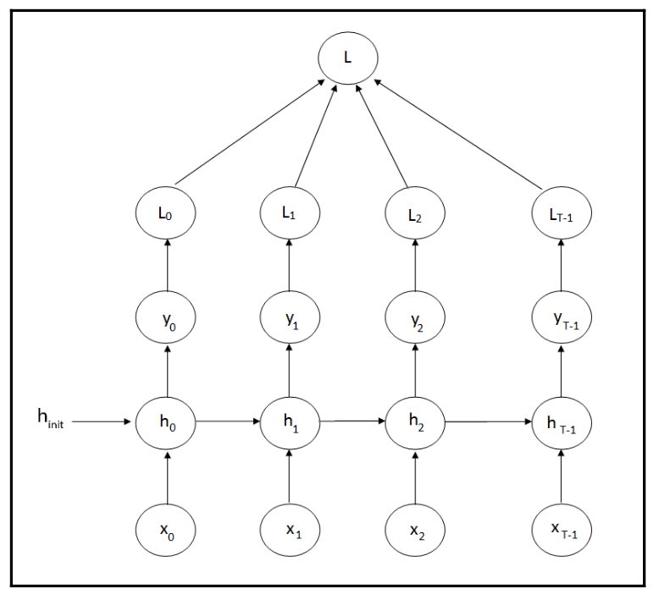
Back Propagation using RNN

Slide 13
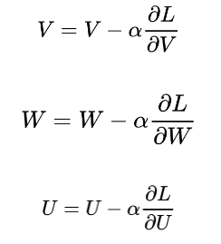
Back Propagation using RNN
We computed the loss, now our goal is to minimize the loss. How can we minimize the loss? We can minimize the loss by finding the optimal weights of the RNN. As we learned, we have three weights in RNNs: input to hidden, U, hidden to hidden, W, and hidden to output, V. We need to find optimal values for all of these three weights to minimize the loss. We can use our favorite gradient descent algorithm to find the optimal weights. We begin by calculating the gradients of the loss function with respect to all the weights; then, we update the weights according to the weight update rule as follows:

Slide 14



Back Propagation using RNN
As we have learned, the loss L at a time step t can be given as follows:
Thus, the gradient of the los L with respect to becomes:

Slide 15
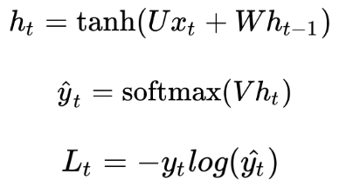
Back Propagation using RNN
First, let's recap the steps involved in the forward propagation:

Slide 16

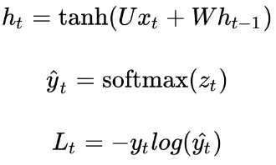
Back Propagation using RNN
Let's suppose that , and substituting this into the previous equation, we can rewrite the preceding steps as follows:

Slide 17

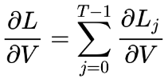
Back Propagation using RNN
After predicting the output, we are in the final layer of the network. Since we are backpropagating, that is, going from the output layer to the input layer, our first weight would be V, which is the hidden to output layer weight. We have seen that the final loss is the sum of the loss over all the time steps, and similarly, the final gradient is the sum of gradients over all the time steps:

Slide 18

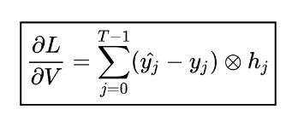
Back Propagation using RNN
Thus, our equation becomes the following:

Slide 19

Back Propagation using RNN
Now, we will compute the gradients of loss with respect to hidden to hidden layer weights, W. Similar to V, the final gradient is the sum of the gradients at all time steps:

Slide 20




Back Propagation using RNN
$$\overset{^}{y_{1}}=softmax\left(Vh_{1}\right)$$
The equation then becomes the following:

Slide 21




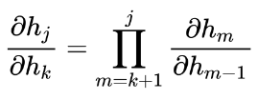
Back Propagation using RNN
The equation then becomes the following:

Slide 22
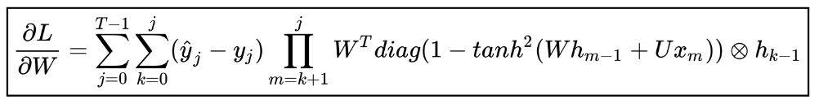
Back Propagation using RNN

Slide 23
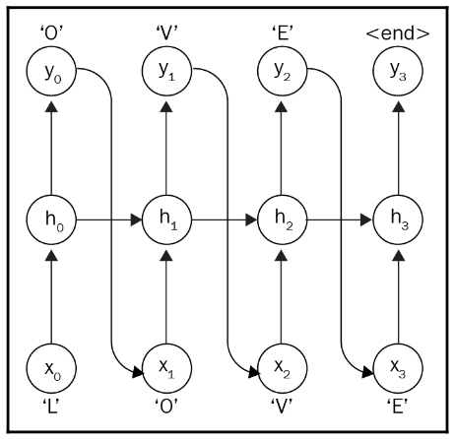
Different RNN Architectures
One-to-one
In a one-to-one architecture, a single input is mapped to a single output, and the output from the time step t is fed as an input to the next time step. For instance, for a text generation task, we take the output generated from a current time step and feed it as the input to the next time step to generate the next word. This architecture is also widely used in stock market predictions. The following figure shows the one-to-one RNN architecture. As you can see, output predicted at the time step t is sent as the input to the next time step:

Slide 24
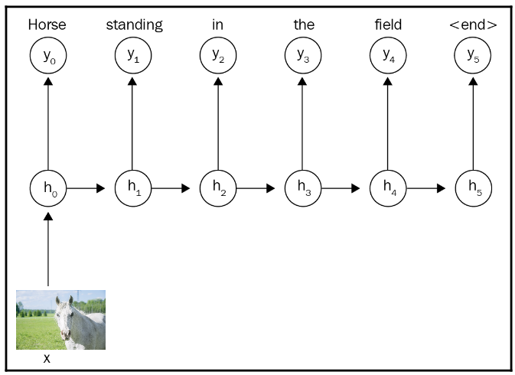
Different RNN Architectures
One-to-many
In a one-to-many architecture, a single input is mapped to multiple hidden states and multiple output values, which means RNN takes a single input and maps it to an output sequence. Although we have a single input value, we share the hidden states across time steps to predict the output. Unlike the previous one-to-one architecture, here, we only share the previous hidden states across time steps and not the previous outputs. One such application of this architecture is image caption generation. We pass a single image as an input, and the output is the sequence of words constituting a caption of the image.

Slide 25
Different RNN Architectures
Many-to-one
A many-to-one architecture, as the name suggests, takes a sequence of input and maps it to a single output value. One such popular example of a many-to-one architecture is sentiment classification. A sentence is a sequence of words, so on each time step, we pass each word as input and predict the output at the final time step. Let's suppose that we have a sentence: Paris is a beautiful city. As shown in the following figure, at each time step, a single word is passed as an input, along with the previous hidden state; and, at the final time step, it predicts the sentiment of the sentence:

Slide 26
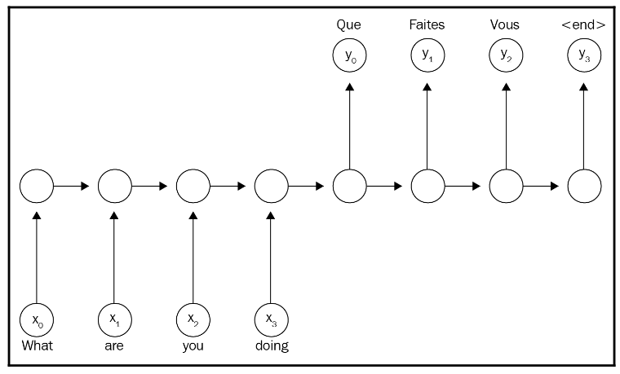
Different RNN Architectures
Many-to-many
In many-to-many architectures, we map a sequence of input of arbitrary length to a
sequence of output of arbitrary length. This architecture has been used in various applications. Some of the popular applications of many-to-many architectures include language translation, conversational bots, and audio generation. Let's suppose that we are converting a sentence from English to French. Consider our input sentence: What are you doing? It would be mapped to, Que faites vous as shown in the following figure:

Slide 27
Long-short-term-memory (LSTM)
The drawback of a recurrent neural network (RNN) is that it will not retain information for a long time in memory. We know that an RNN stores sequences of information in its hidden state but when the input sequence is too long, it cannot retain all the information in its memory due to the vanishing gradient problem, which we discussed in the previous chapter.
To combat this, we introduce a variant of RNN called a long short-term memory (LSTM) cell, which resolves the vanishing gradient problem by using a special structure called a gate. Gates keep the information in memory as long as it is required. They learn what information to keep and what information to discard from the memory.

Slide 28
Long-short-term-memory (LSTM)
While backpropagating an RNN, we discovered a problem called vanishing gradients. Due to the vanishing gradient problem, we cannot train the network properly, and this causes the RNN to not retain long sequences in the memory. To understand what we mean by this, let's consider a small sentence:
The sky is __.
An RNN can easily predict the blank as blue based on the information it has seen, but it cannot cover the long-term dependencies. What does that mean? Let's consider the following sentence to understand the problem better:
Archie lived in China for 13 years. He loves listening to good music. He is a fan of comics. He is fluent in ____.

Slide 29
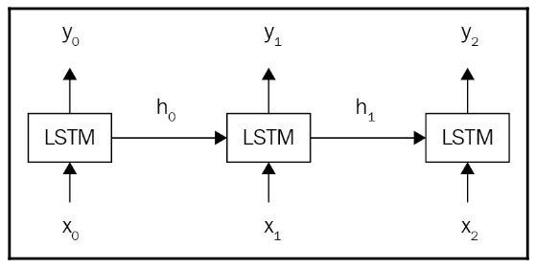
Long-short-term-memory (LSTM)
LSTM is a variant of an RNN that resolves the vanishing gradient problem and retains information in the memory as long as it is required. Basically, RNN cells are replaced with LSTM cells in the hidden units, as shown in the following diagram:

Slide 30
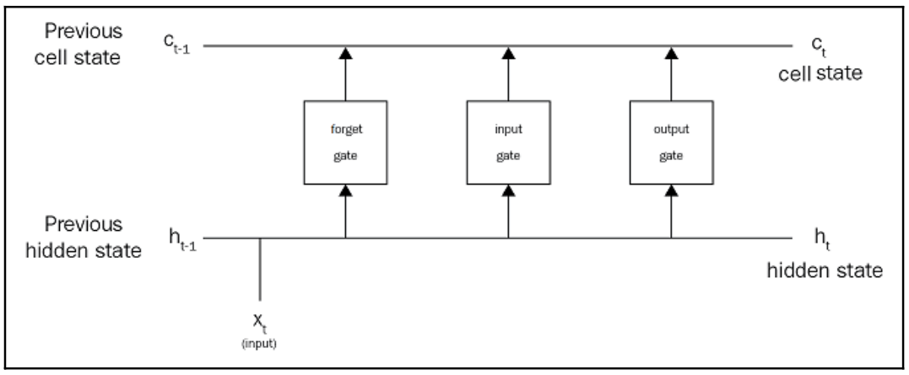
Long-short-term-memory (LSTM)
What makes LSTM cells so special? How do LSTM cells achieve long-term dependency?
How does it know what information to keep and what information to discard from the
memory? This is all achieved by special structures called gates. As shown in the following diagram, a typical LSTM cell consists of three special gates called the input gate, output gate, and forget gate:

Slide 31
Long-short-term-memory (LSTM)
These three gates are responsible for deciding what information to add, output, and forget from the memory. With these gates, an LSTM cell effectively keeps information in the memory only as long as required.

Slide 32
Long-short-term-memory (LSTM)
In an RNN cell, we used the hidden state, , for two purposes: one for storing the information and the other for making predictions. Unlike RNN, in the LSTM cell we break the hidden states into two states, called the cell state and the hidden state:
-The cell state is also called internal memory and is where all the information will
be stored
-The hidden state is used for computing the output, that is, for making predictions
Both the cell state and hidden state are shared across every time step.

Slide 33

Forget gate
The forget gate, ft, is responsible for deciding what information should be removed from the cell state (memory). Consider the following sentence:
Harry is a good singer. He lives in New York. Zayn is also a Good _______.
As soon as we start talking about Zayn, the network will understand that the subject has been changed from Harry to Zayn, and the information about Harry is no longer required. Now, the forget gate will remove/forget information about Harry from the cell state.

Slide 34

Input gate
The input gate is responsible for deciding what information should be stored in the cell state. Let's consider the same example:
Harry is a good singer. He lives in New York. Zayn is also a good singer.
After the forget gate removes information from the cell state, the input gate decides what information it has to keep in the memory. Here, since the information about Harry is removed from the cell state by the forget gate, the input gate decides to update the cell state with information about Zayn.

Slide 35

Output gate
We will have a lot of information in the cell state (memory). The output gate is responsible for deciding what information should be taken from the cell state to give as an output.
Consider the following sentence:
Zayn's debut album was a huge success. Congrats ____.
The output gate will look up all the information in the cell state and select the correct
information to fill the blank. Here, congrats is an adjective that is used to describe a noun. So, the output gate will predict Zayn (noun) to fill the blank. Similar to other gates, it is also controlled by a sigmoid function. The output gate at time step is expressed as follows:

Slide 36
Questions?

