Slide 1
Convolutional Neural Networks
Feb 2026

Slide 2
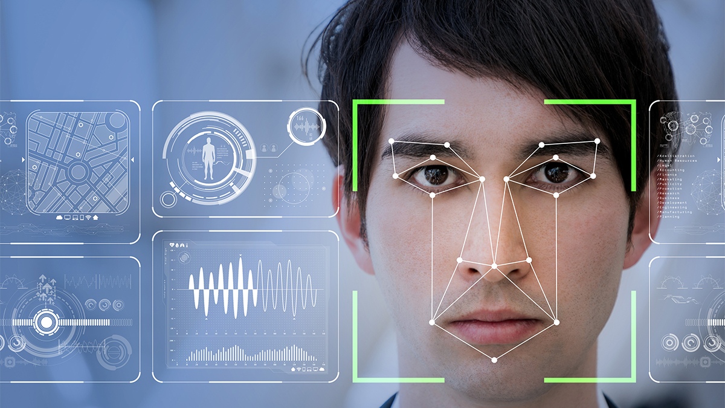
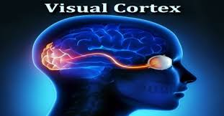
Definition
Convolutional Neural Networks (CNNs) are one of the most commonly used Deep learning algorithms. They are widely used for image-related tasks, such as image recognition, object detection, image segmentation, and more. The applications of CNNs are endless, ranging from powering vision in self-driving cars to the automatic tagging of friends in our Facebook pictures. Although CNNs are widely used for image datasets, they can also be applied to textual datasets.

Slide 3
What are CNNs?
A CNN, also known as a ConvNet, is one of the most widely used deep learning algorithms for computer vision tasks. Let's say we are performing an image-recognition task. Consider the following image. We want our CNN to recognize that it contains a horse:

Slide 4
What are CNNs?
How can we do that? When we feed the image to a computer, it basically converts it into a matrix of pixel values. The pixel values range from 0 to 255, and the dimensions of this matrix will be of [image width x image height x number of channels]. A grayscale image has one channel, and colored images have three channels red, green, and blue (RGB).

Slide 5
What are CNNs?
Let's say we have a colored input image with a width of 11 and a height of 11, that is 11 x 11, then our matrix dimension would be of [11 x 11 x 3]. As you can see in [11 x 11 x 3], 11 x 11 represents the image width and height and 3 represents the channel number, as we have a colored image. So, we will have a 3D matrix.

Slide 6
What are CNNs?

Slide 7
What are CNNs?
With the help of these three layers, the CNN recognizes that the image contains a horse. Now we will explore each of these layers in detail.
Okay, now we have an input matrix of pixel values. What happens next? How does the CNN come to understand that the image contains a horse? CNNs consists of the following three important layers:
The convolutional layer
The pooling layer
The fully connected layer

Slide 8
Convolutional Layers
The convolutional layer is the first and core layer of the CNN. It is one of the building blocks of a CNN and is used for extracting important features from the image. We have an image of a horse. What do you think are the features that will help us to understand that this is an image of a horse?

Slide 9
Convolutional Layers
We can say body structure, face, legs, tail, and so on. But how does the CNN understand these features? This is where we apply a convolution operation to extract the key features from the image that characterize the horse. So, the convolution operation helps us to understand what the image is all about.

Slide 10
Convolutional Layers
As we know, every input image is represented by a matrix of pixel values. Apart from the input matrix, we also have another matrix called the filter matrix. The filter matrix is also known as a kernel, or simply a filter, as shown in the following diagram:

Slide 11
Convolutional Layers
We take the filter matrix, slide it over the input matrix by one pixel, perform element-wise multiplication, sum up the results, and produce a single number. That's pretty confusing, isn't it? Let's understand this better with the aid of the following diagram:

Slide 12
Convolutional Layers
We take the filter matrix, slide it over the input matrix by one pixel, perform element-wise multiplication, sum up the results, and produce a single number. That's pretty confusing, isn't it? Let's understand this better with the aid of the following diagram:
F(20+bias)= C

Slide 13
Convolutional Layers

Slide 14
Convolutional Layers

Slide 15
Convolutional Layers

Slide 16
Convolutional Layers
Okay. What are we doing here? We are basically sliding the filter matrix over the entire input matrix by one pixel, performing element-wise multiplication and summing their results, which creates a new matrix called a feature map or activation map. This is called the convolution operation.

Slide 17
Convolutional Layers
As we've learned, the convolution operation is used to extract features, and the new matrix, that is, the feature maps, represents the extracted features. If we plot the feature maps, then we can see the features extracted by the convolution operation. The following diagram shows the actual image (the input image) and the convolved image (the feature map). We can see that our filter has detected the edges from the actual image as a feature:

Slide 18
Convolutional Layers
Sharpen Filter

Slide 19
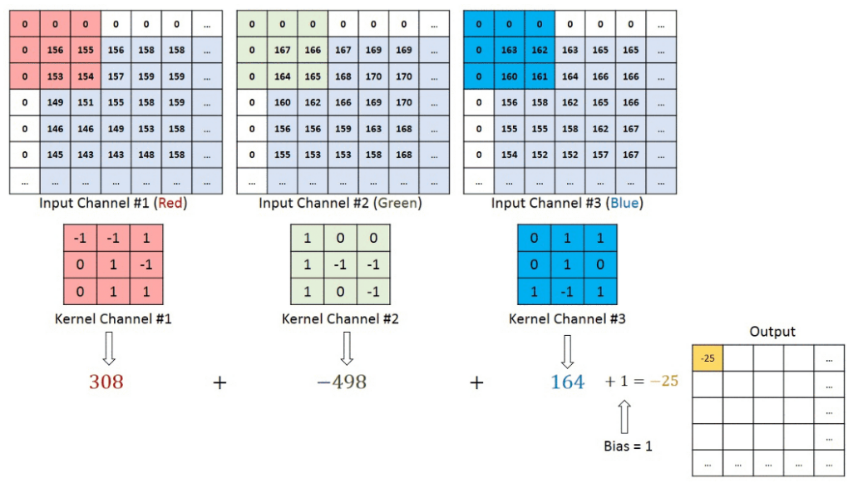
Three Channels and Filters

Slide 20
Three Channels and Filters
Thus, we have learned that with filters, we can extract important features from the image using the convolution operation. So, instead of using one filter, we can use multiple filters for extracting different features from the image, and produce multiple feature maps. So, the depth of the feature map will be the number of filters. If we use seven filters to extract different features from the image, then the depth of our feature map will be seven:

Slide 21
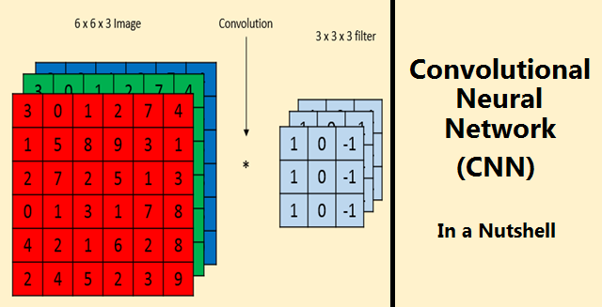
Three Channels and Filters
Okay, we have learned that different filters extract different features from the image. But the question is, how can we set the correct values for the filter matrix so that we can extract the important features from the image? Worry not! We just initialize the filter matrix randomly, and the optimal values of the filter matrix, with which we can extract the important features from the images, will be learned through backpropagation. However, we just need to specify the size of the filter and the number of filters we want to use.

Slide 22
Strides
We have just learned how a convolution operation works. We slide over the input matrix with the filter matrix by one pixel and perform the convolution operation. But we can't only slide over the input matrix by one pixel. We can also slide over the input matrix by any number of pixels. The number of pixels we slide over the input matrix by the filter matrix is called a stride.
If we set the stride to 2, then we slide over the input matrix with the filter matrix by two pixels. The following diagram shows a convolution operation with a stride of 2:

Slide 23
Padding
With the convolution operation, we are sliding over the input matrix with a filter matrix. But in some cases, the filter does not perfectly fit the input matrix. What do we mean by that? For example, let's say we are performing a convolution operation with a stride of 1. There exists a situation where, when we move our filter matrix by two pixels, it reaches the border and the filter matrix does not fit the input matrix. That is, some part of our filter matrix is outside the input matrix, as shown in the following diagram

Slide 24
Padding
In this case, we perform padding. We can simply pad the input matrix with zeros so that the filter can fit the input matrix, as shown in the following diagram. Padding with zeros on the input matrix is called same padding or zero padding:

Slide 25
Padding
Instead of padding them with zeros, we can also simply discard the region of the input matrix where the filter doesn't fit in. This is called valid padding:

Slide 26
Pooling
As a result of the convolution operation, we have some feature maps. But the feature maps are too large in dimension. In order to reduce the dimensions of feature maps, we perform a pooling operation. This reduces the dimensions of the feature maps and keeps only the necessary details so that the amount of computation can be reduced.
There are different types of pooling operations, including max pooling, average pooling, and sum pooling. In max pooling, we slide over the filter on the input matrix and simply take the maximum value from the filter window, as shown in the following diagram:

Slide 27
Pooling
The pooling operation will not change the depth of the feature maps; it will only affect the height and width.

Slide 28
Fully Connected Layers
A CNN can have multiple convolutional layers and pooling layers. However, these layers will only extract features from the input image and produce the feature map; that is, they are just the feature extractors.

Slide 29
How the CNN Learn?
For now, let us give an abstract description of the CNN structure first.

Slide 30
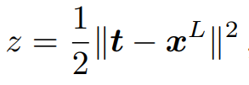
How the CNN Learn?
The last layer is a loss layer. Let us suppose t is the corresponding target (ground-truth) value for the input x 1 , then a cost or loss function can be used to measure the discrepancy between the CNN prediction x L and the target t. For example, a simple loss function could be

Slide 31
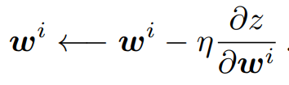
How the CNN Learn?

Slide 32
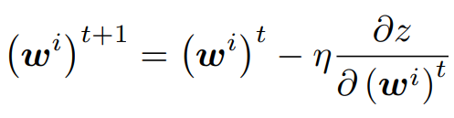
How the CNN Learn?

Slide 33


How the CNN Learn?
In fact, for every layer, we compute two sets of gradients: the partial derivatives of $z$
with respect to the layer parameters${ w}^{i}$, and that layer’s input $x^{i}$.
$$\frac{∂z}{{∂w}^{L}}=0$$
$$\frac{∂z}{{∂x}^{L}}=x^{L}−t$$

Slide 34
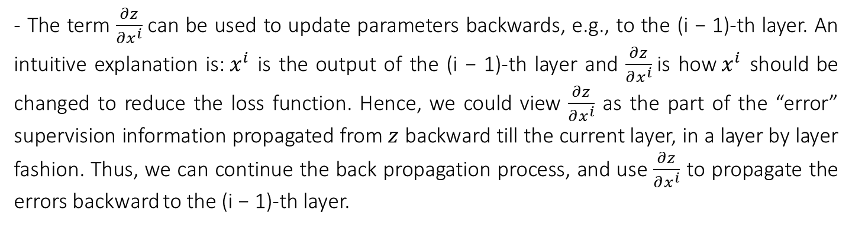
How the CNN Learn?
In fact, for every layer, we compute two sets of gradients: the partial derivatives of $z$
with respect to the layer parameters${ w}^{i}$, and that layer’s input $x^{i}$.
- The term $\frac{∂z}{∂w^{i}}$, as seen in Equation 8, can be used to update the current (i-th) layer’s parameters;
- The term $\frac{∂z}{∂x^{i}}$can be used to update parameters backwards, e.g., to the (i − 1)-th layer. An intuitive explanation is:${ x}^{i}$ is the output of the (i − 1)-th layer and $\frac{∂z}{∂x^{i}}$is how${ x}^{i}$ should be changed to reduce the loss function. Hence, we could view $\frac{∂z}{∂x^{i}}$ as the part of the “error” supervision information propagated from $z$ backward till the current layer, in a layer by layer fashion. Thus, we can continue the back propagation process, and use $\frac{∂z}{∂x^{i}}$ to propagate the errors backward to the (i − 1)-th layer.

Slide 35
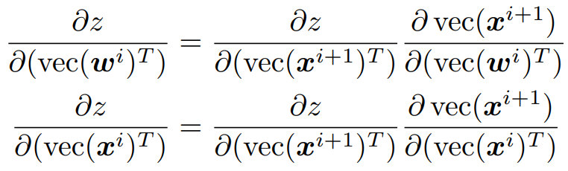
How the CNN Learn?
Using the chain rule, we have,

Slide 36
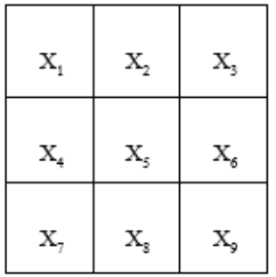
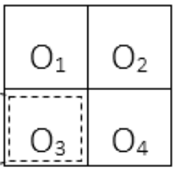
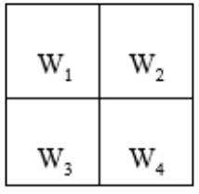
Example

Slide 37
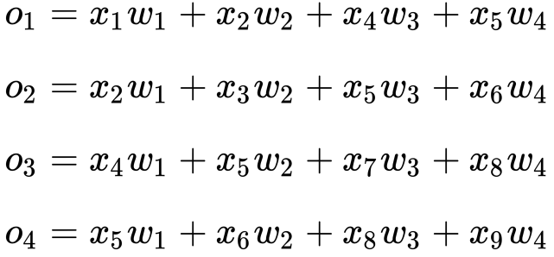
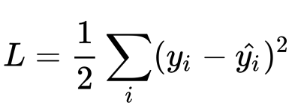
Example

Slide 38
Example

Slide 39
Example

Slide 40
Example

Slide 41
Example

Slide 42
Example

Slide 43
Example

Slide 44
Questions?

