Slide 1
Deep Neural Networks
January 2026

Slide 2
ANN and its Layers (Feedforward)
While neurons are really cool, we cannot just use a single neuron to perform complex tasks. This is the reason our brain has billions of neurons, stacked in layers, forming a network. Similarly, artificial neurons are arranged in layers. Each and every layer will be connected in such a way that information is passed from one layer to another.
A typical ANN consists of the following layers:
- Input layer
- Hidden layer
- Output layer

Slide 3
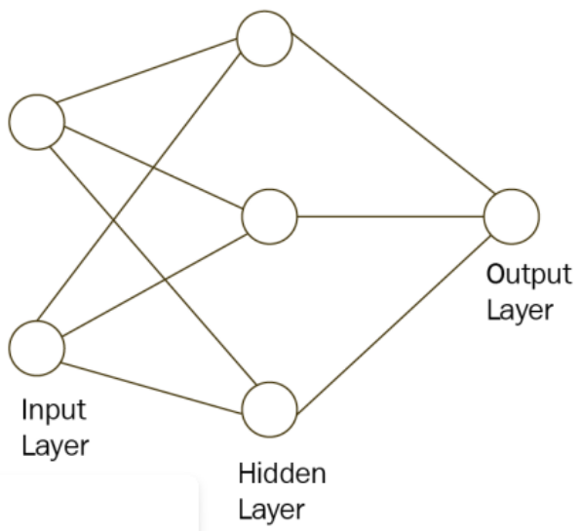
ANN and its Layers
Each layer has a collection of neurons, and the neurons in one layer interact with all the neurons in the other layers. However, neurons in the same layer will not interact with one another. This is simply because neurons from the adjacent layers have connections or edges between them; however, neurons in the same layer do not have any connections. We use the term nodes or units to represent the neurons in the artificial neural network.

Slide 4
ANN and its Layers
Input layer: The input layer is where we feed input to the network. The number of neurons in the input layer is the number of inputs we feed to the network. Each input will have some influence on predicting the output. However, no computation is performed in the input layer; it is just used for passing information from the outside world to the network.
Hidden layer: Any layer between the input layer and the output layer is called a hidden layer. It processes the input received from the input layer. The hidden layer is responsible for deriving complex relationships between input and output. That is, the hidden layer identifies the pattern in the dataset. It is majorly responsible for learning the data representation and for extracting the features.
Output layer: After processing the input, the hidden layer sends its result to the output layer. As the name suggests, the output layer emits the output. The number of neurons in the output layer is based on the type of problem we want our network to solve. If it is a binary classification, then the number of neurons in the output layer is one that tells us which class the input belongs to. If it is a multi-class classification say, with five classes, and if we want to get the probability of each class as an output, then the number of neurons in the output layer is five, each emitting the probability. If it is a regression problem, then we have one neuron in the output layer.

Slide 5
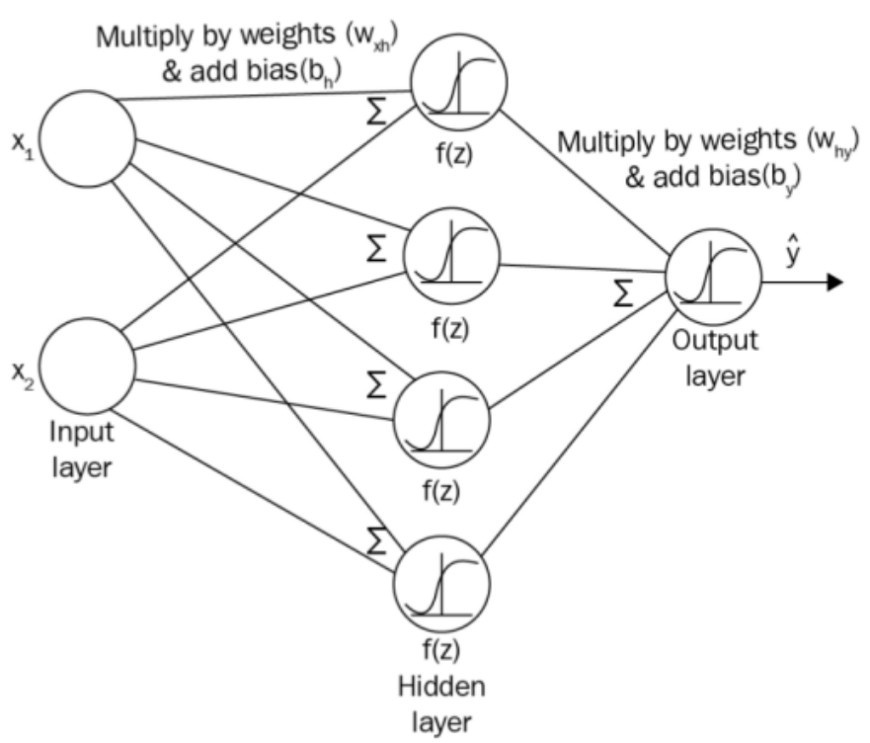
ANN and its Layers
The number of layers in a network is equal to the number of hidden layers plus the number of output layers. We don't take the input layer into account when calculating the number of layers in a network. Consider a two-layer neural network with one input layer, , one hidden layer, , and one output layer, , as shown in the following diagram:

Slide 6
Forward Propagation in ANN
Let's consider we have two inputs, and , and we have to predict the output, . Since we have two inputs, the number of neurons in the input layer will be two. We set the number of neurons in the hidden layer to four, and, the number of neurons in the output layer to one. Now, the inputs will be multiplied by weights, and then we add bias and propagate the resultant value to the hidden layer where the activation function will be applied.

Slide 7
Forward Propagation in ANN
Before that, we need to initialize the weight matrix. In the real world, we don't know which input is more important than the other so that we can weight them and compute the output. Therefore, we will randomly initialize weights and the bias value. The weight and the bias value between the input to the hidden layer are represented by and , respectively. What about the dimensions of the weight matrix? The dimensions of the weight matrix must be number of neurons in the current layer x number of neurons in the next layer. Why is that?

Slide 8

Forward Propagation in ANN
Because it is a basic matrix multiplication rule. To multiply any two matrices, AB, the number of columns in matrix A must be equal to the number of rows in matrix B. So, the dimension of the weight matrix, , should be number of neurons in the input layer x number of neurons in the hidden layer, that is, 2 x 4:

Slide 9

Forward Propagation in ANN
The preceding equation represents, . Now, this is passed to the hidden layer. In the hidden layer, we apply an activation function to . Let's use the sigmoid activation function. Then, we can write:

Slide 10

Forward Propagation in ANN
After applying the activation function, we again multiply result by a new weight matrix and add a new bias value that is flowing between the hidden layer and the output layer. We can denote this weight matrix and bias as and , respectively. The dimension of the weight matrix, will be the number of neurons in the hidden layer x the number of neurons in the output layer. Since we have four neurons in the hidden layer and one neuron in the output layer, the matrix dimension will be 4 x 1. So, we multiply by the weight matrix, , and add bias, , and pass the result to the next layer, which is the output layer:

Slide 11

Forward Propagation in ANN
Now, in the output layer, we apply a sigmoid function to , which will result an output value:

Slide 12
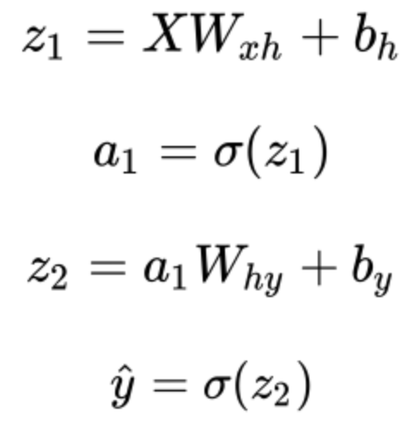
Forward Propagation in ANN
This whole process from the input layer to the output layer is known as forward propagation. Thus, in order to predict the output value, inputs are propagated from the input layer to the output layer. During this propagation, they are multiplied by their respective weights on each layer and an activation function is applied on top of them. The complete forward propagation steps are given as follows:

Slide 13
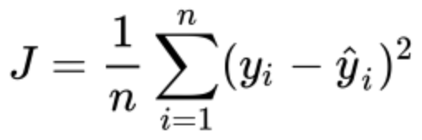
How does ANN learn?

Slide 14
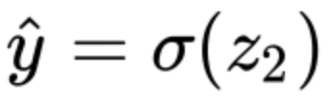
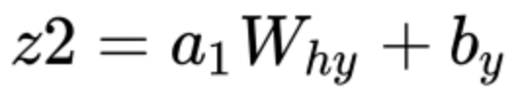
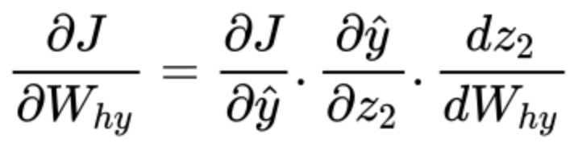
How does ANN learn?

Slide 15
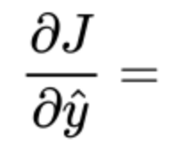

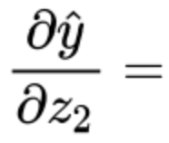

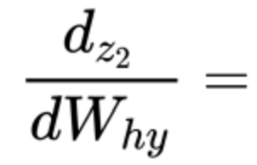

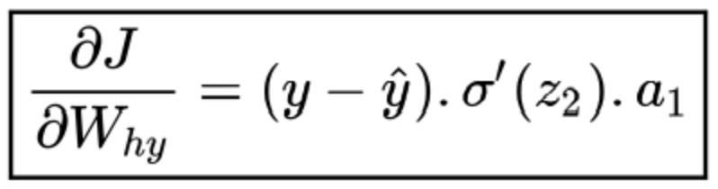
How does ANN learn?
Now, we will compute each of the terms in the preceding equation:

Slide 16

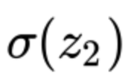

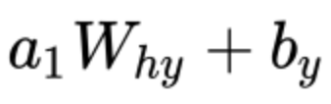




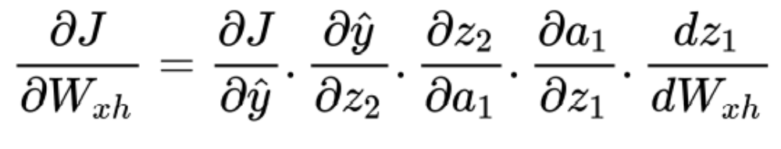
How does ANN learn?
Now, we will compute each of the terms in the preceding equation:

Slide 17
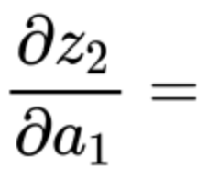
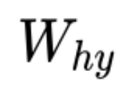
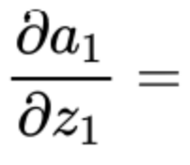

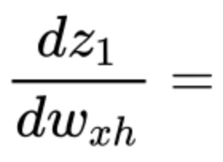

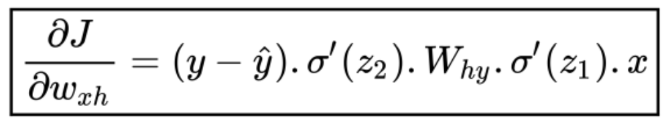
How does ANN learn?
Now, we will compute each of the terms in the preceding equation:

Slide 18
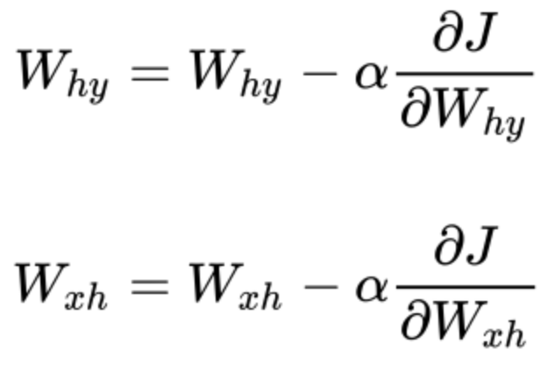
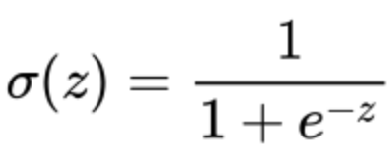
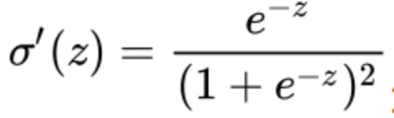
How does ANN learn?
After we have computed gradients for both weights, we will update our initial weights according to the weight update rule:

Slide 19
Common Terms
Forward pass: Forward pass implies forward propagating from the input layer to the output layer.
Backward pass: Backward pass implies backpropagating from the output layer to the input layer.
Epoch: The epoch specifies the number of times the neural network sees our whole training data. So, we can say one epoch is equal to one forward pass and one backward pass for all training samples.
Batch size: The batch size specifies the number of training samples we use in one forward pass and one backward pass.
Number of iterations: The number of iterations implies the number of passes where one pass = one forward pass + one backward pass.

Slide 20
Example
Say that we have 12,000 training samples and that our batch size is 6,000. It will take us two iterations to complete one epoch. That is, in the first iteration, we pass the first 6,000 samples and perform a forward pass and a backward pass; in the second iteration, we pass the next 6,000 samples and perform a forward pass and a backward pass. After two iterations, our neural network will see the whole 12,000 training samples, which makes it one epoch.

Slide 21
Preguntas?

