Slide 1
Deep Learning Pre-Concepts
January 2026

Slide 2
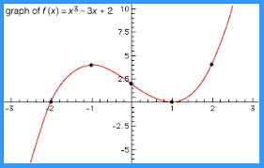
Properties of First and Second Derivatives of a Function

Slide 3


First Derivative

Slide 4


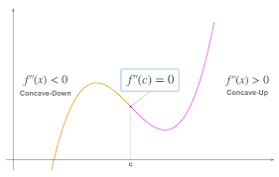
Second Derivative

Slide 5


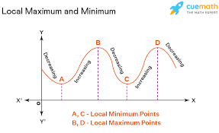
Second Derivative

Slide 6


Gradient

Slide 7



Gradient Properties

Slide 8


Gradient Example

Slide 9

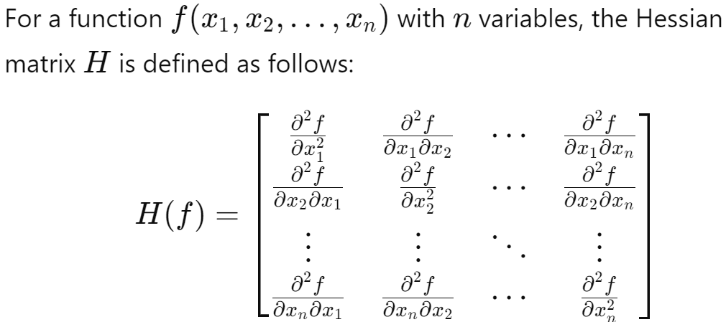
Hessian Matrix

Slide 10


Hessian Properties

Slide 11

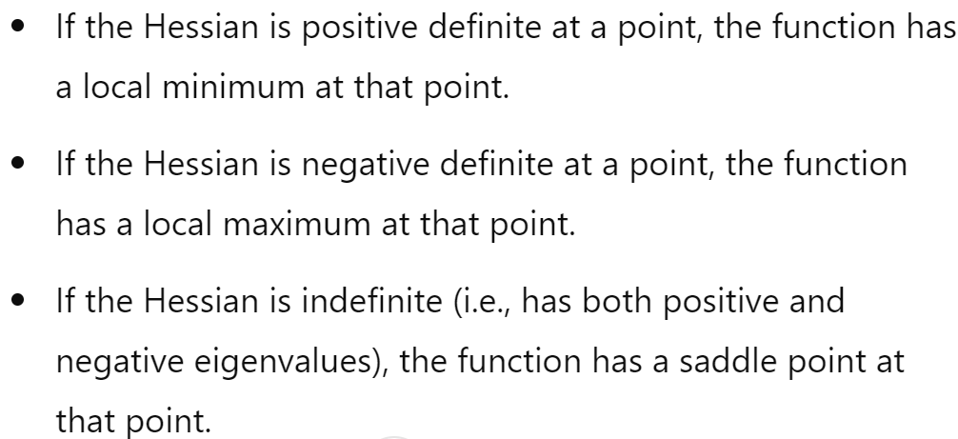
Hessian Properties

Slide 12
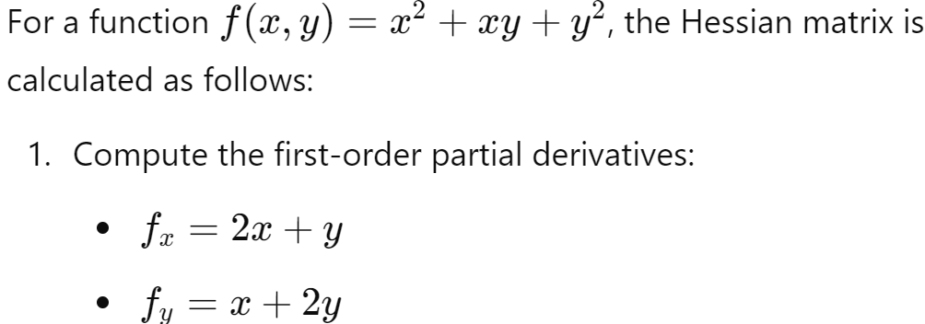
Example

Slide 13
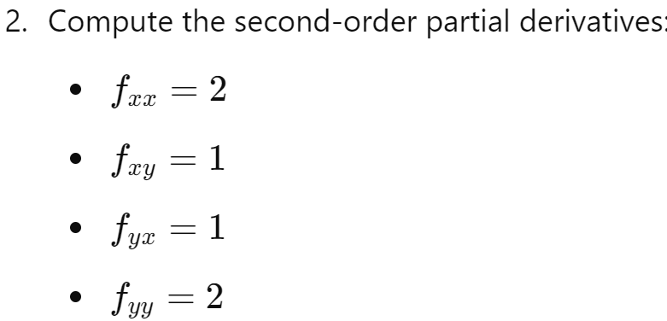
Example

Slide 14
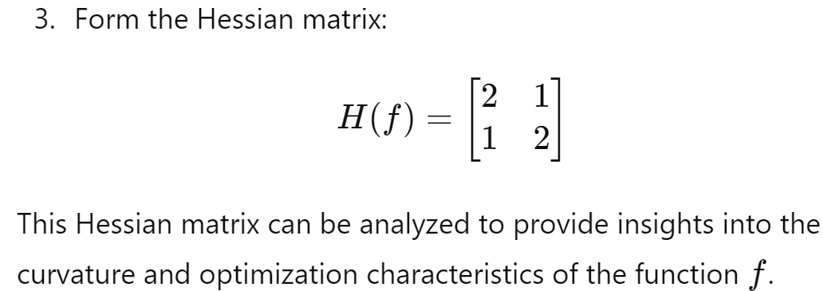
Example

Slide 15

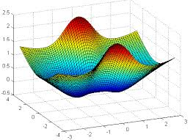
Hessian in Optimization Problems

Slide 16
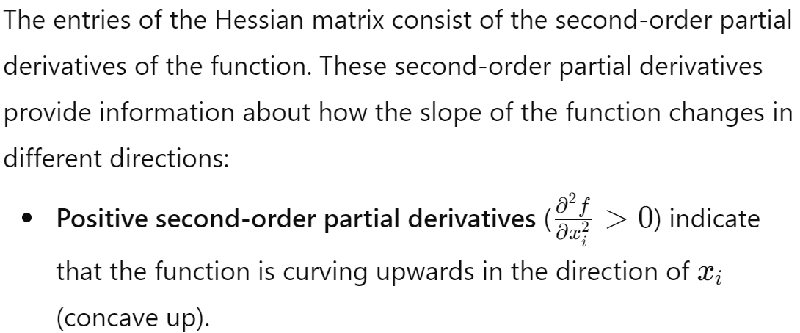

Hessian in Optimization Problems

Slide 17

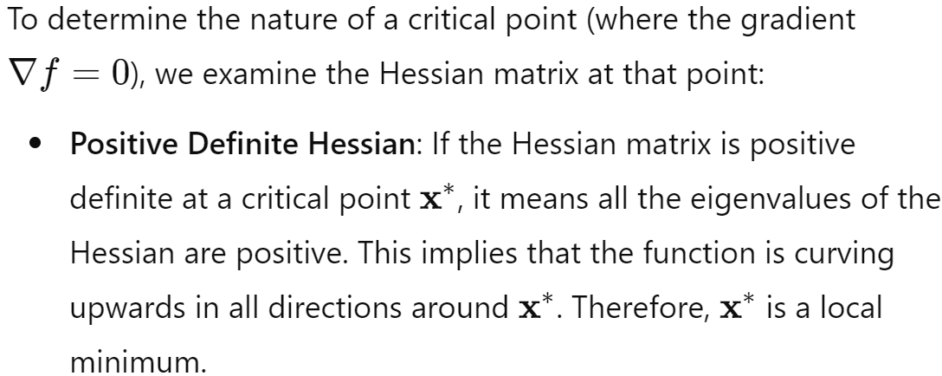
Hessian in Optimization Problems

Slide 18

Hessian in Optimization Problems

Slide 19

Hessian in Optimization Problems

Slide 20

Hessian in Optimization Problems

Slide 21

Hessian in Optimization Problems

Slide 22
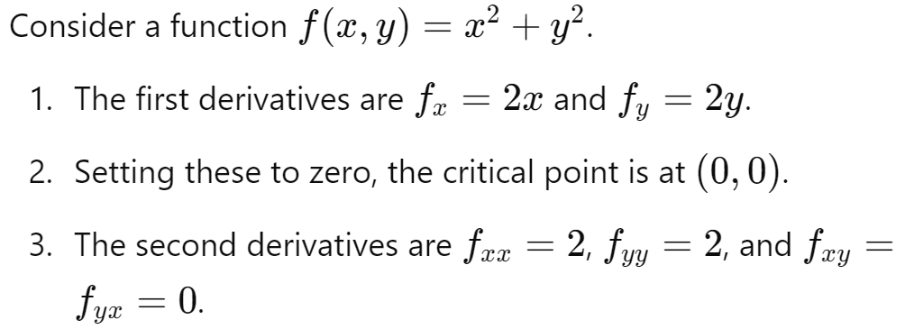
Example

Slide 23
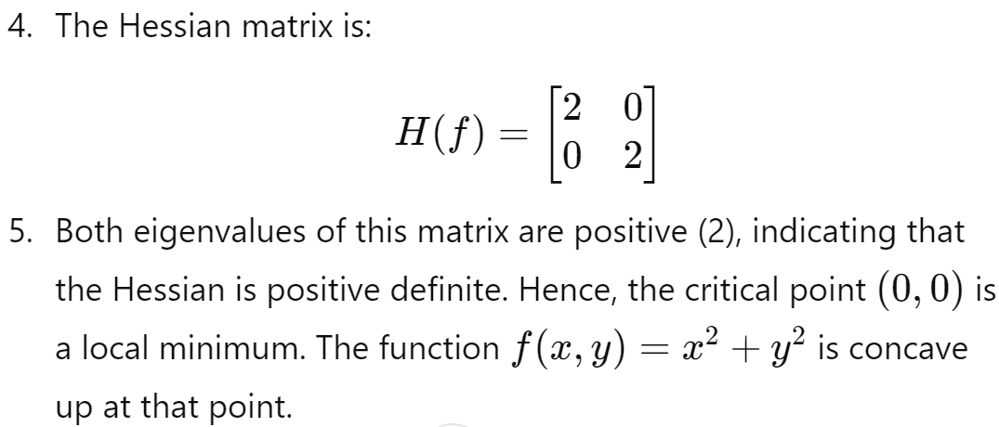
Example

Slide 24
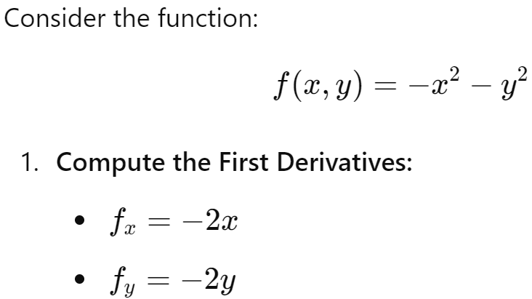
Example

Slide 25
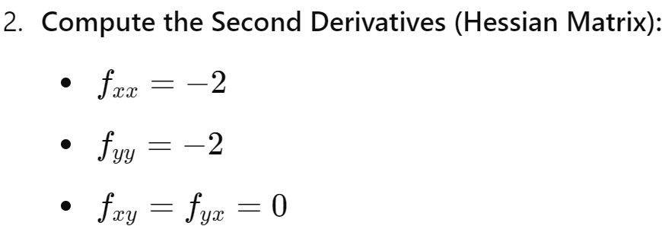
Example

Slide 26
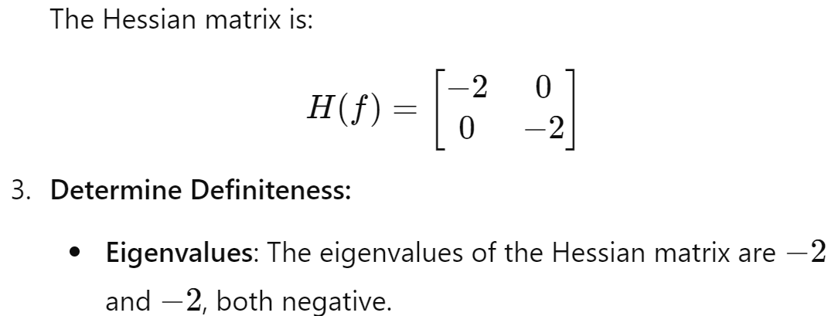

Example

Slide 27
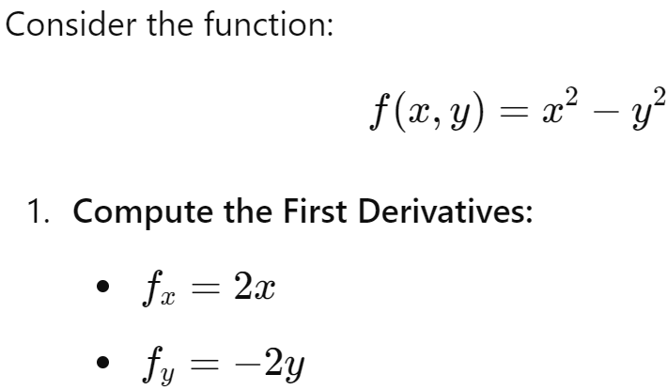
Example

Slide 28
Example

Slide 29
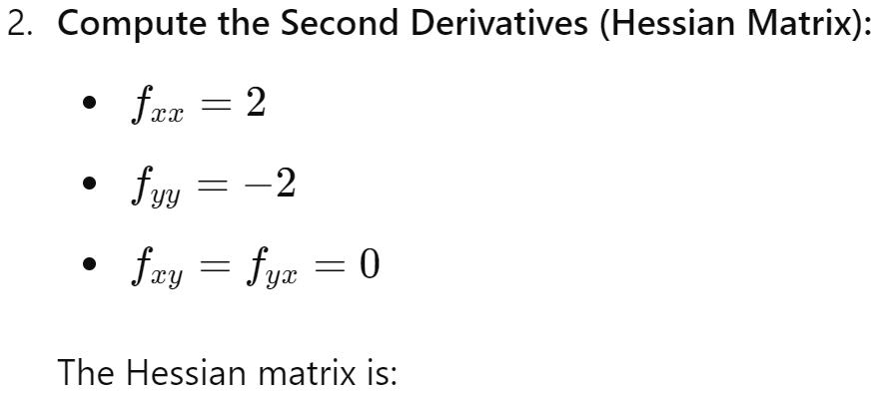

Example

Slide 30

Example

Slide 31
Questions?

