Slide 1
Artificial Neuron
January 2026

Slide 2
Artificial Neuron (Perceptron)
Perceptrons were invented as simple computational models of neurons. A single neuron typically has many inputs (dendrites), a cell body, and a single output (the axon).
Then, we introduce non-linearity to the result, , by applying a function called the activation or transfer function. Thus, our output becomes:
So, a neuron takes the input, x, multiples it by weights, w, and adds bias, b, forms , and then we apply the activation function on and get the output, .

Slide 3
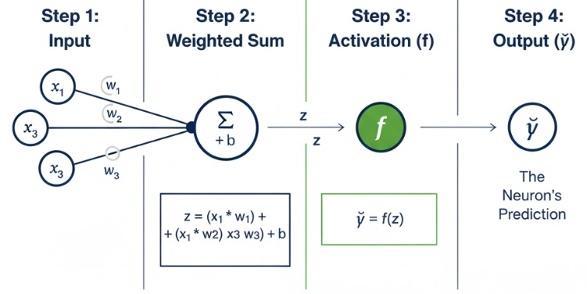
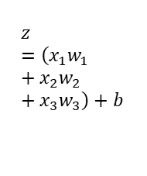
Artificial Neuron – Forward Propagation
Forward propagation (also known as a forward pass) is the process by which an artificial neuron (or an entire network) transforms input data into an output prediction. It is the "thinking" phase of the neuron, where information flows in a single direction—from the inputs, through the mathematical operations, to the final estimate.
Other Neuron
$$z=\left(x_{1}w_{1}+x_{2}w_{2}+x_{3}w_{3}\right)+b$$

Slide 4

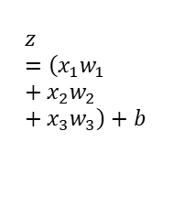
Artificial Neuron – Backward Propagation
Backward propagation (or backpropagation) is the "learning" phase of an artificial neuron. While forward propagation calculates a prediction, backpropagation goes in the reverse direction to figure out exactly how much each weight and bias contributed to the prediction error.
MSE
$$z=\left(x_{1}w_{1}+x_{2}w_{2}+x_{3}w_{3}\right)+b$$

Slide 5
How does ANN learn?
We define a new function called the cost function (J), also known as the loss function (L), which tells us how well our neural network is performing. If the cost or loss is very high, then it means that our network is not predicting the correct output. So, our objective is to minimize the cost function so that our neural network predictions will be better. How can we minimize the cost function? That is, how can we minimize the loss/cost? We learned that the neural network makes predictions using forward propagation. So, if we can change some values in the forward propagation, we can predict the correct output and minimize the loss.

Slide 6
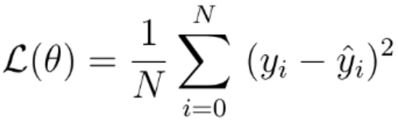
Loss Function (Mean Squared Error, Mean Absolute Error)
This function is defined as the mean of the squared difference between the actual output and the predicted output. It is used when you want your neural network to predict a continuous scalar value
MSE
MAE
When there is high volatility in data

Slide 7
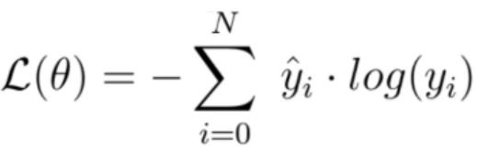
Loss Function (Cross-Entropy Loss Function)
You should always use cross-entropy loss if probabilities are involved. Meaning if you are doing some kind of classification.

Slide 8
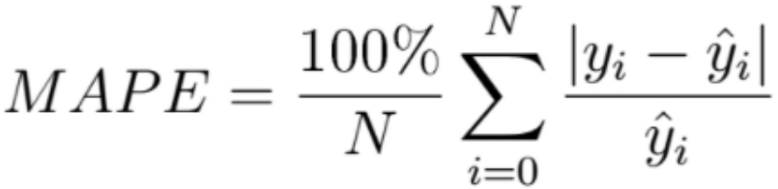
Loss Function (Mean Absolute Percentage Error)
Mean Absolute Percentage Error loss function should be used during demand
forecasting tasks to evaluate the performance of the model during training time.

Slide 9
How does ANN learn?
Gradient descent is one of the most commonly used optimization algorithms. It is used for minimizing the cost function, which allows us to minimize the error and obtain the lowest possible error value. But how does gradient descent find the optimal weights? Let's begin with an analogy.

Slide 10
How does ANN learn?
Similarly, we can represent our cost function as follows. It is a plot of cost against weights. Our objective is to minimize the cost function. That is, we have to reach the lowest point where the cost is the minimum. The solid dark point in the following diagram shows the randomly initialized weights. If we move this point downward, then we can reach the point where the cost is the minimum:

Slide 11
How does ANN learn?
But how can we move this point (initial weight) downward? How can we descend and reach the lowest point? Gradients are used for moving from one point to another. So, we can move this point (initial weight) by calculating a gradient of the cost function with respect to that point (initial weights), which is,

Slide 12
How does ANN learn?
Gradients are the derivatives that are actually the slope of a tangent line as illustrated in the following diagram. So, by calculating the gradient, we descend (move downward) and reach the lowest point where the cost is the minimum. Gradient descent is a first-order optimization algorithm, which means we only take into account the first derivative when performing the updates:

Slide 13
How does ANN learn?
Thus, with gradient descent, we move our weights to a position where the cost is minimum. But, still, how do we update the weights? As a result of forward propagation, we are in the output layer. We will now backpropagate the network from the output layer to the input layer and calculate the gradient of the cost function with respect to all the weights between the output and the input layer so that we can minimize the error. After calculating gradients, we update our old eights using the weight update rule:

Slide 14
Back propagation risk
If the learning rate is large, then we take a large step and our gradient descent will be fast, but we might fail to reach the global minimum and become stuck at a local minimum. So, the learning rate should be chosen optimally:
This whole process of backpropagating the network from the output layer to the input layer and updating the weights of the network using gradient descent to minimize the loss is called backpropagation.

Slide 15
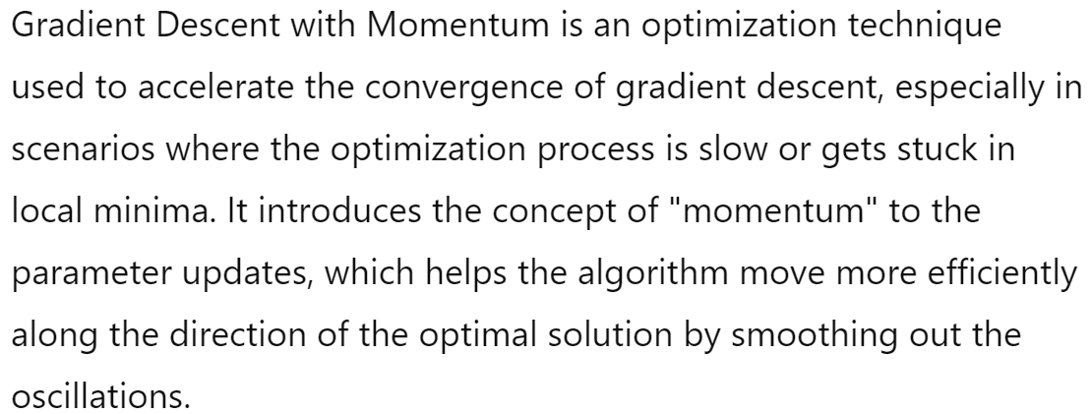
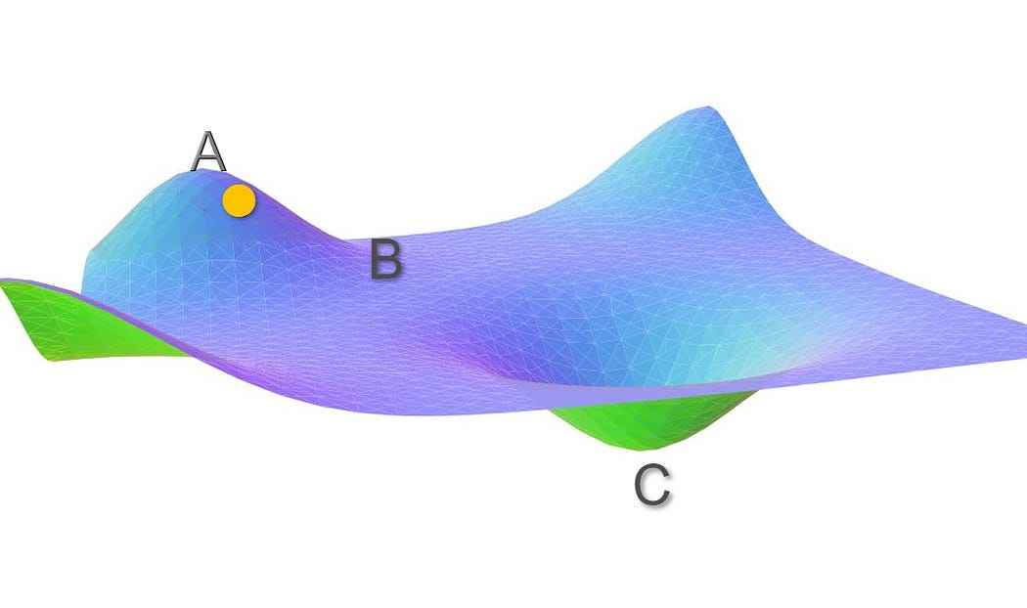
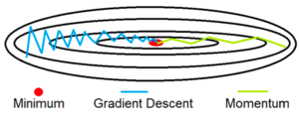
Gradient Descent with Momentum

Slide 16
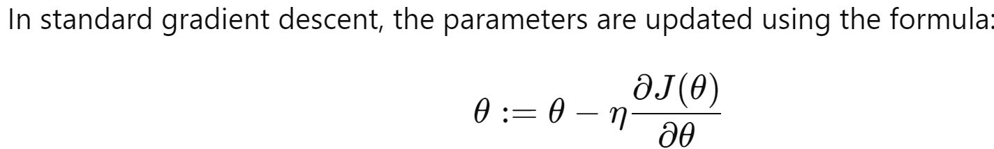
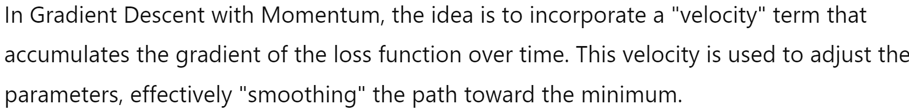
Gradient Descent with Momentum

Slide 17
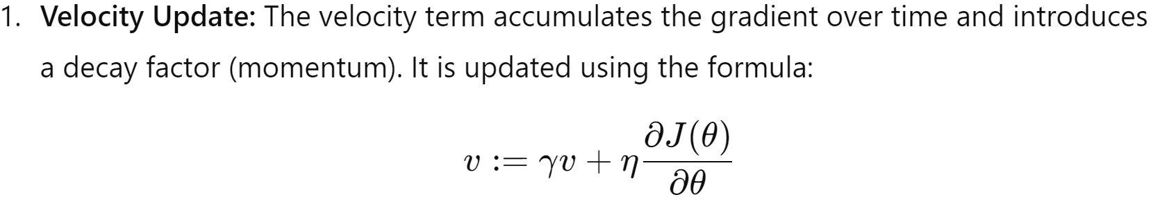
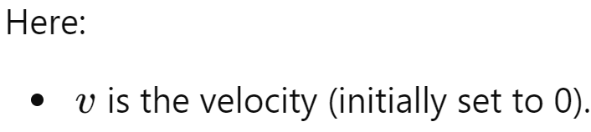
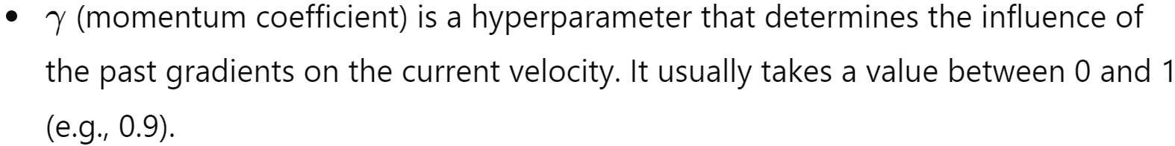
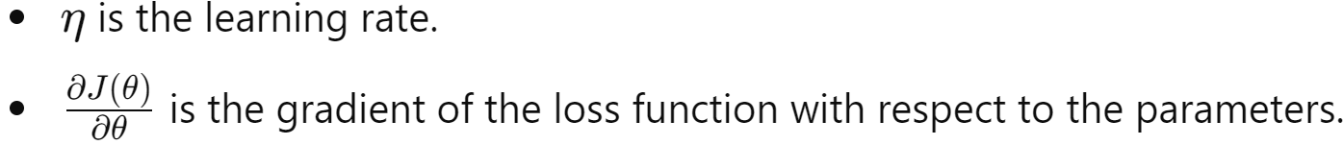
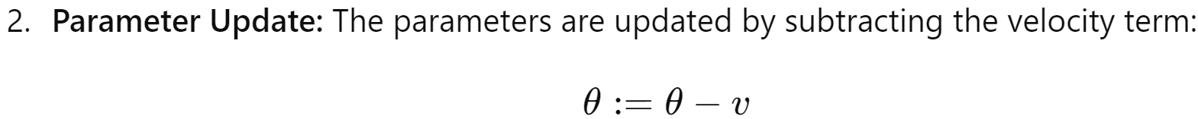
The Update Rule

Slide 18
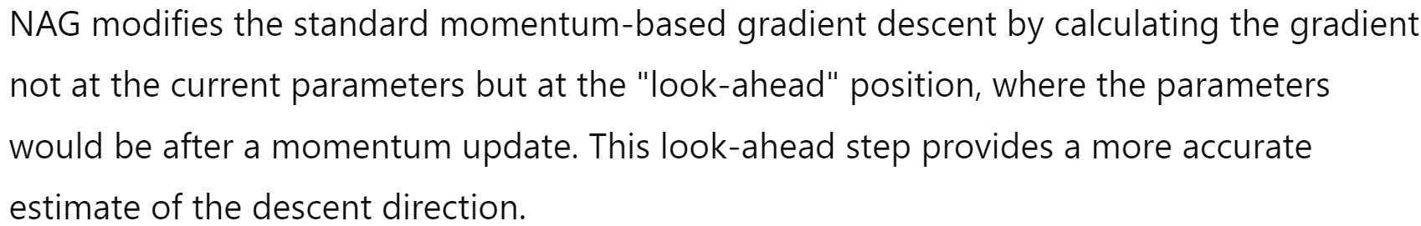
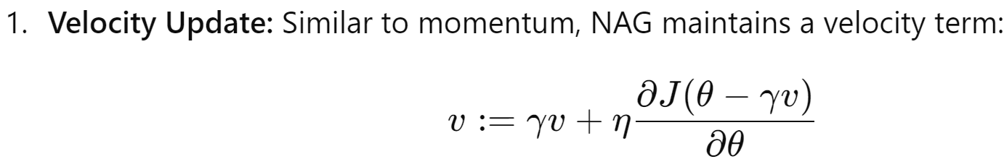
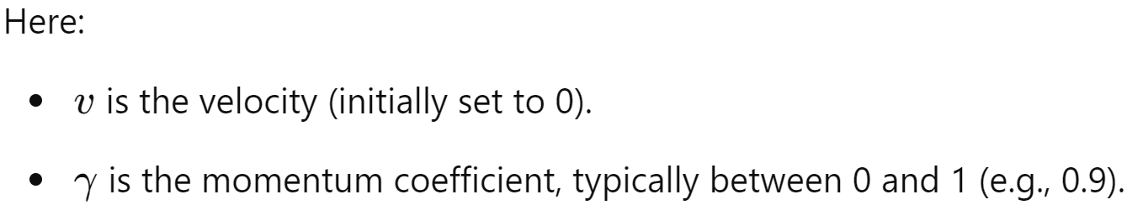
Nesterov Accelerated Gradient (NAG)

Slide 19
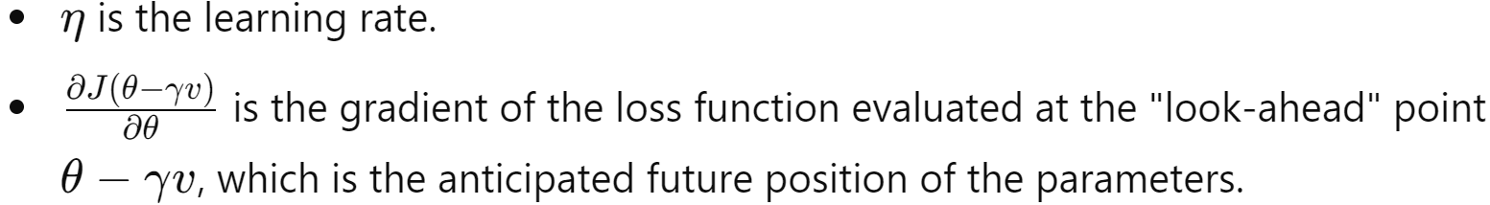
Nesterov Accelerated Gradient (NAG)

Slide 20
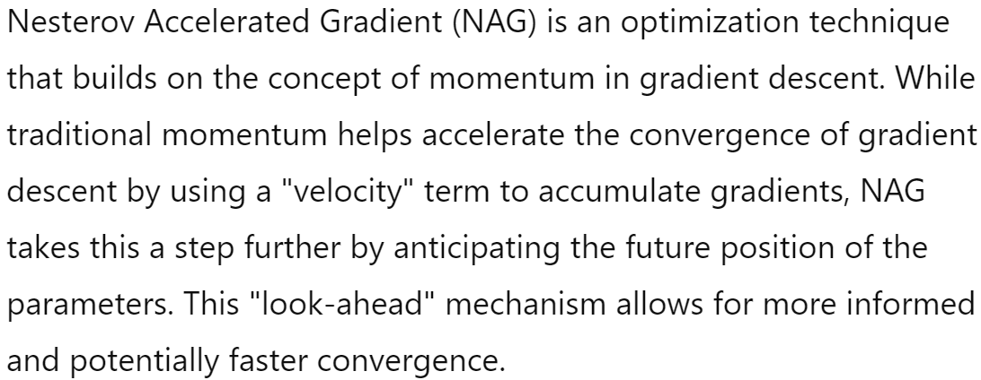
Adaptative Gradient Descent (Adagrad)

Slide 21
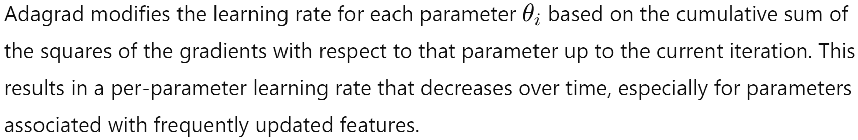
Adaptative Gradient Descent (Adagrad)

Slide 22
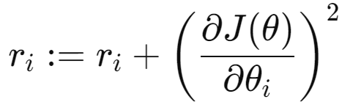
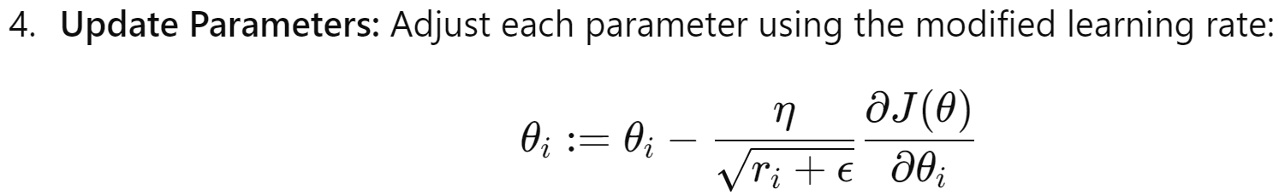
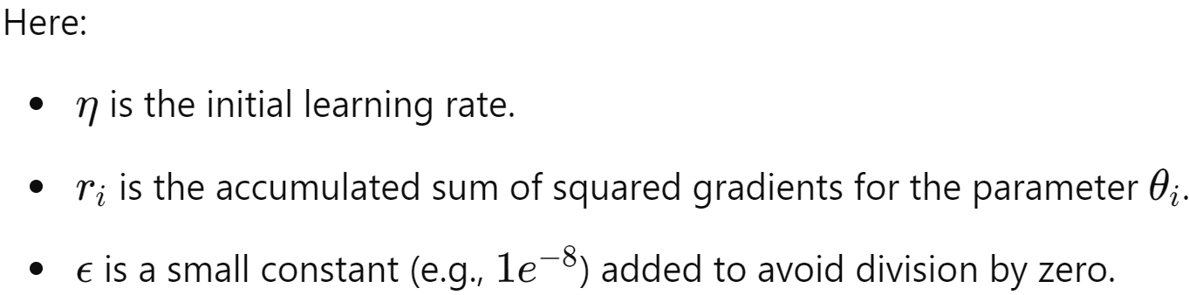
Adaptative Gradient Descent (Adagrad)

Slide 23
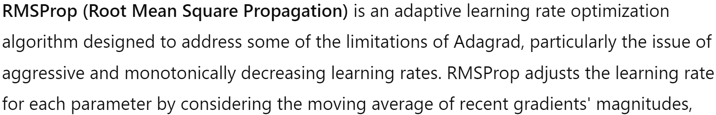
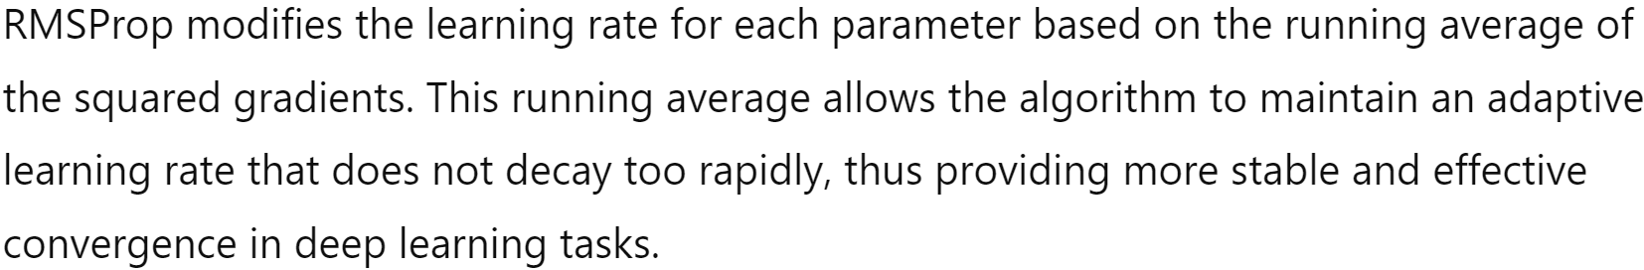
RMSProp

Slide 24
RMSProp

Slide 25
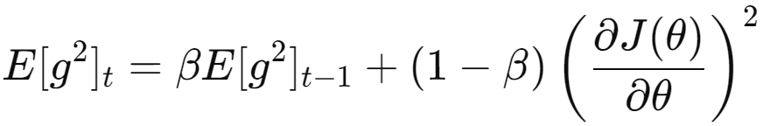
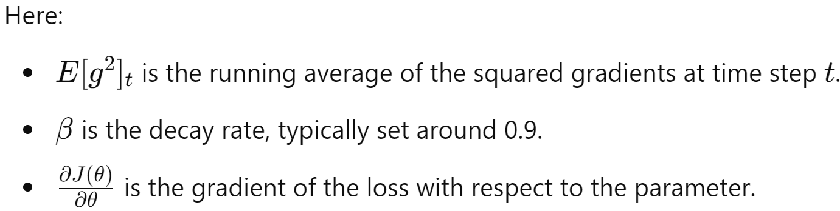
RMSProp

Slide 26
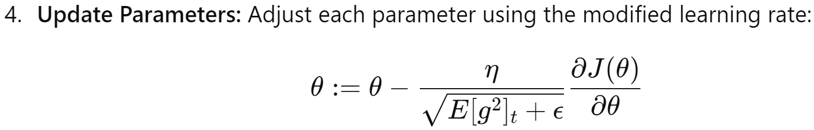
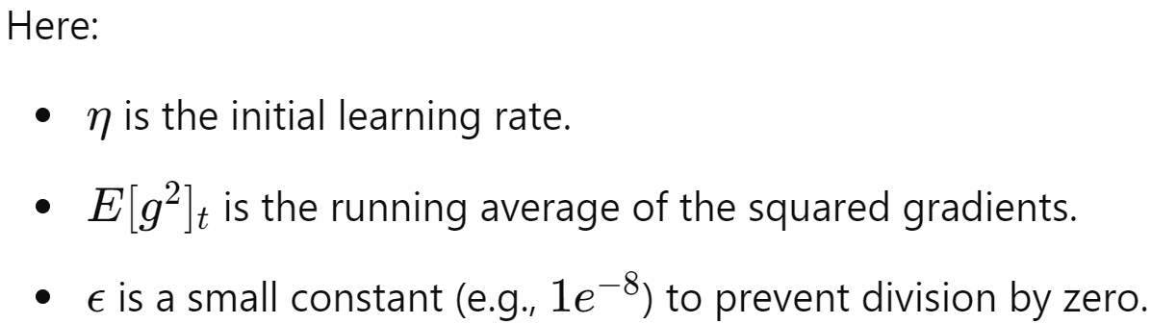
RMSProp

Slide 27


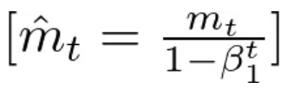
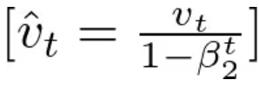
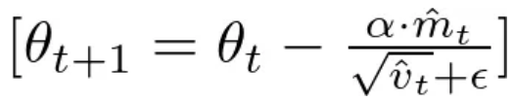
Adaptive Moment Estimation
First Moment to smoot out updates
Second Moment to scale dow learning rates

Slide 28
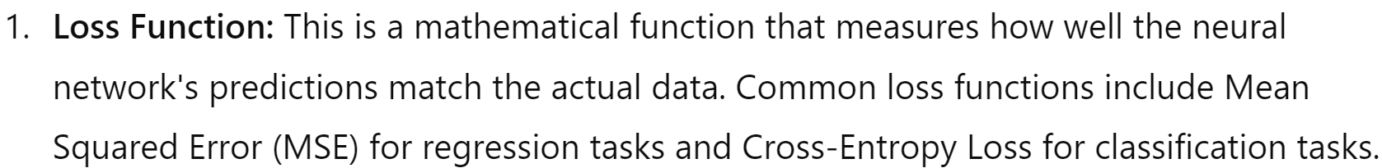
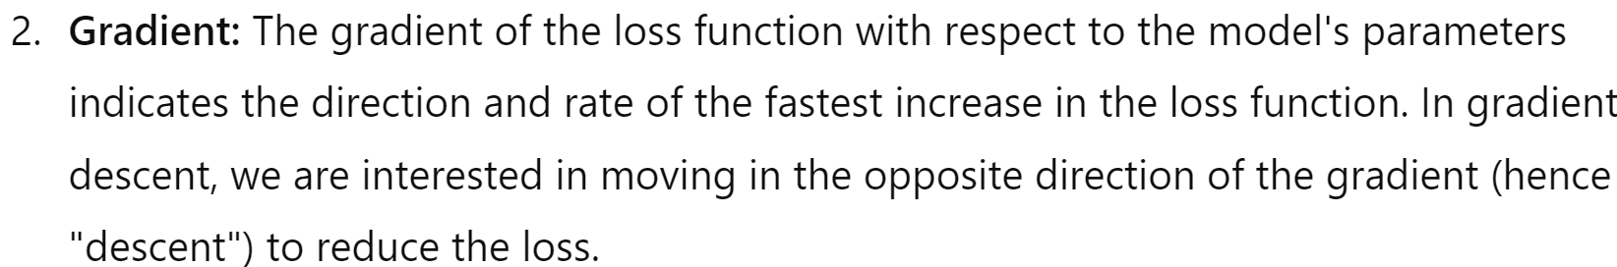
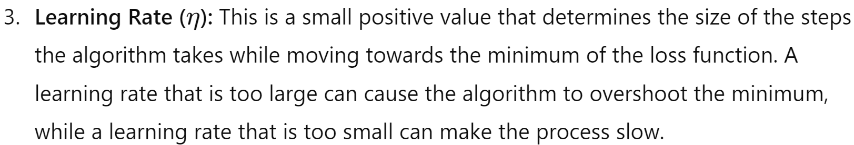
Elements of gradient descent

Slide 29
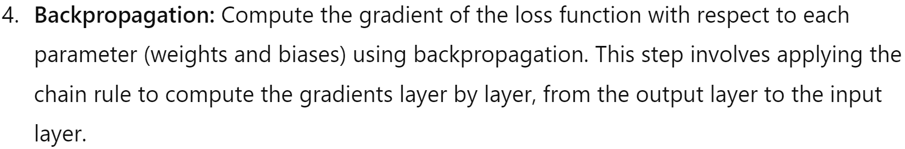
How Gradient Descent Works in Deep Learning

Slide 30
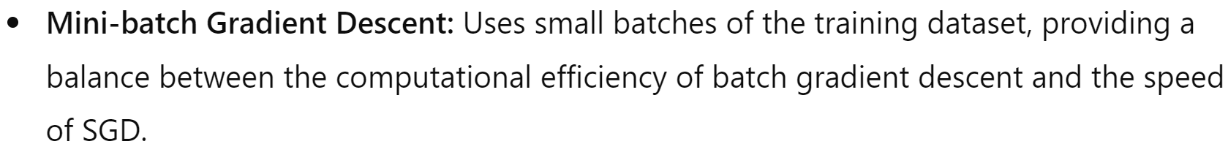
Variants of Gradient Descent

Slide 31
Preguntas?

