Slide 1
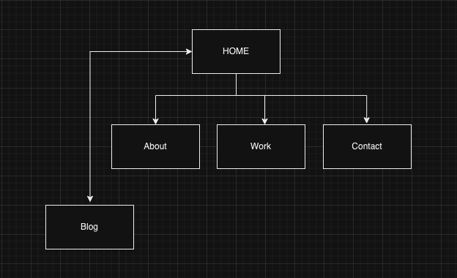
R5 Sitemap and pages overview
Home
The purpose of the landing page is to quickly engage the visitor by having and easy to follow navigation and interesting content that invites the visitor to click through to different sections
This landing page offers a quick glance of the purpose of the site. A brief paragraph of what I do is enough to engage and not distract.
The short text is followed by my latest work. This section shows a couple of images of projects and short description. This section also links to work
A Case study section follows “Latest work” a closer and deeper look into work and services offered. This section also links to work page
Lastly, the page presents The Blog section, which is the only way to access the actual posts. Notice this wasn’t included in the main navigation. This was intentionally done to keep both entities separate
Blog
The Blog is composed of technology posts that can be access and read on this page.
Notice in the sitemap that the Blog can only be accessed from the home page or with a direct URL
The blog and site have no other interaction

Slide 2
R5 Sitemap and pages overview
Work
Work is the second link in the navigation menu. However, is not the only way to get here, there are text links and images which are placed strategically to bring you here.
Work page is meant to be short, clean, and visually appealing. It showcases the work and projects in an attractive grid that also accommodates to different sizes.
At the bottom of the page another short sentence inviting the user to connect or contact
Contact
About
Finally, contact page, third on the navigation menu and las stop for the user.
As clean and concise as possible. Only displaying an encouraging sentence, a contact form, and direct contact information
Contact page has link all throughout the site, nav menu and in text links on the body of each page
About is the first link in the top navigation bar.
About page is a brief history of where I reside in terms of career and most importantly, my inspirations to start a new one.
In this page you can find and download my resume, also see some of my previous work as a quick reel

Slide 3
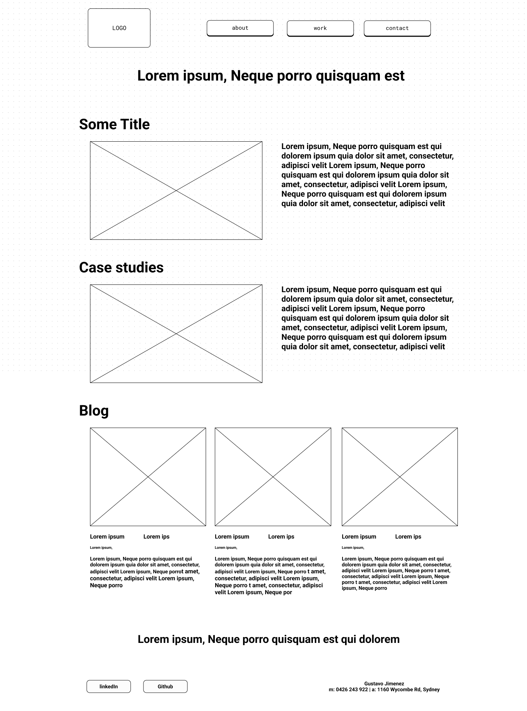
R6 Wireframes
The intention of it
The wireframing process consisted in laying out the general structure of the site
A visual representation of the workflow of my portfolio website, in which I planned to have the main pages to interact quickly and between each other, with the intention of inviting the user to navigate the site step by step, but also, to allow them to get to the point they wish.
All in all I was looking for a clean and easy to understand user interface and smooth user experience

Slide 4
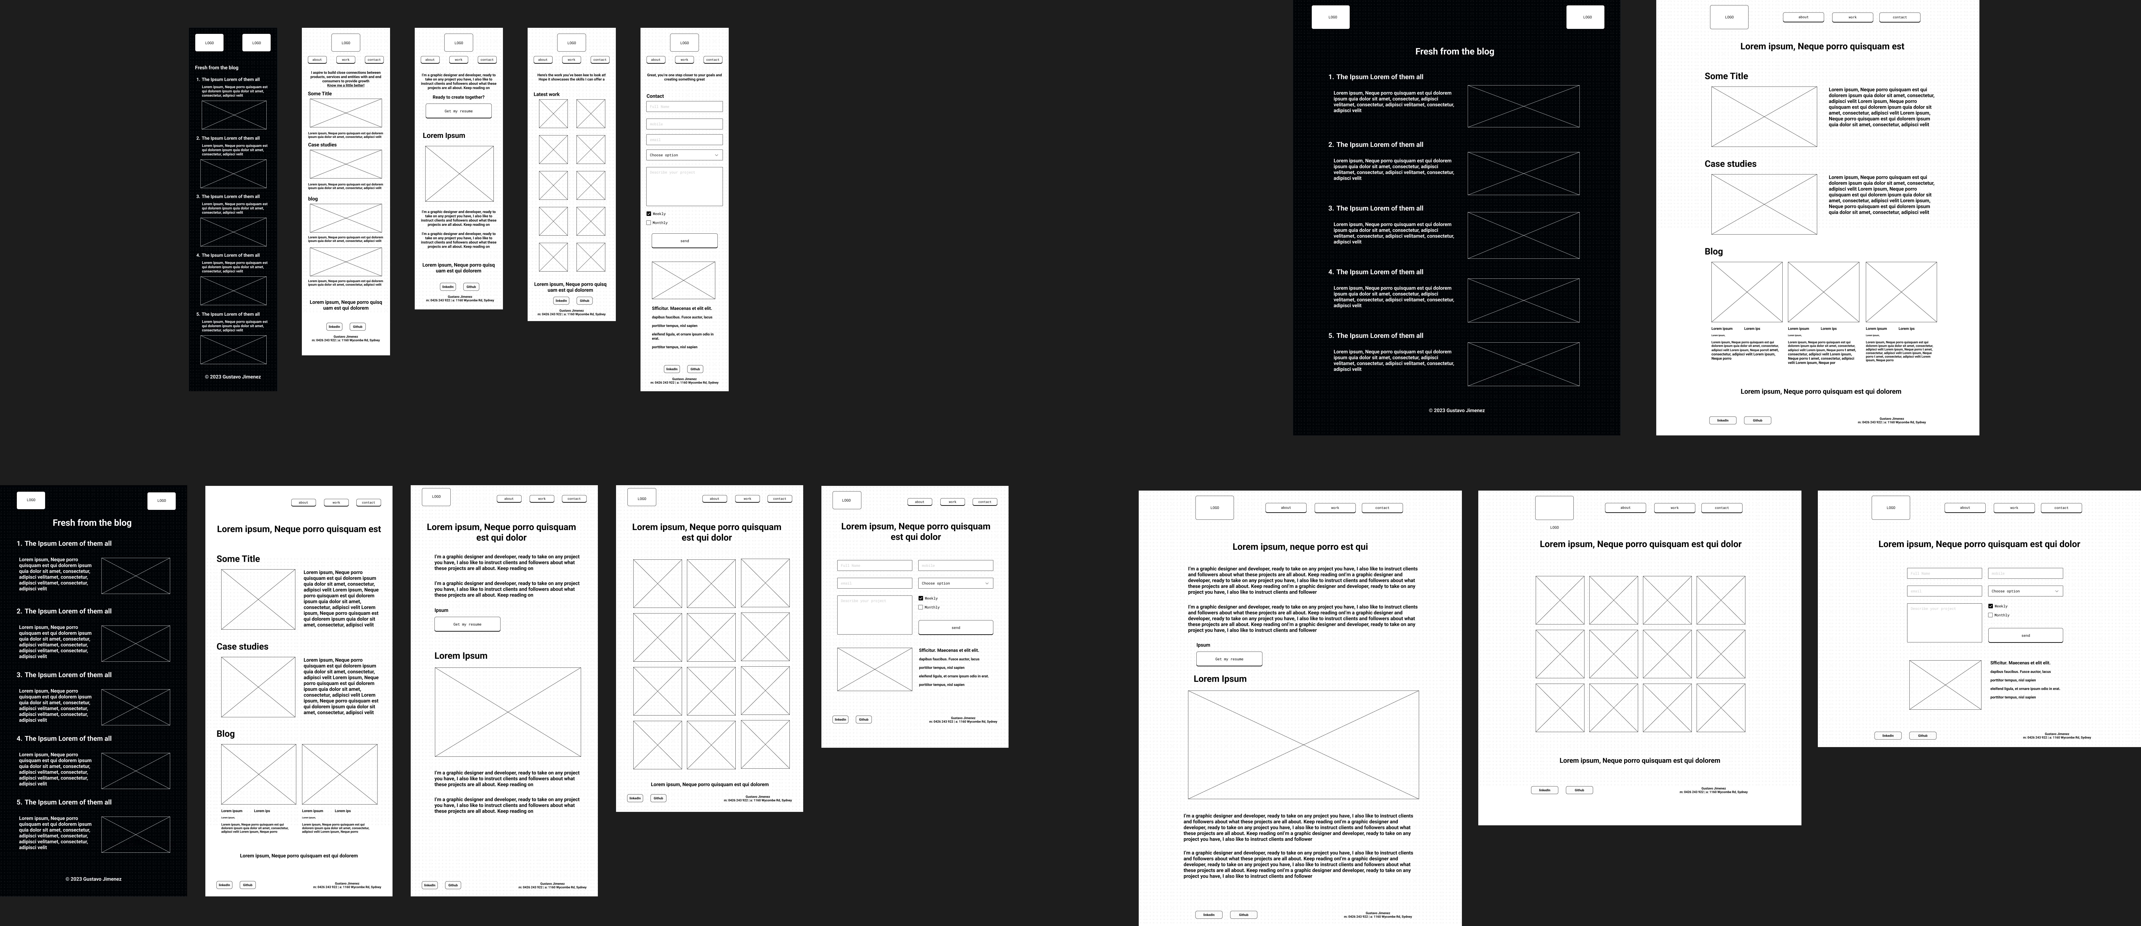
R6 Wireframes and design
Mobile
Desktop
Tablet

Slide 5

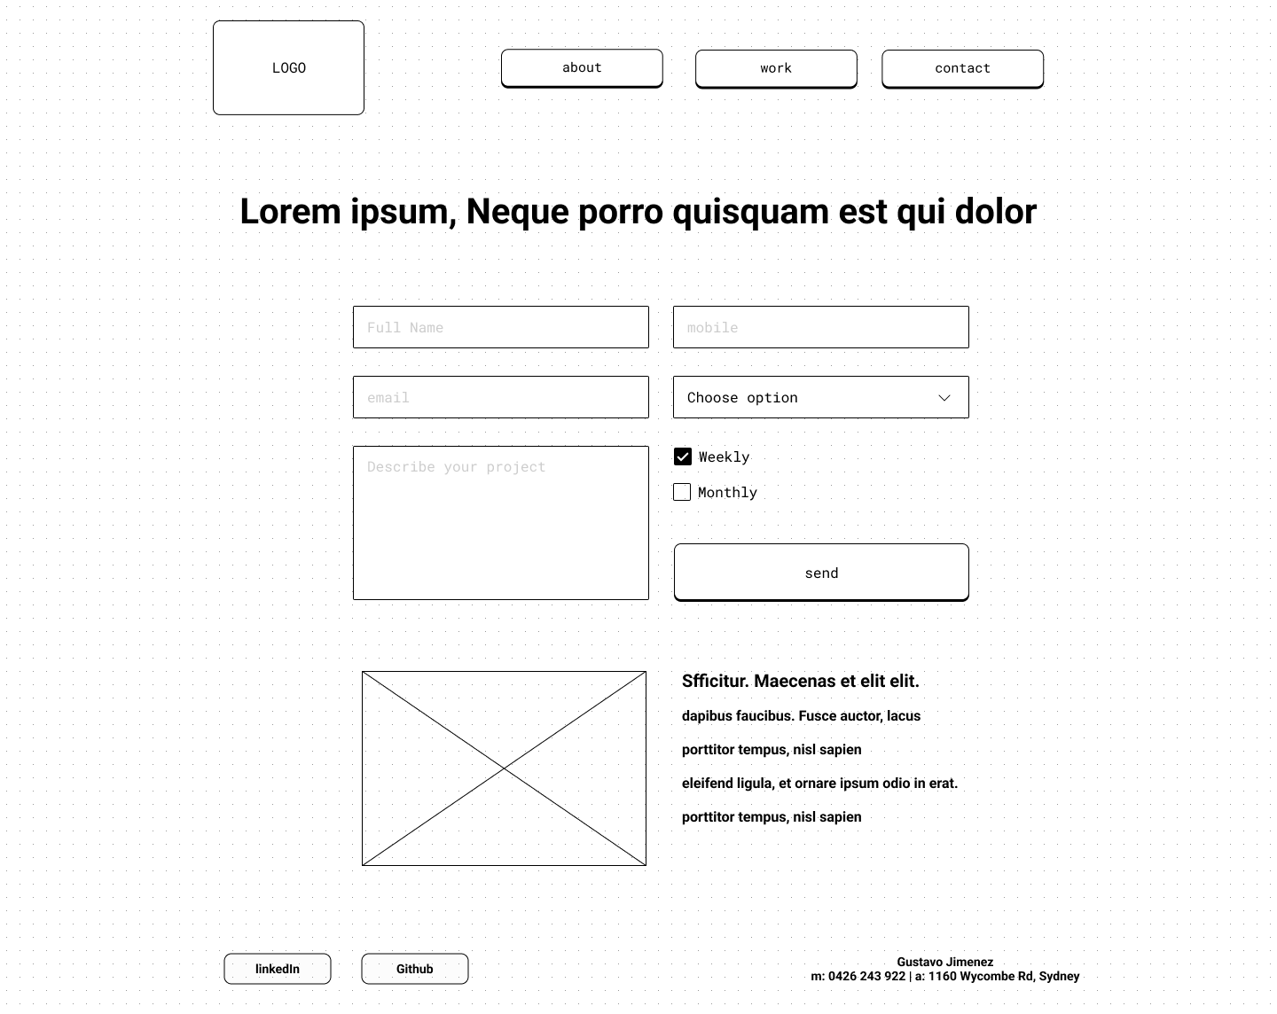


R6 Design
Design idea
The design idea was born from the simplicity and look of the wireframe style I was using, I was looking for a design that allowed me to focus on the code and the responsive components I wanted to try style.
The button was the aha!/why not?! moment, the background was the: I want a clean but sleek site in which the content can rest and be the centre piece.
Following the look of the button, I decided to have a vintage-y, tech-y or old-game-y site look, the animation in the buttons try to reinforce this by bringing a bit of 80s to it
The rather limited colour palette is also taken from old 80s poster and trends. Just a hint of it
The Blog idea
As mentioned before, in my workflow and design, I wanted the blog to sit as its own entity and somewhat separate from the portfolio. This however, keeping some of the visual relation by using the same elements, but as an inverted version, so reading would be more pleasurable to read and spent a good long time on the articles

Slide 6
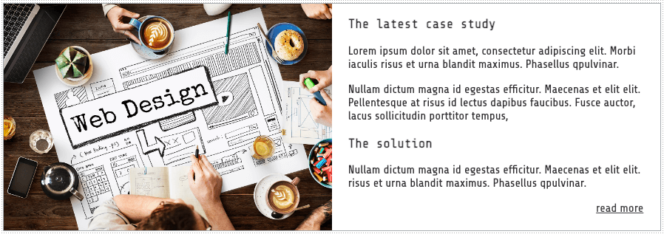
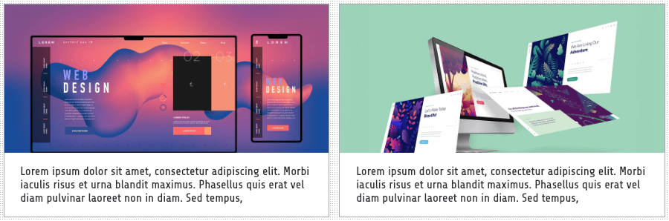
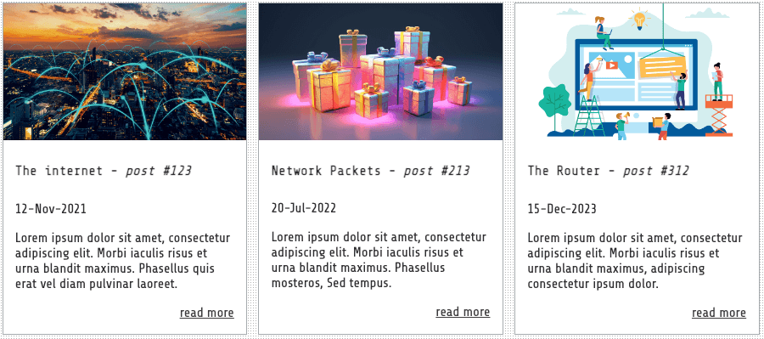
R7 Components
Text and image
The Components used in the site offer flexibility and scalability, besides being simple to implement for responsive sizes
A 2-parts-1-column component which groups the the image and text
This component was used several times on 3 pages including the blog
A 2 columns component, for either text and image, image or text only
A 3 column component, which is ideal for a quick glance to articles, these are more complex, as these contain more styles for the text section

Slide 7
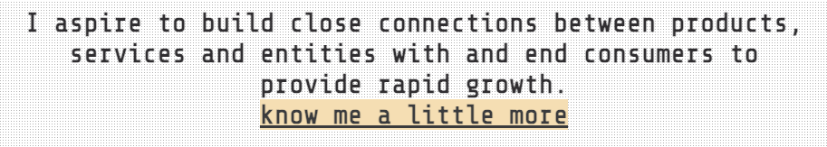
R7 Components
Navigation and links
Components like navigation menus that offer the visitor a friendly and obvious interaction with the site, also indicates the page the user is on
Titles, paragraphs and links need no further styling, only HTML implementation
The footer is simple and clean, with less visually appealing buttons than the main menu, but different form the main menu to indicate you have external links

Slide 8
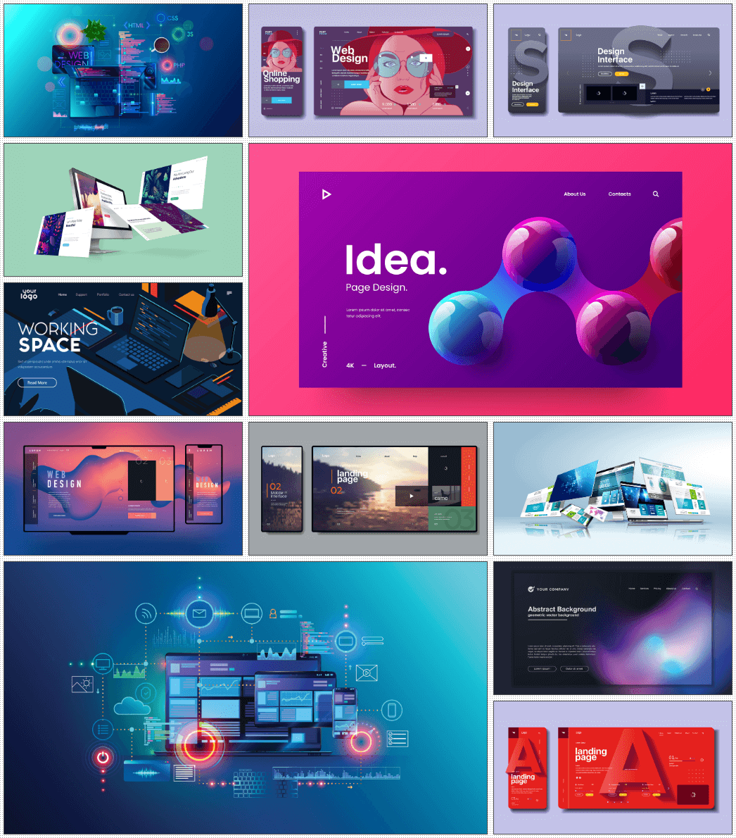
R7 Components
Grid image
A flexible grid component that changes form when displayed on difference screen sizes
This grid can easily adapt to a greater number of images, can easily be adapted for other purposes and implementations

