Slide 1
“Enhancing Underwater Propulsion through Biomimetic Swimming Foils”
By Emad Hassan
Shitttty presentation!!!

Slide 2
Introduction:
The problem of achieving efficient underwater propulsion has been a long-standing challenge in marine engineering. Conventional propulsion systems often suffer from limitations in performance and energy efficiency. To address this issue, biomimetic swimming foils inspired by nature's hydrodynamic designs have emerged as a promising solution. In this study, we compare the performance of biomimetic swimming foils with traditional propulsion systems to showcase their potential in enhancing underwater locomotion.

Slide 3
Comparison:
1. Traditional Propulsion:
High energy consumption
Limited thrust and lift forces
Inefficient maneuverability.
2. Biomimetic Swimming Foils:
Inspired by aquatic organisms with
efficient swimming abilities
Flexible kinematic patterns
Potential for improved hydrodynamic performance

Slide 5
Approach and Methods:
1- Numerical Simulation: Computational Fluid Dynamics (CFD) methods are employed to model fluid-structure interactions of swimming foils. CFD allows for the accurate analysis of hydrodynamic forces and their effects on the foils' motion.
2- Foil Discretization: To accurately represent the hydrodynamic forces acting on the swimming foils, they are discretized into panels. This panel-based approach enables precise calculation of the forces experienced by each element of the foil.
3- Kinematic Parameters: The study considers a wide range of kinematic parameters for the swimming foils. This flexibility in exploring different swimming patterns allows for a comprehensive understanding of the foils' performance under various flow conditions.

Slide 6
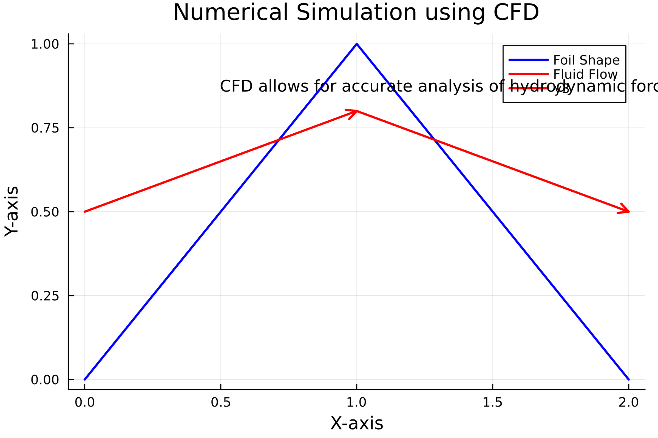

Slide 7
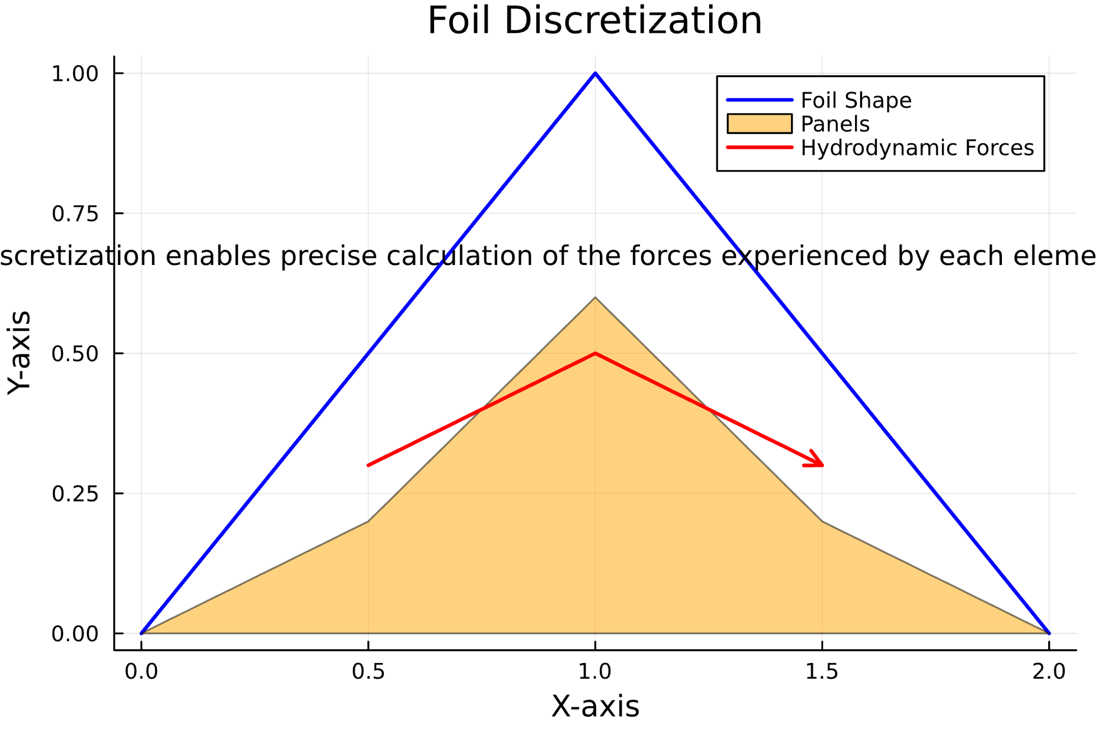

Slide 8
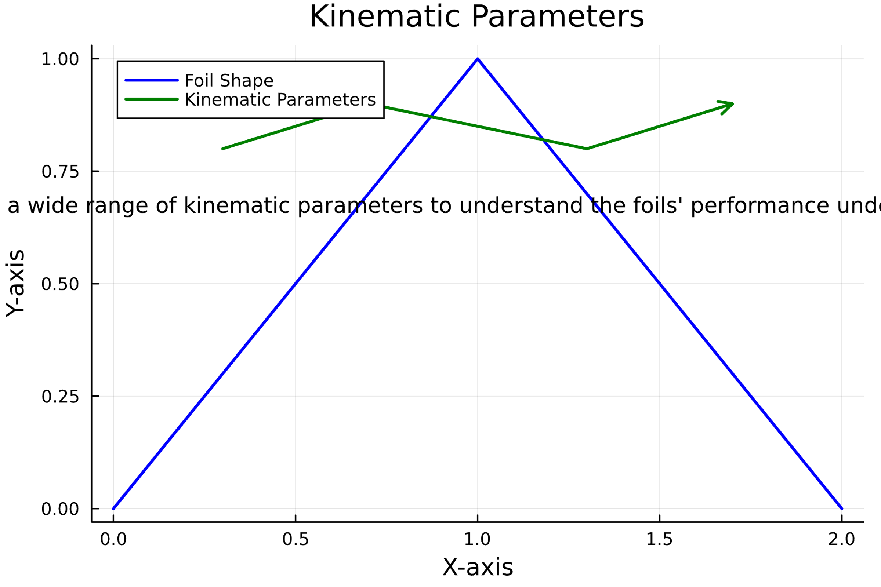

Slide 9
Results:
Comparison of Thrust and Lift Forces: The results show that biomimetic swimming foils exhibit significantly higher thrust and lift forces compared to traditional propulsion systems. This suggests that the design inspired by aquatic organisms with efficient swimming abilities enhances the overall propulsion performance.
Efficiency Metrics: The evaluation of energy efficiency metrics demonstrates that biomimetic foils offer improved energy efficiency. This results in reduced overall power consumption during propulsion, making biomimetic foils a promising alternative for more sustainable propulsion systems.

Slide 10
