Slide 1
Kaggle competition:
How many “useful” votes will a yelp review receive

Slide 2
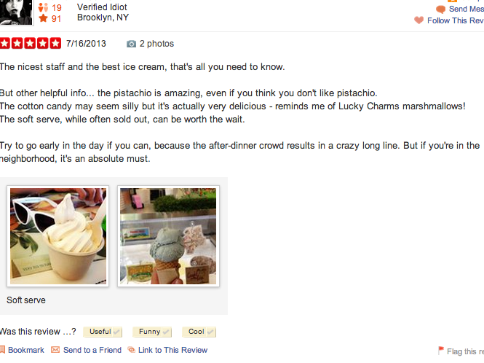
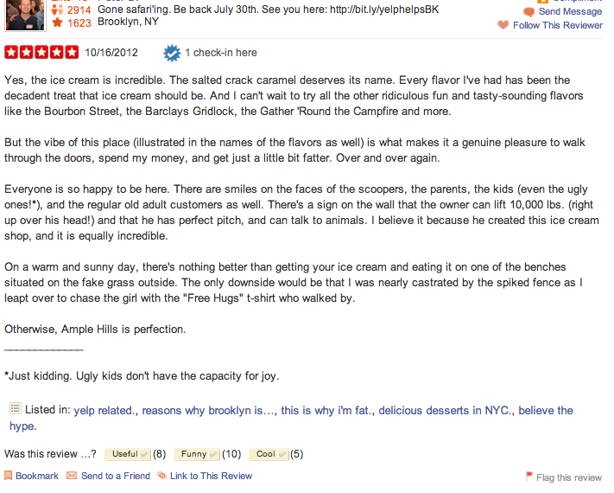
YELP

Slide 3
Kaggle Competition
Sponsored by Yelp.
Ran from March 27th to June 30th.
Yelp tracks 3 community-powered metrics of review quality:
Useful
Funny
Cool.
Other data includes freshness of a review.
Problem statement: can we predict the number of useful votes a review will get ?

Slide 4
Data set
Reviews: 230K
date, text, stars, cool, funny, useful
Unique Users: 43K
# of reviews, # of useful reviews, avg stars, cool, funny, useful
Business: 11K
#of reviews, # of stars
Checkin: 8K
Time of day, type of biz

Slide 5
Methodology
Data:
Collection: Get JSON data into DB
Preparation: Normalize data across tables
Analysis: Choose descriptive features and calculate some features
Algorithm: Random Forest
Training: ran it with 75% of the training data
Testing: ran it with the other 25% to get predictions

Slide 6
Descriptive Features
Review:
Date
Stars
Text
User:
Average Number of stars given
Cool votes
Funny Votes
Useful Votes
Business:
Count of reviews
Stars
Computed
Review star delta
Date Delta from 1/1/13
Text Length
Text Word Count

Slide 7
Observations
features | percent
review_dateDelta | 0.90%
review_stars | 0.23%
review_text_len | 2.13%
review_word_count | 0.17%
user_avgStars | 0.17%
user_cool | 7.17%
user_funny | 84.73%
user_reviews | 3.76%
user_useful | 0.71%
biz_review_count | 0.02%
biz_stars | 0.00%
biz_review_star_delta | 0.01%
RMSLE = 0.4797

Slide 8
Observations 2
Features | percent
review_dateDelta | 0.23%
review_stars | 0.06%
review_text_len | 0.54%
review_word_coun | 0.08%
user_avgStars | 0.01%
user_cool | 0.02%
user_funny | 0.07%
user_reviews | 0.01%
user_useful | 0.01%
useful_pct | 98.94%
biz_review_count | 0.02%
biz_stars | 0.00%
biz_review_star_ | 0.01%
RMSLE = 0.4791

Slide 9
Kaggle
Winner: RMSLE => 0.4404
Mine:
RMSLE => 0.4791
Place: 52 out of 352

Slide 10
Tools
MongoDB
Python
Pandas
Scikit learn: RandomForestRegressor
150 trees
6 mins

Slide 11
Challenges
Too many unknowns to start with (mongodb, python, ML algorithms)
First version of the program took over 4 days to figure out. (2 weekends). Second version took me 45 mins and it was 1/6 the number of lines of code.

Slide 12
Take aways
iPython: awesome interactive python shell. Really good for quickly testing stuff
Pandas: great library! DataFrame has so much stuff like join, merge, PivotTable. Read_csv.
Python: really quick to prototype
Rmsle: hard to understand.
Mongo: didn’t really get to fully exploit it’s value. Not sure of perf vs. straight python.

