Slide 1

Lecture 1: Introduction to Machine Learning?
CS6923: Introduction to machine learning
Prof. Gustavo Sandoval
Credit: Stable Diffusion Model ☺

Slide 2





About me
20 yrs at Microsoft
6 years at NYU
Working on cybersecurity and ML Research

Slide 3
People
Professor: Gustavo Sandoval
Office hours: Tue: 1-2. Zoom: nyu.zoom.us/my/Sandoval
Or by appointment
TAs:

Slide 4
What is Machine Learning?
Learn to improve algorithms from data.
Why?
Human expertise does not exist (ex: complex medical processes we don’t fully understand)
Humans are unable to explain their expertise (speech recognition)
Solution changes in time (routing on a computer network)
Solution needs to be adapted to particular cases (user biometrics)

Slide 5
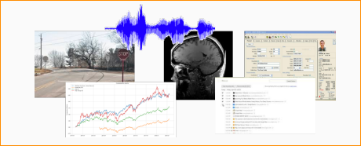
Basic Goal
Goal: Develop algorithms to make decisions or predictions based on data.
Input: A single piece of data (an image, audio file, patient health record, MRI Scan)
Output: A prediction or decision (this image is a stop sign, this stock will go up 15% next quarter, turn the car right)

Slide 6
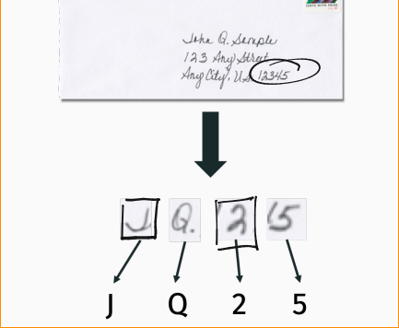
Classic Example:
Optical character recognition (OCR): Decide if a handwritten character is an a, b, … z, 0, 1, ..9

Slide 7
Classic Example
Optical Character Recognition (OCR): Decide if a handwritten character is an a, b, … z,0, 1…9
Applications:
Automatic Mail Sorting
Text search in handwritten documents
Digitizing scanned books
License plate detection for tolls
Etc

Slide 8
Problem: Recognize a digit from the image
MNIST dataset challenge
Dataset developed in 1990s to spur AI research on a challenging problem for the time
Data taken from census forms
Became a classic benchmark for machine vision problems
We will see this dataset extensively in this class

Slide 9
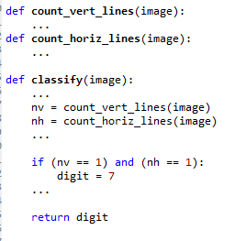
Classical “Expert” Approach
Idea: Use your knowledge about digits
You are an “expert” since you can do the task
So, you construct simple rules and code them
Expert rule example: “Image is a digit 7 if…”:
There is a single horizontal line, and
There is a single vertical line
Rule seems simple and reasonable
But,…

Slide 10
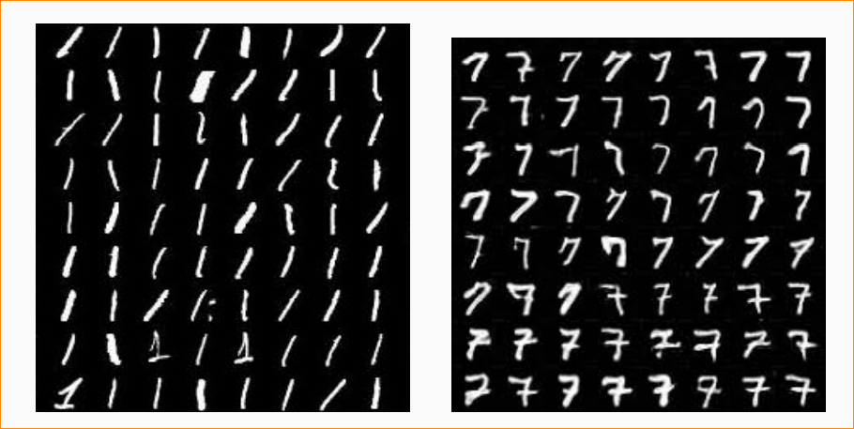
1s vs 7s Algorithms

Slide 11

Problems with Expert Rules
Simple expert rule breaks down in practice
Hard to define a “line” precisely
Orientation, length, thickness, …
May be multiple lines…
General problem: We cannot easily code our knowledge
We can do the task
But, it is hard to translate to simple mathematical formula

Slide 12

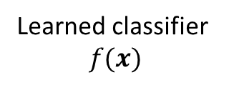
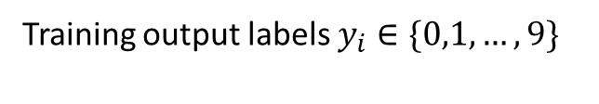
ML Approach: Learn from Data
Training inputs images $x_{i}$ (ex. 5000 ex per class)
?
Training output labels $y_{i}∈\{0,1,…,9\}$
Learned classifier $$f(x)$$
Do not use your “expert” knowledge
Learn the function from data!

Slide 13
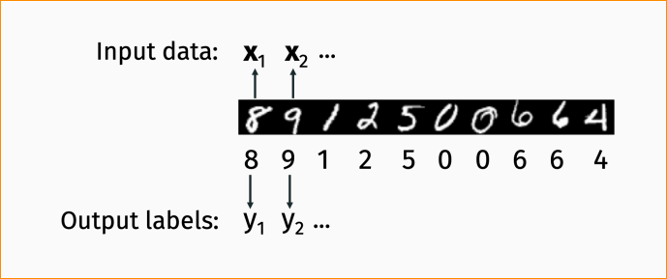

ML Approach: Learn from Data
Step 1:
Collect and label many input/output pairs $\left(x_{i},y_{i}\right), i=1,…,N$ (Called the training data)
Each example has an input $x_{i}$ and output $y_{i}∈\{0, 1, …9\}$
Learn a function $f(x)$ such that: $f\left(x_{i}\right)≈y_{i}$ for “most” training examples.
This is called the training dataset

Slide 14
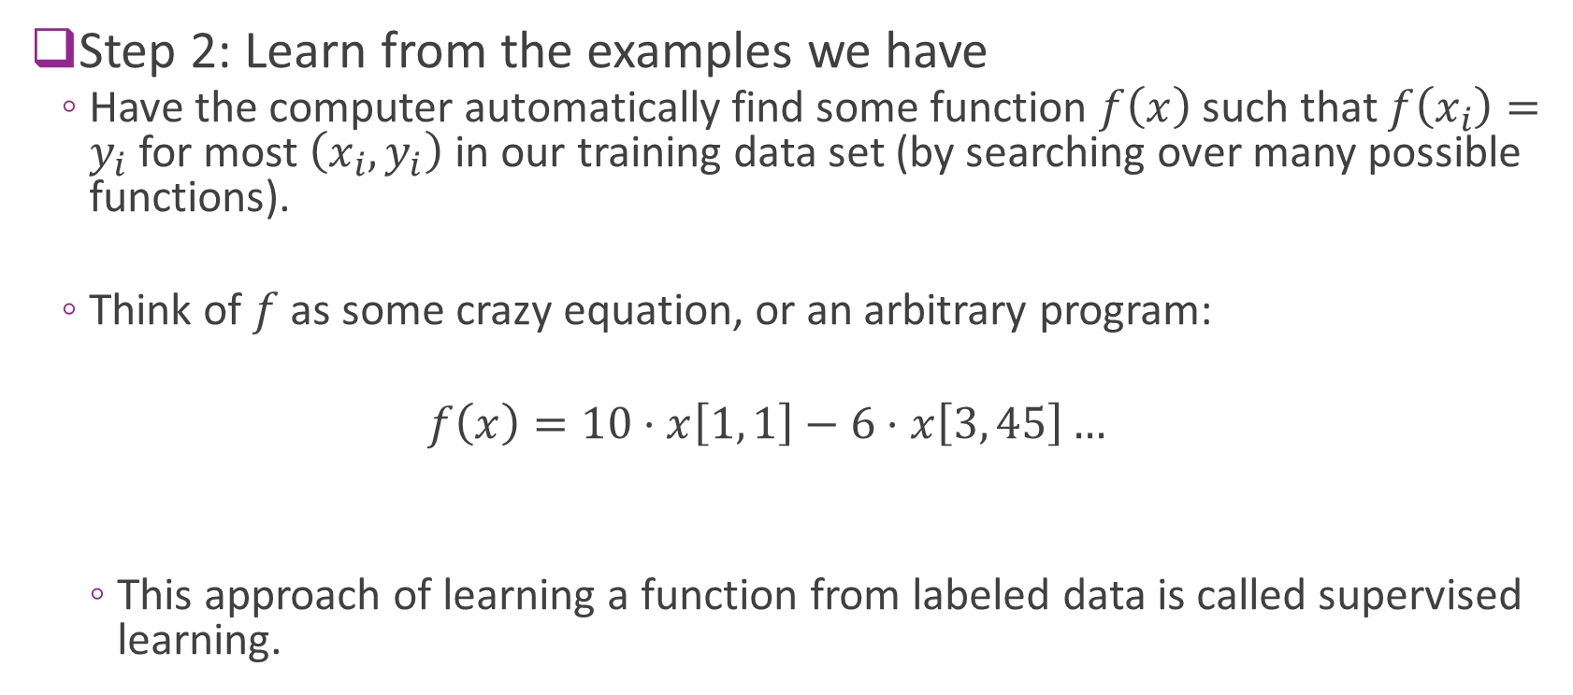
ML Approach: Learn from Data
Step 2: Learn from the examples we have
Have the computer automatically find some function $f\left(x\right)$ such that $f\left(x_{i}\right)=y_{i}$ for most $\left(x_{i}, y_{i}\right)$in our training data set (by searching over many possible functions).
Think of $f$as some crazy equation, or an arbitrary program:
$$f\left(x\right)=10⋅x\left[1, 1\right]−6⋅x\left[3, 45\right]…$$
This approach of learning a function from labeled data is called supervised learning.

Slide 15
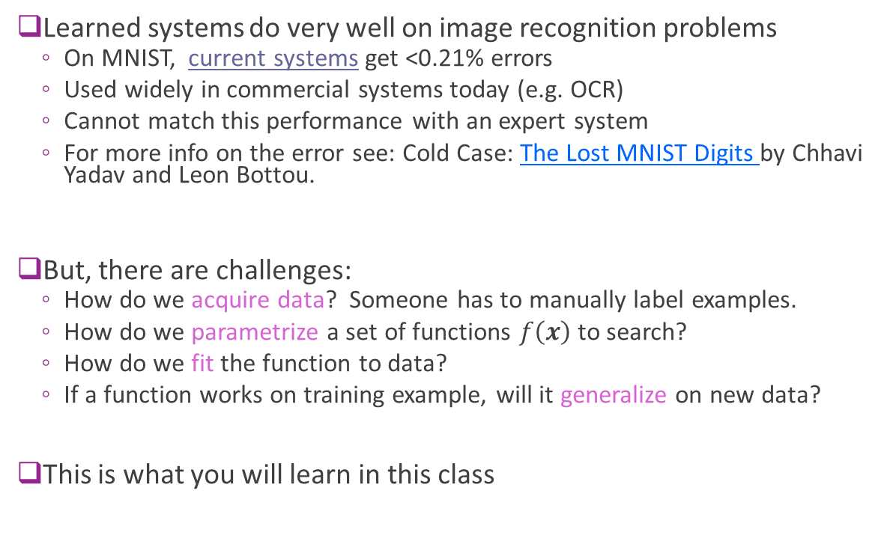
ML Approach Benefits and Challenges
Learned systems do very well on image recognition problems
On MNIST, current systems get <0.21% errors
Used widely in commercial systems today (e.g. OCR)
Cannot match this performance with an expert system
For more info on the error see: Cold Case: The Lost MNIST Digits by Chhavi Yadav and Leon Bottou.
But, there are challenges:
How do we acquire data? Someone has to manually label examples.
How do we parametrize a set of functions $f\left(x\right)$ to search?
How do we fit the function to data?
If a function works on training example, will it generalize on new data?
This is what you will learn in this class

Slide 16
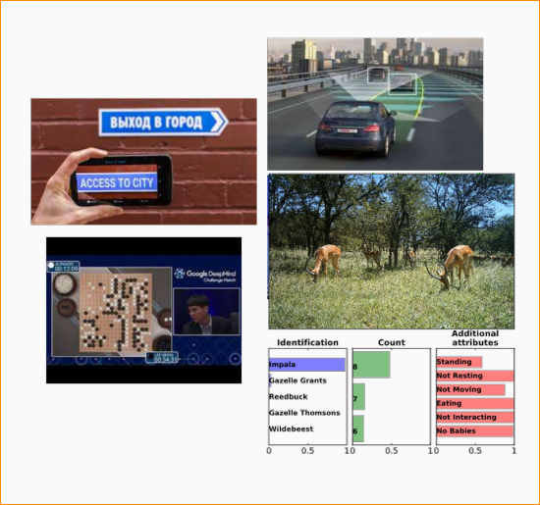
ML is super exciting right now !!!
Autonomous Vehicles
Human level play in very difficult games. (Alpha Go)
Incredible machine translation
Prose and code writing (GPT3 and Codex)
Pervasive impact in science and engineering.
Many, many more.

Slide 17
What is driving ML
Machine learning has benefited from an explosion in our ability to collect and store data:
Cheap, fast storage. Large data centers accessible via the cloud
Pervasive monitoring (satellite imagery, cheap sensors, improved and reduced cost for technologies like LIDAR)
Crowd-sourced data collection (images, text on the internet)
Crowd-sourced data labeling via the internet (Amazon Mechanical Turk, reCAPTCHA, etc.
Having lots of data isn’t enough. We have to know how to use it effectively.

Slide 18
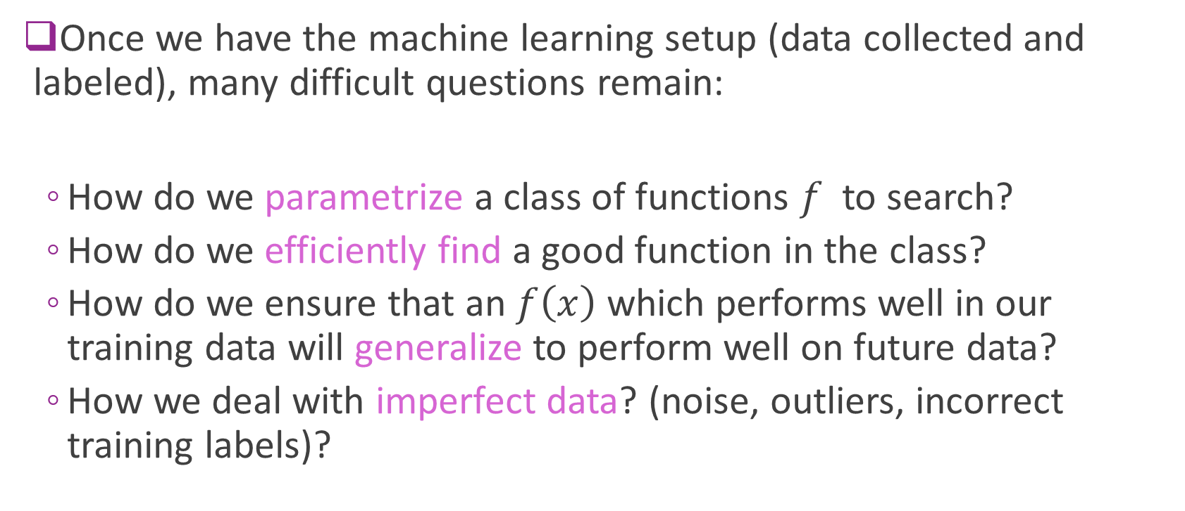
Central Questions in ML
Once we have the machine learning setup (data collected and labeled), many difficult questions remain:
How do we parametrize a class of functions $f$ to search?
How do we efficiently find a good function in the class?
How do we ensure that an $f\left(x\right)$ which performs well in our training data will generalize to perform well on future data?
How we deal with imperfect data? (noise, outliers, incorrect training labels)?

Slide 19
Central Questions in ML
In this course you will learn to answer these central questions through a combination of:
Hands on implementation:
In class demos and take home labs using Python and Jupyter Notebooks
We will user Google Colab as the primary programming environment.
Final Project
Theoretical Exploration:
Written problem sets
Midterm and Final exam.

Slide 20
Course Objectives
Goals of hands-on Component:
Learn how to view and formulate real world problems in the language of machine learning.
Gain experience applying the most popular and successful machine learning algorithms to example problems.

Slide 21
Course Objectives
Goals of theoretical component:
Learn how theoretical analysis can help explain the performance of machine learning algorithms and lead to the design of entirely new methods.
Build experience with the most important mathematical tools used in machine learning, including probability, statistics and linear algebra. This experience will prepare you for more advanced coursework in ML, or research.
Be able understand contemporary research in machine learning, including papers from NeurIPS, ICML, ICLR and other major ML venues.

Slide 22
More advanced classes
Algorithmic Machine Learning and Data Science. (Dr. Rajesh Jayaram)
Statistical and Computational Foundations of Machine Learning (Dr. David Pal)
Foundations of Deep Learning (Prof. Chinmay Hegde, Ph.D. students only)

Slide 23
Three most important things from syllabus
All class information: Brightspace
Campuswire: Here’s the link for our class: https://campuswire.com/p/G34460F4B . Then the key is 6582.
Don’t hesitate to ask me or the TAs for help.

Slide 24
Class Participation
Accounts 10% of your grade and it’s easy to get perfect score:
Ask and answer questions during lecture
Answer polls in poll everywhere during class
Post questions or responses on Campuswire or other things you find interesting.
Participate in office hours.

Slide 25
Simple Linear Regression

Slide 26
Supervised Learning
Step 1:
Collect and label many input/output pairs $\left(x_{i},y_{i}\right), i=1,…,N$ (Called the training data)
Each example has an input $x_{i}$ and output $y_{i}∈\{0, 1, …9\}$
Learn a function $f(x)$ such that: $f\left(x_{i}\right)≈y_{i}$ for “most” training examples.
This is called the training dataset

Slide 27

Supervised
Step 2: Learn from the examples we have
Have the computer automatically find some function $f\left(x\right)$ such that
$f\left(x_{i}\right)≈y_{i}$ for most $\left(x_{i}, y_{i}\right)$in our training data set (by searching over many possible functions).

Slide 28
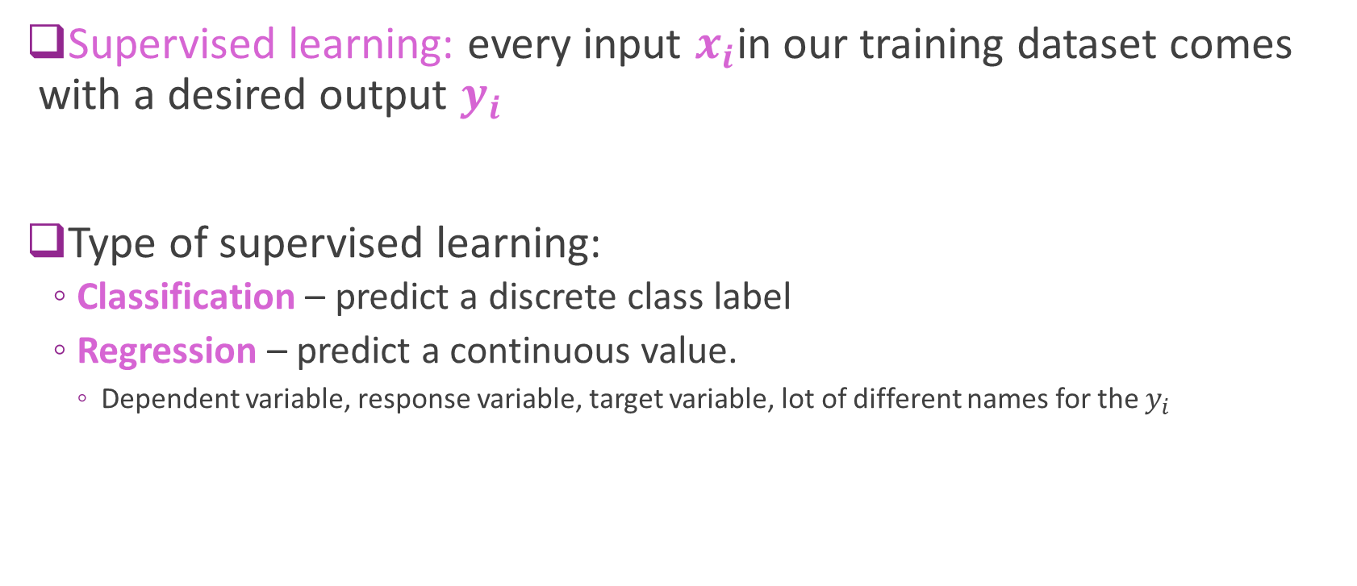
Machine Learning
Supervised learning: every input $x_{i}$in our training dataset comes with a desired output $y_{i}$
Type of supervised learning:
Classification – predict a discrete class label
Regression – predict a continuous value.
Dependent variable, response variable, target variable, lot of different names for the $y_{i}$
Notes:
Yi (typically generated by a human, or some other process)

Slide 29
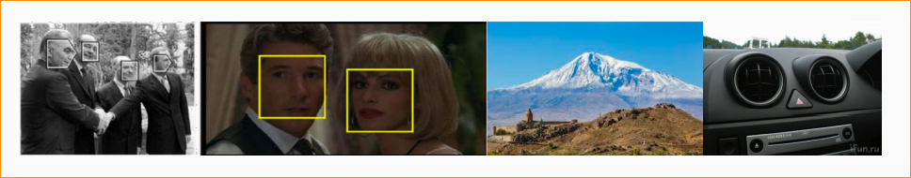

Supervised learning
Another example of supervised learning: Face Detection.
Each input data example $x_{i}$is an image. Each output $y_{i}$ is 1 if the image contains a face or 0 otherwise.
Harder than digit recognition, but we now have very reliable methods (used in nearly all digital cameras, phones, etc)

Slide 30
Supervised Learning: other examples
Object detection: (Input: image, Output: dog or cat)
Spam detection: (Input: email text, Output: spam or not)
Medical diagnosis: (Input: patient data, Output: disease condition or not)
Credit decision making: (Input: financial data, Output: offer loan or not)

Slide 31
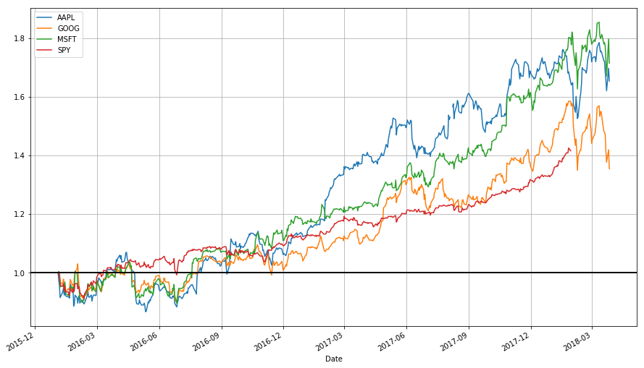
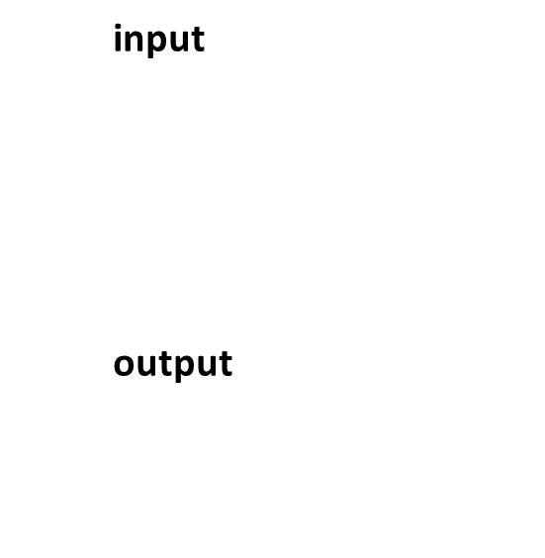
Supervised Regression: Stock Price Prediction
Each input x is a vector of metrics about a company (sales volume, PE ratio, earning reports, historical price data)
Each output $y_{i}$ is the price of the stock 3 months in the future

Slide 32
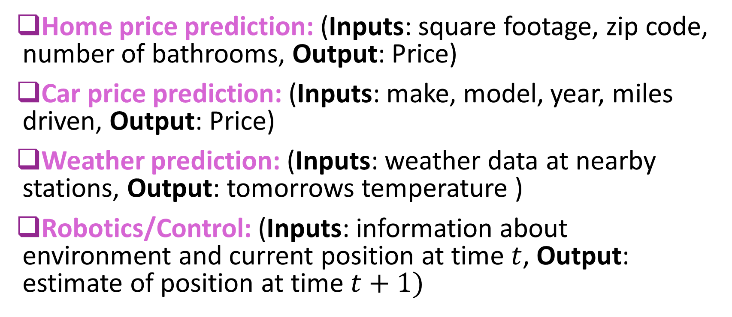
Other examples: Supervised learning
Home price prediction: (Inputs: square footage, zip code, number of bathrooms, Output: Price)
Car price prediction: (Inputs: make, model, year, miles driven, Output: Price)
Weather prediction: (Inputs: weather data at nearby stations, Output: tomorrows temperature )
Robotics/Control: (Inputs: information about environment and current position at time $t$, Output: estimate of position at time $t+1)$

Slide 33
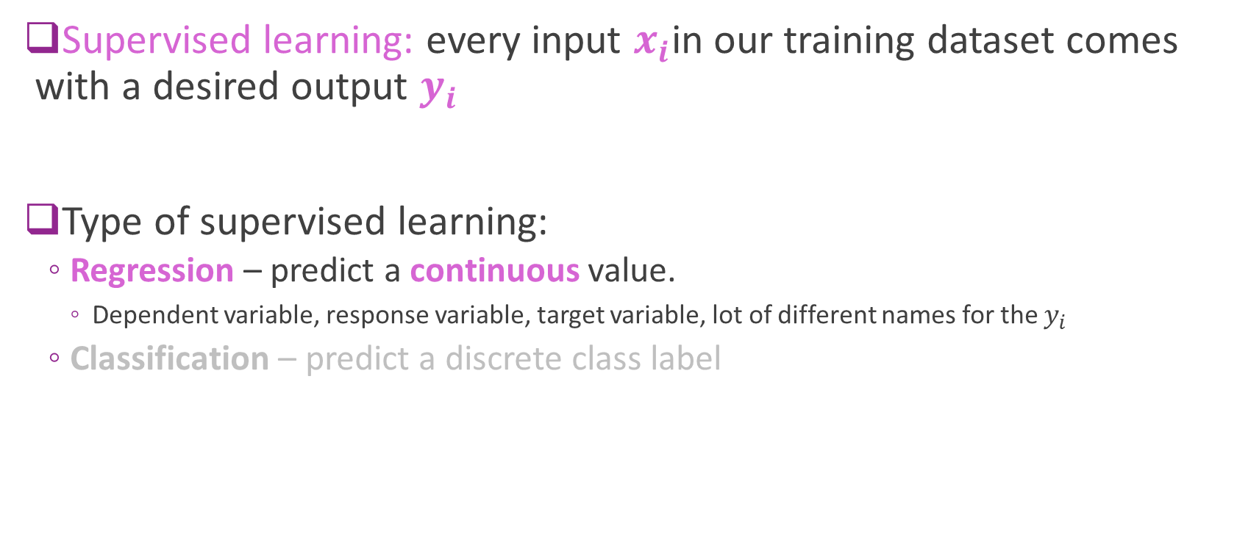
Supervised Learning
Supervised learning: every input $x_{i}$in our training dataset comes with a desired output $y_{i}$
Type of supervised learning:
Regression – predict a continuous value.
Dependent variable, response variable, target variable, lot of different names for the $y_{i}$
Classification – predict a discrete class label
Notes:
Yi (typically generated by a human, or some other process)

Slide 34
Top Journals
Journal of Machine Learning Research www.jmlr.org
Machine Learning
Neural Computation
Neural Networks
IEEE Trans on Neural Networks and Learning Systems
IEEE Trans on Pattern Analysis and Machine Intelligence
Journals on Statistics/Data Mining/Signal Processing/Natural Language Processing/Bioinformatics/...

Slide 35
Top Conferences
International Conference on Machine Learning (ICML)
European Conference on Machine Learning (ECML)
Neural Information Processing Systems (NIPS)
Uncertainty in Artificial Intelligence (UAI)
Computational Learning Theory (COLT)
International Conference on Artificial Neural Networks (ICANN)
International Conference on AI & Statistics (AISTATS)
Knowledge Discovery and Data Mining (KDD)
International Conference on Computer Vision and Pattern Recognition (CVPR)
International Conference on Computer Vision (ICCV)
European Conference on Computer Vision (ECCV)

Slide 36
First a Couple of things
Demo Google Colab
Demo Numpy vectors

Slide 37
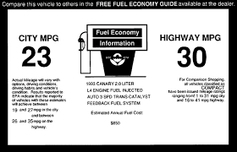
Motivating Example: What Determines mpg in a Car?
Predict the highway miles per gallon (MPG) of a car given quantitative information about its engine.
Demo in car_mpg_demo
What factors might matter?

Slide 38
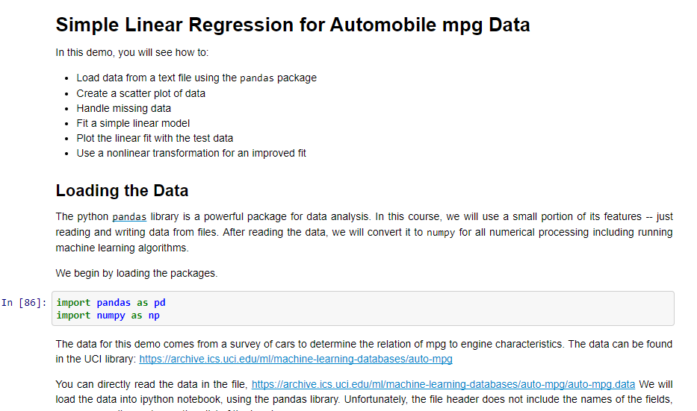
Demo in Google Colab
car_mpg_demo

Slide 39
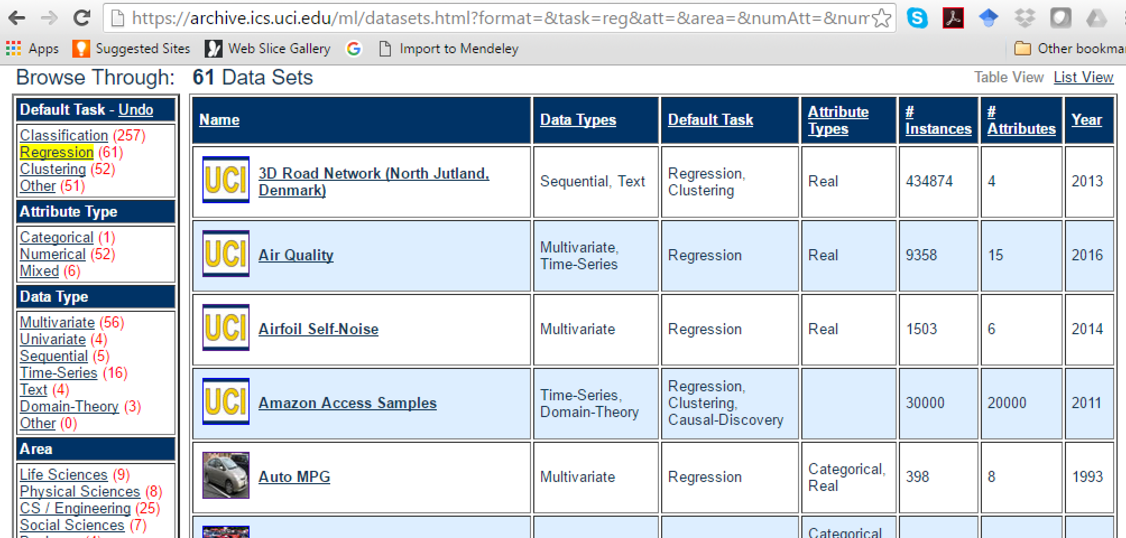
Getting Data
Data from UCI dataset library: https://archive.ics.uci.edu/ml/datasets.html
Today’s lecture

Slide 40
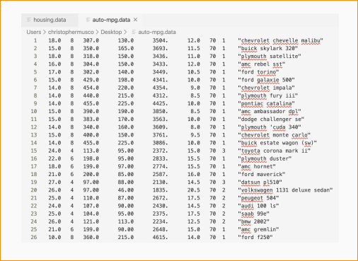
Datasets
They come from UCI (and many other places as a ‘csv’, tab, space or comma delimited files

Slide 41
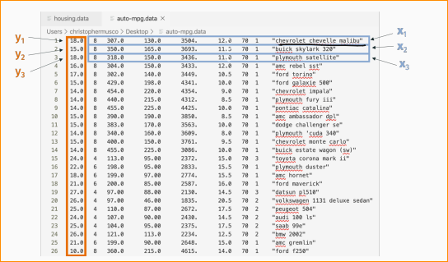
Check it
Check dataset description to know what each column means.
‘mpg’, ‘cylinders’,
‘displacement’, ‘horsepower’,
‘weight’…

Slide 42


Python Packages
Python has many powerful packages
This demo uses three key packages
Pandas:
Used for reading and writing data files
Loads data into dataframes
Numpy
Numerical operations including linear algebra
Data is stored in ndarray structure
We convert from dataframes to ndarray
Matplotlib:
MATLAB-like plotting and visualization

Slide 43
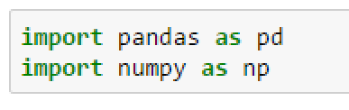
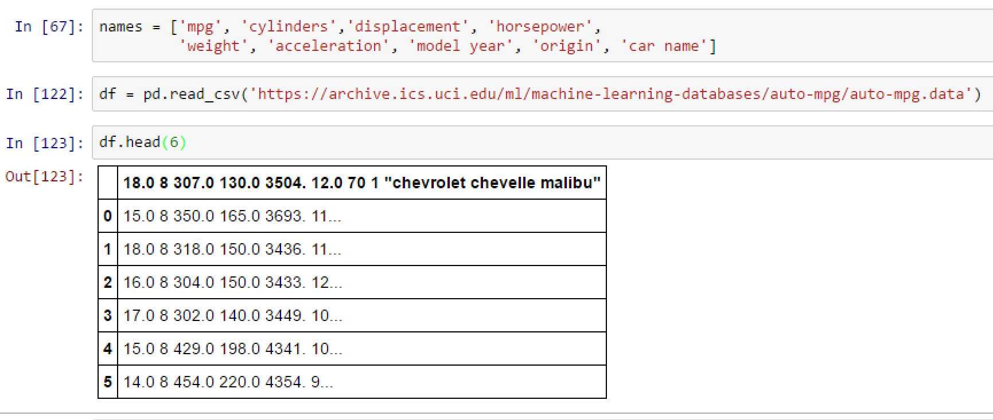
Loading the Data in Jupyter Notebook Try 1: The Wrong Way!
Python pandas library
Read_csv command.
Read URL or file location.
Creates a dataframe object
http://pandas.pydata.org/pandas-docs/stable/dsintro.html#dataframe
Problems
Does not parse columns
All data in a single column
Read_csv assumes columns are delimited by commas
Mistakes first line as header

Slide 44
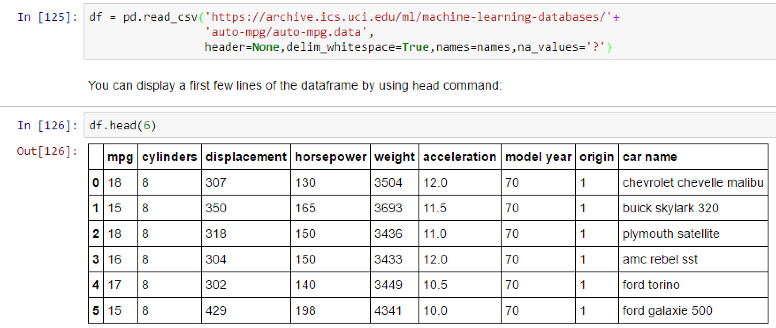
Loading the Data in Jupyter Try 2: Fixing the Errors
Fix the arguments in read_csv
Pandas routines have many options
When you get a problem:
Google is your friend!
You are not the first to have these problems.
Ex: google “pandas.dataframe”
Ex. google “pandas.read”
Dataframe has three components
df.columns, df.index, df.values

Slide 45
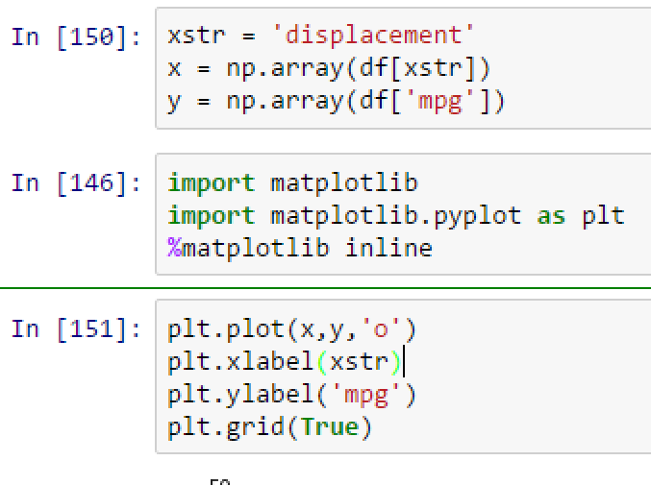
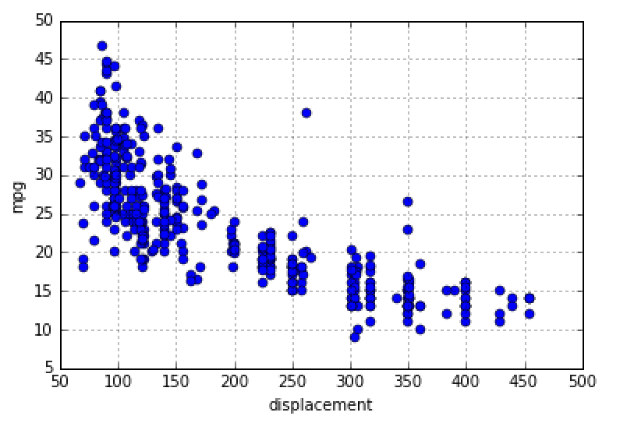
Visualizing the Data
When possible, look at data before doing anything
Python has MATLAB-like plotting
Matplotlib module

Slide 46
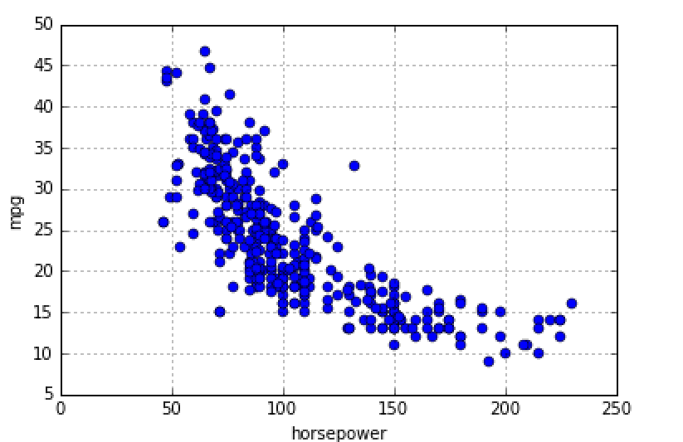
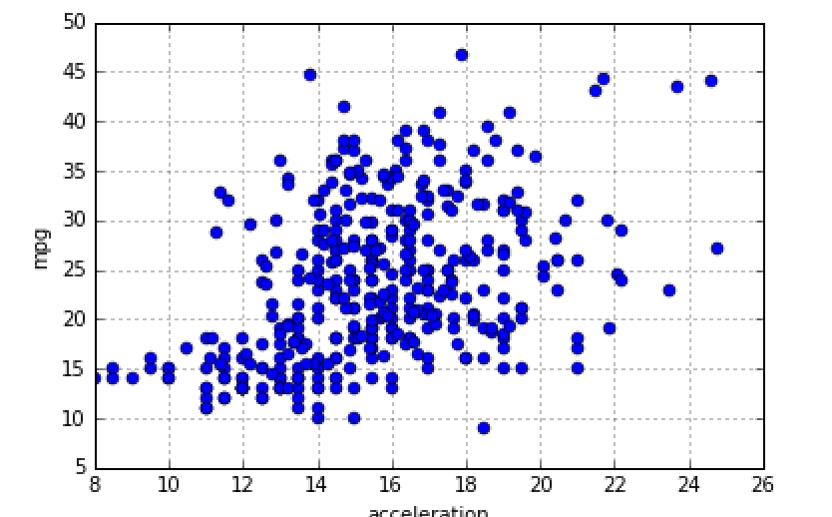
Exercise: Postulate a Model
Try to find a mathematical to predict mpg from displacement, horsepower or acceleration
Make a reasonable / eyeball guess. No need for program now.
What does your model predict when displacement = 200?
Is the prediction reasonable? Can you improve your model?
mpg
Displacement
Horsepower
Acceleration

Slide 47
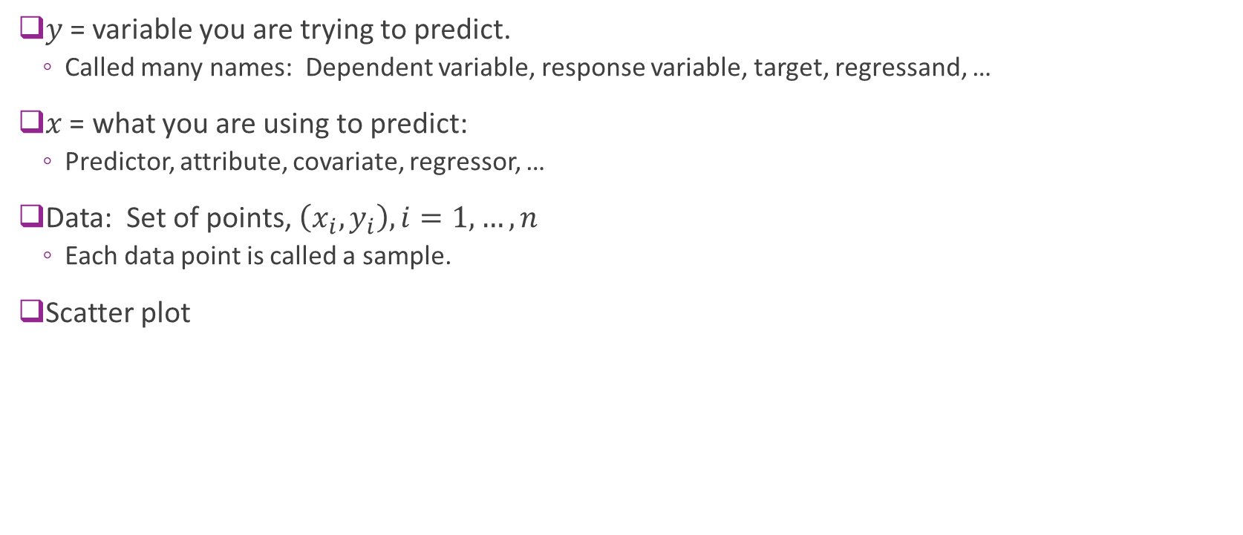


Data
$y$= variable you are trying to predict.
Called many names: Dependent variable, response variable, target, regressand, …
$x$ = what you are using to predict:
Predictor, attribute, covariate, regressor, …
Data: Set of points, $\left(x_{i},y_{i}\right), i=1,…, n$
Each data point is called a sample.
Scatter plot
$y$ = mpg
$x$ = horsepower

Slide 48
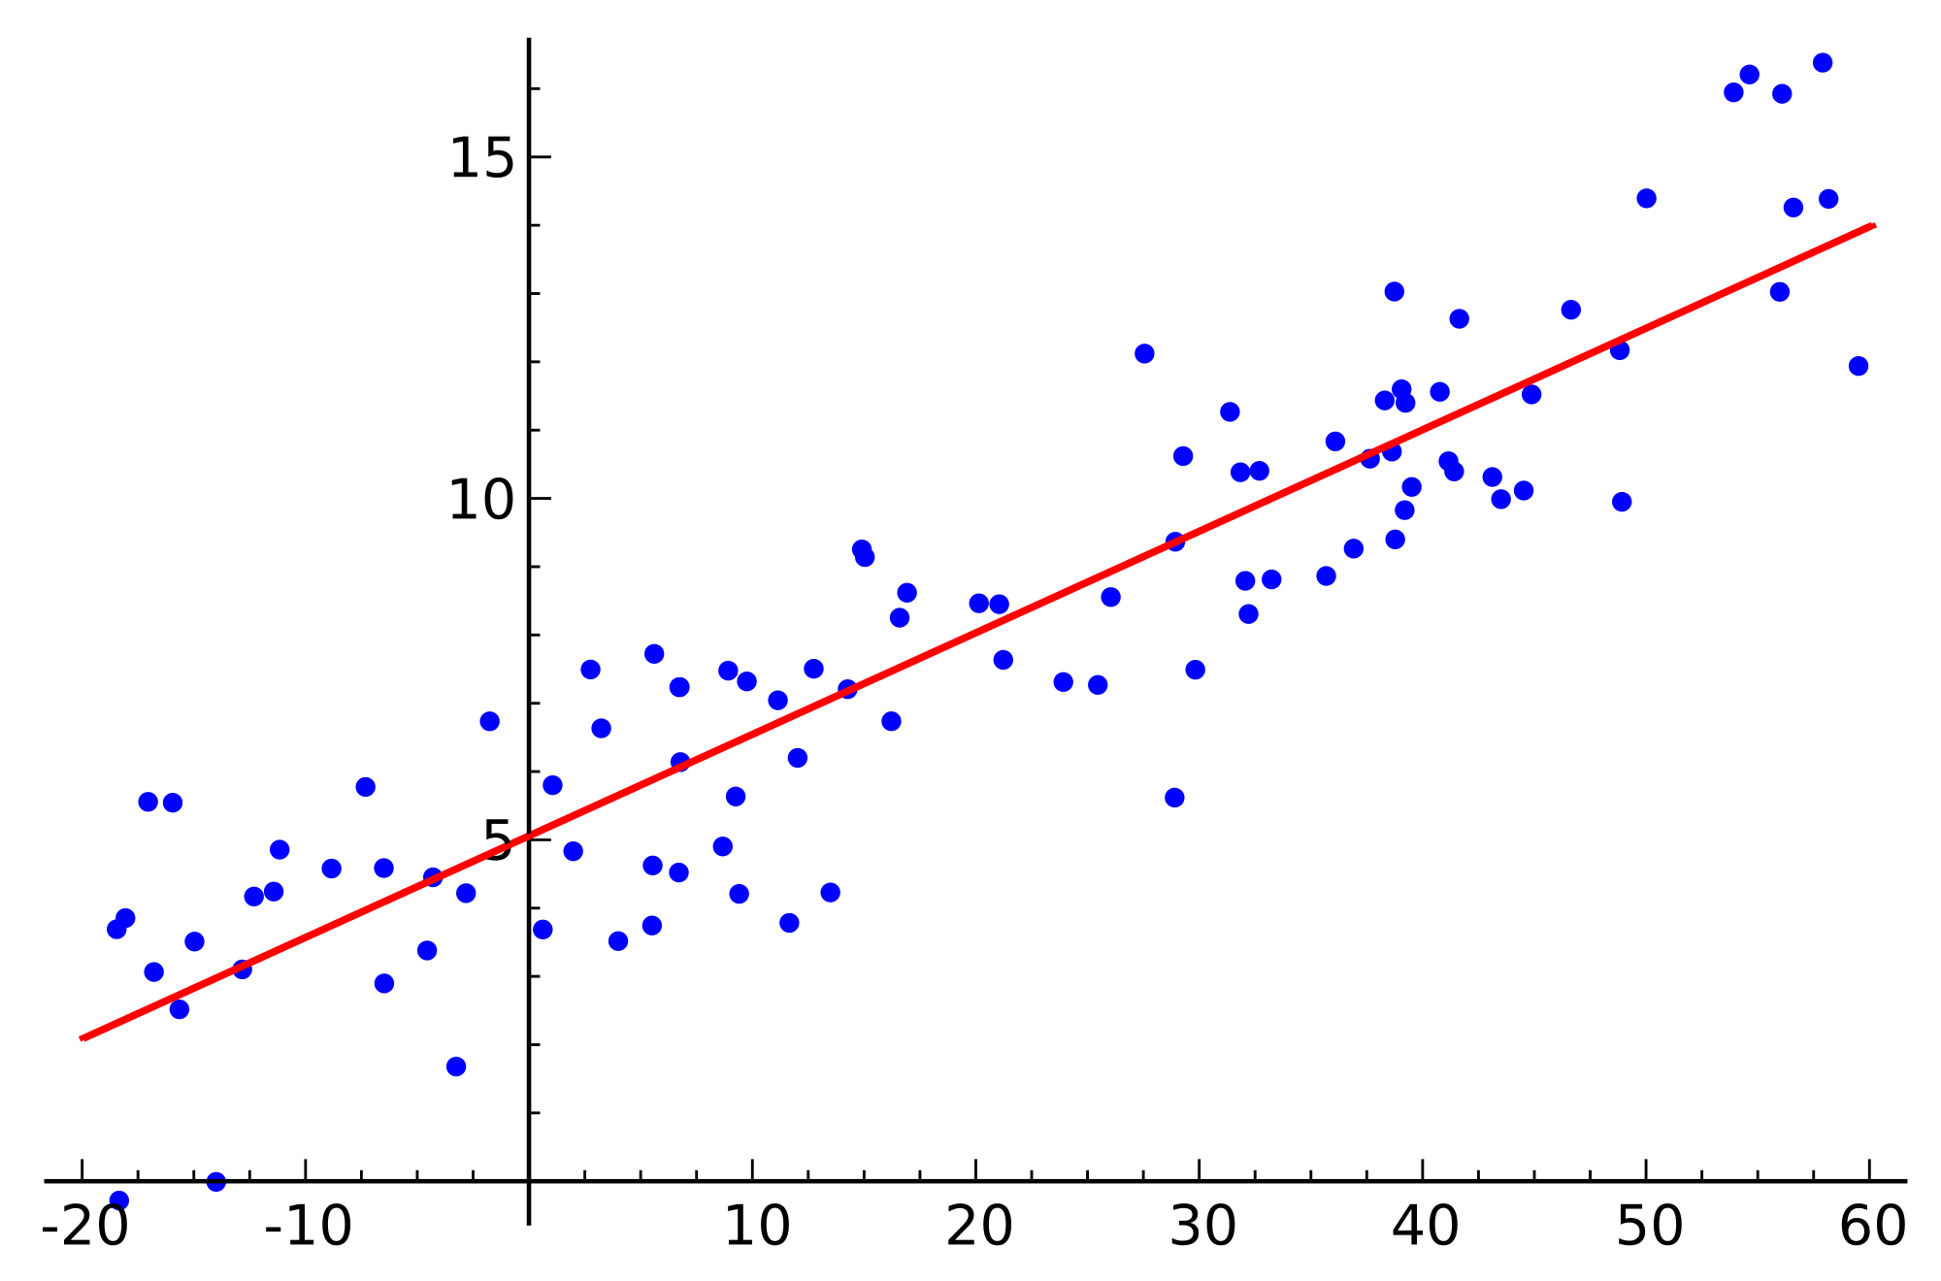
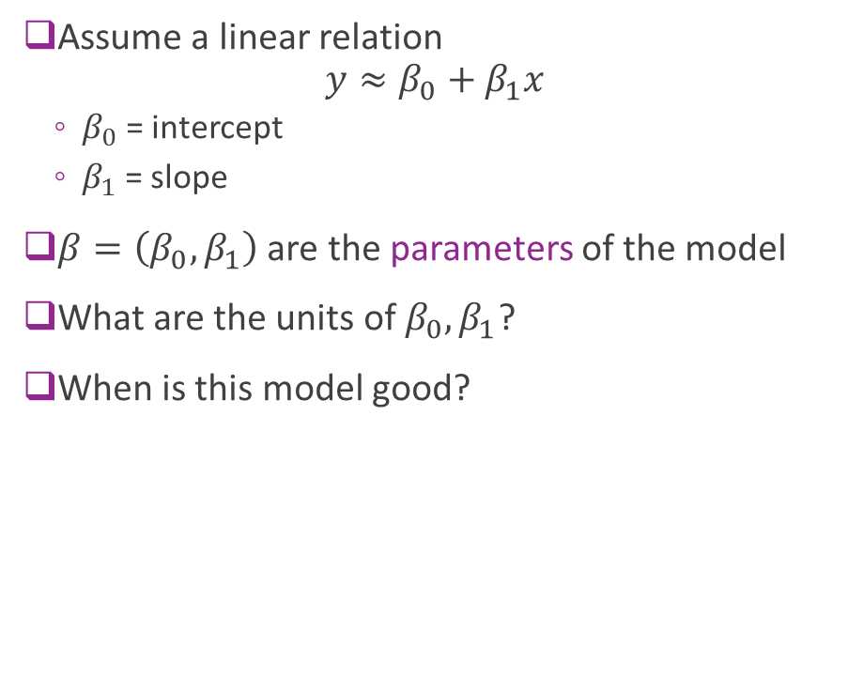
Linear Model
Assume a linear relation $y≈β_{0}+β_{1}x$
$β_{0}$ = intercept
$β_{1}$ = slope
$β=\left(β_{0},β_{1}\right)$ are the parameters of the model
What are the units of $β_{0},β_{1}$?
When is this model good?
Regression line

Slide 49
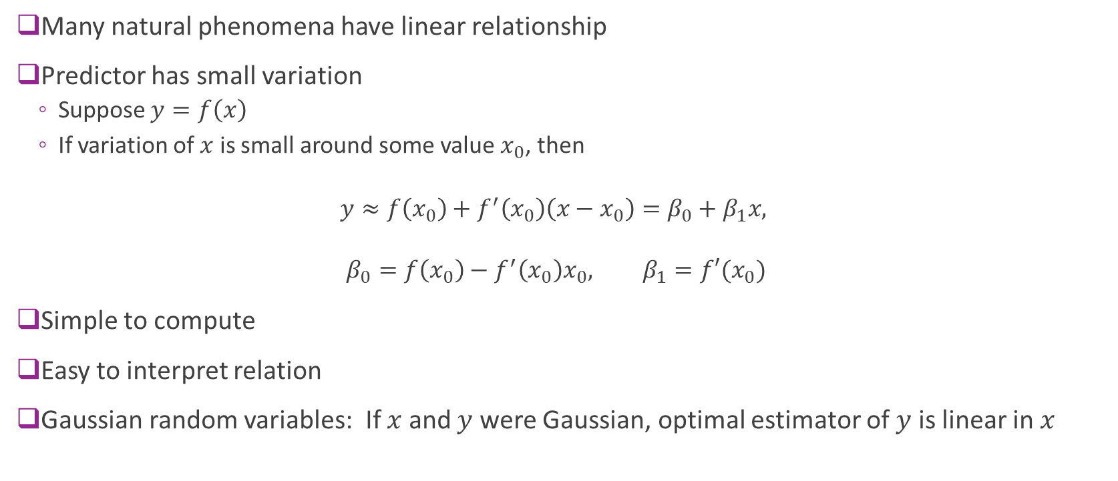
Why Use a Linear Model?
Many natural phenomena have linear relationship
Predictor has small variation
Suppose $y=f\left(x\right)$
If variation of $x$ is small around some value $x_{0}$, then
$$y≈f\left(x_{0}\right)+f^{′}\left(x_{0}\right)\left(x−x_{0}\right)=β_{0}+β_{1}x,$$
$$β_{0}=f\left(x_{0}\right)−f^{′}\left(x_{0}\right)x_{0}, β_{1}=f′(x_{0})$$
Simple to compute
Easy to interpret relation
Gaussian random variables: If $x$ and $y$ were Gaussian, optimal estimator of $y$ is linear in $x$

Slide 50
Outline
Motivating Example: Predicting the mpg of a car
Linear Model
Least Squares Fit Problem
Sample Mean and Variance
LS Fit Solution
Assessing Goodness of Fit

Slide 51
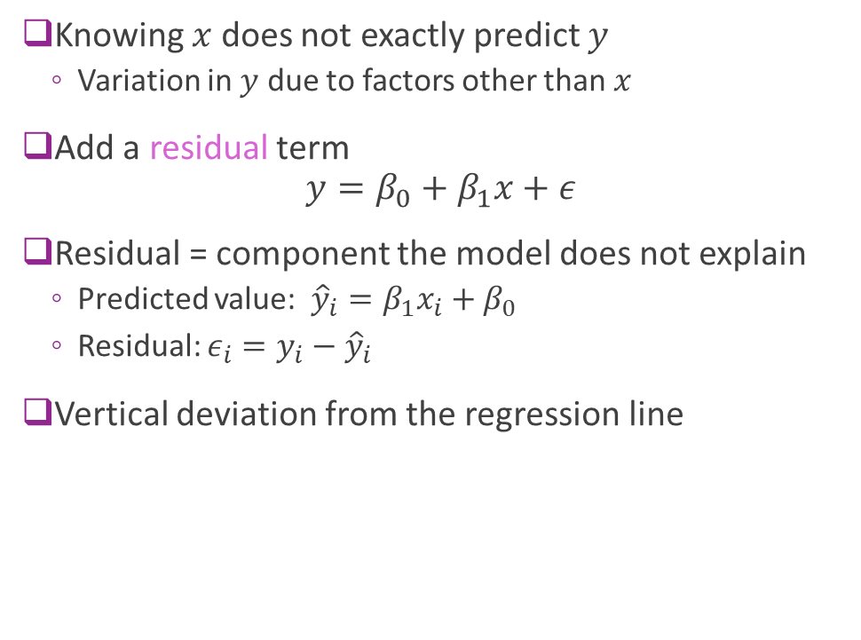
Linear Model Residual
Knowing $x$ does not exactly predict $y$
Variation in $y$ due to factors other than $x$
Add a residual term $y=β_{0}+β_{1}x+ε$
Residual = component the model does not explain
Predicted value: ${\hat{y}}_{i}=β_{1}x_{i}+β_{0}$
Residual: $ε_{i}=y_{i}−{\hat{y}}_{i}$
Vertical deviation from the regression line

Slide 52
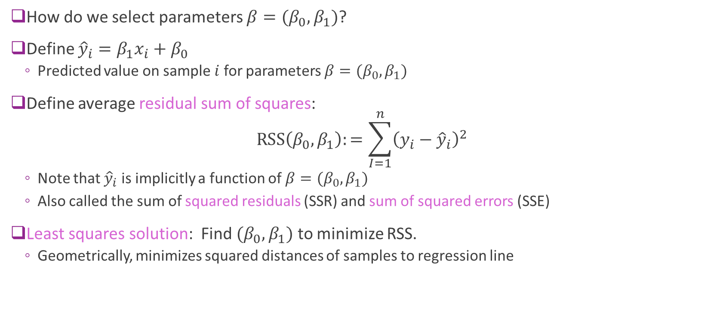
Least Squares Model Fitting
How do we select parameters $β=(β_{0},β_{1})$?
Define ${\hat{y}}_{i}=β_{1}x_{i}+β_{0}$
Predicted value on sample $i$ for parameters $β=(β_{0},β_{1})$
Define average residual sum of squares: $RSS\left(β_{0},β_{1}\right):=\sum_{I=1}^{n}{{\left(y_{i}−{\hat{y}}_{i}\right)}^{2}}$
Note that ${\hat{y}}_{i}$ is implicitly a function of $β=(β_{0},β_{1})$
Also called the sum of squared residuals (SSR) and sum of squared errors (SSE)
Least squares solution: Find $(β_{0},β_{1})$ to minimize RSS.
Geometrically, minimizes squared distances of samples to regression line

Slide 53
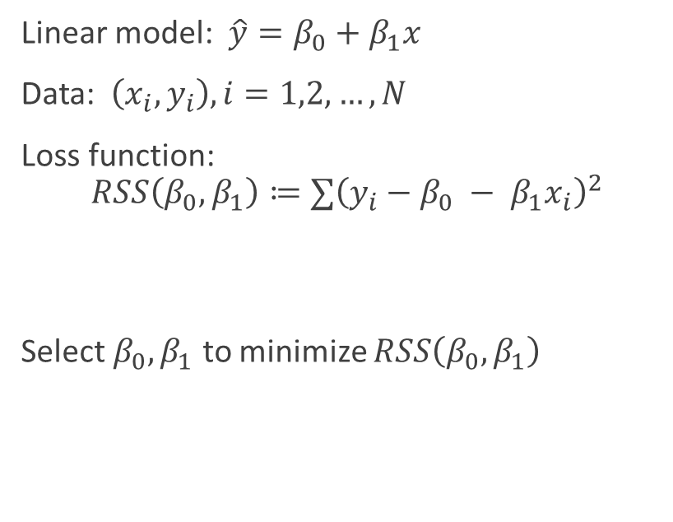
Finding Parameters via Optimization A general ML recipe
General ML problem
Simple linear regression
Find a model with parameters
Get data
Pick a loss function
Measures goodness of fit model to data
Function of the parameters
Find parameters that minimizes loss
Linear model: $\hat{y}=β_{0}+β_{1}x$
Data: $\left(x_{i},y_{i}\right),i=1,2,…,N$
Loss function: $$RSS\left(β_{0},β_{1}\right)≔∑{\left(y_{i}−β_{0} − β_{1}x_{i}\right)}^{2}$$
Select $β_{0},β_{1}$ to minimize $RSS\left(β_{0},β_{1}\right)$

Slide 54
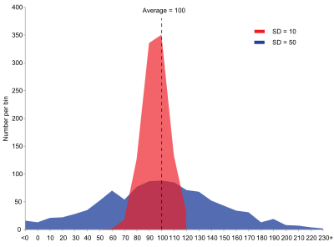
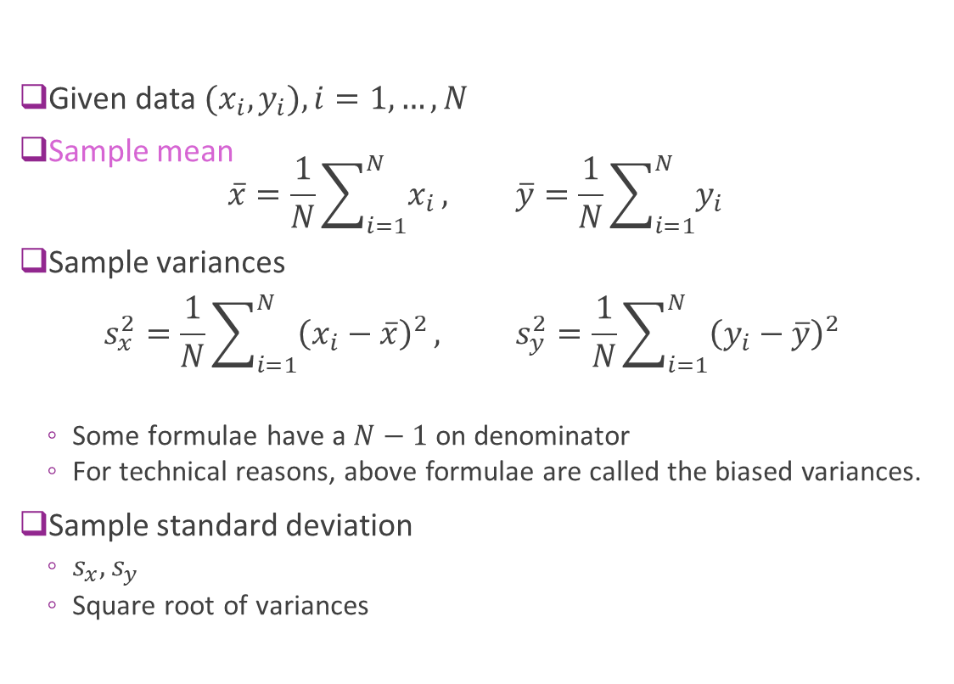
Sample Mean and Standard Deviations
Given data ${(x}_{i},y_{i}), i=1,…,N$
Sample mean $\overline{x}=\frac{1}{N}\sum_{i=1}^{N}{x_{i}}, \overline{y}=\frac{1}{N}\sum_{i=1}^{N}{y_{i}}$
Sample variances $s_{x}^{2}=\frac{1}{N}\sum_{i=1}^{N}{{\left(x_{i}−\overline{x}\right)}^{2}}, s_{y}^{2}=\frac{1}{N}\sum_{i=1}^{N}{{\left(y_{i}−\overline{y}\right)}^{2}}$
Some formulae have a $N−1$ on denominator
For technical reasons, above formulae are called the biased variances.
Sample standard deviation
$s_{x}, s_{y}$
Square root of variances
Visualizing standard deviation
https://en.wikipedia.org/wiki/Standard_deviation

Slide 55

Visualizing Mean and SD on Scatter Plot Question
Using the picture only (no calculators), estimate the following (roughly):
The sample mean mpg and horsepower: $\overline{x}$, $\overline{y}$
The sample std deviations: $s_{x}, s_{y}$

Slide 56

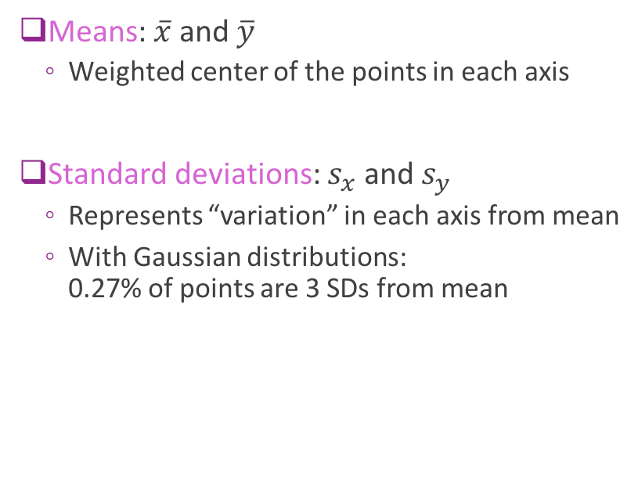



Visualizing Mean and SD on Scatter Plot Approximate answer
Means: $\overline{x}$ and $\overline{y}$
Weighted center of the points in each axis
Standard deviations: $s_{x}$and $s_{y}$
Represents “variation” in each axis from mean
With Gaussian distributions: 0.27% of points are 3 SDs from mean
$$±s_{y}$$
$$\overline{y}$$
$$\overline{x}$$
$$±s_{x}$$

Slide 57
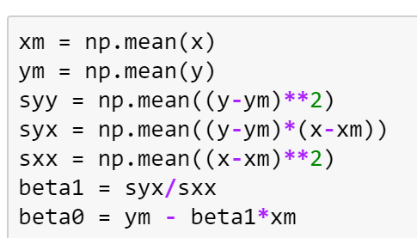

Computing Means and SD in Python
Exact answer can be computed in python
$$±s_{y}$$
$$\overline{y}$$
$$\overline{x}$$
$$±s_{x}$$

Slide 58

Sample Covariance
Sample covariance: $s_{xy}=\frac{1}{N}\sum_{i=1}^{N}{(x_{i}−\overline{x})(y_{i}−\overline{y})}$
Will interpret this momentarily
Cauchy-Schwarz Law: ${|s}_{xy}|<s_{x}s_{y}$
Sample correlation coefficient $r_{xy}=\frac{s_{xy}}{s_{x}s_{y}}∈[−1,1]$
Notes:
Cauchy Schwarz

Slide 59
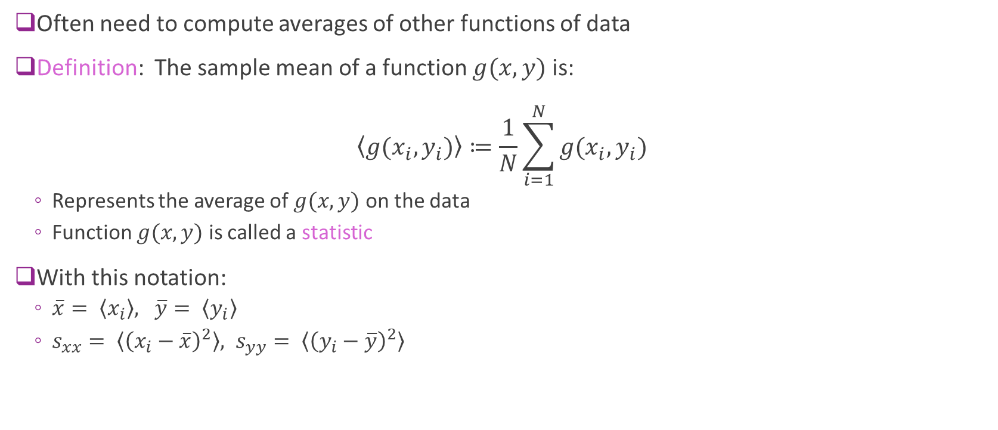
Statistics
Often need to compute averages of other functions of data
Definition: The sample mean of a function $g(x,y)$ is: $\left\langle g(x_{i},y_{i})\right\rangle ≔\frac{1}{N}\sum_{i=1}^{N}{g(x_{i},y_{i})}$
Represents the average of $g(x,y)$ on the data
Function $g(x,y)$ is called a statistic
With this notation:
$\overline{x}= \left\langle x_{i}\right\rangle , \overline{y}= \left\langle y_{i}\right\rangle$
$s_{xx}= \left\langle {\left(x_{i}−\overline{x}\right)}^{2}\right\rangle , s_{yy}= \left\langle {\left(y_{i}−\overline{y}\right)}^{2}\right\rangle$

Slide 60
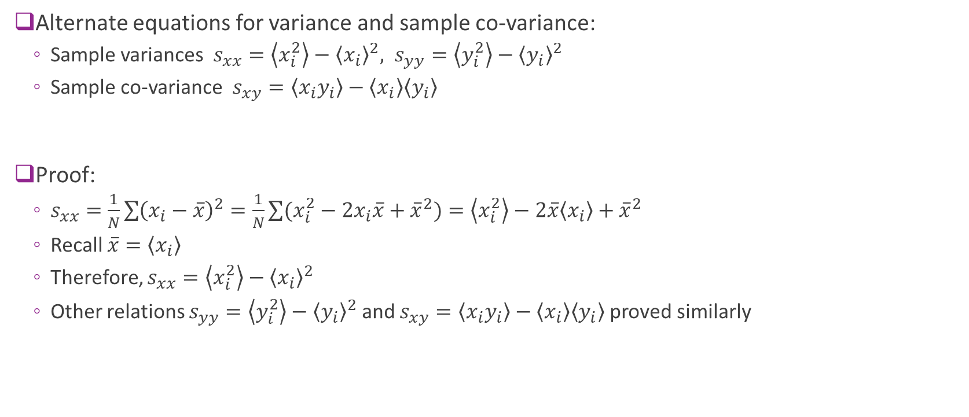
Alternate Equation for Variance
Alternate equations for variance and sample co-variance:
Sample variances $s_{xx}=\left\langle x_{i}^{2}\right\rangle −{\left\langle x_{i}\right\rangle }^{2}, s_{yy}=\left\langle y_{i}^{2}\right\rangle −{\left\langle y_{i}\right\rangle }^{2}$
Sample co-variance $s_{xy}=\left\langle x_{i}y_{i}\right\rangle −\left\langle x_{i}\right\rangle \left\langle y_{i}\right\rangle$
Proof:
$s_{xx}=\frac{1}{N}\sum{{\left(x_{i}−\overline{x}\right)}^{2}}=\frac{1}{N}\sum{(x_{i}^{2}−2x_{i}\overline{x}+{\overline{x}}^{2})}=\left\langle x_{i}^{2}\right\rangle −2\overline{x}\left\langle x_{i}\right\rangle +{\overline{x}}^{2}$
Recall $\overline{x}=$ $\left\langle x_{i}\right\rangle$
Therefore, $s_{xx}=\left\langle x_{i}^{2}\right\rangle −{\left\langle x_{i}\right\rangle }^{2}$
Other relations $s_{yy}=\left\langle y_{i}^{2}\right\rangle −{\left\langle y_{i}\right\rangle }^{2}$ and $s_{xy}=\left\langle x_{i}y_{i}\right\rangle −\left\langle x_{i}\right\rangle \left\langle y_{i}\right\rangle$ proved similarly

Slide 61
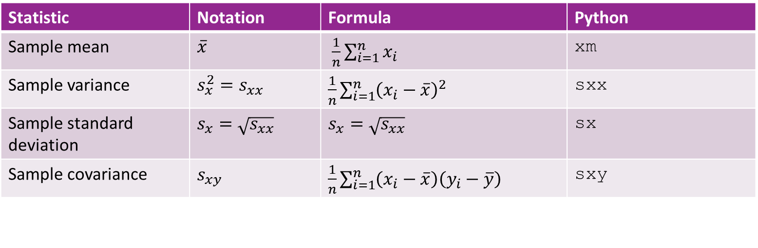
Notation
This class will use the following notation
We will try to be consistent
Note: Other texts use different notations
Statistic | Notation | Formula | Python
Sample mean | $\overline{x}$ | $\frac{1}{n}\sum_{i=1}^{n}{x_{i}}$ | xm
Sample variance | $s_{x}^{2}=s_{xx}$ | $\frac{1}{n}\sum_{i=1}^{n}{{\left(x_{i}−\overline{x}\right)}^{2}}$ | sxx
Sample standard deviation | $s_{x}=\sqrt{s_{xx}}$ | $s_{x}=\sqrt{s_{xx}}$ | sx
Sample covariance | $s_{xy}$ | $\frac{1}{n}\sum_{i=1}^{n}{\left(x_{i}−\overline{x}\right)\left(y_{i}−\overline{y}\right)}$ | sxy

Slide 62
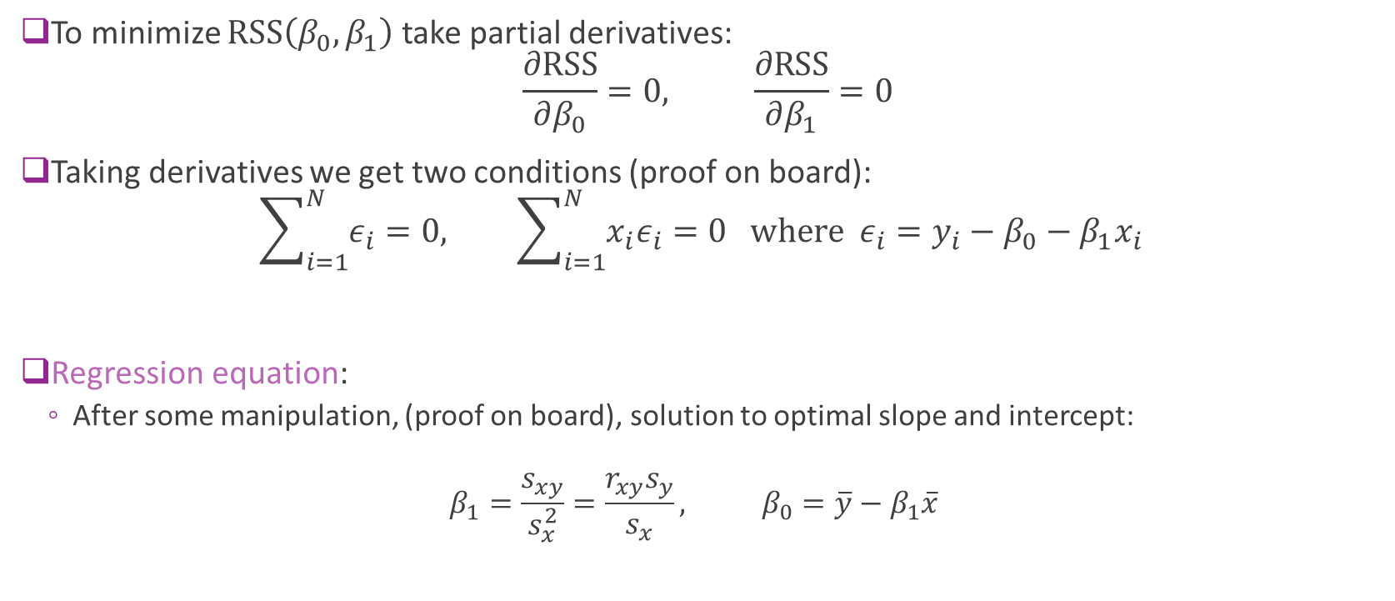
Minimizing RSS
To minimize $RSS\left(β_{0},β_{1}\right)$ take partial derivatives: $\frac{∂\text{RSS}}{∂β_{0}}=0, \frac{∂\text{RSS}}{∂β_{1}}=0$
Taking derivatives we get two conditions (proof on board): $\sum_{i=1}^{N}{ε_{i}}=0, \sum_{i=1}^{N}{{x_{i}ε}_{i}}=0 \text{where} ε_{i}=y_{i}−β_{0}−β_{1}x_{i}$
Regression equation:
After some manipulation, (proof on board), solution to optimal slope and intercept:
$$β_{1}=\frac{s_{xy}}{s_{x}^{2}}=\frac{r_{xy}s_{y}}{s_{x}}, β_{0}=\overline{y}−β_{1}\overline{x}$$

Slide 63
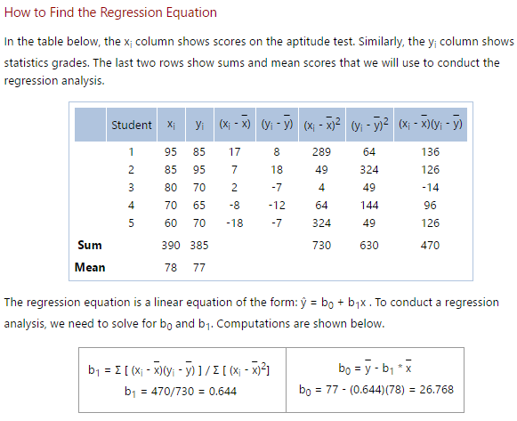
Simple Example
From: http://stattrek.com/regression/regression-example.aspx?Tutorial=AP
Very nice simple problems
Predict aptitude on one test from an earlier test
Draw a scatter plot and regression line

Slide 64



Auto Example
Python code
Regression line: $$\text{mpg}=β_{0}+β_{1} \text{horsepower}$$

Slide 65


Minimum RSS
Minimum RSS (Proof on board) $\min_{β_{0},β_{1}} RSS\left(β_{0},β_{1}\right)=N\left(1−r_{xy}^{2}\right)s_{y}^{2}$
Coefficient of Determination: $R^{2}=r_{xy}^{2}$
Explains portion of variance in $y$ explained by $x$
$s_{y}^{2}$=variance in target $y$
$\left(1−R^{2}\right)s_{y}^{2}$=residual sum of squares after accounting for $x$

Slide 66



Visually seeing correlation
$R^{2}=r_{xy}^{2}≈1:$ Linear model is a very good fit
$R^{2}=r_{xy}^{2}≈0:$ Linear model is a poor fit.
$β_{1}=\frac{r_{xy}s_{y}}{s_{x}}⇒$ Sign($β_{1}$ ) = Sign($r_{xy}$)
Linear models with varying levels of $r_{xy}$
Very good fit
No linear relationship But, may be other relationships

Slide 67

When the Error is Large…
Many sources of error for a linear model
Always good to visually inspect the scatter plot
Look for trends
Example to the left
All four data sets have same regression line
But, errors and their reasons are different
How would you describe these errors?

Slide 68



A Better Model for the Auto Example
Fit the inverse: $\frac{1}{\text{mpg} }=β_{0}+β_{1}\text{horsepower}$
Uses a nonlinear transformation
Will cover this idea later

