Slide 1
Lecture 7 Non-Linear Optimization
EE-uy 4563/EL-GY 9143: Introduction to machine learning
Prof. Sundeep rangan

Slide 2
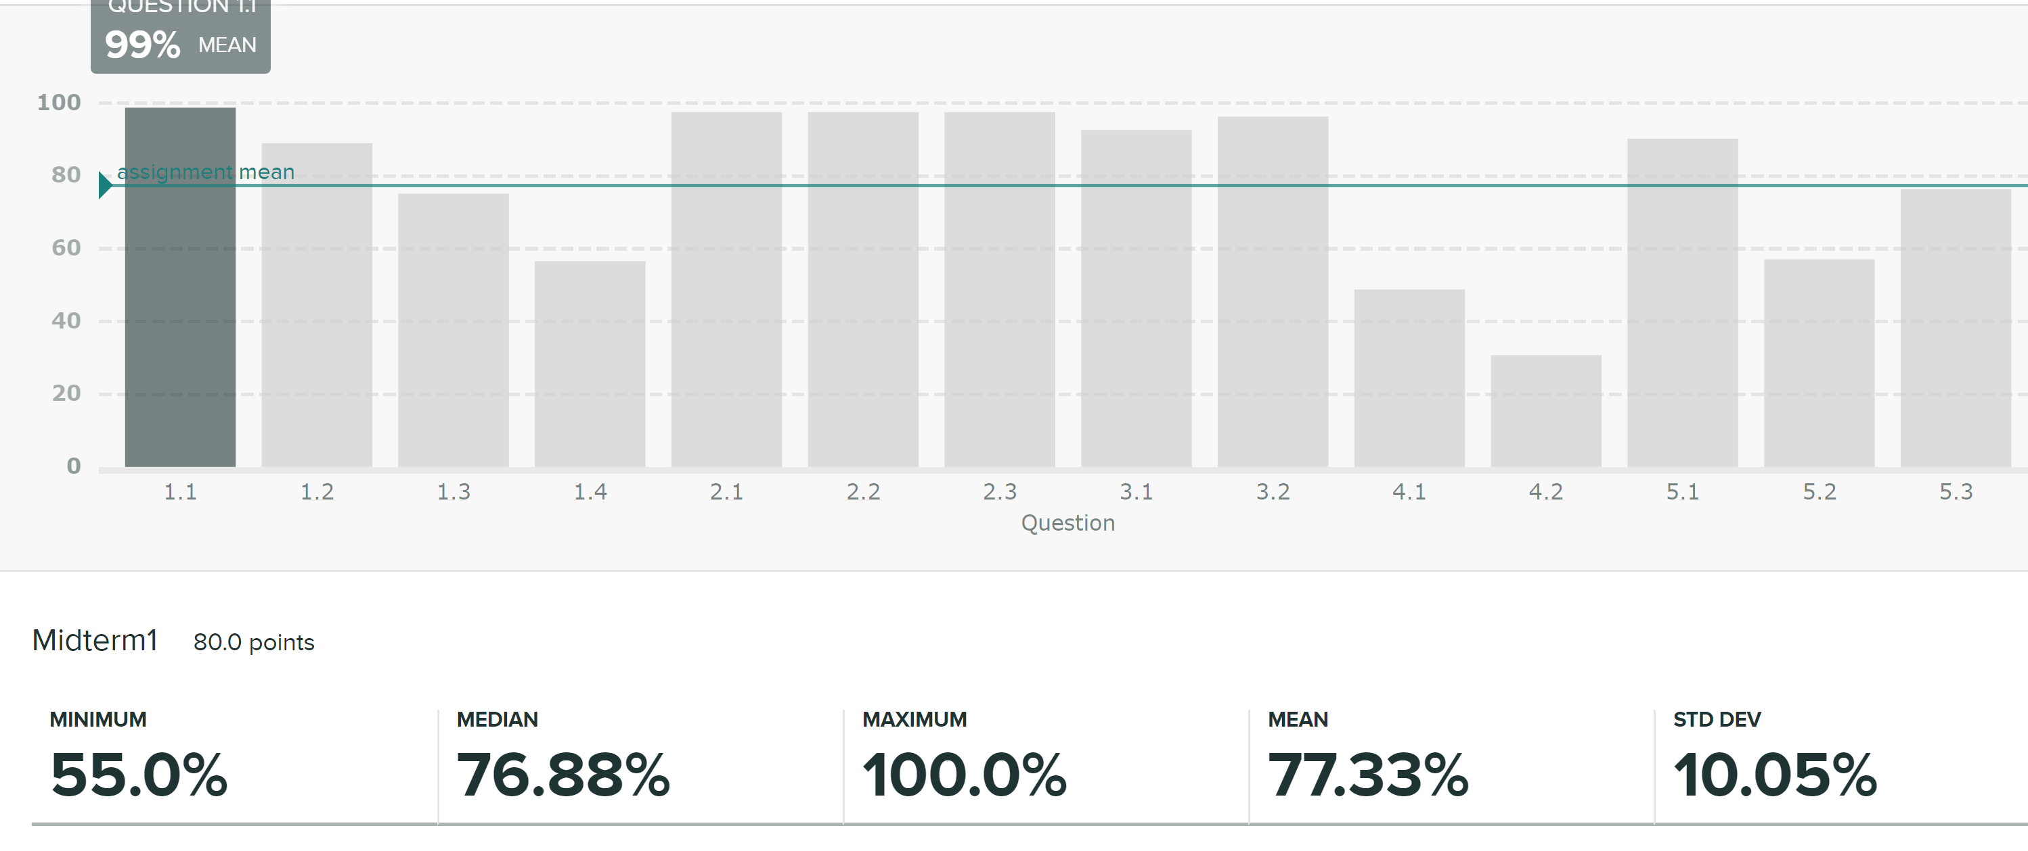
Midterm

Slide 3
Final Project 25%
Grading:
Project Plan | 15
Report | 40
Code | 30
Presentation | 15

Slide 4
Learning Objectives
Identify the objective function, parameters and constraints in an optimization problem
Compute the gradient of a loss function for scalar, vector and matrix parameters
Efficiently compute a gradient in python.
Write the gradient descent update
Describe the effect of the learning rate on convergence
Determine if a loss function is convex

Slide 5
Outline
Motivating example: Build an optimizer for logistic regression
Gradients of multi-variable functions
Gradient descent
Adaptive step size
Convexity

Slide 6
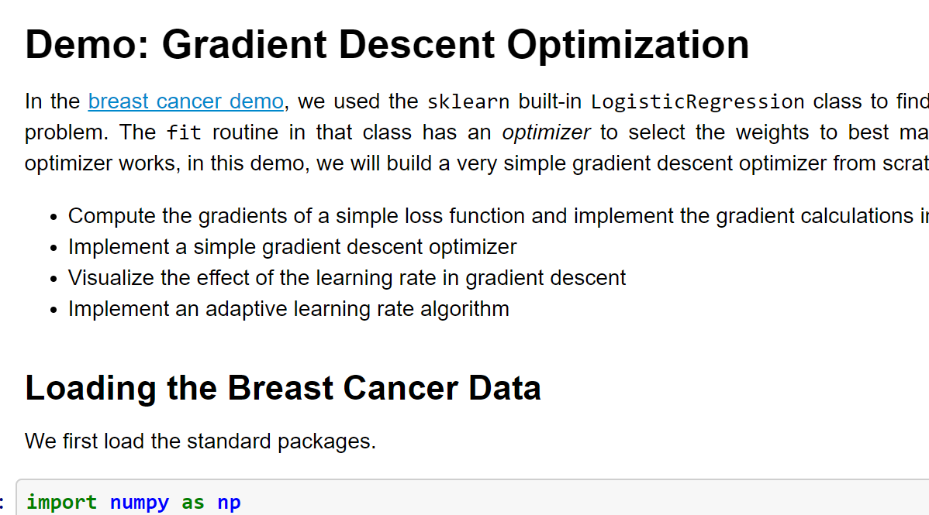
Demo on GitHub
https://github.com/sdrangan/introml/blob/master/optim/grad_descent.ipynb

Slide 7


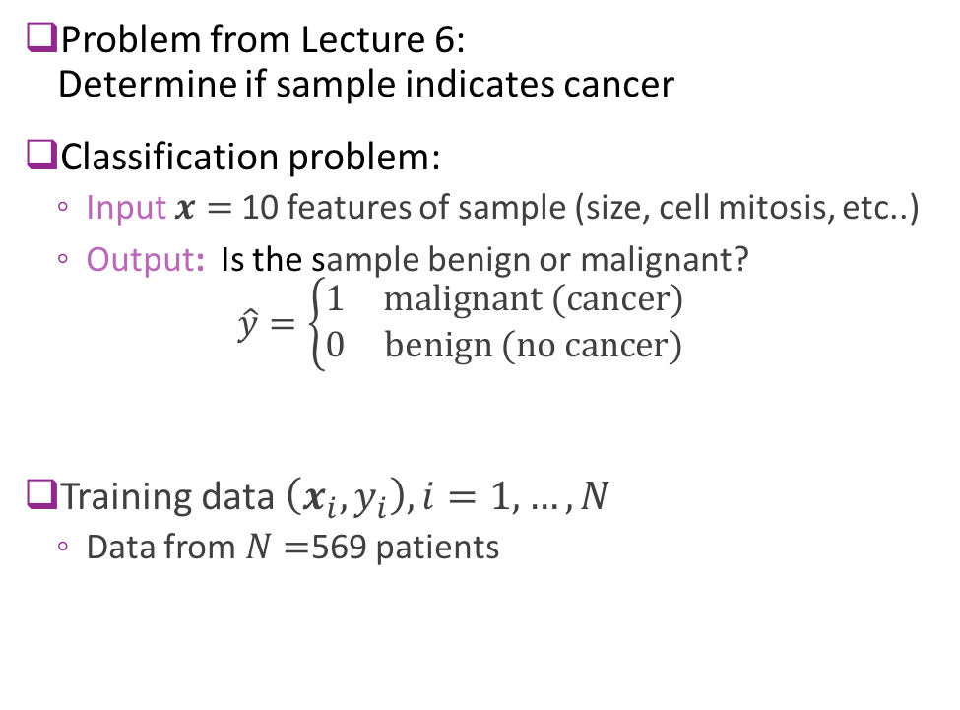
Recap: Breast Cancer Example
Problem from Lecture 6: Determine if sample indicates cancer
Classification problem:
Input $x=$10 features of sample (size, cell mitosis, etc..)
Output: Is the sample benign or malignant? $\hat{y}=\left\{\begin{matrix}1 & \text{malignant}\text{ (}\text{cancer}\text{)} \\ 0 & \text{benign}\text{ (}\text{no} \text{cancer}\text{)}\end{matrix}\right.$
Training data $\left(x_{i},y_{i}\right), i=1,…,N$
Data from $N=$569 patients
Grades of carcinoma cells
http://breast-cancer.ca/5a-types/

Slide 8
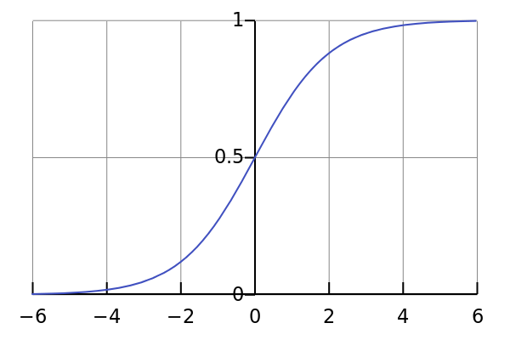
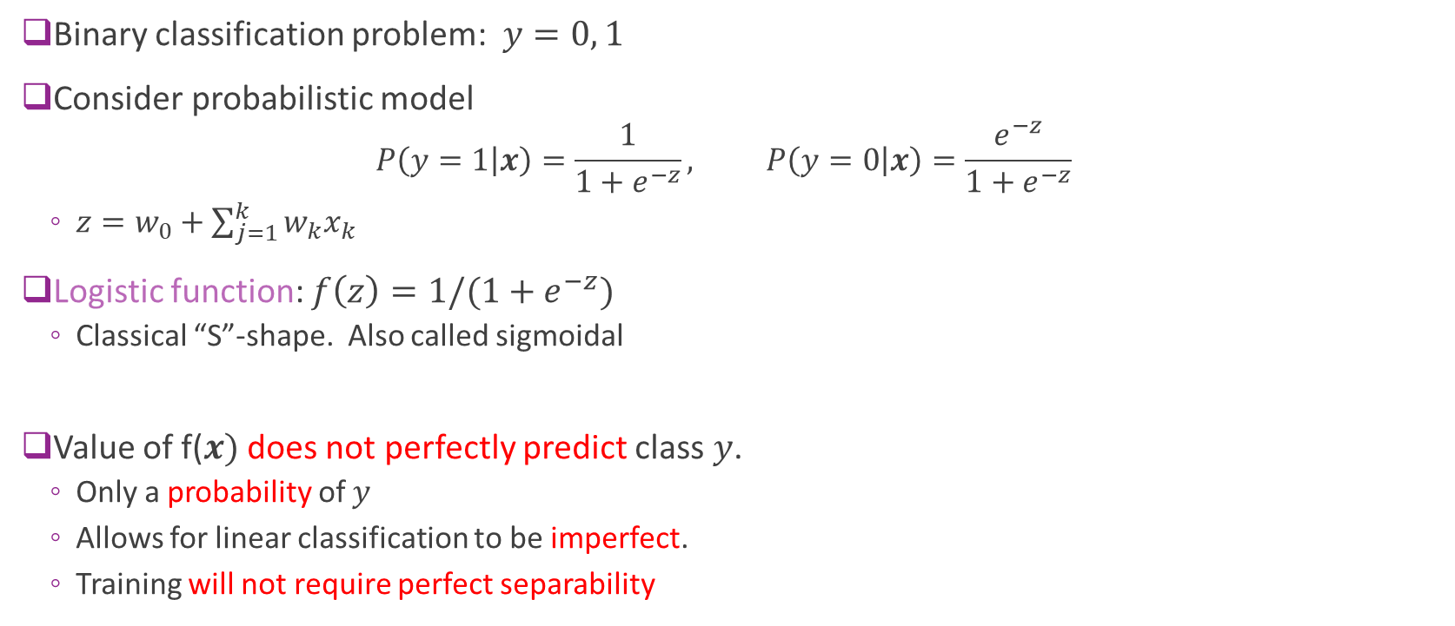
Logistic Model for Binary Classification
Binary classification problem: $y=0, 1$
Consider probabilistic model
$$P\left(y=1 | x\right)=\frac{1}{1+e^{−z}}, P\left(y=0 | x\right)=\frac{e^{−z}}{1+e^{−z}}$$
$z=w_{0}+\sum_{j=1}^{k}{{w_{k}x}_{k}}$
Logistic function: $f\left(z\right)=1/(1+e^{−z})$
Classical “S”-shape. Also called sigmoidal
Value of f($x)$ does not perfectly predict class $y$.
Only a probability of $y$
Allows for linear classification to be imperfect.
Training will not require perfect separability

Slide 9
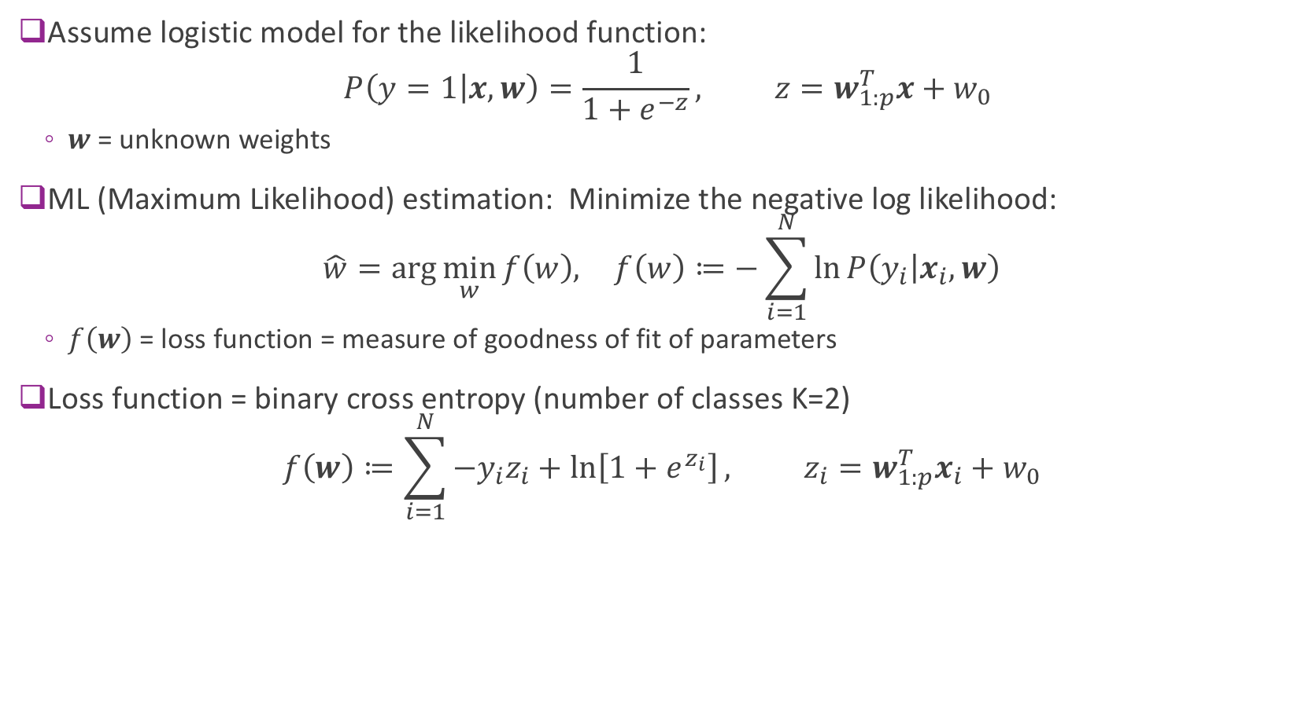
Logistic Regression Maximum Likelihood
Assume logistic model for the likelihood function: $P\left(y=1 | x,w\right)=\frac{1}{1+e^{−z}}, z=w_{1:p}^{T}x+w_{0}$
$w$= unknown weights
ML (Maximum Likelihood) estimation: Minimize the negative log likelihood: $\hat{w}=\arg{\min_{w}{f\left(w\right), }} f\left(w\right)≔−\sum_{i=1}^{N}{\ln{P\left(y_{i} | x_{i},w\right)}}$
$f\left(w\right)$ = loss function = measure of goodness of fit of parameters
Loss function = binary cross entropy (number of classes K=2) $f\left(w\right)≔\sum_{i=1}^{N}{{−y}_{i}z_{i}+\ln\left[1+e^{z_{i}}\right]}, z_{i}=w_{1:p}^{T}x_{i}+w_{0}$

Slide 10
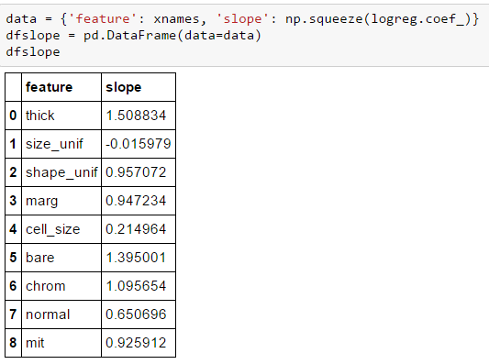


Minimizing the Loss Function
Used sklearn LogisticRegression.fit method
Used built-in optimizer to minimize loss function
Questions:
How does this optimizer work?
How would we build one from scratch

Slide 11
Outline
Motivating example: Build an optimizer for logistic regression
Gradients of multi-variable functions
Gradient descent
Adaptive step size
Convexity

Slide 12
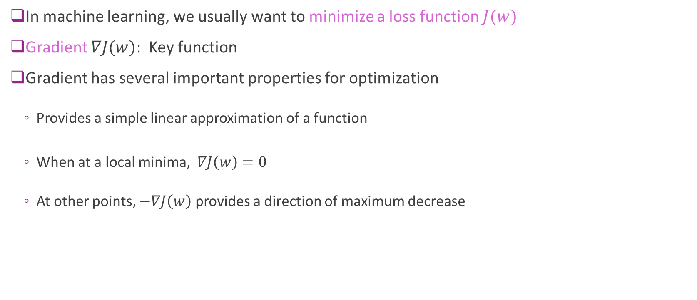
Gradients and Optimization
In machine learning, we usually want to minimize a loss function $J(w)$
Gradient $∇J(w)$: Key function
Gradient has several important properties for optimization
Provides a simple linear approximation of a function
When at a local minima, $∇J\left(w\right)=0$
At other points, $−∇J\left(w\right)$ provides a direction of maximum decrease

Slide 13
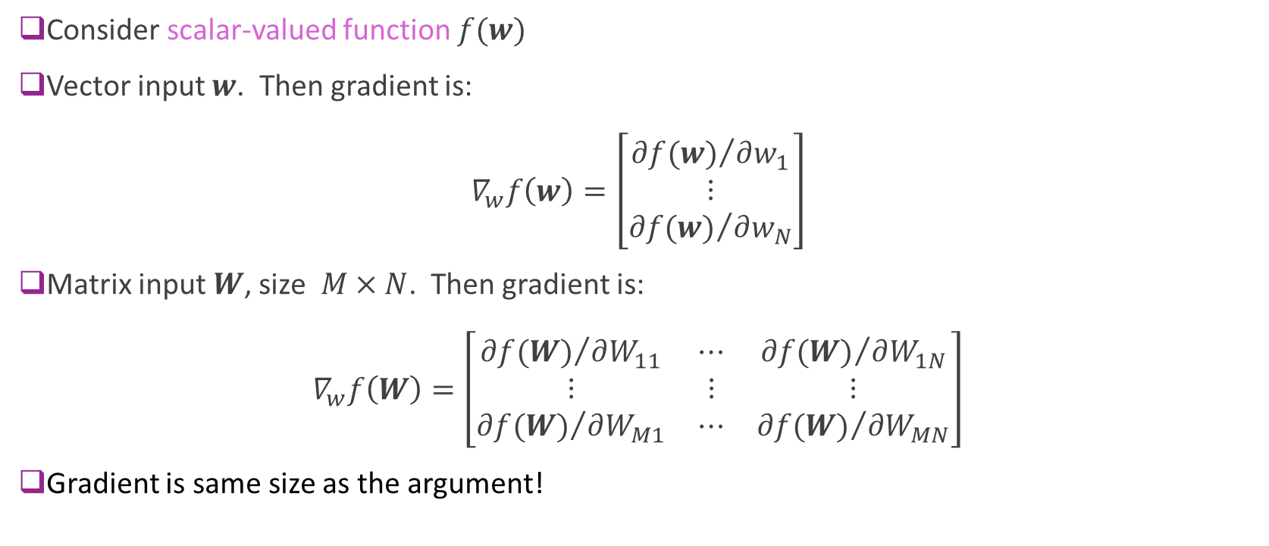
Gradient Defined
Consider scalar-valued function $f(w)$
Vector input $w$. Then gradient is: $∇_{w}f\left(w\right)=\left[\begin{matrix}{∂f(w)}/{∂w_{1}} \\ ⋮ \\ {∂f(w)}/{∂w_{N}}\end{matrix}\right]$
Matrix input $W$, size $M×N$. Then gradient is: $∇_{w}f\left(W\right)=\left[\begin{matrix}{∂f(W)}/{∂W_{11}} & ⋯ & {∂f(W)}/{∂W_{1N}} \\ ⋮ & ⋮ & ⋮ \\ {∂f(W)}/{∂W_{M1}} & ⋯ & {∂f(W)}/{∂W_{MN}}\end{matrix}\right]$
Gradient is same size as the argument!
Notes:
Scalar valued function takes one or more values but returns a single value

Slide 14
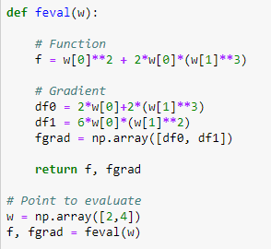


Example 1
$f\left(w_{1},w_{2}\right)=w_{1}^{2}+2w_{1}w_{2}^{3}$
Partial derivatives:
${∂f}/{∂w_{1}}=2w_{1}+2w_{2}^{3}$
${∂f}/{∂w_{2}}=6w_{1}w_{2}^{2}$
Gradient: $∇f=\left[\begin{matrix}2w_{1}+2w_{2}^{3} \\ 6w_{1}w_{2}^{2}\end{matrix}\right]$
Example to right:
Computes gradient at $w=\left(2,4\right)$
Gradient is a numpy vector

Slide 15
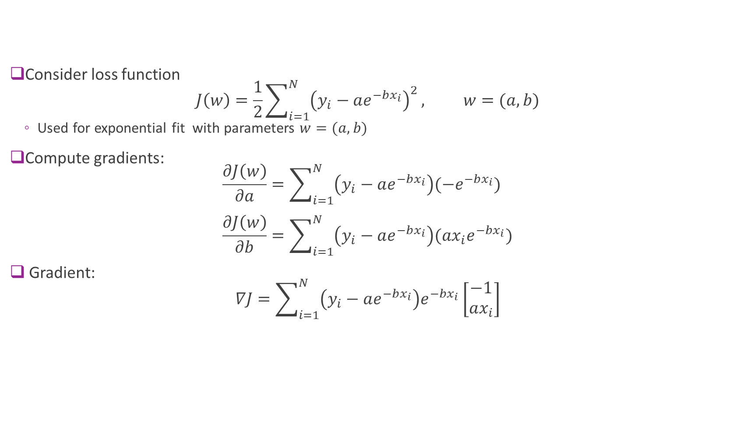
Example 2
Consider loss function $J\left(w\right)=\frac{1}{2}\sum_{i=1}^{N}{{\left(y_{i}−ae^{−bx_{i}}\right)}^{2}}, w=(a,b)$
Used for exponential fit with parameters $w=(a,b)$
Compute gradients: $\frac{∂J\left(w\right)}{∂a}=\sum_{i=1}^{N}{\left(y_{i}−ae^{−bx_{i}}\right)(−e^{−bx_{i}})}$ $\frac{∂J\left(w\right)}{∂b}=\sum_{i=1}^{N}{\left(y_{i}−ae^{−bx_{i}}\right)(ax_{i}e^{−bx_{i}})}$
Gradient: $∇J=\sum_{i=1}^{N}{\left(y_{i}−ae^{−bx_{i}}\right)e^{−bx_{i}}}\left[\begin{matrix}−1 \\ ax_{i}\end{matrix}\right]$

Slide 16
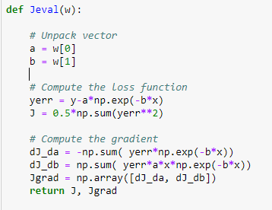
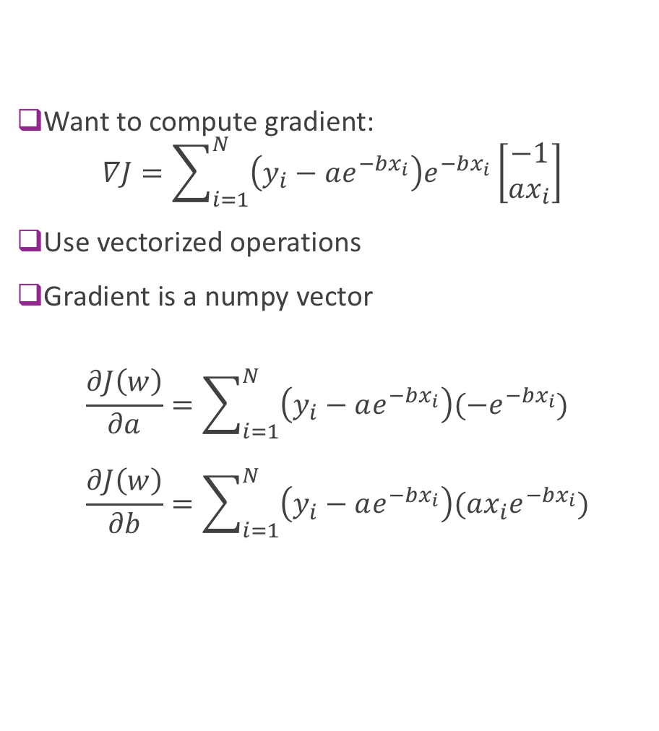
Example 2 in Python
Want to compute gradient: $∇J=\sum_{i=1}^{N}{\left(y_{i}−ae^{−bx_{i}}\right)e^{−bx_{i}}}\left[\begin{matrix}−1 \\ ax_{i}\end{matrix}\right]$
Use vectorized operations
Gradient is a numpy vector
$$\frac{∂J\left(w\right)}{∂a}=\sum_{i=1}^{N}{\left(y_{i}−ae^{−bx_{i}}\right)(−e^{−bx_{i}})} \\ \frac{∂J\left(w\right)}{∂b}=\sum_{i=1}^{N}{\left(y_{i}−ae^{−bx_{i}}\right)(ax_{i}e^{−bx_{i}})}$$

Slide 17
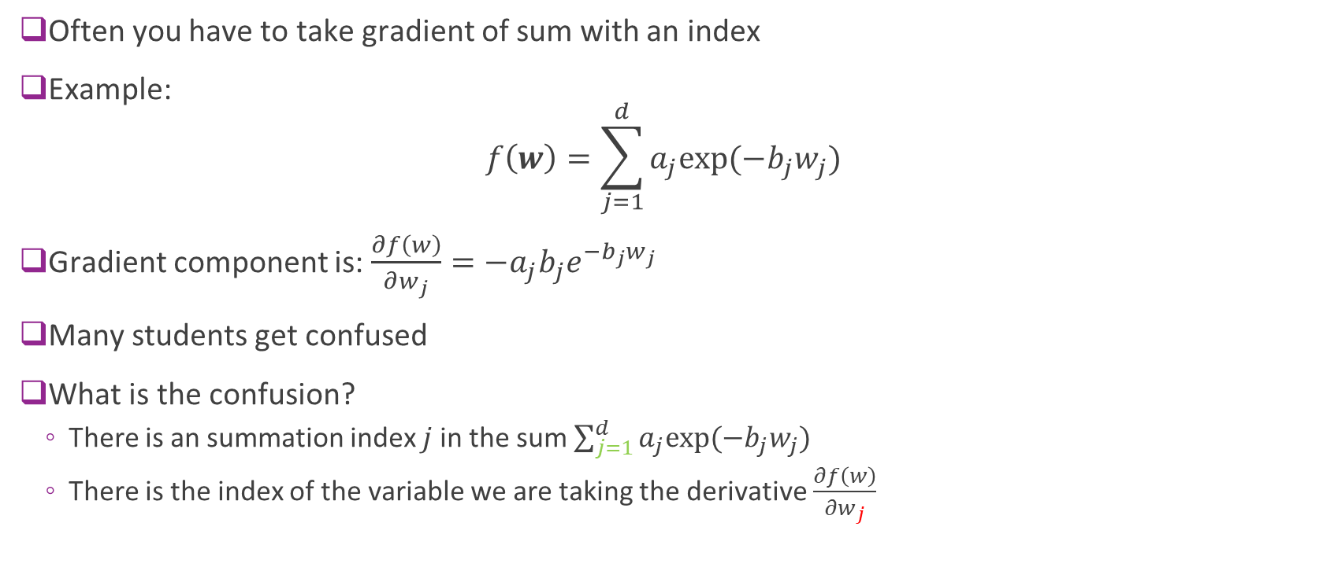
Example 3: Gradients with Sums
Often you have to take gradient of sum with an index
Example: $f\left(w\right)=\sum_{j=1}^{d}{a_{j}exp⁡(−b_{j}w_{j})}$
Gradient component is: $\frac{∂f\left(w\right)}{∂w_{j}}={−a}_{j}b_{j}e^{−b_{j}w_{j}}$
Many students get confused
What is the confusion?
There is an summation index $j$ in the sum $\sum_{j=1}^{d}{a_{j}exp⁡(−b_{j}w_{j})}$
There is the index of the variable we are taking the derivative $\frac{∂f\left(w\right)}{∂w_{j}}$

Slide 18
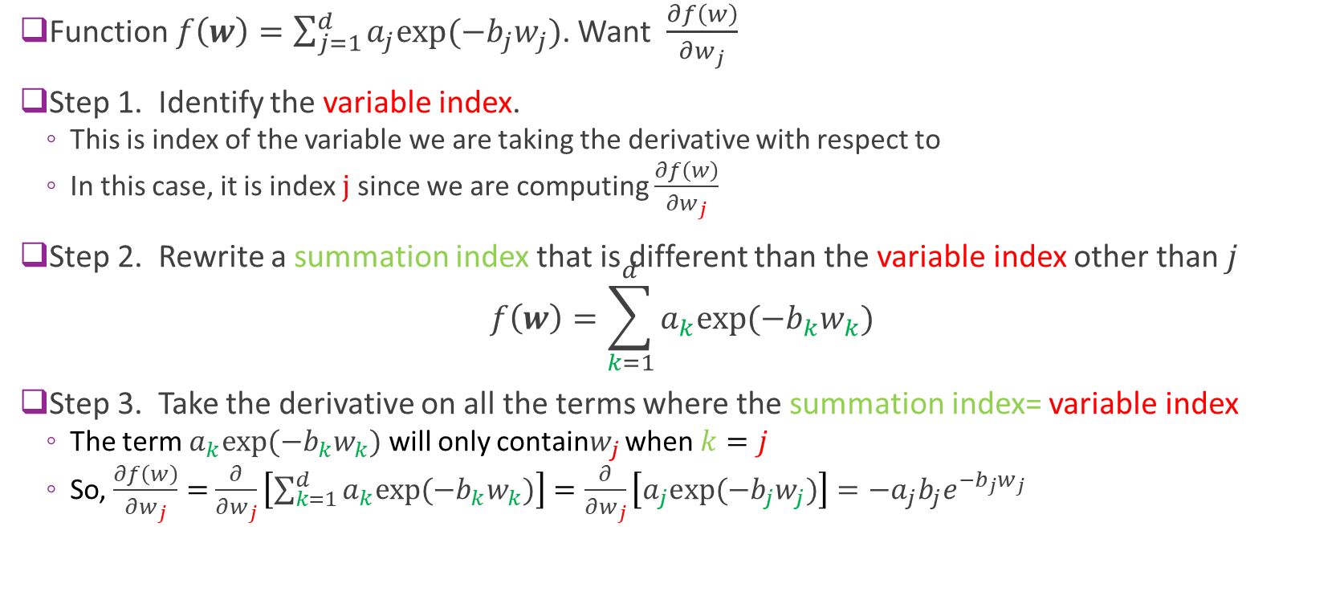
Gradients with Sums
Function $f\left(w\right)=\sum_{j=1}^{d}{a_{j}exp⁡(−b_{j}w_{j})}$. Want $\frac{∂f\left(w\right)}{∂w_{j}}$
Step 1. Identify the variable index.
This is index of the variable we are taking the derivative with respect to
In this case, it is index $j$ since we are computing $\frac{∂f\left(w\right)}{∂w_{j}}$
Step 2. Rewrite a summation index that is different than the variable index other than $j$ $f\left(w\right)=\sum_{k=1}^{d}{a_{k}exp⁡(−b_{k}w_{k})}$
Step 3. Take the derivative on all the terms where the summation index= variable index
The term $a_{k}exp⁡(−b_{k}w_{k})$ will only contain$w_{j}$ when $k=j$
So, $\frac{∂f\left(w\right)}{∂w_{j}}=$ $\frac{∂}{∂w_{j}}\left[\sum_{k=1}^{d}{a_{k}exp⁡(−b_{k}w_{k})}\right]=\frac{∂}{∂w_{j}}\left[a_{j}exp⁡(−b_{j}w_{j})\right]=−a_{j}b_{j}e^{−b_{j}w_{j}}$

Slide 19




Chain Rule
We all know chain rule for scalar functions
We have a composite function:
$y=f(g\left(x\right))$
This is the same as
$y=f\left(z\right),$
$z=g(x)$
Chain rule says: $\frac{dy}{dx}=\frac{dy}{dz}\frac{dz}{dx}=f^{′}\left(z\right)g^{′}\left(x\right)=f^{′}\left(g\left(x\right)\right)g^{′}\left(x\right)$
$$x$$
$$z$$
$$y$$

Slide 20

Chain Rule
Chain rule says: $\frac{dy}{dx}=\frac{dy}{dz}\frac{dz}{dx}=f^{′}\left(z\right)g^{′}\left(x\right)=f^{′}\left(g\left(x\right)\right)g^{′}\left(x\right)$
Example: $y=\ln\left(z\right), z=\cos{x}$
Then $\frac{dy}{dx}=\frac{dy}{dz}\frac{dz}{dx}=\frac{1}{z}(−\sin{x})$
We can leave it like this or substitute $z=\cos{x}⇒\frac{dy}{dx}=\frac{1}{\cos{x}}(−\sin{x)}=−\tan{x}$
Excellent review at Khan Academy
$$x$$
$$z$$
$$y$$

Slide 21

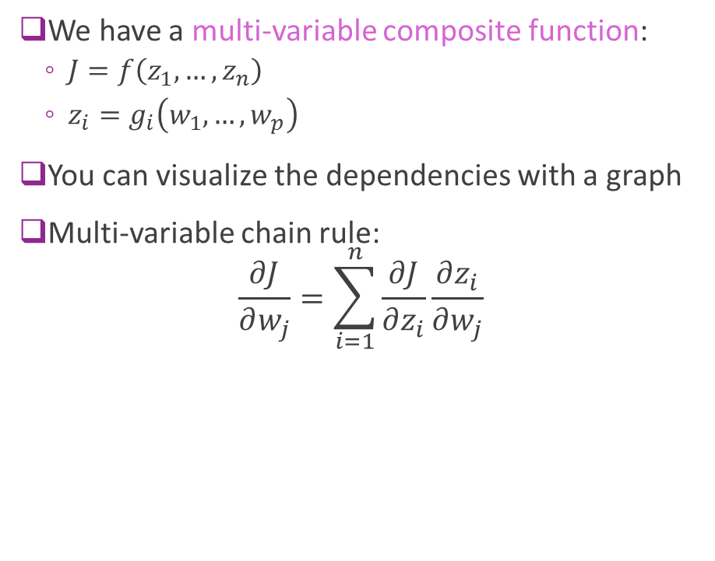






Multi-Variable Chain Rule
We have a multi-variable composite function:
$J=f\left(z_{1},…,z_{n}\right)$
$z_{i}=g_{i}\left(w_{1},…,w_{p}\right)$
You can visualize the dependencies with a graph
Multi-variable chain rule: $\frac{∂J}{∂w_{j}}=\sum_{i=1}^{n}{\frac{∂J}{∂z_{i}}\frac{∂z_{i}}{∂w_{j}}}$
$$z_{1}$$
$$w_{1}$$
$$J$$
$$⋮$$
$$⋮$$
$$w_{p}$$
$$z_{n}$$
Notes:
We are trying to see how much J varies with respect to W1

Slide 22

Example 4: Loss Function
We are given data, $\left(x_{i},y_{i}\right), i=1,…,N$
Consider model ${\hat{y}}_{i}=\log{(\sum_{j}{w_{j}x_{ij})}}$
MSE loss function: $J=\sum_{i=1}^{N}{{\left(y_{i}−{\hat{y}}_{i}\right)}^{2}}$
Find gradient component: $\frac{∂J}{∂w_{j}}$

Slide 23

Example 4: Loss Function
Solution:
Let $z_{i}=$ $\sum_{j}{w_{j}x_{ij}}$ and ${\hat{y}}_{i}=\log{(z_{i})}$
Now use multi-variable chain rule $\frac{∂J}{∂w_{j}}=\sum_{i=1}^{n}{\frac{∂J}{∂z_{i}}\frac{∂z_{i}}{∂w_{j}}}$
$\frac{∂J}{∂z_{i}}=2\left({\hat{y}}_{i}−y_{i}\right)\frac{∂{\hat{y}}_{i}}{∂z_{i}} = 2\left({\hat{y}}_{i}−y_{i}\right)\frac{1}{z_{i}}$
Using summation rule: $\frac{∂z_{i}}{∂w_{j}}=x_{ij}$
Hence: $\frac{∂J}{∂w_{j}}= \sum_{i=1}^{n}{\frac{∂J}{∂z_{i}}\frac{∂z_{i}}{∂w_{j}}}= 2\sum_{i=1}^{n}{\left({\hat{y}}_{i}−y_{i}\right)\frac{x_{ij}}{z_{i}}}$

Slide 24
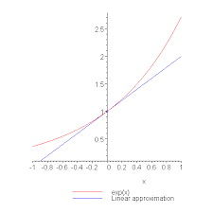
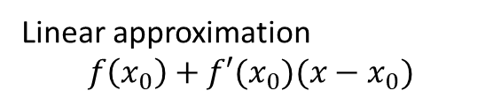
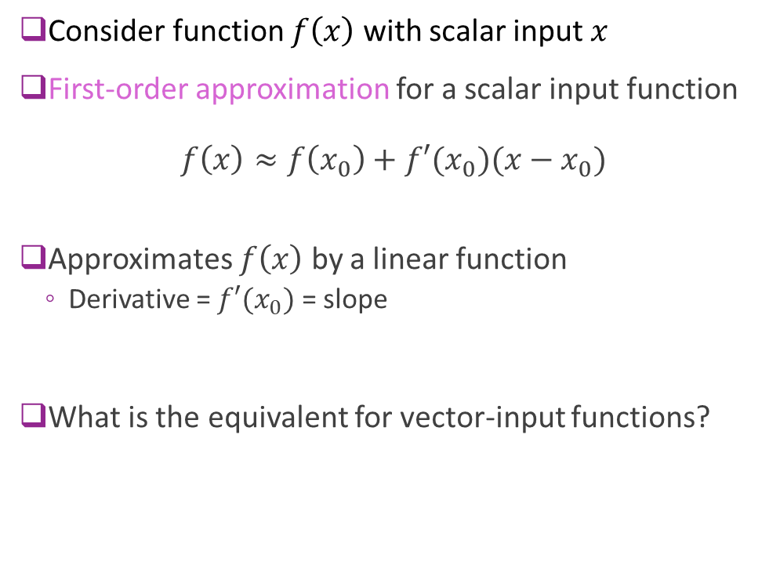
First-Order Approximations Scalar-Input Functions
Consider function $f\left(x\right)$ with scalar input $x$
First-order approximation for a scalar input function $f\left(x\right)≈f\left(x_{0}\right)+f′(x_{0})(x−x_{0})$
Approximates $f\left(x\right)$ by a linear function
Derivative = $f′(x_{0})$ = slope
What is the equivalent for vector-input functions?
Linear approximation
$$f\left(x_{0}\right)+f′(x_{0})(x−x_{0})$$
Notes:
Surface of the earth example

Slide 25
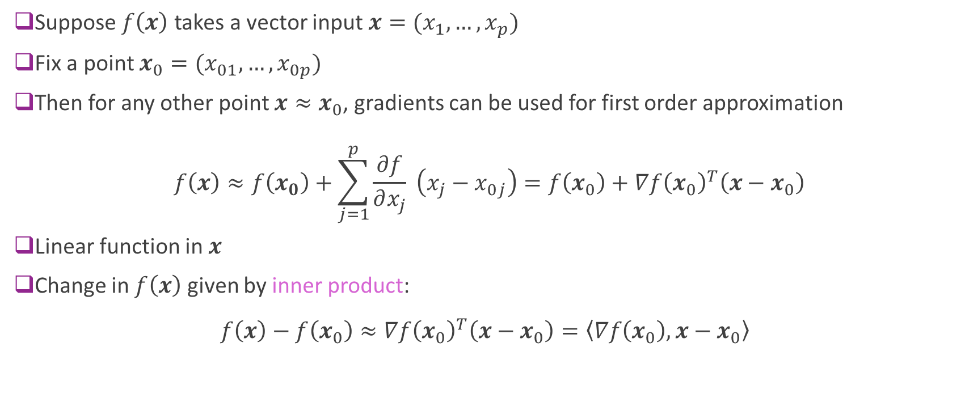
First-Order Approximations Vector Input Functions
Suppose $f\left(x\right)$ takes a vector input $x=(x_{1},…,x_{p})$
Fix a point $x_{0}=(x_{01},…,x_{0p})$
Then for any other point $x≈x_{0}$, gradients can be used for first order approximation
$$f\left(x\right)≈f\left(x_{0}\right)+\sum_{j=1}^{p}{\frac{∂f}{∂x_{j}}} \left(x_{j}−x_{0j}\right)=f\left(x_{0}\right)+∇f{\left(x_{0}\right)}^{T}\left(x−x_{0}\right)$$
Linear function in $x$
Change in $f\left(x\right)$ given by inner product: $f\left(x\right)−f\left(x_{0}\right)≈∇f{\left(x_{0}\right)}^{T}\left(x−x_{0}\right)=\left\langle ∇f\left(x_{0}\right),x−x_{0}\right\rangle$
Notes:
The derivative on each of these functions

Slide 26
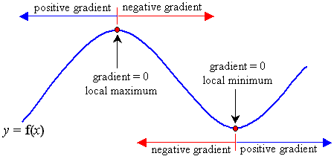
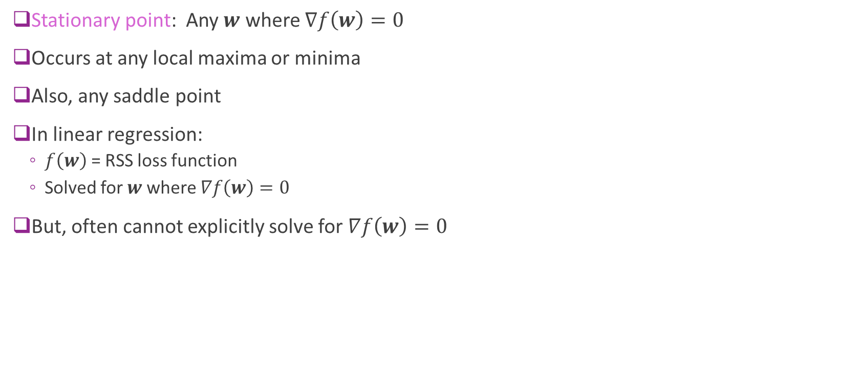
Gradients and Stationary Points
Stationary point: Any $w$ where $∇f\left(w\right)=0$
Occurs at any local maxima or minima
Also, any saddle point
In linear regression:
$f\left(w\right)$ = RSS loss function
Solved for $w$ where $∇f\left(w\right)=0$
But, often cannot explicitly solve for $∇f\left(w\right)=0$
Notes:
In general cannot solve it.

Slide 27
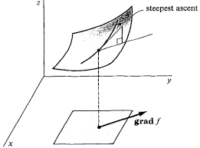
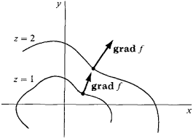
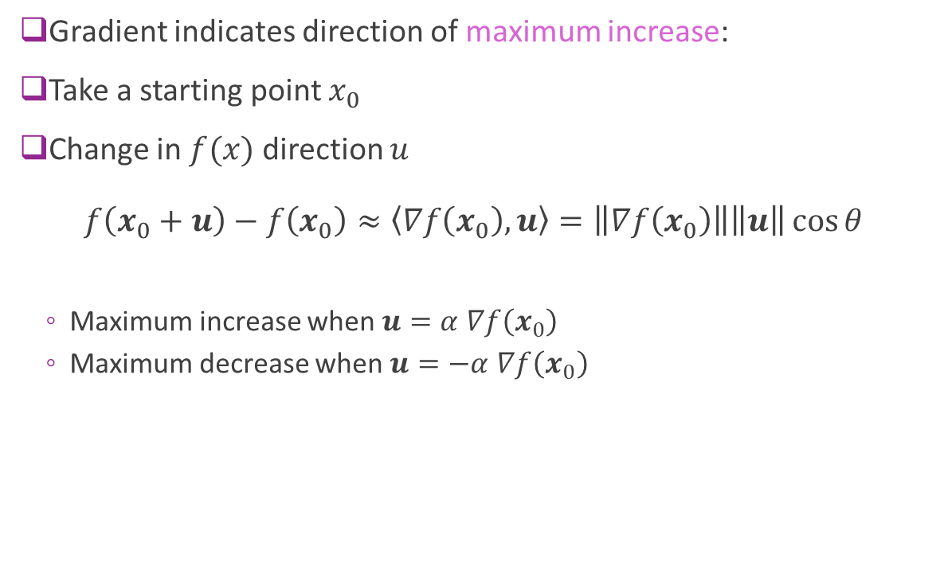
Direction of Maximum Increase
Gradient indicates direction of maximum increase:
Take a starting point $x_{0}$
Change in $f(x)$ direction $u$ $f\left(x_{0}+u\right)−f\left(x_{0}\right)≈\left\langle ∇f\left(x_{0}\right),u\right\rangle =\left\|∇f\left(x_{0}\right)\right\|\left\|u\right\|\cos{θ}$
Maximum increase when $u=α$ $∇f\left(x_{0}\right)$
Maximum decrease when $u=−α$ $∇f\left(x_{0}\right)$
Notes:
Norm of gradient x norm

Slide 28
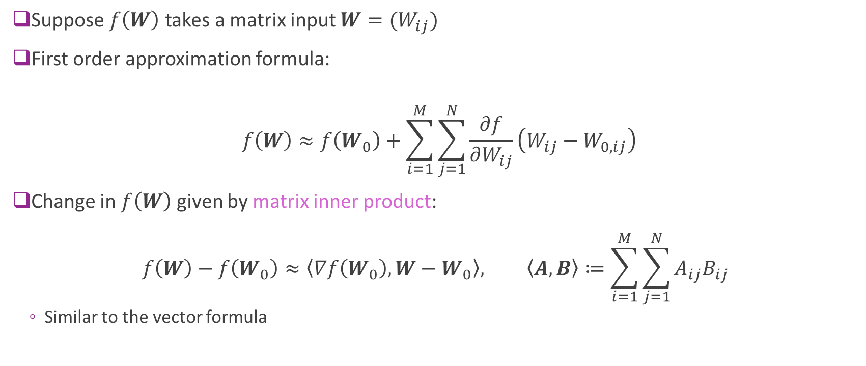
First-Order Approximations Matrix Input Functions (Advanced)
Suppose $f\left(W\right)$ takes a matrix input $W=(W_{ij})$
First order approximation formula:
$$f\left(W\right)≈f\left(W_{0}\right)+\sum_{i=1}^{M}{\sum_{j=1}^{N}{\frac{∂f}{∂W_{ij}}\left(W_{ij}−W_{0,ij}\right)}}$$
Change in $f\left(W\right)$ given by matrix inner product: $f\left(W\right)−f\left(W_{0}\right)≈\left\langle ∇f\left(W_{0}\right),W−W_{0}\right\rangle , \left\langle A,B\right\rangle ≔\sum_{i=1}^{M}{\sum_{j=1}^{N}{A_{ij}B_{ij}}}$
Similar to the vector formula

Slide 29
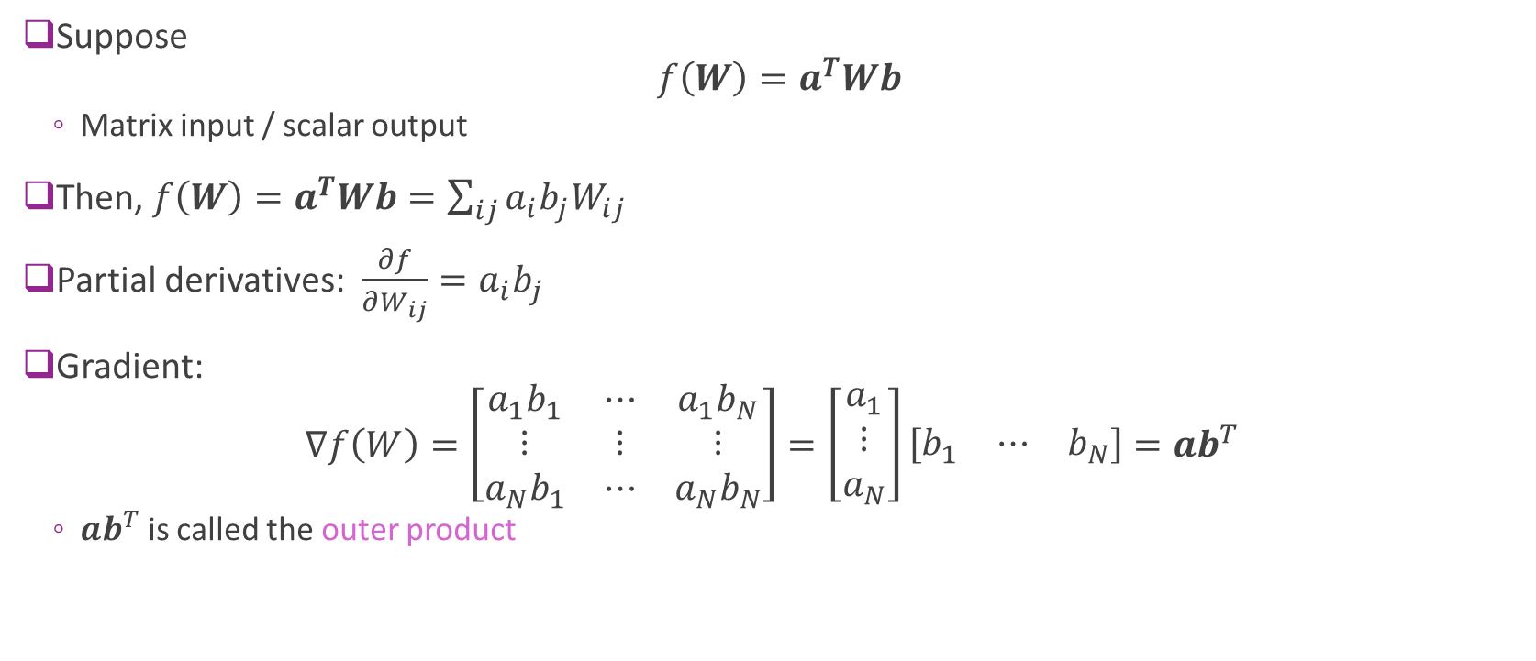
Example 3: Matrix-Input Function
Suppose $f\left(W\right)=a^{T}Wb$
Matrix input / scalar output
Then, $f\left(W\right)=a^{T}Wb=\sum_{ij}{a_{i}b_{j}W_{ij}}$
Partial derivatives: $\frac{∂f}{∂W_{ij}}=a_{i}b_{j}$
Gradient: $∇f\left(W\right)=\left[\begin{matrix}a_{1}b_{1} & ⋯ & a_{1}b_{N} \\ ⋮ & ⋮ & ⋮ \\ a_{N}b_{1} & ⋯ & a_{N}b_{N}\end{matrix}\right]=\left[\begin{matrix}a_{1} \\ ⋮ \\ a_{N}\end{matrix}\right]\left[\begin{matrix}b_{1} & ⋯ & b_{N}\end{matrix}\right]=ab^{T}$
$ab^{T}$ is called the outer product

Slide 30
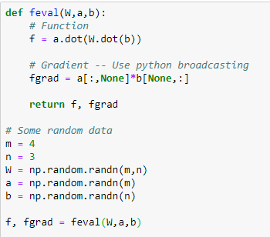

Example 3 in Python
Function: $f\left(W\right)=a^{T}Wb$
Use python `dot` for matrix-vector products
Gradient: $∇f\left(W\right)=ab^{T}$
Want fgrad[i,j] = a[i]b[j]
Avoid for-loops
Use python broadcasting
a[:,None] = m x 1
b[None,:] = 1 x n

Slide 31
Outline
Motivating example: Build an optimizer for logistic regression
Gradients of multi-variable functions
Gradient descent
Adaptive step size
Convexity

Slide 32
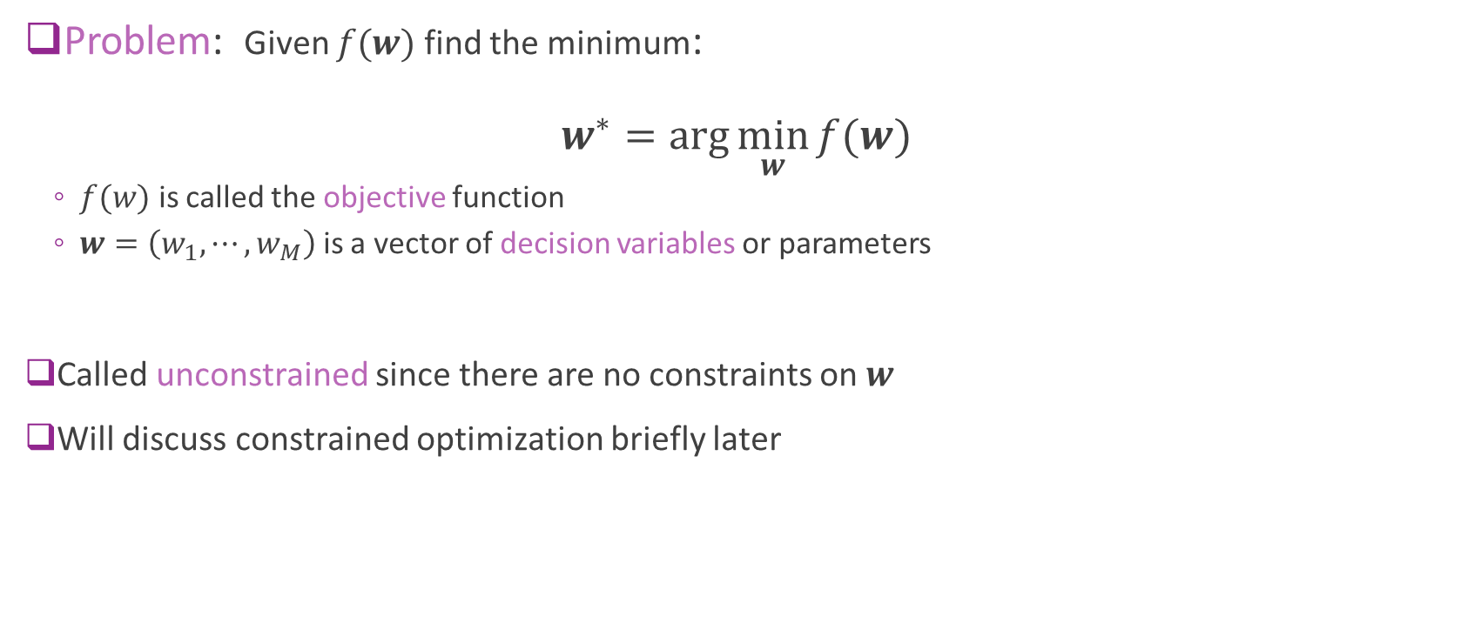
Unconstrained Optimization
Problem: Given $f(w)$ find the minimum: $w^{∗}=\arg{\min_{w}{f(w)}}$
$f(w)$ is called the objective function
$w=\left(w_{1},⋯,w_{M}\right)$ is a vector of decision variables or parameters
Called unconstrained since there are no constraints on $w$
Will discuss constrained optimization briefly later
Notes:
Remember to draw the picture of min vs argmin
Sometimes called the cost function, we want to find the x that minimizes this

Slide 33
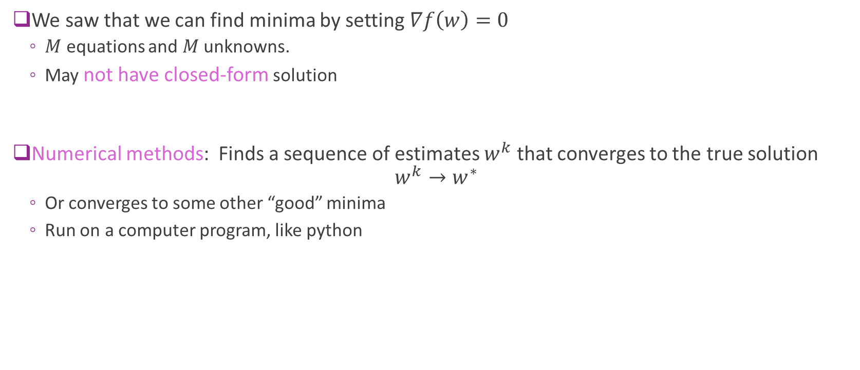
Numerical Optimization
We saw that we can find minima by setting $∇f\left(w\right)=0$
$M$ equations and $M$ unknowns.
May not have closed-form solution
Numerical methods: Finds a sequence of estimates $w^{k}$ that converges to the true solution $w^{k}→w^{∗}$
Or converges to some other “good” minima
Run on a computer program, like python

Slide 34
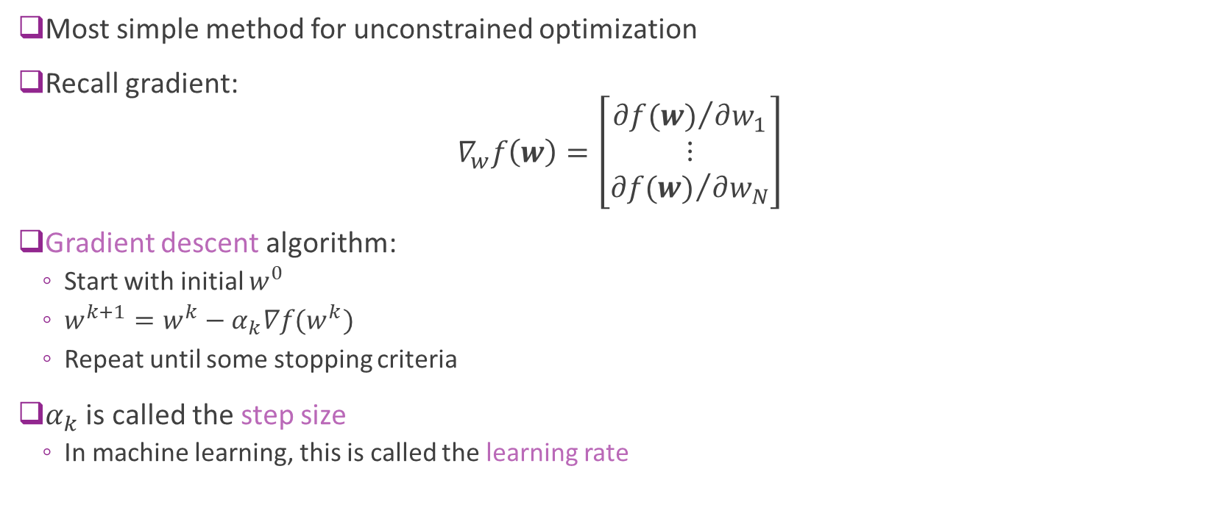
Gradient Descent
Most simple method for unconstrained optimization
Recall gradient: $∇_{w}f\left(w\right)=\left[\begin{matrix}{∂f(w)}/{∂w_{1}} \\ ⋮ \\ {∂f(w)}/{∂w_{N}}\end{matrix}\right]$
Gradient descent algorithm:
Start with initial $w^{0}$
$w^{k+1}=w^{k}−α_{k}∇f(w^{k})$
Repeat until some stopping criteria
$α_{k}$ is called the step size
In machine learning, this is called the learning rate
Notes:
Direction of the negative gradient Is the max decrease.

Slide 35
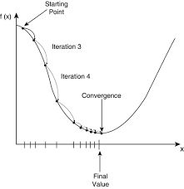
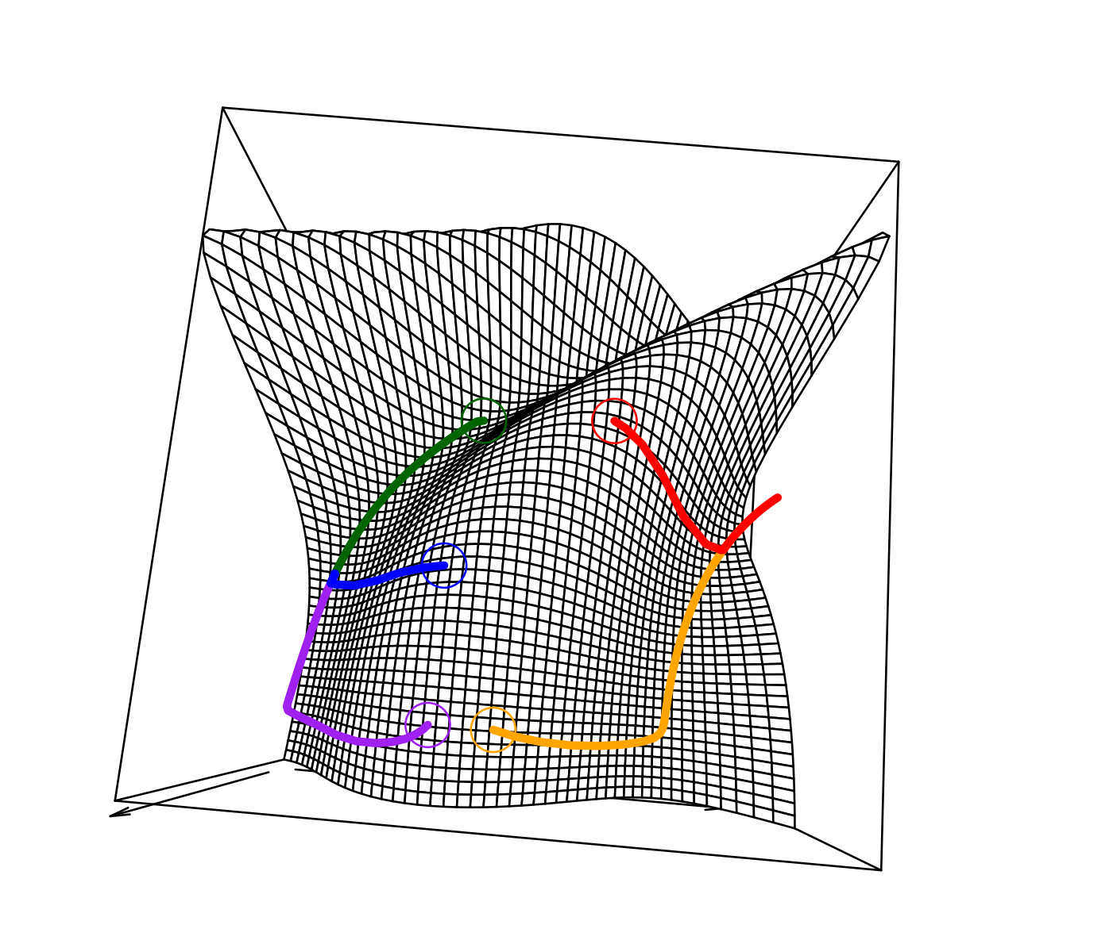
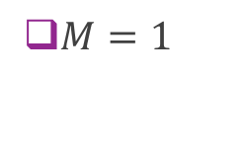

Gradient Descent Illustrated
$M=2$
$M=1$
Notes:
2d = Tangentail to the countour

Slide 36
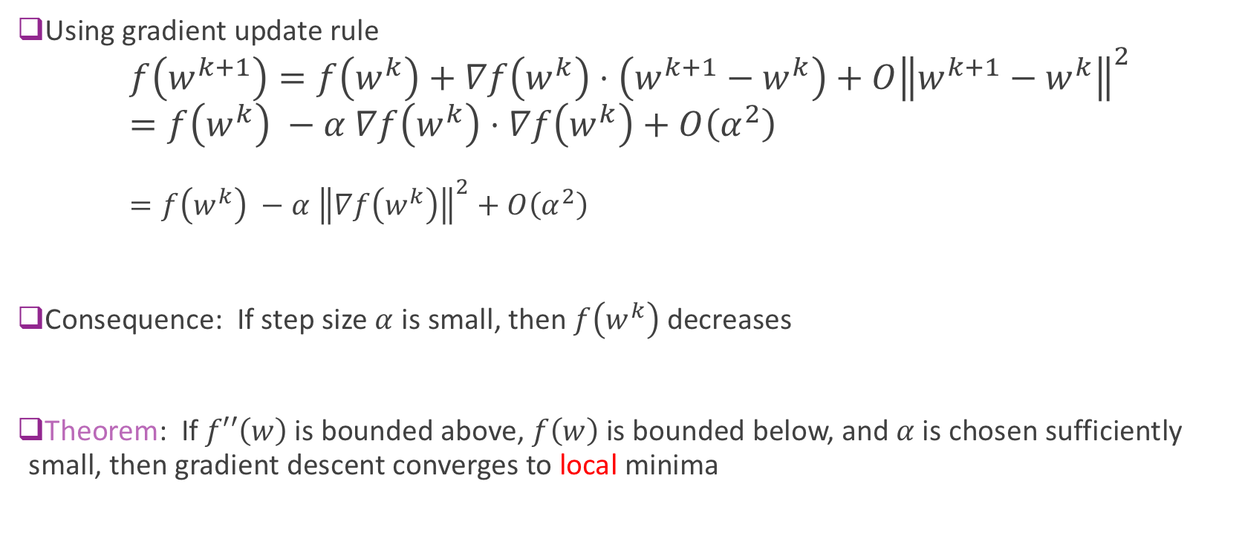
Gradient Descent Analysis
Using gradient update rule $f\left(w^{k+1}\right)=f\left(w^{k}\right)+∇f\left(w^{k}\right)⋅\left(w^{k+1}−w^{k}\right)+O{\left\|w^{k+1}−w^{k}\right\|}^{2}$ $=f\left(w^{k}\right) −α ∇f\left(w^{k}\right)⋅∇f\left(w^{k}\right)+O\left(α^{2}\right)$ $=f\left(w^{k}\right) −α {\left\|∇f\left(w^{k}\right)\right\|}^{2}+O\left(α^{2}\right)$
Consequence: If step size $α$ is small, then $f\left(w^{k}\right)$ decreases
Theorem: If $f′′\left(w\right)$ is bounded above, $f\left(w\right)$ is bounded below, and $α$ is chosen sufficiently small, then gradient descent converges to local minima

Slide 37
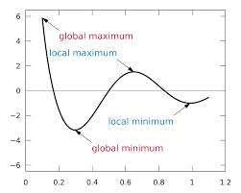
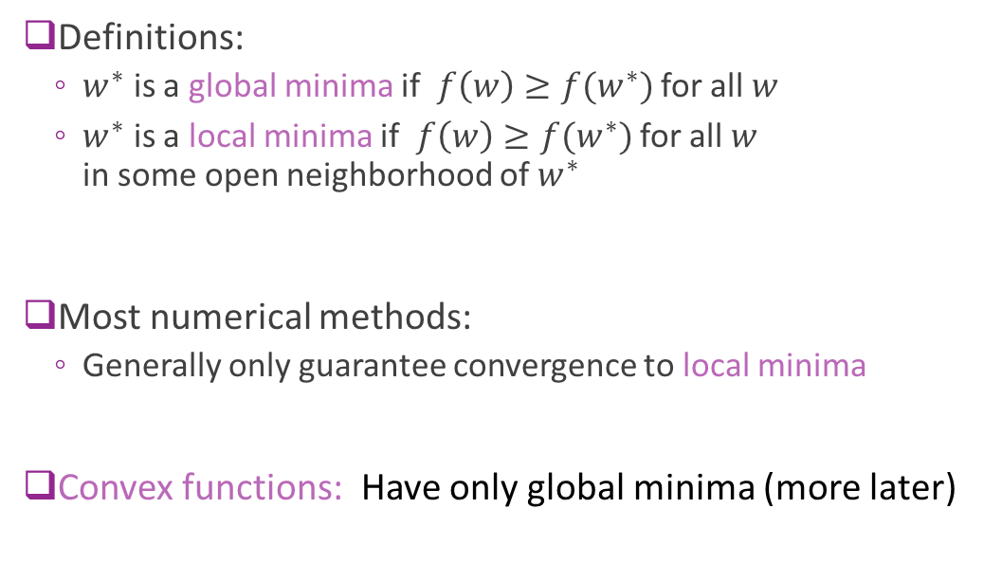
Local vs. Global Minima
Definitions:
$w^{∗}$ is a global minima if $f\left(w\right)≥f(w^{∗})$ for all $w$
$w^{∗}$ is a local minima if $f\left(w\right)≥f(w^{∗})$ for all $w$ in some open neighborhood of $w^{∗}$
Most numerical methods:
Generally only guarantee convergence to local minima
Convex functions: Have only global minima (more later)
Notes:
One of the many issues

Slide 38
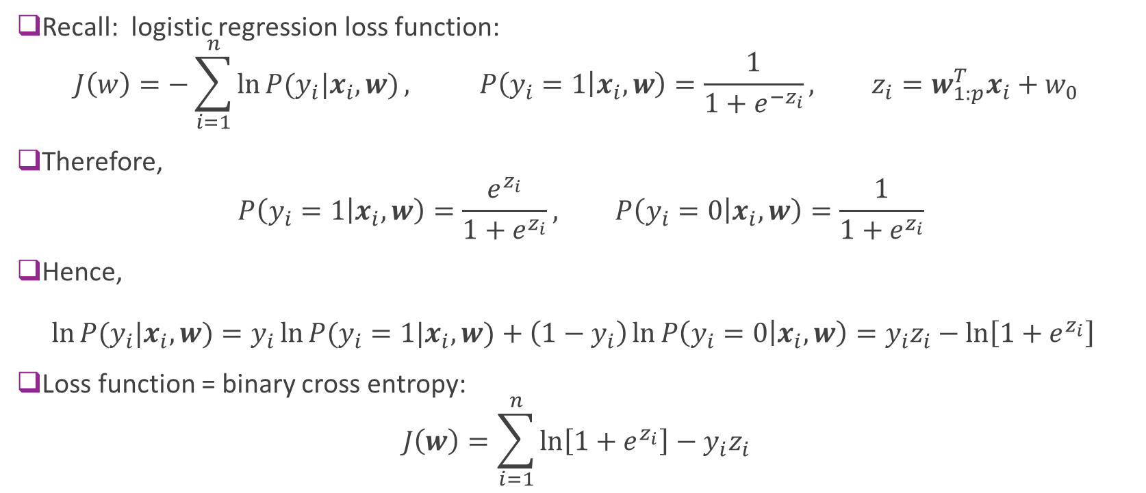
Logistic Loss Function for Binary Classification (Review)
Recall: logistic regression loss function: $J\left(w\right)=−\sum_{i=1}^{n}{\ln{P(y_{i}|x_{i},w)}}, P\left(y_{i}=1 | x_{i},w\right)=\frac{1}{1+e^{−z_{i}}}, z_{i}=w_{1:p}^{T}x_{i}+w_{0}$
Therefore, $P\left(y_{i}=1 | x_{i},w\right)=\frac{e^{z_{i}}}{1+e^{z_{i}}}, P\left(y_{i}=0 | x_{i},w\right)=\frac{1}{1+e^{z_{i}}}$
Hence, $\ln{P(y_{i}|x_{i},w)}=y_{i}\ln{P(y_{i}=1|x_{i},w)}+\left(1−y_{i}\right)\ln{P\left(y_{i}=0 | x_{i},w\right)}=y_{i}z_{i}−\ln\left[1+e^{z_{i}}\right]$
Loss function = binary cross entropy: $J\left(w\right)=\sum_{i=1}^{n}{\ln\left[1+e^{z_{i}}\right]−y_{i}z_{i}}$

Slide 39
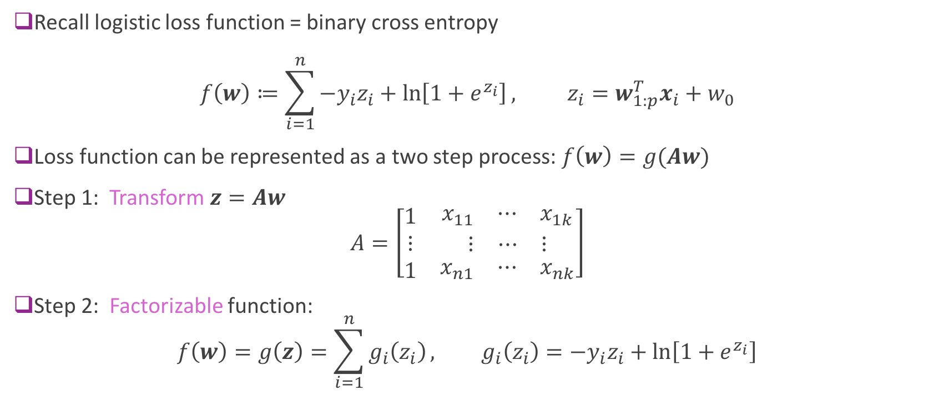
Logistic Loss as a Two Step Function
Recall logistic loss function = binary cross entropy $f\left(w\right)≔\sum_{i=1}^{n}{{−y}_{i}z_{i}+\ln\left[1+e^{z_{i}}\right]}, z_{i}=w_{1:p}^{T}x_{i}+w_{0}$
Loss function can be represented as a two step process: $f\left(w\right)=g(Aw)$
Step 1: Transform $z=Aw$ $A=\left[\begin{matrix}1 & \begin{matrix}x_{11} & ⋯ & x_{1k}\end{matrix} \\ ⋮ & \begin{matrix}⋮ & ⋯ & ⋮\end{matrix} \\ 1 & \begin{matrix}x_{n1} & ⋯ & x_{nk}\end{matrix}\end{matrix}\right]$
Step 2: Factorizable function: $f\left(w\right)=g\left(z\right)=\sum_{i=1}^{n}{g_{i}\left(z_{i}\right)}, g_{i}\left(z_{i}\right)={−y}_{i}z_{i}+\ln\left[1+e^{z_{i}}\right]$

Slide 40
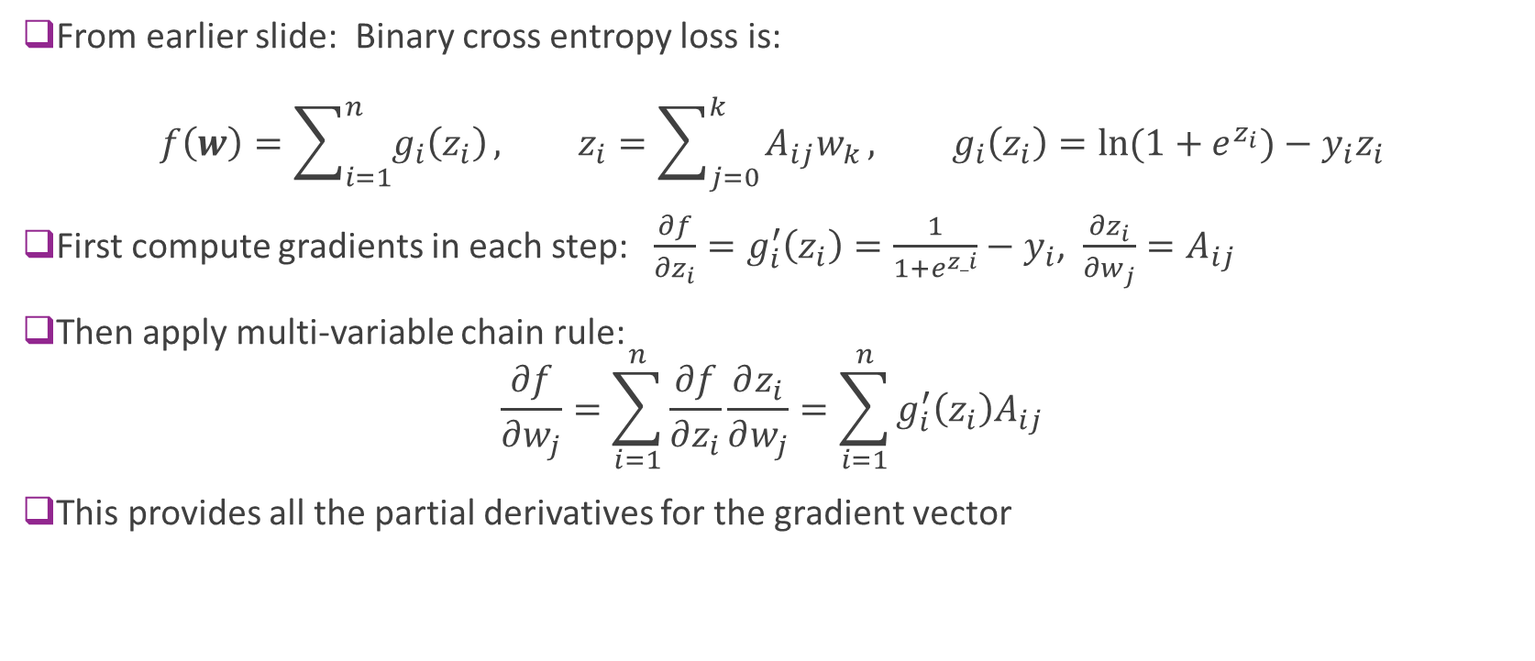
Gradient of Binary Cross Entropy Loss
From earlier slide: Binary cross entropy loss is: $f\left(w\right)=\sum_{i=1}^{n}{g_{i}\left(z_{i}\right)}, z_{i}=\sum_{j=0}^{k}{A_{ij}w_{k}}, g_{i}\left(z_{i}\right)=\ln{(1+e^{z_{i}})}−y_{i}z_{i}$
First compute gradients in each step: $\frac{∂f}{∂z_{i}}=g_{i}^{′}\left(z_{i}\right)=\frac{1}{1+e^{z_i}}−y_{i}$, $\frac{∂z_{i}}{∂w_{j}}=A_{ij}$
Then apply multi-variable chain rule: $\frac{∂f}{∂w_{j}}=\sum_{i=1}^{n}{\frac{∂f}{∂z_{i}}\frac{∂z_{i}}{∂w_{j}}}=\sum_{i=1}^{n}{g_{i}^{′}\left(z_{i}\right)A_{ij}}$
This provides all the partial derivatives for the gradient vector

Slide 41
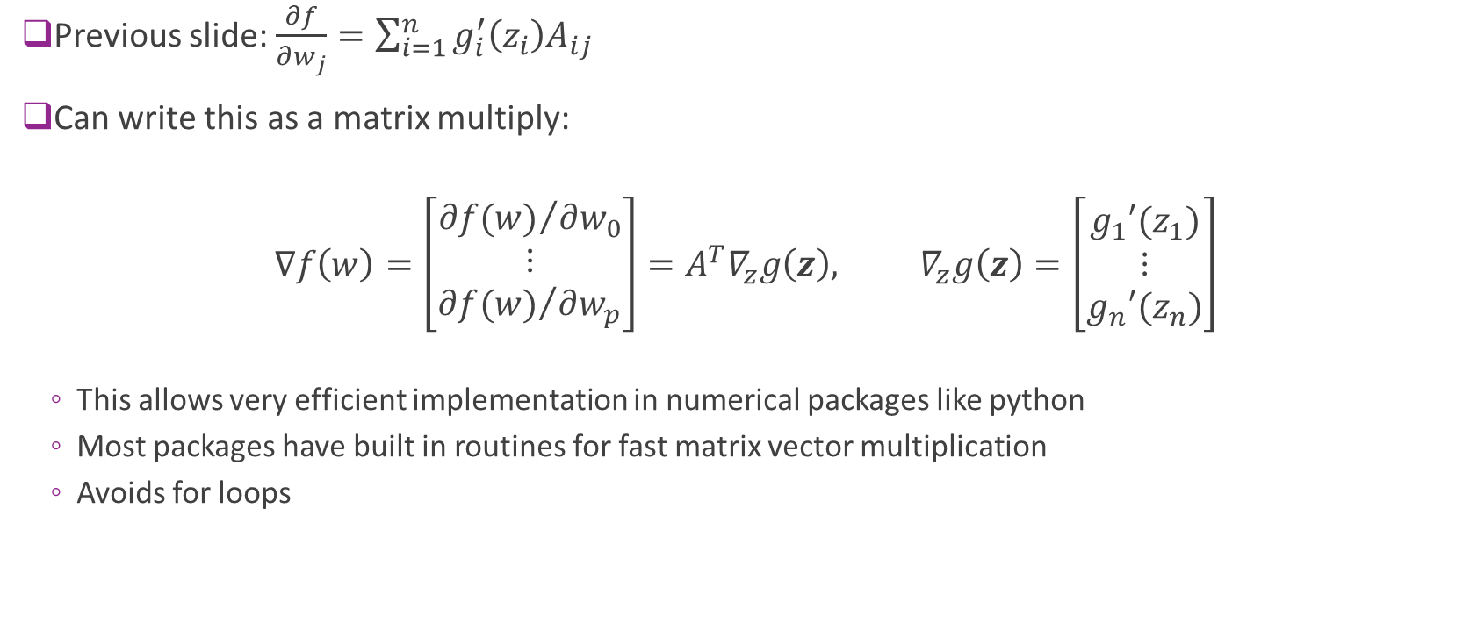
Gradients with Matrix Multiplication
Previous slide: $\frac{∂f}{∂w_{j}}=\sum_{i=1}^{n}{g_{i}^{′}\left(z_{i}\right)A_{ij}}$
Can write this as a matrix multiply:
$$∇f\left(w\right)=\left[\begin{matrix}{∂f(w)}/{∂w_{0}} \\ ⋮ \\ {∂f(w)}/{∂w_{p}}\end{matrix}\right]=A^{T}∇_{z}g\left(z\right), ∇_{z}g\left(z\right)=\left[\begin{matrix}g_{1}′(z_{1}) \\ ⋮ \\ g_{n}′(z_{n})\end{matrix}\right]$$
This allows very efficient implementation in numerical packages like python
Most packages have built in routines for fast matrix vector multiplication
Avoids for loops

Slide 42
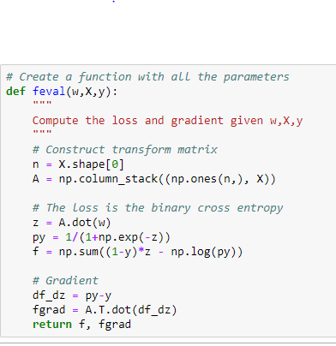
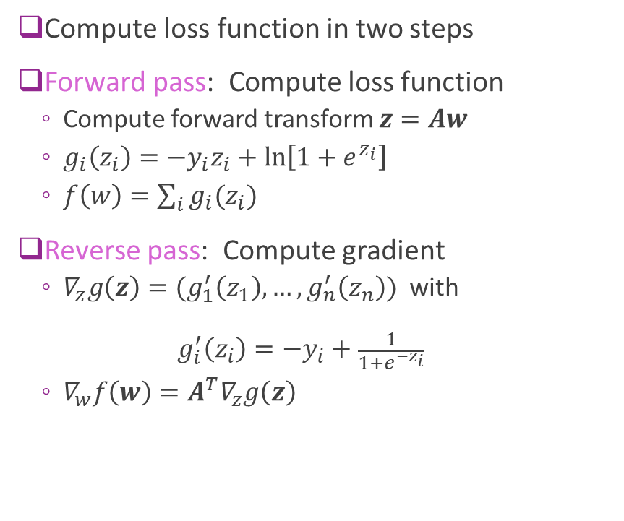
Summary
Compute loss function in two steps
Forward pass: Compute loss function
Compute forward transform $z=Aw$
$g_{i}\left(z_{i}\right)={−y}_{i}z_{i}+\ln\left[1+e^{z_{i}}\right]$
$f\left(w\right)=\sum_{i}{g_{i}(z_{i})}$
Reverse pass: Compute gradient
$∇_{z}g\left(z\right)=(g_{1}^{′}\left(z_{1}\right),…,g_{n}^{′}\left(z_{n}\right))$ with ${ g}_{i}^{′}\left(z_{i}\right)=−y_{i}+\frac{1}{1+e^{{−z}_{i}}}$
$∇_{w}f\left(w\right)=A^{T}∇_{z}g\left(z\right)$

Slide 43


Implementation in Python
Optimizer requires a python method to compute:
Objective function $f\left(w\right)$, and
Gradient $∇f\left(w\right)$
For logistic loss:
$$f\left(w\right)≔\sum_{i=1}^{N}{{−y}_{i}z_{i}+\ln\left[1+e^{z_{i}}\right]}, z=Aw$$
Thus, $f\left(w\right)$ and $∇f\left(w\right)$ depends on training data $(x_{i},y_{i})$
How do we pass these?
Two methods to pass data to the function:
Method 1: Use a class
Method 2: Use lambda calculus
Training data

Slide 44



Method 1: Create a Class
Create a class for the objective function
Pass data $(x_{i},y_{i})$in constructor
Also perform any pre-computations
Pass argument $w$ to method feval
Evaluates function and gradient
Can access the data as class members
Note forward-backward method
Instantiate the class with data

Slide 45


Testing the Gradient
Always test your implementation!
Pick two points $w_{0}$, $w_{1}$ that are close
Make sure: $f\left(w_{1}\right)−f\left(w_{0}\right)≈∇f{\left(w_{0}\right)}^{T}\left(w_{1}−w_{0}\right)$

Slide 46


Method 2: Lambda Calculus
Create a function that take $w, X, y$
Use lambda function to fix $X, y$

Slide 47


Gradient Descent
Input parameters:
Function to return objective and gradient
Initial value $w^{0}$
Learning rate $α$
Number of iterations
Code returns:
Final estimate $w^{k}$
Final function value ${f(w}^{k})$
History (for debugging)

Slide 48



Gradient Descent on Logistic Regression
Random initial condition
1000 iterations
Convergence is slow.
Final accuracy poor
estimate has not converged

Slide 49


Different Step Sizes
Faster learning rate => Faster convergence
But, may be unstable

Slide 50
Outline
Motivating example: Build an optimizer for logistic regression
Gradients of multi-variable functions
Gradient descent
Adaptive step size
Convexity

Slide 51

Adaptive Step Size Selection
Most practical algorithms change step size adaptively $w^{k+1}=w^{k}−α_{k}∇f(w^{k})$
Tradeoff: Selecting large $α_{k}$:
Larger steps, faster convergence
But, may overshoot

Slide 52

Armijo Rule
Recall that we know if $w^{k+1}=w^{k}−α∇f(w^{k})$
$$f\left(w^{k+1}\right)=f\left(w^{k}\right) −α {\left\|∇f\left(w^{k}\right)\right\|}^{2}+O(α^{2})$$
Armijo Rule:
Select some $c∈(0,1)$. Usually $c=1/2$
Select $α$ such that $f\left(w^{k+1}\right)≤f\left(w^{k}\right) −cα {\left\|∇f\left(w^{k}\right)\right\|}^{2}$
Decreases by at least at fraction $c$ predicted by linear approx.
Simple update:
If Armijo rule passes: Accept point and increase step size: $α^{k+1}=βα^{k}, β>1$
If Armijo rule fails: Reject point and decrease step size: $α^{k+1}=β^{−1}α^{k}$
Can also use a line search

Slide 53



Armijo Rule Illustrated
Armijo rule: $f\left(w^{k+1}\right)≤f\left(w^{k}\right)−cα {\left\|∇f\left(w^{k}\right)\right\|}^{2}$
Guarantees decrements every iteration
No overshoot
Line representing $y(α)=f\left(w^{k}\right)−cα {\left\|∇f\left(w^{k}\right)\right\|}^{2}$ for a given c
Feasible region for $w^{k+1}$

Slide 54



Adaptive Gradient Descent in Python
Simple modification of fixed step size case
What is $β$ here?

Slide 55

In-Class Exercise
Complete Jupyter notebook

Slide 56
Outline
Motivating example: Build an optimizer for logistic regression
Gradients of multi-variable functions
Gradient descent
Adaptive step size
Convexity

Slide 57

Convex Sets
Definition: A set $X$ is convex if for any $x,y∈X$, $tx+\left(1−t\right)y∈X for all t∈[0,1]$
Any line between two points remains in the set.
Examples:
Square, circle, ellipse
$\left\{x \right|Ax≤b \}$ for any matrix $A$ and vector $b$

Slide 58


Convex Set Visualized
Convex
Not convex

Slide 59


Convex Functions
A real-valued function $f\left(x\right)$ is convex if:
Its domain is a convex set, and
For all $x,y$ and $t∈[0,1]$: $f\left(tx+\left(1−t\right)y\right)≤tf\left(x\right)+\left(1−t\right)f\left(y\right)$

Slide 60

Convex Function Examples
Linear function of a scalar $f\left(x\right)=ax+b$
Linear function of a vector $f\left(x\right)=a^{T}x+b$
Quadratic $f\left(x\right)=\frac{1}{2}ax^{2}+bx+c$ is convex iff $a≥0$
If $f^{′′}\left(x\right)$ exists everywhere, $f(x)$ is convex iff ${ f}^{′′}\left(x\right)≥0.$
When $x$ is a vector $f^{′′}\left(x\right)≥0$ means the Hessian must be positive semidefinite
$f\left(x\right)=e^{x}$
If $f\left(x\right)$ is convex, so is $f\left(Ax+b\right)$
Logistic loss is convex!

Slide 61

Global Minima and Convex Function
Theorem: If $f(w)$ is convex and $w$ is a local minima, then $w$ is a global minima
Implication for optimization:
Gradient descent only converges to local minima
In general, cannot guarantee optimality
Depends on initial condition
But, for convex functions can always obtain optimal

Slide 62
Other Topics We Did Not Cover
Our optimizer is OK, but not nearly as fast as sklearn method
Many techniques we did not cover
Newton’s method
Quasi-Newton’s method
Non-smooth optimization
Constrained optimization
Take an optimization class and learn more.

Slide 63
What you should know
Identify the objective function, parameters and constraints in an optimization problem
Compute the gradient of a loss function for scalar, vector parameters
Matrix parameters are advanced (graduate students only)
Efficiently compute a gradient in python.
Write the gradient descent update
Describe the effect of the learning rate on convergence
Determine if a loss function is convex

