Slide 1
Data Analysis using Python
Gustavo Sandoval
@gussand

Slide 2
Make sure you have the prerequisites installed
Open a terminal window
Type:
python
import pandas as pd

Slide 3
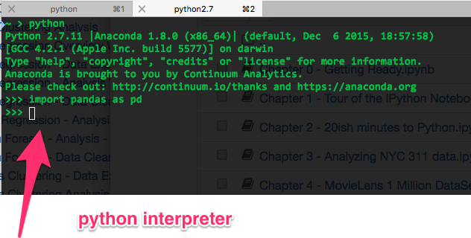
You should see something like:

Slide 4
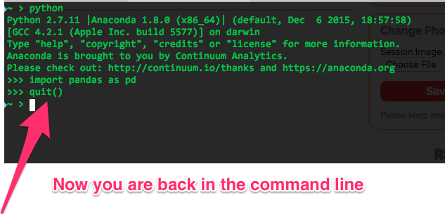
Exit out of the python interpreter

Slide 5
Download my github
https://github.com/GusSand/itp_talk_2016
Clone or download as zip

Slide 6
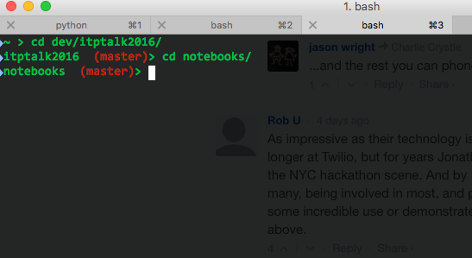
Get to the notebooks directory
Instructions:
Open a command line to the directory where you downloaded the code from github in the previous step
Cd to the notebooks directory

Slide 7
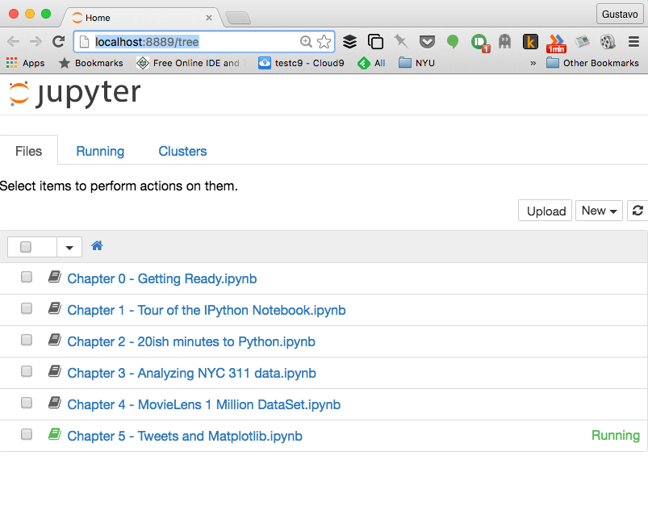
Open ipython

Slide 8
Wait
I’m gonna wait until everyone is in Chapter 1….

