Slide 1
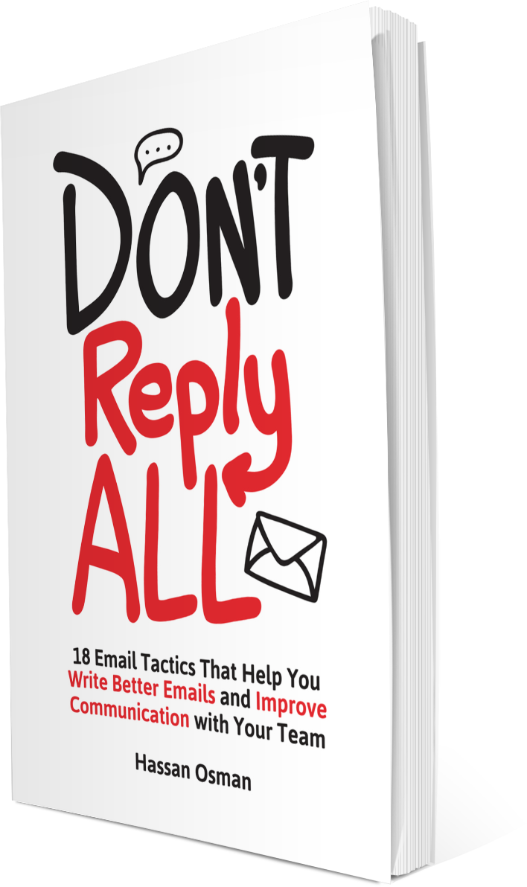
DON’T REPLY ALL
18 Email Tactics That Help You Write Better Emails and Improve Communication with Your Team

Slide 2
#1
ASSIGN TASKS USING THE 3WS
3Ws: Who, What, and When (every task should have all 3)
1.WHO
2.WHAT
3.WHEN
Name of a specific person (not a group)
Explicit description (no assumptions)
Exact date and time
(clear deadline)
Example: “Sam, please send me the updated status report by Monday, Nov 23 at 3pm US Eastern Time”

Slide 3
#2
WRITE THE PERFECT SUBJECT LINE
Two-second overview of your email (like the headline of an article)
TIP 1
TIP 2
Summarize the 3Ws
Example: “Sam/Jim/Karla - need those actions by tom COB”
Use prefix modifiers (avoid a suffix)
Example: “[URGENT] Info regarding your Dec 1st trip”
TIP 3
TIP 4
Write the entire email in the subject line
Use EOM (End of Message)
Example: “We’re going to Border Cafe for lunch @1pm <EOM>”
Change the subject line only when the subject changes

Slide 4
#3
TL;DR* – WRITE EMAILS THAT ARE 5 SENTENCES OR LESS
Shorter emails get addressed faster (5 sentences or less is the sweet spot)
TIP 1
TIP 2
TIP 3
Know what you want
Ask yourself “What do I really want the recipient to know or do?”
Get to that point immediately
Don’t dance around or pad your message with useless verbiage
Highlight a lack of required response
(or action)
Examples: “FYI,” “NNTR,” or “No Action Needed”
*TL;DR stands for Too Long; Didn’t Read

Slide 5
#4
BREAK LONG EMAILS INTO TWO PARTS
Label them “Quick Summary” and “Details”
PART 1: Quick Summary
PART 2: Details
Keep this part 5 sentences or less
Summarize the main gist of your message
Elaborate on the summary
Include any background or supporting information

Slide 6
#5
MAKE YOUR EMAILS SCANNABLE
People don’t read emails anymore (they just scan them)
TIP 1
TIP 2
Use bullet points for all your actions and questions
Separate them out and don’t bury them in paragraphs
Use sub-headings, white space, highlights and/or bold text
Make it easy for readers to scan for important information

Slide 7
#6
Show Instead of Tell by Attaching Screenshots
Screenshots make everyone’s life easier
TIP 1
TIP 2
Use screenshots to save time and improve clarity
Give someone step-by-step instructions or highlight a slide in an attached PPT deck
Press “PrtSc” on a PC or “Command+Shift+3” on a Mac
Or use Evernote, Skitch, or Snipping Tool

Slide 8
#7
Spell Out Time Zones, Dates, and Acronyms
Avoid useless back & forth emails by being specific
TIP 1
TIP 2
Get the time zones spelled out clearly
Mention the exact time zone, day, and date.
Example: “How about tomorrow, Friday, July 16, 2016 at 8:30am US Eastern Time?”
Do the same for acronyms
Spell out acronyms at least once in an email
Type the phrase with the acronym in parentheses immediately afterward

Slide 9
#8
Use “If…then…” Statements
They hold people accountable, clarify expectations, and reduce the amount of follow-ups
TIP 1
TIP 2
Use “If…then…” for clarity on next steps
Example: “If you have any other questions, then please call the support desk at XXX-XXX-XXXX.”
Use “If…then…” to explain assumptions
Example: “Your note wasn’t very clear to me. If you meant <A>, then I suggest we do <X>.”
TIP 3
TIP 4
Use “If…then…” for accountability
Example: “If I don’t hear back by Friday Jan 15 at noon Central Time, then I’ll assume you’re good.”
Use “If… then…” for reminders
Example: “If I don’t respond back to you by later tonight, then please remind me again tomorrow morning.”

Slide 10
#9
Present Options Instead of Open-Ended Questions
Email is a horrible medium for brainstorming and long-form discussions
TIP 1
TIP 2
Present clear options
Instead of asking “What do you guys think about this?” you can say “Do you think we should do A, B or C?”
Give alternatives when scheduling meetings
Instead of asking “When do you think we should meet?” give them two or three date & time options to choose from

Slide 11
#10
Re-Read Your Email Once for a Content Check
Content mistakes include replying to the wrong question, stating the facts incorrectly, adding in the wrong date, or just not making sense whatsoever
TIP 1
TIP 2
Re-read your entire email
Re-read your entire email from top to bottom. Not a portion of it. Not just the actions. All of it.
Re-read the questions and your answers
Re-reading the questions as well as the answers helps ensure that your responses make sense before you reply

Slide 12
#11
Save Drafts of Repetitive Emails
A standard format improves communication with your team members
TIP 1
TIP 2
Use a template for weekly and monthly status calls
A similar look and feel helps with readability over time
Save drafts based on client or topic
This keeps the communication flow consistent across your different teams and customers

Slide 13
#12
Write It Now, Send It Later Using Delay Delivery
Schedule messages to go out anytime from a few minutes to a few weeks later
TIP 1
TIP 2
Use delay delivery to send emails when they’re most likely to be read
Ensure a maximum open rate by sending messages during your recipients’ normal working hours
Use delay delivery as a reminder tool
Schedule emails to be sent as reminders to your team before a certain deadline

Slide 14
#13
Don’t Reply All (Unless You Absolutely Have To)
Reply all is a horrible feature when it’s misused
TIP 1
TIP 2
Apply the golden rule of reply all
Don’t use reply all when only the original sender needs to read your message
Mention when you’re removing members from the reply all list
State that at the top of your email so that everyone is aware (e.g., “Removing Customer”)
TIP 3
TIP 4
Send a follow-up reply all email after any offline discussions
Summarize offline discussions and proactively send a follow-up email to the team
State what you want your recipients to do
Let them know at the end of your email if you want them to reply all to the message or to unicast back to you alone

Slide 15
#14
Reply to Questions Inline
Answer immediately after the questions themselves
TIP 1
TIP 2
TIP 3
Use a different color font*
Choose a darker colored font instead of a lighter one because the former is easier to see on a white background
You can also use a bold fonts instead of different colors
Copy the original questions in your reply
Copy the entire list of questions from the original email, paste them in your own email message, and then answer them to improve readability
If the questions were not separated out, then do that yourself
Copy/ paste any hidden questions, list them out in separate bullet points in your reply, and then answer them
*If you use a different color font, make sure your recipients are not color-blind first.

Slide 16
#15
Reply Immediately to Time-Sensitive Emails
Send a quick acknowledgement email to calm people down
TIP 1
TIP 2
Make sure the acknowledgment is meaningful
Add a little bit of information to explain what your response means so that your readers are reassured
Don’t reply with just an “Ok” unless it makes sense to do so
Spell out your need for an acknowledgment
Let your readers know that you want them to acknowledge your own emails
Example: “Please confirm that you received this email and that you’ll get this done.”

Slide 17
#16
Read the Latest Email Before Responding
A response could be based on outdated information because some newer messages were left unopened
TIP 1
TIP 2
Sort your email messages by subject
Click on the email subject you want to find, then sort by the “Subject” field to view all related emails consecutively
You can also use “conversation threading” where messages with the same subject line are visually grouped together
If you make a mistake, correct it by replying back to the team
Do everyone a favor and immediately respond with a clarification if you unintentionally reply to an outdated email

Slide 18
#17
Write the Perfect Out-of-Office (OOO) Auto Reply
Set up an automated message when you’re unreachable through email
TIP 1
TIP 2
Always set up an OOO reply
Don’t leave anyone hanging and unsure about why you’re not responsive
Make sure the OOO is meaningful
State the exact dates, highlight your backup contacts, and set the right expectations

Slide 19
#18
Share the Rules of Email Ahead of Time
Establish ground rules so that everyone communicates more effectively
TIP 1
TIP 2
Set up a short meeting with your team
Go over the best practices and make sure everyone agrees on them ahead of time
Be flexible on the rules
Use what you like, delete what you don’t, and add any new ones that apply to your team

Slide 20
GET THE BOOK AT:
http://www.thecouchmanager.com/dontreplyall

