Slide 1
STELLENBOSCH UNIVERSITY · DEPARTMENT OF ECONOMICS
Coffee Hub
Premium Coffee Sourcing Recommendations
for the Neelsie Entrepreneur
Data Science Practical · 2026 | Student number: 26572982

Slide 2
Methodology
01
02
03
Data Overview
Keyword Matching
Selection Threshold
2 095 expert-reviewed coffees from global roasters — each with up to 3 expert descriptions, cost per 100g (USD), roast strength, and roaster location.
15 sensory descriptors extracted from the Stellenbosch student survey word cloud: chocolate, sweet, aroma, mouthfeel, fruit, bright, floral, citrus, balanced, smooth, dark, rich, notes, finish, savory.
Coffees scoring 10+ keyword matches selected as 'Stellenbosch-approved'. Balances quality filtering with supply-side flexibility — 444 coffees (21%) qualify.

Slide 3
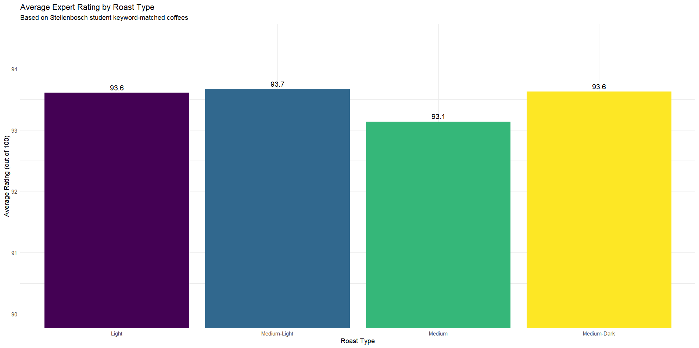
Rating by Roast Type
KEY INSIGHTS
Medium-Light scores highest
at 93.7 avg — and represents 71% of available supply.
Medium-Dark most consistent
with the tightest rating spread.
Roast type alone is not a strong differentiator
— all roasts score 93+.
Filter: keyword score ≥ 10. n=444 coffees.

Slide 4
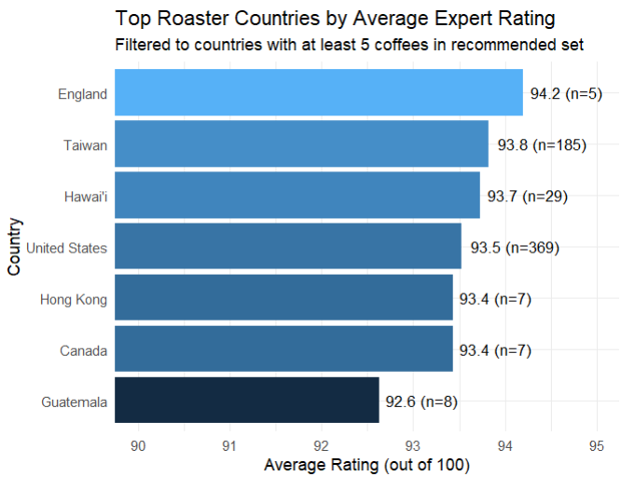
Top Roaster Countries by Rating
KEY INSIGHTS
England tops at 94.2
but only n=5 coffees — supply risk.
Taiwan (93.8, n=185) and US (93.5, n=369)
offer best quality AND reliable supply volume.
Recommendation:
Prioritise Taiwan and US as primary sourcing regions.
Filter: countries with ≥5 coffees in the recommended set.

Slide 5
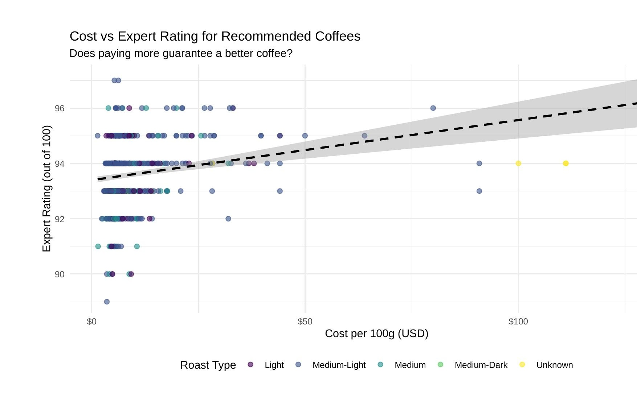
Does Price Guarantee Quality?
KEY INSIGHTS
Weak positive trend
exists but confidence interval widens sharply above $50.
Most 93–96 rated coffees
cluster below $50/100g.
Overspending is not justified
quality below $50 matches expensive options.
Dashed line = linear trend. Shaded band = 95% confidence interval.

Slide 6
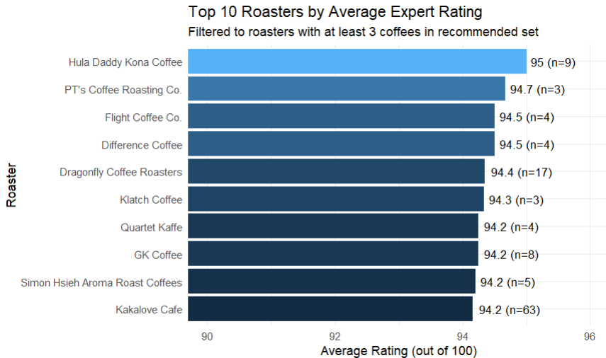
Top 10 Roasters by Expert Rating
KEY INSIGHTS
Hula Daddy Kona Coffee
leads at 95.0 avg across n=9 coffees.
Dragonfly Coffee Roasters
most reliable: 94.4 with n=17.
Kakalove Cafe
strongest at scale: 94.2 across n=63 coffees.
Filter: roasters with ≥3 coffees in the recommended set.

Slide 7
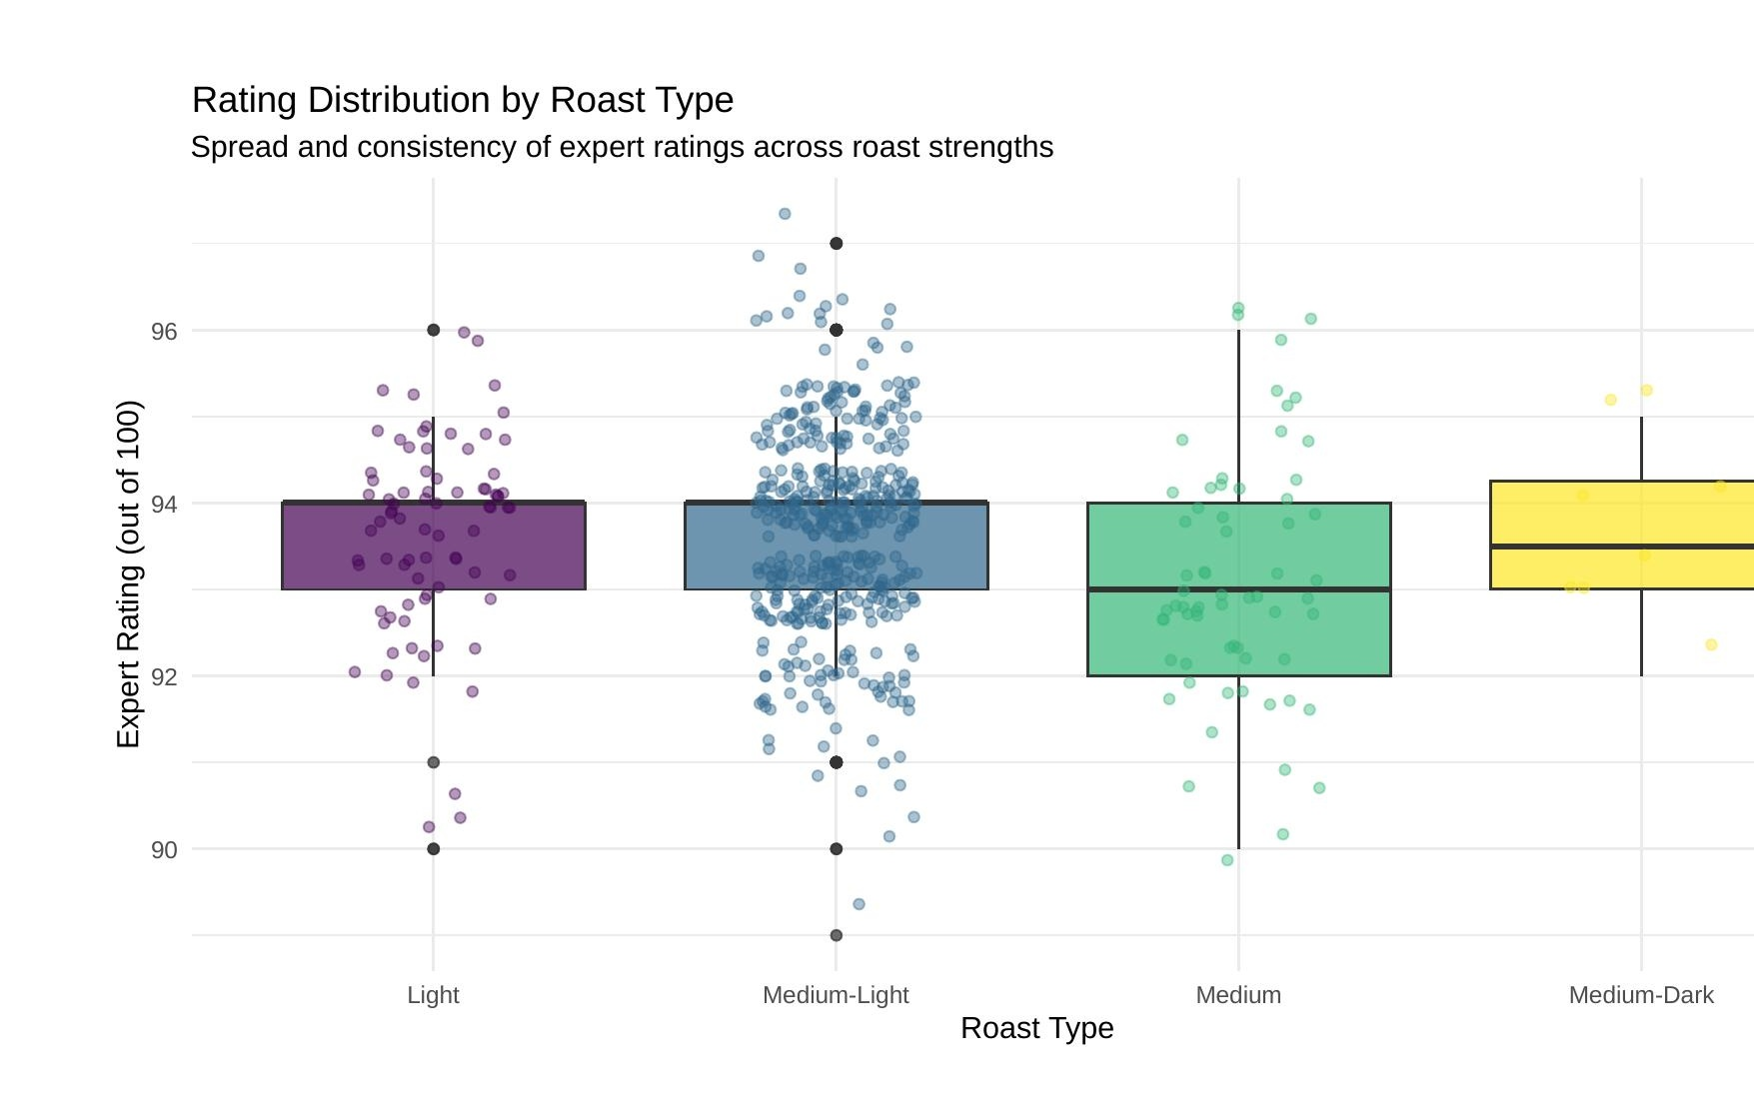
Rating Consistency by Roast Type
KEY INSIGHTS
Medium-Dark most consistent
— smallest box and shortest whiskers.
Medium-Light most variable
— widest spread, but highest peaks (97+).
Medium roasts
— lowest median and wide spread. Least predictable.
Boxes = IQR. Dots = individual coffees. Whiskers = full range.

Slide 8
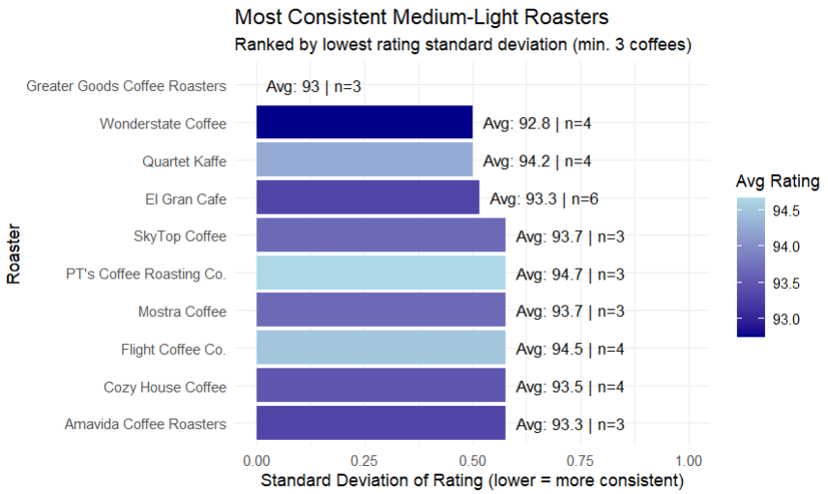
Consistent Medium-Light Suppliers
Medium-Light roasts score highest on average but require careful supplier selection. These roasters deliver consistently:
1
Greater Goods Coffee Roasters is the most consistent
2
PT's Coffee Roasting Co. and Flight Coffee Co. offer the
Best combination of consistency and high ratings
4
5

Slide 9
Final Recommendations
Summary for the Neelsie Coffee Entrepreneur
ROAST
Prioritise Medium-Light (93.7 avg, 71% of supply). Stock Medium-Dark for customers wanting maximum consistency.
REGION
Source from Taiwan (n=185, 93.8) and United States (n=369, 93.5) — best balance of quality and reliable supply.
COST
Do not overspend. Excellent coffees available below $50/100g. Price above this does not reliably predict better quality.
SUPPLIERS
Top picks: Hula Daddy Kona (95.0), Dragonfly Coffee Roasters (94.4, n=17), Kakalove Cafe (94.2, n=63).
ML PICKS
For Medium-Light: PT's Coffee Roasting Co. (94.7) and Flight Coffee Co. (94.5) — highest rated with low variability.

