Slide 1
CSE 505
Lecture #16
October 29, 2012

Slide 2
Design Patterns
(Gamma et al 1994)
Definition: A design pattern is a solution to
recurring design problem in a certain context.
Disciplined configurations of classes, interface,
aggregation, and inheritance.
Goal: Structured Object-oriented Programming.
Lecture 16: 10/29/2012
CSE 505 / Jayaraman

Slide 3
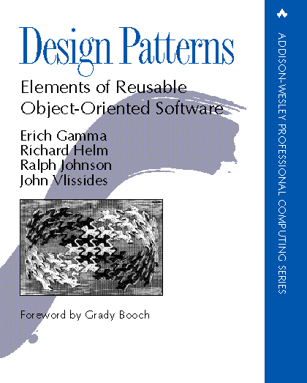
The original book
Lecture 16: 10/29/2012
CSE 505 / Jayaraman

Slide 4
Problems in OO software
Extending functionality by subclassing
Inability to alter classes easily
Tight coupling between classes
Dependence on object representations
Lecture 16: 10/29/2012
CSE 505 / Jayaraman

Slide 5
Problems in OO software
Creating an object by naming a class explicitly
Dependence on software/hardware platforms
Dependence upon on specific operations
Dependence upon algorithmic details
Lecture 16: 10/29/2012
CSE 505 / Jayaraman

Slide 6
Principles behind the Patterns
Delegation and Late Binding
“Objectifying” methods
Loose coupling between classes
Indirect Object Creation
Lecture 16: 10/29/2012
CSE 505 / Jayaraman

Slide 7
Categories Design Pattern
Three broad categories of patterns:
* Creational
* Structural
* Behavioral
Lecture 16: 10/29/2012
CSE 505 / Jayaraman

Slide 8
Creational
Structural
Behavioral
Factory Method
Abstract Factory
Prototype
Singleton
Builder
Bridge
Composition
Decorator
Adapter
Proxy
Façade
…
Template Method
Strategy
State
Iterator
Observer
Visitor
Memento
…
Lecture 16: 10/29/2012
CSE 505 / Jayaraman

Slide 9
Design Patterns in PLs
The major OO languages incorporate the design patterns is many ways
The Java libraries incorporate several design patterns.
The iterator pattern has special syntax in C++, Java, and Smalltalk (internal iterator).
Observer pattern has had a major influence on user-interface design.
Lecture 17: 3/26/2012
CSE 505 / Jayaraman

Slide 10
Design Patterns in
Java Libraries
Adapter – Swing to AWT using action listeners
Composite – UI components (buttons, scrollbars, etc.) may be placed in containers (panels, windows). Nested containers allowed.
Strategy – how components are laid out in container. Many strategies: flow, grid, etc.
Iterator – used in collection classes
Observer, Factory, Singleton
Lecture 17: 3/26/2012
CSE 505 / Jayaraman

Slide 11
Illustration - Template Method
Template Method pattern involves the technique
of defining superclass methods in terms of one
or more abstract methods which are defined
by the subclasses.
We have already this technique earlier.
Lecture 16: 10/29/2012
CSE 505 / Jayaraman

Slide 12
Template Method Pattern
Abstract Class
TemplateMethod()
PrimitiveOperation1()
PrimitiveOperation2()
…
PrimitiveOperation1()
…
PrimitiveOperation2()
…
ConcreteClass
PrimitiveOperation1()
PrimitiveOperation2()
Lecture 16: 10/29/2012
CSE 505 / Jayaraman

Slide 13
BST Classes
Abs_Tree
insert, min,
max, print
value, left, right
Tree
DupTree
count
Lecture 16: 10/29/2012
CSE 505 / Jayaraman

Slide 14
class Tree extends Abs_tree {
public Tree(int n) {super(n);}
protected Abs_tree add_node(int n)
{return new Tree(n);}
protected void count_duplicates() {}
protected void print_node()
{System.out.print(value + " ");}
}
class Duptree extends Abs_tree {
public Duptree(int n)
{super(n); count = 1;};
protected Abs_tree add_node(int n)
{return new Duptree(n);}
protected void count_duplicates()
{count++;}
protected void print_node()
{System.out.print(value + "/"
+ count + " ");}
protected int count;
}
public void insert(int n) {
if (value == n)
count_duplicates();
else if (value < n)
if (right == null)
right = add_node(n);
else right.insert(n);
else if (left == null)
left = add_node(n);
else left.insert(n);
}
Abs_tree.insert
➔ Template Method
Lecture 16: 10/29/2012
CSE 505 / Jayaraman

Slide 15
Strategy Pattern
“Objectifying
an Algorithm”
str
Strategy
Algorithm()
Context
str.Algorithm()
ConcreteStrategyA
Algorithm()
ConcreteStrategyB
Algorithm()
ConcreteStrategyC
Algorithm()
Lecture 16: 10/29/2012
CSE 505 / Jayaraman

Slide 16
Strategy Pattern
str
SortingStrategy
Sort(arr)
Context
str.Sort(arr)
QuickSort
Sort(arr)
BubbleSort
Sort(arr)
InsertionSort
Sort(arr)
Lecture 16: 10/29/2012
CSE 505 / Jayaraman

Slide 17
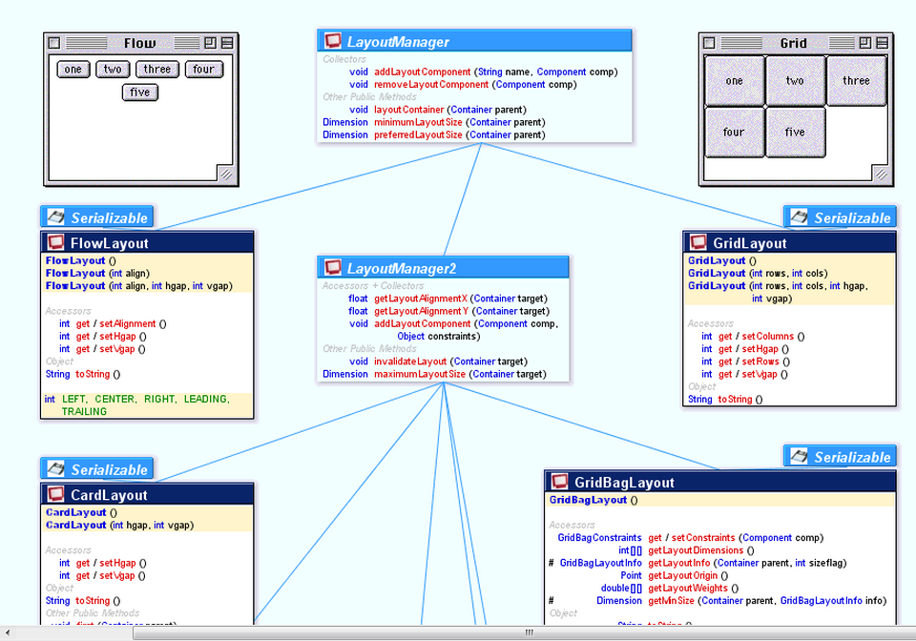
Java Layout Managers
http://www.falkhausen.de/en/diagram/html/java.awt.LayoutManager.html
Lecture 16: 10/29/2012
CSE 505 / Jayaraman

Slide 18
Motivation for State
The State pattern shows how to define
an object that exhibits different behavior
as its internal state changes.
Classic example: finite-state machine
Lecture 16: 10/29/2012
CSE 505 / Jayaraman

Slide 19
Some States of an Airline Reservation System
From Bertrand Meyer’s
1986 OOPSLA paper
Exit
0
0
0
0
0
0
Init
3
2
1
1
3
2
1
1
Confrm
Help
Inform
1
1
1
1
2
3
2
3
Reserv
Lecture 16: 10/29/2012
CSE 505 / Jayaraman

Slide 20
Behavior in each State
Display a panel
Read user input
Check for errors
Process input
Transition to next state
Lecture 16: 10/29/2012
CSE 505 / Jayaraman

Slide 21
The Function-Oriented Solution
It is common to represent an FSM by a matrix
(state * input → state), and to write something like:
void do_one_state(in s: STATE) {
var input: T; ok: boolean;
repeat
display(s); read(s, input); ok← check(s,input);
if not(ok) then message(s, input);
until ok;
process(s, input);
…
}
Lecture 16: 10/29/2012
CSE 505 / Jayaraman

Slide 22
Case Analysis on States
The type STATE is a variant record usually,
and the procedures display, read, check, …,
perform a case analysis on the state variable:
case state of
Init:
Confirm:
Help: …
}
There may be many cases to consider! Adding
new states involves modifying case analysis code.
Lecture 16: 10/29/2012
CSE 505 / Jayaraman

Slide 23
State Pattern
Context
s
State
op1() … opn()
driver
s.op1()
s.op2()
…
s.opn()
State1
op1() … opn()
State2
op1() … opn()
State3
op1() … opn()
CSE 505 / Jayaraman
Lecture 16: 10/29/2012

Slide 24
State Interface
interface State {
void display ();
void read ();
boolean check ();
void message ();
void process ();
void id (): STATE;
void final (): boolean;
}
Lecture 16: 10/29/2012
CSE 505 / Jayaraman

Slide 25
class Init implements State {
public void display() {
write(stdout, Ënter an input >= 0 and <= 3");
}
public void read()
{read(stdin, input); }
public void check()
{return (input >= 0 and input <= 3);}
public void message() {write(stdout,"Your input >= 0 and <= 3");}
public void process() {...}
public CHOICE next_choice() {...}
public STATE id() {
return some identifier for this state
}
public boolean final() { return false; }
protected T input
}
Lecture 16: 10/29/2012
CSE 505 / Jayaraman

Slide 26
Strategy and State
They have similar class diagrams but
their motivations are different:
- Strategy ‘objectifies’ an operation, so as facilitate multiple implementations
- State allows an object to exhibit different behaviors (multiple operations)
as the object state changes.
Lecture 16: 10/29/2012
CSE 505 / Jayaraman

Slide 27
Factory Method Motivation
Key Idea: “Virtual Constructor”
Creating an object indirectly helps
achieve greater generality on the
client side.
CSE 505 / Jayaraman
Lecture 16: 10/29/2012

Slide 28
Factory Method Pattern
Creator
FactoryMethod()
AnOperation()
Prod
…
Prod = FactoryMethod()
…
ConcreteCreator
FactoryMethod()
ConcreteProd
return
new ConcreteProd(..)
CSE 505 / Jayaraman
Lecture 16: 10/29/2012

Slide 29
BST Classes
Abs_Tree
insert, min,
max, print
value, left, right
Tree
DupTree
count
Lecture 16: 10/29/2012
CSE 505 / Jayaraman

Slide 30
Factory and Template Methods
Template Method
Abs_Tree
… left = add_node(n)
…
right = add_node(n) …
… insert,
add_node,
Factory Method
value, left, right
Tree
DupTree
return
new Tree(n)
return
new DupTree(n)
add_node()
add_node()
count
Lecture 16: 10/29/2012
CSE 505 / Jayaraman

Slide 31
BST Classes with
insert and add_node
public void insert(int n) {
if (value == n)
count_duplicates();
else if (value < n)
if (right == null)
right = add_node(n);
else right.insert(n);
else if (left == null)
left = add_node(n);
else left.insert(n);
}
class Tree extends Abs_tree {
public Tree(int n) {super(n);}
protected Abs_tree add_node(int n)
{return new Tree(n);}
}
class Duptree extends Abs_tree {
public Duptree(int n)
{super(n); count = 1;};
protected Abs_tree add_node(int n)
{return new Duptree(n);}
protected int count;
}
Lecture 16: 10/29/2012
CSE 505 / Jayaraman

Slide 32
Abstract Factory Motivation
Client
MacWidgets
mb = new MacButton
ms = new MacScrollbar
... mb … ms …
MacButton
MacScrollbar
Suppose the client program wishes to
work with other kinds of widgets, e.g.
XWidgets, MotifWidgets, etc.
Lecture 16: 10/29/2012
CSE 505 / Jayaraman

Slide 33
Abstract Factory Motivation (cont’d)
Client
MacWidgets
MacButton
MacScrollbar
mb = new MacButton
ms = new MacScrollbar
... mb … ms …
XWidgets
XButton
XScrollbar
xb = new XButton
xs = new XScrollbar
... xb … xs …
MotifWidgets
MotifButton
MotifScrollbar
CSE 505 / Jayaraman
Lecture 16: 10/29/2012

Slide 34
Abstract Factory Pattern
AbstractFactory
CreateProdA()
CreateProdB()
Client
AbstractProdA
ProdA2
ProdA1
AbstractProdB
ConcreteFactory1
CreateProdA()
CreateProdB()
ConcreteFactory2
CreateProdA()
CreateProdB()
ProdB2
ProdB1
Lecture 16: 10/29/2012
CSE 505 / Jayaraman

Slide 35
Abstract Factory: Example
GUIFactory
CreateButton()
CreateScrollbar()
Client
XWidget
XButton
XScrollbar
XFactory
CreateButton()
CreateScrollbar()
MacFactory
CreateButton()
CreateScrollbar()
MacWidget
return
new XScrollbar
MacButton
MacScrollbar
Lecture 16: 10/29/2012
CSE 505 / Jayaraman

Slide 36
Abstract Factory Example (cont’d)
Client
MacWidgets
MacButton
MacScrollbar
GUIFactory g;
g = new XFactory;
g.createButton();
…
g.createScrollbar();
…
XWidgets
XButton
XScrollbar
MotifWidgets
only this is
Product Family
dependent
MotifButton
MotifScrollbar
Lecture 16: 10/29/2012
CSE 505 / Jayaraman

Slide 37
Motivation for Composite
The Composite pattern shows how to
define recursive structures, i.e., objects
that aggregate other objects of the same
class.
A classic example is the BST, but there
are many other examples.
Lecture 16: 10/29/2012
CSE 505 / Jayaraman

Slide 38
Composite Pattern
Client
Component
Operation()
Add(Component)
Remove(Component)
GetChild(int)
1..*
children
1
Leaf
Operation()
Component
Operation()
Add(Component)
Remove(Component)
GetChild(int)
foreach g in children
{ g.Operation(); }
Lecture 16: 10/29/2012
CSE 505 / Jayaraman

Slide 39
Example of Composite
1..*
Client
Component
1..*
Display()
Comp
Comp
Capacitor
Resistor
Series
Parallel
Display()
Display()
Display()
1
Display()
1
Lecture 16: 10/29/2012
CSE 505 / Jayaraman

Slide 40
Aside: “Constrained Objects”
The circuit example shows that a declarative variant of the traditional OO paradigm is desirable. E.g.
Resistor
Series
forall C in Comp:
C.I = I
V = I * R
sum C in Comp:
C.V = V
V, I, R
Comp
Lecture 16: 10/29/2012
CSE 505 / Jayaraman

Slide 41
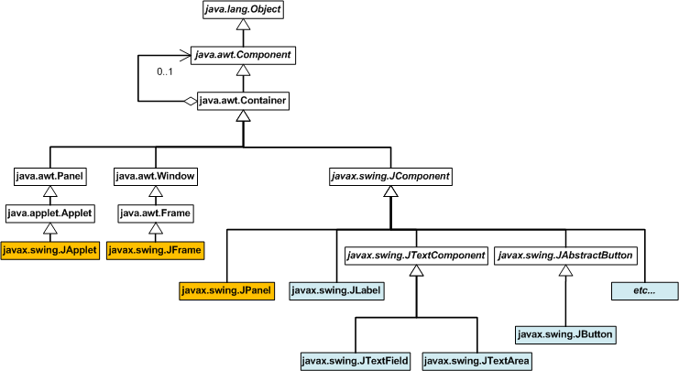
Composite Pattern in Java
1..*
http://www.clear.rice.edu/JavaResources/GUI/
Lecture 16: 10/29/2012
CSE 505 / Jayaraman

Slide 42
Motivation for Decorator
This is another design pattern motivated
by the need to avoid explosion in class
hierarchy when multiple refinements, or
“decorations”, of a class are possible.
CSE 505 / Jayaraman
Lecture 16: 10/29/2012

Slide 43
Window
Bordered
Window
Scrollable
Window
Modern PLs do not support “multiple
inheritance”
BorderedScrollable
Window
CSE 505 / Jayaraman
Lecture 16: 10/29/2012

Slide 44
Class Diagram
A
A1
A2
A3
A12
A23
A31
A123
We would like to avoid this class explosion …
CSE 505 / Jayaraman
Lecture 16: 10/29/2012

Slide 45
Decorator Design Pattern
Component
op()
comp
A
op()
Decorator
op()
comp.op()
A1
op()
addedState
op();
extend()
A2
super.op();
extend();
addedstate
Lecture 16: 10/29/2012
CSE 505 / Jayaraman

Slide 46
Object Level Behavior
ScrollbarDecoration
Draw()
BorderDecoration
Draw()
Window
Draw()
CSE 505 / Jayaraman
Lecture 16: 10/29/2012

Slide 47
Strategy vs Decorator
Strategy lets you change the “guts” but Decorator lets you change the “skin”.
That is, strategy allows you to make changes on the insider while keeping the outside the same. Decorator allows you to dynamically add properties on the outside.
Decorator also allows dynamically composing functionalities.
Lecture 16: 10/29/2012
CSE 505 / Jayaraman

