Slide 1
CSE 505
Lecture #17
October 31, 2012

Slide 2
Creational
Structural
Behavioral
Factory Method
Abstract Factory
Singleton
Prototype
Builder
Composition
Adapter
Bridge
Decorator
Proxy
Façade
…
Template Method
Strategy
State
Visitor
Iterator
Command
Observer
…
Lecture 17: 10/31/2012
CSE 505 / Jayaraman

Slide 3
Singleton Design Pattern
Singleton
private Singleton()
makeSingleton()
getSingletonData()
static uniqueInstance
singletonData
return uniqueInstance
Example: single instance of ‘manager’ objects
CSE 505 / Jayaraman
Lecture 17: 10/31/2012

Slide 4
Singleton
class StorageManager {
private StorageManager (T x) { data = x; }
public static StorageManager single(T x) {
if (sm == null) sm = new StorageManager(x);
return sm;
}
protected static StorageManager sm = null;
T data;
}
private
constructor
Client Code: … StorageManager.single(…); …
CSE 505 / Jayaraman
Lecture 17: 10/31/2012

Slide 5
Visitor Design Pattern
Useful for “visiting” each node of an aggregate structure and performing a set of operations on each node. For example:
Aggregate Structure: Parse Tree
Operations: Type Check, Pretty Print, Generate Code, etc.
Key Criterion: Consolidate the logic of each operation in a single class, rather than fragmenting the logic across multiple classes.
Lecture 17: 10/31/2012
CSE 505 / Jayaraman

Slide 6
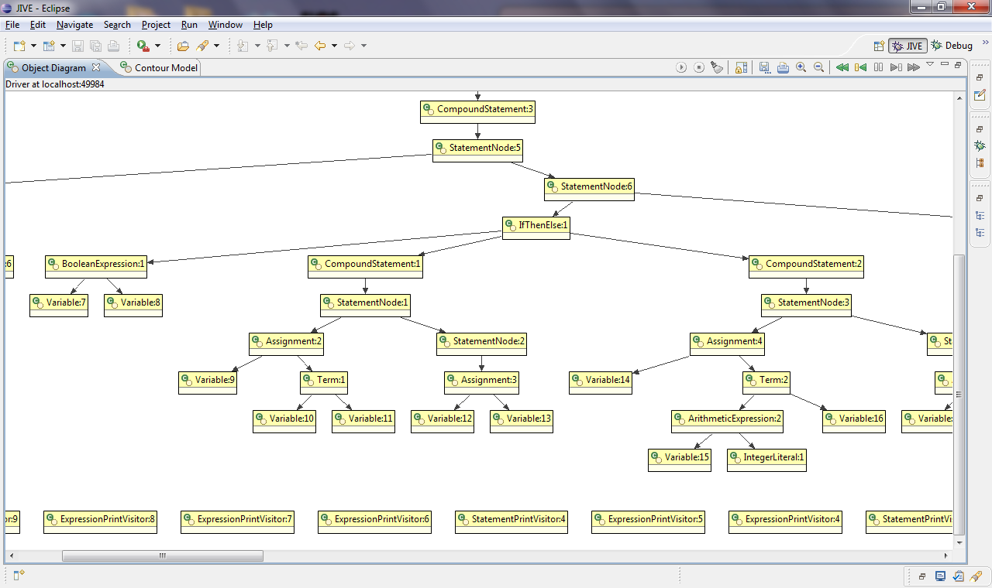
Sample Parse Tree
Lecture 17: 10/31/2012
CSE 505 / Jayaraman

Slide 7
Motivation for Visitor
Node
Client
Type_check
…
AssignNode
BinaryOpNode
AssignNode
Type_check
Type_check
Type_check
…
…
…
Pretty_print
Pretty_print
Pretty_print
Code_gen
Code_gen
Code_gen
…
…
…
Poor Design: The logic of the node operations is scattered
across many classes. Node interface also gets bloated.
Lecture 17: 10/31/2012
CSE 505 / Jayaraman

Slide 8
Visitor Design Pattern
Visitor
visit(NodeA)
visit(NodeB)
Client
Visitor1
Visit(NodeA)
Visit(NodeB)
Visitor2
Visit(NodeA)
Visit(NodeB)
Node
Accept(Visitor)
NodeA
Accept(Visitor v)
OperationA()
NodeB
Accept(Visitor v)
OperationB()
v.visit(this)
v.visit(this)
Lecture 17: 10/31/2012
CSE 505 / Jayaraman

Slide 9
Visitor Pattern
interface Visitor {
public void visit(AssignNode an);
public void visit(BinOpNode bn);
public void visit(IfNode in);
}
class TypeCheckVisitor implements Visitor {
public void visit(AssignNode an) { ..}
public void visit(BinOpNode bn){ .. }
public void visit(IfNode in) { .. }
}
class PrettyPrintVisitor implements Visitor {
public void visit(AssignNode an) { ..}
public void visit(BinOpNode bn){ .. }
public void visit(IfNode in) { .. }
}
abstract class Node {
public Node(value n) { …}
public void accept(Visitor v) { }
}
class AssignNode extends Node {
public AssignNode() { … }
public void accept(Visitor v) {
v.visit(this);
}
}
class BinOpNode extends Node {
public BinOpNode() { … }
public void accept(Visitor v) {
v.visit(this);
}
}
class IfNode extends Node {
public IfNode() { … }
public void accept(Visitor v) {
v.visit(this);
}
}
Lecture 17: 10/31/2012
CSE 505 / Jayaraman

Slide 10
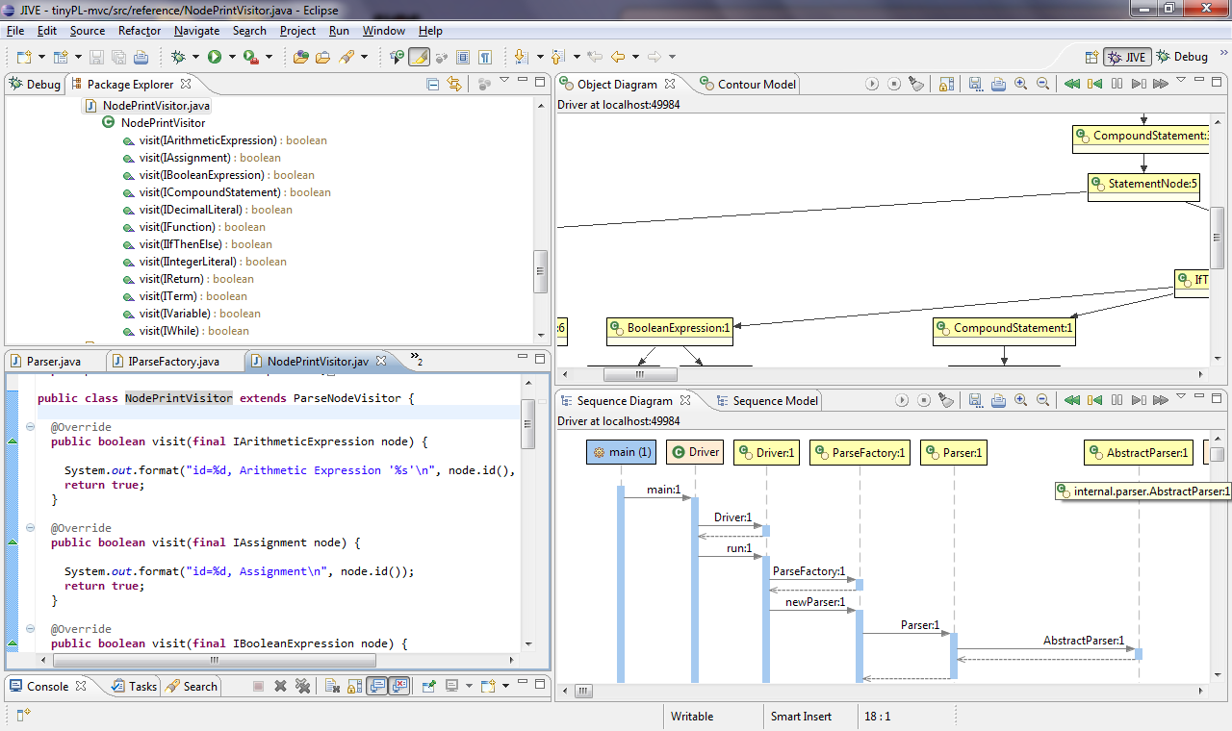
Lecture 17: 10/31/2012
CSE 505 / Jayaraman

Slide 11
Lecture 17: 10/31/2012
CSE 505 / Jayaraman

Slide 12
Iterator Design Pattern
Two types of Iterators:
  Interal
  External
Internal Iterator (see Lecture 5):
  Takes an operation and applies it to all
  elements in an aggregate structure
External Iterator:
  elements one at a time
CSE 505 / Jayaraman
Lecture 17: 10/31/2012

Slide 13
(External) Iterator
Aggregate
CreateIterator()
Client
Iterator
First()
Next()
Done()
CurrentItem()
ConcreteAggregate
CreateIterator()
ConcreteIterator
return new ConcreteIterator(this)
Lecture 17: 10/31/2012
CSE 505 / Jayaraman

Slide 14
External Iterator (cont’d)
class Abs_tree {
…
public TreeIterator createIterator() {
…
}
…
}
class Tree extends Abs_tree {
…
public TreeIterator createIterator() {
return new TreeIterator(this);
}
…
}
interface iterator {
public Node First();
public Node Next();
public boolean Done();
public Node Current();
}
class TreeIterator implements Iterator {
public TreeIterator(Abs_tree tr) {…}
public Node First() { … }
public Node Next() { … }
public boolean Done() { … }
public Node Current() { … }
…
}
Lecture 17: 10/31/2012
CSE 505 / Jayaraman

Slide 15
Comments on External Iterator
Effectively simulates a coroutine, with operations such as done(), next(), current(), etc.
Unlike a coroutine, there is no yield operation in an external iterator when implemented in many OO Languages – Python being an exception.
We have to maintain the state of the traversal through the state of the object.
Lecture 17: 10/31/2012
CSE 505 / Jayaraman

Slide 16
Motivation for Bridge
The Bridge pattern shows how to connect
two hierarchies (A, A1, A2, …)
and (B, B1, B2, …) without causing a
quadratic explosion in the class diagram:
A1_B1, A1_B2, A1_B3, …
A2_B1, A2_B2, A2_B3, …
Especially useful in linking abstraction and
implementation hierarchies.
Lecture 17: 10/31/2012
CSE 505 / Jayaraman

Slide 17
Bridge Design Pattern
Client
imp
Implementor
OperationImp()
Abstraction
Operation()
imp.OperationImp();
RefinedAbstraction
ConcreteImplementorA
OperationImp()
ConcreteImplementorB
OperationImp()

Slide 18
Simulating Generics via Inheritance
Abs_tree
left
right
int value
Tree
DupTree
Suppose we want real BST, string BST, etc.
How can we extend the above class diagram?
Lecture 17: 10/31/2012
CSE 505 / Jayaraman

Slide 19
An undesirable solution
Abstree_r
Abstree_s
left
right
left
right
real value
string value
Tree_r
DupTree_r
Tree_s
DupTree_s
Lecture 17: 10/31/2012
CSE 505 / Jayaraman

Slide 20
Use the Bridge Pattern
Abs_tree
left
right
Elem
insert …
eq, lt
Elem value
Tree
DupTree
IntElem
RealElem
eq, lt
eq, lt
public boolean eq(Elem e) {
IntElem i;
i = (IntElem) e;
return (intvalue == i.intvalue);
}
intvalue
Lecture 17: 10/31/2012
CSE 505 / Jayaraman
Casting Needed!

Slide 21
Motivation for Decorator
This is another design pattern motivated
by the need to avoid explosion in class
hierarchy when multiple refinements, or
“decorations”, of a class are possible.
CSE 505 / Jayaraman
Lecture 17: 10/31/2012

Slide 22
Window
Bordered
Window
Scrollable
Window
Multiple Inheritance
not usually supported
BorderedScrollable
Window
CSE 505 / Jayaraman
Lecture 17: 10/31/2012

Slide 23
“decorations”
Class Diagram
A
A1
A2
A3
A12
A23
A31
A123
We would like to avoid this class explosion …
CSE 505 / Jayaraman
Lecture 17: 10/31/2012

Slide 24
Decorator Design Pattern
Component
op()
comp
A
op()
Decorator
op()
comp.op()
A1
op()
addedState
op();
extend()
A2
super.op();
extend();
addedstate
CSE 505 / Jayaraman
Lecture 17: 10/31/2012

Slide 25
Object Level Behavior
ScrollbarDecoration
Draw()
BorderDecoration
Draw()
Window
Draw()
CSE 505 / Jayaraman
Lecture 17: 10/31/2012

Slide 26
Adapter Design Pattern
Motivation: When objects with different
interfaces need to communicate with
each other, an adapter object is often
used as a go-between.
Two types of adapters:
object adapter (aggregation)
class adapter (inheritance).
CSE 505 / Jayaraman
Lecture 17: 10/31/2012

Slide 27
Object Adapter
Can’t modify
these classes
Client
A
oper(x)
B
oper(x, y)
Adapter
oper(x)
ad
ad.oper(x, 1)
CSE 505 / Jayaraman
Lecture 17: 10/31/2012

Slide 28
Strategy vs Decorator
Strategy lets you change the “guts” but Decorator lets you change the “skin”.
That is, strategy allows you to make changes on the inside while keeping the outside the same. Decorator allows you to dynamically add properties on the outside.
Decorator also allows dynamically composing functionalities (behaviors).
Lecture 17: 10/31/2012
CSE 505 / Jayaraman

Slide 29
Observer Design Pattern
Separation of a “model” from its many “views”
Example: regional sales data (the model) can be viewed as a pie chart or as a bar chart.
When the model changes, the views are updated. There are two models for updating: the “push” model and “pull” model.
Model-View-Controller (MVC) is a common design pattern in user-interface design
Lecture 17: 10/31/2012
CSE 505 / Jayaraman

Slide 30
Observer Design Pattern
1..n
Observer
Update()
Subject
Attach(Observer)
Detach(Observer)
Notify()
observers
forall o in observers {
o.Update()
}
ConcreteObserver
Update()
observerState
observerState=
subject.GetState()
ConcreteSubject
GetState()
SetState()
subjectState
subject
1..1
…
Notify()
pull model
Lecture 17: 10/31/2012
CSE 505 / Jayaraman

Slide 31
Command Design Pattern
Command
execute()
Invoker
Client
Receiver
action()
ConcreteCommand
execute()
state
receiver
receiver.action();

Slide 32
Command Pattern in Java GUIs
public class MyFrame extends JFrame implements ActionListener {
private JButton button1 = new JButton("Exit");
private JButton button2 = new JButton("Cancel");
private JButton button3 = new JButton("Also Exit");
public MyFrame() {
button1.setActionCommand("EXIT");
button2.setActionCommand("CANCEL");
button3.setActionCommand("EXIT");
button1.addActionListener(this);
button2.addActionListener(this);
button3.addActionListener(this); % add buttons to frame ...
}
public void actionPerformed(ActionEvent evt) {
String cmd = evt.getActionCommand();
if (cmd == "EXIT") { ... exit } % for buttons 1 and 3
else if (cmd == "CANCEL") { ... cancel }
}
}
Lecture 17: 10/31/2012
CSE 505 / Jayaraman

Slide 33
Exception Handling in Java
Syntax:
try { … reading from a file…
}
catch (FileNotFoundException e) { System.err.println(“file not found”; }
catch (IOException e) { S
System.err.println("IO Exception: “
+ e.getMessage()); }
Similar to ML, handler is found through a combination of static and dynamic scoping. Difference: Java exceptions are objects!
Lecture 17: 10/31/2012
CSE 505 / Jayaraman

Slide 34
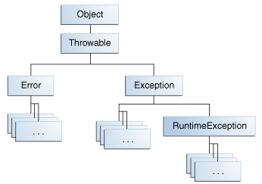
Java Exception Hierarchy
Lecture 17: 10/31/2012
CSE 505 / Jayaraman

Slide 35
User Defined Exception
class DuplicateInsertion extends Exception {
public String message;
public DuplicateInsertion(String s) {
super(s);
message = "Duplicate insertion " + s;
}
}
class Tree {
…
public void insert(int n) throws DuplicateInsertion {
if (value == n) throw new DuplicateInsertion(n + " ");
…
}
…
}
Lecture 17: 10/31/2012
CSE 505 / Jayaraman

Slide 36
class BST_Driver {
public static void main (String args[]) throws java.io.IOException {
Tree tr;
tr = new Tree(5);
try {
tr.insert(10);
tr.insert(20);
tr.insert(10); % 10 was already inserted!
tr.insert(30);
}
catch (DuplicateInsertion d) {
System.out.println(d.message);
}
…
}
Lecture 17: 10/31/2012
CSE 505 / Jayaraman

