Slide 1
CSE 505
Lecture #24
November 28, 2012

Slide 2
Modeling Complex Systems
Motivating Domains
  Engineering
  Biological
  Organizational
  …
Common Characteristics
  Complex Assembly
  Laws of behavior
  Natural visual representations
Lecture 24: 11/28/2012
CSE 505/Jayaraman
Notes:
Complex systems consist of several interconnected, interdependent components
And examples of such systems occur in several engineering disciplines e.g. electrical, civil, chemical, environmental engg
In structured documents, in biological sciences, ecological systems
Our focus is on complex systems that have the following characs –
A complex system can be broken down into subcomponents, i.e., its an assembly of components
The behavior of each component by itsel and in relation to other components is governed by certain laws or rules
& a each component and assembly can be associated with a visual representation.
CS – as an example of a complex system, consider a truss

Slide 3
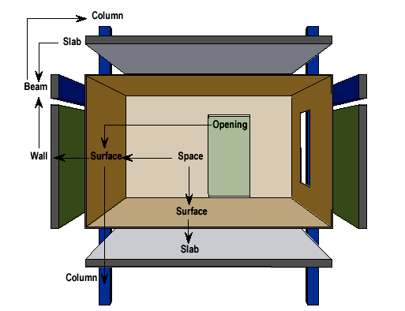
Building Elements
Lecture 24: 11/28/2012
(Kalay et al 1998)
CSE 505/Jayaraman

Slide 4
Examples of Laws/Constraints
“The load on a wall ≤ its load bearing capacity.”
“The sum of the forces at a joint should be zero.”
Various other constraints, such as:
- ‘mate’ constraints
- ‘flush’ constraints
- ‘angle’ constraints
etc.
Lecture 24: 11/28/2012
CSE 505/Jayaraman

Slide 5
Our Principles of Modeling
compositional specification of structure
➔ objects
declarative specification of behavior
  ➔ constraints
visual specification of assembly ➔ diagrams
Lecture 24: 11/28/2012
CSE 505/Jayaraman

Slide 6
Constrained Objects as instances of Declarative ADTs
Constrained Object is an object whose internal state is regulated by constraints.
Many examples:
- cells of a spreadsheet
- elements of a circuit
- beams and joints in a truss
- planets in motion
- …
Lecture 24: 11/28/2012
CSE 505/Jayaraman

Slide 7
Circuit as Constrained Object
V1 = I1 * R1
V = I * R
V2 = I2 * R2
V3 = I3 * R3
V1 =
V2 =
V3 =
V
I1 + I2 + I3
=
I
1/R1 + 1/R2 + 1/R3
=
1/R
Lecture 24: 11/28/2012
CSE 505/Jayaraman

Slide 8
Truss as Constrained Object
Load
Load
Sum of Forces
should = 0
Beam
Joint
Lecture 24: 11/28/2012
CSE 505/Jayaraman

Slide 9
Constraints
A constraint is a relation among vars, e.g.,
32 + 1.8*C = F
Constraints are additive, and collectively enforce the conditions among variables
X ≥ 1
X ≤ 10
● Constraint Satisfaction is the technique for solving constraints
Lecture 24: 11/28/2012
CSE 505/Jayaraman

Slide 10
Quantified Constraints
Given a list of numbers, to enforce a constraint that all numbers must be positive, we can say:
forall X in L: X > 0
Given a list of numbers, to enforce a constraint that the sum of all numbers must be less than 100, we can say:
(sum X in L: X) < 100
Lecture 24: 11/28/2012
CSE 505/Jayaraman

Slide 11
Overview of Cob Programs
class class_id [ extends class_id ] {
attributes
attributes
constraints
constraints
constructor
constructor_clause
}
Class inheritance
equations,
inequations,
conditional,
quantified,
aggregate
Lecture 24: 11/28/2012
CSE 505/Jayaraman

Slide 12
Simple Example: date
class date {
attributes
int D, M, Y
constructor date(D1, M1, Y1) {
D1 = D, M1 = M, Y1 = Y
}
}
Lots of invalid dates,
e.g., 100-200-0
Lecture 24: 11/28/2012
CSE 505/Jayaraman

Slide 13
Version 2: date
class date {
attributes
int D, M, Y
constraints
1 <= D, D <= 31,
1 <= M, M <= 12,
1 <= Y
constructor date(D1, M1, Y1) {
D1 = D, M1 = M, Y1 = Y
}
}
Not yet OK: 4-31-2012
Lecture 24: 11/28/2012
CSE 505/Jayaraman

Slide 14
Version 3: date
class date {
attributes
int D, M, Y
constraints
1 <= D, D <= 31,
1 <= M, M <= 12,
1 <= Y,
D <= 30 ← member(M, [4,6,9,11])
constructor date(D1, M1, Y1) {
D1 = D, M1 = M, Y1 = Y
}
}
2-29-2011 allowed!
This is a
Constraint!
Lecture 24: 11/28/2012
CSE 505/Jayaraman

Slide 15
Version 4: date
class date {
attributes
int D, M, Y
constraints
1 <= D, D <= 31,
1 <= M, M <= 12,
1 <= Y,
D <= 30 ← member(M, [4,6,9,11])
D <= 29 ← M = 2, leap(Y)
D <= 28 ← M = 2, \+ leap(Y)
constructor date(D1, M1, Y1) {
D1 = D, M1 = M, Y1 = Y
}
}
Lecture 24: 11/28/2012
CSE 505/Jayaraman

Slide 16
Predicates
The class definition should allow predicates:
member(X, [X|_]).
member(X,[_|T]) :- member(X,T).
Definition of leap(Y):
leap(Y) :- Y mod 400 = 0, !.
leap(Y) :- Y mod 100 = 0, !, fail.
leap(Y) :- Y mod 4 = 0.
Lecture 24: 11/28/2012
CSE 505/Jayaraman

Slide 17
date(31, M, 2006)
↓
1 <= 31, 31 <= 31,
1 <= M, M <= 12,
1 <= 2006,
31 <= 30 ← member(M, [4,6,9,11])
31 <= 29 ← M = 2, leap(2006)
31 <= 28 ← M = 2, \+ leap(2006)
↓
1 <= M, M <= 12,
\+ member(M, [4,6,9,11]),
\+ (M=2, leap(2006)),
\+ (M=2, \+ leap(2006))
1 <= M, M <= 12,
\+ member(M, [4, 6, 9, 11])
\+ (M=2)
→
Lecture 24: 11/28/2012
CSE 505/Jayaraman

Slide 18
Constructive Negation
member(X, [X | _]).
member(X, [_ | T]) :- member(X, T)
member(M, [4,6,9,11])
succeed
The solution to
\+ member(M,[4,6,9,11])
is a constraint:
M≠4,
M≠6,
M≠9,
M≠11
M=4
member(M, [6,9,11])
succeed
M=6
member(M, [9,11])
succeed
M=9
member(M, [11])
succeed
member(M, [])
M=11
Lecture 24: 11/28/2012
fail
CSE 505/Jayaraman

Slide 19
date(31, M, 2006)
↓
1 <= 31, 31 <= 31,
1 <= M, M <= 12,
1 <= 2006,
31 <= 30 ← member(M, [4,6,9,11])
31 <= 29 ← M = 2, leap(2006)
31 <= 28 ← M = 2, \+ leap(2006)
↓
1 <= M, M <= 12,
\+ member(M, [4, 6, 9, 11])
\+ (M=2)
1 <= M, M <= 12,
\+ member(M, [4,6,9,11]),
\+ (M=2, leap(2006)),
\+ (M=2, \+ leap(2006))
→
↓
1 <= M, M <= 12,
M≠4, M ≠6, M≠9, M≠11,
M ≠2
Lecture 24: 11/28/2012
CSE 505/Jayaraman

Slide 20
Cob Constraints
constraint ::= constraint_atom
| quantified_constraint
| conditional_constraint
| creational_constraint
constraint_atom ::= term relop term |
constraint_predicate_id(terms)
relop ::= = | != | > | < | >= | <=
term ::= constant | var | attribute | function_id(terms)
| sum var in enum : term
| prod var in enum : term
| min var in enum : term
| max var in enum : term
Lecture 24: 11/28/2012
CSE 505/Jayaraman

Slide 21
quantified_constraint ::= forall var in enum : constraint
| exists var in enum : constraint
conditional_constraint ::= constraint_atom ← literals
literals ::= literal [ , literal ] +
literal ::= [ not ] atom
atom ::= predicate_id(terms) | constraint_atom
creational_constraint ::= attribute = new class_id(terms)
Lecture 24: 11/28/2012
CSE 505/Jayaraman

Slide 22
Typical Modeling Scenario
modeling ::= define_classes ;
build_instance ;
solve_instance ;
[ [ modify ; re_solve ] ⁺;
query *
] ⁺
Lecture 24: 11/28/2012
CSE 505/Jayaraman

Slide 23
Circuit Definition
class component {
attributes
Real V, I, R;
constraints
V = I * R;
constructor component(V1, I1, R1) {
V = V1; I = I1; R = R1;
}
}
Ohm’s Law
Lecture 24: 11/28/2012
CSE 505/Jayaraman

Slide 24
Cob Class for Parallel Circuit
class parallel extends component {
attributes
component [ ] C;
constraints
forall X in C: (X.V = V);
(sum X in C: X.I) = I;
(sum X in C: 1/X.R) = 1/R;
constructor parallel(P) {
C = P;
}
}
Lecture 24: 11/28/2012
CSE 505/Jayaraman

Slide 25
Engineering Modeling
Problems in engineering modeling sometimes require trigonometric functions such as sin, cos, etc.
Also interval constraints that specify “tolerance” values are also common
Differential equations are also needed to specify time-varying phenomena
Sometimes, we want “soft” constraints,
or preferences, also in the specification.
Lecture 24: 11/28/2012
CSE 505/Jayaraman

Slide 26
Modeling Tools
Constrained Object Language (Cob)
  Text-based language
Constraint-Based UML (CUML)
  Domain-independent graphical modeling language
Domain-Specific Visual Programming
  Diagrammatic notations customized for specific application domains, e.g., circuits, trusses, etc.
Lecture 24: 11/28/2012
CSE 505/Jayaraman
Notes:
(Draw & execute circuits, trusses).

Slide 27
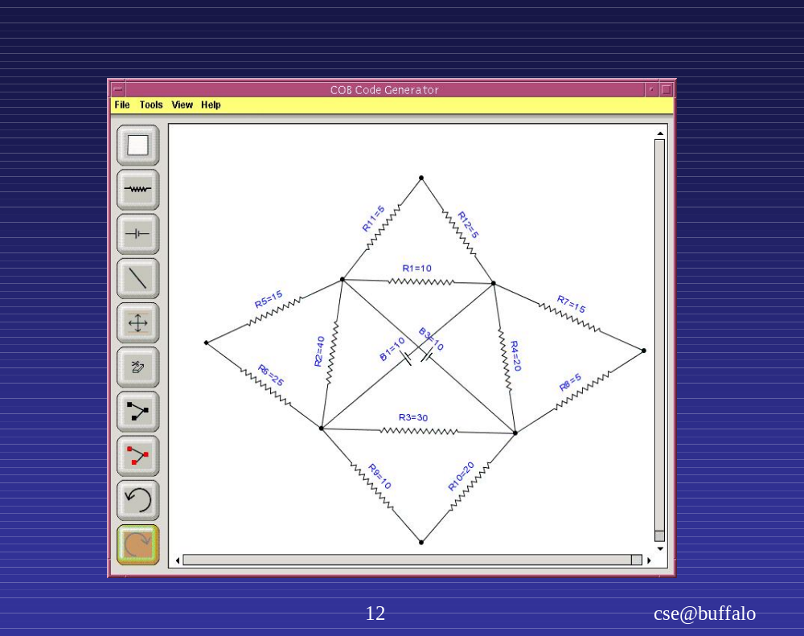
Lecture 24: 11/28/2012
CSE 505/Jayaraman

Slide 28
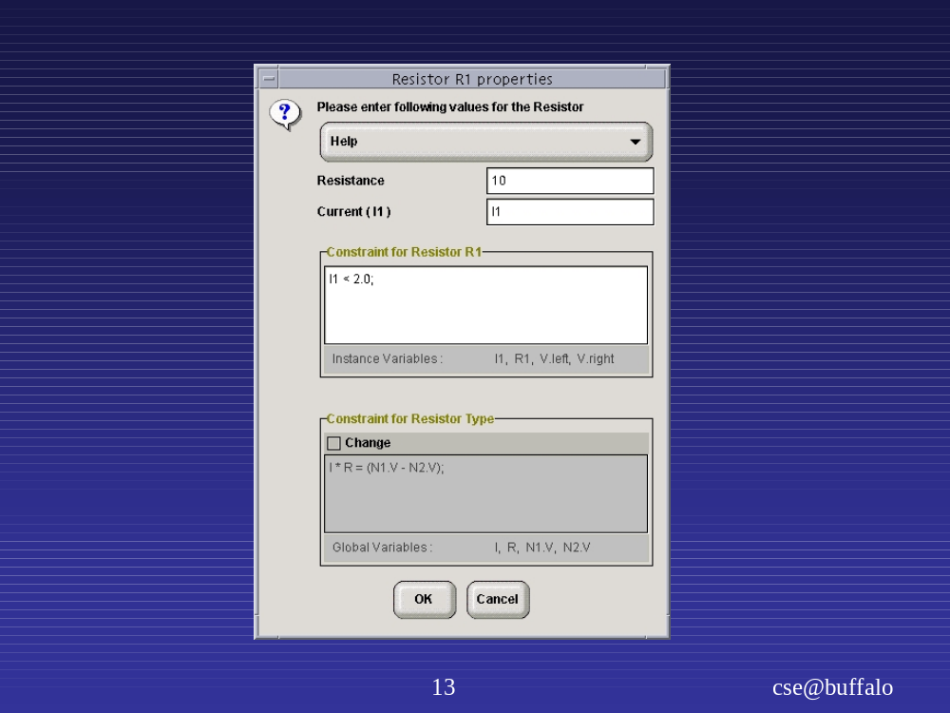
resistor
value
extra
constraint
change
resistor
behavior
Lecture 24: 11/28/2012
CSE 505/Jayaraman

Slide 29
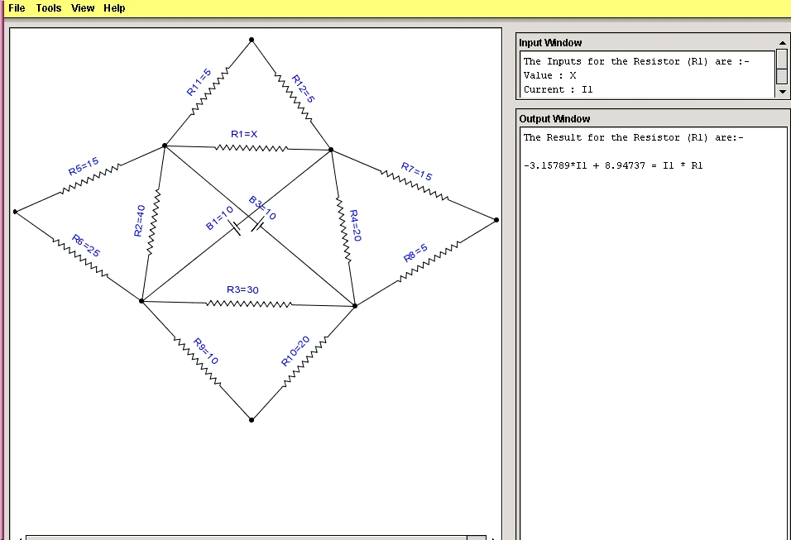
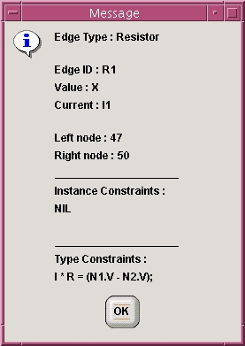
R1 is
unknown
output
constraint
Lecture 24: 11/28/2012
CSE 505/Jayaraman

Slide 30
Component
Real V, I, R
V = I * R
CUML Class Diagram
Comp: 1..N
Comp: 1..N
Series
Component [ ] Comp
forall C in Comp: (C.I = I)
(sum D in Comp: D.V) = V
(sum D in Comp: E.R) = R
Parallel
Component [ ] Comp
forall C in Comp: (C.V = V)
(sum D in Comp: D.I) = I
(sum E in Comp: 1/E.R) = 1/R
Lecture 24: 11/28/2012
CSE 505/Jayaraman

Slide 31
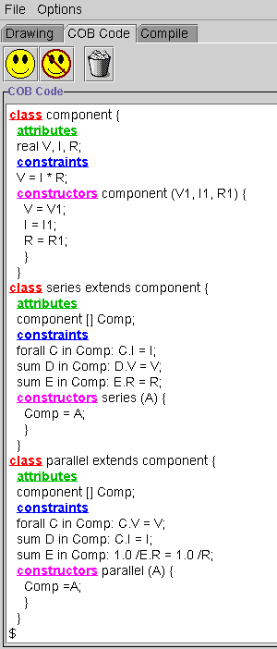
CUML Class Diagram
Compiler
Textual Cob Code
Lecture 24: 11/28/2012
CSE 505/Jayaraman

Slide 32
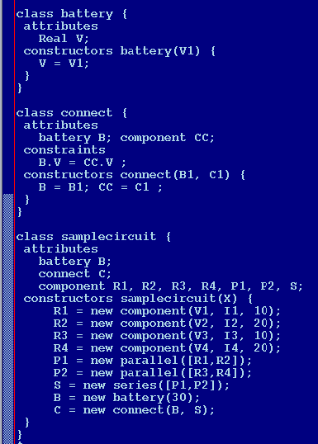
CUML Class Diagram
Compiler
Textual Cob Code
Lecture 24: 11/28/2012
CSE 505/Jayaraman

Slide 33
Optimized Code
V1 = V2 = I1 * 10 = I2 * 20
V3 = V4 = I3 * 20 = I4 * 20
S.I = I1 + I2 = I3 + I4
1/P1.R = 1/10 + 1/ 20
V3 = S.I * P2 .R
1/P2.R = 1/20 + 1/20
30 = S.I + S.R
30 = V1 + V3
S.R = P1.R + P2.R
Lecture 24: 11/28/2012
CSE 505/Jayaraman

Slide 34

Compiled CUML
Code
Compiled Circuit
Diagram Code
Answers
Cob Compiler
Diagram
Manager
Constraint
Engine
CLP® Code
Optimized Code
Optimizer
Lecture 24: 11/28/2012
CSE 505/Jayaraman

Slide 35
From Algebraic Constraints to Differential Equations
Lecture 24: 11/28/2012
CSE 505/Jayaraman

Slide 36

Heat Plate Example
0 | 0 | 0 | 0 | 0 | 0
100 | ? | ? | ? | ? | 200
100 | ? | ? | ? | ? | 200
100 | ? | ? | ? | ? | 200
100 | ? | ? | ? | ? | 200
50 | 50 | 50 | 50 | 50 | 50
Lecture 24: 11/28/2012
CSE 505/Jayaraman

Slide 37
class heatplate {
attributes
real [6][6] P;
constraints
forall I in 2..5:
forall J in 2..5:
P[I,J] = (P[I+1,J] + P[I, J+1] +
P[I, J-1] + P[I-1,J]) / 4;
constructors heatplate(A, B, C, D) {
forall I in 1..6: P[1, I] = A;
forall J in 1..6: P[6, J] = B;
forall K in 2..5: P[K, 1] = C;
forall L in 2..5: P[L, 6] = D;
}
}
Lecture 24: 11/28/2012
CSE 505/Jayaraman

Slide 38
Modeling Time with
Series Variables
series real X;
Takes on a series of values:
<x₁, x₂, x₃, …, x_{k}>
Operators:
  x’ ➔ next value of x
  x` ➔ previous value of x
  x<1> = 0 ➔ initial value of x
Lecture 24: 11/28/2012
CSE 505/Jayaraman

Slide 39
Fibonacci Series
series int fib;
…
fib<1> = 1;
fib<2> = 1;
fib = fib` + fib``
Lecture 24: 11/28/2012
CSE 505/Jayaraman

Slide 40
Series Variable - Example
Index | X
1 | 0
2 | 0.5
3 | 1.0
4 | 1.5
5 | 2.0
series real X;
…
X<1> = 0;
X = X` + 0.5
…
Lecture 24: 11/28/2012
CSE 505/Jayaraman

Slide 41
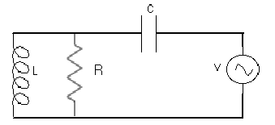
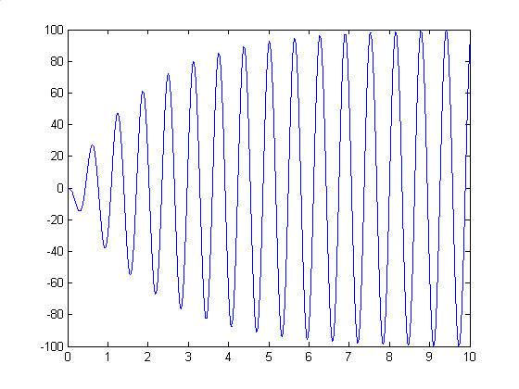
From DC to AC Circuits
I = C dV/dt
V = L dI/dt
Lecture 24: 11/28/2012
CSE 505/Jayaraman

Slide 42
From Differential to
Difference Equations
I = C x dV/dt
↓
I = C x (V2 – V1)/(T2 – T1)
↓
I = C x (V2 – V1) assuming unit time step
↓
I = C x (V – V`) assuming V is a series variable
Lecture 24: 11/28/2012
CSE 505/Jayaraman

Slide 43
Node-based Definition
abstract class component {
attributes
real V1, I1;
real V2, I2;
constraints
I1 + I2 = 0;
}
class resistor extends component{
attributes
real R;
constraints
V1 - V2 = I1*R;
constructor resistor(R1) {
R = R1;
}
}
Lecture 24: 11/28/2012
CSE 505/Jayaraman

Slide 44
Definition of Capacitor:
I = C . dV/dT
abstract dynamic
class component {
attributes
series real I1, I2;
series real V1,V2;
constraints
I1 + I2 = 0;
}
dynamic class
capacitor extends component {
attributes
real C;
constraints
I1 = C * ((V1 - V2) - (V1`- V2`));
constructor capacitor(C1) {
C = C1;
V1<1> = 0; V2<1> = 0;
} }
holds for all time steps
Lecture 24: 11/28/2012
CSE 505/Jayaraman

Slide 45
Definition of Inductor:
V = L . dI/dt
abstract dynamic
class component {
attributes
series real I1, I2;
series real V1, V2;
constraints
I1 + I2 = 0;
}
dynamic class
inductor extends component {
attributes
real L;
constraints
V2 – V1 = L * (I1 – I1`);
constructor capacitor(L1) {
L = L1;
I1<1> = 0;
} }
Lecture 24: 11/28/2012
CSE 505/Jayaraman

Slide 46
Termination
How does the AC circuit terminate?
In general, two approaches:
1. run until stopping condition reached
(sqrt example)
2. run for certain number of time steps
(AC circuit example)
Lecture 24: 11/28/2012
CSE 505/Jayaraman

